Slide 1

Welcome to Year 5...

Slide 2

Our Team... Year 5
5E
Mr Elahi
Class Teacher
5F
Ms Foissey
Class Teacher
Pupil Support Assistants
Ms Javed
5R
Miss Richards
Class teacher
(YGL)
Pastoral Support
Mrs Hemming
Mrs Darnley
Phase Leader

Slide 3

02
01
03
04
Our Curriculum
Reading, Maths and spellings
Assessment and Intervention
Other areas of learning

Slide 4
01
We have a broad curriculum which covers all areas of learning. Please use the parents’ overview to talk to your child about what they will be learning this year.

Slide 5
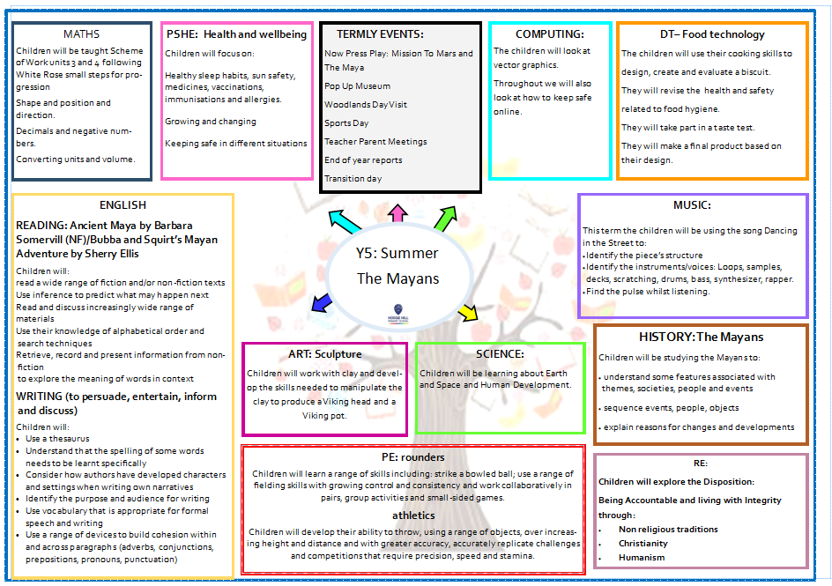

Slide 6
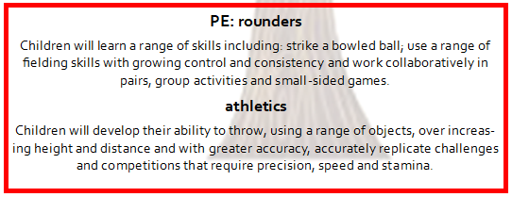
PE

Slide 7
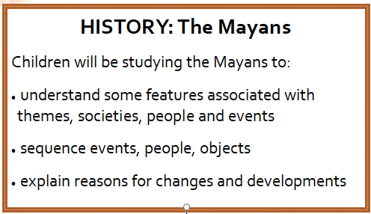
History

Slide 8
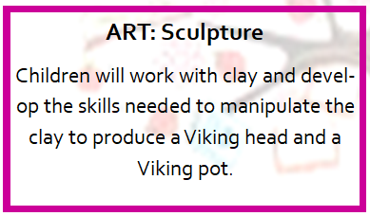
Sculpture

Slide 9
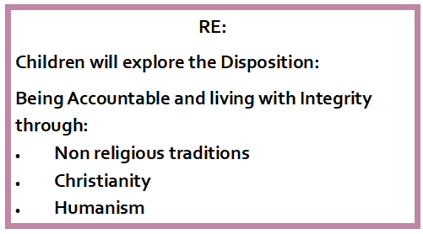
RE

Slide 10

SCIENCE

Slide 11

PSHE
Single gender classes
We teach the scientific terminology
Part of safeguarding
about the physical and emotional changes during puberty
key facts about the menstrual cycle and menstrual wellbeing (girls only)
strategies to manage the changes during puberty including menstruation (girls only)
the importance of personal hygiene routines during puberty (and no more) including washing regularly and using deodorant (girls and boys to be taught separately)
how to discuss the challenges of puberty with a trusted adult at home
how to get information, help and advice about puberty
schools.1decision.co.uk/info/videos/gac-scorm-puberty/index.html
Pupils are told to direct questions to parents

Slide 12
02
Reading, Maths and spellings

Slide 13
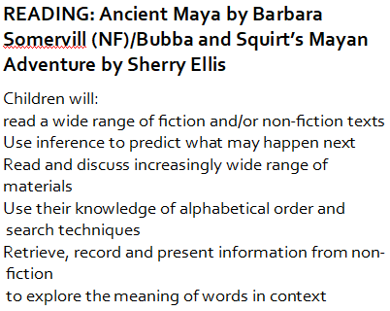

Reading

Slide 14
Reading at Home
Expectation:
Read at home 5x week.
Books and reading records must be in school every day.
Books will be changed with class teacher.

Slide 15
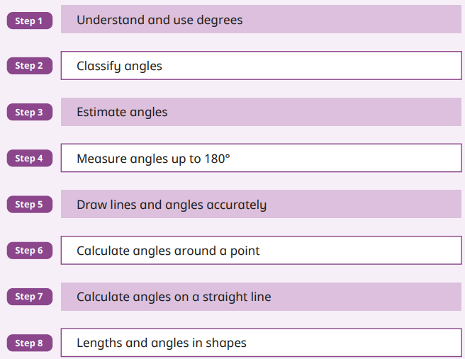
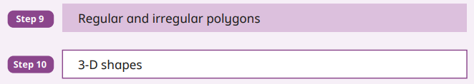
Maths
We follow the White Rose Small Steps for progression.
Focus on:
Shape

Slide 16
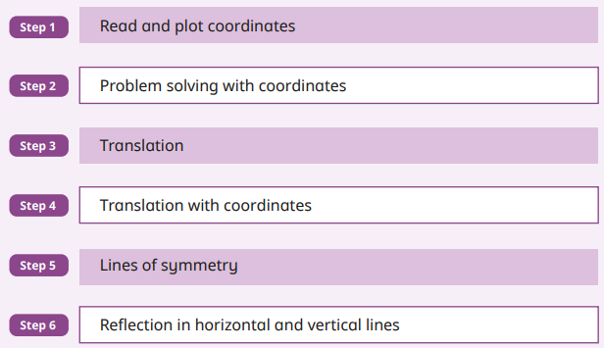
Maths
We follow the White Rose Small Steps for progression.
Focus on:
Position and direction

Slide 17
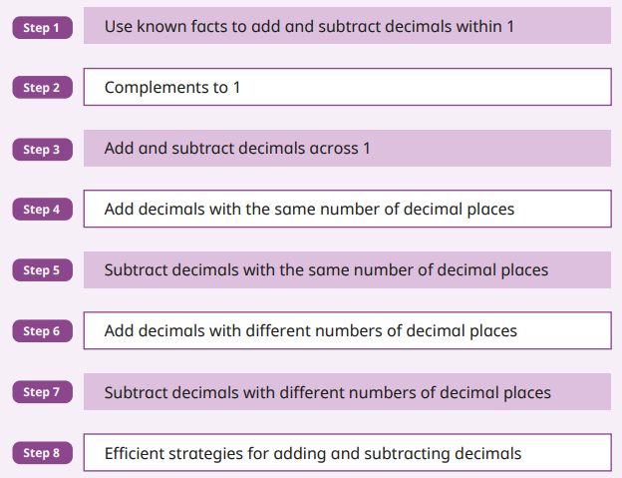
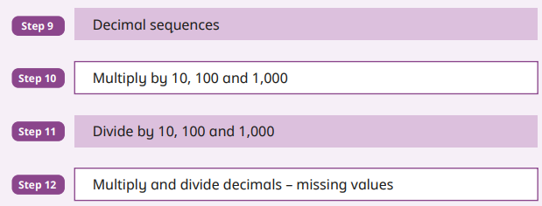
Maths
We follow the White Rose Small Steps for progression.
Focus on:
Decimals

Slide 18
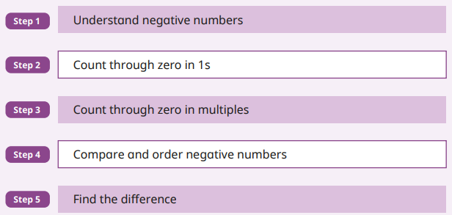
Maths
We follow the White Rose Small Steps for progression.
Focus on:
Negative numbers

Slide 19
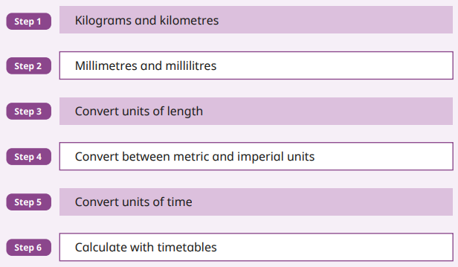
Maths
We follow the White Rose Small Steps for progression.
Focus on:
Converting units

Slide 20
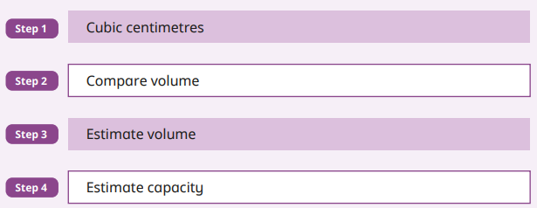
Maths
We follow the White Rose Small Steps for progression.
Focus on:
Volume

Slide 21

Maths at Home
Expectation:
Play at home 5x week.
Weekly competitions between classes in Year 5 and 6.

Slide 22
Homework
Reading 5 times a week with reading diaries updated after every read.
Times Tables Rockstars should be played 5 times a week.
Musical instruments (if participating), once taken home should be practiced as often as possible.
Please can an adult at home sign your child’s reading diary every time they read. This is invaluable support for the teacher and each child earns a dojo point for their House every time this happens.

Slide 23
03
Assessments and Interventions

Slide 24

Year 5 assessments
Each term, your child will be assessed using summative assessments.
Your child will have Maths and Reading assessments. We will use teacher assessment to check their understanding of writing.

Slide 25
Additional Support
Children who need extra support will have an additional intervention session to help them catch up on the day’s learning.
These groups are constantly reviewed according to the need of the children and ongoing assessment.
Details on how you can support your child at home are on the school’s website.

Slide 26
04
Other areas of learning

Slide 27

It is important that the children bring in their PE kit:
5F – Monday and Thursday
5R – Monday and Thursday
5E – Monday and Friday

Slide 28

Some children have
elected to continue learning their instrument from Year 4 :
5F – Monday - cornet
5E – Monday - flute
5R – Tuesday - ukulele

Slide 29
Educational Visits
Now Press Play:
      Mission to Mars (science)
      The Maya (history)
Woodlands day visit

Slide 30
Attendance League –
97% (2.5 days)
Being in school every day that it is open, is important to your child’s achievement, wellbeing, and their wider development. Evidence shows that the students with the highest attendance throughout their time in school gain the best GCSE and A Level results. Regular attendance at school also teaches and embeds good routines which are easily transferred into the working life as young people leave education and enter the world of work.

Slide 31

Thank you for listening, any questions?

Slide 32
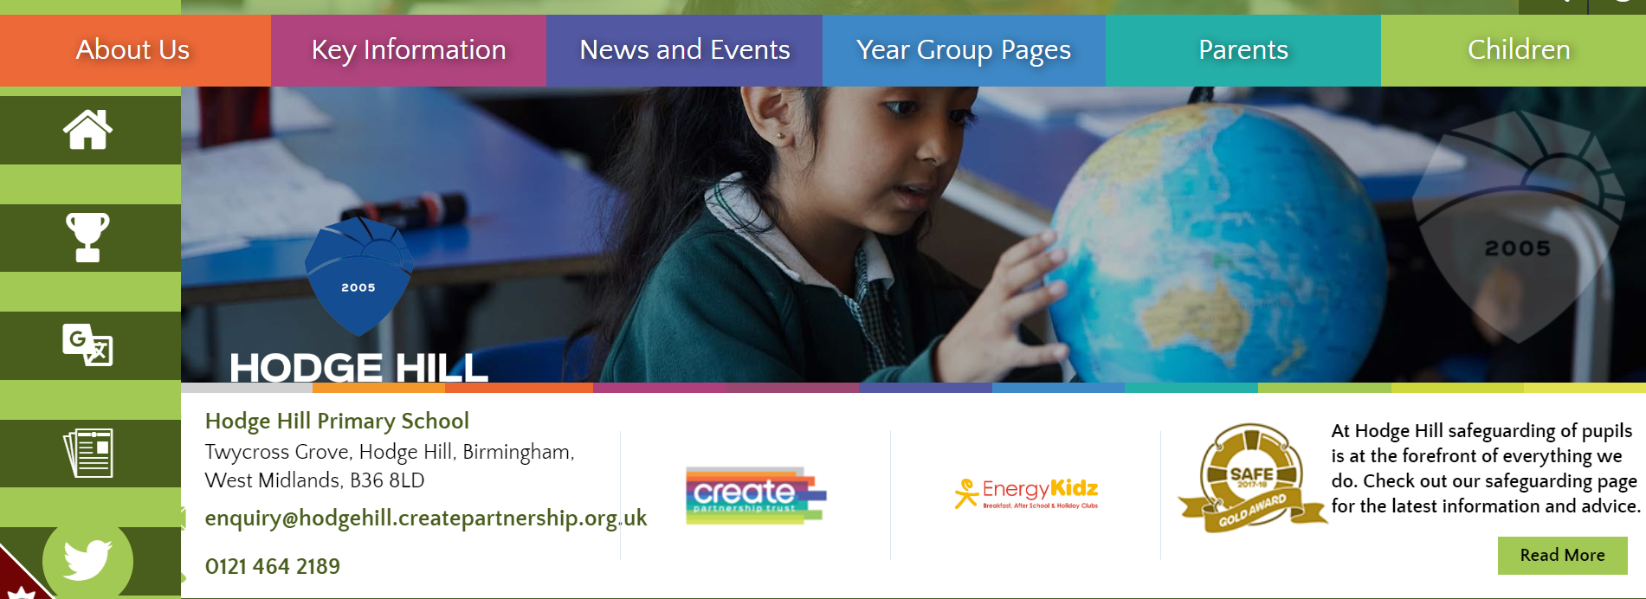
All of this meeting’s information and more can be found on the Y5 Year Group Page on the school’s website

