Slide 1



Welcome to year 1

Slide 2

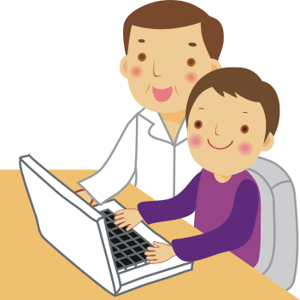
Meet the Year 1 team
Mr Burton- Rabbits Class Teacher
Miss Warren - Squirrels Class Teacher
Miss Godfroy (TA)
Mrs Webster (TA)
Miss Hussain (TA)
Mrs Croome (TA)

Slide 3

Routines of the day
Register.
Please ensure you have ordered your child’s lunch before the start of the school day.
English, Maths, Reading and Phonics are taught daily.
In the autumn term children will get MOLT sessions throughout the week.
Topics are taught in the afternoons (Science, Art, History, Geography, RE, DT and Computing)
PE kits are to be in school all week. Year 1 have outdoor PE on a Monday, Indoor PE on a Thursday and Team Spirit every other Wednesday.
Outdoor PE – Trainers, jogging bottoms and a jumper for colder weather
Indoor PE – Top and Shorts

Slide 4
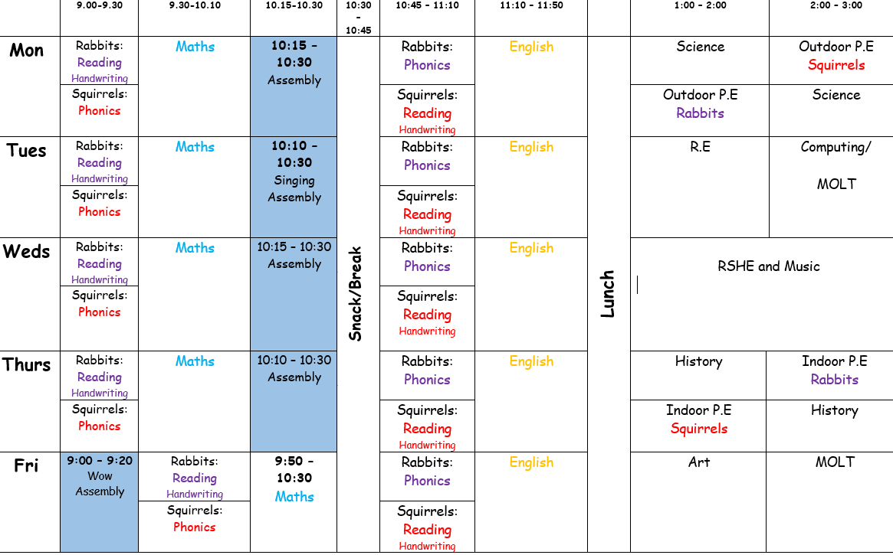
Routines of the day

Slide 5

Independent learners
At the Hollybrook schools we are committed to creating independent learners.
Children will change their phonics reading book with a teacher on a weekly basis.
Children will be prompted to hand in letters in book bags to the teacher – teachers do not check children's book bags so please encourage your child to hand in letters in the morning.

Slide 6

Home learning
Topic based home learning is set at least once a half term and is the opportunity for your child to explore their own interests within a topic being covered.
It is project based homework where children can choose how they want to display their learning e.g. Poster, model etc.
We appreciate your commitment to support your child's learning with these projects.
Home learning is shared in the classroom as part of our topic time.

Slide 7
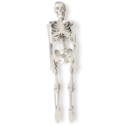
Topic
Topic flyers will be sent home at the beginning of each term to share with you what your child will be learning in each curriculum subject.
Our current topic is Animal Kingdom!
As part of this topic children are exploring the human body and their senses. Then we will be learning about the classification of animals e.g reptiles, amphibians, mammals, birds and fish.

Slide 8

Reading
Teachers will lead a reading session with your child three times a week where the children will read in a small group.
Every child will receive a ‘Reading Passport’ which is their home reading log and when they have read a certain number of times at home they will be rewarded with a certificate.
We encourage children to read their phonetic reading book at least 4 times a week a home.
Children will have Library visits where they will have the opportunity to chose a book to enjoy with you at home. Our computer system will only allow the children to take out a book once they have returned their old one, therefore please ensure they return their book each week.

Slide 9

Phonics
We follow the Letters and Sounds revised programme.
In Year 1 the focus of phonics is mostly on different graphemes (letters to write the sound) to represent the same phoneme (small unit of sound). E.g. ay is one of the alternative graphemes for the /ai/ phoneme.
Tricky words- These are words that children have to read by sight and cannot use their phonics knowledge to read e.g. they, the, some etc.
Children will receive a list of key words for them to practise at the end of each half term as they are assessed half termly to monitor their progress. Please ensure these are practised at home as much as possible!

Slide 10

MOLT
This is an opportunity for children to practise and master the skills that they are learning in class.
We aim for children to have at least two MOLT sessions a week. This will be increased during the first half term as the children settle into the new routine.
The classroom is laid out so the children can choose what learning they would like to improve. E.g. Using number lines to add numbers, to practise writing tricky words on whiteboards etc.

Slide 11
House Points
All children have been allocated a house team:
Fire (red), Earth (green), Water (blue) or Air (yellow)
Children will be awarded house points within school when they demonstrate good team work, resilience, independence, risk taking, reflection, motivation and creativity. Each house point is displayed in the classroom and then collected to earn certificates/badges which will be presented to individual children during whole school assemblies.

Slide 12
Wow
Each week a child will be chosen as ‘worker of the week’ – this will be awarded for excellent demonstration of our Behaviours for Learning in either their work or their behaviour in and around the school. The children will be invited to verbally share their success at the weekly WOW assembly where they will be presented with a certificate to take home and one to be displayed in the school hall on our WOW boards. Parents will be invited to attend these assemblies to share their children’s success.

Slide 13
VIP’s
Each week, one child will be selected from each class to be the VIP. They will wear the VIP jumper or badge for the week, leaving their own jumper/polo top in class ready to change back into on the Friday before going home. The VIP will be given important jobs to do in their classroom. VIPs will have a special tea.

Slide 14

Communication
Parents evenings take place in the Autumn and Spring terms. During these you will receive targets to help support your child at home.
If you have any concerns about your child please talk to their class teacher at the end of the day.
The office is able to get messages to the class teacher if you are unable to speak to your child's teacher directly.
We do not use Tapestry in Year One. You will receive positive messages about your child on Marvellous Me for things such as: WOW invitations, praise they have had in particular lessons during the day and class messages.

Slide 15

A few reminders…
Children need to come to school in their school uniform. Red jumper/cardigan, black or grey trousers/skirts/shorts, white polo tops, grey/black pinafores, black shoes, red summer dresses.

Slide 16
A few reminders…
Please ensure that your child does not wear nail varnish to school.
Please make sure that long hair is tied up.
Please make sure that only stud earrings are worn however these will have to be taped during PE.
Please remember that jewellery is not permitted to be worn at school.

Slide 17
A few reminders…
Please ensure your child has a book bag in school as they have a number of items to carry.
All children should have a water bottle in school every day.
Please remember your child needs a PE kit (indoor and outdoor) in school at all times and won’t go home until the end of each half term

