Slide 1
DofE Expedition Training
Introduction to Expedition
Notes:
This is a brief 10-15 minute segment to make sure participants understand the requirements and purpose of expedition, know what to anticipate in training, know what skills they need to develop and have a chance to ask general questions about expedition.

Slide 2
What is Expedition?
Introduction to Expedition
6 Hours – 1 night – 6 Hours
An unaccompanied, self-reliant journey completed by your own efforts
Before your journey you must Train, Plan and Practice
An Expedition must have a Goal
Notes:
Some ideas you might want to introduce:
The Expedition is different from other sections of the Award, you have to work in a team and there’s less individual choice than other sections
Acknowledge – The Expedition may be a section you are really looking forward to or for you it might be the biggest challenge of the Duke of Edinburgh Award
The Expedition is intended to be a challenge but should also be fun. It develops and demonstrates loads of valuable skills including teamwork, perseverance, problem-solving, being organised, navigation, caring for one another and the environment.

Slide 3
What is Expedition?
Introduction to Expedition
7 Hours – Night 1 – 7 Hours – Night 2 – 7 Hours
An unaccompanied, self-reliant journey completed by your own efforts
Before your journey you must Train, Plan and Practice
An Expedition must have an Aim
Notes:
Some ideas you might want to introduce:
The Expedition is different from other sections of the Award, you have to work in a team and there’s less individual choice than other sections
Acknowledge – The Expedition may be a section you are really looking forward to or for you it might be the biggest challenge of the Duke of Edinburgh Award
The Expedition is intended to be a challenge but should also be fun. It develops and demonstrates loads of valuable skills including teamwork, perseverance, problem-solving, being organised, navigation, caring for one another and the environment.

Slide 4
What is Expedition?
Introduction to Expedition
8 Hours – Night 1 – 8 Hours - Night 2 – 8 Hours - Night 3 – 8 Hours
An unaccompanied, self-reliant journey completed by your own efforts
Before your journey you must Train, Plan and Practice
An Expedition must have an Aim
Notes:
Some ideas you might want to introduce:
The Expedition is different from other sections of the Award, you have to work in a team and there’s less individual choice than other sections
Acknowledge – The Expedition may be a section you are really looking forward to or for you it might be the biggest challenge of the Duke of Edinburgh Award
The Expedition is intended to be a challenge but should also be fun. It develops and demonstrates loads of valuable skills including teamwork, perseverance, problem-solving, being organised, navigation, caring for one another and the environment.

Slide 5
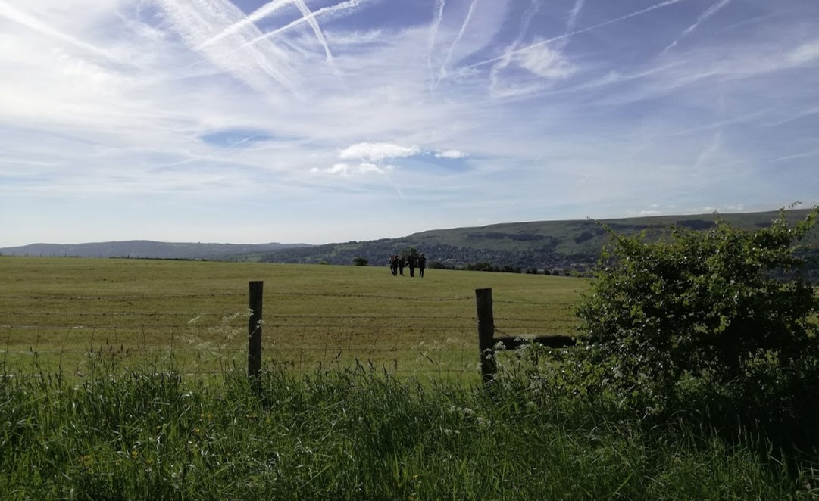
Introduction to Expedition
Notes:
Some ideas you might want to introduce:
The Expedition is different from other sections of the Award, you have to work in a team and there’s less individual choice than other sections
Acknowledge – The Expedition may be a section you are really looking forward to or for you it might be the biggest challenge of the Duke of Edinburgh Award
The Expedition is intended to be a challenge but should also be fun. It develops and demonstrates loads of valuable skills including teamwork, perseverance, problem-solving, being organised, navigation, caring for one another and the environment.

Slide 6
What’s covered in Expedition Training?
Introduction to Expedition
In the Classroom
Maps
Navigation
Food and Menu Planning
Hazards
Route Planning
Clothing and Equipment
Expedition Aims
On a training walk
More Navigation!
Campcraft
First Aid
Dealing with Emergencies
Countryside Code
Expedition Aims

Slide 7
Expedition Requirements
Introduction to Expedition
1) Participants must behave responsibly with respect for their team members, Leaders, landowners, the public and animals, and must understand and adhere to the Countryside, Scottish Outdoor Access, Highway and Water Sports Codes (as appropriate).
2) Expeditions must be unaccompanied and self-sufficient. The team must be properly equipped, and supervision must be carried out remotely, considering what is reasonably practicable for participants and ensuring their welfare is paramount.
3) Participants must actively participate in a debrief with their Assessor at the end of the expedition and, at Silver and Gold level, a presentation must be delivered after the expedition.
Notes:
The 20 conditions are in your course notes booklet. Most things are taken care of (time of year, size of group etc) before you go on your expedition but there are things that you need to ensure you do (or don’t do) on expedition (see 12-18)

