Slide 1
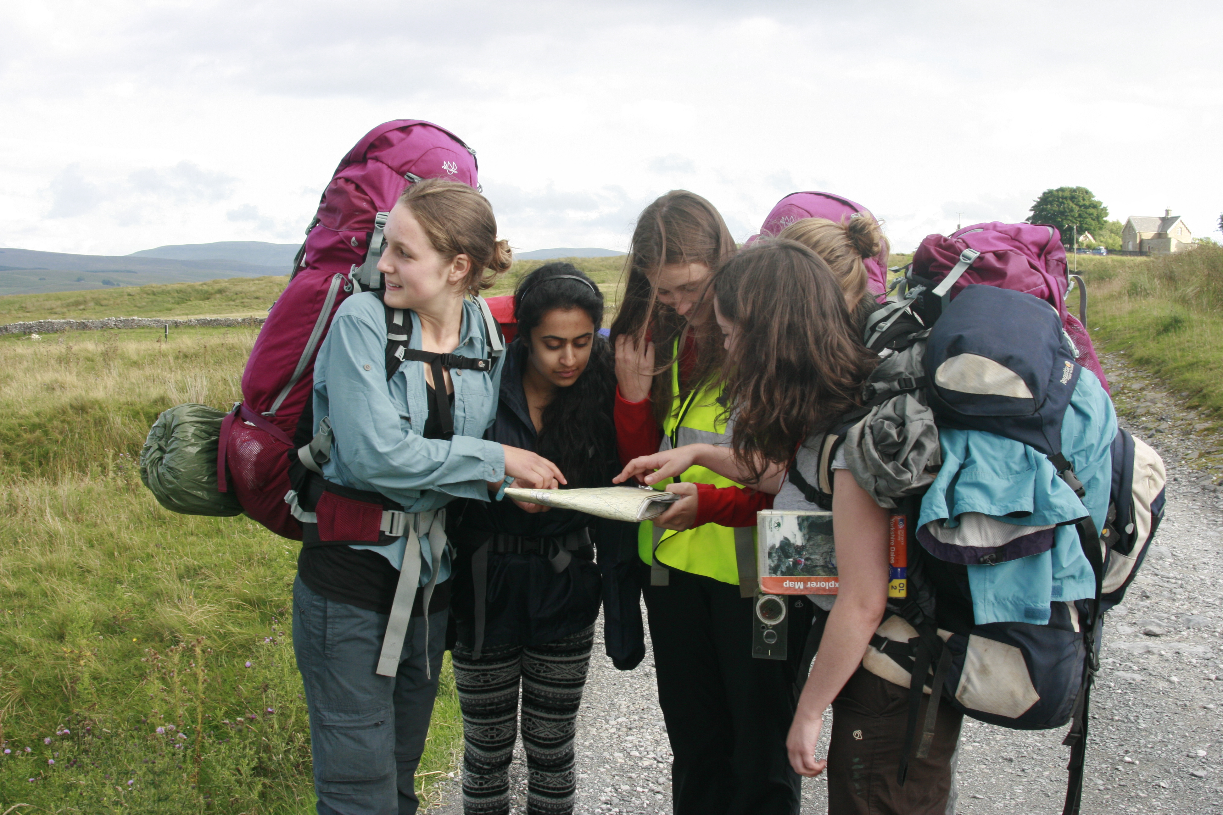
Navigating using maps

Slide 2
Navigating using maps
You must always have a strategy for each leg
Your strategy may change during the day depending how ‘difficult’ the leg is to navigate
Introducing the 5 D’s
A strategy to enable you to navigate without having to look at the map ALL day
Notes:
A strategy could be walk along with your finger on the map where you are all day (very intensive).
(click for next row) You may wish / have to do this for a bit if you are in a complicated field system with lots of twists and turns. (incidentally, whenever you enter a field try and see if you can see where you are going to exit it (can you see the style, or gate or little yellow arrow).
(Click)The main strategy that we teach is known as the 5 D’s it will mean that you don’t have to have your nose in the map all the time so you can enjoy your walk and the company of your friends even when you are navigating

Slide 3
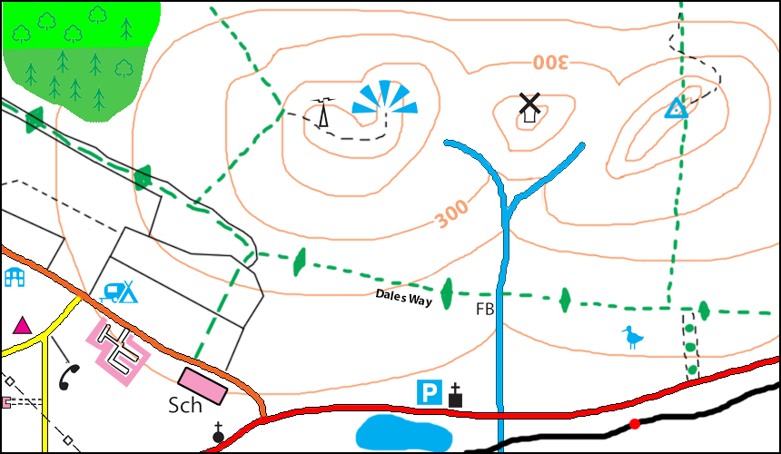
Navigating using maps
Some definitions
Handrail
Tick Feature
Catchment point
Overshoot
Notes:
But first some definitions
A handrail is usually a footpath but could be a stream, ridge or even compass bearing
Tick feature is something you will come to while on your hand rail
Catchment point is the point you stop at the end of your leg
Overshoot is something you will come to if you go too far

Slide 4
The 5 D’s
Navigating using maps
Destination
Direction
Distance / Duration
Description
Dangers (navigational and physical)
Notes:
There are 5 words beginning with D that you can use to describe a navigational leg. What do you think they could be?
What makes a good destination (end of leg)
Rough direction or bearing? (just saying That way is usually enough) if taking a bearing do you take it on the whole leg or just the first 50 meters?
Measure the distance and work out how long it should take you
What are you going to pass and roughly when will you pass it
Where might you go wrong?, do you need an overshoot? Can you see any likely physical dangers on the route from the map?

Slide 5
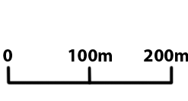
The 5 D’s
Navigating using maps
N
Destination
Direction
Distance / Duration
Description
Dangers (navigational and physical)
Notes:
First thing to decide is how long the leg will be, if there is a lot of detail or if you are new to all this then keep the legs short. You don’t want to be holding too much information in your head
Ask students for the 5 D’s on the following legs
Phonebox to footpath by school
Footpath by school to foot bridge
Footbridge to trig point

Slide 6
Navigating using maps
Relocation Strategies
Think back to where your last known point
Look around you
Move a bit
Retrace your steps
Notes:
Think back to where you last knew where you were and remember what you passed since and try and find those feature on the map
Look around you and identify features that you are close to. Can you find them on a map (I do this in 2 stages, things I could walk to in 30 seconds, things I could walk to in 5 minutes)
Move a bit (up to 100m to somewhere where you will get a different view and repeat the above step). For instance If you are stood by a wall, just walking up to it and looking over may show you the shape of the next field
Retrace your steps until you know where you are again

Slide 7
Navigating using maps
Some pages in the workbook that could be completed now
Page 8: Map symbols
Page 9: Tick features
Page 10: Relocation strategies
Notes:
Some pages in the workbook that could be completed now
Page 8: Map symbols
Page 9: Tick features
Page 10: Relocation strategies

