Slide 1
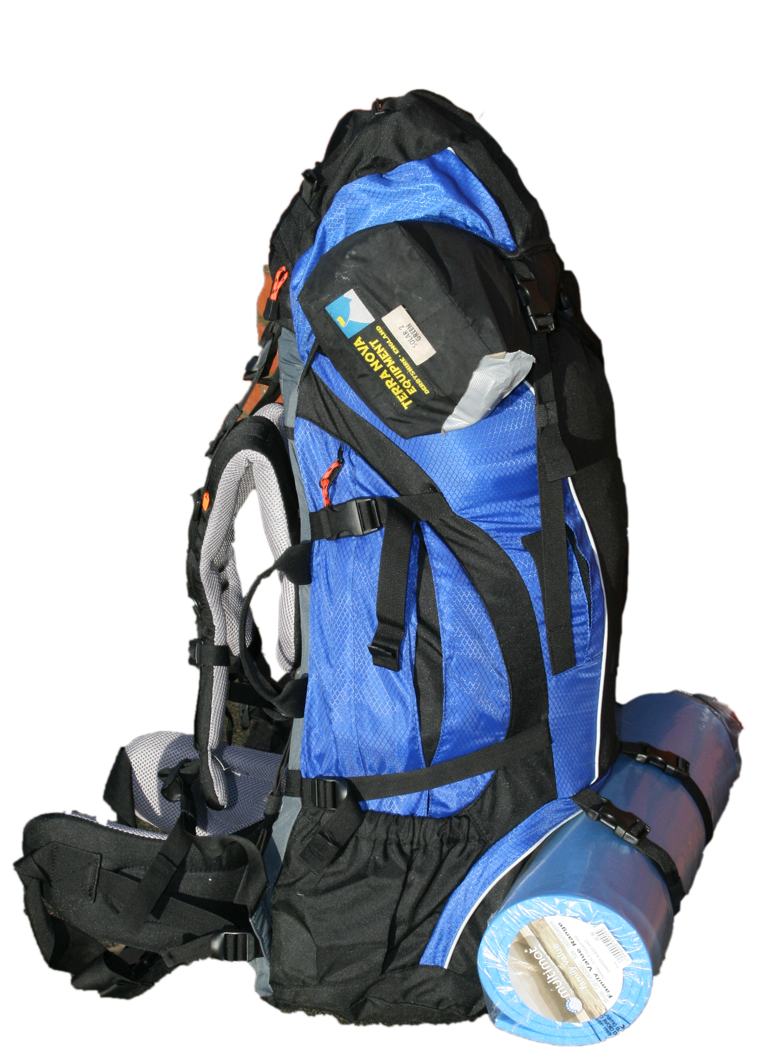
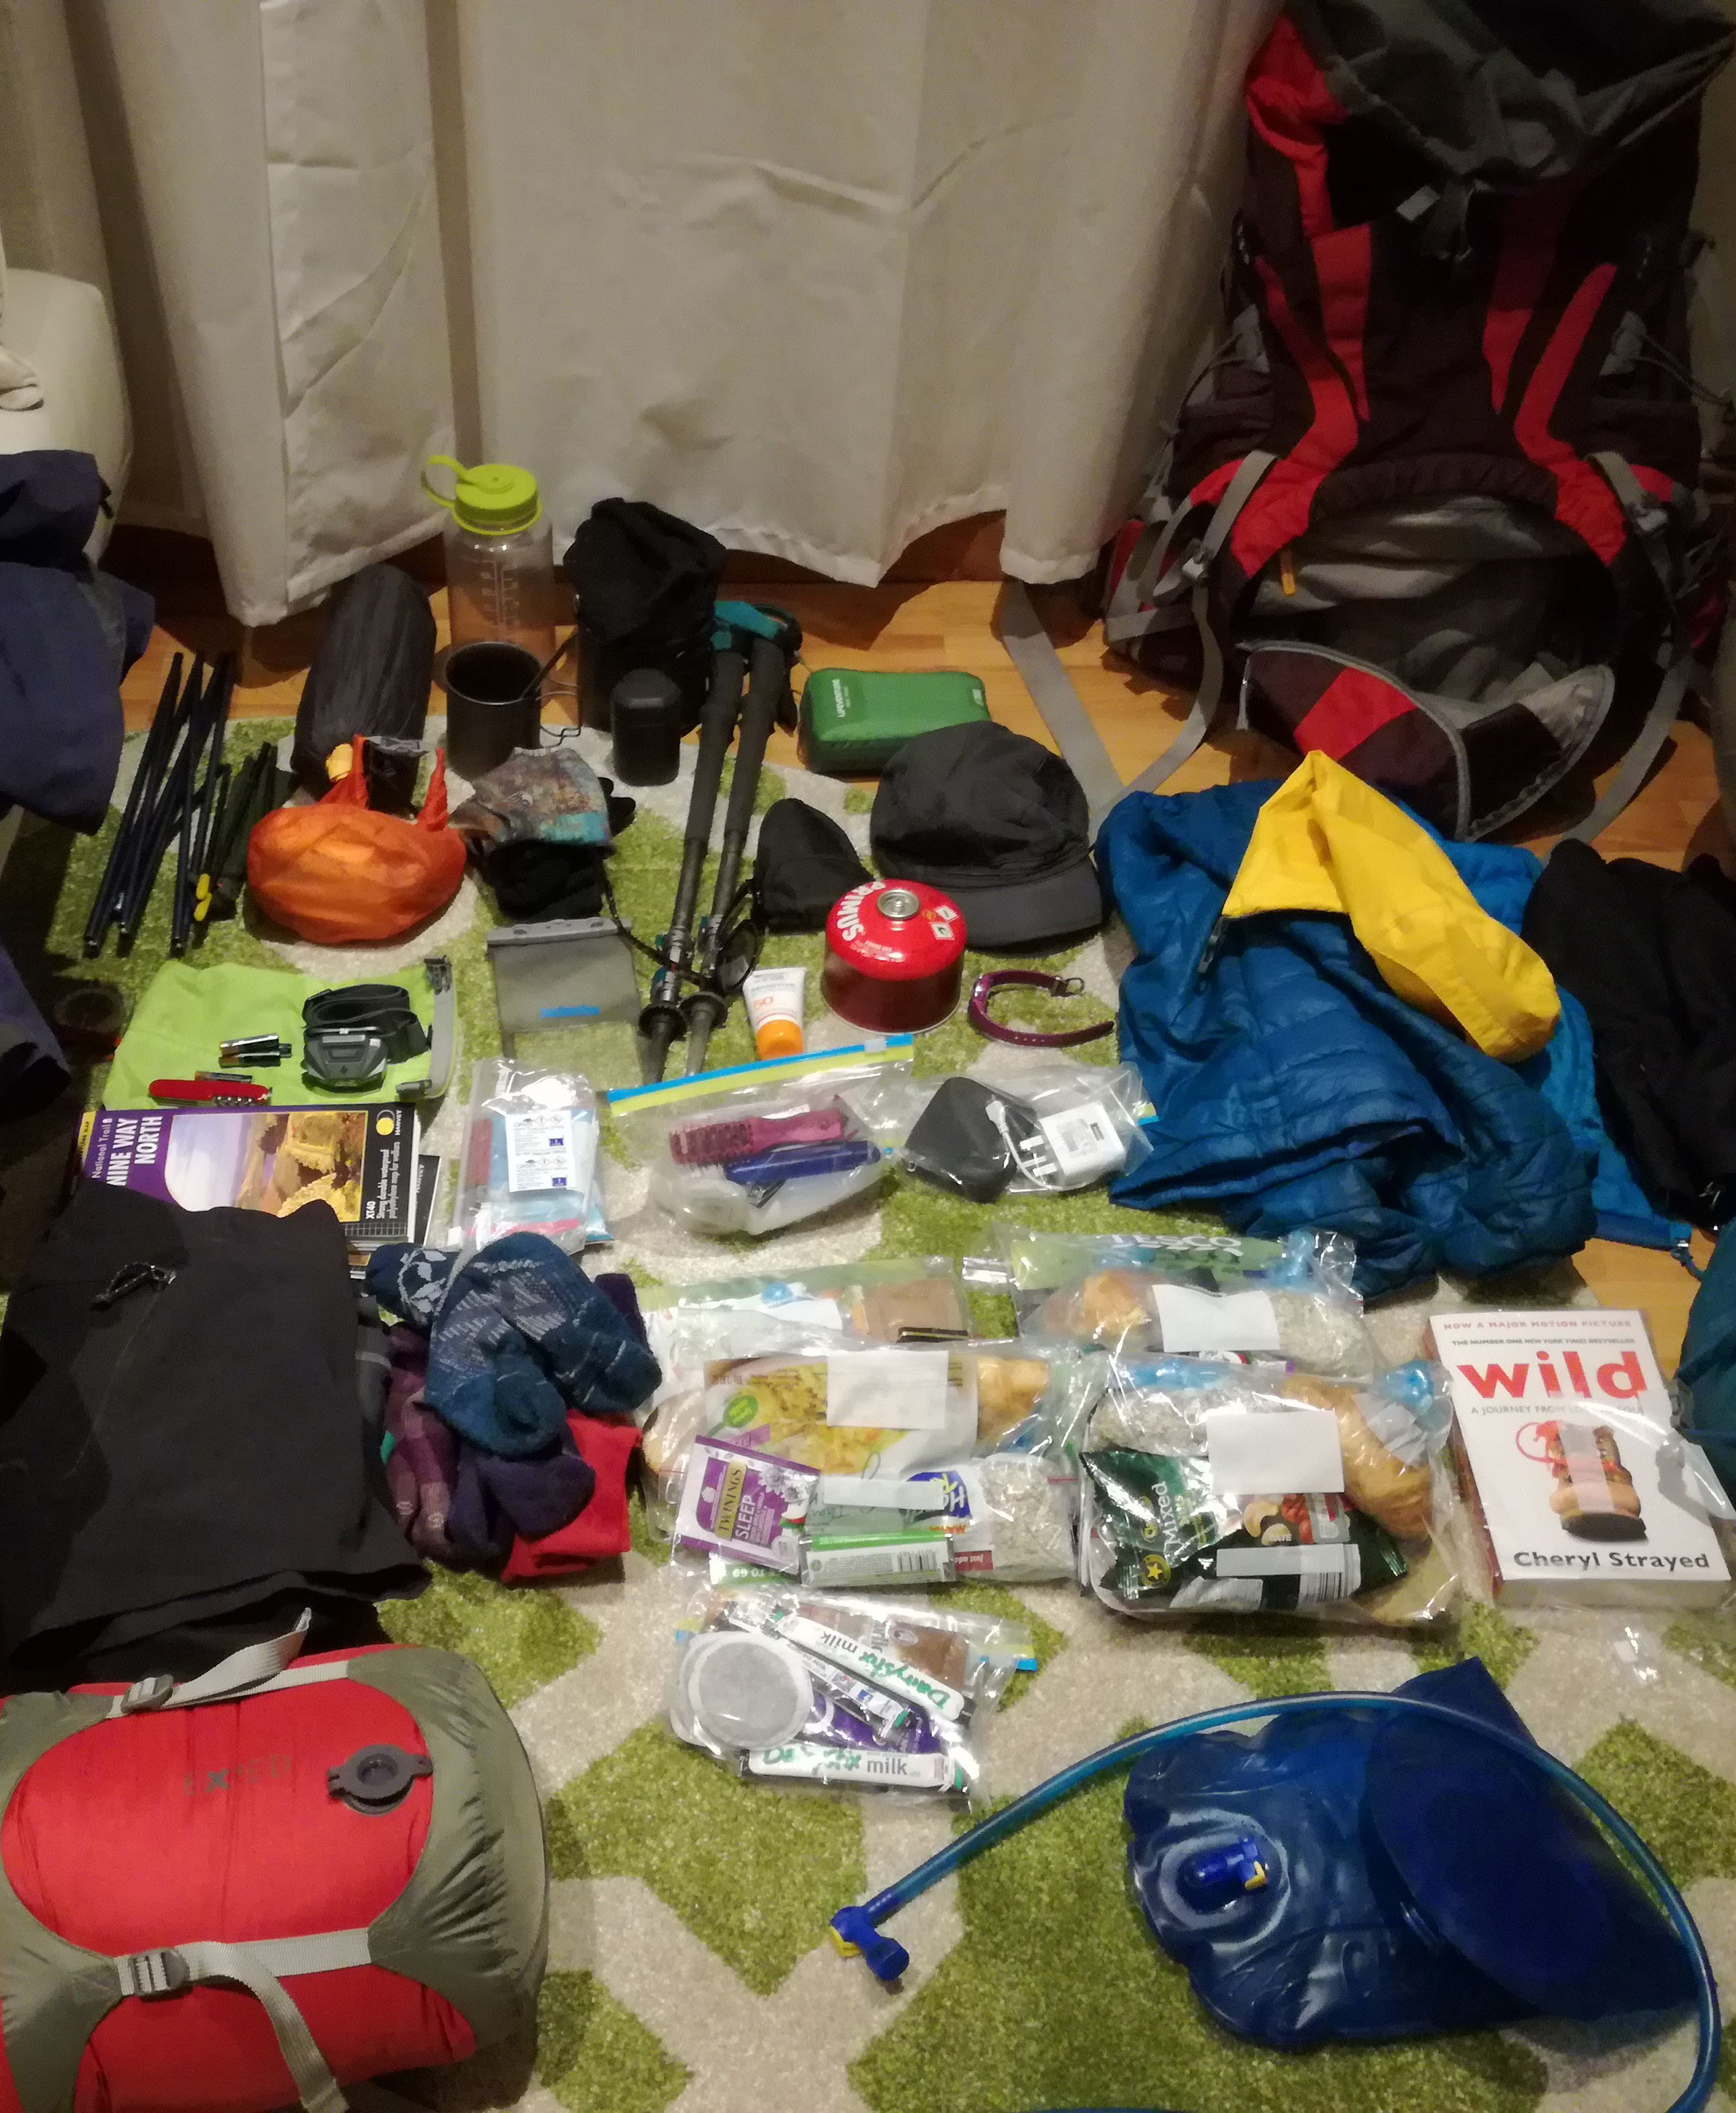
Kit and rucksack packing

Slide 2
Kit and rucksack packing
This is on page 17 of your Workbook
Notes:
Go through the equipment list (it is also in their work book) with the team checking that the participants have items (making notes on what we may need to lend).
Discuss in the group how many of each item they may wish to bring. Suggest the participants write in the boxes quantities that they feel they will need as we go along.
Talk about suitability of different types of item. There are 2 questions on page 17 of the workbook that you might want to cover here the question are
Why are synthetic fabrics better than cotton
What is the most important factor in footwear selection and why

Slide 3
Rucksack Packing – Where to put things
Kit and rucksack packing
Principle 1: Heavy items should be close to your back, evenly weighted (side to side) and near the top
Principle 2: Items you may need should be accessible
Notes:
Principle 1: Heavy items should be close to your back evenly weighted (side to side) and near the top
Place a heavy item like your tent under the lid rather than on the straps on the bottom at the back.
Principle 2: Items you may need should be accessible
Pack your snacks, lunch, drinks, waterproofs, hat, gloves, torch, etc near the top of the bag or in the outer pockets

Slide 4
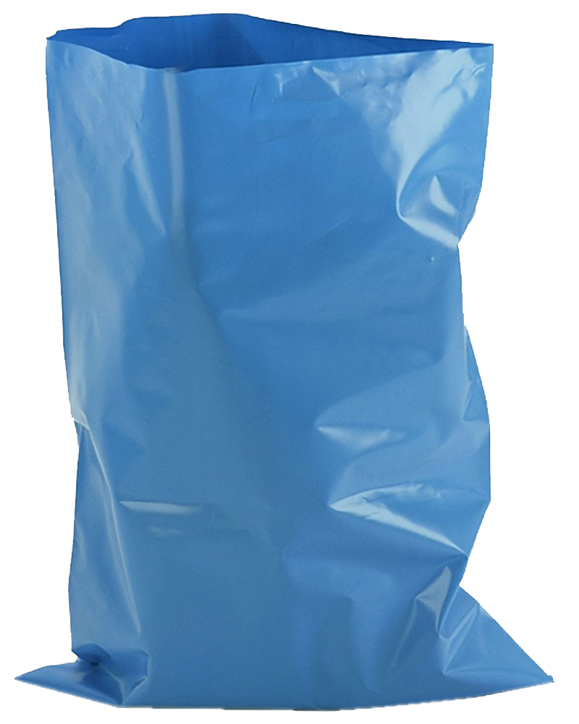
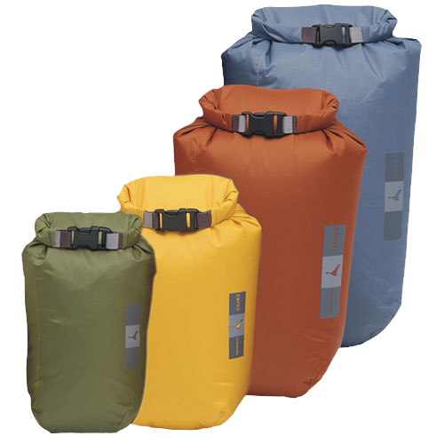
Rucksack Packing – tips and tricks
Kit and rucksack packing
Waterproof EVERYTHING!
Put your sleeping bag at the bottom
Don’t hang stuff on the outside
No more than ¼ your body weight
Learn how to adjust your rucksack
Dry bags
Image from
www.thegorgeoutdoors.co.uk
Rubble sack
Image from
www.justbinbags.co.uk
Notes:
Waterproof everything – everything must be in plastic bags, dry bags or a big heavy duty bin liner or rubblesack (double bag your sleeping bag). Mention that the rain covers are only any good for a light shower. Mention that some (expensive) rucksacks are advertised as and genuinely waterproof but you still shouldn’t rely on it
Put your sleeping bag at the bottom – You won’t need it and you know you can sit on it without breaking anything
Hanging stuff – you might lose it and you wont look slick
¼ body weight – think about what you don’t need, spread the load more in your team

Slide 5
Kit and rucksack packing
Complete the exercise on page 16 of your Workbook
Notes:
There are two questions on Stoves on page 16 of the workbook that they may not have covered yet

