Slide 1
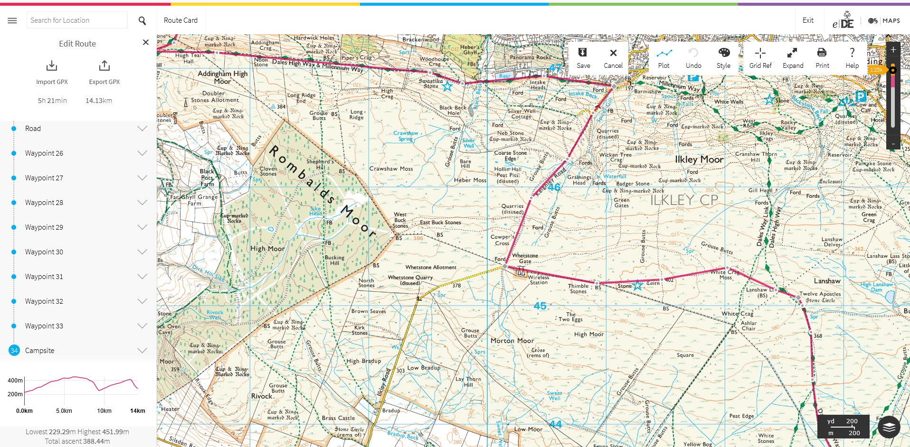
Planning a route using e-DofE mapping

Slide 2
Route planning using eDofE
Why route plan?
To ensure that a viable route exists
To ensure that you are out for the required amount of time
To ensure you aren’t out for too long
To make sure you take in close by places of interest
Why make a route card?
So your supervisor knows roughly where you are
To help you keep to navigate and keep to time when walking
So that the DofE know who is out and where in case of incidents

Slide 3
Route planning using eDofE
Equipment required
Details of your day’s start, finish and via points
Expected distance to travel
Dates and times of your expedition
Computer with access to the internet
Your eDofE login details

Slide 4
Route planning using eDofE
Plotting a route
Draw a straight line between your start and end points
Add any ‘via’ points
Wiggle the route around public rights to follow your route
Change the style of the line (red, thinner & more transparent)
Ask your supervisor to check it and agree suitable ends of legs
Edit the waypoints at the end of legs to put in names of the checkpoints and descriptions of the legs
Ask your supervisor to check it
Complete the rest of the route card
Save, export and email the route
A video telling you how to use eDofE mapping can be found here https://youtu.be/ZlQwm5fdVe4
and here http://bit.ly/plotaroute
Notes:
The video is also linked from the DofE downloads page of our website.
The video fails to mention bearings, escape notes or project time

