Slide 1
The Countryside Code

Slide 2
The Countryside code
Respect Everyone
Protect the Environment
Enjoy the outdoors

Slide 3
Respect Everyone
The Countryside code
Be considerate of those living, working and enjoying the countryside
Leave gates and property as you find them

Slide 4
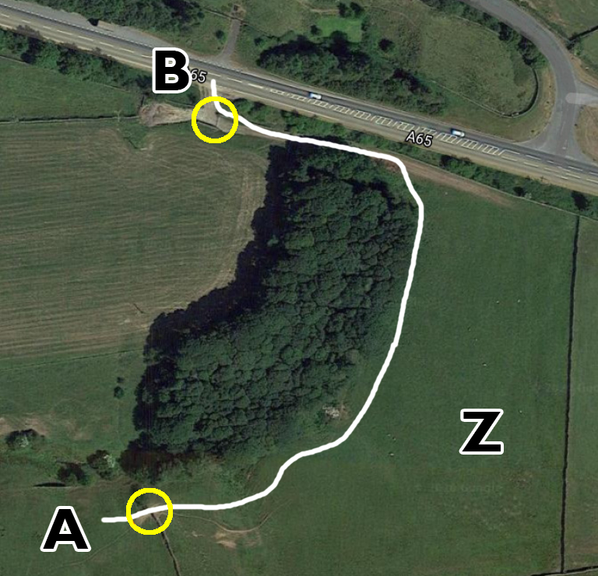
Respect Everyone
The Countryside code
Lots of sheep in field A, some sheep in field Z
Gates at the yellow circles are both open.
Would you leave them open or close them as you pass through?
Notes:
This exercise is in the workbook too

Slide 5
Respect Everyone
The Countryside code
Be considerate of those living, working and enjoying the countryside
Leave gates and property as you find them
Be nice, say hello
Follow local signs and keep to paths unless on Access Land
Notes:
On follow local signs and keep to paths, don’t climb walls or fences

Slide 6
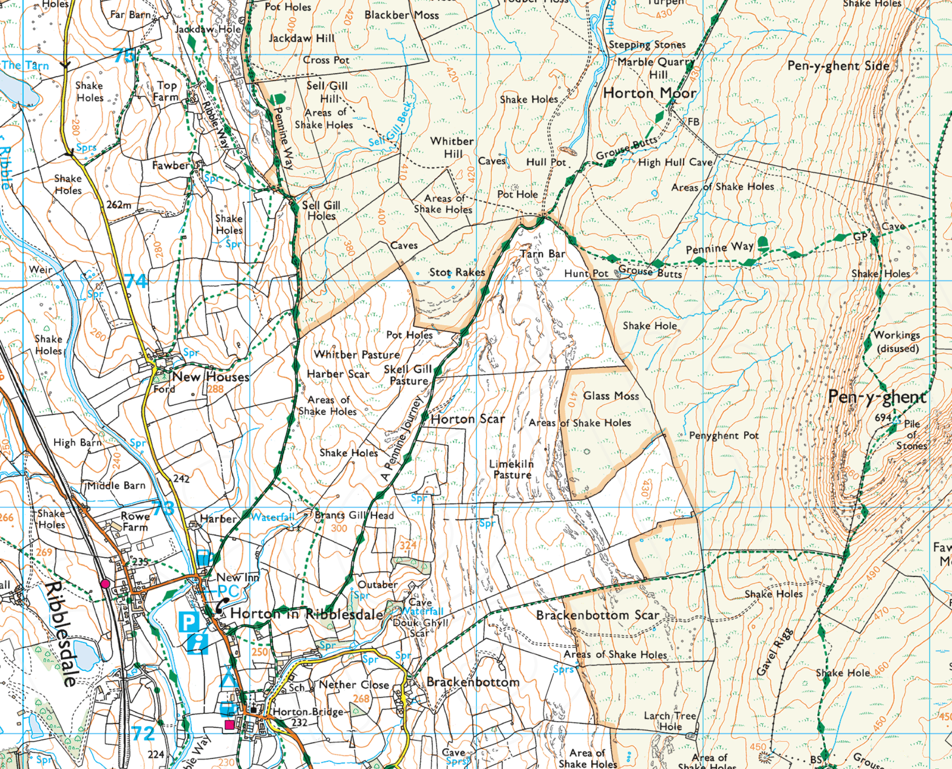
Respect Everyone
The Countryside code
Notes:
This is access land, this logo is often on styles as you enter access land

Slide 7
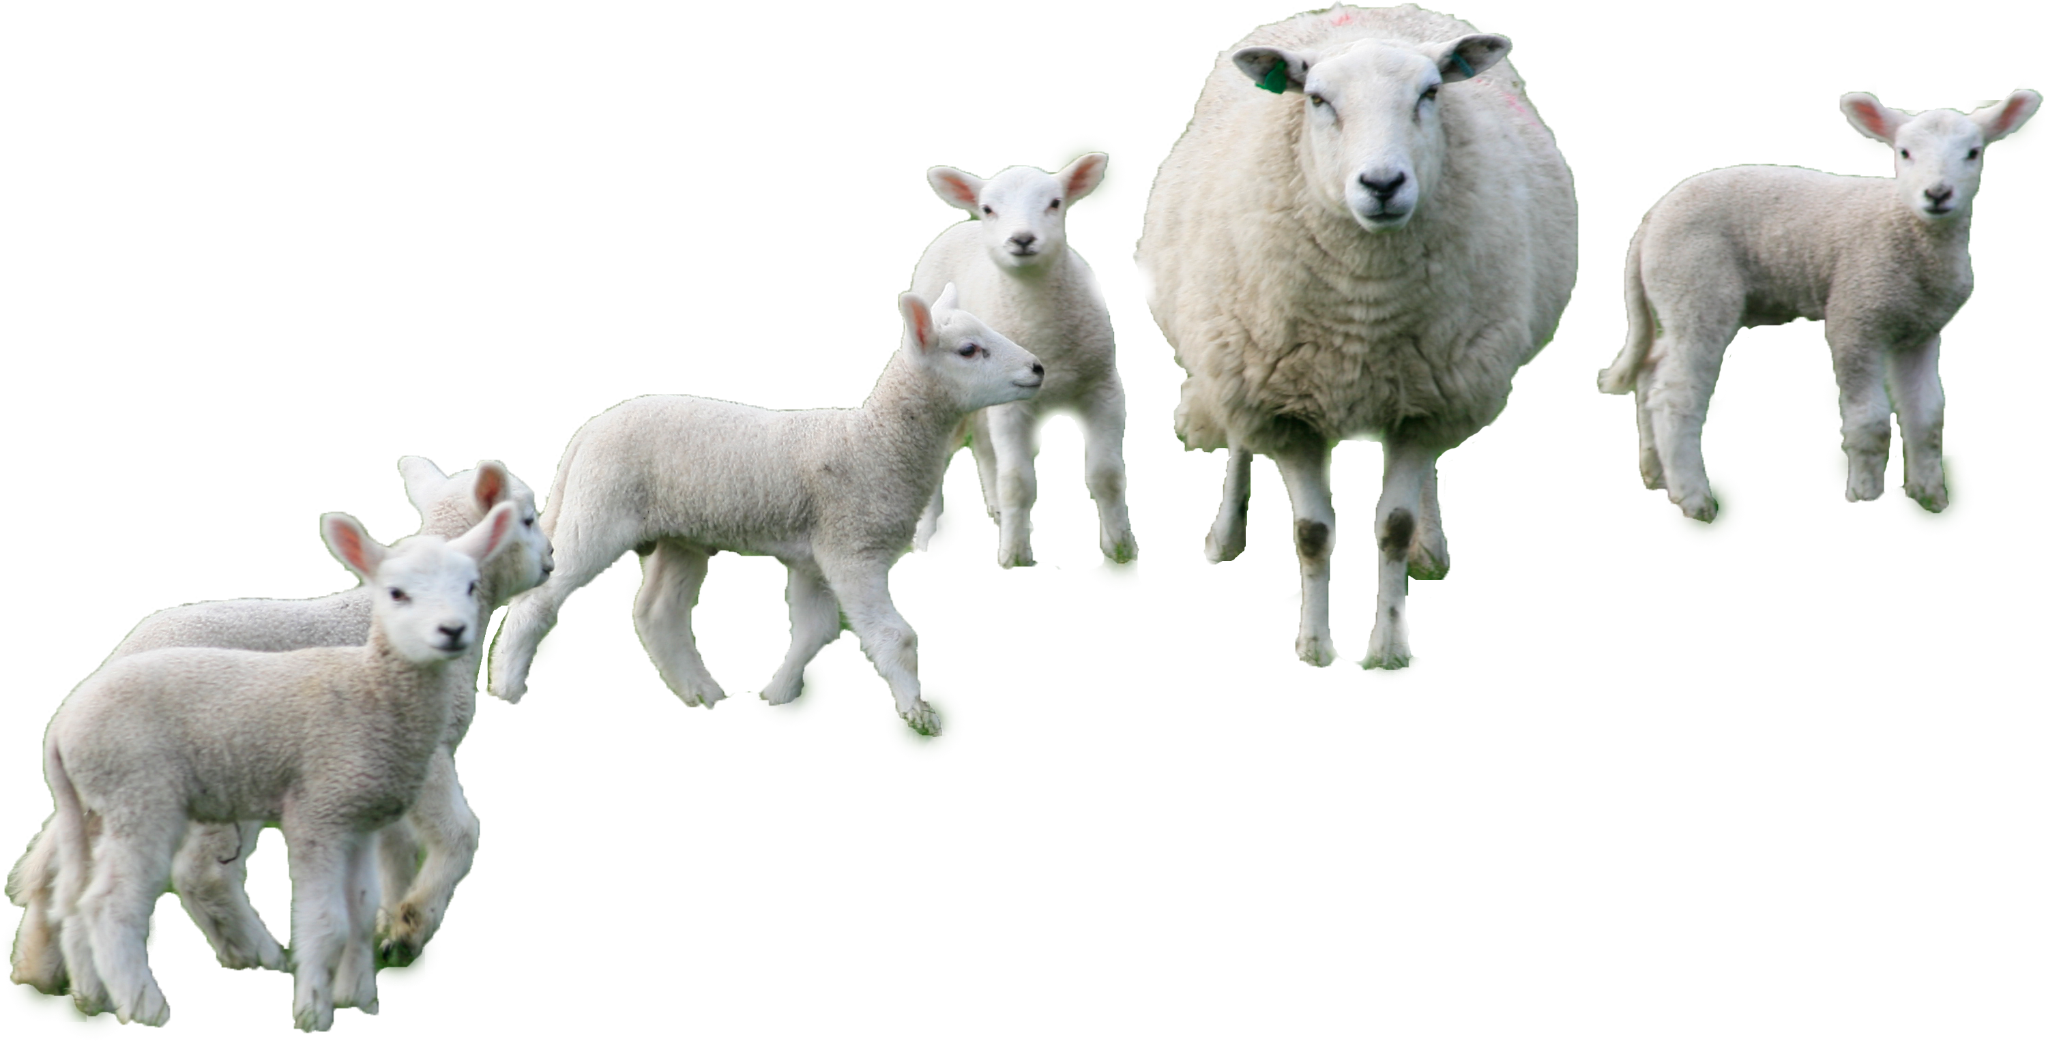
Protect the environment
The Countryside code
Take your litter home – Leave no trace
Think about erosion
Don’t go to the toilet close to streams
Don’t wash up in streams
Be careful with fire
Take care around animals
Notes:
Take your litter home, what about banana skins, orange peal, apple cores
Single file, walk on the path not next to it

Slide 8
Enjoy the outdoors
The Countryside code
Check your route and local conditions
Plan your adventure, know what to expect
Enjoy your visit
Notes:
Check for access land closures
Check the weather and weather history (water levels)
Go prepared, the better prepared you are the more comfortable you will be

