Slide 1
Parents’ evening presentation

Slide 2
Next Step Programme
University visits/ Open Days/ UCAS convention
Guidance on Personal statements & employability
UNIFROG
Student Progress Reviews each term with Tutors
1:1 career guidance
Personal Statement support from, L Critchley, G Beddow and Holly Jones Qualifications guidance from Becky Bell.
Mr Symes regularly advises and counsels on future career choices.

Slide 3

SIXTH FORM ENRICHMENT
Year 13
UNIVERSITY APPLICATION/ PREPARATION
CITIZENSHIP IN CONTEXT/ SUPPORTING CATHOLIC ETHOS
FINANCE (STUDENT LIFE, BUDGETS, LINKS WITH JMU)
REVISION TECHNIQUES/ PERSONAL WELL BEING
STUDENT SUPPORT
STUDENT SHADOWING AT UNIVERSITIES

Slide 4
ENRICHMENT AROUND SCHOOL
Head Boy/ Head Girl
Student Leadership team
Extended Project Qualification
Duke of Edinburgh
Subject specific enrichment/ educational visits

Slide 5
Parents’ evening presentation

Slide 6
What is UCAS?
350+ universities and colleges:
  4 in Northern Ireland
  15 in Wales
  19 in Scotland
  324 in England
35,000+ courses available
Security marking: PUBLIC
21 September 2023
| 6

Slide 7
Choices available
Higher education
Apprenticeships/ traineeships
Studying abroad
Gap year
Getting a job
Understand the options available: ucas.com
Security marking: PUBLIC
21 September 2023
| 7

Slide 8
Apprenticeship advice
25%
of applicants declining all offers in 2018 told UCAS they had chosen an apprenticeship instead.
UCAS has apprenticeship advice to help students make informed decisions about their post-16 and post-18 opportunities.
Find out about:
  the different types of apprenticeships
  how to find and apply for apprenticeships
  preparing for the application and interview process
Go to ucas.com/understanding-apprenticeships.
Security marking: PUBLIC
21 September 2023
| 8

Slide 9
Why higher education?
Opportunities while studying:
Chance to study a subject they are passionate about.
Achieve a qualification that could lead to their chosen career.
Grow in confidence, make lifelong friends, and gain independence and important life skills that will widen their prospects.
With a degree, they’ll have:
  the opportunity to follow their career path
  better job prospects, as many employers target graduates
  higher earning potential
Security marking: PUBLIC
21 September 2023
| 9

Slide 10
Choosing the right university for you
Style – from the traditional, with a focus on subject-based courses and research, to modern universities, with a greater focus on vocational courses.
Location – some are based in large cities, others in smaller towns - a major influence on the environment and lifestyle.
Size – larger universities can have more than 20,000 students, whereas some of the smallest have only a few thousand.
Culture and facilities – influenced by a range of factors, including the diversity of students who attend.
What graduates do – all universities collect destination statistics. It can be interesting to find out the types of jobs or further study students go on to.
Tuition fees – can vary between course providers. Check if there are any scholarships or bursaries available.
Living costs – accommodation, transport, and food can vary enormously.
Security marking: PUBLIC
21 September 2023
| 10

Slide 11
Choosing the right course for you
What does the course cover?
Courses with the same title may be very different.
Look carefully at the core course content, and the range of optional studies/modules available.
Which modules are the most interesting and relevant to your career aspirations?
See if the course or university/college offers any internship, placement, or study abroad opportunities.
How is the course taught – structured teaching, or more independent research? How many lectures are there, and how much group work will be done in seminars?
How is the course assessed?
Security marking: PUBLIC
21 September 2023
| 11

Slide 12
Research resources

Slide 13
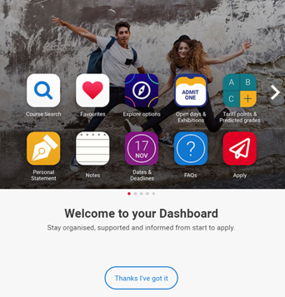
Before you apply…
Register in the UCAS Hub to explore your options, such as:
explore careers, subjects, universities and apprenticeships
find and favourite over 35,000 courses
search for virtual tours and online events
turn predicted grades into Tariff points
speak to those in the know using Unibuddy
Security marking: PUBLIC
21 September 2023
| 13

Slide 14

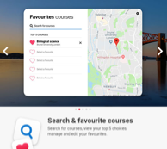

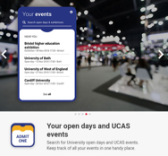
UCAS Hub
Security marking: PUBLIC
21 September 2023
| 14

Slide 15

Research – it’s free!
Learning from others – chat to uni students student videos and blogs.
Career options – use the job profiles to explore different career roles and pathways.
Take the Buzz quiz to find out more about individual strengths, and what roles may suit you.
The Career Finder tool is ideal for considering options after education, including searching for apprenticeships.
Security marking: PUBLIC
21 September 2023
| 15

Slide 16





Apply key facts
It’s an online application
Maximum of five choices.
Choice restrictions:
  medicine, veterinary, medicine/science, dentistry
  (maximum of four)
  Oxford or Cambridge
Simple application cost:
  one choice – £20.50
  two to five choices – £26.50
Equal consideration.
‘Invisibility’.
5
Security marking: PUBLIC
21 September 2023
| 16

Slide 17
When to apply for 2024 entry
19 May UCAS Undergraduate Apply opens for 2024 entry.
8 September First day for receipt of completed applications.
15 October* Application deadline for courses in medicine, veterinary medicine/science, and dentistry, and courses at Oxford or Cambridge.
HOLY FAMILY DEADLINE: 1ST DECEMBER
31st January* Equal consideration application deadline.
25 February Extra opens.
30 June* Last date for applications before Clearing.
Security marking: PUBLIC
21 September 2023
| 17

Slide 18
Completing the UCAS application
A student registers at: ucas.com/apply
Sections to complete:
1. Personal details
2. Additional information
3. Student finance
4. Choices
5. Education
6. Employment
7. Personal statement
8. Referee details
Teacher/ adviser adds their reference
Applications are sent to UCAS
Universities/ colleges make their decisions
Security marking: PUBLIC
21 September 2023
| 18

Slide 19







The personal statement
The only section you have full control over
Your only chance to market themselves individually
UCAS’ similarity detection service:
every personal statement is run through software to check for plagiarism.
The same for all of your choices
A maximum of 4,000 characters, or 47 lines
A minimum of 1,000 characters
There isn’t a spelling or grammar check
No formatting is allowed
Security marking: PUBLIC
21 September 2023
| 19

Slide 20



Decisions
Universities and colleges will review the:
They may also ask for:
personal statement
Admissions test
qualifications
Interview
reference
Portfolio/audition
Security marking: PUBLIC
21 September 2023
| 20

Slide 21
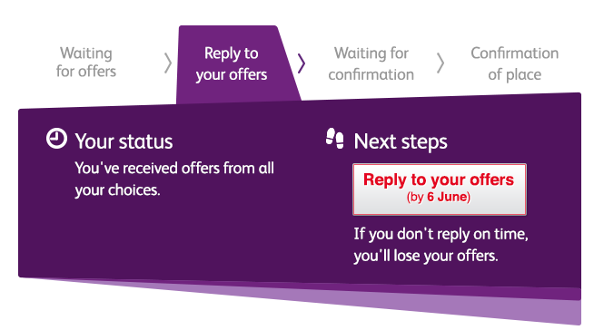

Tracking applications
Track allows applicants to:
follow the progress of their application 24/7
see their choices and personal information
view their offers
reply to offers online
In Track, a student can hold up to two offers:
  firm – if they meet the conditions of the offer they will be placed here
  insurance –if they are not placed with their firm choice, they may be placed with their insurance choice.
Security marking: PUBLIC
21 September 2023
| 21

Slide 22

Other options
Extra (25 Feb – 4 Jul)
  Used all five choices and had no offers.
  Add Extra choices for consideration one at a time in Track.
Clearing (5 Jul – 19 Oct)
Apply after 30 June, receive no offers, decline all offers, not met conditions.
Find vacancies from July, and add one choice in Track.
Adjustment (up to five days in Aug)
Placed with firm choice, and did better than expected.
Register in Track, then find another university or college. The new university or college adjusts the record.
Security marking: PUBLIC
21 September 2023
| 22

Slide 23
How can you support them?
Research
Use the parents/guardians’ section of the UCAS website at www.ucas.com/parents.
Sign up
Sign up for updates from UCAS, and get everything you need to know about the application process direct to your inbox.
Open days
Attend virtual events and open days – you may have a different perspective.
Be proactive
Make sure they read everything carefully that is sent to them and don’t book family holidays at key times!
Security marking: PUBLIC
21 September 2023
| 23

Slide 24
Thank you
Security marking: PUBLIC
21 September 2023
| 24

