Slide 1
All about Music

Slide 2
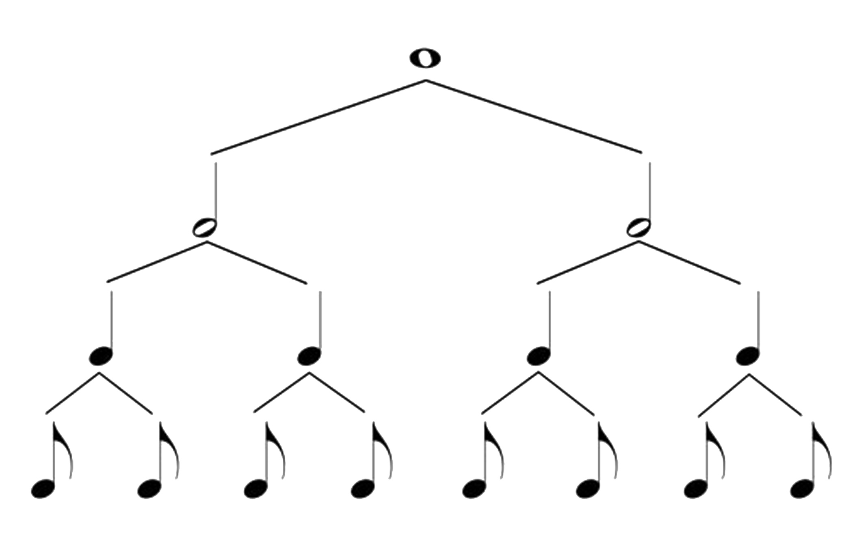
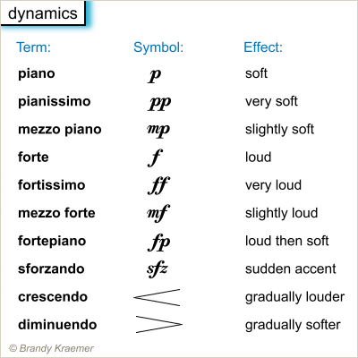
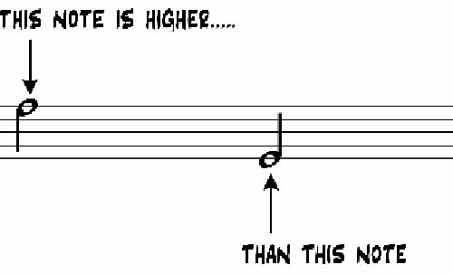
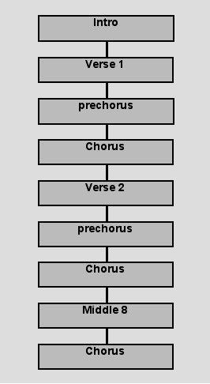
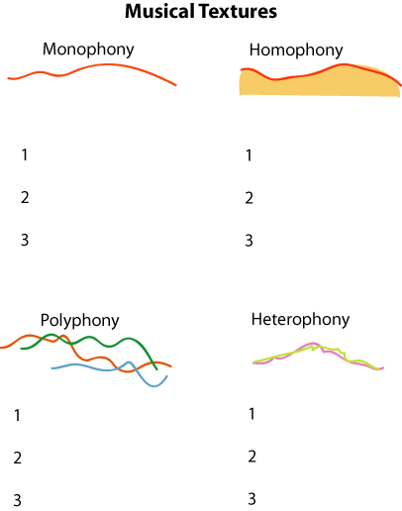
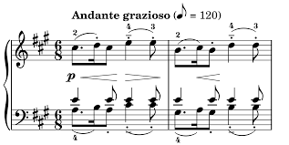
DURATION
DYNAMICS
PITCH
Youtube Link 1
Youtube Link 2
Youtube Link 1
Youtube Link 1
ELEMENTS OF MUSIC
Youtube Link 2
Youtube Link 1
Youtube Link 1
Youtube Link 1
Youtube Link 2
STRUCTURE
TEMPO
TEXTURE

Slide 3
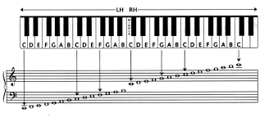
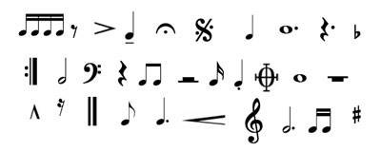
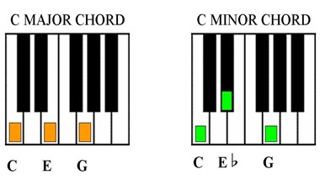
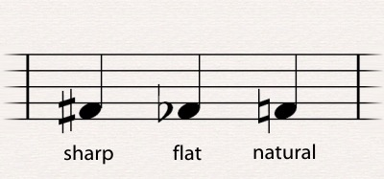
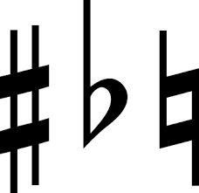
NOTES
SYMBOLS
Youtube Link 1
Youtube Link 1
Youtube Link 2
Youtube Link 2
Youtube Link 3
THEORY OF MUSIC
Youtube Link 1
Youtube Link 1
Youtube Link 2
CHORDS
SHARPS AND FLATS

Slide 4
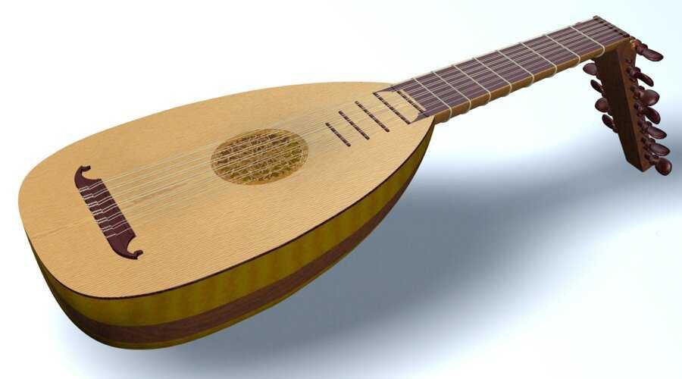
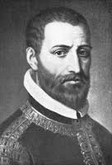
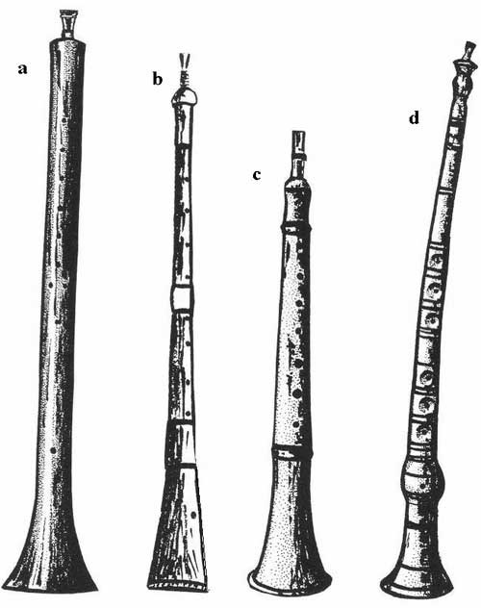
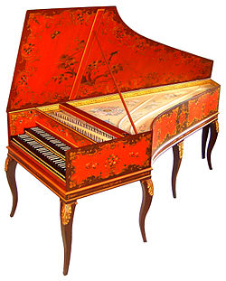
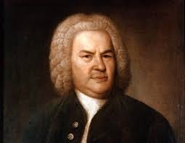
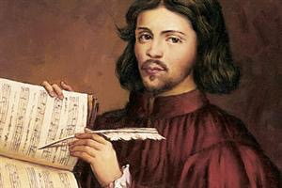
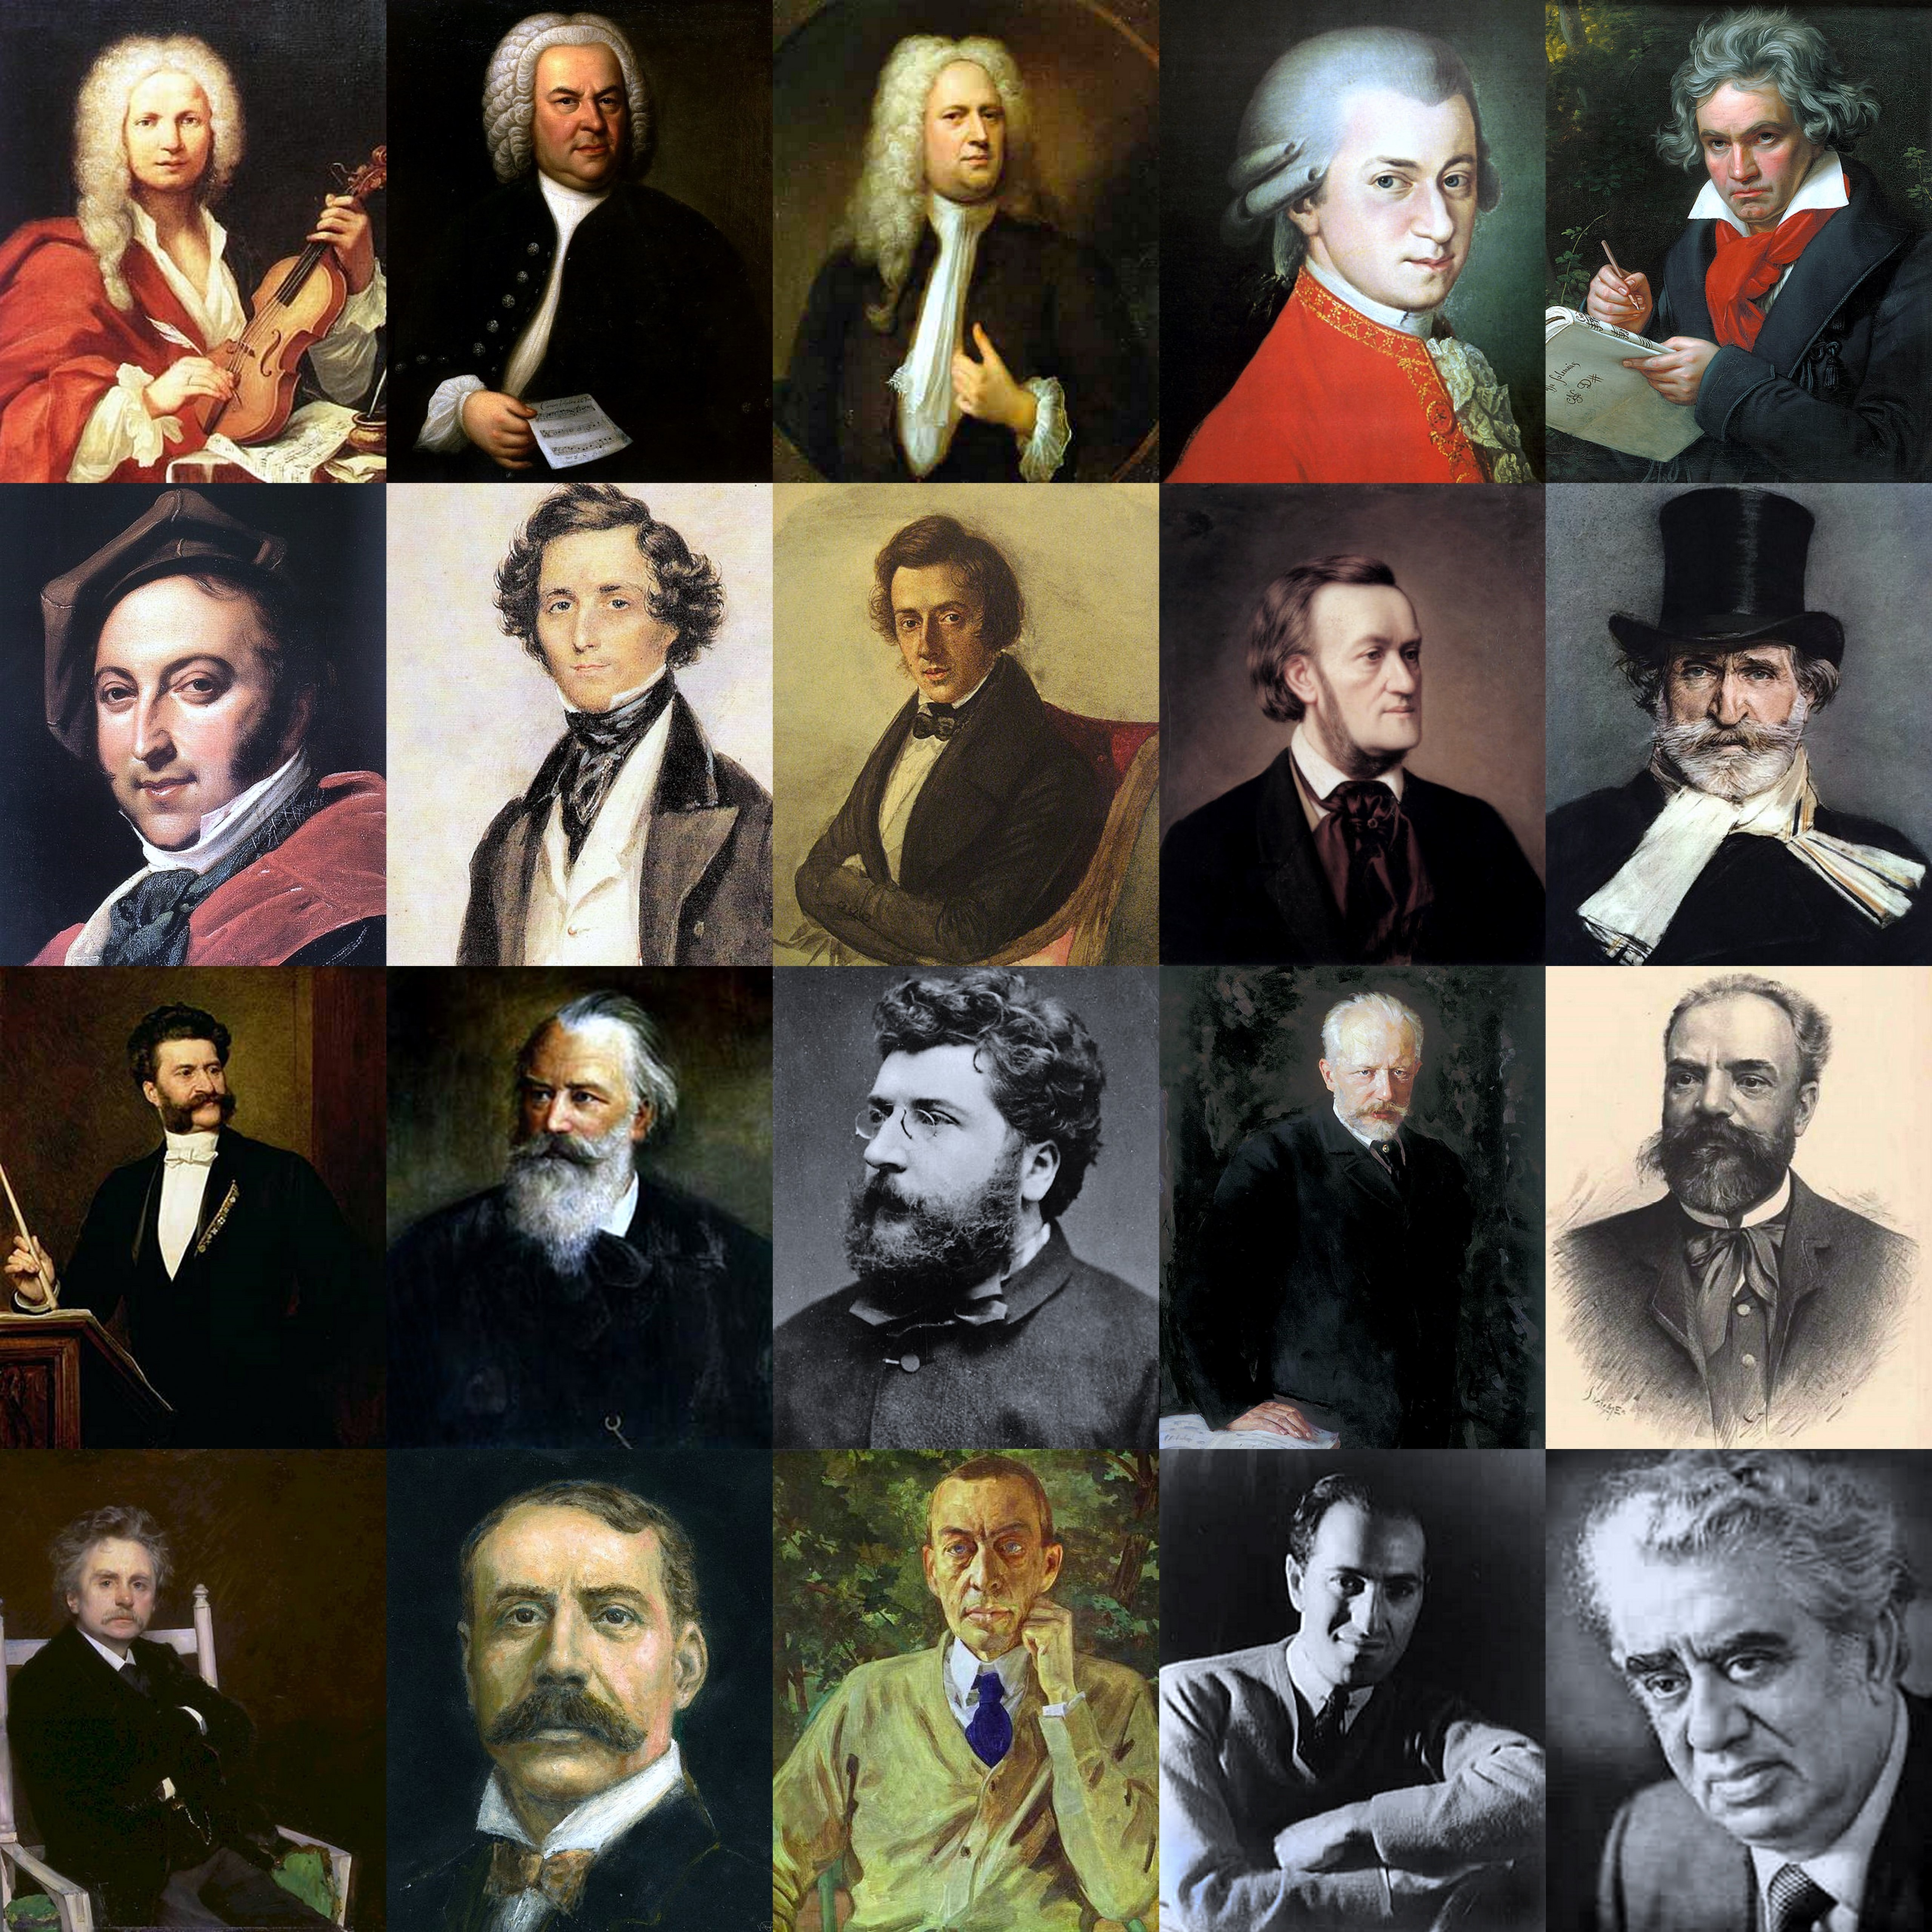
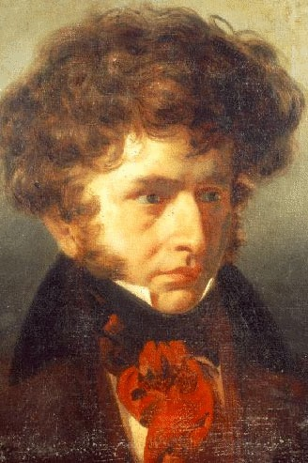
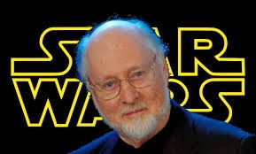
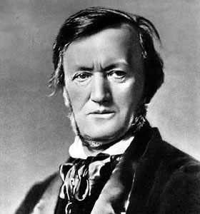
MEDIEVAL
RENAISSANCE
BAROQUE
Youtube Link 1
Youtube Link 1
Youtube Link 1
Youtube Link 2
Youtube Link 2
MUSICAL PERIODS
Youtube Link 1
Youtube Link 1
Youtube Link 1
Youtube Link 2
Youtube Link 2
CLASSICAL
ROMANTIC
MODERN

Slide 5
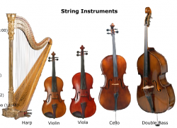
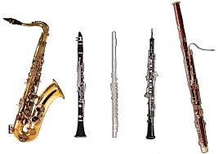
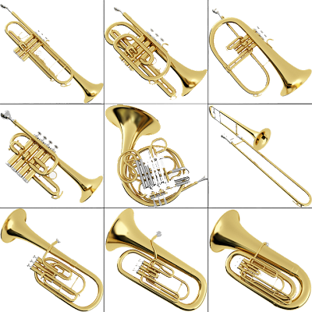
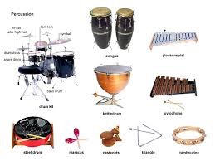
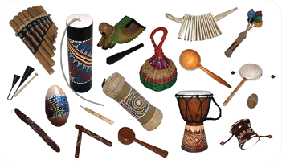
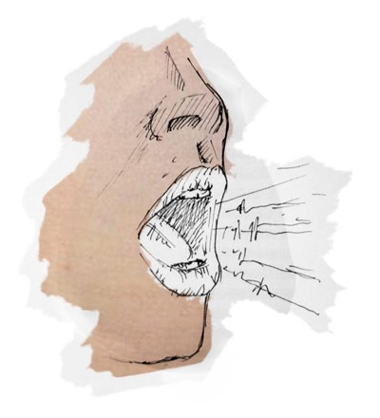
STRINGS
WOODWIND
BRASS
Youtube Link 1
Youtube Link 1
Youtube Link 1
Youtube Link 2
Youtube Link 2
Youtube Link 2
INSTRUMENTS OF THE ORCHESTRA
Youtube Link 1
Youtube Link 1
Youtube Link 1
Youtube Link 2
Youtube Link 2
Youtube Link 2
PERCUSSION
VOICE
WORLD INSTRUMENTS

