Slide 1
Anglo-Saxons
In the case of the king, the resources and tools with which to rule are that he have his land fully manned: he must have praying men, fighting men and working men. You know also that without these tools no king may make his ability known.
King Alfred’s digressions in his translation of Boethius’s Consolation of Philosophy
British history from before 1066

Slide 2
LEARNING OBJECTIVES
At the end of the module, students should be able to:
Trace the beginning and end of Anglo-Saxon period of England
Map the Anglo-Saxon kingdoms
Be familiar with the rule and succession of Anglo-Saxon kings
Analyse the life and society of Anglo-Saxons
KEY WORDS
Anglo-Saxon
Jutes
Saxons
Angles
Kingdoms
Paganism
Christianity
Tithing
Hundreds
Normans
Burhs
MODULE CONTENT
This module includes the following topics:
Anglo-Saxon Timeline
The Anglo-Saxons
Anglo-Saxon Kingdoms
Society and Structure
Anglo-Saxon Kings
End of Anglo-Saxon Kingdom
ANGLO-SAXON TIMELINE
By 449, three shiploads of Saxon warriors arrived in Hengist and Horsa in Kent.
In 635, Aidan founded a monastery in Lindisfarne, followed by the Synod of Whitby in 664.
Alfred the Great defeated the Danes at Edington in 878.
In 410, after the sacking of Rome by Alaric, King of the Goths, Roman legions departed from Britannia.
According to legends, King Arthur defeated the Saxons at Mount Badon in 518.
By 793, Danish raiders began attacking Lindisfarne, Jarrow, and Iona.
By 597, Augustine, an Italian monk, arrived in Kent and founded a Benedictine monastery at Canterbury and converted the King of Kent to Christianity.

Slide 3
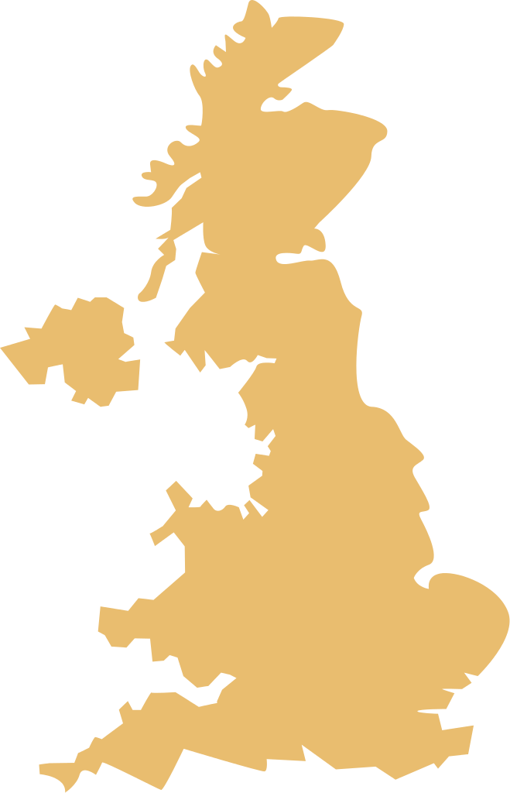
Between 919 and 920, Edward the Elder, heir of Alfred, became the overlord of West Wales, Scotia, Strathclyde, and York. By the end of the series of submissions, eight British kings swore fealty to Edgar, Edward’s grandson.
The reign of Athelstan was generally acknowledged as the first king of England.
A year after the consecration of the Westminster Abbey, Harold II, King of England, defeated Harald Hardrada and Tostig at Stamford Bridge. On the other hand, William II of Normandy defeated Harold II at the Battle of Hastings.
In 1016, Cnut was crowned as the King of England, followed by Denmark in 1018.
ROMAN EMPIRE TIMELINE
THE ANGLO-SAXONS
Historically, the Anglo-Saxons were members of the Germanic people who inhabited territories of present-day England and Wales between the 5th century until the Norman conquest in 1066.
ANGLES
SAXONS
JUTES
Based on St. Bede the Venerable, the Anglo-Saxons were descendants of the Angles, Saxons, and the Jutes who belonged to the Germanic tribes. Moreover, they were described as a group of people who migrated to Britain in the 5th century from northern Germany.
ANGLO-SAXONS
ANGLES
SAXONS
The migration was believed to have been prompted by the invitation of Britons ruler. Vortigern took fight against the threats of Picts and Scotti, people inhabiting present-day Scotland.
JUTES
Ethnically speaking, the Anglo-Saxons were a mixture of the Germanic peoples who then coexisted with the Celtics and previous Vikings.
NORTHUMBRIA
MERCIA
EAST ANGLIA
ESSEX
WESSEX
KENT
SUSSEX

Slide 4
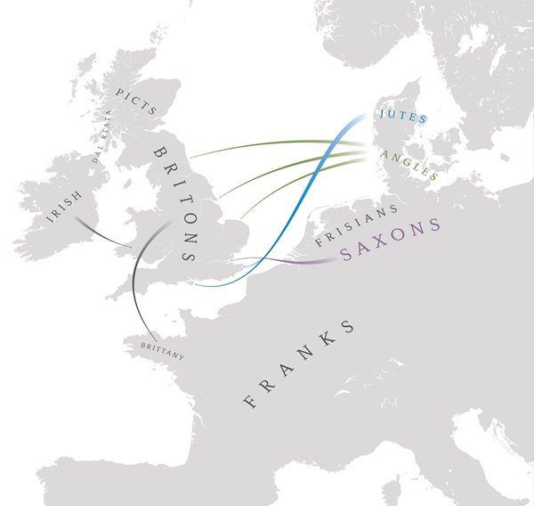
Aside from the people, Anglo-Saxon is also used to refer to the period of British history from the end of the Roman occupation in 410 and the Norman conquest in 1066. Other historians called the period the early medieval ages.
Gradually, foreign mercenaries began to populate Britain after the Roman legions departed. With little resistance from the populace of Britannia, Germanic-speaking Angels, Saxons, Jutes, and even Frisians arrived. Aside from the Celtics, who inhabited areas of Britain prior to the foreigners, the Anglo- Saxons faced minor difficulties in settling and forming kingdoms.
They spoke Old English, ancestor of modern-day English, closely related to other Germanic languages of Old Friesian, Old High German, and Old Norse. Before 1100, many books were written and read in England indicating that Anglo-Saxons were literate.
Map showing the migration of the Angles, Saxons, and Jutes to Britain
The term Anglo-Saxon is believed to have been first used by writers in the 8th century.
Based on excavations of burial sites and Christian writings, Anglo-Saxons in the fifth and sixth centuries were pagans. Early cemeteries suggested that they favoured cremation over inhumation. At times, the dead were buried with grave goods. It was only in the 6th century when Christianity through Augustine, an Italian monk, reached Kent to convert King Ethelbert.
List of major Anglo-Saxon gods
Successfully, Augustine who was later appointed as Bishop by the Pope, converted the King of Kent to Christianity. King Ethelbert gave permission to build a church in Canterbury. In no time, Christianity spread in other parts of Britain. Pagan temples and pagan celebrations were replaced with Christian ones.
God | God of ...
Blader Eostre Frigg Hel Loki Saxnot Thunor Tiw Wade Wayland Woden | Immortality Birth Love Death Cunning Family Thunder War Sea Metalworking Chief God
Pagans worshiped many gods. which they believed to have roles in their everyday life.
Today, names of some of the days of the week are based from the names of Anglo-Saxons gods, including Tuesday (Tiws), Wednesday (Woden or Odin), Thursday ( Thor), and Frida (Frigga or Freya).

Slide 5
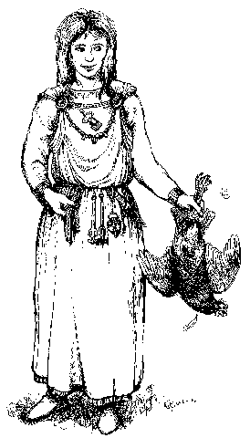
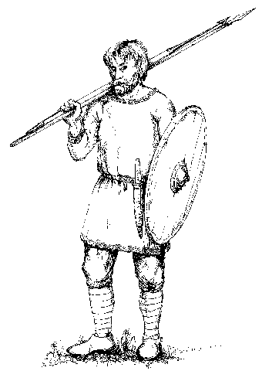
Due to light raw materials, there is little evidence of how early Anglo-Saxons dressed. With fragments of textiles and few records of continental Germanic people, clothing of early Anglo-Saxons was presented in several works of literature.
MEN
Evidence indicated that early Anglo-Saxon men wore a one-piece short cloak or cape made of sheepskin or fur. Both sexes were suggested to wear hacele, a hooded cloak. Most men wore tunics that were usually mid-thigh to knee length. Some men of wealth wore linen undershirts. Leather belts were used to hold up both the trousers and girdle the tunic.
Image of early Anglo-Saxons
WOMEN
A basic clothing for Anglo-Saxon women was a peplos. Usually a tubular garment, a peplos was clasped at the shoulders through brooches and was often worn ankle length. Brooches depend on regional patterns.
GUIDE QUESTION
After learning about the events during the Anglo-Saxon period, take note of the following questions:
What were the events comprising the beginning and end of the Anglo-Saxon period?
Who were the Anglo-Saxons?
How can you describe their way of life?
ACTIVITY
Given your knowledge about the Vikings, Celts, and Normans, make a comparative table about this group of people. Design your own categories, e.i clothing.
ANGLO-SAXONS
VIKINGS
NORMANS
CELTS

Slide 6
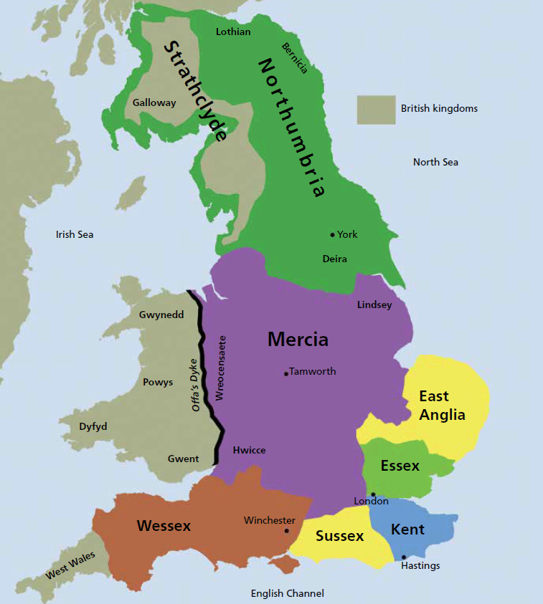
ANGLO-SAXON KINGDOMS
Between 650 to 800 AD, Anglo-Saxon kingdoms were established with constant threat from rival kings.
Settled by the Jutes, Kent was probably formed from at least two smaller kingdoms. With Ethelbert as king, Kent became one of the wealthiest kingdoms in southern Britain. At the time of his reign, laws of Kent were written down as charters to be implemented.
With the establishment of Canterbury by Augustine, subjects like poetry, astronomy, mathematics, and Greek were taught, making it a major intellectual centre.
Similar to Kent, other kingdoms began to emerge. East Anglia inhabited by the Angles: the North Folk (living in modern Norfolk), and the South Folk (living in Suffolk) was known for its wealth as excavated at Sutton Hoo. Under the influence of the King of Kent, East Anglia was also converted to Christianity. The Sutton Hoo treasures included important items from the Byzantine Empire and Scandinavia.
In the north, Northumbria became the most powerful kingdom in the north from the smaller kingdoms of Bernicia and Deira. With its strong cultural connection with Ireland and Rome, Northumbria emerged as the most influential Anglo-Saxon Kingdom. In 635, the monastery on Lindisfarne was built and became the kingdom’s cultural and political centre.
When Mercia gained power in the 700s, Northumbria’s dominance declined. In the 7th century, Penda, a Mercian king who refused to convert to Christianity, defeated two Northumbrian kings. During the reign of Penda, Mercia accumulated enormous wealth and military power. By a time, Kent, Mercia, and East Anglia were ruled by one king, Ethelbald, who became known as the King of South English. Succeeded by King Offa, Mercia extended its power and seized London, East Anglia, and Kent. With the death of King Offa, the Pope deposed the late king’s son and abolished the archbishopric of Lichfield (it replaced the archbishop of Canterbury). By the 800s, East Anglia was freed from Mercian control.
In 825, King Ecgberht of the West Saxons defeated Beornwulf, King of the Mercians, which resulted in the transfer of overlordship of the kingdoms Kent, Sussex, Surrey, and Essex to West Saxon (Wessex).
Territorial gains under King Ethelwulf were further sealed with the marriage alliance to a Frankish princess and great granddaughter of Charlemagne.

Slide 7
GUIDE QUESTION
After learning about the Anglo-Saxon kingdoms, take note of the following questions:
What were the kingdoms of England?
Who inhabited and ruled each kingdom?
ACTIVITY
ROMAN EMPIRE TIME
SOCIETY AND STRUCTURE
Using the map, trace who inhabited and ruled the kingdoms of England.
Due to successful trade and use of land in towns and villages, England at the time of the Anglo-Saxons became one of the wealthiest kingdoms in Europe.
ROYAL FAMILY
Upon gaining dominance in the mid 9th century, the royal family of the Kingdom of Wessex was the recognised English family.
MAJOR NOBILITY
MINOR NOBILITY
Also part of major nobility were bishops and some churchmen.
FREEMEN
SERFS
A king and his family topped the social hierarchy. As a rule, succession to the throne was hereditary, however, the Witan of council of leaders also held right to choose who would be the best successor amongst the royal family.
The earls who owned lands and other properties served as the king’s right hand men. Amidst not being hereditary, by the 10th century, earls became concentrated to few families.
Thegns were the backbone of the Anglo-Saxon army. With loyalty and service, a thegn received lands and the chance to be an earl.
Freeman were members of the upper group of commoners who participated in local courts in times of disputes.
Serfs made up the majority of England’s population and did not own land. They worked for others for food and shelter.

Slide 8
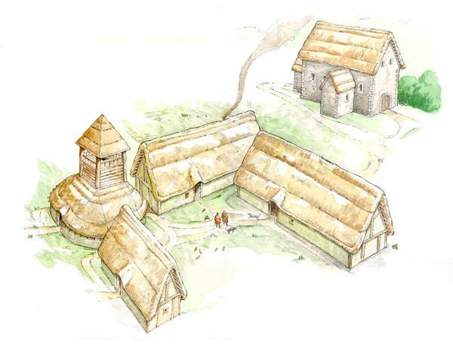
Courts were also organised in hierarchy. The king had the power to appoint officials in charge of local courts in each shire and borough.
Local courts were composed of Tithings, or group of ten families.
They were responsible for maintaining order and enforcing laws against murder and theft.
A group of ten Tithings was known as the Hundreds, who elected a constable. Meanwhile, a collection of Hundreds formed shires or counties. The head of the shire was called a shire-reeve or sheriff. Each shire was under the control of an earl who needed to pay the king one third of collected fines or taxes.
Local courts were called ‘hundred’ courts, where local cases were heard.
X 10
Based on a series of excavations, Anglo-Saxon settlement was pictured. Compared to the Roman and Normans, Anglo-Saxon houses were short-lived. Materials used in housing were largely timber, leather, and textile. Major churches were the only buildings made of stone.
Burh means fortress or fortified settlement.
Most houses were built facing the sun for heat and light. The biggest house in an Anglo-Saxon village was the Hall, where the king and his warriors lived. A hall was long with the fire on a stone in the middle. Like other civilizations, villages were built near natural resources, such as water, wood, and food. For protection, most villages were secured with high fences.
A reconstruction drawing of an Anglo-Saxon settlement at Bishopstone. This shows a high-status courtyard house, probably of the early 9th century.
The Anglo-Saxons both domesticated and hunted animals for food. Moreover, household goods were made of wood, metal, and pottery. They also traded goods like hunting dogs and slaves in exchange for glass and other foreign items. Villages were usually composed of less than 100 inhabitants.
In order to protect Anglo-Saxon England from the raiding Danes, Alfred the Great began the policy of fortification of towns, or burhs. Fortified towns were built to advance the kingdom’s defense force. Most burhs protected centres of commerce and the seat of local government. In exchange for free plot of lands, settlers built fortifications.
Although not as sophisticated as the Romans, Anglo-Saxon burhs were effective in protecting towns against the Vikings. Burhs were built through the following steps:
Digging of very deep trench
Building of wooden or stone walls
Large gates were positioned on either end of the town

Slide 9
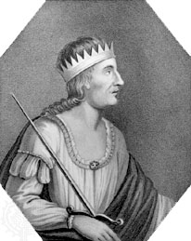
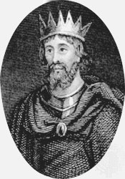
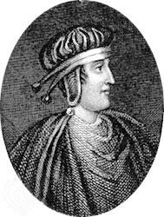
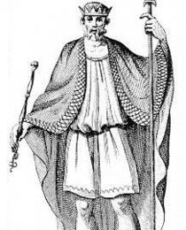
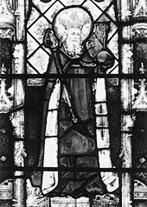
GUIDE QUESTION
After learning about Anglo-Saxon society, take note of the following questions:
What composed the social hierarchy?
Are there any similarities with the feudal system? Explain.
How significant was the building of burhs?
ACTIVITY
ANGLO-SAXON
________________
Based on your knowledge of early civilisations, make a comparative analysis of social structures. Compare and contrast the Anglo-Saxon social hierarchy to another of your choice.
ROMAN EMPIRE TIMELINE
ANGLO-SAXON KINGS
Egbert, King of Wessex, ruled between 802 and 839. During this time West Saxon dominated the kingdoms in England.
Aethelbald, eldest son of Ethelwulf, took his father’s authority in 855 and married the daughter of the King of Franks, who was also his stepmother.
Ethelred, the third son of Ethelwulf, ruled between 866 and 871. His reign was characterised by long struggle against the raiding Danes.
As son of Egbert, Ethelwulf succeeded the throne and ruled until 856. He was known for sealing an alliance with the kingdom of Mercia through the marriage of his daughter.
Ethelbert, the former king’s brother, ruled from 860 to 866. He was the first Anglo-Saxon king to become a Christian.

Slide 10
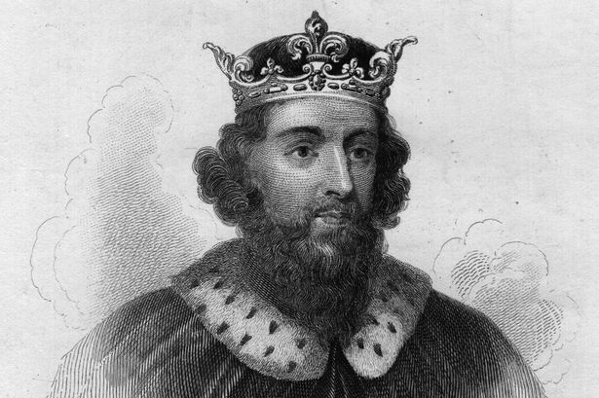
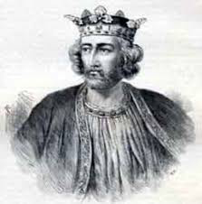
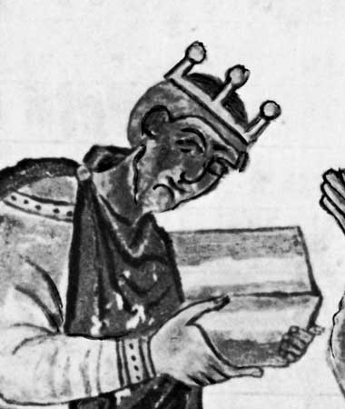
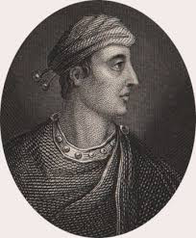
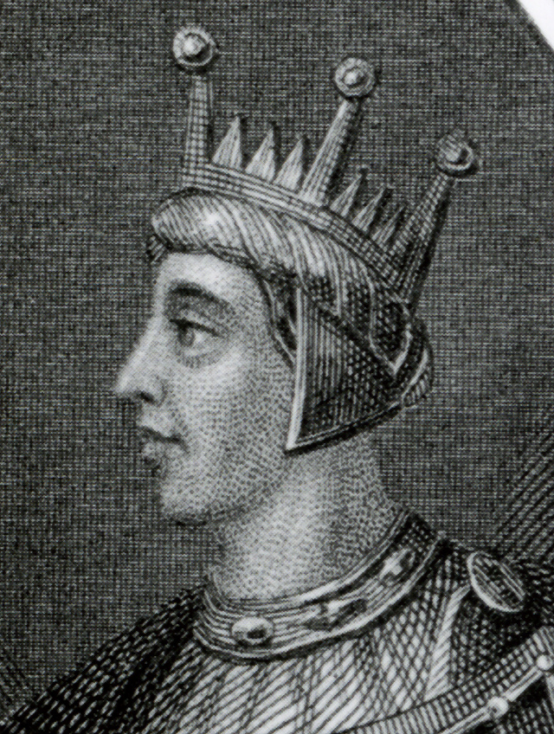
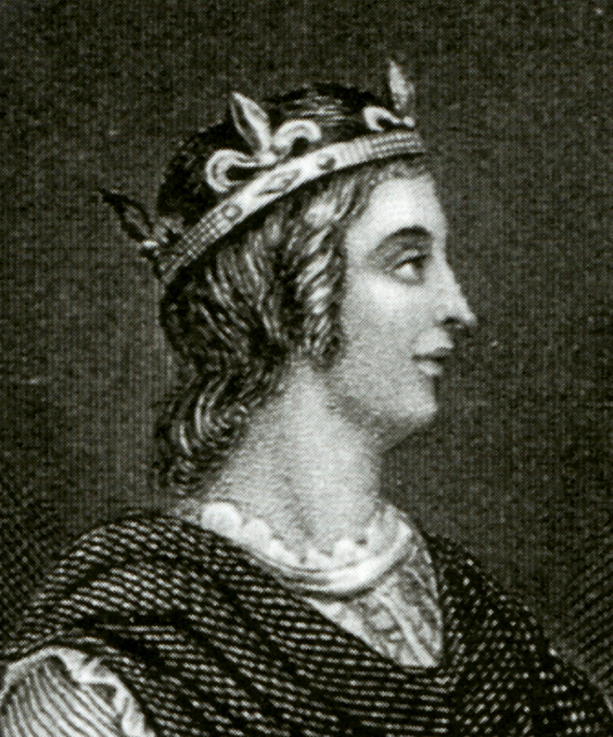
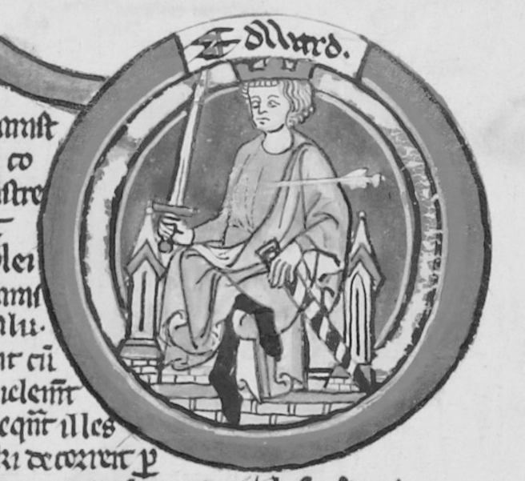
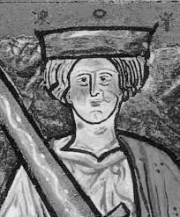
The fifth son of Aethelwulf, Alfred the Great ruled between 871 and 899 and was known for assembling the legal code from his predecessors.
Edward the Elder succeeded his father Alfred, ruled for 25 years and defeated the Vikings in Northumbria. His military successes against the Danes, Scots, and Britons spread Anglo-Saxon influence in England.
Athelstan, Edward’s heir, was known for extending the kingdom. During his reign all five Welsh kings submitted to him and paid tributes.
When Athelstan died without a successor, his half brother Edmund assumed the throne after successfully suppressing the rebellion by Mercian Danes. During his 7 years reign, he recaptured northern England once invaded by the
Vikings.
In 946, Eadred succeeded his brother as king and brought up Edmund’s sons Edwy and Edgar as his heirs.
Crowned by the archbishop of Canterbury, Edwy, Edmund I’s eldest son, faced the break away of Mercia and Northumbria.
Upon his brother’s death, Edgar, King in Mercia and the Danelaw, succeeded the throne. Also known as Edgar the Peaceful, he united the English kingdom with justice and order.
Edward II the Martyr became King of England in 975 and was murdered in 978 by his half brother’s supporters.
Upon the murder of his half brother, Ethelred the Unready became king. Without military skills, he was deposed by the Viking Sweyn of Denmark and fled to Normandy in 1013. He returned in 1014 after
the death of the Viking
king.

Slide 11
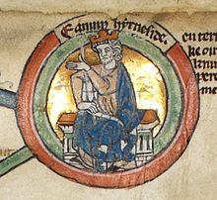
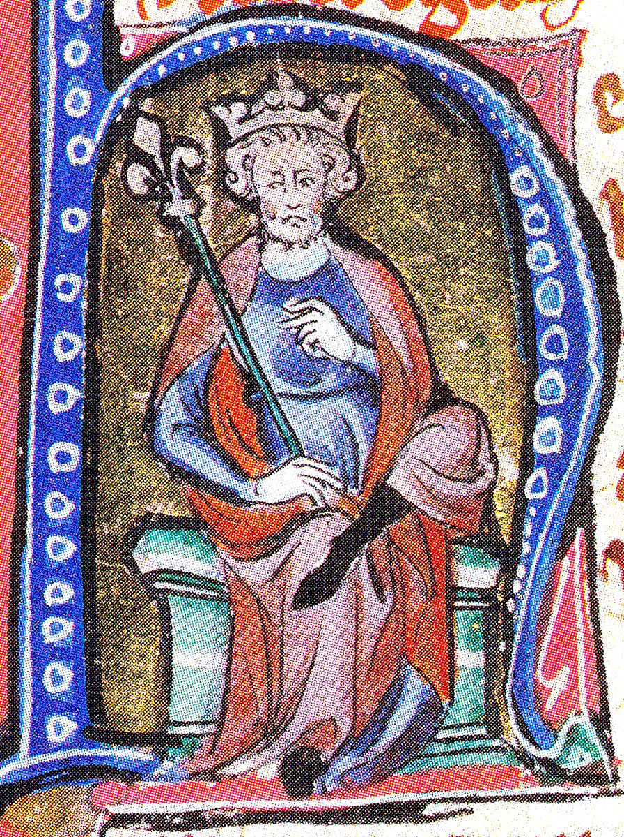
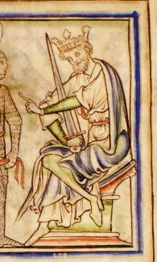
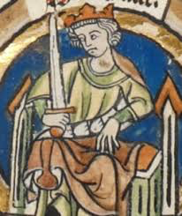
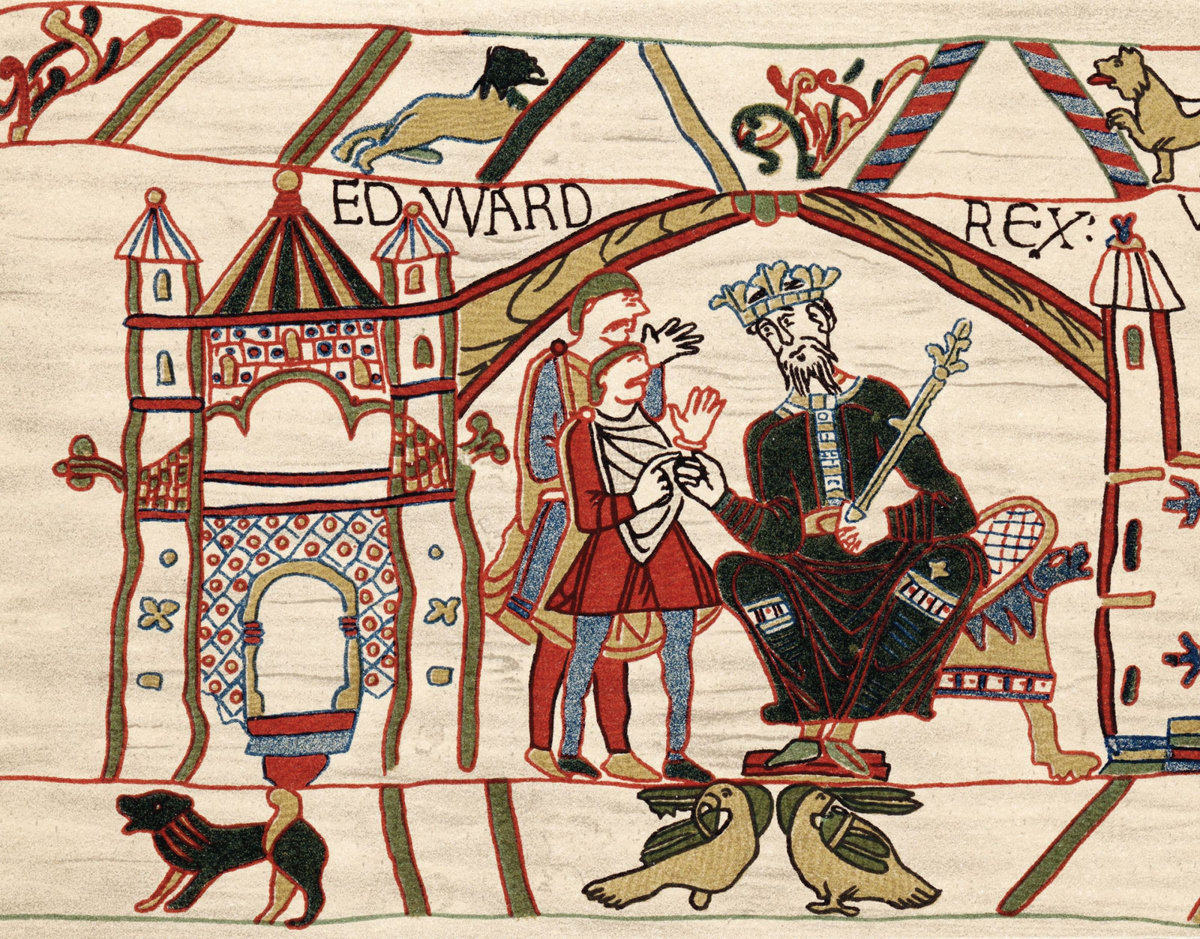
Edmund II the Ironside, son of Ethelred, ruled the Danelaw independent of his father. He became the King of England from April to November 1016.
Canute the Great, son of Sweyn, ruled as King of England between 1016 and 1035 when his rivals (sons of previous kings) fled abroad. Aside from being King of England, he was also the King of Norway and Denmark, which made him the largest overlord in the north.
Upon the death of Canute, his sons Harold Harefoot and Harthacanute shared the rule of the kingdom. Harold took over Mercia and Northumbria while his brother ruled Wessex and Denmark. When Harold died in 1040, Harthacanute succeeded him until 1042.
Edward the Confessor lacked necessary military skills as he was brought up in exile in Normandy. Amidst being undisputed king, he had few rivals in the persona of Godwin of Wessex, one of Canute’s powerful earls. In order to seal alliance, Edward married Godwin’s daughter Edith in 1045. However, Godwin defied Edward and assembled his own army. As a result, Godwin was sent in exile abroad. The appointment of Normans at court also began.
Threatened by the claim of William, Duke of Normandy, Edward made an alliance with Harold, Godwin’s son. Harold led the king’s army. While on his deathbed, Edward named Harold as his successor. During his reign, Edward became known as a simple king who did not live off the revenues of his own land. With deep religiosity, he ordered the building of the Westminster Abbey, where he was buried in 1066.
Bayeux tapestry of Edward the Confessor, King of England
Invited by his brother Hardicanute, Edward, son of Ethelred to his second wife Emma, became the King of England in 1042.

Slide 12
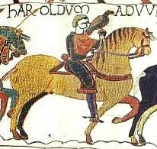
Edward’s brother-in- law, Harold Godwinson, was confirmed by the Witenagemot, or king’s council, as Earl of Wessex and King of England on January 6, 1066, the day after Edward’s death. King Harold’s throne was threatened by William Duke of Normandy and Harald, King of Norway. In September 1066, Harald Hardrada and Tostig (King Harold’s brother) invaded England, but were later defeated.
Both Harald and Tostig were killed in the battle. Meanwhile, William, who claimed to be Edward’s successor, in 1064 sailed to Sussex. On October 14, 1066, Harold was defeated at the Battle of Hastings, which ended the Anglo-Saxon rule of England. The Duke of Normandy then became known as William the Conqueror.
Harold Godwinson from the Bayeux Tapestry
GUIDE QUESTION
After learning about the Anglo-Saxon kings, take note of the following questions:
Who was the most notable Anglo-Saxon king?
What did you notice on the rule of succession?
How significant were the rules of Edward the Confessor and Harold Godwinson?
ACTIVITY
Choose an Anglo-Saxon king that strikes you the most and write a short biographical narrative about him.

Slide 13
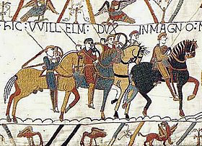
ROMAN EMPIRE TIMELINE
END OF ANGLO-SAXON KINGDOM
By the beginning of the 11th century, the kingdoms of England were challenged by conquests; first by Canute in 1016; and second by William of Normandy in 1066, which also ended the Anglo-Saxon rule of England.
Following the Norman conquest of England, Anglo-Saxon nobility were either exiled or lowered down to peasantry. By 1087, it was estimated that only 8 percent of the total English land remained to be under Anglo-Saxon control. Lords were replaced by Normans and Anglo-Saxon soldiers were sent as mercenaries, mostly in the Byzantine Empire.
Bayeux tapestry depicting the Battle of Hastings, 1066
Anglo-Saxon commoners learned Norman French to understand the new ruler, whilst many still spoke Old English. By 1200, scholars called Anglo-Saxon English the Middle English. Moreover, nearly all Anglo-Saxon abbeys and cathedrals were replaced with Norman-inspired architecture. It took about a decade for William the Conqueror to consolidate his kingdom.
GUIDE QUESTION
After learning how the Anglo-Saxon period ended, take note of the following questions:
Who was William the Conqueror?
How did Harold Godwinson become King of England?
What were the changes brought by the Norman conquest of England?
ACTIVITY
Make a timeline highlighting the reign of Edward the Confessor, the battle to the throne, and the Battle of Hastings.

