Slide 1
English Language GCSE
Component 2 – Analysing how writers use language

Slide 2
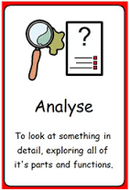
Learning Objective:
AO2 Skills
Comment on, explain and analyse how writers use language, using relevant subject terminology to support your views.
Key term:
Analyse: examine (something) methodically and in detail, typically in order to explain and interpret it.

Slide 3
In the exam:
There are many ways you can be asked to explain, comment upon and analyse. For example:
What impressions do you get of…?
What do you think and feel about …?
Explain how…
What are the writer’s thoughts and feelings about…?
How does the writer…?

Slide 4
In the exam:
These questions will then often have bullet points which you need to follow too:
Comment on the language and tone of the writer.
Comment on the writer’s structure.
Comment on the writer’s choice of literary elements.
What you are being asked how a writer achieves a certain effect or influences you to think or do something.
It doesn’t mean write a list of features with no explanation!
You must show an understanding of the words and examples you select.
You will be rewarded for using appropriate vocabulary, just identifying the simile or short sentence is not enough.
Remember AO2 asks for “relevant subject terminology”

Slide 5
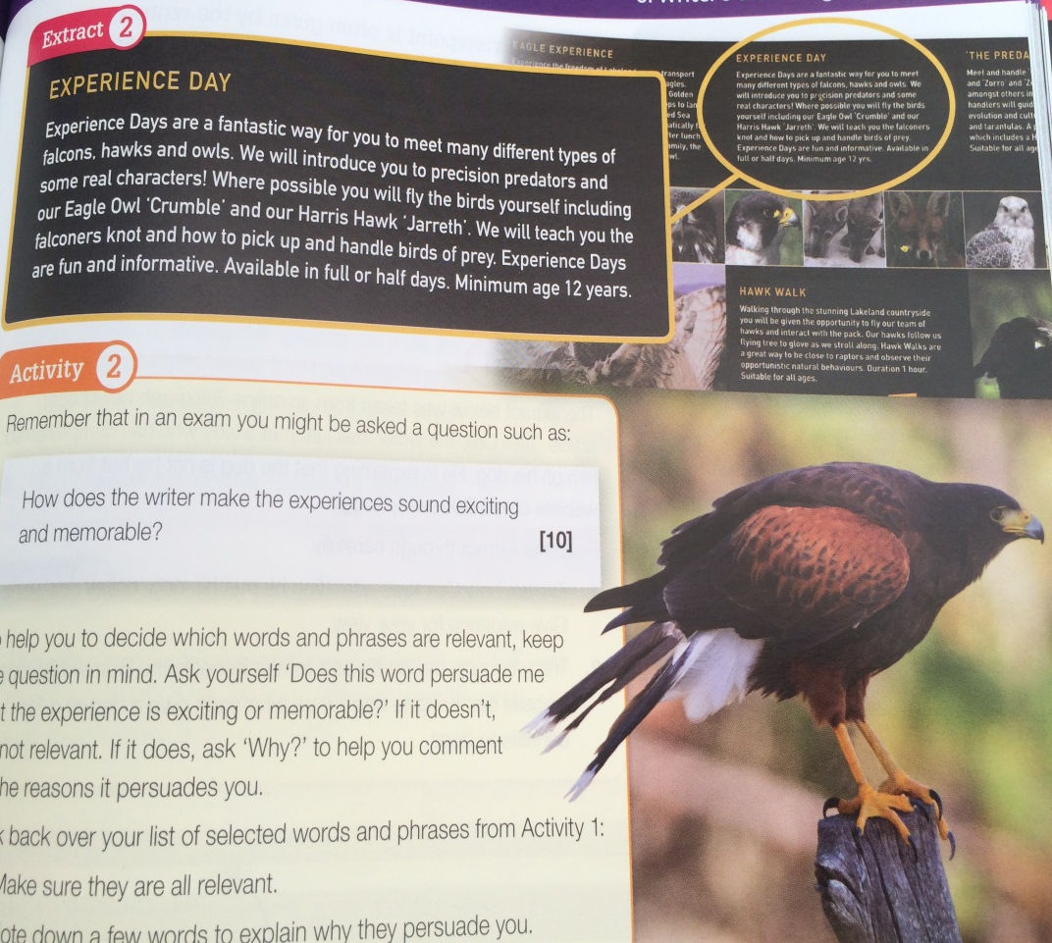
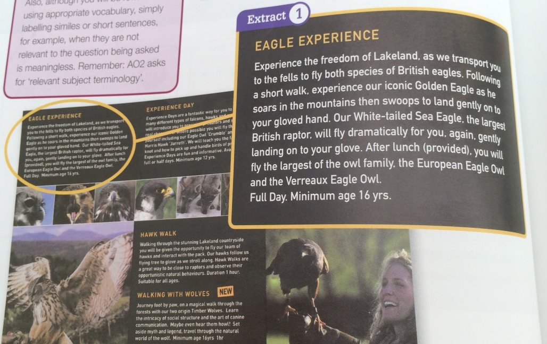
Our texts
Promotional materials like leaflets and websites often use persuasive language about a place or experience in order to sell it to their target audience.
Read the two extracts from the ‘Predator Experience’ leaflet.

Slide 6
Activity 1
10 minutes
Make a list of words and phrases which help to persuade the reader that the experience will be exciting and memorable.
Exciting and memorable language and techniques
“Swoops to land gently”

Slide 7
Activity 2
10 minutes
Remember that in your exam you might be asked a question such as:
How does the writer make the experiences sound exciting and memorable? [10]
To help decide which words and phrases are relevant, keep this question in mind.
“Does this word persuade me that the experience is exciting or memorable?” If it does ask Why? To help comment on the reasons it persuades you.
Look back at your list.. Make sure all the words are relevant. Note down a few words to explain why they persuade you.
Oxymoron – bird plunging to the ground yet lands softly.
Exciting and memorable language and techniques
“Swoops to land gently”

Slide 8
Did you identify this terminology?
Adjectives
‘iconic Golden Eagle’ – specifically chosen to describe the noun as impressive.
‘precision predators’ - specifically chosen to describe the noun as impressive.
Superlatives
‘largest British raptor’ – specifically chosen to impress and persuade, this can’t be beaten.
‘largest of the owl family’ - specifically chosen to impress and persuade you that this can’t be bettered.
Links, patterns (oxymoron)
Eagle flies dramatically, but lands gently.
Present tense verbs
‘soars’ ‘swoops’ used to visualise the flight of the Golden Eagle.

Slide 9
Did you identify this terminology?
Second-person pronoun
‘you’ ‘your’ – puts the reader in control of the bird
Suggestions that the birds have real personalities:
“some real characters”
Expressions and verbs that put the reader closer to the animals:
“on your gloved hand”
“on to your glove”
“pick up”
“handle”
Adjectives
‘fun’ ‘fantastic’ used to suggest energy and enthusiasm, what a great time it will be!

Slide 10
Question and Mark Scheme
How does the writer make the experiences sound exciting and memorable? [10]
Mark | Criteria
0 | Nothing worthy of credit.
1-2 | Identifies and begins to comment on some examples. May struggle to engage with the text or the question.
3-4 | Identifies and gives straightforward comments on some examples. Simply identifies some subject terminology.
5-6 | Explains how a number of different examples create impressions. Begins to show some understanding of language, structure and tone are used to achieve effect. Begins to use relevant subject terminology accurately to support their comments.
7-8 | Makes accurate comments about how a range of different examples create impressions. Begin to analyse how language, structure and tone are used to achieve effects. Subject terminology is used accurately to support comments effectively.
9-10 | Makes accurate and perceptive comments about how a wide range of different examples create impressions. Provide detailed analysis of how language, structure and tone are used to achieve effects. Subtleties of the writer’s technique are explored. Well-considered, accurate use of subject terminology supports comments effectively.

Slide 11
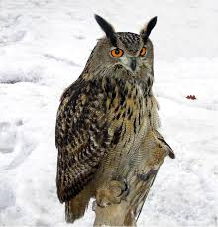
Activity 3
How does the writer make the experiences sound exciting and memorable? [10]
Write a response to the question. Comment on at least three language features, either from the list we have discussed or use your own ideas. Explain how they help to persuade the reader that the experience will be exciting and memorable.
10 minutes
20 minutes

Slide 12
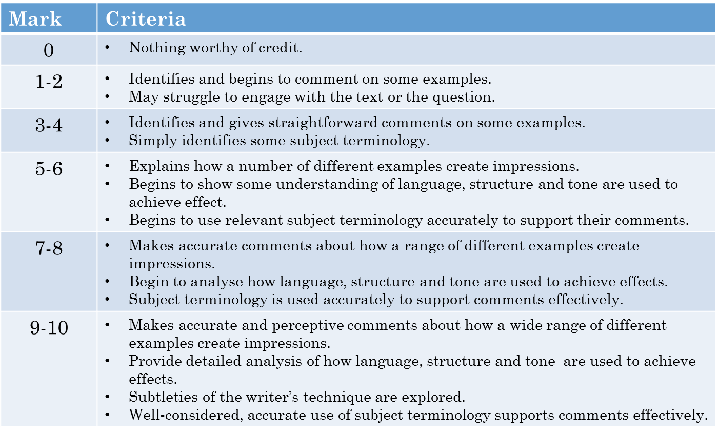
PEER assessment
How does the writer make the experiences sound exciting and memorable? [10]
Highlight examples of where your response fulfils top marks.
Write an WWW,EBI, and ACT comment.
Pass back and improve your response.

