Slide 1
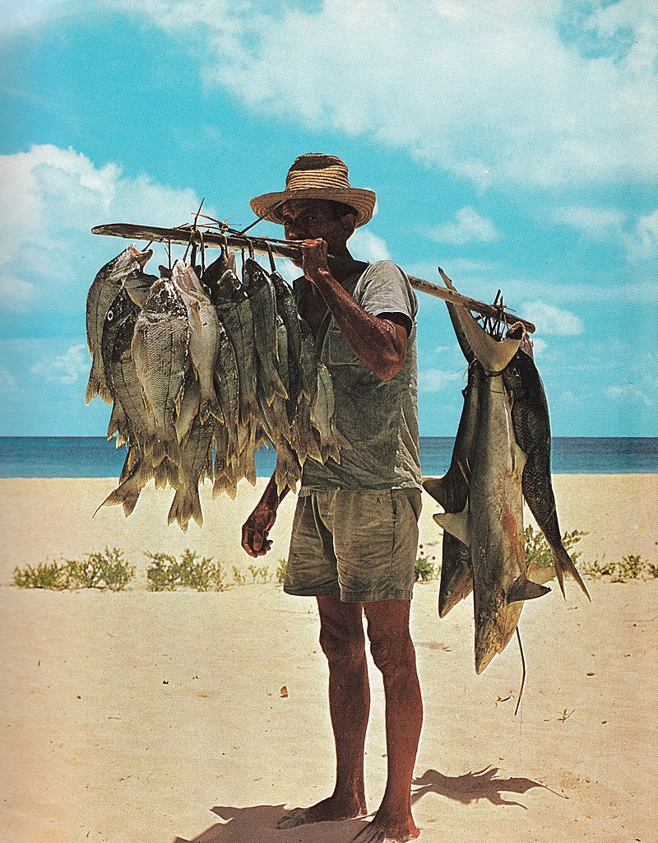
FIRST CONTACT WITH INDIA AND AMERICA ACTIVITY 3
Study the topography of Seychelles. Afterward, analyse its importance towards the objectives of the foreign powers during the Age of Exploration.
________________________________________________________________________________________________________________________________________________________________________________________________________________________________________________________________________________________________________________________________________________________________________________________________________________________________________________________________________________________________________________________________________________________________
Fisherman at Seychelles, 1977
Image source: https://upload.wikimedia.org/wikipedia/commons/6/6d/Fisherman_and_his_catch_Seychelles.jpg
Analysation
RENAISSANCE AND REFORMATION
FIRST CONTACT WITH INDIA AND AMERICA
Notes:
Image Source:
https://upload.wikimedia.org/wikipedia/commons/6/6d/Fisherman_and_his_catch_Seychelles.jpg

