Slide 1
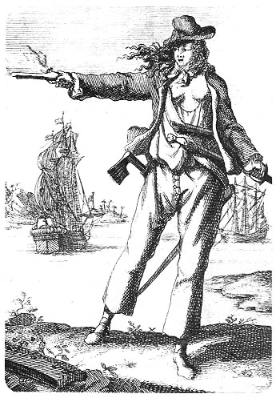
FIRST CONTACT WITH INDIA AND AMERICA ACTIVITY 4
One of the well-known pirates during the 18th century was Anne Bonny. Their trial (together with Mary Read) was recorded and published through a transcript. Analyse one of her famous statements, "As to hanging, it is no great hardship. For were it not for that, every cowardly fellow would turn pirate and so unfit the sea, that men of courage must starve."
______________________________________________________________________________________________________________________________________________________________________________________________________________________________________________________________________________________________________________________________________________________________________________________
Anne Bonny as depicted in A General History of the Pyrates
Image source: https://upload.wikimedia.org/wikipedia/commons/b/be/Bonney%2C_Anne_%281697-1720%29.jpg
Analysation
RENAISSANCE AND REFORMATION
FIRST CONTACT WITH INDIA AND AMERICA
Notes:
Image Source:
https://upload.wikimedia.org/wikipedia/commons/b/be/Bonney%2C_Anne_%281697-1720%29.jpg

