Slide 1
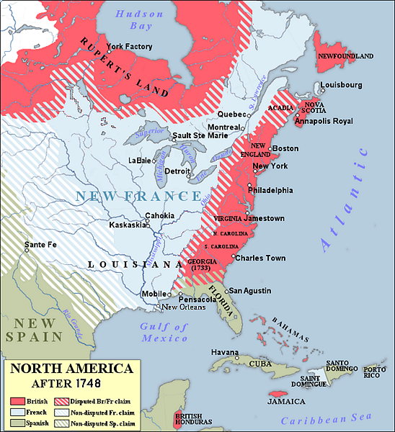
FIRST CONTACT WITH INDIA AND AMERICA ACTIVITY 5
Complete the cause and effect table of the British contact with India and America.
CAUSE
EFFECT
Great Britain During the Age of Exploration
The Thirteen Colonies by 1748
Image source: https://upload.wikimedia.org/wikipedia/commons/3/31/North_America_1748.PNG
Cause and Effect
RENAISSANCE AND REFORMATION
FIRST CONTACT WITH INDIA AND AMERICA
Notes:
Image Source:
https://upload.wikimedia.org/wikipedia/commons/3/31/North_America_1748.PNG

