Slide 1
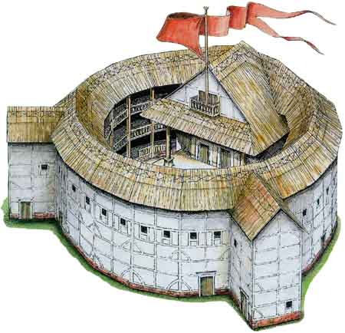
The Life and Times of William Shakespeare Lesson 3 Elizabethan Theatre
LO:
To learn about the features of the Elizabethan theatre.

Slide 2
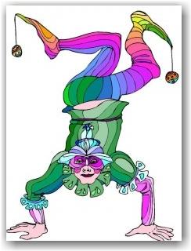
Street Entertainment
By Royal Approval
Queen Elizabeth I loved theatre and if she visited the theatre, she would have sat in the Gentleman’s Rooms, a private box in the galleries.
Ordinary people could not afford to sit in the more expensive seats in the tiers of the Globe, so would pay to watch a play in the standing area at the front of the stage. This was the cheapest area and the people that watched from here were called groundlings.
The Globe is the most famous Elizabethan Theatre and it was owned and built by William Shakespeare. The Globe theatre that exists in London today is an exact reproduction of Shakespeare's original Globe.
Shakespeare’s theatre company was called ‘The Lord Chamberlain’s Men’.
After Queen Elizabeth I’s death, King James took to the throne. He loved theatre too and in particular the works of Shakespeare. He sponsored Shakespeare’s theatre company and they came to be known as The King’s Men.
The Elizabethans were very fond of any type of entertainment and they had plenty of ways of enjoying themselves. Street theatre like acrobats, jugglers and musicians would play in streets.
Other, more gruesome forms of entertainment that always attracted crowds were public hangings or executions.
Another cruel sport that the Elizabethan’s enjoyed was animal fighting. Special arenas or yards were built with galleries all around where people could pay to see how many dogs would dare to attack a fierce bull or huge bear. This was called bull or bear baiting.
Queen Elizabeth I had her own bull and bear master to organise these tournaments.

Slide 3
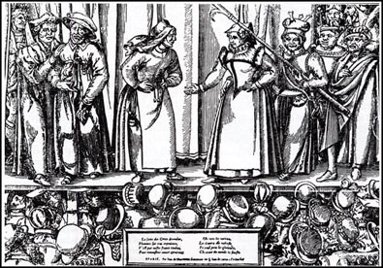
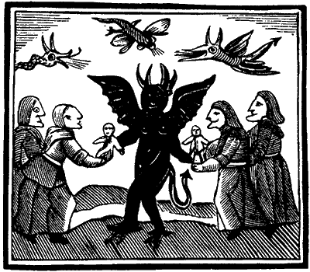
Blood, Guts and Other Special Effects
Elizabethan audiences loved blood, gore and guts. Popular plays of the day were full of witches, wizards, ghosts, murders and battles and the actors used lots of ingenious ways to create special effects.
For example, to recreate the effect of someone being killed in battle, actors used bladders full of pigs blood which burst when another actor pretended to stab them.
The sound of thunder was created by rolling a cannon ball across the floor at the back of the stage or above the stage.
Sometimes a trap door in the heavens was used to fly characters down to the stage, looking like they had appeared from the sky.
If the audience was not impressed with a show, they could add their own ‘special effects’ like boos and hisses and throw rotten fruit, vegetables and eggs at the actors!
In Elizabethan Theatre, all of the parts were played by men. Young men played the parts of women and girls while older men may have had parts like witches, wizards or hags.
Women and girls were not allowed to act.
Actors generally wore Elizabethan dress as costumes. They were very elaborate and sometimes very expensive. For example, costumes made of silk, satin and velvet and embroidered with gold and silver thread were often worn.
If a play was set in historical times like Shakespeare’s play Cymbleine which was set in Roman times, actors may have worn Roman style costume so that audiences knew the characters were Roman.

Slide 4
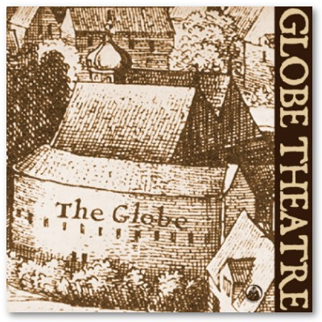
The Globe
The stage in the Globe theatre was open on three sides.
At the back of the stage there were doors for actors to make their entrances and exits.
There was a trap door in the floor of the stage which was used in particular for characters like witches and ghosts to “appear” or “disappear”.
The stage was usually called an “apron stage” because it stuck out into the audience like an apron.
At either side of an Elizabethan Theatre stage, there were two pillars to support the stage roof, but they were also used as part of the play by providing hiding places for characters.
The balcony above the stage was used by musicians who played during the performance or for scenes in plays like the balcony scene in Shakespeare’s Romeo and Juliet.
Theatres like the Globe could hold up to 2500 people, but as there were no lights, shows were put on during daylight hours. If there was a scene in a play that was supposed to be at night time, the actors would let the audience would know through words or actions. For example, in Macbeth, one of the lines that lets the audience know it was set at night is “How goes the night boy?”

