Slide 1
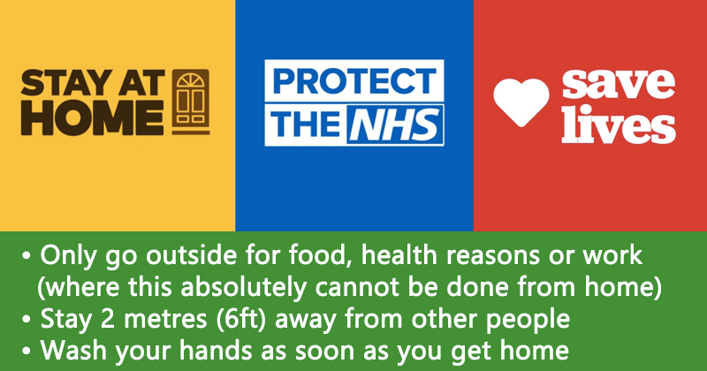
Managing Money during the Coronavirus Pandemic LO: To understand the different ways in which we manage money and why it is important to manage it effectively. STARTER TASK: Would the following be classed as Essential Spending or Non- Essential Spending or BOTH
Monthly gym membership
Chocolate and sweet treats
Clothes
Rent or mortgage
Electricity/gas
Food – collected or delivered
Toiletries, including toothpaste and shower gel
New PC games

Slide 2
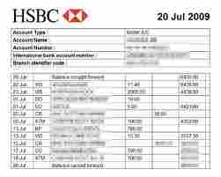
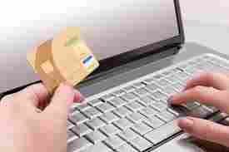
It is important that we understand how to manage our money.
TASK 2: How many ways can you think of which help us (or our parents) to manage money?

Slide 3
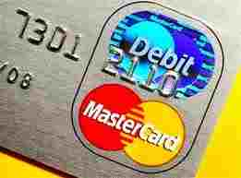
Do you know the difference between a debit card and a credit card?
A debit card allows you to pay for goods using the money in your bank account electronically. When you have used all the money in your account your debit card may be declined in the shop.
A credit card allows you to spend a certain amount which the bank will lend you electronically. You have a month to pay this back or the bank will charge you interest (e.g. you may have borrowed £100 but you will have to pay back £120).
What are the benefits to paying for things electronically?
Can you think of any times when having a credit card would be useful?
Can you think of any dangers with using a credit card?

Slide 4
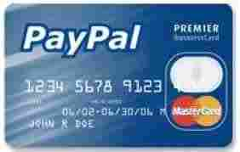
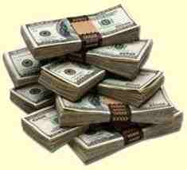
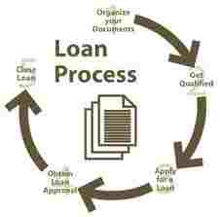
Can you think of any other ways that you can pay for things?

Slide 5
Task 3: Can you think of any other ways that you can pay for things?
Matchup the types of finance in purple to the definition in red:
Interest Free Credit
Hire Purchase
Subscription
Internet banking
Cash
You pay with money in your pocket
You make a payment by transferring money in your bank account online
When you are making a big purchase you may pay in instalments and this way you do not pay any interest
When you are making a payment for a big purchase you may pay in instalments but you must pay a percentage interest
When you are paying for a service you pay for it every month or week and this payment is on-going until you stop using the service

Slide 6
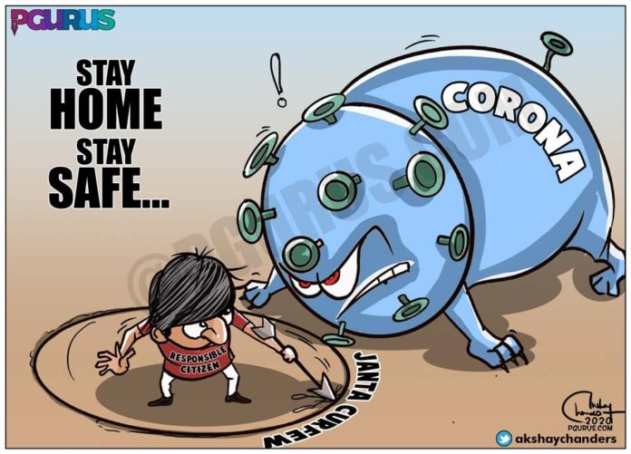
Task 4: What do you think would be the best way to pay for the following?
A chocolate bar and a can of coke from the corner shop (following the 2m/6ft rule!!)
A sofa
A car
A gas bill
A gym membership
Your grocery shopping for a month
A holiday
Bus fare

Slide 7
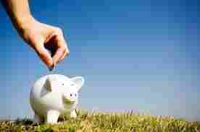
As well as spending, you should also try to save…
Task 5: Why do you believe that saving is important?
Give three answers.
1.
2.
3.

Slide 8
What are the different ways of saving?
Pension schemes
Budgeting
Buying Shares
Other types of investments
ISA

Slide 9
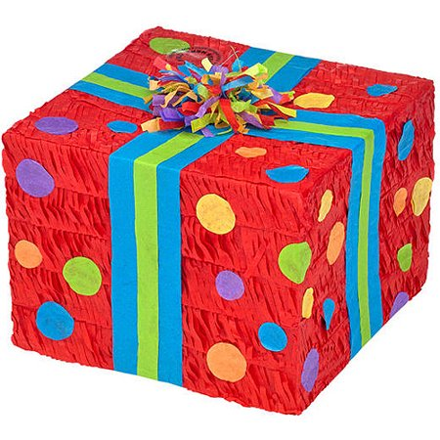
It is your Mum’s and your best friend’s birthdays’ this month…
You are still in isolation at home but have £15 spare in your savings.
TASK 6:
1. How are you going to get a card each for them and a present?
2. How much are you going to spend on each person?
Give a detailed account on the sheet provided.

Slide 10
Evaluation Task:
Did you manage to save any money on the ‘birthday’ budgeting task?
Did you find the budgeting task hard? Why/Why not?
Have you learnt anything from this lesson?
Why do you think it is important to think about how we pay for things?
Why do you think it is important to try and save some of our monthly income?

