Slide 1
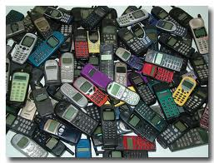
Persuasive Techniques
Learning Objectives:
How to write a persuasive letter:
Generate ideas
Structure and organise ideas.

Slide 2
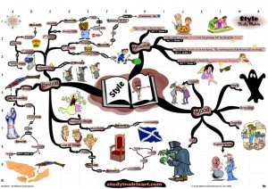
Organise and Structure Ideas
Mindmap your arguments for (or against) mobile phones in schools.
Make sure mindmaps are organised with main ideas and branches off this.
Include counterarguments.
Sequence the main ‘branches’.
Be neat and clear.

Slide 3
Advanced level…
Can you name any
other presentational devices?

Slide 4
Counterargument
Rule of 3
Rhetorical question
Fact
Opinion
Exaggeration
Alliteration
Anecdote
Command
Exclamation
Emotive Language
Comparative
Superlative
Flattery
Address reader directly

Slide 5
If in doubt, use…AFOREST
Anecdote
Fact
Opinion
Rhetorical question
Exaggeration/Experts
Alliteration
Statistics
Triples (rule of 3)

Slide 6
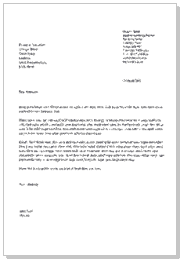
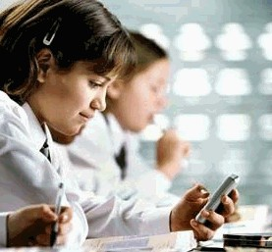
Task
Write a formal letter to the headteacher arguing either for or against the use of mobile phones in class.

Slide 7
Reflection
How do you write a persuasive text?
Write down some ideas in your books
Bullet points.

Slide 8
A model: to give you help.
Dear Mrs Dunbavin,
I write regarding the issue of mobile devices in school. I think that students should be abllowed to use their own devices in class and in my letter I will explain why.
Many people claim that mobile devices are a distraction in the classroom. I disagree. Used correctly and properly supervised, devices like ipads or other tablets can be a wonderful educational tool. A nearby high school has recently provided a tablet computer to each of their year 7 students to use in class and for homework! If mobile devices are so disruptive, why have they done this?
Hope High is a school which promotes and celebrates innovation. In that case, why can’t students express this by developing their skills during each lesson? Yes, some people might argue that students need to learn to write correctly. However…
Another reason...
Furthermore...
An additional argument...
Finally...
Thank-you for taking the time to read my letter and I look forward to your reply.
Yours faithfully,

