Slide 1
THE HUNDRED YEARS’ WAR
“The breakdown of the historic feudal order, no longer able to meet the demands of changing times, and its gradual replacement by an order of nations increasingly aware of their growing national characteristics... was the fundamental cause of the long conflict.”
Christopher Allmand, The Hundred Years War: England and France at War C.1300-c.1450
The development of Church, state and society in Medieval Britain 1066-1509

Slide 2
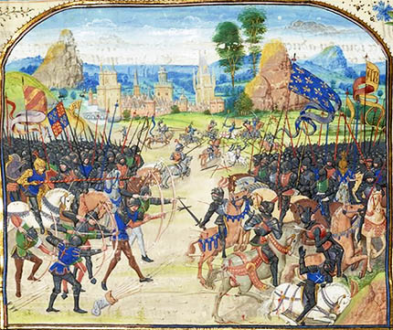
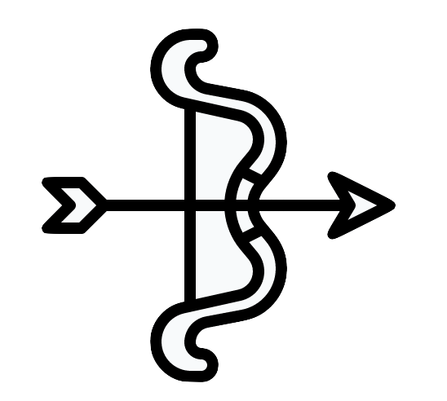
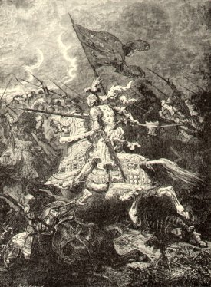
LEARNING OBJECTIVES
At the end of the module, students should be able to:
Understand the factors that effectively began the Hundred Years’ War
Explain the roles of the key leaders of England and France in the Hundred Years’ War
Discuss the battles that transpired and the treaties that resulted from them in the span of the Hundred Years’ War
KEY WORDS
Hundred Years’ War Battle of Poitiers
Battle of Sluys Treaty of Brétigny
Battle of Crécy Black Death
MODULE CONTENT
This module includes the
following topics:
War Overview and Key Figures
Start of the Hundred Years’ War
The Course of the Hundred Years’ War
The Battle of Poitiers 1365, from Froissart's 'Chronicles' from the 14th century.
WAR OVERVIEW
Historians adopted the term "Hundred Years' War" as a means to periodise all the events that culminated in the longest military conflict in European history (1337 to 1453). The conflict drew in many allies of the English House of Plantagenet against the French House of Valois over the right to rule the kingdom of France and the issue of sovereignty.
The Hundred Years’ War was a series of conflicts from 1337 to 1453 (It was actually 116 years long).
It was between the English House of Plantagenet and the French House of Valois.
The battle spanned five generations of kings and two rival dynasties over the largest kingdom in Western Europe.
Over and above warfare, the people endured famine and plague.
Nationalism gained new momentum and fervour.
England dominated for decades, but victories see-sawed.
Battle of Crécy, an English victory.

Slide 3
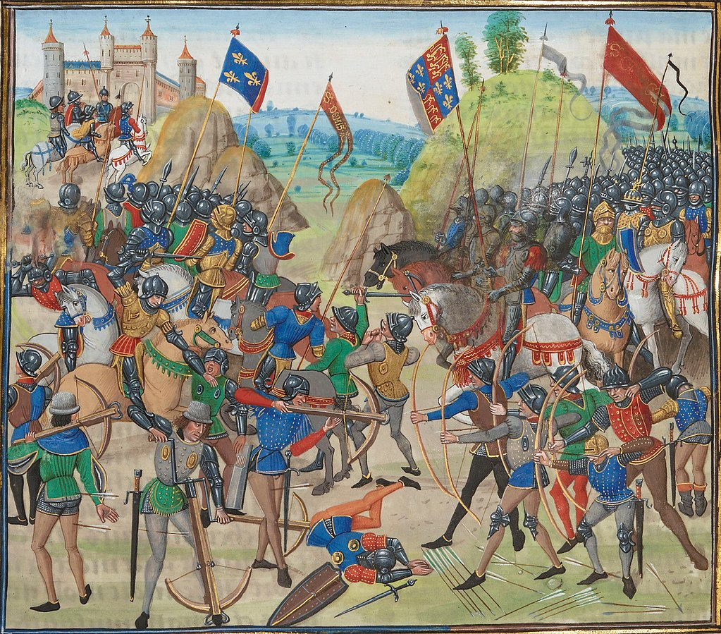
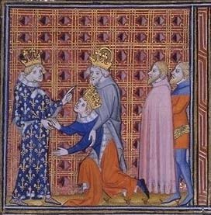
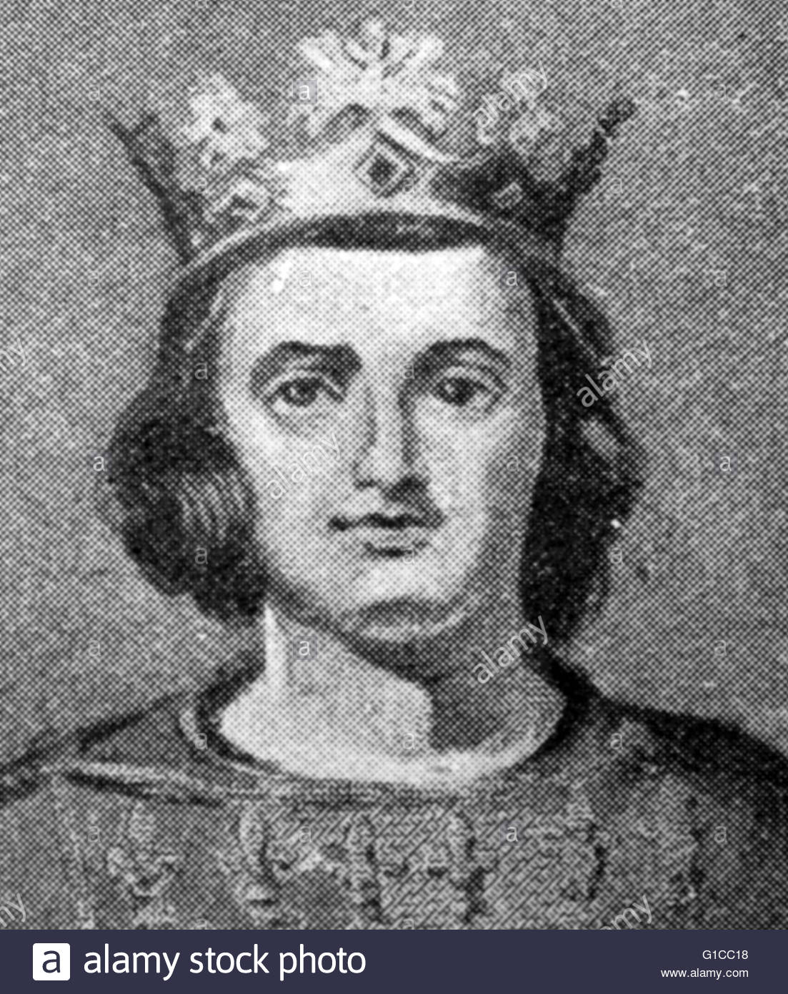
The 100 Years’ War was divided into three phases:
The Edwardian (1337-60)
The Caroline War (1369-1389)
Lancastrian War (1415-1453)
French kings technically held the advantage over England with more money and military resources, more people and larger territory.
The English army under Edward III was well disciplined and used longbows to stop French cavalry.
Edward III won the sea Battle of Sluys in 1340, which gained England control of the Channel.
Edward III’s son, the Black Prince, won significant victories at Crécy (1346) and captured Calais, then winning Poitiers (1356).
Battle of Crécy, an English victory
Philip VI died and was replaced by King John II (1350), who was captured by the Black Prince at Poitiers.
In 1359, the captive King John II of France was forced to accept the Treaty of London.
The treaty handed over too much territory (almost ⅓ of France) to England and the Estates rejected it.
Edward invaded again but was weak, so negotiated the Treaty of Brétigny. France agreed to the terms.
John II died in England and was succeeded by Charles V.
The Black Prince died before becoming king of England. His son acceded when his grandfather, Edward III died a year later (1377).
Nine years after the Treaty of Brétigny (1369), Phase 2, or the Caroline War, kicked off.
By 1380, Charles V had regained almost all the territory ceded in the Treaty of Brétigny.
KEY FIGURES
Charles IV, also known as Charles the Fair was the King of France from January 3, 1322 to February 1, 1328. He made a bid for the German throne in 1324 following the peasant revolt in Flanders, but was unsuccessful.
Charles came to power following a period of tension between England and France. Edward II, King of England, refused to pay homage to the King of France, Charles’ older brother.
Charles waged war with England by his invasion of Aquitaine, in what is called the War of Saint-Sardos. The war is considered one of the precursors of the Hundred Years’ War.
Charles IV of France
The English were defeated in 1325 and King Edward II was overthrown.
Charles the Fair gave his name to his nephew, Charles IV
In 1327, the English throne agreed to a peace treaty, together with a huge land settlement, which is one of the highlights of the reign of Charles IV.
Charles the Fair

Slide 4
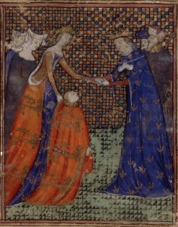
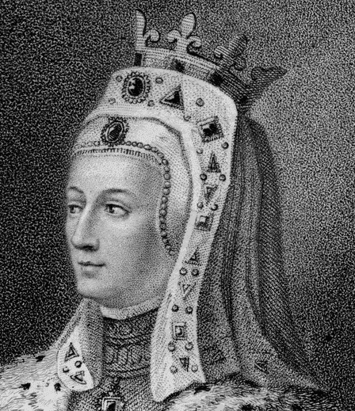
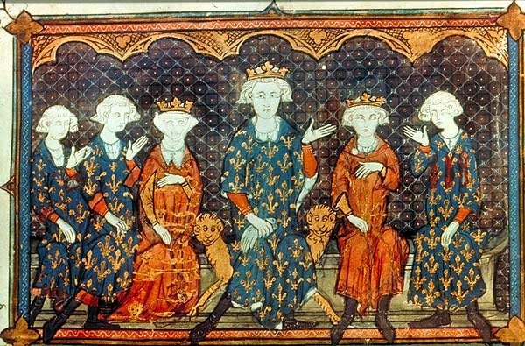
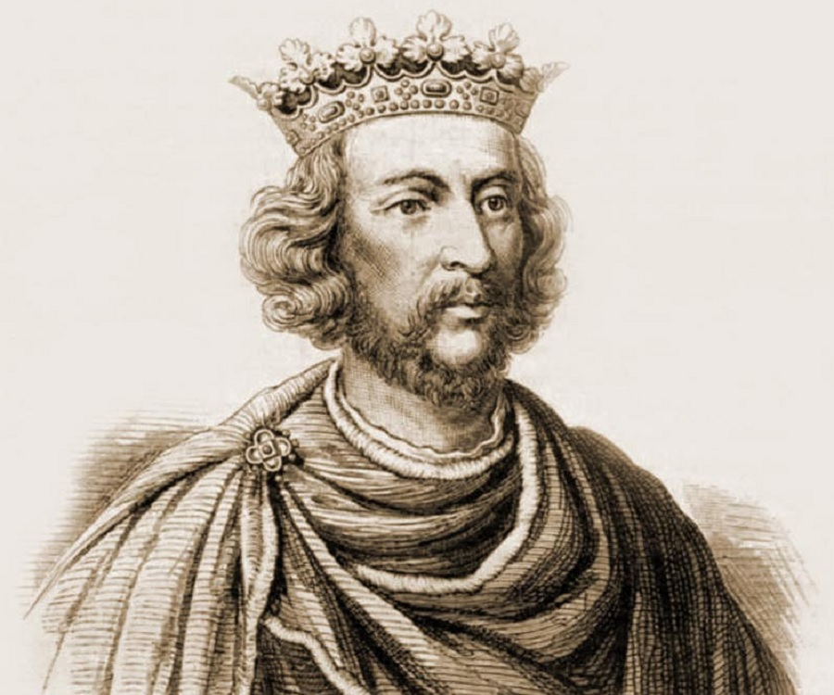
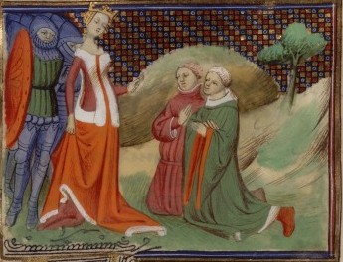
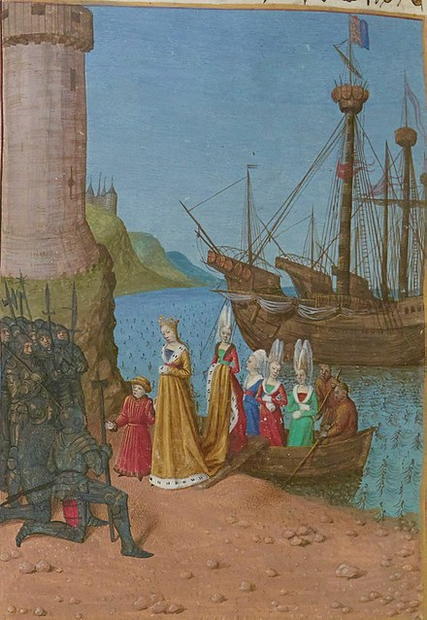
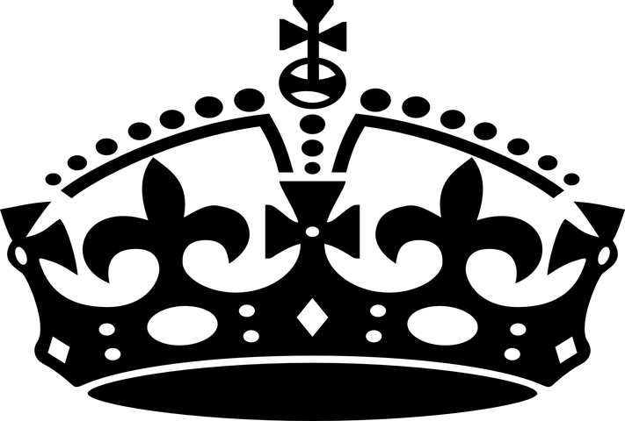
Charles died in 1328 with no male heirs. However, he did give his name to Charles IV who became the Holy Roman Emperor.
Without heirs, his line became extinct. There became a dispute on the succession to the French throne between the monarchs descended from Philip III of France, Charles's grandfather. On the other hand, there were also English monarchs descended from Charles's sister Isabella. That was a significant factor of the Hundred Years' War.
Isabella of France
Edward III of England gives homage to Charles IV of France
Isabella is the sister of Charles IV. She had been called the She-wolf of France, known for her intelligence and charisma.
At age 12, Isabella travelled to England and married King Edward II in 1308 despite the king’s alleged relationship with his favorite nobleman Piers Gaveston. After Gaveston was murdered in 1312, Isabella tried to reconcile Edward II and the barons. Edward had a new favorite Hugh Despenser the Younger, who Isabella could not tolerate. As queen, Isabella faced multiple challenges in court and internal tension grew, resulting in an increasingly problematic marriage and her bid of power of England.
In 1325, Isabella sailed for France in a diplomatic mission. She refused to return to England until the Despenser family was ousted from court.
Isabella of France
Isabella deposed the King of England with her lover, Roger Mortimer.
When Charles IV died and did not have any heirs, English monarchs descended from Isabella’s line became a significant factor of the Hundred Years' War. Isabella had a son, Edward III of England. She tried to claim the French throne for Edward III but France rejected, wanting a Frenchman for the crown.
Philip IV’s family portrait. Charles IV and Isabella are in this portrati.
Edward III of England
In 1326, Isabella arrives in England with her son, Edward III
Edward III is the son of Isabella of France. At age 17, he became King of England after a coup d'état against Mortimer who was de facto ruler after he and Isabella deposed his father, Edward II.
Hugh Despenser before Queen Isabella

Slide 5
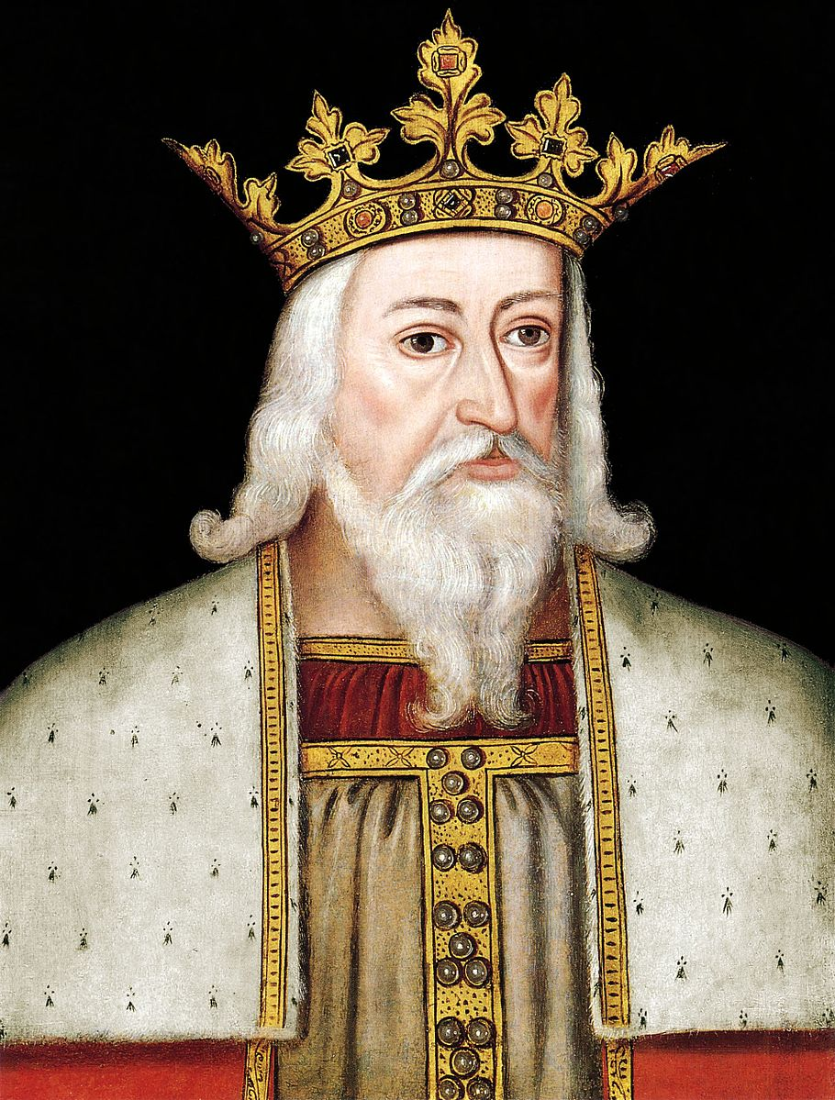
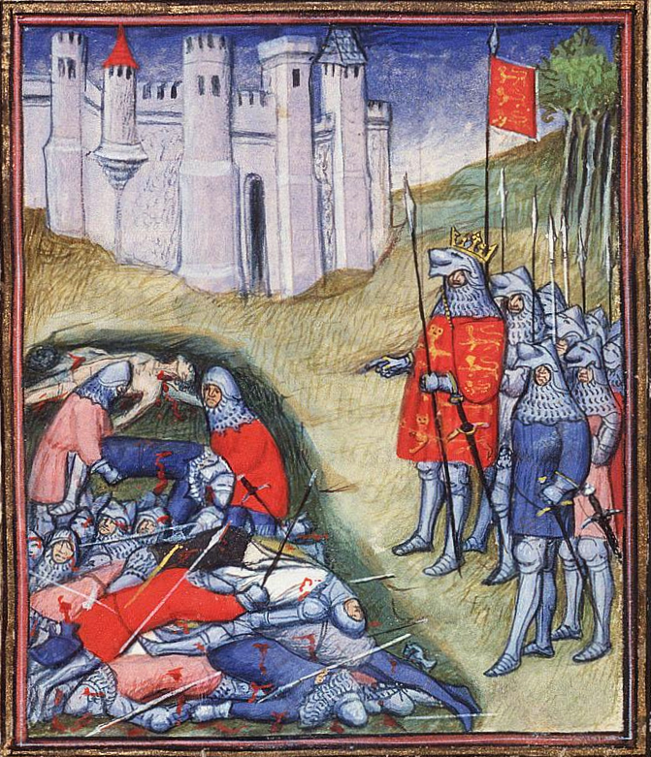
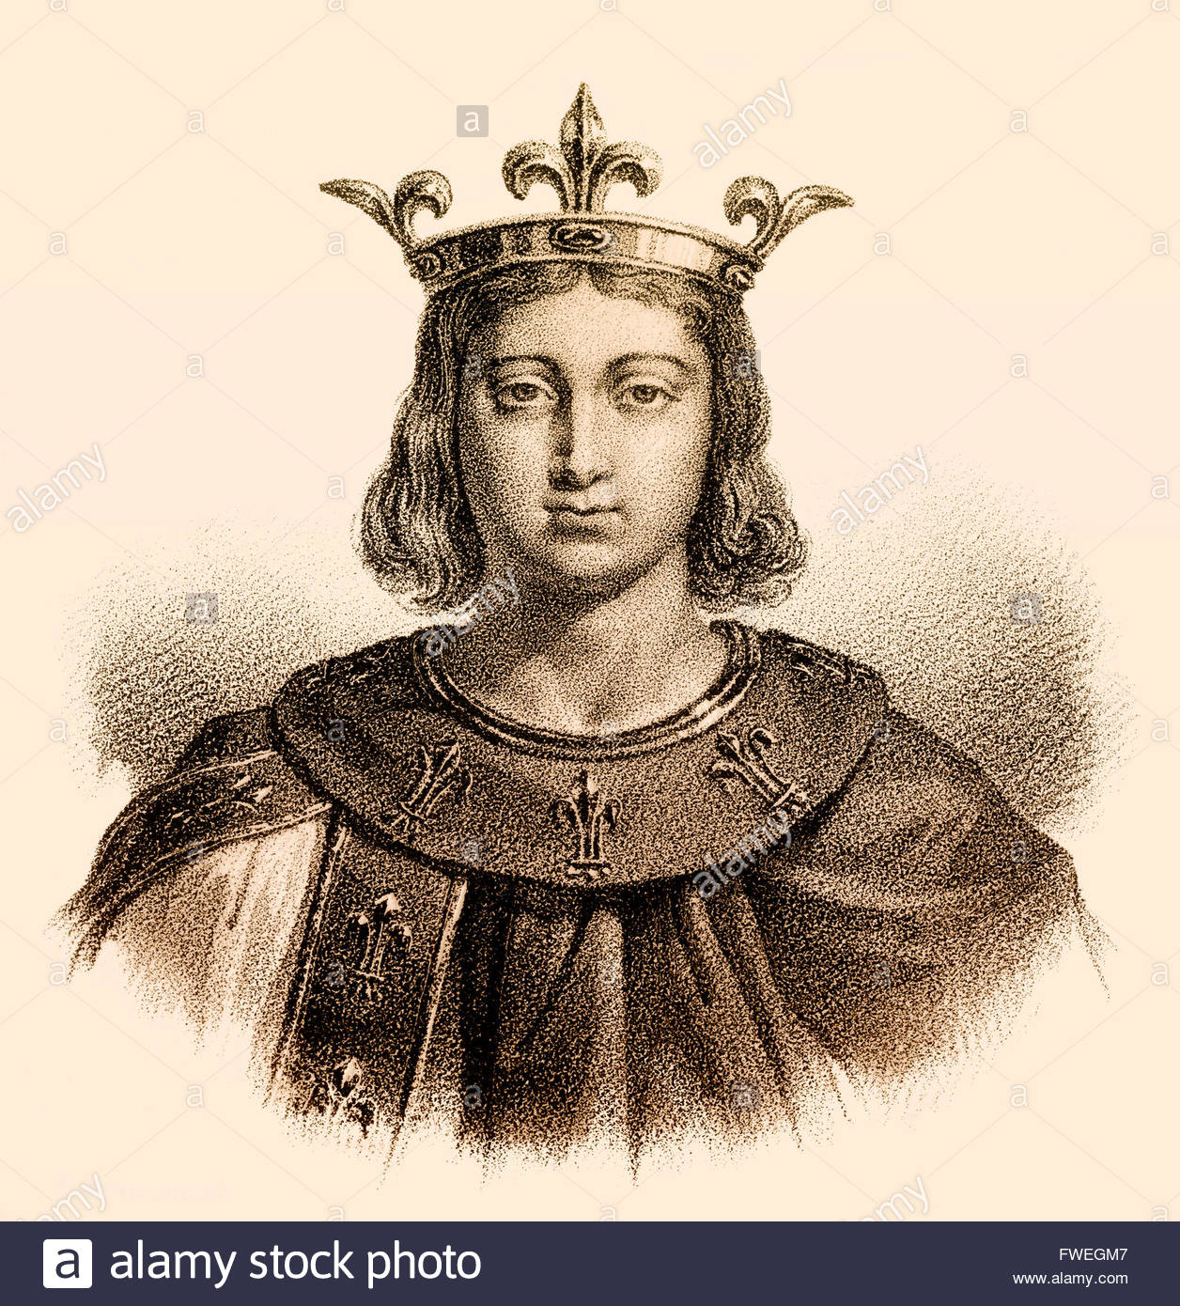
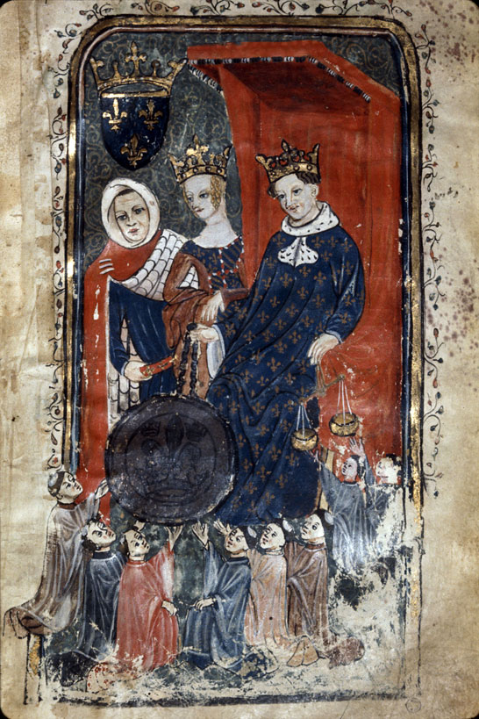
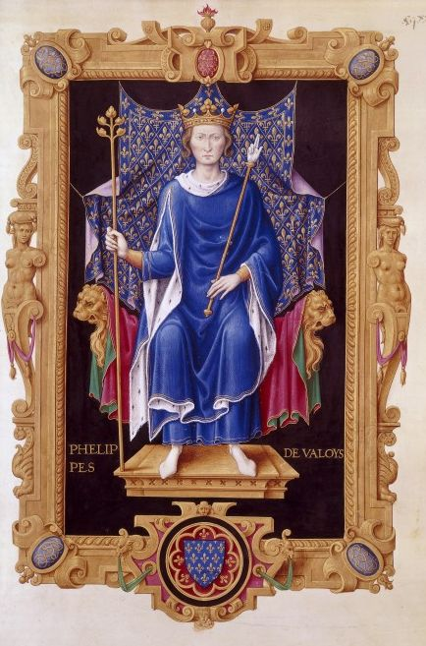
Edward III was the closest male relative of Charles IV. Isabella tried to claim succession for him but failed.
Edward III ruled England from 1327 until his death in 1377. Upon his claim to the French throne in 1337, the Hundred Years’ War began.
During the war’s early years, Edward led triumphant battles with his English forces. His victories in the Battles of Sluys and Crécy were the highlights of his leadership. In 1360, the war was concluded with the Treaty of Brétigny which was favorable to England. Edward was approached to run for Holy Roman Emperor but he declined after thoughtful consideration.
Edward III’s portrait made in the 16th century
Philip VI is the patrilineal cousin of Charles IV. He is a royalty in his own right and was crowned Philip VI of France at age 17. He became the first king of House Valois.
His reign coincided with the outburst of the Hundred Years’ War. He had to raise taxes for war and in order to do so, he made concessions to noblemen, clergymen, and the bourgeoisie, resulting in the rise of the estates and a financial reform movement in the clergy.
Philip VI of France
Edward III counting the dead at the Battle of Crécy
In the 1340s, France suffered multiple internal crises following defeat in wars against the English. Philip’s council was under the influence of the powerful Duke of Burgundy.
When the Black Death spread in 1348 and 1349, the political problems were moved to the backseat and France was further destabilised.
After Philip died in 1350, France was left with the problems of war and the plague.
Philip VI and his first wife Joan of Burgundy
Philip VI of France
GUIDE QUESTION
After learning about the key figures, take note of the following questions:
Who is Charles IV of France?
Who is Isabella of France?
Who is Edward III of England?
Who is Philip VI of France?

Slide 6
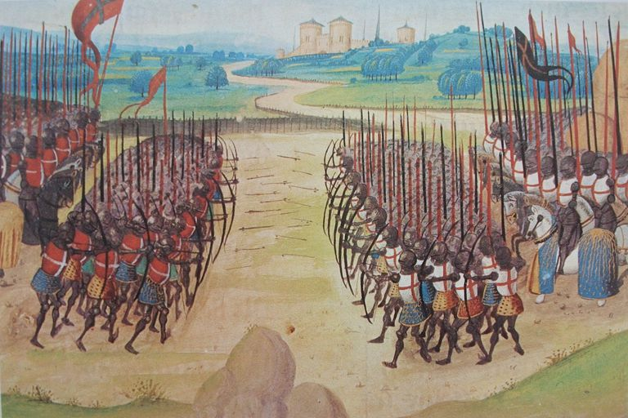
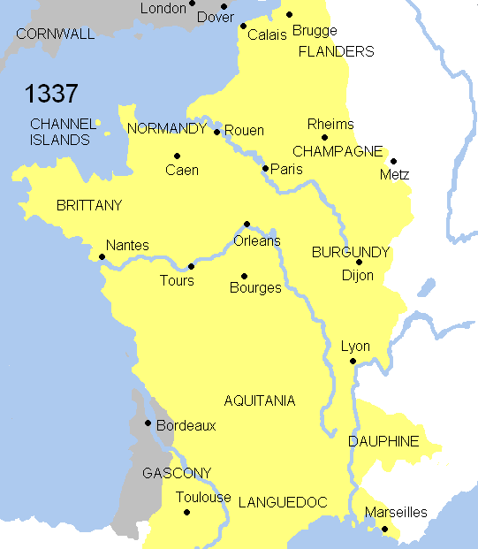
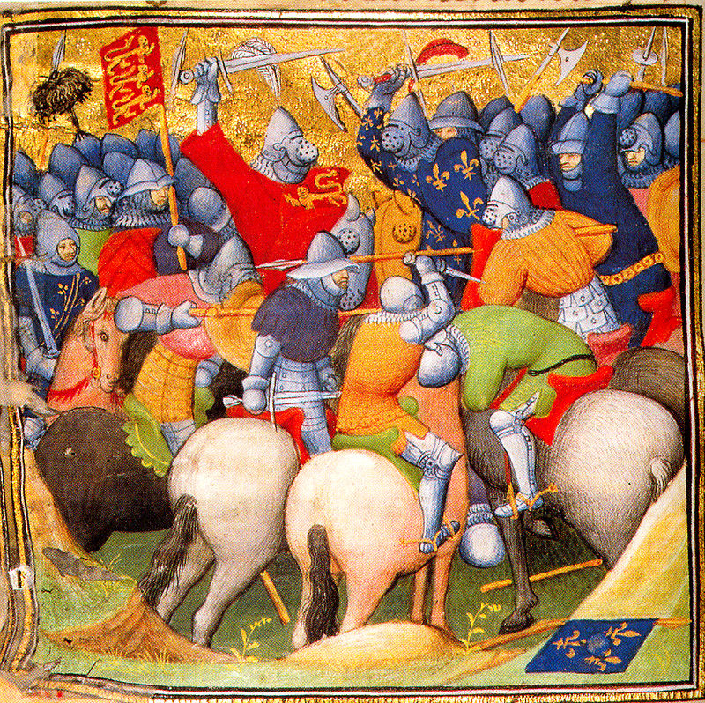
ACTIVITY
England’s monarchic origins lay in France. Construct a family tree, outlining each person’s role in the Edwardian War. While at work, include actions that antagonised the opposing sides and escalated into war.
START OF THE HUNDRED YEARS’ WAR
France vs. England Sovereignty
Vassal: a holder of land by feudal tender on condition of homage and allegiance to the overlord.
The English royal family was French in origin.
House Plantagenet originated from Anjou in the 1100s.
This French origin meant much land and titles were held by the English.
As per fiefdom, having French titles meant being vassal to the king of France – a major source of conflict.
The size of English land ownership in France varied over the years, sometimes dwarfing that of French ownership.
Fiefdoms
France would strip away land, wealth, and titles from England where opportunity arose in order to keep the growth of England in check.
This especially happened when England was at war with Scotland, an ally of France.
But by 1337, only Gascony in France was held by England.
English (grey) lands in France.
Igniting Conflict
Battle of Crécy, 1346, from the Grandes Chroniques de France. British Library, London.
Edward III (reigning England from 1327) experienced ongoing conflict with Scotland.
Philip VI of France allied with Scottish King David II.
Edward III knew he couldn’t fight a war on two fronts.
In retaliation, Edward III provided refuge for French fugitive, Robert III of Artois.

Slide 7
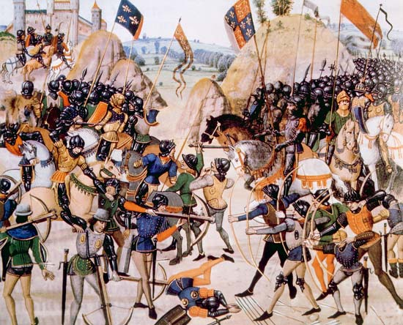
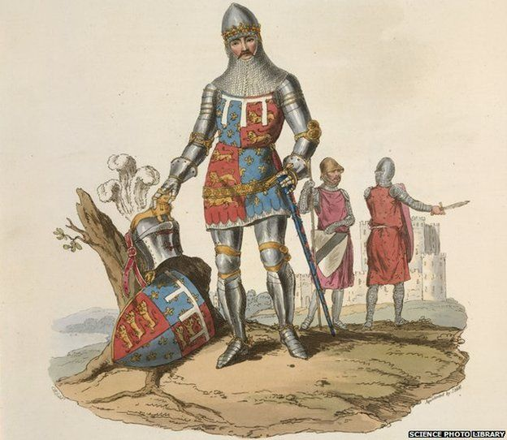
Refusing to expel Robert III, Philip VI confiscated Edward III’s French Duchy of Aquitaine.
Edward III responded by reasserting his claim to the French Throne.
Conflict ensued from 1337 to 1360.
Phase 1: Edwardian War
Edward III’s alliances didn’t measure up to France’s.
He experienced no real victories in the early stages other than a naval victory at Sluys in June 1340, which secured English control of the Channel.
Discontent grew back home in England, created by debt and financial pressure from the war.
By 1340, Edward III returned to England and purged his administration. Instability continued, however.
New limitations were imposed on English monarchs who were given defined duties and limits.
Come July 1346, Edward III staged a major offensive in Normandy with 15,000 men and met up with English forces in Flanders.
The 35,000-strong army dominated the Battle of Crécy.
Battle of Crécy, 1346, a victory for England.
Having lost the Battle of Crécy and Calais to England, the Estates of France refused to fund Philip VI’s plan to counter-attack and invade England.
By 1348, the Black Death was sweeping through England and France wiping out over a third of the population.
The epidemic killed millions, creating labour shortages and impacting wages and inflation.
Both Philip VI and Edward III concentrated on stabilising their countries and ceased conflict. Military operations in France only resume on a large-scale in the mid-1350s.
Philip VI died in 1350 and was succeeded by his son, John II.
In 1356, Edward III’s eldest son, Edward, the Black Prince, fought and won the Battle of Poitiers. He captured King John II and his son Philip.
England enjoyed a series of victories and held large swathes of France. The French king was in custody and the French government nearing collapse in his absence.
Treaty of London, 1359
Proposed by England and accepted by France, The Treaty of London followed the Black Prince’s resounding victory at Poitiers.
In the terms, England was permitted to annex its lands (Normandy, Anjou, Maine, Aquitaine) within its ancient limits of Calais and Ponthieu, as well as given independence rather than fiefdom of the Duchy of Brittany.
In addition, France would pay a ransom of three million écus for the John II’s release.
The French Estates-General rejected the treaty, stating too much territory was being relinquished.
Edward III launched a fresh invasion. His weak army led him to reopen negotiations, however.
Edward, The Black Prince.

Slide 8
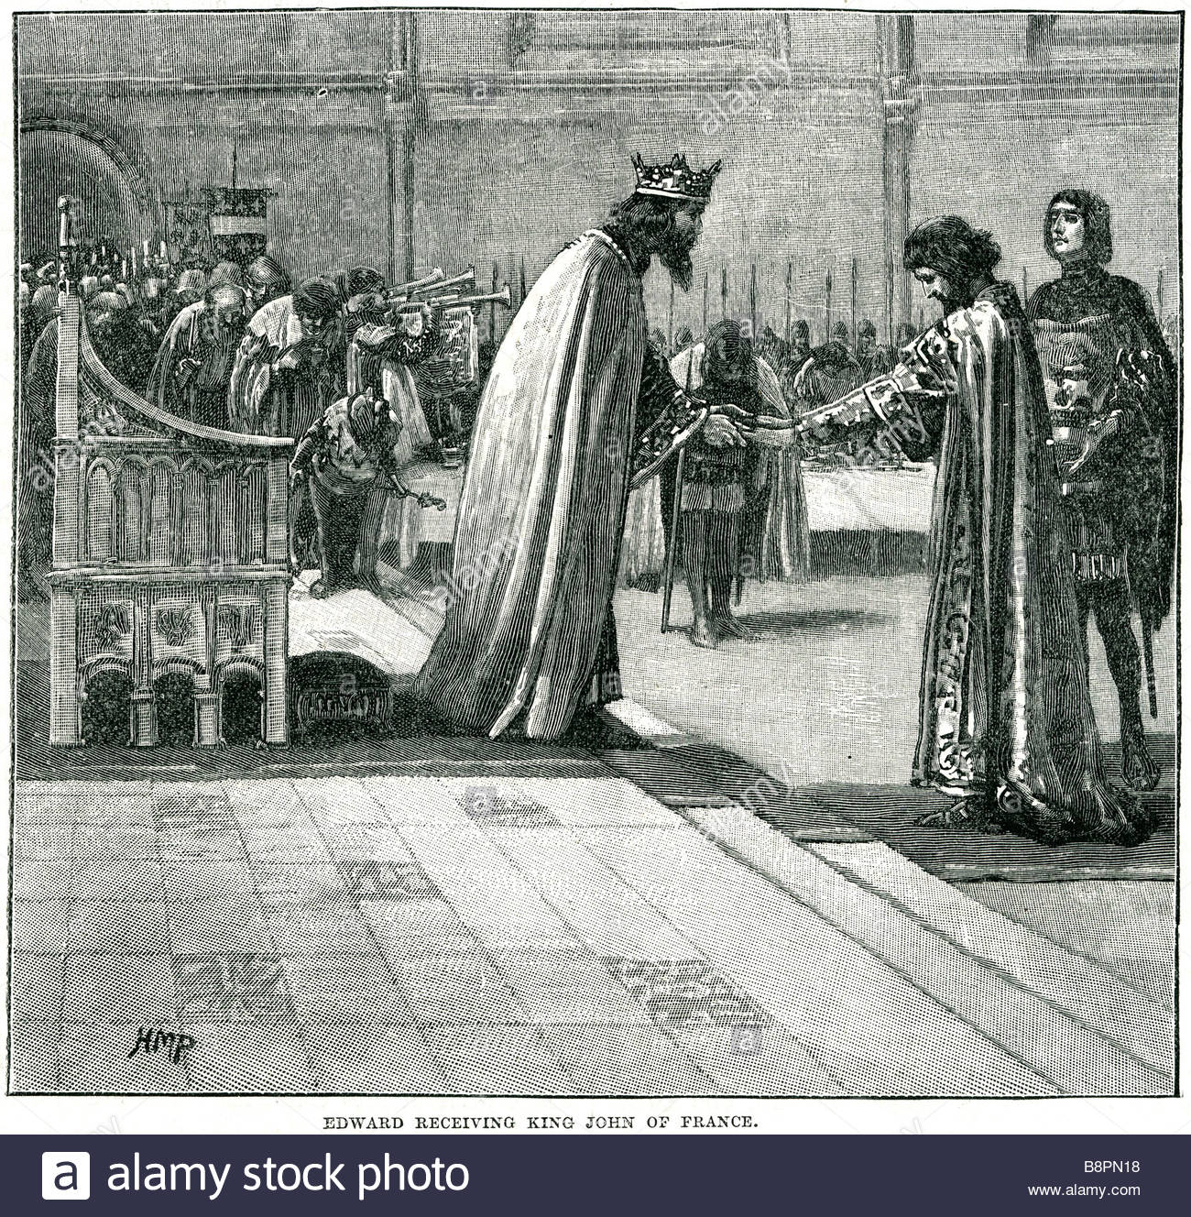
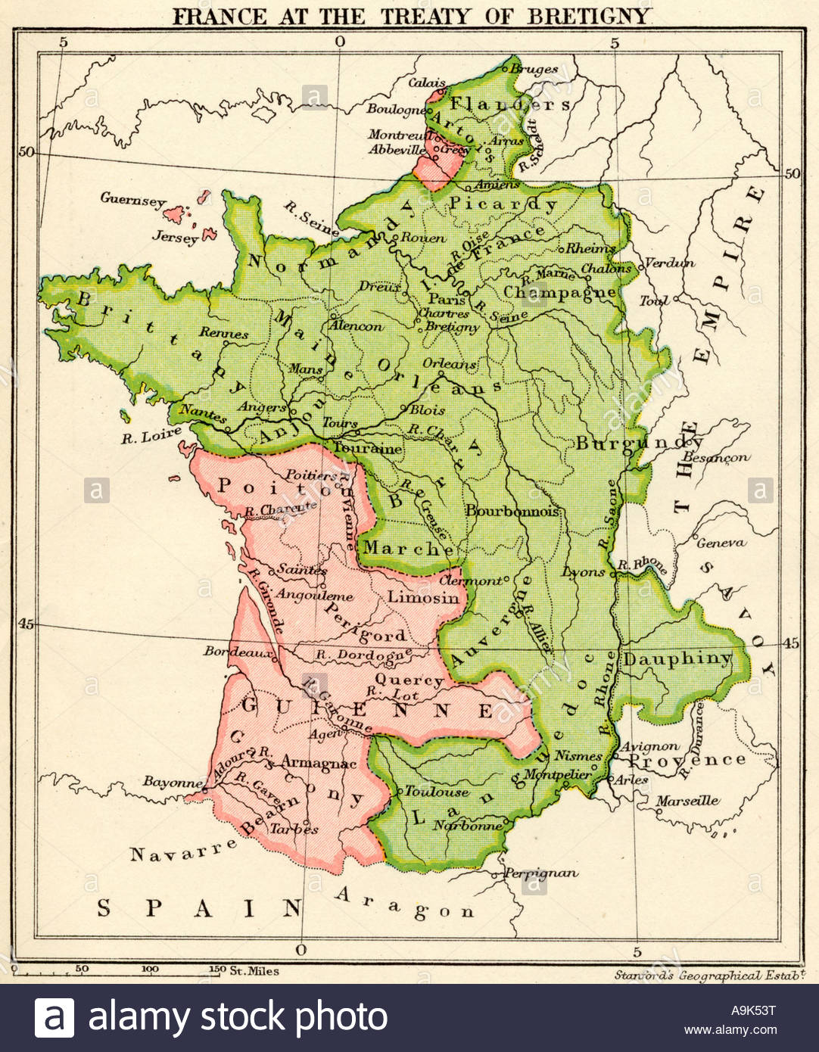
Treaty of Brétigny, 1360
This was a truce signed between King John II of France and Edward III of England on 8 May 1360.
Edward accepted the Treaty of Brétigny, securing his French possessions in full sovereignty, clear of homage.
Guyenne, Gascony, Poitou, Saintonge, Aunis, Agenais, Périgord, Limousin, Quercy, Bigorre, the countship of Gauré, Angoumois, Rouergue, Montreuil-sur-Mer, Ponthieu, Calais, Sangatte, Ham, and the countship of Guînes.
Edward III relinquished the Duchy of Touraine, the courtships of Anjou and Maine, and independence of Brittany and Flanders. He relinquished his claim to the French throne.
It marked the end of the first phase of the 100 Years’ War.
Edward III receives King John of France for The Treaty of Brétigny, signed on 8 May 1360
GUIDE QUESTION
After learning about the Hundred Years’ War, take note of the following questions:
What nations fought against each other in the Hundred Years’ War?
How did the Hundred Years’ War start?
Why was it called the Hundred Years’ War?
What happened during the Edwardian War?
What is the Treaty of London?
ACTIVITY
Knowing what you know about fiefdoms, vassals, and heritability, explain how the issue of homage to France led to the outbreak of the 100 Years’ War. Then, outline the terms and effects of the Treaties of London and Brétigny.
A map detailing the Treaty of Brétigny
THE COURSE OF THE HUNDRED YEARS’ WAR
Alliances in the Edwardian War: England
Pre-war: France was an ally of Scotland’s David II, sworn enemy of England.
Pre-war: England retaliated by providing refuge to Robert III of Artois, fugitive of France.
Edward III’s strategy after confiscation of Aquitaine was to hold Gascony with existing army and invade France from the north.

Slide 9
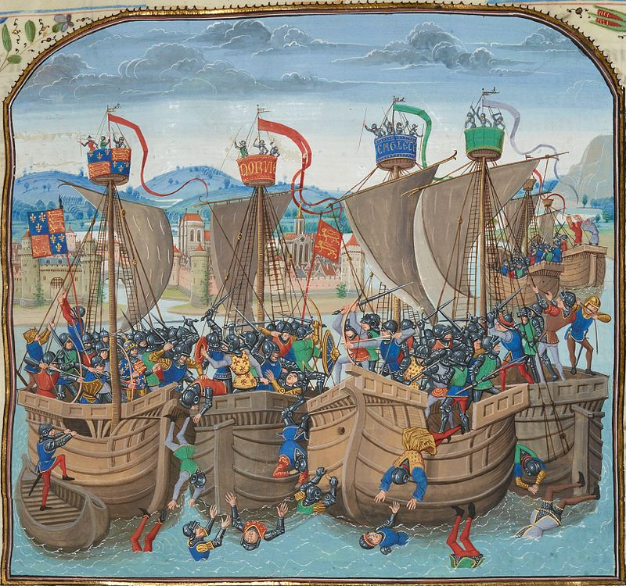
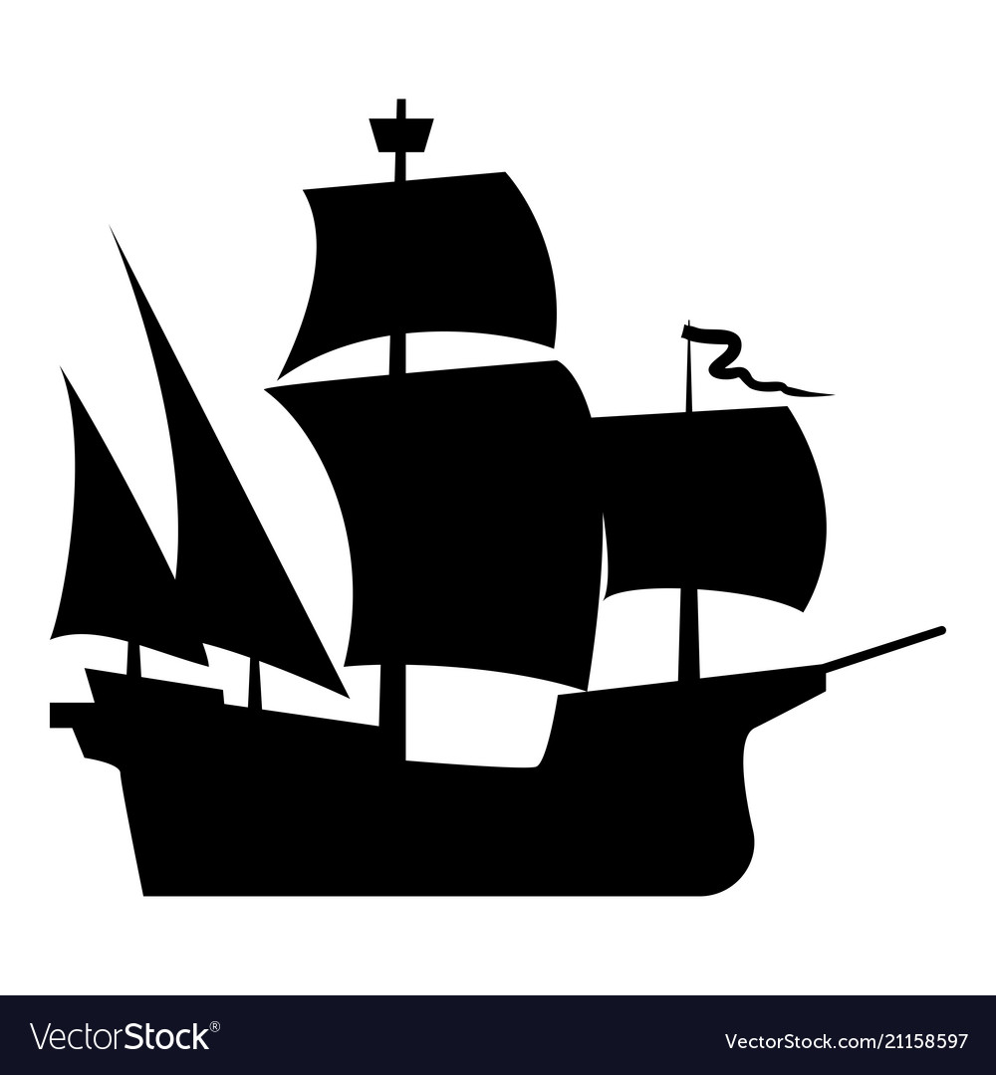
Edward III gained allies in the Low Countries through the promise of money. To finance this, revenue was drawn from wool taxes and substantial loans and advances from banking houses and merchants were taken.
England leveraged Flemish allies in the Battle of Sluys.
Allies of England
Kingdom of England
Principality of Wales
Duchy of Gascony
Duchy of Aquitaine
Duchy of Brittany
County of Flanders
County of Hainaut
Holy Roman Empire
Kingdom of Bohemia
France was at an advantage over England with more money, more military resources, and a larger population.
This kept France successful in the initial stages of the Edwardian War, while Edward III was trying to bankroll his campaign.
France executed a series of raids by sea on the southern and south-eastern coasts of England.
In 1339, Philip VI ordered the invasion of England. They assembled at Sluys.
The French fleet was supplemented with hired ships from Genoa and Monaco.
Allies of France
Kingdom of France
Kingdom of Scotland
Genoa mercenaries
Kingdom of Bohemia
Duchy of Lorraine
Kingdom of Majorca
Kingdom of Navarre
Kingdom of Castile
Tactics: Battle of Sluys (24 June 1340)
France executed raids on the southern and south-eastern coasts of England.
They disrupted England’s sources of revenue: Gascon wine and Flanders wool.
French galleys were fast and manoeuvrable in shallow waters and were operated by highly-trained crews from Genoa, Monaco and other Mediterranean ports.
in 1339, Philip VI ordered the invasion of England. They assembled at Sluys.
France’s fleet in Sluys was 213-strong with more than 20,000 men.
England had only three warships and no more than 150 ships.
Battle of Sluys from Froissart's Chronicles, c.1470.
The Battle of Sluys was bitterly fought in June 1340.
England spent its time manoeuvring to gain the advantage of wind and tide.
The French ships fouled against each other to the east of their starting position. By the time they’d separated and moved west against wind and tide, they made contact with the English in disarray.
The English rained down arrows with their more advanced longbows. 190 French ships were captured.
England gained naval control of the Channel.
This didn’t halt French raids of English coastal towns, however.

Slide 10
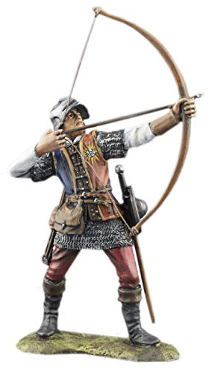
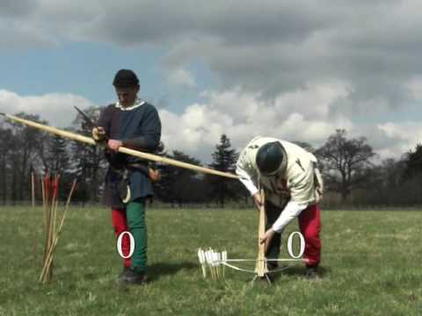
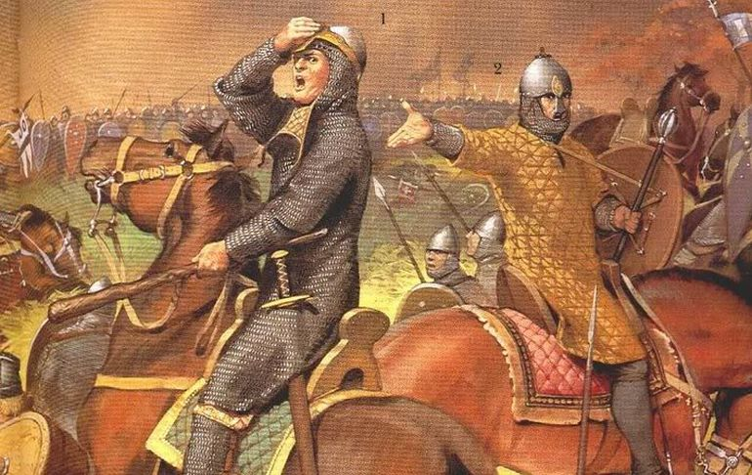
Military Technology & Tactics
English archers could fire the longbow at twice the rate of French crossbowmen.
Effective for felling unarmoured horses.
The range of a longbow was an average of 300 yards (270m) compared to the 200 yards (180m) of the crossbow.
The longbow was a significant military advantage for land and sea battles.
English Longbow
French crossbow
English longbow
English Longbow vs. Continental Crossbow
Video: https://www.youtube.com/watch?v=HagCuGXJgUs
Video demonstrating the speed and efficiency of the longbow to the crossbow
Chevauchée
A horse charge for raiding in Medieval warfare.
Used for weakening the enemy by burning and pillaging to reduce productivity.
A tactic for drawing enemies into battle and forcing subjects to break loyalty.
Chevauchée would cause an influx of refugees into fortified towns and castles, straining resources.
A favoured tactic of Edward III and the Black Prince.
Chevauchée declined at the end of the 14th century as the focus of warfare turned to sieges.
Illustration of Chevauchée, a popular military tactic in Medieval warfare
Battle of Crécy,
26 August 1346
England
France
Pretext: Edward III lead destructive chevauchée through Picardy following the victory at Sluys.
The first of three victories for England.
England was aided by Welsh, Breton, Flemish, and German mercenaries.
Led by Edward III. Black Prince commander.
Experience gained from land battles with Scotland and against Muslims.
The rise of the longbow, ribauldequin, and infantry in warfare.
Major loss for France.
French, Scottish, Genoese, and Majorcan troops much larger than England’s forces.
Led by Philip VI.
Heavy losses of French knights through peasant uprisings.
Disruption through English chevauchée.
A decisive defeat for France.
Crossbows ineffective against longbow.
Crippled French army’s ability to come to the aid of Calais.

Slide 11
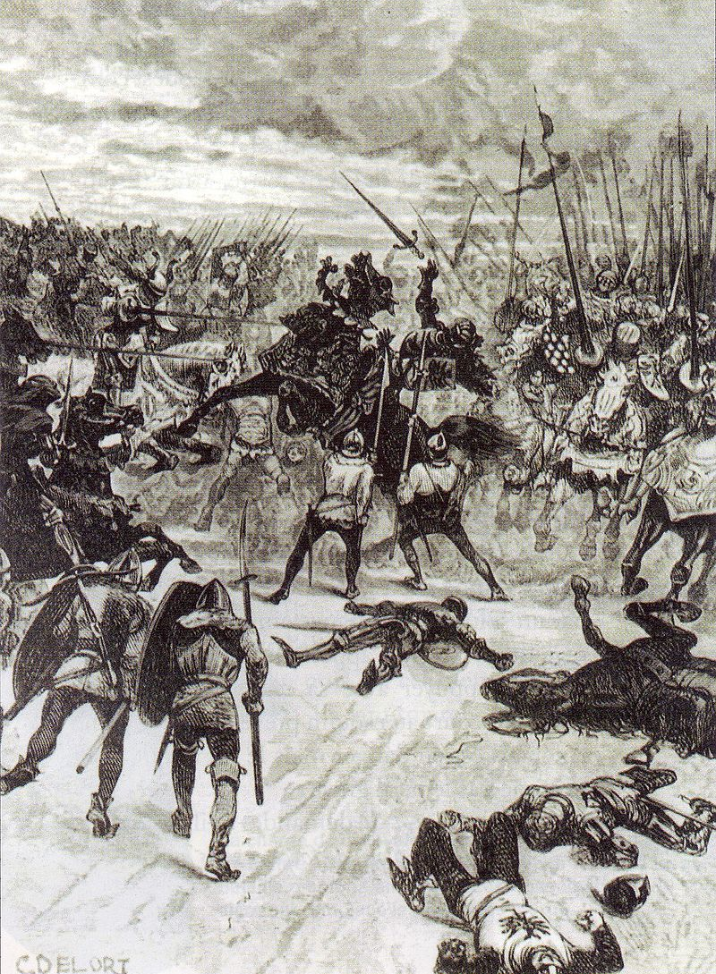
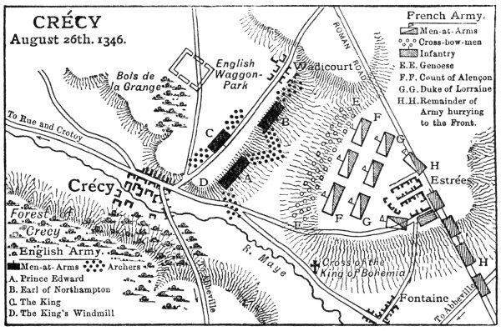
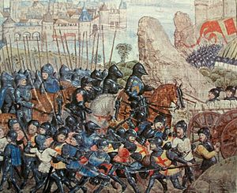
England
France
A rainstorm saw longbowmen destring their bows to protect them.
Volleys of longbow arrows inflicted heavy casualties.
Obstacles hampered French cavalry under heavy longbow fire.
First big win for Black Prince.
Blind King John of Bohemia, ally of England, was killed.
A solid victory for England.
Crossbowmen didn’t destring their bows, which slackened from the rain.
In battle, the weakened crossbows made little impact on English lines.
Retreating Genoese archers threw French cavalry into disarray.
French cavalry was obstructed by obstacles laid by English.
Philip withdrew.
Above: Battle of Crécy formations.
Left: Etching of the death of King John of Bohemia at the Battle of Crécy.
The Taking of Calais, July 1346
On the back of the Crécy victory, in July 1346, Edward III mounted an invasion across the Channel.
Landing in St. Vaast, they headed north, pillaging as they went.
Philip VI ordered any crossings of the Seine destroyed.
Edward III turned back south and found a crossing at Poissy.
England reached the river Somme and crossed at a tidal ford at Blanchetaque while Philip VI’s army was stranded.
Unopposed, England lay siege on Calais, a strategic asset for the English, capturing it in 1347.
England could now keep troops in the north of France.
Image depicting the capture of Calais.

Slide 12
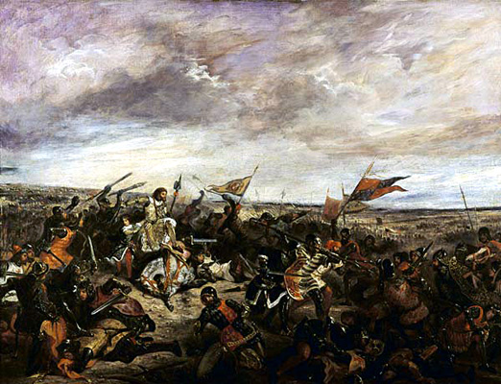
Battle of Poitiers, 19 Sept 1356
Pretext: In 1347-51, the Black Death was ravaging Europe.
Come 1355, it had passed through England, which had recovered comparatively quickly to Europe.
Edward, the Black Prince, had been executing chevauchées of Avignonet, Castelnaudary, Carcassonne, Narbonne, Auvergne, Limousin, and Berry. He failed to take Bourges.
King Philip VI died and was succeeded by his son, John II of France.
The Battle of Poitiers (1356) Eugène Delacroix
England
France
A major English victory for England.
Fought at Nouaillé, near the city of Poitiers in Aquitaine, western France.
The Black Prince lead an army of English, Welsh, Breton, and Gascon troops, many veterans of the Battle of Crécy.
Attacked by a larger French force led by John II.
The Black Prince captured John II, his youngest son, and much French nobility.
The Black Prince held John II ransom.
Severely weakened after the defeat at Crécy.
French supported by Scottish forces.
John II was captured.
Another major blow to France.
France was thrown into chaos by the loss of the king and nobility.
In the interim, Dauphin Charles faced populist revolts across the kingdom.
Treaty of London, 1359
Proposed by England and accepted by France, The Treaty of London followed the Black Prince’s resounding victory at Poitiers.
In the terms, England was permitted to annex its lands (Normandy, Anjou, Maine, Aquitaine) within its ancient limits of Calais and Ponthieu. England also granted independence rather than fiefdom of the Duchy of Brittany.
In addition, France would pay a ransom of three million écus for John II’s release.
The French Estates-General reject the treaty, stating too much territory was being relinquished.
Edward III launched a fresh invasion. His weak army led him to reopen negotiations, however.
Edward, The Black Prince.

Slide 13
Timeline of the Edwardian War
1346
1340
The Battle of Crécy (1st major battle). Edward III defeats Philip VI. The Black Prince gains war experience. French loss leads to Calais being taken by England a year later.
1337-1360
The Battle of Sluys. Smaller fleet of English ships defeat larger French fleet. England gains control of the Channel.
Provocation between France and England over sovereignty of land in France.
1360
1356
1347-51
The Treaty of Brétigny negotiated and ratified. England gains much independent territory. Edward III relinquishes claim to the French throne.
The Battle of Poitiers (2nd major battle). The Black Prince starts raiding. France and England engage in battle, John II captured.
Interlude for the Black Death. Wreaks havoc on English and French population, economy, etc. England recovers quickly.
GUIDE QUESTION
After learning about the battles, take note of the following questions:
What were the major battles fought in the Hundred Years’ War?
What is the difference between the English longbow and the Continental crossbow?
What was the result and aftermath of the Hundred Years’ War?
ACTIVITY
Create a brief timeline of the Hundred Years’ War from 1337–1453. Section the timeline into the major phases of the series of conflicts.
The Edwardian War
(1337-60)
The Caroline War (1369-1389)
The Lancastrian War (1415-1453)

Slide 14
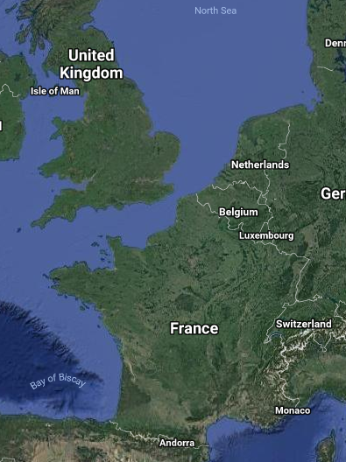
SUPPLEMENTARY ACTIVITY
The capture and ransom of John II forced France to accept the Treaty of Brétigny. Research the terms and conditions of the Treaty of Brétigny. Mark on the map areas that were given to England and land that England surrendered to France. Then, outline how the treaty set the stage for the second phase of the 100 Years’ War: The Caroline War, nine years later.
Satellite view of France and Britain
England’s longbow played a significant role in its victories. Using your historical knowledge and additional research, compare the English longbow with the Continental crossbow. Research their advantages and disadvantages. Consider how their care impacted battle results.

