Slide 1
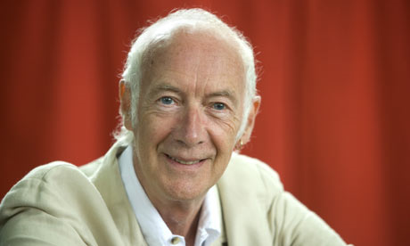
The Sound Collector Poem
By
Roger McGough
This is a great little poem about the importance of sounds in our daily existence. In the poem, Roger McGough imagines a mysterious stranger one day collecting all the sounds that fill our lives and taking them away……….
LO:
To recognise the techniques used in
The Sound Collector poem.

Slide 2


Big Question: Can you identify key poetic devices ?
Date:
Words of the Week
‘’Pattern”
5 Minute starter
  What is a cinquaine?
  What is the shape of a cinquaine?
  Does a cinquaine poem have to rhyme?
  What is the syllable structure of each line?
Word bank:
Sound verb
Syllable
Rhythm
Rhyme
Sound
Noun
Stanza
Syllables
Silent work
Extension task: Write down a short paragraph explaining what type of themes are traditionally used in a cinquaine.
Add/Build
Behaviours: Group discussion, debating, decision making, collaboration

Slide 3
Big Question: Can you identify key poetic devices ?
Date:
5 Minute starter
  A five-line poem – cinq being French for 5.
  A diamond shape.
  No, a cinquaine poem doesn’t have to rhyme.
  The structure is, 2, 4, 6, 8, 2 (Subject; description, action, feeling, conclusion).
Answers…..
Words of the Week
‘Pattern’
Word bank:
Sound verb
Syllable
Rhythm
Rhyme
Sound
Noun
Stanza
Syllables
Extension task: Individual responses and: A cinquaine can be about any topic that you like, so for example, your favourite pet, chocolate, the weather, a parent, brother or sister.
Add/Build
Behaviours: Group discussion, debating, decision making, collaboration

Slide 4

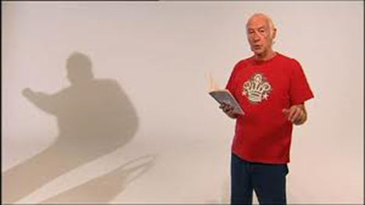
A fine collection of everyday sound words associated with living in a house.
But once a stranger takes away those sounds, they are sorely missed.
'Life will never be the same...’
The Sound Collector Poem
By
Roger McGough
A stranger called this morning
Dressed all in black and grey
Put every sound into a bag
And carried it away.
https://www.bbc.co.uk/bitesize/clips/zc6qxnb

Slide 5
The Sound Collector Poem
By
Roger McGough
So, what sounds did we hear in the poem?

Slide 6

Did you notice a pattern in the poem?
The Sound Collector Poem
By
Roger McGough
Sound verb
The whistling of the kettle
The turning of the lock
The purring of the kitten
The ticking of the clock
Noun
The …………… (sound verb) of the …………… (object/noun)

Slide 7
What is the pattern of syllables in each line?
The Sound Collector Poem
By
Roger McGough
The whistling of the kettle
The turning of the lock
The purring of the kitten
The ticking of the clock
7
6
7
6
The …………… (sound verb) of the …………… (object/noun)

Slide 8


Did you notice a rhyming pattern?
The Sound Collector Poem
By
Roger McGough
The whistling of the kettle
The turning of the lock
The purring of the kitten
The ticking of the clock
Rhyming words
Lines 2 and 4 rhyme.
Is this the same in each stanza?
Let’s have a look…

Slide 9


Did you notice a pulse and rhythm?
The Sound Collector Poem
By
Roger McGough
There is a steady 4 beat pulse per line with an anacrusis (pick up beat)
The crying of the baby
The squeaking of the chair
The swishing of the curtain
The creaking of the stair
Rhyming words
Lines 2 and 4 rhyme again.
7,6,7,6, pattern of syllables per line again, giving a repeated rhythm.

Slide 10
However…what happens in verse 4?
The Sound Collector Poem
By
Roger McGough
Irregular
The hissing of the frying pan
The ticking of the grill
The bubbling of the bathtub
As it starts to fill
8
6
7
5
Lines 2 and 4 rhyme again.
The 7,6,7,6, pattern of syllables per line has changed to: 8,6,7,5
The poem is an irregular poem!!

Slide 11




The Sound Hunt
Your collection challenge:
You may leave the classroom with your teachers and collect/record the sounds that you hear around school, both inside and outside.
Your writing challenge:
Write your own sound collector poem in
the style of Roger McGough.

Slide 12


My Sound Collector Poem
In the style of
Roger McGough
Write your own poem and come up with an action or sound effect for each line.
Your poem must begin with this stanza: And end with this stanza:
A stranger called to school this morning
Dressed all in black and grey
Put every sound into a bag
And carried them away
Remember to:
Think about the sounds that you have collected.
Follow the poem’s pattern: “the …… of the ……”
Write three to four stanzas.
Practise your performance.
A stranger called to school this morning
He didn't leave his name
Left us only silence
Life will never be the same

Slide 13
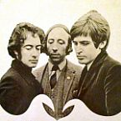
Fun Time
Roger McGough was born in Liverpool.
In the 1960’s, he worked as an English teacher and,
with John Gorman, organised arts events. After meeting
Mike McGear (Paul McCartney’s brother!), the trio formed The Scaffold.
The group scored several hit records, reaching number one in the UK Singles Chart in 1968 with their version of "Lily The Pink". McGough wrote the lyrics for many of the group's songs and also recorded the musical comedy/poetry .
https://www.youtube.com/watch?v=2x8D4T--0v4

