Slide 1

Year 7 Knowledge Organiser HT1
Knowledge is Power
Name: ______________________________
Form: _______

Slide 2
Contents Page
Subject | Page
English | 1
Maths | 2
Science | 3
Spanish | 5
History | 7
Geography | 8
PE | 9
Computing | 10
Art | 12
Cooking and Nutrition | 13
Music | 14
Performing Arts | 15
Design and Technology | 16
‘Thinking’ reflection log | 17
Reading log | 24
Reading Extracts | 31
Cursive Handwriting Practice | 36

Slide 3
English
Week 3 – Key Terms
Racism | When a person is treated worse, excluded, disadvantages, bullied, humiliated or degraded because of their race or ethnicity.
Disability | A physical or mental condition that limits a person’s movements, senses or activities.
Emotive language | Words/language used to cause an emotional response from the reader.
Pathetic Fallacy | When a character’s mood is reflected in the weather/ environment.
Week 5 - Key Vocabulary
Reluctant | To be unwilling and hesitant to do something.
Exuberant | To be full of energy and excitement.
Intricate | To be very complicated and detailed.
Remorse | A feeling of deep regret.
Distraught | To be deeply agitated especially from emotion.
Week 1 - Key Terms
Stereotype | a widely held but fixed and oversimplified image or idea of a particular type of person or thing.
Perspective | a particular attitude towards or way of regarding something; a point of view.
Prejudice | preconceived opinion that is not based on reason or actual experience.
Identity | Identity is the qualities, beliefs, personality, looks and/or expressions that make a person or group.
Week 6 - Key Terms
Imagery | Imagery is visually descriptive or figurative language.
Structure | Structure refers to the order of ideas in a piece of writing.
Tone | Tone is the general character or attitude of a place, piece of writing, situation.
Homophobia | Is the dislike and prejudice against gay people.
Week 4 - Key Vocabulary
Tension | A part of a novel that evokes emotions such as worry, anxiety, excitement, fear and stress on the part of both the reader and the characters in a novel.
Triplet | Is any group of three. This might be three sentences or even three individual words.
Connotation | An idea or emotion that a work evokes in addition to its literal or primary meaning.
Week 7 - Steps of an Analytical Paragraph
1. Point – create a point from the evidence, which answers the question directly and has an adjective.
2. Evidence – select a piece of evidence first which helps you to answer the question and is relevant and rich.
3. Subject terminology – identify and state which subject terms are used in your evidence.
3. Explanation – explain how your evidence is relevant to the question and helps support your point.
4. Effect on reader – how does this make the reader think, feel or imagine.
Week 2 – Devices
Imperative Verb | A word which tells you what to do.
Short Sentences | A small group of words within one sentence.
Rhetorical Questions | A question posed in order to make a point rather than to get an answer.
Metaphor | Describing something by saying it is something else.
1

Slide 4
Maths
Key Word | Definition
Integer | A whole number
Place value | The value of each digit in a number
Decimal point | Point or dot which is used to separate the whole part and the fractional part of a number
Partitioning | When numbers are separated into smaller units to make maths calculations easier
Square number | The answer when an integer is multiplied by itself
Cube number | The answer when an integer is multiplied by itself three times
Square root | The number you would multiply by itself to get a value
Cube root | The number you would multiply by itself three times to get a value
Prime number | A number which has exactly two factors: the number one and itself
The first 13 prime numbers | 2, 3, 5, 7, 11, 13, 17, 19, 23, 29, 31, 37, 41
Decimal places | The positions of digits to the right of the decimal point in a decimal number
Significant figures | Significant figures are the digits in a number that contribute to the accuracy of it. We start counting significant figures at the first non-zero digit of a number which is called the first significant figure
Negative number | A negative number is a real number that is less than zero
Zero pairs | A pair of numbers that add up to zero
2

Slide 5
Science
Organisms
Key word | Definition
Cell | Basic unit of life. Unicellular organisms only have one cell. Multicellular organisms have many cells.
Cell Membrane | Controls the movement of substances in and out of the cell.
Cytoplasm | Jelly-like substance where chemical reactions take place.
Nucleus | Carries genetic information and controls the cell.
Mitochondria | Where respirations takes place
Cell Wall | Made of cellulose, provides support to the cell.
Vacuole | Contains cell sap.
Chloroplasts | Contains the green pigment chlorophyll, the site of photosynthesis.
Tissue | Something made from just one type of specialised cell.
Organ | Something made from different groups of specialised cells all working together.
Organ System | When a number of organs work together.
Unicellular organism | A single-celled organism, is an organism that consists of a single cell,
Diffusion | Particles spread from a region of higher concentration to a region of lower concentration
Key word | Microscope key skills
Light Microscope | A device which uses light and a series of lenses to produce a magnified image of an object.
Lenses | Part of the microscope that increases the magnification. There are two lenses (objective lens and the eyepiece lens)
Stage | Platform that holds a sample to view under a microscope
Slide | a thin flat piece of glass used to hold objects to view under a microscope
Coverslip | Very thin piece of glass used to cover a specimen to avoid contact between the liquid and the objective lens, and prevent damage to the objective lens.
Focusing knob | Part of the microscope that allows for quick focusing by moving the objective lens or stage up and down
Resolution | The smallest change that can be read from a measuring device for example a ruler measured in mm or cm
Magnification | How much bigger a sample/object appears under the microscope than it is in real life.
Total magnification | Total magnification = Eyepiece lens magnification x Objective lens magnification
3

Slide 6
Science
Solids, liquids and gases
Key word | Definition
Particle | The general term for a small piece of matter.
State of Matter | The distinct forms in which matter can exist (solid, liquid, gas)
Solid | A substance with a fixed shape and volume.
Liquid | A substance with a fixed volume but not a fixed shape.
Gas | A substance that does not have a fixed shape or volume.
Chane of state | The change of a substance from one physical form to another.
Melting | The change of state when a solid changes to a liquid.
Freezing | The change of state when a liquid changes to a solid.
Condensing | The change of state when a gas changes to a liquid.
Evaporation | The change of state when a liquid changes to a gas.
Sublimation | The change of state from solid to gas
Key word | Definition
Density | The amount of mass that 1cm3 of a substance has.
Dense | Something which is heavy for its volume.
Gas pressure | The force exerted by gas particles per unit area of a surface
Physical properties | Factors such as a substance’s boiling point, density or melting point.
4

Slide 7
Spanish
Spanish | English
Hola | Hi
Adiós | Goodbye
¿Cómo te llamas? | What is your name?
Me llamo… | My name is...
¿Qué tal? | How’s it going?
estoy | I am
Bien | Well
Mal | Bad
Cansado/a | Tired
Enfermo/a | Sick
Triste | Sad
Feliz | Happy
¿Dónde vives? | Where do you live?
Vivo en | I live in
Uno / dos / tres / cuatro / cinco | 1 / 2 / 3 / 4 / 5
Seis / siete / ocho / nueve / diez | 6 / 7 / 8 / 9 / 10
Once / doce / trece / catorce / quince | 11 / 12 / 13 / 14 / 15
Spanish | English
Dieciséis / diecisiete / dieciocho / diecinueve | 16 / 17 / 18 / 19
Veinte | 20
Veintiuno / veintidós... | 21 / 22...
Treinta | 30
Treinta y uno | 31
¿Cuántos años tienes? | How old are you?
Tengo...años | I am...years old
enero | January
febrero | February
marzo | March
abril | April
mayo | May
Junio | June
Julio | July
agosto | August
septiembre | September
octubre | october
5

Slide 8
Spanish
Spanish | English
noviembre | November
diciembre | December
¿Cuándo es tu cumpleaños? | When is your birthday
Mi cumpleaños es el… | My birthday is the...
Soy / eres / es | I am / you are / s/he is
Listo/a | Smart
Serio/a | Serious
Perezoso/a | Lazy
Simpático/a | Nice/friendly
Tímido/a | Shy
Contento/a | Happy
Optimista | Optimistic
Responsable | Responsible
Tonto/a | Silly
Paciente | Patient
Inteligente | Intelligent
Divertido/a | Amusing
Spanish | English
Generoso/a | Generous
Y | And
Pero | But
Aunque | Although
También | Also
Sin embargo | However
Además | Furthermore
Guapo(a) / feo(a) | Pretty / ugly
Delgado(a) / gordo(a) | Skinny / fat
Alto(a) / bajo(a) | Tall / short
Joven | Young
Fuerte / debil | Strong / weak
Un perro / un gato / un hámster | A dog / a cat / a hamster
Está en | It is located in
Inglaterra / España / Francia / Italia | England / Spain / France / Italy
Negro / azul / blanco / rojo / gris | Black / blue / white / red / grey
6

Slide 9
History
Key Term | Definition
Capital punishment | Death penalty
Parole | Let out for good behaviour
Rehabilitate | Restore and help people
Probation | Supervision for an offender
Community service | Punishment in the local community
Warrant | Able to arrest a person
Life sentence | Minimum term served
Extradition | Send to another country
Deterrent | Something that discourages or is intended to discourage someone from doing something
Vigiles | A group of Roman watchmen, established by Emperor Augustus in ancient Rome. They acted as a police force, primarily responsible for maintaining order.
Praetorian Guard | The imperial guard of the Imperial Roman army that served various roles for the Roman emperor including being a bodyguard unit, counterintelligence, crowd control
Key Term | Definition
Perpetrator | A person who carries out a harmful, illegal, or immoral act
Tithing | The smallest and lowest unit of law enforcement in England. Every boy or man over 12 was supposed to be in a tithing
Hue and Cry | A traditional method of law enforcement where a victim of a crime would raise a loud outcry to summon the community to pursue and apprehend the offender
Justice | The system of laws, institutions, and processes designed to address criminal activity and ensure fairness
Forest Laws | A set of laws established by William the Conqueror in Norman England to protect royal hunting grounds and their inhabitants.
Night Watchman | Individuals responsible for patrolling streets at night, primarily for security and to prevent crime
Justice of the Peace | An individual authorized to perform certain legal functions, including hearing minor criminal cases and witnessing legal documents
Sheriff | An important official of a shire or county charged primarily with legal duties
7

Slide 10
Geography
Key Word | Definition
Contents page | A page at the start of the atlas which tells you where information will be. It will give you the page numbers.
Index page | A page in the book, usually at the back of a book with a list of topics/names with reference to page numbers.
Key | More detailed information provided from a map/ diagram. Often uses colours or symbols to represent features.
OS Map | OS is short for Ordnance Survey map. It uses a range of symbols, abbreviations and language to show features on the landscape of GB. When working out a grid reference use this saying, ‘Down the corridor and up the stairs’.
4 figure grid ref | Shows the location of a place in 4 figures. E.g. 45,90
6 figure grid reference | Shows the location of a specific place in 6 figures, this is more accurate than 4 figure. E.g. 457,901.
Scale | The ratio of a distance on a map, graph or diagram to the corresponding actual distance.
Relief | Height above sea level and is shown in many ways on a map.
Spot height | It is an exact point on a map with a height recorded.
Contour lines | This show the GRADIENT of the hill. This means contour lines tell us how steep the hill is.
Layer colouring | It involves colouring the area between selected contours in different colours. The darker the colour the higher the land.
Latitude | Lines of latitude circle the Earth in an east-west direction. They are parallel to each other.
Longitude | Lines of longitude run from the top of the Earth to the bottom. They are not parallel as lines of latitude are – they meet at a point at the north and south poles.
Physical geography- | A branch of geography that looks at the natural features of the planet, such as the ocean, mountains and rivers.
Human geography- | A branch of geography that looks at human activities and how humans have shaped the planets surface, such as cities, jobs and the economy.
Environmental geography- | A branch of geography that looks at how humans have affected the planet, such as pollution, impacts on wildlife and the earth natural features
Continents | Large and continuous land that is made up of several countries. 7 continents Africa, North America, South America, Asia, Europe, Antarctica , Oceania
Ocean | Large body of water. 5 main oceans Atlantic, Pacific, Indian , Artic, Southern
8

Slide 11


PE
Key Term | Definition
Muscular system | Works in conjunction with the skeleton to produce movement of the limbs and body
Antagonistic pairs | Muscles are arranged in antagonistic pairs. As one contracts, its partner relaxes
Agonist | The muscle that contracts to produce movement
Antagonist | The muscle that relaxes to allow the movement to occur
Skeleton | Is the central structure of the body
9

Slide 12
Computing
Transition unit:
Personal Drive | An area where you store all of the documents that you save | An area where you store all of the documents that you save
File Management | An operating system allows users to open, copy, rename, move or delete files | An operating system allows users to open, copy, rename, move or delete files
Files and Folders | A folder is a digital container for storing other folders and individual files such as a word document or a presentation | A folder is a digital container for storing other folders and individual files such as a word document or a presentation
E-safety | Staying safe online. Making sure that people are protected from harm of using any electronic device for online purposes. | Staying safe online. Making sure that people are protected from harm of using any electronic device for online purposes.
E-mail | Is short for electronic mail. An email is sent from one computer to multiple computers through the use of email addresses. | Is short for electronic mail. An email is sent from one computer to multiple computers through the use of email addresses.
Data | In computing, data refers to acts, concepts, or instructions | In computing, data refers to acts, concepts, or instructions
AI (Artificial intelligence) | The capability of computer systems to perform tasks typically associated with human intelligence | The capability of computer systems to perform tasks typically associated with human intelligence
Machine learning | AI applications use this to ‘learn’ from examples in the form of data | AI applications use this to ‘learn’ from examples in the form of data
Three Main Types of Malware:
Virus | Like a normal common cold a virus spreads from one computer to another through programs. It can work by slowing your computer down.
Trojan | A Trojan horse will actually pretend to be a useful and safe program but it actually will try and attack your device.
Worms | Very similar to viruses as they do duplicate and spread. However, they can do this hundred and thousands of times and infect other computers in minutes through email attachments.
Phishing | Trying to trick someone into handing over sensitive information through the use of emails.
Plagiarism | Copying work from another source and passing it off as your own.
Digital Footprint | A trail of data you leave when using the internet. Sites visited, emails, pictures sent etc.
Cyberbullying | Bullying someone through any use of technology.
10

Slide 13
Computing
Types of Cyberbullying:
Harassment | Using text messaging, instant messaging and email to harass, threaten or embarrass the target.
Impersonation | Developing a screen name that is similar to the victim’s screen name and then posting rude or hurtful remarks while pretending to be the victim.
Creating websites | Spreading rumours, lies or gossip about the victim online through websites or blogs.
Trolling | Provoking or antagonising someone online and looking for a reaction
Grooming | When an adult befriends a child in preparation to commit a further criminal offence
Ways to Prevent Cyberbullying:
Notice | Recognize if there has been a change in mood or behaviour and explore what the cause might be.
Talk | Ask questions to learn what is happening, how it started, and who is involved.
Report | Most social media platforms and schools have clear policies and reporting processes. If a classmate is cyberbullying, report it the school.
Support | Peers, mentors, and trusted adults can sometimes intervene publicly to positively influence a situation where negative or hurtful content posts about a child.
11

Slide 14
Art
Key Word | Definition
Line | An element of art defined by a point moving in space. Line may be two-or three-dimensional, descriptive, implied, or abstract
Shape | An element of art that is two-dimensional, flat, or limited to height and width.
Form | An element of art that is three-dimensional and encloses volume; includes height, width AND depth (as in a cube, a sphere, a pyramid, or a cylinder). Form may also be free flowing
Mark making | describes the different lines, dots, marks, patterns and textures created in a drawing. It can apply to any drawing materials. It can be loose and expressive or controlled and neat. The results will depend on your choice of media, tools and techniques
Tone | Tone means how light or dark something is. The tones artists and designers use and the contrast between them can create very different moods and visual effects.
Tonal contrast | the range of tones used in a drawing. A wider range means a greater contrast. You can manipulate the contrast depending on how much you want the object or specific part of the art work to stand out. If you are drawing from observation, the contrast can depend on how bright your light source.
12

Slide 15
Cooking and Nutrition
Key word | Definition
Hazard | Anything that is dangerous
Kitchen Hygiene | Ensuring that everything is clean when preparing food
Kitchen Safety | Being safe in the kitchen
Cross contamination | Transfer of bacteria from one person, object or place to another
4Cs | The four principles for food safety: clean, cook, chill, cross contamination
Bacteria | Small single celled organisms that can only be seen under a microscope
Claw grip | A method of cutting food that ensures that the finger tips are tucked out of the way and will not get caught by the knife
Bridge Hold | A method of cutting food that ensures that fingers are out of the way as the knife cuts through the food
Cooking utensils | Small items such as bowls, sieves and whisks that are used for preparation and mixing of ingredients
Cooking equipment | Large equipment such as refrigerators, ovens and hobs.
Weigh | Finding out how heavy an ingredient is
Measure | To find out the size or amount of an ingredient
Key word | Microscope key skills
Hob | The flat part of a cooker with hot plates or burners
Grill | The part of the cooker that sends heat downwards for cooking the food
Oven | The part of the oven that is used for baking and roasting foods
Nutrients | Natural chemical substances in foods that are essential for body growth, function and health
Macro Nutrients | Nutrients needed by the body in large a mounts
Micro Nutrients | Nutrients needed in the body in smaller amounts
Rubbing in | A technique in which fat is rubbed into flour and traps air in the mixture
Diet | All the foods that a person eats
Balanced Diet | A variety of foods eaten in the correct amounts to provide the nutrients that the body needs.
13

Slide 16



Music
Pitch | How high or low a note is.
Tempo | The speed of the music.
Dynamics | How loud or quiet the music is.
Rhythm | A pattern of long and short notes.
Structure | The order of sections in a piece (e.g., verse/chorus).
Texture | How many layers of sound there are and how they interact.
Timbre | The unique sound quality of a voice or instrument.
Silence | The absence of sound, used for effect.
Call and Response | One phrase is sung or played, and another responds.
Unison | Everyone singing the same thing at the same time.
Harmony | Two or more notes sung or played at the same time.
Projection | Using breath and posture to sing with a strong, confident sound.
14
Notes:
HT1 – Singing 2025-26

Slide 17
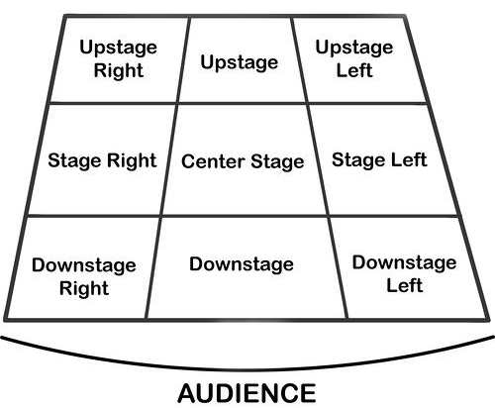
Performing Art
Key Word | Definition
Body Language | How an actor uses their body to communicate meaning. For example, crossing your arms could mean you are fed up
Gesture | a movement of the body, particularly the hands, arms, or head, that conveys meaning or expresses an idea, emotion, or intention
Levels | Levels can be used to show status, relationships, and even to indicate changes in location or time
Proxemics | The deliberate use of distance between you and other characters or objects to communicate something to an audience
Facial Expression | Using the face to express that characters feelings and emotions.
Key Word | Definition
Amphitheatre | Circular or oval open air theatre with a large ranked seating area
Apron | The apron is a section of the stage which the floor projects towards or into the auditorium
Black Box | A flexible studio theatre where the audience and actors are in the same room surrounded by black tabs
End On | Traditional audience seating layout where the audience is looking at the stage from the same direction.
Found Space | A performance space that wasn’t designed to be one e.g historic buildings
In the Round | Theatre in the Round is a form of audience seating layout where the acting area is surrounded on all sided by seating. There is often a number of entrances through the seating
Promenade | Form of staging where the audience moves around the performance space and sees the play at a variety of different locations
Proscenium Arch | The opening in the wall which stands between stage and auditorium in some theatres; the picture frame through the audience sees the play’ fourth wall’
Site-specific theatre | A piece of performance which has been deigned to work only in a particular non-theatre space
Stage Directions
Stage directions are from the performers perspective
15

Slide 18
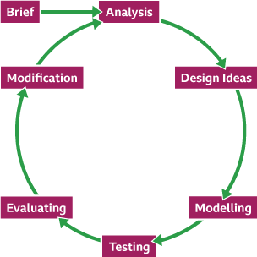
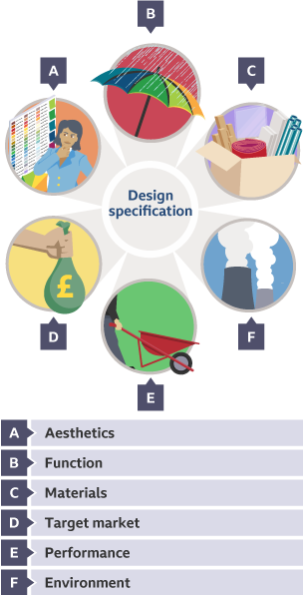
Design and Technology - RM
Key Words | Definition
Aesthetic | How something looks e.g. this product is aesthetically pleasing
Analysis | Learn and evaluate designs to identify features that could be improved.
Anthropometrics | The practice of taking measurements of the human body and providing data that can be used by designers.
Design Brief | A short statement which outlines the problem to be solved and a set of instructions given to a designer by a client.
Design Process | Provides us with a series of important stages during the design and development of a solution.
Ergonomics | The study of people in their working environment
Innovative | New and creative in approach.
Hazardous | Dangerous and involving risk, especially to someone's health.
Market Research | When designers and businesses gather important information about the needs and preferences of people who might use their products.
PPE | Personal Protective Equipment must be worn when instructed to do so.
Risk Assessment | A careful examination of the things that could cause harm to people, and helps you to put precautions in place to prevent injury and ill-health.
Specification | Containing detail of a product's requirement or characteristic - processes, materials and other information needed to design the product.
Sustainability | Something that does not damage the environment e.g. plant based plastic
The 6 Rs | Rethink, Refuse, Reduce, Reuse, Recycle, Repair
The Design Process
16

Slide 19
W/c 8th September Thinking definition: Thinking is making connections, reasoning and asking questions to make the learning stick
Reflecting on learning behaviours for thinking… | Experience log
 | Successful moment… | In hindsight… Where you could have done better on reflection? | At home…
I gave an idea and reasoned/justified.
I reflected on my idea and made it better after discussing with others
I used a revision strategy to help make the learning stick.
I made connections between what I am learning and the outside world.
I asked questions to deepen my understanding.
17

Slide 20
W/c 15th September Thinking definition: Thinking is making connections, reasoning and asking questions to make the learning stick
Reflecting on learning behaviours for thinking… | Experience log
 | Successful moment… | In hindsight… Where you could have done better on reflection? | At home…
I gave an idea and reasoned/justified.
I reflected on my idea and made it better after discussing with others
I used a revision strategy to help make the learning stick.
I made connections between what I am learning and the outside world.
I asked questions to deepen my understanding.
18

Slide 21
W/c 22nd September Thinking definition: Thinking is making connections, reasoning and asking questions to make the learning stick
Reflecting on learning behaviours for thinking… | Experience log
 | Successful moment… | In hindsight… Where you could have done better on reflection? | At home…
I gave an idea and reasoned/justified.
I reflected on my idea and made it better after discussing with others
I used a revision strategy to help make the learning stick.
I made connections between what I am learning and the outside world.
I asked questions to deepen my understanding.
19

Slide 22
W/c 29th September Thinking definition: Thinking is making connections, reasoning and asking questions to make the learning stick
Reflecting on learning behaviours for thinking… | Experience log
 | Successful moment… | In hindsight… Where you could have done better on reflection? | At home…
I gave an idea and reasoned/justified.
I reflected on my idea and made it better after discussing with others
I used a revision strategy to help make the learning stick.
I made connections between what I am learning and the outside world.
I asked questions to deepen my understanding.
20

Slide 23
W/c 6th October Thinking definition: Thinking is making connections, reasoning and asking questions to make the learning stick
Reflecting on learning behaviours for thinking… | Experience log
 | Successful moment… | In hindsight… Where you could have done better on reflection? | At home…
I gave an idea and reasoned/justified.
I reflected on my idea and made it better after discussing with others
I used a revision strategy to help make the learning stick.
I made connections between what I am learning and the outside world.
I asked questions to deepen my understanding.
21

Slide 24
W/c 13th October Thinking definition: Thinking is making connections, reasoning and asking questions to make the learning stick
Reflecting on learning behaviours for thinking… | Experience log
 | Successful moment… | In hindsight… Where you could have done better on reflection? | At home…
I gave an idea and reasoned/justified.
I reflected on my idea and made it better after discussing with others
I used a revision strategy to help make the learning stick.
I made connections between what I am learning and the outside world.
I asked questions to deepen my understanding.
22

Slide 25
W/c 20th October Thinking definition: Thinking is making connections, reasoning and asking questions to make the learning stick
Reflecting on learning behaviours for thinking… | Experience log
 | Successful moment… | In hindsight… Where you could have done better on reflection? | At home…
I gave an idea and reasoned/justified.
I reflected on my idea and made it better after discussing with others
I used a revision strategy to help make the learning stick.
I made connections between what I am learning and the outside world.
I asked questions to deepen my understanding.
23

Slide 26
Reading Log w/c 8th September (20 mins reading per day – all five logs MUST be completed)
Date | Title of novel | Number of pages read | Summary about what I have read
 |  |  | • • •
 |  |  | • • •
 |  |  | • • •
 |  |  | • • •
 |  |  | • • •
Checked by form tutor:
24

Slide 27
Reading Log w/c 15th September (20 mins reading per day – all five logs MUST be completed)
Date | Title of novel | Number of pages read | Summary about what I have read
 |  |  | • • •
 |  |  | • • •
 |  |  | • • •
 |  |  | • • •
 |  |  | • • •
Checked by form tutor:
25

Slide 28
Reading Log w/c 22nd September (20 mins reading per day – all five logs MUST be completed)
Date | Title of novel | Number of pages read | Summary about what I have read
 |  |  | • • •
 |  |  | • • •
 |  |  | • • •
 |  |  | • • •
 |  |  | • • •
Checked by form tutor:
26

Slide 29
Reading Log w/c 29th September (20 mins reading per day – all five logs MUST be completed)
Date | Title of novel | Number of pages read | Summary about what I have read
 |  |  | • • •
 |  |  | • • •
 |  |  | • • •
 |  |  | • • •
 |  |  | • • •
Checked by form tutor:
27

Slide 30
Reading Log w/c 6th October (20 mins reading per day – all five logs MUST be completed)
Date | Title of novel | Number of pages read | Summary about what I have read
 |  |  | • • •
 |  |  | • • •
 |  |  | • • •
 |  |  | • • •
 |  |  | • • •
Checked by form tutor:
28

Slide 31
Reading Log w/c 13th October (20 mins reading per day – all five logs MUST be completed)
Date | Title of novel | Number of pages read | Summary about what I have read
 |  |  | • • •
 |  |  | • • •
 |  |  | • • •
 |  |  | • • •
 |  |  | • • •
Checked by form tutor:
29

Slide 32
Reading Log w/c 20th October (20 mins reading per day – all five logs MUST be completed)
Date | Title of novel | Number of pages read | Summary about what I have read
 |  |  | • • •
 |  |  | • • •
 |  |  | • • •
 |  |  | • • •
 |  |  | • • •
Checked by form tutor:
30

Slide 33
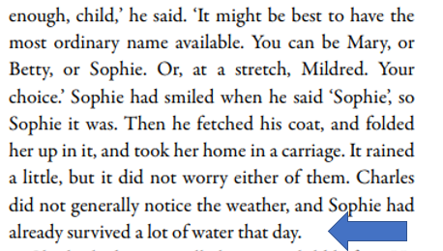
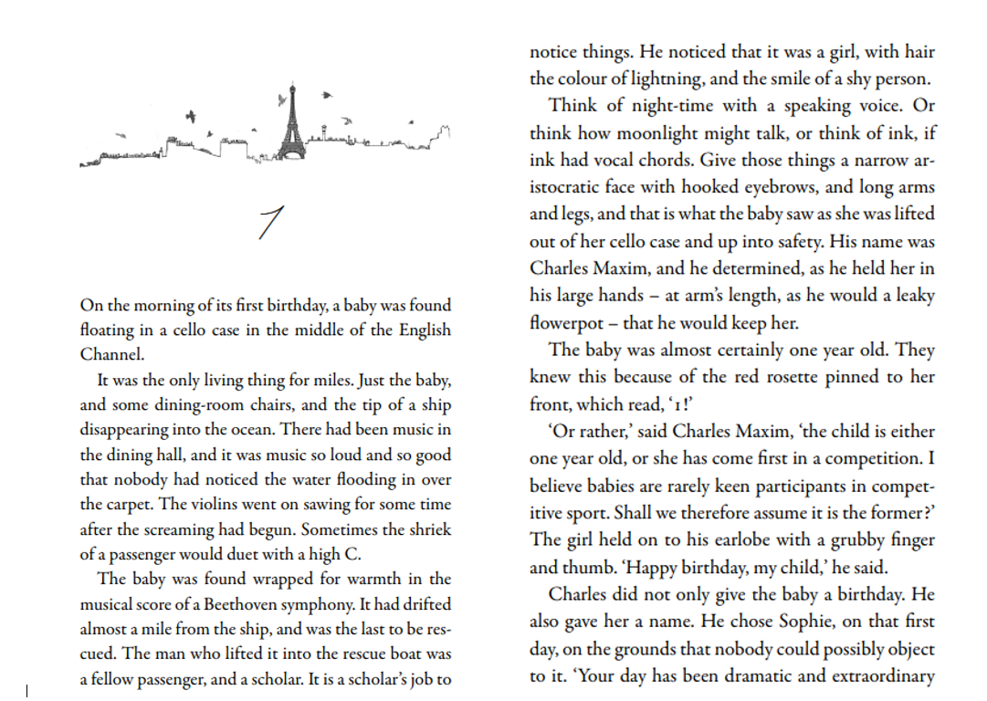
1. Rooftoppers – Katherine Rundell
Vocabulary:
Aristocratic - high social status. In appearance it means to look elegant and stylish.
Cello - as musical instrument that looks like a violin but is larger and held upright.
31
Notes:
Ok, so let’s all have the extract in front of us. I am going to read now and you are going to follow with your finger or ruler.
READ THE EXTRACT. PAUSE ON THE WORDS THAT THE STUDENTS MAY NOT KNOW.

Slide 34
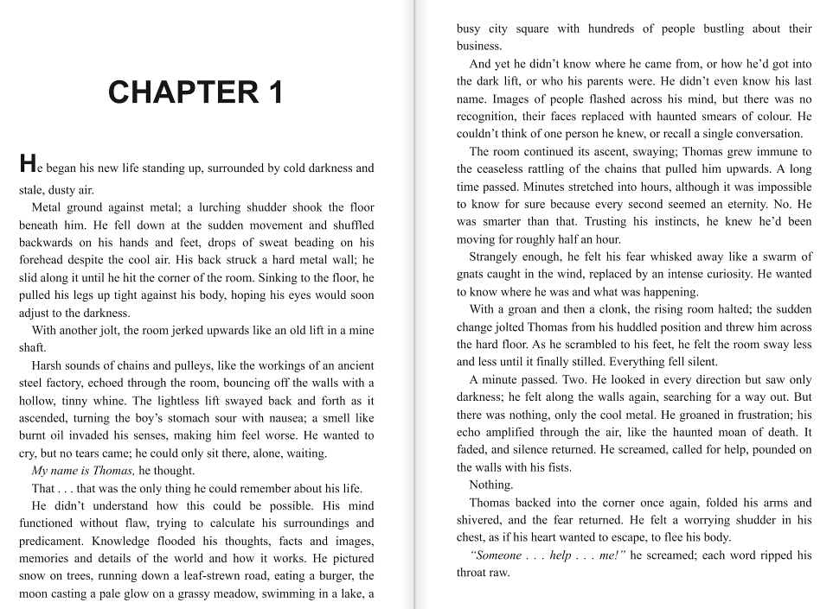
2. The Maze Runner by James Dashner
Vocabulary:
to ascend – to go up
bustling – to move about in an energetic or busy manner
to amplify – to increase the volume, make lounder
to pound – hit heavily and repeatedly
32
Notes:
Ok, so let’s all have the extract in front of us. I am going to read now and you are going to follow with your finger or ruler.
READ THE EXTRACT. PAUSE ON THE WORDS THAT THE STUDENTS MAY NOT KNOW.

Slide 35
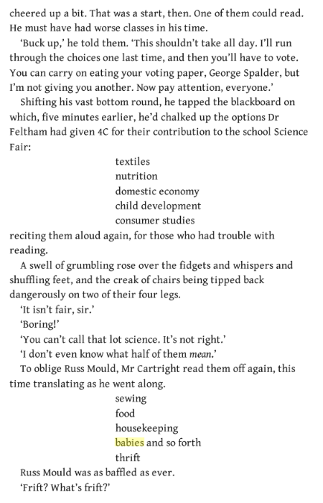
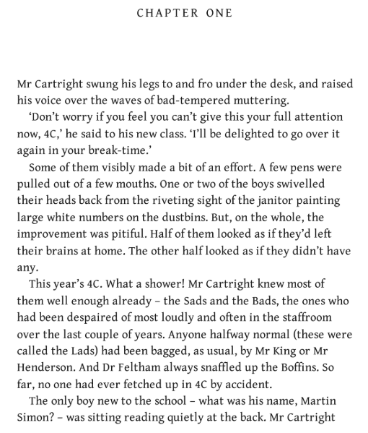
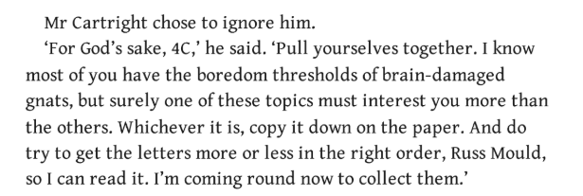
3. Flour Babies by Anne Fine
Vocabulary:
riveting – completely engrossing, extremely interesting
pitiful – inadequate, not good enough
Boffin – someone who knows a lot about science and is not interested in other things
textiles – cloth, woven fabric
33
Notes:
Ok, so let’s all have the extract in front of us. I am going to read now and you are going to follow with your finger or ruler.
READ THE EXTRACT. PAUSE ON THE WORDS THAT THE STUDENTS MAY NOT KNOW.

Slide 36
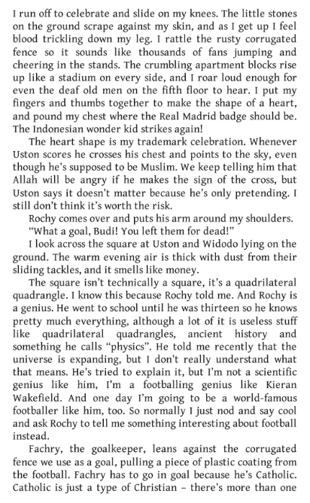
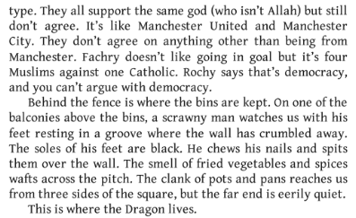
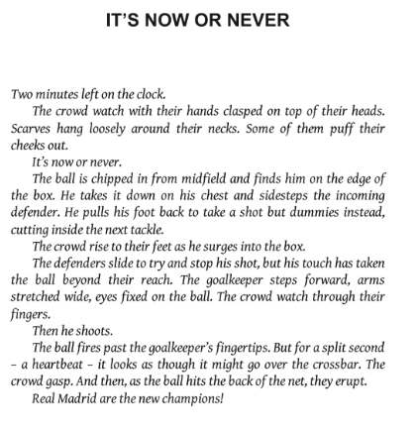
4. Kick by Mitch Johnson
Vocabulary:
trickling – flow in a small stream
corrugated – moulded into tight ridges and valleys
democracy – a type of government where people are given the right to vote
34
Notes:
Ok, so let’s all have the extract in front of us. I am going to read now and you are going to follow with your finger or ruler.
READ THE EXTRACT. PAUSE ON THE WORDS THAT THE STUDENTS MAY NOT KNOW.

Slide 37
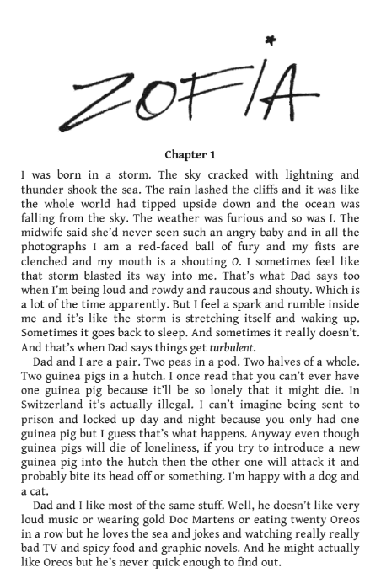
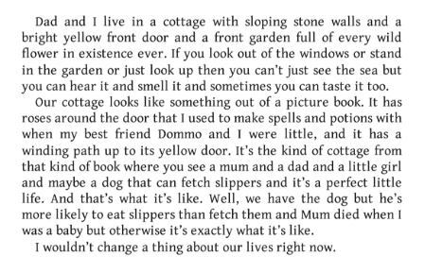
5. The Light in Everything by Katya Balen
Vocabulary:
rowdy – noisy and boisterous
raucous – making a disturbingly harsh and loud noise
turbulent – full of conflict and disorder, or confusion
35
Notes:
Ok, so let’s all have the extract in front of us. I am going to read now and you are going to follow with your finger or ruler.
READ THE EXTRACT. PAUSE ON THE WORDS THAT THE STUDENTS MAY NOT KNOW.

Slide 38

36

Slide 39

37

Slide 40

38

Slide 41

39

Slide 42

40

Slide 43

41

