Slide 1

Year 7 Knowledge Organiser HT2
Knowledge is Power
Name: ______________________________
Form: _______

Slide 2
Contents Page
Subject | Page
English | 1
Maths | 2
Science | 3
Spanish | 5
History | 7
Geography | 8
PE | 9
Computing | 11
Art | 12
Cooking and Nutrition | 13
Music | 14
Performing Arts | 15
Design and Technology | 16
‘Thinking’ reflection log | 17
Reading log | 24
Reading Extracts | 31
Cursive Handwriting Practice | 43

Slide 3
English
Week 5 - Key Terms
Show, Not Tell | A technique used to allow the reader to experience the story.
Sensory Imagery | Words and phrases which appeal to the five senses.
Emotive Language | Words used to cause an emotional response.
Rising Action | All the events that happen in the story on the way to the climax.
Week 3 - Devices
Personification | Giving human characteristics to a non human object.
Metaphor | Comparing by referring to one thing as another.
Simile | A comparison of two different objects using like or as.
Rhetorical question | A question asked in order to get a dramatic effect rather than to be answered.
Pathetic Fallacy | When a character’s mood is reflected in the weather/ environment.
Week 1 - Key Terms
Victorian Era | A widely held but fixed and oversimplified image or idea of a particular type of person or thing.
Context | Social, political and religious events that influence the writing of a text.
Atmosphere | A type of feeling or mood that readers get from a narrative.
Gothic Literature | A style of writing that is characterised by elements of fear, horror, death and gloom, as well as nature, individuality and very high emotion.
Week 6 - Key Terms
Perspective | A particular attitude towards something
Shift in Focus | Changes in ideas and perspectives
Effect on Reader | How a particular piece of language makes a reader feel
Writers Choices | Why a writer has chosen a certain word or phrase to focus on
Week 4 - Key Terms
Setting | Setting is the place or type of surroundings where something is positioned or where an event takes place.
Structure | Structure refers to the order of ideas in a piece of writing.
Tone | Tone is the general character or attitude of a place, piece of writing, situation.
Imagery | Imagery is visually descriptive or figurative language.
Bildungsroman | A novel which explores a character’s moral development and maturation.
Week 2 - Context
Industrial revolution | A sudden improvement in technology. Lots of machines and factories were being made.
Urbanisation | The move from the countryside to the city.
Poverty | A state or condition where a person lacks financial resources and essentials for a certain standard of living.
Factories | Buildings where goods are manufactured.
Workhouse | An institution where people were offered employment and accommodation.
Week 7 - Steps of an Analytical Paragraph
1. Point – Create a point from the evidence, which answers the question directly and has an adjective.
2. Evidence – Select a piece of evidence first which helps you to answer the question and is relevant and rich.
3. Explanation – Explain what the quote means and zoom into specific words
4. Link to context – Link back to what was happening during the Victorian era.
1

Slide 4
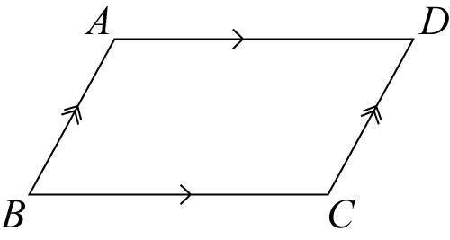
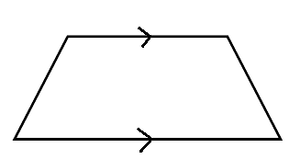
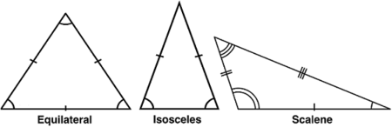
Maths
Area and Perimeter
Keyword | Definition
Perimeter | Total length of all the sides of a shape
Units of perimeter | mm, cm, m
Area | The total space taken up by a flat 2D shape
Units of area | mm², cm², m²
Parallel Lines | Two lines that never meet
Parallelogram | A quadrilateral with two pairs of parallel sides
Trapezium | A quadrilateral with one pair of parallel sides
Isosceles triangle | A triangle with two equal sides and angles
Equilateral triangle | A triangle with three equal sides and angles
Negative numbers
Keyword | Definition
Negative number | A negative number is a real number that is less than zero
Zero pairs | A pair of numbers that add up to zero
Parallelogram
Trapezium
2

Slide 5
Science
Scientific model
Keyword | Definition
Apparatus | equipment used by scientists.
Balance | a piece of apparatus used for measuring mass.
Boiling tube | a large glass container used for heating or mixing liquids. A boiling tube is larger than a test tube.
Bunsen burner | a piece of apparatus used for heating things.
Stop watch | a modern piece of apparatus used for measuring time.
Experiment | the controlled use of apparatus and observations in order to find out why and how things happen.
Measuring cylinder | a piece of apparatus used for measuring volume.
Test tube | a small glass container used for mixing chemicals.
Thermometer | a piece of apparatus used for measuring temperature.
Hazard symbol | a sign used in laboratories to warn of dangers.
Keyword | Measurements
Length | a measure of how long or short something is. It is measured in mm, cm, m, km or light years.
Mass | a measure of how much matter is in something. It is measured in mg, g, Kg, or tonnes.
Temperature | a measure of how hot or cold something is. It is measured in ºC (degrees Celsius).
Volume | a measure of how much space is taken up by something. It is measured in mm³, cm³, dm³ or m³.
Keyword | Scientific model
Hypothesis | A scientific statement that explains certain facts or observations
Prediction | This describes what you think will happen in an experiment
Independent variable | This is the variable that is changed during an investigation. There should only be one of these.
Dependent variable | This is the variable that changes as a result of a change in the independent variable
Control variable | Variables that remain constant, to make sure that an investigation is valid
3

Slide 6
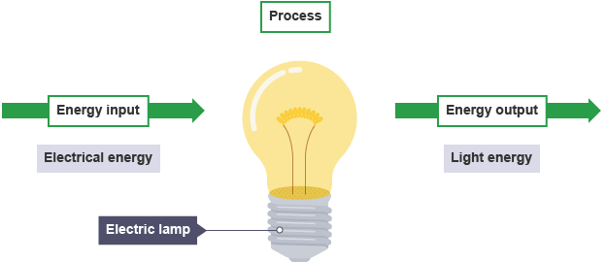
Science
Energy
Key Word | Definition
Energy | The sum of the forces acting upon an object (overall force)
Kinetic Energy | The energy stored when an object is moving
Gravitational Potential Energy | The energy stored when an object is lifted above the ground
Elastic Potential Energy | The energy stored when an object stretches
Thermal Energy | The energy stored when an object heats up
Chemical Energy | The energy stored in chemical bonds
Useful Energy | The energy transferred that the object is meant to be used for e.g. light transferred from a phone
Wasted Energy | The energy transferred that the object is not meant to be used for e.g. heat transferred from a phone
Efficiency | The useful energy transferred in a device out of the total energy transferred
Power | The energy transferred per second
Dissipated | The energy transferred to the surroundings
Energy transfer diagram | A diagram to show the input and output energies, including the useful and wasted energy
Insulation | Reducing the thermal energy transfers in an object
Energy Transfers
Input energy
Output energy
Electrical Energy
Light Energy
Electric Lamp
4

Slide 7
Spanish
Spanish | English
El padre | Father
La madre | Mother
El hermano | Brother
La hermana | Sister
El tío | Uncle
La tía | Auntie
El primo | Cousin (male)
La prima | Cousin (female)
el padrastro | Stepfather
La madrastra | Stepmother
El amigo | Friend (male)
La amiga | Friend (female)
La familia | Family
Se llama / se llaman | (s)He is called / they are called
Tiene ____ años | He/she is ____ years old
Cuarenta | 40
cincuenta | 50
Spanish | English
Sesenta | 60
Setenta | 70
Ochenta | 80
Noventa | 90
Cien | 100
Los ojos | Eyes
El pelo | Hair
Azul | Blue
Verde | Green
Gris | Grey
Marrón | Brown (eyes)
Rubio | Blonde
Castaño | Brunette
Negro | Black
Largo | Long
Corto | Short
Tiene / tienen | (s)He has/they have
5

Slide 8
Spanish
Spanish | English
Y | And
Pero | But
También | Also
Sin embargo | However
Aunque | Although
Además | Furthermore
Así que | So/therefore
Un poco | A little
Bastante | Quite
Muy | Very
Demasiado | Too
Soy | I am
Son | They are
Listo/a | Smart/clever
Sensible | Sensitive
Perezoso/a | Lazy
Nervioso/a | nervous
Spanish | English
Gracioso/a | Funny
Fuerte | Strong
Feliz | Happy
Extraño/a | Strange
Divertido/a | Amusing
Deportivo/a | Sporty
Comprensivo/a | Understanding
Trabajador/a | Hard working
Tonto/a | Silly
Me gusta(n) | I like it/them
Me encanta (n) | I love it/them
Gordo(a) / Delgado(a) | fat / thin
Fuerte / débil | Strong / weak
Alto(a) / bajo(a) | Tall / short
Guapo(a) / feo(a) | Goodlooking / ugly
Bonito/a | pretty
6

Slide 9
History
Key Term | Definition
King Edward the Confessor | His death in 1066 without a child/ heir led to the Norman conquest of England.
Harold Godwinson | He was a wealthy nobleman, and it is claimed that Edward the Confessor named him successor on his deathbed.
William of Normandy | William was a Duke who controlled Normandy, a large region in northern France. William was a distant relative of Edward the Confessor.
Harald Hardrada | Viking and king of Norway. He was also a distant relative of King Cnut, who had previously been a king of England
Battle of Hastings | 14 October 1066 between William, the Duke of Normandy, and an English army under the Anglo-Saxon King Harold Godwinson.
Magna Carta | June 1215 was the first document to put into writing the principle that the king and his government was not above the law.
Black Death | Devastating global epidemic of bubonic plague that struck Europe and Asia in the mid-1300s killing over 1/3 Europe’s population.
Peasants Revolt | In 1381, peasants rebelled against King Richard II. The peasants were angry about a range of issues, such as low pay and the introduction of a poll tax.
King Edward the Confessor | His death in 1066 without a child/ heir led to the Norman conquest of England.
Harold Godwinson | From Wessex, in England. He was a wealthy nobleman, and it is claimed that Edward the Confessor named him successor on his deathbed.
Key Term | Definition
Heir | Next in line to be King or Queen.
Claimant | Someone who believes they have a right to something and wish to take it.
The Bayeux Tapestry | An embroidered cloth nearly 70 metres (230 ft) long and 50 centimetres (20 in) tall, which depicts the events leading up to the Norman conquest of England.
Domesday Book | A manuscript record of the "Great Survey" of much of England and parts of Wales completed in 1086 by order of King William the Conqueror.
Excommunicated | A person excluded from the communion of believers and the rights of church membership.
Doom Painting | A traditional English term for a wall-painting of the Last Judgment in a medieval church. This is the moment in Christian eschatology when Christ judges souls to send them to either Heaven or Hell.
Quarantine | Separating the sick from the healthy to stop the spread of a disease.
Peasant | A poor smallholder or agricultural labourer of low social status.
Poll Tax | Known as a head tax, is a tax levied as a fixed sum on every liable individual. Head taxes were important sources of revenue for many governments from ancient times until the 19th century.
Heir | Next in line to be King or Queen.
7

Slide 10
Geography
Key Word | Definition
Distribution | The way something is spread out or arranged over a geographic area
Population density | The number of people in a given area.
Settlement | Places where people live
Urban | A built environment such as a town or city
Rural | The countryside
Urbanisation | The increase in the proportion of people living in towns and cities
Rural to urban migration | People moving from the countryside to cities
Push factor | Forces people away from their home
Pull factor | Encourages people to move
Megacities | A city with a population of over 10 million people
Natural increase | The difference between the number of births and the number of deaths recorded over a period
Opportunity | An occasion or situation that makes it possible to do something
Challenge | A difficult problem which needs solutions
Squatter settlement | Used as a general term to define low-quality housing on land that is usually illegal, occupied by the poor, usually on the edge of cities
Informal sector | Often unskilled and labour intensive, require little money to set up, offer no protection to the workers and they pay no tax
Sustainability | Meeting the needs of current generations without compromising the needs of future generations
Sustainable cities | Settlements designed to have as little impact on the environment as possible
8

Slide 11
PE
Health and Fitness
Muscular Strength | The amount of the force muscles can generate against a resistance
Muscular Endurance | The ability to use voluntary muscles, over long periods of time without getting tired
Flexibility | The range of movement at a joint
Cardiovascular Fitness (Aerobic Endurance) | The ability of the heart and circulatory system to meet the demands of the body for a long period of time
Body composition | The percentage of a body that is fat, muscle, bone and water
Coordination | The ability to move two or more body parts at the same time
Reaction Time | The time taken for a response to occur after a stimulus
Agility | The ability to change direction at speed
Balance | The ability to keep the body steady when in a static position or when moving
Speed | The time taken to cover a set distance/complete a movement
Power | The ability to combine speed and strength
Principles of training
Progressive Overload | Working the body harder than normal/gradually increasing the amount of exercise you do
Reversibility | If training is not regular, adaptations will be reversed. This can happen when suffering from illness, injury or after an off season
Specificity | Training showed be matched to the requirements of the sport or position the performer is in. Training must be specifically designed to develop the right muscles, type of fitness or skills
Individual needs | All PEP’s would differ depending on performers goals/target, strengths /weaknesses, age/gender and current health/fitness levels
Overtraining | Occurs when you train too hard and do not allow the body enough rest/recovery time Signs include extended muscle soreness, frequent illness & increase injuries
9

Slide 12
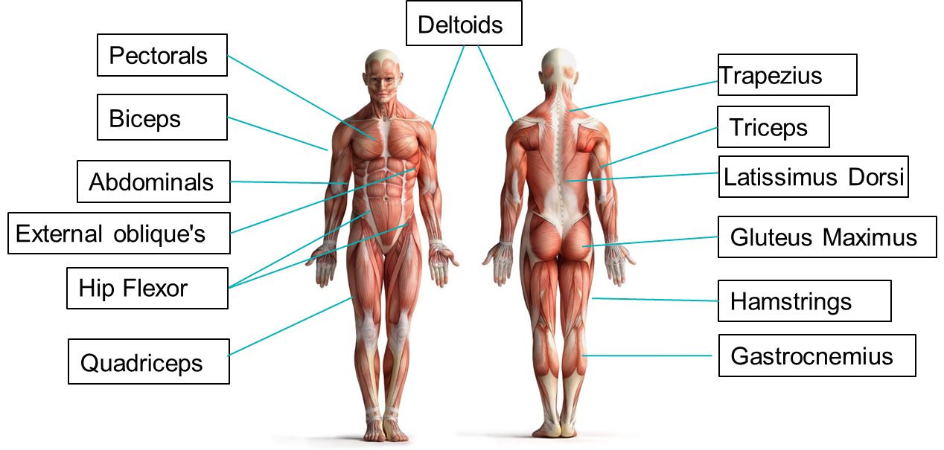
PE
10

Slide 13
Computing
Systems Architecture
Hardware | Any physical parts that make up a computer e.g. keyboard and mouse
Software | The programs that run on a computer in order for you to use it
Input Device | Any device that is used to send data to a computer e.g. keyboard, mouse, microphone
Output Device | Any device that is used to take information out of the computer to the user e.g. monitor, speakers
Storage Device | Any device that can store data
CPU | Central Processing Unit. This is known as the brain of the computer because it is used to process data and instructions.
Motherboard | The main circuit board of a computer. This is like the skeleton of a computer because it connects everything together.
Hard disk or Hard drive | A storage device that stores and retrieves digital data using magnetic storage with one or more rotating plates coated with magnetic material
Graphics card | Processes video calculations so that it can display images and videos on a monitor
Sound card | Used to produce high-quality sound by converting analogue waves into digital data
Power supply | A device that supplies electric power
RAM | Random Access Memory. Information is temporarily stored on the computer and it is erased when you restart or shut down your computer (volatile).
ROM | Read Only Memory. Information is permanently stored, even when the computer is off (non-volatile).
OS | Operating Systems. This is responsible for managing the hardware and providing an environment for programs to run in
Application | A type of computer program that performs a specific personal, educational, and business task
11

Slide 14
Art
Key Word | Definition
Tint | a shade or variety of a colour.
Shade | a colour, especially with regard to how light or dark it is or as distinguished from one nearly like it.
Blend | mix (a substance) with another substance so that they combine together.
Limited colour palette | it means limiting the number of colours you use in the painting to the bare essentials. A limited colour palette removes confusion as you only use the colours that you have chosen such as 3 colours, 4 colours etc. For example, if you’re using a limited colour palette of blue, white and red, you only have these three colours to choose from – making it simpler.
Natural | existing in or derived from nature; not made or caused by humankind.
Organic | Organic shapes are irregular and imperfect. Naturally these shapes will all be slightly different from one another. They are often curved and flowing and can seem unpredictable.
Wet into wet | Wet-on-wet is a direct painting technique that can be used with all wet paint mediums: watercolour, gouache, acrylic, and oil paints.
Burnishing | enhance or perfect (something such as a reputation or a skill).
Transparent | See-through (washes that are thinly applied).
Wash | A very watery mix applied with a large brush.
12

Slide 15
Cooking and Nutrition
Key Word | Definition
Nutrition | A study of what people eat and how all the nutrients in foods work together in the body
Nutrients | Natural chemical substances in foods that are essential for body growth, function and health
Macro Nutrients | Nutrients needed by the body in large a mounts
Micro Nutrients | Nutrients needed in the body in smaller amounts
Amino acids | The building blocks of protein
Saturated fats | These fats usually come from animal sources and can be harmful to health
Unsaturated fats | These fats usually come from plant sources and can be good for health
Protein alternatives | Sources of protein other than meat that are suitable for vegetarians
Eatwell Guide | A diagram created by the UK government to show the proportions of food we need to eat to have a balanced diet, be healthy and maintain a healthy weight.
Rubbing in | A technique in which fat is rubbed into flour and traps air in the mixture
pastry | A mixture of flour , fat and liquid which is made into a dough.
Boiling | Cooking in liquid at boiling point
simmering | Cooking food just below boiling point
baking | Placing food in dry heat in a hot oven, which cooks the food through
roasting | Cooking in the oven in hot fat
grilling | Cooking food under direct heat
Deep fat frying | Cooking by covering food in very hot oil
13

Slide 16
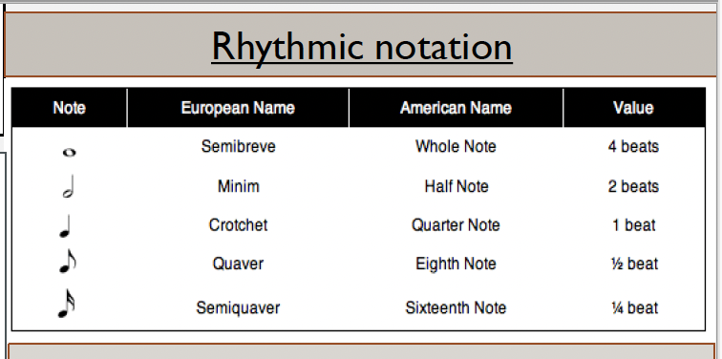
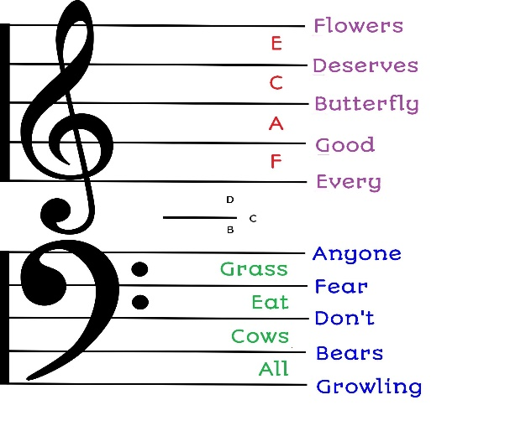
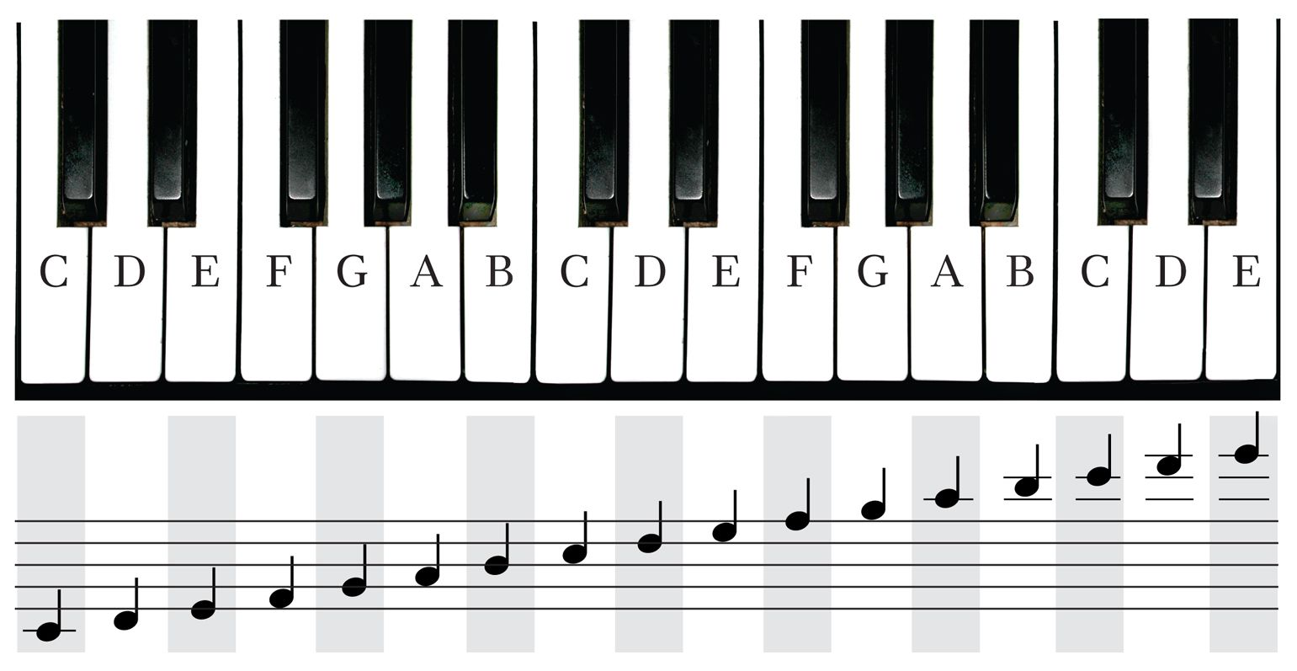
Music
Expression | how musicians add emotion through dynamics, tempo changes, and phrasing
Orchestration | The way instruments are used and combined in music
Timbre | The unique sound quality of a voice or instrument.
Texture | How many layers of sound there are and how they interact.
Harmony | Two or more notes sung or played at the same time.
Pitch | How high or low a note is.
Tempo | The speed of the music.
Dynamics | How loud or quiet the music is.
Rhythm | A pattern of long and short notes.
Structure | The order of sections in a piece (e.g., verse/chorus).
Silence | The absence of sound, used for effect.
14
Notes:
HT1 – Singing 2025-26

Slide 17
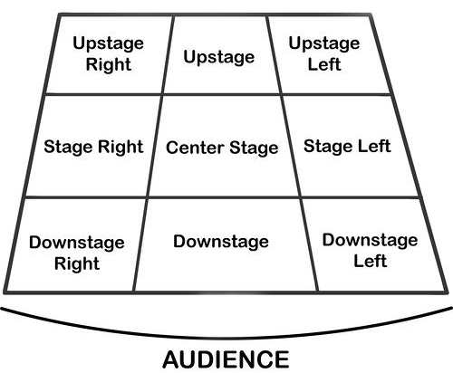
Performing Art
Key Word | Definition
Body Language | How an actor uses their body to communicate meaning. For example, crossing your arms could mean you are fed up
Gesture | a movement of the body, particularly the hands, arms, or head, that conveys meaning or expresses an idea, emotion, or intention
Levels | Levels can be used to show status, relationships, and even to indicate changes in location or time
Proxemics | The deliberate use of distance between you and other characters or objects to communicate something to an audience
Facial Expression | Using the face to express that characters feelings and emotions.
Key Word | Definition
Amphitheatre | Circular or oval open air theatre with a large ranked seating area
Apron | The apron is a section of the stage which the floor projects towards or into the auditorium
Black Box | A flexible studio theatre where the audience and actors are in the same room surrounded by black tabs
End On | Traditional audience seating layout where the audience is looking at the stage from the same direction.
Found Space | A performance space that wasn’t designed to be one e.g historic buildings
In the Round | Theatre in the Round is a form of audience seating layout where the acting area is surrounded on all sided by seating. There is often a number of entrances through the seating
Promenade | Form of staging where the audience moves around the performance space and sees the play at a variety of different locations
Proscenium Arch | The opening in the wall which stands between stage and auditorium in some theatres; the picture frame through the audience sees the play’ fourth wall’
Site-specific theatre | A piece of performance which has been deigned to work only in a particular non-theatre space
Stage Directions
Stage directions are from the performers perspective
15

Slide 18
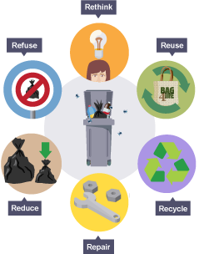
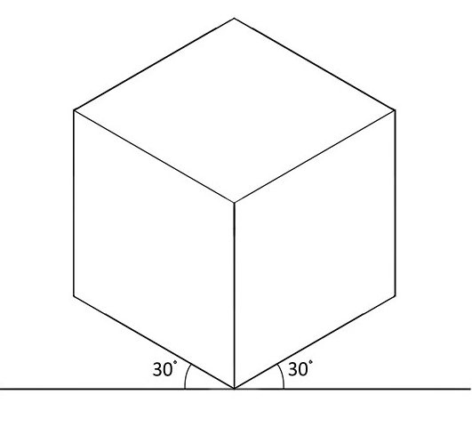
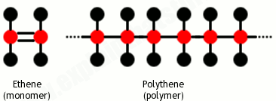
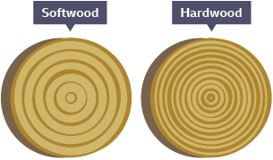
Design and Technology - RM
Year 7
Key Words | Definition
Coniferous | Evergreen trees that bear cones.
Deciduous | Trees and shrubs that loose their leaves in the autumn
Deforestation | The chopping down and removal of trees to clear an area of forest.
Evergreen | A tree or plant that keeps its leaves all year round.
Hardwood | Mainly have large broad leaves, which usually produce a seed or fruit.
Isometric Drawing | A 3D representation of a design with no vanishing points.
Marking Out | Marks made on an item before cutting or forming.
Polymer | A large molecule formed from many identical smaller molecules (monomers), can be natural or synthetic.
Pollution | Contaminating the air, water or ground with harmful substances.
Key Words | Definition
Properties | The qualities a material possesses which suit its specific purpose.
Physical Properties | The traits a material has before it is used
Softwoods | Come from coniferous trees and often have pines or needles.
Sustainability | Does not damage the environment e.g. plant based plastic
Thermoforming | Can be heated and shaped, then heated and shaped again.
Thermosetting | Can only be heated and shaped once.
Tolerance | The amount of error you will allow a part to have.
Working Properties | The material behaves when it is manipulated.
Isometric Drawing
Wide Grain
Softwood
Polymer
Narrow Grain
Hardwood
16

Slide 19
W/c 3rd November Thinking definition: Thinking is making connections, reasoning and asking questions to make the learning stick
Reflecting on learning behaviours for thinking… | Experience log
 | Successful moment… | In hindsight… Where you could have done better on reflection? | At home…
I gave an idea and reasoned/justified.
I reflected on my idea and made it better after discussing with others
I used a revision strategy to help make the learning stick.
I made connections between what I am learning and the outside world.
I asked questions to deepen my understanding.
17

Slide 20
W/c 10th November Thinking definition: Thinking is making connections, reasoning and asking questions to make the learning stick
Reflecting on learning behaviours for thinking… | Experience log
 | Successful moment… | In hindsight… Where you could have done better on reflection? | At home…
I gave an idea and reasoned/justified.
I reflected on my idea and made it better after discussing with others
I used a revision strategy to help make the learning stick.
I made connections between what I am learning and the outside world.
I asked questions to deepen my understanding.
18

Slide 21
W/c 17th November Thinking definition: Thinking is making connections, reasoning and asking questions to make the learning stick
Reflecting on learning behaviours for thinking… | Experience log
 | Successful moment… | In hindsight… Where you could have done better on reflection? | At home…
I gave an idea and reasoned/justified.
I reflected on my idea and made it better after discussing with others
I used a revision strategy to help make the learning stick.
I made connections between what I am learning and the outside world.
I asked questions to deepen my understanding.
19

Slide 22
W/c 24th November Thinking definition: Thinking is making connections, reasoning and asking questions to make the learning stick
Reflecting on learning behaviours for thinking… | Experience log
 | Successful moment… | In hindsight… Where you could have done better on reflection? | At home…
I gave an idea and reasoned/justified.
I reflected on my idea and made it better after discussing with others
I used a revision strategy to help make the learning stick.
I made connections between what I am learning and the outside world.
I asked questions to deepen my understanding.
20

Slide 23
W/c 1st December Thinking definition: Thinking is making connections, reasoning and asking questions to make the learning stick
Reflecting on learning behaviours for thinking… | Experience log
 | Successful moment… | In hindsight… Where you could have done better on reflection? | At home…
I gave an idea and reasoned/justified.
I reflected on my idea and made it better after discussing with others
I used a revision strategy to help make the learning stick.
I made connections between what I am learning and the outside world.
I asked questions to deepen my understanding.
21

Slide 24
W/c 8th December Thinking definition: Thinking is making connections, reasoning and asking questions to make the learning stick
Reflecting on learning behaviours for thinking… | Experience log
 | Successful moment… | In hindsight… Where you could have done better on reflection? | At home…
I gave an idea and reasoned/justified.
I reflected on my idea and made it better after discussing with others
I used a revision strategy to help make the learning stick.
I made connections between what I am learning and the outside world.
I asked questions to deepen my understanding.
22

Slide 25
W/c 15th December Thinking definition: Thinking is making connections, reasoning and asking questions to make the learning stick
Reflecting on learning behaviours for thinking… | Experience log
 | Successful moment… | In hindsight… Where you could have done better on reflection? | At home…
I gave an idea and reasoned/justified.
I reflected on my idea and made it better after discussing with others
I used a revision strategy to help make the learning stick.
I made connections between what I am learning and the outside world.
I asked questions to deepen my understanding.
23

Slide 26
Reading Log w/c 3rd November (20 mins reading per day – all five logs MUST be completed)
Date | Title of novel | Number of pages read | Summary about what I have read
 |  |  | • • •
 |  |  | • • •
 |  |  | • • •
 |  |  | • • •
 |  |  | • • •
Checked by form tutor:
24

Slide 27
Reading Log w/c 10th November (20 mins reading per day – all five logs MUST be completed)
Date | Title of novel | Number of pages read | Summary about what I have read
 |  |  | • • •
 |  |  | • • •
 |  |  | • • •
 |  |  | • • •
 |  |  | • • •
Checked by form tutor:
25

Slide 28
Reading Log w/c 17th November (20 mins reading per day – all five logs MUST be completed)
Date | Title of novel | Number of pages read | Summary about what I have read
 |  |  | • • •
 |  |  | • • •
 |  |  | • • •
 |  |  | • • •
 |  |  | • • •
Checked by form tutor:
26

Slide 29
Reading Log w/c 24th November (20 mins reading per day – all five logs MUST be completed)
Date | Title of novel | Number of pages read | Summary about what I have read
 |  |  | • • •
 |  |  | • • •
 |  |  | • • •
 |  |  | • • •
 |  |  | • • •
Checked by form tutor:
27

Slide 30
Reading Log w/c 1st December (20 mins reading per day – all five logs MUST be completed)
Date | Title of novel | Number of pages read | Summary about what I have read
 |  |  | • • •
 |  |  | • • •
 |  |  | • • •
 |  |  | • • •
 |  |  | • • •
Checked by form tutor:
28

Slide 31
Reading Log w/c 8th December (20 mins reading per day – all five logs MUST be completed)
Date | Title of novel | Number of pages read | Summary about what I have read
 |  |  | • • •
 |  |  | • • •
 |  |  | • • •
 |  |  | • • •
 |  |  | • • •
Checked by form tutor:
28

Slide 32
Reading Log w/c 15th December (20 mins reading per day – all five logs MUST be completed)
Date | Title of novel | Number of pages read | Summary about what I have read
 |  |  | • • •
 |  |  | • • •
 |  |  | • • •
 |  |  | • • •
 |  |  | • • •
Checked by form tutor:
30

Slide 33
1. Holes – Louis Sachar
Part 1
The shovel felt heavy in Stanley's soft, fleshy hands. He tried to jam it into the earth, but the
blade banged against the ground and bounced off without making a dent. The vibrations ran up
the shaft of the shovel and into Stanley's wrists, making his bones rattle.
It was still dark. The only light came from the moon and the stars, more stars than Stanley
had ever seen before. It seemed he had only just gotten to sleep when Mr. Pendanski came in
and woke everyone up.
Using all his might, he brought the shovel back down onto the dry lake bed. The force
stung his hands but made no impression on the earth. He wondered if he had a defective
shovel. He glanced at Zero, about fifteen feet away, who scooped out a shovelful of dirt and
dumped it on a pile that was already almost a foot tall.
For breakfast they'd been served some kind of lukewarm cereal. The best part was the
orange juice. They each got a pint carton. The cereal actually didn't taste too bad, but it had
smelled just like his cot.
Then they filled their canteens, got their shovels, and were marched out across the lake.
Each group was assigned a different area.
The shovels were kept in a shed near the showers. They all looked the same to Stanley,
although X-Ray had his own special shovel, which no one else was allowed to use. X-Ray claimed
it was shorter than the others, but if it was, it was only by a fraction of an inch.
The shovels were five feet long, from the tip of the steel blade to the end of the wooden
shaft. Stanley's hole would have to be as deep as his shovel, and he'd have to be able to lay the
shovel flat across the bottom in any direction. That was why X-Ray wanted the shortest shovel.
The lake was so full of holes and mounds that it reminded Stanley of pictures he'd seen of the
moon. "If you find anything interesting or unusual," Mr. Pendanski had told him, "you should
report it either to me or Mr. Sir when we come around with the water truck. If the Warden likes
what you found, you'll get the rest of the day off." "What are we supposed to be looking for?"
Stanley asked him.
"You're not looking for anything. You're digging to build character. It's just if you find
anything, the Warden would like to know about it."
He glanced helplessly at his shovel. It wasn't defective. He was defective. He noticed a thin
crack in the ground. He placed the point of his shovel on top of it, then jumped on the back of
the blade with both feet.
31
Notes:
Ok, so let’s all have the extract in front of us. I am going to read now and you are going to follow with your finger or ruler.
READ THE EXTRACT. PAUSE ON THE WORDS THAT THE STUDENTS MAY NOT KNOW.

Slide 34
1. Holes – Louis Sachar
The shovel sank a few inches into the packed earth.
He smiled. For once in his life it paid to be overweight.
He leaned on the shaft and pried up his first shovelful of dirt, then dumped it off to the
side.
Only ten million more to go, he thought, then placed the shovel back in the crack and
jumped on it again.
He unearthed several shovelfuls of dirt in this manner, before it occurred to him that he was
dumping his dirt within the perimeter of his hole. He laid his shovel flat on the ground and
marked where the edges of his hole would be. Five feet was awfully wide.
He moved the dirt he'd already dug up out past his mark. He took a drink from his canteen.
Five feet would be awfully deep, too.
The digging got easier after a while. The ground was hardest at the surface, where the sun
had baked a crust about eight inches deep. Beneath that, the earth was looser.
But by the time Stanley broke past the crust, a blister had formed in the middle of his right
thumb, and it hurt to hold the shovel.
Vocabulary:
Defective – Imperfect or faulty; not working properly.
32
Notes:
Ok, so let’s all have the extract in front of us. I am going to read now and you are going to follow with your finger or ruler.
READ THE EXTRACT. PAUSE ON THE WORDS THAT THE STUDENTS MAY NOT KNOW.

Slide 35
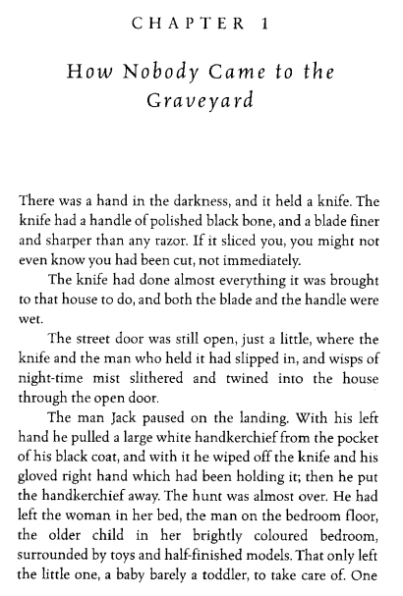
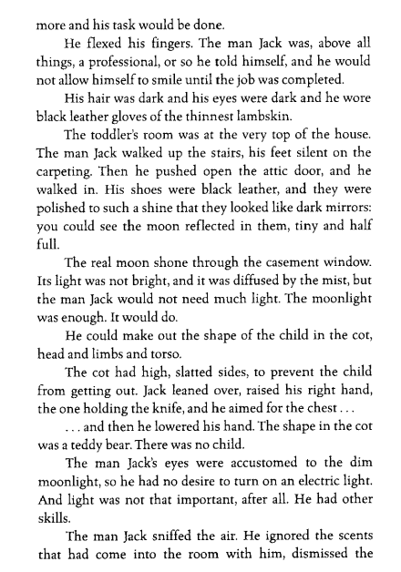
2. The Graveyard Book - Neil Gaiman
Vocabulary:
Accustomed - Familiar with something through repeated experience.
Lambskin - Soft leather made from the skin of a young sheep.
Casement - A window that opens on hinges like a door.
Diffused - Spread out and softened; not concentrated.
33
Notes:
Ok, so let’s all have the extract in front of us. I am going to read now and you are going to follow with your finger or ruler.
READ THE EXTRACT. PAUSE ON THE WORDS THAT THE STUDENTS MAY NOT KNOW.

Slide 36
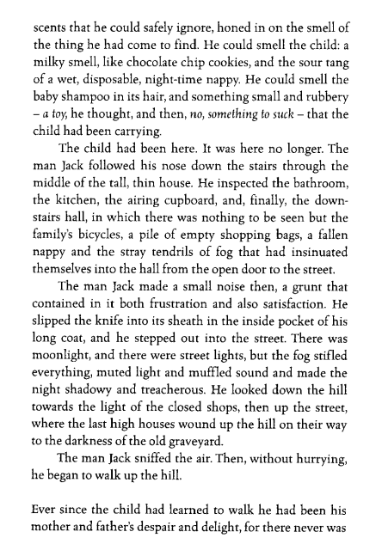
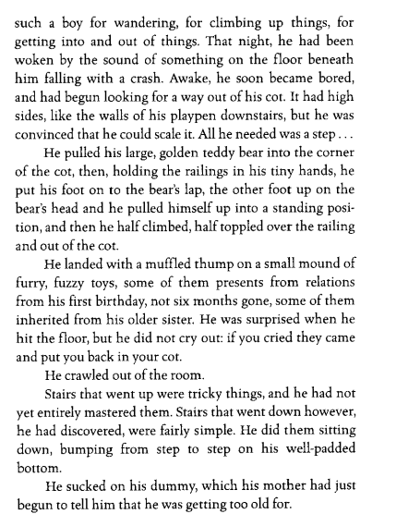
2. The Graveyard Book - Neil Gaiman
34
Notes:
Ok, so let’s all have the extract in front of us. I am going to read now and you are going to follow with your finger or ruler.
READ THE EXTRACT. PAUSE ON THE WORDS THAT THE STUDENTS MAY NOT KNOW.

Slide 37
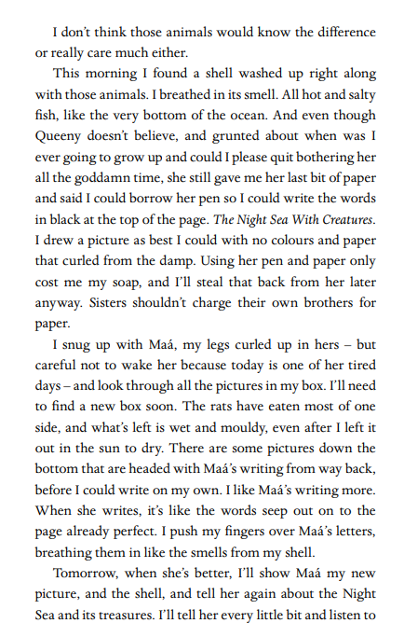
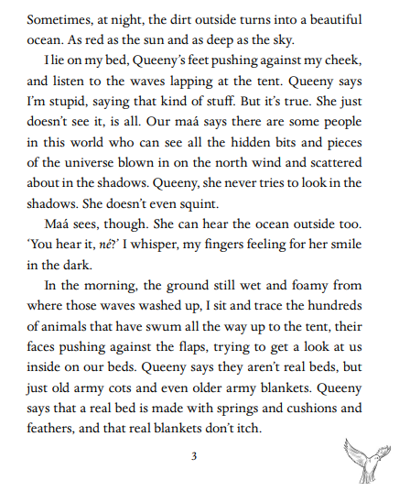
The knife worked at the bone. Twisting, curving, smoothing. And when the bird emerged, knowing and strong, the hand placed a coin deep into its core. ‘May you for ever bring us luck and protection, and may you carry our souls to freedom
3. The Bone Sparrow - Zana Fraillon
35
Notes:
Ok, so let’s all have the extract in front of us. I am going to read now and you are going to follow with your finger or ruler.
READ THE EXTRACT. PAUSE ON THE WORDS THAT THE STUDENTS MAY NOT KNOW.

Slide 38
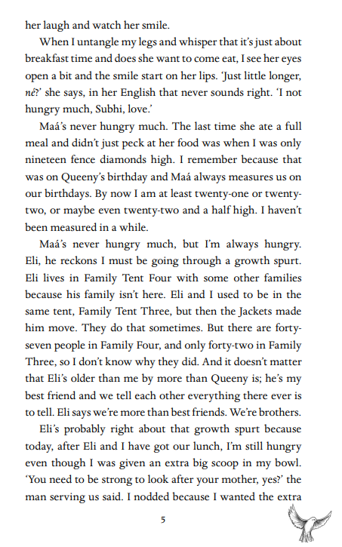
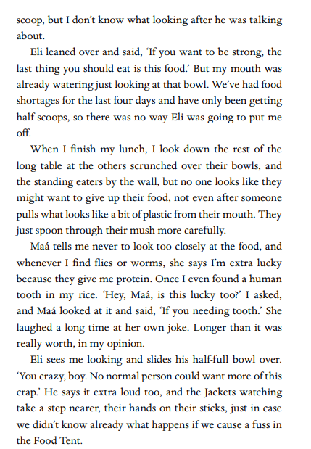
3. The Bone Sparrow - Zana Fraillon
36
Notes:
Ok, so let’s all have the extract in front of us. I am going to read now and you are going to follow with your finger or ruler.
READ THE EXTRACT. PAUSE ON THE WORDS THAT THE STUDENTS MAY NOT KNOW.

Slide 39
NARNIA – THE SILVER CHAIR
Chapter II
JILL IS GIVEN A TASK
Without a glance at Jill the lion rose to its feet and gave one last blow. Then, as if satisfied with its work, it turned and stalked slowly away, back into the forest.
"It must be a dream, it must, it must," said Jill to herself. "I'll wake up in a moment." But it wasn't, and she didn't.
"I do wish we'd never come to this dreadful place," said Jill. "I don't believe Scrubb knew any more about it than I do. Or if he did, he had no business to bring me here without warning me what it was like. It's not my fault he fell over that cliff. If he'd left me alone we should both be all right." Then she remembered again the scream that Scrubb had given when he fell, and burst into tears.
Crying is all right in its way while it lasts. But you have to stop sooner or later and then you still have to decide what to do. When Jill stopped, she found she was dreadfully thirsty. She had been lying face downward, and now she sat up. The birds had ceased singing and there was perfect silence except for one small persistent sound which seemed to come a good distance away. She listened carefully and felt almost sure it was the sound of running water.
Jill got up and looked round her very carefully. There was no sign of the lion; but there were so many trees about that it might easily be quite close without her seeing it. For all she knew, there might be several lions. But her thirst was very bad now, and she plucked up her courage to go and look for that running water. She went on tip-toes, stealing cautiously from tree to tree, and stopping to peer round her at every step.
4. Narnia - C. S. Lewis
37
Notes:
Ok, so let’s all have the extract in front of us. I am going to read now and you are going to follow with your finger or ruler.
READ THE EXTRACT. PAUSE ON THE WORDS THAT THE STUDENTS MAY NOT KNOW.

Slide 40
4. Narnia - C. S. Lewis
The wood was so still that it was not difficult to decide where the sound was coming from. It grew clearer every moment and, sooner than she expected, she came to an open glade and saw the stream, bright as glass, running across the turf a stone's throw away from her. But although the sight of the water made her feel ten times thirstier than before, she didn't rush forward and drink. She stood as still as if she had been turned into stone, with her mouth wide open. And she had a very good reason; just on this side of the stream lay the lion.
It lay with its head raised and its two fore-paws out in front of it, like the lions in Trafalgar Square. She knew at once that it had seen her, for its eyes looked straight into hers for a moment and then turned away—as if it knew her quite well and didn't think much of her.
"If I run away, it'll be after me in a moment," thought Jill. "And if I go on, I shall run straight into its mouth." Anyway, she couldn't have moved if she had tried, and she couldn't take her eyes off it. How long this lasted, she could not be sure; it seemed like hours. And the thirst became so bad that she almost felt she would not mind being eaten by the lion if only she could be sure of getting a mouthful of water first.
"If you're thirsty, you may drink."
They were the first words she had heard since Scrubb had spoken to her on the edge of the cliff. For a second she stared here and there, wondering who had spoken. Then the voice said again, "If you are thirsty, come and drink," and of course she remembered what Scrubb had said about animals talking in that other world, and realised that it was the lion speaking. Anyway, she had seen its lips move this time, and the voice was not like a man's. It was deeper, wilder, and stronger; a sort of heavy, golden voice. It did not make her any less frightened than she had been before, but it made her frightened in rather a different way.
"Are you not thirsty?" said the Lion.
"I'm dying of thirst," said Jill.
"Then drink," said the Lion.
"May I—could I—would you mind going away while I do?" said Jill.
38
Notes:
Ok, so let’s all have the extract in front of us. I am going to read now and you are going to follow with your finger or ruler.
READ THE EXTRACT. PAUSE ON THE WORDS THAT THE STUDENTS MAY NOT KNOW.

Slide 41
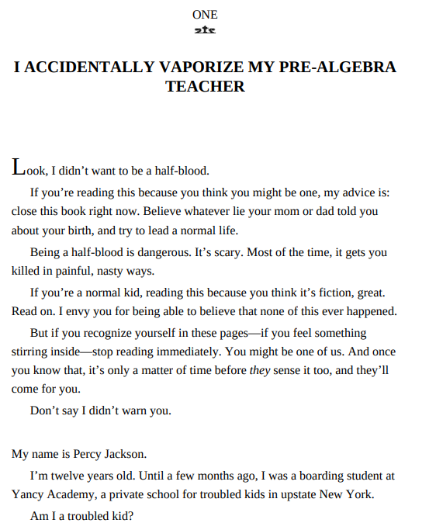
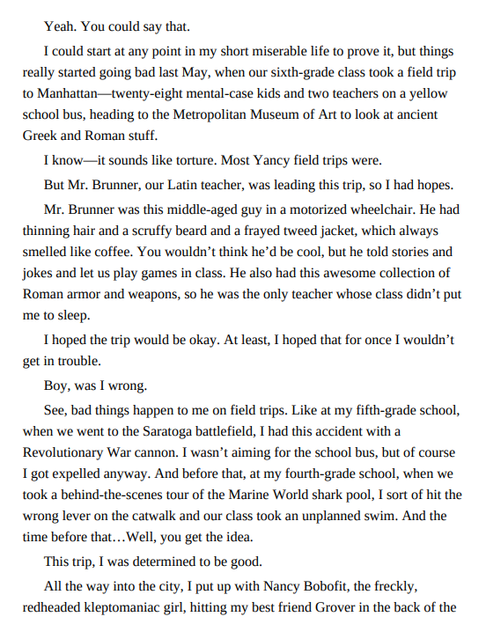
5. Percy Jackson and the Lightening thief - Rick Riodran
39
Notes:
Ok, so let’s all have the extract in front of us. I am going to read now and you are going to follow with your finger or ruler.
READ THE EXTRACT. PAUSE ON THE WORDS THAT THE STUDENTS MAY NOT KNOW.

Slide 42
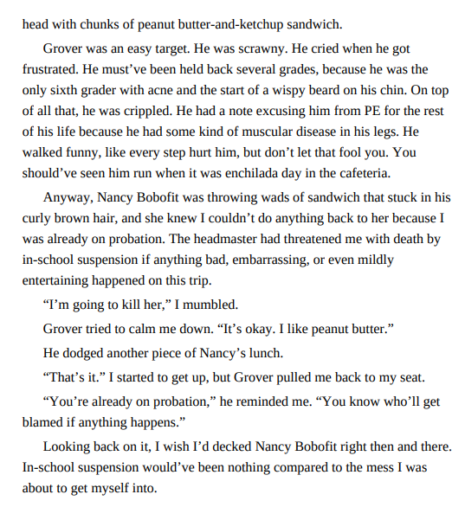
5. Percy Jackson and the Lightening thief - Rick Riodran
Vocabulary:
Half-blood – A person of mixed heritage; in this context, part human and part god
Kleptomaniac – A person who has a compulsive urge to steal.
40
Notes:
Ok, so let’s all have the extract in front of us. I am going to read now and you are going to follow with your finger or ruler.
READ THE EXTRACT. PAUSE ON THE WORDS THAT THE STUDENTS MAY NOT KNOW.

Slide 43
6. Tales from a secret Annex – Anne Frank
Vocabulary:
Was There a Break-in?
Wednesday evening, March 24, 1943
Mother, Father, Margot and I were sitting quite pleasantly together when Peter suddenly came in and whispered in Father's ear. I caught the words "a barrel falling over in the warehouse" and "someone fiddling with the door."
Margot heard it too, but was trying to calm me down, since I'd turned white as chalk and was extremely nervous. The three of us waited. In the meantime Father and Peter went downstairs, and a minute or two later Mrs. van Daan came up from where she'd been listening to the radio. She told us that Pim had asked her to switch it off and tiptoe upstairs. But you know what happens when you're trying to be quiet--the old stairs creaked twice as loud. Five minutes later Peter and Pim, the color drained from their faces, appeared again to relate their experiences.
They had positioned themselves under the staircase and waited. Nothing happened. Then all of a sudden they heard a couple of bangs, as if two doors had been slammed shut inside the house. Pim bounded up the stairs, while Peter went to warn Dussel, who finally presented himself upstairs, though not without kicking up a fuss and making a lot of noise. Then we all tiptoed in our stockinged feet to the van Daan family on the next floor. Mr. van D. had a bad cold and had already gone to bed, so we gathered around his bedside and discussed our suspicions in a whisper.
41
Notes:
Ok, so let’s all have the extract in front of us. I am going to read now and you are going to follow with your finger or ruler.
READ THE EXTRACT. PAUSE ON THE WORDS THAT THE STUDENTS MAY NOT KNOW.

Slide 44
6. Tales from a secret Annex – Anne Frank
Every time Mr. van D. coughed loudly, Mrs. van D. and I nearly had a nervous fit. He kept coughing until someone came up with the bright idea of giving him codeine. His cough subsided immediately.
Once again we waited and waited, but heard nothing. Finally we came to the conclusion that the burglars had fled when they heard footsteps in an otherwise quiet building. The problem now was that the chairs in the private office were neatly grouped round the radio, which was tuned to England. If the burglars had forced the door and the air-raid wardens were to notice it and call the police, that would get the ball rolling, and there could be very serious repercussions. So Mr. van Daan got up, pulled on his coat and pants, put on his hat and cautiously followed Father down the stairs, with Peter (armed with a heavy hammer, to be on the safe side) right behind him. The ladies (including Margot and me) waited in suspense until the men returned five minutes later and told us that there was no sign of any activity in the building. We agreed not to run any water or flush the toilet; but since everyone's stomach was churning from all the tension, you can imagine the stench after we'd each had a turn in the bathroom.
Incidents like these are always accompanied by other disasters, and this was no exception. Number one: the Westertoren bells stopped chiming, and they were always so comforting. Plus Mr. Voskuijl left early last night, and we weren't sure if he'd given Bep the key and she'd forgotten to lock the door.
Well, the night had just begun, and we still weren't sure what to expect. We were somewhat reassured by the fact that between eight-fifteen--when the burglar had first entered the building--and ten-thirty, we hadn't heard a sound. The more we thought about it, the less likely it seemed that a burglar would have forced a door so early in the evening, when there were still people out on the streets. Besides that, it occurred to us that the warehouse manager at the Keg Company next door might still have been at work. What with the excitement and the thin walls, it's easy to mistake the sounds. Besides, your imagination often plays tricks on you in moments of danger.
So we lay down on our beds, though not to sleep. Father and Mother and Mr. Dussel were awake most of the night, and I'm not exaggerating when I say that I hardly got a wink of sleep. This morning the men went downstairs to see if the outside door was still locked, but all was well!
Of course, we gave the entire office staff a blow-by-blow account of the incident, which had been far from pleasant. It's much easier to laugh at these kinds of things after they've happened, and Bep was the only one who took us seriously.
Note: The next morning the toilet was clogged, and Father had to stick in a long wooden pole and fish out several pounds of excrement and strawberry recipes (which is what we use for toilet paper these days). Afterward we burned the pole.
42
Notes:
Ok, so let’s all have the extract in front of us. I am going to read now and you are going to follow with your finger or ruler.
READ THE EXTRACT. PAUSE ON THE WORDS THAT THE STUDENTS MAY NOT KNOW.

Slide 45
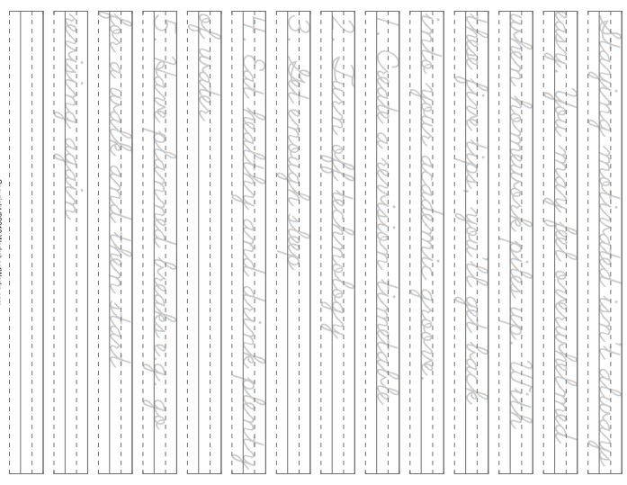
43

Slide 46
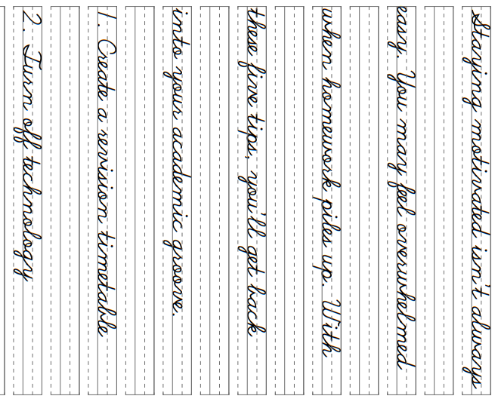
44

Slide 47
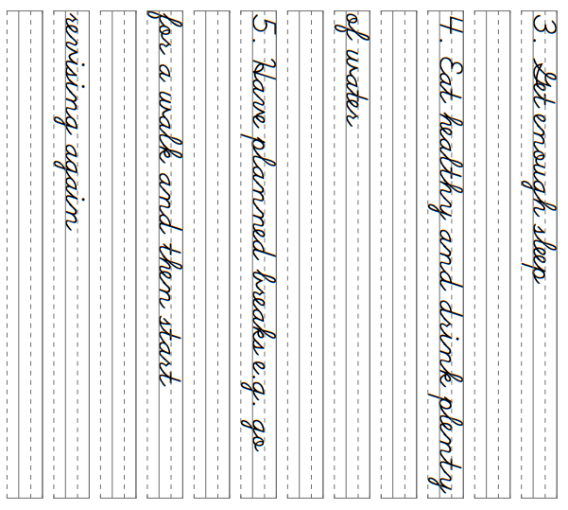
45

Slide 48
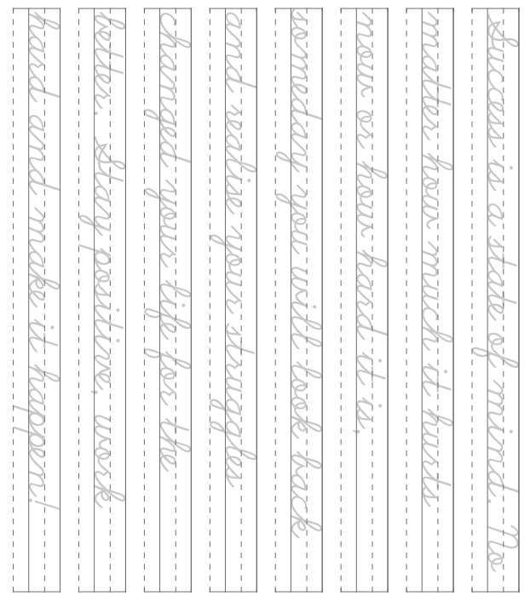
46

Slide 49
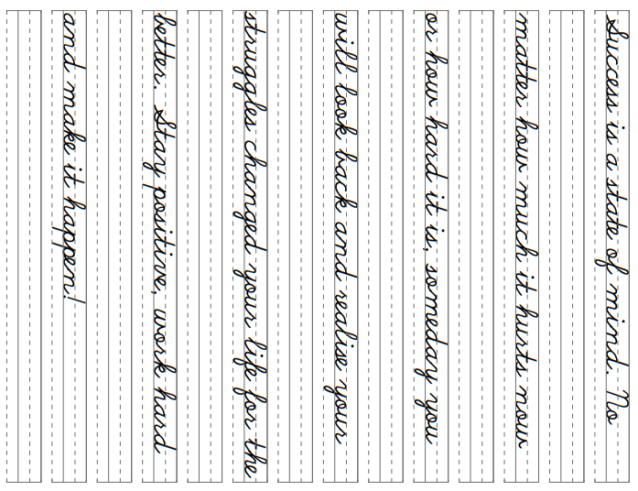
46

