Slide 1

Year 7 Knowledge Organiser HT3
Knowledge is Power
Name: ______________________________
Form: _______

Slide 2
Contents Page
Subject | Page
English | 1
Maths | 2
Science | 3
History | 4
Geography | 5
Spanish | 6
PE | 7
Performing Arts | 11
Computing | 12
Art | 13
Cooking and Nutrition | 14
Music | 15
DT | 16
‘Thinking’ reflection log | 17
Reading log | 23
Reading Extracts | 28
Cursive Handwriting Practice | 38

Slide 3
English
Week 3 - Devices
Device | Definition
Personification | Giving human characteristics to a nonhuman object.
Metaphor | Comparing by referring to one thing as another.
Simile | A comparison of two different objects using like or as.
Hyperbole | The use of obvious exaggeration for effect.
Emotive language | Language intended to create an emotional response.
Onomatopoeia | A word that imitates the sound it represents.
Week 1 – Sentence Openers
Sentence Starters | Changing the way that sentences start using adverbs and can make the writing more engaging and interesting for the reader.
Adverb Opener | A ‘ly’ word that starts a sentence.
Place Phrase | A sentence starter that tells us the location of something.
Creative Writing | The process of crafting original and imaginative works of literature and prose.
Week 5– Criteria for Creative Writing
1. Use ambitious adjectives (find these in the thesaurus)
2. Use language devices to hook your reader
3. Use sensory description (see, hear, touch, smell, taste)
4. Varied sentence openers
5. Varied sentence types (simple, short, complex)
6. Write in paragraphs
Week 2 - Key Terms
Setting | Setting is the place or type of surroundings where something is positioned or where an event takes place.
Structure | Structure refers to the order of ideas in a piece of writing.
Tone | Tone is the general character or attitude of a place, piece of writing, situation.
Imagery | Imagery is visually descriptive or figurative language.
Week 4 - Key Terms
Show, Not Tell | A technique used to allow the reader to experience the story.
Sensory Imagery | Words and phrases which appeal to the five senses.
Shift in Focus | The change of focus between different paragraphs.
Pathetic Fallacy | When the weather reflects the mood.
Zooming In | When the reader is guided to a particular aspect of the text
Week 6 – Criteria for creative writing
1. Belligerent → argumentative
2. Charismatic → charming
3. Complacent → lazy
4. Intrepid → adventurous
5. Mendacious → lying
1

Slide 4
Maths
Algebra
Algebra | The part of maths in which letters are used to represent numbers
Variable | A letter that represents a specific number
Term | A number, letter or combination of both which forms part of an expression
Expression | An expression is a group of mathematical symbols representing a number or quantity. Expressions never have an equals sign (=)
Equation | An equation is a mathematical statement that shows that two expressions are equal. It always includes an equals sign
Formula | A formula is a rule written using symbols that describe a relationship between different quantities. It always includes an equals sign
Inverse operation | Applying the opposite operation to a calculation in order to balance (solve) an equation
Coefficient | The number that multiplies the variable
Fraction
Key Word | Definition
Fraction | A number that is part of a whole
Numerator | How many parts there are, on the top of the fraction
Denominator | The total number of parts, what is being divided by, on the bottom of the fraction
Mixed number | A whole number and a fraction together
Improper fraction | A fraction with a bigger numerator than denominator
Equivalent | Equal in value
Algebra
Solve | An instruction used in algebra telling you to find the value of the variable in the equation
Simplify | Write an expression in its most compact or efficient way without changing the value of the expression
Collect like terms | Collect terms with the same letter together by adding or subtracting them as indicated
Expand | Remove the brackets, by multiplying everything inside the brackets by what is on the outside
2

Slide 5
Science
Key Word | Definition
Energy | The sum of the forces acting upon an object (overall force)
Kinetic Energy | The energy stored when an object is moving
Gravitational Potential Energy | The energy stored when an object is lifted above the ground
Elastic Potential Energy | The energy stored when an object stretches
Thermal Energy | The energy stored when an object heats up
Chemical Energy | The energy stored in chemical bonds
Useful Energy | The energy transferred that the object is meant to be used for e.g. light transferred from a phone
Wasted Energy | The energy transferred that the object is not meant to be used for e.g. heat transferred from a phone
Efficiency | The useful energy transferred in a device out of the total energy transferred
Power | The energy transferred per second
Dissipated | The energy transferred to the surroundings
Energy transfer diagram | A diagram to show the input and output energies, including the useful and wasted energy
Insulation | Reducing the thermal energy transfers in an object
Keyword | Measurements
Length | a measure of how long or short something is. It is measured in mm, cm, m, km or light years.
Mass | a measure of how much matter is in something. It is measured in mg, g, Kg, or tonnes.
Temperature | a measure of how hot or cold something is. It is measured in ºC (degrees Celsius).
Volume | a measure of how much space is taken up by something. It is measured in mm³, cm³, dm³ or m³.
Keyword | Scientific model
Hypothesis | A scientific statement that explains certain facts or observations
Prediction | This describes what you think will happen in an experiment
Independent variable | This is the variable that is changed during an investigation. There should only be one of these.
Dependent variable | This is the variable that changes as a result of a change in the independent variable
Control variable | Variables that remain constant, to make sure that an investigation is valid
3
Notes:
2024_5HT3

Slide 6
History
Key Term | Definition
Richard III | King of England from 26 June 1483 until his death in 1485.
Henry VII | King of England and Lord of Ireland from his seizure of the crown on 22 August 1485 until his death in 1509. The first Tudor King.
Henry VIII | King of England from 1509 until his death in 1547. Henry is best known for his six marriages, and creation of Church of England.
Mary I | Mary I, also known as "Bloody Mary“. Queen of England and Ireland from 1553 to 1558. Wife of King Philip II of Spain.
Elizabeth I | Queen of England and Ireland from 1558 to 1603. The last monarch of the House of Tudor.
Edward VI | Edward VI was King of England and Ireland from 1547 until 1553. He was crowned at the age of nine.
Catholic | Follows the Pope and the Catholic Church.
Protestant | A member or follower of any of the Western Christian Churches that are separate from the Roman Catholic Church
Reformation | A 16th-century movement for the reform of abuses in the Roman Church ending in the establishment of the Protestant Churches.
Dissolution | To close something down (e.g. monasteries).
Monastery | A building or buildings occupied by a community of monks living under religious vows.
Regency Council | The group of experienced nobleman who were appointed by Henry VIII to rule on Edward VI’s behalf until he was 18.
Key Term | Definition
Peasant | A poor smallholder or agricultural labourer of low social status
Villein | A feudal tenant entirely subject to a lord or manor to whom he paid dues and services in return for land.
Feudalism (Feudal System) | A way of structuring society around relationships derived from the holding of land in exchange for service or labour.
Manor | A large country house with lands.
Crops | A cultivated plant that is grown on a large scale commercially, especially a cereal, fruit, or vegetable.
Lord | A man of noble rank or high office; a nobleman.
Noble | Belonging by rank, title, or birth to the aristocracy.
Baron | This is a title of honour. It ranks as one of the lower titles for nobility.
Rebellion | An act of resistance against authority
Fine | A punishment for breaking the law/rules. Need to supply money as compensation.
Heretic | Someone who disagrees with the accepted beliefs.
Heir | A person who inherits something.
Lord Protector | A person acting on behalf of an absent monarch.
4

Slide 7
Geography
Key Word | Definition
Geological time period | A unit of geological time where new rock is made.
Inner core | The core is the innermost part of the Earth which is solid.
Outer core | The outermost part of the core which is a liquid
Mantle | A zone of hot rock in the interior of the earth located between the outer crust and the molten core. It has the properties of a solid, although it can also flow, very slowly.
Crust | The outer layer of the Earth on top of the mantle.
Tectonic plates | Large slabs of the Earth’s crust.
Plate boundary | A plate boundary is where two tectonic plates meet.
Tsunami | Tsunami is a Japanese word which means 'harbour wave'. A tsunami is a large sea wave caused by the displacement of a large volume of water. They can be caused by earthquakes triggered by moving sections of the Earth's crust under the ocean.
Magma | Magma is the name of hot, molten rock beneath the surface
Lava | Lava is the name of hot, molten rock above the surface
Igneous rock | Cooled and solidified magma or lava.
Constructive plate boundary | A constructive plate boundary occurs when two tectonic plates move away from each other. Magma rises from the mantle to the surface and cools to create new land.
Destructive plate boundary | A destructive plate boundary occurs when two tectonic plates are forced towards each other and one is forced under the other. As the bottom plate moves into the mantle it is melted and destroyed.
Conservative plate boundary | A conservative plate boundary is when two tectonic plates run side by side of each other.
Focus | The focus is the point where energy is released in the earths crust to form an earthquake.
Epicentre | The epicentre is the point on the earths surface above the focus.
5

Slide 8
Spanish
Spanish | English
Odio | I hate
Prefiero | I prefer
(no) me gusta | I (don’t) like
Me encanta | I love
Bailar | To dance
Cantar | To sing
Charlar | To chat
Cocinar | To cook
Descansar | To relax
Escribir | To write
Jugar | To play
Leer | To read
Pasear | To walk
Viajar | To travel
Porque es | Because it is
Aburrido | Boring
Divertido | Amusing
Spanish | English
Emocionante | Exciting
Malo | Bad
Genial | Great
Interesante | Interesting
Horrible | Terrible
Juego | I play
Al baloncesto | Basketball
al fútbol | Football
Al tenis | Tennis
Al rugby | Rugby
Al voleibol | Volleyball
Hago | I do
Artes marciales | Martial arts
Atletismo | Athletics
Equitación | Horse riding
Gimnasia | Gymnastics
natación | swimming
Spanish | English
Nunca | Never
Casi nunca | Almost never
A veces | Sometimes
De vez en cuando | From time to time
A menudo | Often
Normalmente | Normally
Los lunes | On Mondays
Los martes | On Tuesdays
Todos los días/cada día | Every day
6

Slide 9
PE
Health and Fitness
Muscular Strength | The amount of the force muscles can generate against a resistance
Muscular Endurance | The ability to use voluntary muscles, over long periods of time without getting tired
Flexibility | The range of movement at a joint
Cardiovascular Fitness (Aerobic Endurance) | The ability of the heart and circulatory system to meet the demands of the body for a long period of time
Body composition | The percentage of a body that is fat, muscle, bone and water
Coordination | The ability to move two or more body parts at the same time
Reaction Time | The time taken for a response to occur after a stimulus
Agility | The ability to change direction at speed
Balance | The ability to keep the body steady when in a static position or when moving
Speed | The time taken to cover a set distance/complete a movement
Power | The ability to combine speed and strength
Principles of training
Progressive Overload | Working the body harder than normal/gradually increasing the amount of exercise you do
Reversibility | If training is not regular, adaptations will be reversed. This can happen when suffering from illness, injury or after an off season
Specificity | Training showed be matched to the requirements of the sport or position the performer is in. Training must be specifically designed to develop the right muscles, type of fitness or skills
Individual needs | All PEP’s would differ depending on performers goals/target, strengths /weaknesses, age/gender and current health/fitness levels
Overtraining | Occurs when you train too hard and do not allow the body enough rest/recovery time Signs include extended muscle soreness, frequent illness & increase injuries
7

Slide 10
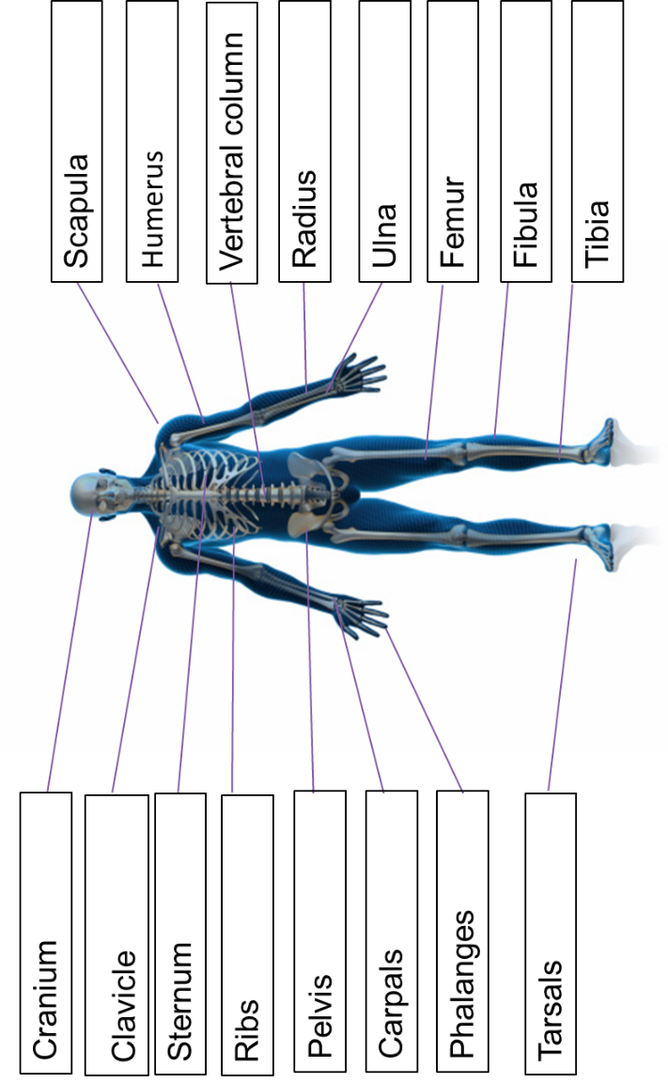
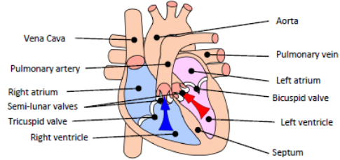
PE
Cardiovascular System
Skeletal System
8

Slide 11
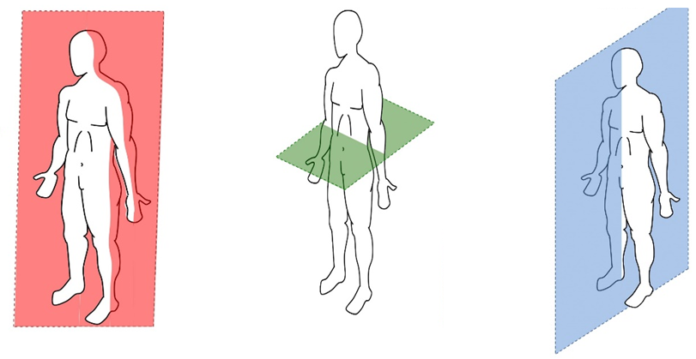
PE
BIOMECHANICS - Planes and axes for movement
Plane | An imaginary line that divides the body into two
Frontal Plane (left picture) | A vertical plane that divides the body into front and back.
Transverse plane (middle picture) | A horizontal plane that divides the body into upper and lower halves.
Sagittal plane (right picture) | A vertical plane that divides the body into right and left sides.
9

Slide 12

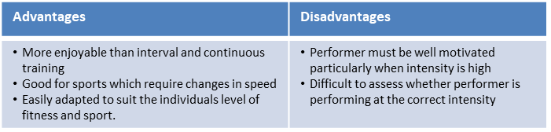
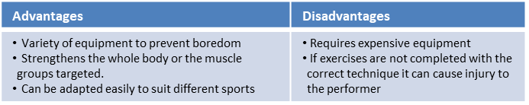
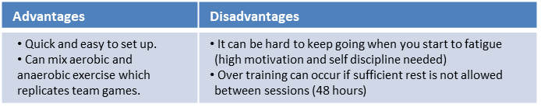
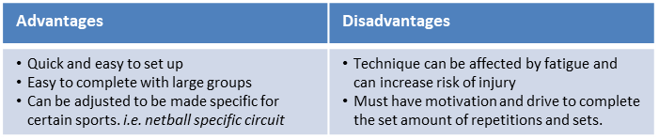
Key Word | Definition
Methods of training
Continuous training - | Involves a steady but regular pace at a moderate intensity (aerobic) which should last for at least 20 minutes. i.e. running, walking, swimming, rowing or cycling. Used by a marathon runner.
Fartlek training | Referred to as ‘speed play’ This is a form interval training but without rest. Involves a variety of changing intensities over different distances and terrains. i.e. 1 lap at 50% max, 1 lap walking, 1 lap at 80% (aerobic and anaerobic used) Used by games players – Hockey players
Weight/Resistance training | A form of training that uses progressive resistance against a muscle group. Used by cyclists. Muscular strength: High weight x low repetitions. Muscular endurance: Low weight x high repetitions
Interval training | Involves periods of work followed by periods of rest. i.e. Sprint for 20 metre + walk back to start. Used by a 200m sprinter
Plyometric training | Involves high-impact exercises that develop power. i.e. bounding/hopping, squat jumps. Used by long jumpers, 100 m sprinters or basketball players.
Circuit training | A series of exercises completed one after another. Each exercise is called a station. Each station should work a different area of the body to avoid fatigue. i.e. press ups, sit ups, squats, shuttle runs.
PE
10

Slide 13
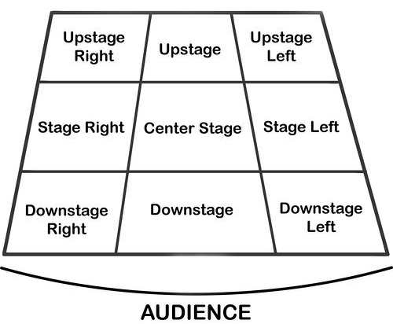
Performing Art
Key Word | Definition
Body Language | How an actor uses their body to communicate meaning. For example, crossing your arms could mean you are fed up
Gesture | a movement of the body, particularly the hands, arms, or head, that conveys meaning or expresses an idea, emotion, or intention
Levels | Levels can be used to show status, relationships, and even to indicate changes in location or time
Proxemics | The deliberate use of distance between you and other characters or objects to communicate something to an audience
Facial Expression | Using the face to express that characters feelings and emotions.
Key Word | Definition
Amphitheatre | Circular or oval open air theatre with a large ranked seating area
Apron | The apron is a section of the stage which the floor projects towards or into the auditorium
Black Box | A flexible studio theatre where the audience and actors are in the same room surrounded by black tabs
End On | Traditional audience seating layout where the audience is looking at the stage from the same direction.
Found Space | A performance space that wasn’t designed to be one e.g historic buildings
In the Round | Theatre in the Round is a form of audience seating layout where the acting area is surrounded on all sided by seating. There is often a number of entrances through the seating
Promenade | Form of staging where the audience moves around the performance space and sees the play at a variety of different locations
Proscenium Arch | The opening in the wall which stands between stage and auditorium in some theatres; the picture frame through the audience sees the play’ fourth wall’
Site-specific theatre | A piece of performance which has been deigned to work only in a particular non-theatre space
Stage Directions
Stage directions are from the performers perspective
11

Slide 14
Computing
Input, Output and storage
Input | Input refers to any information or data that is sent to a computer for processing
Processing | Computer processing refers to the actions that a computer takes to execute commands a user makes
Output | When the computer has processed the information and carried out the task it sends it back out
Storage | storage is the component within your computer that allows you to store and access data
Hardware and Software
Hardware | External and internal devices and equipment that enable you to perform major functions
Software | A set of instructions, data or programs used to operate computers and execute specific tasks
Peripherals | Are divided into three kinds: input devices, output devices, and storage devices
Binary | A number system that only uses two digits: 1 and 0
Computer Components
RAM | Stores data being used by the CPU - temporary
ROM | Stores the initial basic program when the computer first starts
CPU | Central Processing Unit – The brains of the computer. Controls all tasks
MOTHERBOARD | Main board of the computer - connects all computer parts together
HARD DISK | Stores data permanently – where files are saved to
GRAPHICS CARD | Outputs data to graphics devices such as monitors
POWER SUPPLY | Provides power to all parts of the computer
12

Slide 15
Art
Key Word | Definition
Pattern | A pattern is an arrangement of lines or shapes, especially a design in which the same shape is repeated at regular intervals over a surface.
Motif | A decorative image or design, especially a repeated one forming a pattern.
Repetition | The action of repeating something that has already been designed.
Irregular | Not even or balanced in shape or arrangement.
Symmetrical | Made up of exactly similar parts facing each other or around an axis
Tessellating | Decorate or cover (a surface) with a pattern of repeated shapes, especially polygons, that fit together closely without gaps or overlapping.
Harmonious colour | The visually satisfying effect of combining similar, related elements. For instance: adjacent colours on the colour wheel, similar shapes etc.
Complimentary Colour | Complementary colours are two colours on opposite sides of the colour wheel.
Vivid | Intensely deep or bright.
Opaque | Not able to be seen through; not transparent.
Pattern | A pattern is an arrangement of lines or shapes, especially a design in which the same shape is repeated at regular intervals over a surface.
13

Slide 16
Cooking and Nutrition
Key Word | Definition
Hazard | Anything that is dangerous
Kitchen Hygiene | Ensuring that everything is clean when preparing food
Kitchen Safety | Being safe in the kitchen
Cross contamination | Transfer of bacteria from one person, object or place to another
Eat Well Guide | A pictorial food guide showing the amounts and types of foods that are needed to make up a healthy balanced diet
Claw grip | A method of cutting food that ensures that the finger tips are tucked out of the way and will not get caught by the knife
Food poisoning | An illness caused by eating contaminated food
Bacteria | Microscopic living organisms which can be found everywhere
Salmonella | Food poisoning bacteria found in chicken, some dairy products and raw eggs
Food provenance | The origin of food. Knowing how food is grown, reared and caught
Recipe | A set of instructions used for preparing a food product
Food Miles | The distance food ravels from the farm to the fork
14

Slide 17
Music
Key Word | Definition
Call and response | Call and response is a musical or verbal interaction where a leader makes a call and the group or audience responds with a specific phrase or action. This can be seen in various forms of music, such as gospel, jazz, and traditional African music, as well as in verbal communication and public speaking.
Unison | is when 2 or more singers (or instruments or a combination of both) sing the same melody line, or tune. They follow the same notes exactly all the time with exactly the same rhythm. Unison singing can be done on different pitches an octave apart - or 2 or 3 octaves apart.
A Cappella | A Cappella music is group or solo singing without instrumental accompaniment, or a piece intended to be performed in this way.
Pitch and SATB | The highness or lowness of a sound is called Pitch. Generally speaking, men have Low pitch voices whilst women have High pitch voices. The highest-pitched woman’s voice is called a Soprano and a lower-pitched woman’s voice is called an Alto. A high-pitched man’s voice is called a Tenor and a low-pitched man’s voice is called a Bass.
Dynamic | The volume of a sound or piece of music – loud/soft
A Round/Canon | A round, also called canon, is a musical composition with a minimum of three voices sing exactly the same melody at the unison (and may continue repeating it indefinitely), but with each voice beginning at different times so that different parts of the melody coincide in the different voices, but nevertheless fit harmoniously together.
Timbre | Each instrument own unique ‘tone quality’ and the voice as an instrument had different Timbre
The diaphragm | The diaphragm is basically the muscle below the human lungs and slightly above the stomach responsible for controlling inhalation and exhalation of breath. Most people have heard singers being advised to breathe using their diaphragm every time they sing
Texture | Sometimes voices sing different parts at the same time creating Harmony. Not all vocal music is accompanied by instruments, unaccompanied singing is called A Cappella.
Rhythm | Rhythm is the pattern of sounds and beats in music that creates a sense of movement and flow. It is like the heartbeat of a song that helps us feel the music and dance or sing along. Rhythm can be fast or slow, simple or complex, and is created by combining different beats and notes in a particular order. It is an essential element of music that makes it enjoyable and exciting to listen to.
Tempo | Tempo refers to the speed of music. It's how fast or slow a song sounds.
15

Slide 18
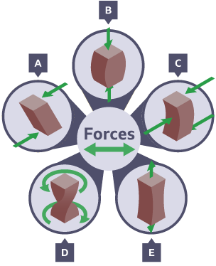
Design and Technology - RM
Year 7
Key Words | Definition
Automation | Using automatic equipment in production.
CAD | Computer Aided Design - use of computer software to design in 3D/2D
CAM | Computer Aided Manufacturing - use of software and computer-controlled machinery to automate a manufacturing process.
Conductor | Materials which allow an electrical current to flow through easily e.g. copper is a good conductor of electricity as it has a low resistance.
Design Fixation | When a designer finds it difficult, to produce a range of innovative solutions, to a design problem.
Forces | Act on materials all the time - even if a material appears stationary it still has a force acting on it.
Finishing Technique | Can be either to protect a product or to provide an aesthetic quality.
Idea Generation | The process of creating, developing, and communicating new ideas.
Key Words | Definition
Input Devices | An electronic component capable of passing information from the outside world into an electronic system for processing.
Insulator | Materials that do not allow an electrical current to flow through them e.g. rubber has a high resistance so it usually covers the copper wire.
Output Devices | A device used to output data or information from a computer, eg a monitor, printer or speakers.
PCB | Printed Circuit Board
Process Devices | A device, usually an integrated circuit, that controls the process functions of a system.
Resistors | Used to restrict the flow of current around a circuit and can prevent damage to components.
User Centred Design | (UCD) is a design approach that prioritizes the needs, wants, and limitations of the end-users throughout the entire design process.
Forces
Shearing
Compression
Bending
Torsion
Tension
Advantages of CAD | Disadvantages of CAD
Ideas can be drawn and developed quickly | Expensive to set up
Designs can be viewed from all angles and with a range of materials | Needs a skilled workforce
Some testing and consumer feedback can be done before costly production takes place | Difficult to keep up with constantly changing and improving technology
Advantages of CAM | Disadvantages of CAM
Fast and accurate production | Expensive to set up
Machines can run constantly on repetitive tasks | Needs a skilled workforce of engineers

Slide 19
W/c 5th January Thinking definition: Thinking is making connections, reasoning and asking questions to make the learning stick
Reflecting on learning behaviours for thinking… | Experience log
 | Successful moment… | In hindsight… Where you could have done better on reflection? | At home…
I gave an idea and reasoned/justified.
I reflected on my idea and made it better after discussing with others
I used a revision strategy to help make the learning stick.
I made connections between what I am learning and the outside world.
I asked questions to deepen my understanding.
17

Slide 20
W/c 12th January Thinking definition: Thinking is making connections, reasoning and asking questions to make the learning stick
Reflecting on learning behaviours for thinking… | Experience log
 | Successful moment… | In hindsight… Where you could have done better on reflection? | At home…
I gave an idea and reasoned/justified.
I reflected on my idea and made it better after discussing with others
I used a revision strategy to help make the learning stick.
I made connections between what I am learning and the outside world.
I asked questions to deepen my understanding.
18

Slide 21
W/c 19th January Thinking definition: Thinking is making connections, reasoning and asking questions to make the learning stick
Reflecting on learning behaviours for thinking… | Experience log
 | Successful moment… | In hindsight… Where you could have done better on reflection? | At home…
I gave an idea and reasoned/justified.
I reflected on my idea and made it better after discussing with others
I used a revision strategy to help make the learning stick.
I made connections between what I am learning and the outside world.
I asked questions to deepen my understanding.
19

Slide 22
W/c 26th January Thinking definition: Thinking is making connections, reasoning and asking questions to make the learning stick
Reflecting on learning behaviours for thinking… | Experience log
 | Successful moment… | In hindsight… Where you could have done better on reflection? | At home…
I gave an idea and reasoned/justified.
I reflected on my idea and made it better after discussing with others
I used a revision strategy to help make the learning stick.
I made connections between what I am learning and the outside world.
I asked questions to deepen my understanding.
20

Slide 23
W/c 2nd February Thinking definition: Thinking is making connections, reasoning and asking questions to make the learning stick
Reflecting on learning behaviours for thinking… | Experience log
 | Successful moment… | In hindsight… Where you could have done better on reflection? | At home…
I gave an idea and reasoned/justified.
I reflected on my idea and made it better after discussing with others
I used a revision strategy to help make the learning stick.
I made connections between what I am learning and the outside world.
I asked questions to deepen my understanding.
21

Slide 24
W/c 9th February Thinking definition: Thinking is making connections, reasoning and asking questions to make the learning stick
Reflecting on learning behaviours for thinking… | Experience log
 | Successful moment… | In hindsight… Where you could have done better on reflection? | At home…
I gave an idea and reasoned/justified.
I reflected on my idea and made it better after discussing with others
I used a revision strategy to help make the learning stick.
I made connections between what I am learning and the outside world.
I asked questions to deepen my understanding.
22

Slide 25
Reading Log w/c 5th January (20 mins reading per day – all five logs MUST be completed)
Date | Title of novel | Number of pages read | Summary about what I have read
 |  |  | • • •
 |  |  | • • •
 |  |  | • • •
 |  |  | • • •
 |  |  | • • •
Checked by form tutor:
23

Slide 26
Reading Log w/c 12th January(20 mins reading per day – all five logs MUST be completed)
Date | Title of novel | Number of pages read | Summary about what I have read
 |  |  | • • •
 |  |  | • • •
 |  |  | • • •
 |  |  | • • •
 |  |  | • • •
Checked by form tutor:
24

Slide 27
Reading Log w/c 19th January (20 mins reading per day – all five logs MUST be completed)
Date | Title of novel | Number of pages read | Summary about what I have read
 |  |  | • • •
 |  |  | • • •
 |  |  | • • •
 |  |  | • • •
 |  |  | • • •
Checked by form tutor:
25

Slide 28
Reading Log w/c 26th January (20 mins reading per day – all five logs MUST be completed)
Date | Title of novel | Number of pages read | Summary about what I have read
 |  |  | • • •
 |  |  | • • •
 |  |  | • • •
 |  |  | • • •
 |  |  | • • •
Checked by form tutor:
26

Slide 29
Reading Log w/c 2nd February (20 mins reading per day – all five logs MUST be completed)
Date | Title of novel | Number of pages read | Summary about what I have read
 |  |  | • • •
 |  |  | • • •
 |  |  | • • •
 |  |  | • • •
 |  |  | • • •
Checked by form tutor:
27

Slide 30
Reading Log w/c 9th February (20 mins reading per day – all five logs MUST be completed)
Date | Title of novel | Number of pages read | Summary about what I have read
 |  |  | • • •
 |  |  | • • •
 |  |  | • • •
 |  |  | • • •
 |  |  | • • •
Checked by form tutor:
27

Slide 31
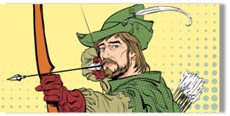
1. Robin Hood and Little John
They’d passed the graveyard on the edge of the village by the light of a full moon, and the hoot of an owl signalled their passage. They spent the next few hours trudging through the gloom of the forest on their way back to Nottingham. Mist hung about the ground at knee height, giving the forest an ethereal feel. Robin’s friend, Will, turned to him and confessed quietly he wasn’t happy about the uncomfortable silence which enveloped the woods. Usually, even at such an early hour, the woods were filled with noises, but tonight all was deathly silent.
They reached the river crossing just after dawn had broken and found a sun-dappled space to sit, eat and rest a while before crossing the water into the part of the forest inhabited by outlaws. Robin stood and stretched before retrieving his pack, his quiver and his bow. “Come on!” he said to Will, who lay napping on the heather and he nudged him with the toe of his boot. “How much longer is it?” said Will screwing up his face and shielding his eyes from the low hanging sun, “we’ve been walking all night!”
“Not much further,” said Robin, “but keep your wits about you now…you never know who is lurking in the woods on the Wester’ side.”
Robin had only taken a few steps onto the bridge when there was a flurry of movement at the other end. Either side of the bridge, men with bows erupted from the foliage; their arrows aimed at Robin and Will. One of the men started to cross the bridge towards them. The man was one of the tallest that they had ever seen. He was a whole head taller than Robin. He carried a long staff as thick as a man’s wrist and he was grinning from ear to ear - flashing his teeth at the two weary travellers. “Look sharp!” Robin hissed at Will. “Bridge tax!” the tall man bellowed, “stand where you are!” The two of them continued to edge further forwards until Robin was standing face to face with the brigand. “You cannot come across this bridge without paying the fee!”
With unnatural speed, Robin had pulled an arrow from his quiver, nocked it and was now stood with his drawn bow pointing in the giant’s bearded face. “Now, now…” said the Giant taking a step backwards, “there is no need for that.” Robin took half a step towards the bandit who suddenly swung his staff violently, knocking Robin’s bow into the river; sending his arrow flying off to embed itself into the trunk of a nearby by tree.
The outlaw laughed, “if you want to fight rather than pay, then it needs to be a fair fight.” he said as he handed Robin another staff. “If you can knock me, Little John, from the bridge then I will waive the fee.” Robin let out a deep sigh as he hefted the staff. ‘Little John?’ he thought to himself, ‘the man is as big as a bull and twice as fierce!’
Synopsis:
Robin Hood meets Little John for the first time. Robin Hood first met his lifelong friend Little John when they found themselves on a narrow bridge, both refusing to budge. When Robin threatened Little John with an arrow, John protested that it was not fair that he only had a staff.
Vocabulary:
Ethereal – delicate and light in a way that seems to be otherworldly.
Sun-dappled – an area that is covered with small spots or patches of sunlight amidst a lot of shade.
Flurry – a burst of swirling, and rapid movement
Foliage – lots of plants/leaves
Bandit – a robber or outlaw
28
Notes:
Ok, so let’s all have the extract in front of us. I am going to read now and you are going to follow with your finger or ruler.
READ THE EXTRACT. PAUSE ON THE WORDS THAT THE STUDENTS MAY NOT KNOW.

Slide 32

2. The Boy in the Striped Pyjamas
‘All I know is this,’ began Shmuel. ‘Before we came here I lived with my mother and father and my brother Josef in a small flat above the store where Papa makes his watches. Every morning we ate our breakfast together at seven o’clock and while we went to school, Papa mended the watches that people brought to him and made new ones too. I had a beautiful watch that he gave me but I don’t have it any more. It had a golden face and I wound it up every night before I went to sleep and it always told the right time.’
‘What happened to it?’ asked Bruno.
‘They took it from me,’ said Shmuel.
‘Who?’
‘The soldiers, of course,’ said Shmuel as if this was the most obvious thing in the world.
‘And then one day things started to change,’ he continued. ‘I came home from school and my mother was making armbands for us from a special cloth and drawing a star on each one. Like this.’ Using his finger he drew a design in the dusty ground beneath him.
‘And every time we left the house, she told us we had to wear one of these armbands.’
‘My father wears one too,’ said Bruno. ‘On his uniform. It’s very nice. It’s bright red with a black-and-white design on it.’ Using his finger he drew another design in the dusty ground on his side of the fence.
‘Yes, but they’re different, aren’t they?’ said Shmuel. ‘No one’s ever given me an armband,’ said Bruno.
‘But I never asked to wear one,’ said Shmuel.
‘All the same,’ said Bruno, ‘I think I’d quite like one. I don’t know which one I prefer though, your one or Father’s.’
Shmuel shook his head and continued with his story. He didn’t often think about these things anymore because remembering his old life above the watch shop made him very sad.
We wore the armbands for a few months,’ he said. ‘And then things changed again. I came home one day and Mama said we couldn’t live in our house anymore -‘
‘That happened to me too!’ said Bruno, delighted that he wasn’t the only boy who’d been forced to move. ‘The Fury came for dinner, you see, and the next thing I knew we moved here. And I hate it here,’ he added in a loud voice. ‘Did he come to your house and do the same thing?’
Synopsis:
This extract is from a novel written in the 21st century but set in the Second World War. It is about a rather unusual friendship which develops between two boys. Bruno is the son of a German soldier who has been sent to work in a concentration camp1 in Poland. He meets a Jewish boy called Shmuel who has been sent to the camp with his family. They make friends by talking through the fence which divides them.
Vocabulary:
‘a star on each one’ – Jewish people were made to wear armbands with the Star of David to make them stand out.
‘bright red with a black-and-white design on it’ - a military armband with the sign of a swastika. This was a symbol of the German invaders
29
Notes:
Ok, so let’s all have the extract in front of us. I am going to read now and you are going to follow with your finger or ruler.
READ THE EXTRACT. PAUSE ON THE WORDS THAT THE STUDENTS MAY NOT KNOW.

Slide 33
2. The Boy in the Striped Pyjamas
‘No, but when we were told we couldn’t live in our house we had to move to a different part of Cracow where the soldiers built a big wall and my mother and father and my brother and I all had to live in one room.’
‘All of you?’ asked Bruno. ‘In one room?’
‘And not just us,’ said Shmuel. ‘There was another family there and the mother and father were always fighting with each other and one of the sons was bigger than me and he hit me even when I did nothing wrong.’
‘You can’t have all lived in one room,’ said Bruno, shaking his head. ‘That doesn’t make any sense.’
‘All of us,’ said Shmuel, nodding his head. ‘Eleven in total.’
Bruno opened his mouth to contradict again – he didn’t really believe that eleven people could live in the same room together – but changed his mind.
‘We lived there for some months,’ continued Shmuel, ‘All of us in that one room. There was one small window in it but I didn’t like to look out of it because then I would see the wall and I hated the wall because our real home was on the other side of it. Then one day the soldiers all came with huge trucks,’ continued Shmuel, ‘And everyone was told to leave the houses. Lots of people didn’t want to and they hid wherever they could find a place but in the end I think they caught everyone. And the trucks took us to a train and the train…’ He hesitated and bit his lip. Bruno thought he was going to start crying and couldn’t understand why.
‘The train was horrible,’ said Shmuel, ‘There were too many of us in the carriages for one thing. And there was no air to breathe. And it smelled awful.’
‘That’s because you all crowded onto one train,’ said Bruno, remembering the two trains he had seen at the station when he had left Berlin. ‘When we came here there was another one on the other side of the platform but no one seemed to see it. That was the one that we got. You should have got on it too.’
‘I don’t think we would have been allowed,’ said Shmuel, shaking his head. ‘We weren’t able to get out of our carriage.’ ‘The doors are at the end,’ explained Bruno.
‘There weren’t any doors,’ said Shmuel. ‘Of course there were doors,’ said Bruno with a sigh. ‘They’re at the end,’ he repeated. ‘Just past the buffet section.’ ‘There weren’t any doors,’ insisted Shmuel. ‘If there had been, we would all have got off.’
Vocabulary:
Cracow – a large city in southern Poland. Many Jewish families were forced to move there and live in a small part of the city called a ghetto which was walled off from the rest of the city.
Carriages - the Jewish families were taken to the camps in over-crowded train carriages with no windows or seats.
30
Notes:
Ok, so let’s all have the extract in front of us. I am going to read now and you are going to follow with your finger or ruler.
READ THE EXTRACT. PAUSE ON THE WORDS THAT THE STUDENTS MAY NOT KNOW.

Slide 34
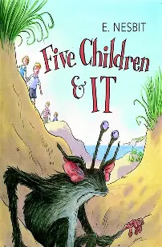
3. Five Children and It
The children have been playing in an old gravel-pit, trying to dig a hole to Australia. Some of the children have grown bored and have drifted off to explore an old cave instead, but Anthea has remained behind, digging the hole. Anthea suddenly screamed: “Cyril! Come here! Oh, come quick—It’s alive! It’ll get away! Quick!”
They all hurried back.
“It’s a rat, I shouldn’t wonder,” said Robert. “Father says they infest old places—and this must be pretty old if the sea was here thousands of years ago”—
“Perhaps it is a snake,” said Jane, shuddering.
“Let’s look,” said Cyril, jumping into the hole. “I’m not afraid of snakes. I like them. If it is a snake I’ll tame it, and it will follow me everywhere, and I’ll let it sleep round my neck at night.”
“No, you won’t,” said Robert firmly. He shared Cyril’s bedroom. “But you may if it’s a rat.”
“Oh, don’t be silly!” said Anthea; “it’s not a rat, it’s much bigger. And it’s not a snake. It’s got feet; I saw them; and fur! No—not the spade. You’ll hurt it! Dig with your hands.”
“And let it hurt me instead! That’s so likely, isn’t it?” said Cyril, seizing a spade.
“Oh, don’t!” said Anthea. “Squirrel, don’t. I—it sounds silly, but it said something. It really and truly did”—
“What?” “It said, ‘You let me alone.’”
But Cyril merely observed that his sister must have gone off her head, and he and Robert dug with spades while Anthea sat on the edge of the hole, jumping up and down with hotness and anxiety. They dug carefully, and presently everyone could see that there really was something moving in the bottom of the Australian hole.
Then Anthea cried out, “I’m not afraid. Let me dig,” and fell on her knees and began to scratch like a dog does when he has suddenly remembered where it was that he buried his bone.
“Oh, I felt fur,” she cried, half laughing and half crying. “I did indeed! I did!” when suddenly a dry husky voice in the sand made them all jump back, and their hearts jumped nearly as fast as they did.
“Let me alone,” it said. And now everyone heard the voice and looked at the others to see if they had heard it too.
“But we want to see you,” said Robert bravely.
“I wish you’d come out,” said Anthea, also taking courage. “Oh, well—if that’s your wish,” the voice said, and the sand stirred and spun and scattered, and something brown and furry and fat came rolling out into the hole, and the sand fell off it, and it sat there yawning and rubbing the ends of its eyes with its hands.
Synopsis:
The story of Five Children and It
begins with the discovery of a magical creature known as the Psammead by a group of siblings in a gravel pit.
The Psammead grants wishes that last until sunset, leading to a series of
whimsical and often comical
escapades.
Vocabulary:
Gravel-pit – a pile full of gravel
Infest – overrun, invade
Merely – simply, only
Husky – throaty, rough voice
Courage – bravery
Seizing – taking, grasping, snatching
31
Notes:
Ok, so let’s all have the extract in front of us. I am going to read now and you are going to follow with your finger or ruler.
READ THE EXTRACT. PAUSE ON THE WORDS THAT THE STUDENTS MAY NOT KNOW.

Slide 35
3. Five Children and It
“I believe I must have dropped asleep,” it said, stretching itself. The children stood round the hole in a ring, looking at the creature they had found. It was worth looking at. Its eyes were on long horns like a snail’s eyes, and it could move them in and out like telescopes; it had ears like a bat’s ears, and its tubby body was shaped like a spider’s and covered with thick soft fur; its legs and arms were furry too, and it had hands and feet like a monkey’s.
“What on earth is it?” Jane said. “Shall we take it home?” The thing turned its long eyes to look at her, and said— “Does she always talk nonsense, or is it only the rubbish on her head that makes her silly?” It looked scornfully at Jane’s hat as it spoke.
“She doesn’t mean to be silly,” Anthea said gently; “we none of us do, whatever you may think! Don’t be frightened; we don’t want to hurt you, you know.”
“Hurt me!” it said. “Me frightened? Upon my word! Why, you talk as if I were nobody in particular.” All its fur stood out like a cat’s when it is going to fight.
“Well,” said Anthea, still kindly, “perhaps if we knew who you are in particular we could think of something to say that wouldn’t make you angry. Everything we’ve said so far seems to have done so. Who are you? And don’t get angry! Because really we don’t know.”
“You don’t know?” it said. “Well, I knew the world had changed—but—well, really— Do you mean to tell me seriously you don’t know a Psammead when you see one?”
“A Sammyadd? That’s Greek to me.”
“So it is to everyone,” said the creature sharply. “Well, in plain English, then, a Sand-fairy. Don’t you know a Sand-fairy when you see one?”
It looked so grieved and hurt that Jane hastened to say, “Of course I see you are, now. It’s quite plain now one comes to look at you.”
“You came to look at me, several sentences ago,” it said crossly, beginning to curl up again in the sand.
“Oh—don’t go away again! Do talk some more,” Robert cried. “I didn’t know you were a Sand-fairy, but I knew directly I saw you that you were much the wonderfullest thing I’d ever seen.”
The Sand-fairy seemed a shade less disagreeable after this.
Vocabulary:
Scornfully – mockingly, rudely, disdainfully
Tubby – plump, chubby
Psammead – a sand fairy
32
Notes:
Ok, so let’s all have the extract in front of us. I am going to read now and you are going to follow with your finger or ruler.
READ THE EXTRACT. PAUSE ON THE WORDS THAT THE STUDENTS MAY NOT KNOW.

Slide 36
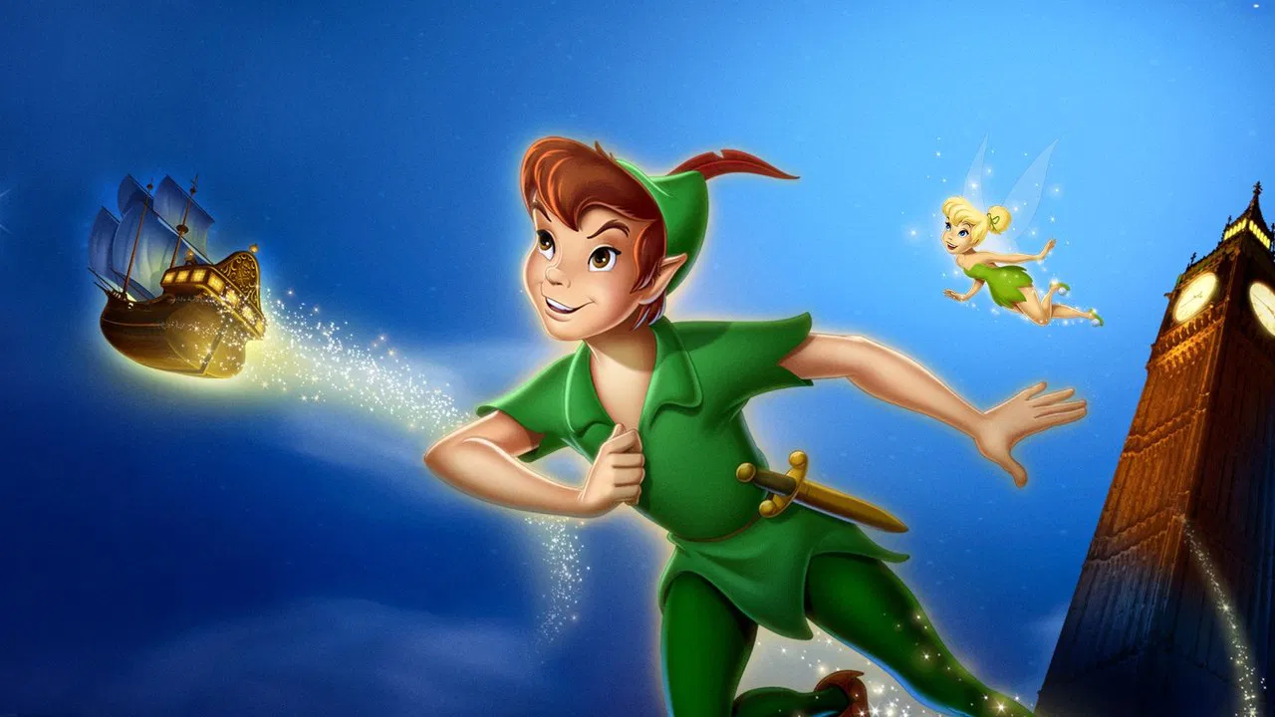
4. Peter Pan
Mrs. Darling loved to have everything just so, and Mr. Darling had a passion for being exactly like his neighbours; so, of course, they had a nurse. As they were poor, owing to the amount of milk the children drank, this nurse was a prim Newfoundland dog, called Nana, who had belonged to no one in particular until the Darlings engaged her.
She had always thought children important, however, and the Darlings had become acquainted with her in Kensington Gardens, where she spent most of her spare time peeping into perambulators, and was much hated by careless nursemaids, whom she followed to their homes and complained of to their mistresses. She proved to be quite a treasure of a nurse.
How thorough she was at bath-time, and up at any moment of the night if one of her charges made the slightest cry. Of course her kennel was in the nursery. She had a genius for knowing when a cough is a thing to have no patience with and when it needs stocking around your throat. She believed to her last day in old-fashioned remedies like rhubarb leaf, and made sounds of contempt over all this new-fangled talk about germs, and so on. It was a lesson in propriety to see her escorting the children to school, walking sedately by their side when they were well behaved, and butting them back into line if they strayed.
On John's footer [in England soccer was called football, "footer for short] days she never once forgot his sweater, and she usually carried an umbrella in her mouth in case of rain. There is a room in the basement of Miss Fulsom's school where the nurses wait.
They sat on forms, while Nana lay on the floor, but that was the only difference. They affected to ignore her as of an inferior social status to themselves, and she despised their light talk. She resented visits to the nursery from Mrs. Darling's friends, but if they did come she first whipped off Michael's pinafore and put him into the one with blue braiding, and smoothed out Wendy and made a dash at John's hair.
Synopsis:
The novel Peter Pan began as a play in 1904, and was made into a novel in 1911. It is the story of three English children: Wendy, John and Michael Darling. They meet the amazing Peter Pan, a boy who lives in magical Neverland. In this passage, the reader is introduced to Nana, the Darling children’s nurse and nanny.
Vocabulary:
Perambulators – prams
Charges – people she is responsible for
Propriety – politeness, decency
Remedies – a medicine or treatment for a disease or injury
Pirouette – twirl, an act of spinning on one foot
33
Notes:
Ok, so let’s all have the extract in front of us. I am going to read now and you are going to follow with your finger or ruler.
READ THE EXTRACT. PAUSE ON THE WORDS THAT THE STUDENTS MAY NOT KNOW.

Slide 37
4. Peter Pan
No nursery could possibly have been conducted more correctly, and Mr. Darling knew it, yet he sometimes wondered uneasily whether the neighbours talked.
He had his position in the city to consider.
Nana also troubled him in another way. He had sometimes a feeling that she did not admire him. "I know she admires you tremendously, George," Mrs. Darling would assure him, and then she would sign to the children to be especially nice to father.
Lovely dances followed, in which the only other servant, Liza, was sometimes allowed to join. Such a midget she looked in her long skirt and maid’s cap, though she had sworn, when engaged, that she would never see ten again. The gaiety of those romps! And gayest of all was Mrs. Darling, who would pirouette so wildly that all you could see of her was the kiss, and then if you had dashed at her you might have got it. There never was a simpler happier family until the coming of Peter Pan.
Synopsis:
The novel Peter Pan began as a play in 1904, and was made into a novel in 1911. It is the story of three English children: Wendy, John and Michael Darling. They meet the amazing Peter Pan, a boy who lives in magical Neverland. In this passage, the reader is introduced to Nana, the Darling children’s nurse and nanny.
Vocabulary:
Conducted – to carry out
Uneasily – in a way that shows anxiety or discomfort
Tremendously – greatly
34
Notes:
Ok, so let’s all have the extract in front of us. I am going to read now and you are going to follow with your finger or ruler.
READ THE EXTRACT. PAUSE ON THE WORDS THAT THE STUDENTS MAY NOT KNOW.

Slide 38

5. Alice in Wonderland
Alice was not a bit hurt, and she jumped up on to her feet in a moment: she looked up, but it was all dark overhead: before her was another long passage, and the White Rabbit was still in sight, hurrying down it. There was not a moment to be lost: away went Alice like the wind, and was just in time to hear it say, as it turned a corner, “Oh my ears and whiskers, how late it’s getting!” She was close behind it when she turned the corner, but the Rabbit was no longer to be seen: she found herself in a long, low hall, which was lit up by a row of lamps hanging from the roof.
There were doors all round the hall, but they were all locked; and when Alice had been all the way down one side and up the other, trying every door, she walked sadly down the middle, wondering how she was ever to get out again.
Suddenly she came upon a little three-legged table, all made of solid glass: there was nothing on it but a tiny golden key, and Alice’s first idea was that this might belong to one of the doors of the hall; but, alas! either the locks were too large, or the key was too small, but at any rate it would not open any of them. However, on the second time round, she came upon a low curtain she had not noticed before, and behind it was a little door about fifteen inches high: she tried the little golden key in the lock, and to her great delight it fitted!
Alice opened the door and found that it led into a small passage, not much larger than a rat-hole: she knelt down and looked along the passage into the loveliest garden you ever saw. How she longed to get out of that dark hall, and wander about among those beds of bright flowers and those cool fountains, but she could not even get her head through the doorway; “and even if my head would go through,” thought poor Alice, “it would be of very little use without my shoulders. Oh, how I wish I could shut up like a telescope! I think I could, if I only knew how to begin.” For, you see, so many out-of-the-way things had happened lately, that Alice had begun to think that very few things indeed were really impossible.
There seemed to be no use in waiting by the little door, so she went back to the table, half hoping she might find another key on it, or at any rate a book of rules for shutting people up like telescopes: this time she found a little bottle on it (“which certainly was not here before,” said Alice), and tied round the neck of the bottle was a paper label, with the words “DRINK ME” beautifully printed on it in large letters.
Synopsis:
Alice’s Adventures in Wonderland tells the tale of a young girl who falls into a world of nonsense. After following a talking rabbit, Alice has tumbled down a hole into a strange underground world.
Vocabulary:
Telescope – device for making objects that look far away look closer
Alas – sadly, unfortunately
35
Notes:
Ok, so let’s all have the extract in front of us. I am going to read now and you are going to follow with your finger or ruler.
READ THE EXTRACT. PAUSE ON THE WORDS THAT THE STUDENTS MAY NOT KNOW.

Slide 39

5. Alice in Wonderland
It was all very well to say “Drink me,” but the wise little Alice was not going to do that in a hurry. “No, I’ll look first,” she said, “and see whether it’s marked ‘poison’ or not;” for she had read several nice little stories about children who had got burnt, and eaten up by wild beasts, and other unpleasant things, all because they would not remember the simple rules their friends had taught them: such as, that a red-hot poker will burn you if you hold it too long; and that, if you cut your finger very deeply with a knife, it usually bleeds; and she had never forgotten that, if you drink much from a bottle marked “poison,” it is almost certain to disagree with you, sooner or later.
However, this bottle was not marked “poison,” so Alice ventured to taste it, and finding it very nice (it had, in fact, a sort of mixed flavour of cherry-tart, custard, pineapple, roast turkey, toffee, and hot buttered toast), she very soon finished it off.
“What a curious feeling!” said Alice. “I must be shutting up like a telescope.”
And so it was indeed: she was now only ten inches high, and her face brightened up at the thought that she was now the right size for going through that little door into that lovely garden. First, however, she waited for a few minutes to see if she was going to shrink any further: she felt a little nervous about this: “for it might end, you know,” said Alice to herself, “in my going out altogether, like a candle. I wonder what I should be like then?” And she tried to fancy what the flame of a candle looks like after the candle is blown out, for she could not remember ever having seen such a thing.
After a while, finding that nothing more happened, she decided on going into the garden at once; but, alas for poor Alice!
When she got to the door, she found she had forgotten the little golden key, and when she went back to the table for it, she found she could not possibly reach it: she could see it quite plainly through the glass, and she tried her best to climb up one of the legs of the table, but it was too slippery; and when she had tired herself out with trying, the poor little thing sat down and cried.
Vocabulary:
Tried to fancy – imagine
36
Notes:
Ok, so let’s all have the extract in front of us. I am going to read now and you are going to follow with your finger or ruler.
READ THE EXTRACT. PAUSE ON THE WORDS THAT THE STUDENTS MAY NOT KNOW.

Slide 40
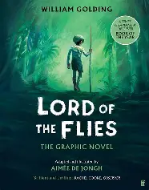
6. Lord of the Flies
Signs of life were visible now on the beach. The sand, trembling beneath the heat haze, concealed many figures in its miles of length; boys were making their way toward the platform through the hot, dumb sand.
Three small children, no older than Johnny, appeared from startlingly close at hand, where they had been gorging fruit in the forest. A dark little boy, not much younger than Piggy, parted a tangle of undergrowth, walked on to the platform, and smiled cheerfully at everybody. More and more of them came. Taking their cue from the innocent Johnny, they sat down on the fallen palm trunks and waited. Ralph continued to blow short, penetrating blasts. Piggy moved among the crowd, asking names and frowning to remember them. The children gave him the same simple obedience that they had given to the men with megaphones. Some were naked and carrying their clothes; others half-naked, or more or less dressed, in school uniforms, grey, blue, fawn, jacketed, or jerseyed. There were badges, mottoes even, stripes of colour in stockings and pullovers. Their heads clustered above the trunks in the green shade; heads brown, fair, black, chestnut, sandy, mouse-coloured; heads muttering, whispering, heads full of eyes that watched Ralph and speculated. Something was being done.
The children who came along the beach, singly or in twos, leapt into visibility when they crossed the line from heat haze to nearer sand. Here, the eye was first attracted to a black, bat-like creature that danced on the sand, and only later perceived the body above it. The bat was the child’s shadow, shrunk by the vertical sun to a patch between the hurrying feet. Even while he blew, Ralph noticed the last pair of bodies that reached the platform above a fluttering patch of black. The two boys, bullet-headed and with hair like tow, flung themselves down and lay grinning and panting at Ralph like dogs. They were twins, and the eye was shocked and incredulous at such cheery duplication. They breathed together, they grinned together, they were chunky and vital. They raised wet lips at Ralph, for they seemed provided with not quite enough skin, so that their profiles were blurred and their mouths pulled open. Piggy bent his flashing glasses to them and could be heard between the blasts, repeating their names. “Sam, Eric, Sam, Eric.”
Then he got muddled; the twins shook their heads and pointed at each other and the crowd laughed. At last Ralph ceased to blow and sat there, the conch trailing from one hand, his head bowed on his knees. As the echoes died away so did the laughter, and there was silence.
Synopsis:
This extract is from the opening chapter of a novel by William Golding. Written in 1954, it is about a group of school boys who have been stranded on a deserted island.
Vocabulary:
Haze – a state of mental confusion
Mottoes – a short sentence or phrase as encapsulating a belief
Incredulous – unable to believe something
Duplication – the action or process of copying something
37
Notes:
Ok, so let’s all have the extract in front of us. I am going to read now and you are going to follow with your finger or ruler.
READ THE EXTRACT. PAUSE ON THE WORDS THAT THE STUDENTS MAY NOT KNOW.

Slide 41
38

Slide 42
39

Slide 43
40

Slide 44
41

Slide 45
42

Slide 46
43

Slide 47
44

Slide 48
45

