Slide 1

Year 7 Knowledge Organiser HT4
Knowledge is Power
Name: ______________________________
Form: _______

Slide 2
Contents Page
Subject | Page
English | 1
Maths | 2
Science | 3
Spanish | 4
History | 5
Geography | 6
PE | 7
Computing | 11
Art | 12
Cooking and Nutrition | 13
Music | 14
DT | 15
Drama | 16
‘Resilience’ reflection log | 17
Reading log | 21
Cursive Handwriting Practice | 27

Slide 3
English
Week 3 - Devices
Device | Definition
Personification | Giving human characteristics to a non human object.
Metaphor | Comparing by referring to one thing as another.
Simile | A comparison of two different objects using like or as.
Hyperbole | The use of obvious exaggeration for effect.
Emotive Language | Language intended to create an emotional response.
Onomatopoeia | A word that imitates the sound it represents.
Week 5 – Structural Devices
Hook openings | The start of the text must interest the reader.
Flashback | A scene set earlier in time than the main story.
Foreshadowing | Giving the reader an indication of future events.
Focus shift | When the writers focus changes within as the text progresses.
Week 1 – Key Words
Villain | The main antagonist in the story.
Antagonist | A person who competes with another person.
Protagonist | The main character who drives the story forward.
Hero | A hero is someone who is good. They act with pure intentions and do their best to help people
Anti-Hero | Someone who is neither a hero or a villain. They may do good, but also hurt others.
Moral | Standards of behaviour. Principles of right and wrong.
Quotation | A quotation is when you use a part of the text in your responses, shown by speech marks.
Structure | The order the author decides when writing an extract/story. For example, beginning, middle and end.
Setting | The place / type of surroundings where the text takes place.
First-Person Narrative | A story written from the perspective of one character using the word ‘I’.
Week 4 – Context/ Victorian Fears
1. Fear of the supernatural
2. Fear of the unknown
3. Fear of the other
4. Fear of evil
5. Fear of superstition
Week 2 – Stereotypes of a Villain
Stereotype | Judgement about another person based on their character.
Desire | A strong feeling or want for something.
Malicious | Intending to do harm.
Wicked | Evil and morally wrong.
Immoral | Behaviour that goes against the accepted morals.

Slide 4
Maths
Ratio
Key Word | Definition
Ratio | Relationship between two or more numbers
Proportion | A comparison of two numbers that each represent the parts of a whole
Part | One ‘part’ of the ratio is how much one is worth
Share | Divide an amount into a ratio
Simplest form | Divide all numbers by the same amount until you cannot simplify further
Fraction
Key Word | Definition
Fraction | A number that is part of a whole
Numerator | How many parts there are, on the top of the fraction
Denominator | The total number of parts, what is being divided by, on the bottom of the fraction
Mixed number | A whole number and a fraction together
Improper fraction | A fraction with a bigger numerator than denominator
Equivalent | Equal in value
2

Slide 5
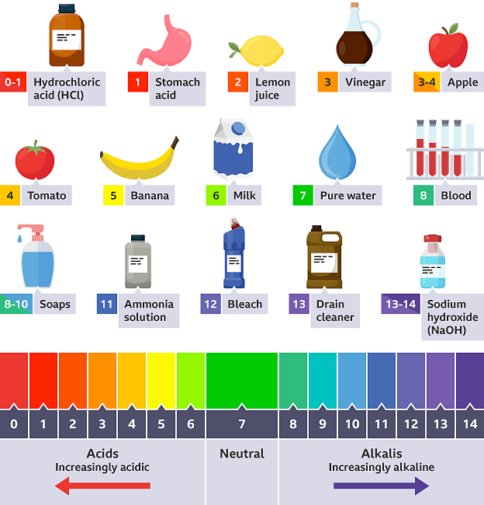
Science
Key Word | Definition
Neutral | When a substance is neither acidic nor alkaline, and has a pH of 7.
pH | A scale of acidity or alkalinity. A pH value below 7 is acidic, a pH value above 7 is alkaline.
Universal Indicator Paper | Paper stained with universal indicator, a chemical solution that produces many different colour changes corresponding to different pH levels.
Key Word (forces) | Definition
Resultant Force | The sum of the forces acting upon an object (overall force)
Newton | The unit of Force, symbol N
Mass | The particles that make up an object
Weight | The force of gravity acting upon your mass
Air resistance | A force that acts on an object which is moving through air. Air resistance acts in the opposite direction to the direction of movement.
Friction | Forces which resist an object moving
Acids and Alkalis
Hydrochloric acid (HCl)
Stomach acid
Lemon juice
Vinegar
Apple
Balanced forces | when two forces are acting equally on an object
Unbalanced forces | when two forces are acting unequally on an object
Key Word | Definition
Acid | Corrosive substance which has a pH lower than 7. Acidity is caused by a high concentration of hydrogen ions.
Acidic | Having a pH lower than 7.
Alkali | A base which is soluble in water.
Alkaline | Having a pH greater than 7.
Litmus Paper | An indicator that can be red or blue. Red litmus paper turns blue in alkalis, while blue litmus turns red in acids.
Neutralise | To be make neutral by removing any acidic or alkaline nature.
Drain cleaner
Sodium hydroxide
(NaOH)
Soaps
Ammonia solution
Bleach
Acids
(increasingly acidic)
Neutral
Alkalis
(increasingly alkaline)
3
Notes:
2025 HT4

Slide 6
Spanish
Spanish | English
Vivo en | I live in
Una casa | A house
Un piso | A flat
Mi casa/piso está en | My house/flat is located in
Un pueblo | A town
Una ciudad | A city
Las montañas | The mountains
La costa | The coast
La habitación | Bedroom
La cocina | Kitchen
El salón | Living room
El estudio | Study
El cuarto de baño | Bathroom
El jardín | Garden
La entrada | Hall
Hay… | There is/are
Un armario | A wardrobe
Spanish | English
Una lámpara | A lamp
Una cama | A bed
Un lavabo | A sink
Una mesa | A table
Un sillón | An armchair
Una silla | A chair
Un sofá | A sofa
Unas cortinas | Some curtains
Un tapete | A carpet
Una mesilla de noche | A bedside table
Arreglo mi habitación | I tidy my room
Cocino | I cook
Paso la aspiradora | I vacuum
Saco la basura | I take out the rubbish
Lavo los platos | I wash the dishes
Pongo/quito la mesa | I set/clear the table
Corto el cespéd | I mow the lawn
4

Slide 7
History
Key Terms
Artisans | Skilled workers who make things by hand.
Asantehema | ‘Queen Mother’; an older female who advises but is not necessarily the mother of the Asantehene.
Asantehene | Name given to the ruler of the Kingdom of Asante
Benin Bronzes | Collection of brass and bronze objects made in the Kingdom of Benin
Caravan | A group of people and animals travelling together across the desert.
Civil War | A war between two groups of people in the same country.
Colony | Country or area under the full or partial control of another country.
Craft Guilds | A group of a certain type of craftspeople, with their own rules.
Dia | Name given to the rulers of the Kingdom of Goa and Kingdom of Songhay.
Exile | Being prevented from living in the country you were born in as punishment.
Key Terms
Griots | Storytellers in Mali who pass down history through songs and spoken word.
Hajj | The pilgrimage Muslims make to Makkah, their most holy city.
Imam | A Muslim leader who leads prayers in a mosque
Islam | Religion follow by Muslims.
Mansa | Name given to the ruler of Mali.
Matriarchal | A society in which women, not men, lead.
Matrinlineal | A society in which people inherit their mother’s family name and status rather than their father’s.
Mosque | A Muslim place of worship.
Oba | Name given to the ruler of the Kingdom of Benin.
Plantations | Large farms where crops such as sugar, coffee, and tobacco are grown.
Reformation | Name used to describe the changes made to the Roman Catholic Church in the 16th C.
Scholars | Highly educated people.
Tribute | A payment that a more powerful ruler demands from a less powerful ruler. Can also be an offering of goodwill.

Slide 8
Geography
Key Word | Definition
Weather | The short term day to day conditions in the atmosphere over a small/local area.
Climate | The weather conditions measured over a large region across an average of 30 years.
Precipitation | Water in any form that falls to Earth (eg rain, snow, sleet, hail).
Temperature | Measurement of how hot or cold.
Relief rainfall | Rain caused when air is forced to rise over hills and mountains.
Frontal rainfall | Rain caused when warm air has to rise over cold air to cause rain.
Convectional rainfall | Rain that is produced when air rises due to being heated and evaporated.
Latitude | A measurement of distance north or south of the equator, which has a latitude of 0° .
Altitude | Height above sea level, normally measured in meters.
Ocean Currents | A continuous, directed movement of ocean water that flows in Earth’s oceans.
Air pressure | The weight of the air in the atmosphere pushing down to Earth.
Low pressure | Caused by warm, less dense air rising.
High pressure | Caused by cool, dense sinking air.
Microclimate | A very small area which has different weather conditions to the area as a whole.
Tropical storm | A low pressure wind system formed over warm ocean water.
Drought | A long period of time with little to no rainfall, causing water shortages.
Extreme weather | Weather that is unseasonal, unusual or severe.
Mild | not extremely hot or cold, not extremely wet or dry
Temperate | a climate that is usually mild
Maritime | influenced by the sea/ocean
Continental | influenced by the land
6

Slide 9


PE
Skeletal System
Cardiovascular System
7

Slide 10
PE
Muscular system - Antagonistic pairs
Tendons connect muscle to bone and ligaments connect bone to bone. Voluntary muscles allow for movement as they produce a force which causes the attached bones to move in a specific direction. Muscles which are attached via tendons work together to create this.
Antagonistic pairs | Is where two muscles work together to create movement. There are two main categories that outline how these muscles work together; agonist and the antagonist.
Agonist | Is the also known as the prime mover. This is the muscle that contracts and causes the movement.
Antagonist | This is the opposite muscle that relaxes and in most cases lengthens as the movement occurs.
Muscular system – Muscle fibre types
All skeletal muscle contains a mixture of Slow Twitch and Fast Twitch muscle fibres- this is based on their speed of contraction. There are 3 types of muscle fibre.
Fast Twitch | Is broken down into two types;Type 2 x & Type 2 b.
Fast twitch - Type 2 x/2b | Produces highest force, fast contracting, Low endurance, good for short distances – Sprint start
Type 2a | Produce high force, moderate speed of contraction, medium endurance, more resistant to fatigue, Sprinting over longer distances.
Slow Twitch | They contract slowly and with less force. Provide a low speed of contraction, high endurance, can keep going, don’t produce much power. These fibres have a rich blood (and oxygen) supply. This makes them red in colour. They are slower to fatigue, and so are used for more endurance events e.g. long distance swimming/ running.
8

Slide 11
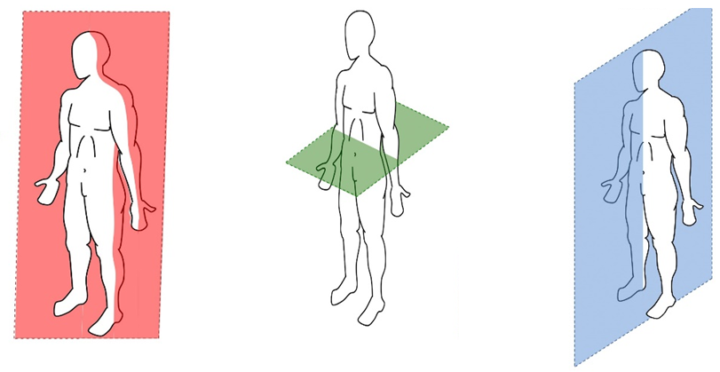
PE
BIOMECHANICS - Planes and axes for movement
Plane | An imaginary line that divides the body into two
Frontal Plane (left picture) | A vertical plane that divides the body into front and back.
Transverse plane (middle picture) | A horizontal plane that divides the body into upper and lower halves.
Sagittal plane (right picture) | A vertical plane that divides the body into right and left sides.
9

Slide 12
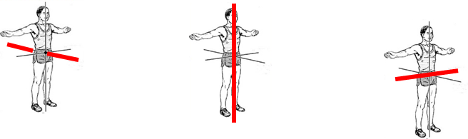
PE
BIOMECHANICS - Planes and axes for movement
PAxes for movement | An axis is an imaginary line at right angles to the plane
Sagittal axis (left picture) | Runs through the body horizontally from the back to front.
Vertical axis (middle picture) | Runs through the body vertically from the top to bottom.
Frontal axis (right picture) | Runs through the body horizontally from the left to right.
10

Slide 13
Computing
Binary Logic
Binary | Base 2 number system. This mean that it only has 2 possible values – 0 or 1.
Denary | Also known as decimal. A base 10 number system. This means it has 10 possible values – 0, 1, 2, 3, 4, 5, 6, 7, 8 and 9.
Hexadecimal | Base 16 number system. This means it has 16 possible values – 0, 1, 2, 3, 4, 5, 6, 7, 8, 9, A, B, C, D, E and F
Bits | The smallest piece of data in a computer. It can only be 0 or 1.
Nibble | A group of 4 bits.
Byte | A group of 8 bits. It can often store one character, like a letter or number.
Character set | A collection of characters that a computer recognises. For example, letters, numbers and symbols.
ASCII | American Standard Code for Information Interchange. A character set that uses 7 or 8 bits to represent characters.
Unicode | A character set that can store characters from many languages around the world.
Logic unit | Part of the computer that makes decisions by comparing data. It uses the AND, OR, and NOT rules.
Binary processing unit | Part of the computer that works with binary numbers to process simple calculations.
Logic processor | Part of the computer that handles logical tasks such as comparisons and decisions.

Slide 14
Art
Key Word | Definition
Tint | a shade or variety of a colour.
Shade | a colour, especially with regard to how light or dark it is or as distinguished from one nearly like it.
Blend | mix (a substance) with another substance so that they combine together.
Limited colour palette | it means limiting the number of colours you use in the painting to the bare essentials. A limited colour palette removes confusion as you only use the colours that you have chosen such as 3 colours, 4 colours etc. For example, if you’re using a limited colour palette of blue, white and red, you only have these three colours to choose from – making it simpler.
Natural | existing in or derived from nature; not made or caused by humankind.
Organic | Organic shapes are irregular and imperfect. Naturally these shapes will all be slightly different from one another. They are often curved and flowing and can seem unpredictable.
Wet into wet | Wet-on-wet is a direct painting technique that can be used with all wet paint mediums: watercolour, gouache, acrylic, and oil paints.
Burnishing | enhance or perfect (something such as a reputation or a skill).
Transparent | See-through (washes that are thinly applied).
Wash | A very watery mix applied with a large brush.
Harmonious colours | Harmonious colours sit beside each other on the colour wheel. These colours work well together and create an image which is pleasing to the eye. Harmonious colours may also be referred to as analogous colours.
Complimentary colours | is particular colour scheme draws from two colours on the opposite side of the colour wheel. When you do this, the result is a high-contrast colour combo that's bright and that pops. Examples of complementary colour combinations are: Red and green; yellow and purple; orange and blue; green and magenta.
Primary colours | any of a group of colours from which all other colours can be obtained by mixing
Secondary colours | a colour resulting from the mixing of two primary colours
Tertiary colours | A tertiary colour or intermediate colour is a colour made by mixing one part of a primary colour with half part of another primary
The Colour Wheel | a circle with different coloured sectors used to show the relationship between colours
12

Slide 15
Cooking and Nutrition
Key Word | Definition
Hazard | Anything that is dangerous
Kitchen Hygiene | Ensuring that everything is clean when preparing food
Kitchen Safety | Being safe in the kitchen
Cross contamination | Transfer of bacteria from one person, object or place to another
Eat Well Guide | A pictorial food guide showing the amounts and types of foods that are needed to make up a healthy balanced diet
Claw grip | A method of cutting food that ensures that the finger tips are tucked out of the way and will not get caught by the knife
Food poisoning | An illness caused by eating contaminated food
Bacteria | Microscopic living organisms which can be found everywhere
Cooking utensils | Small items such as bowls, sieves and whisks that are used for preparation and mixing of ingredients
Bridge Hold | A method of cutting food that ensures that fingers are out of the way as the knife cuts through the food
Cooking Equipment | Large equipment such as refrigerators, ovens and hobs. Smaller equipment include saucepans and baking trays.
Weighing | Finding out how heavy an ingredient is
13

Slide 16



Music
Key Word | Definition
a Cappella | Singing without an instrumental accompaniment
Structure | the order the different sections of a song or piece of music are played in.
Harmony | is the combination of different musical notes played simultaneously.
Unison | To perform together "as one"
Dynamic | How loud or quiet the piece is
Beat | a regular, repeating pulse that underlies a musical pattern
Timbre | Each instrument own unique ‘tone quality’ and the voice as an instrument had different Timbre
Silence | Absence of sound
Texture | How many layers the piece has
Rhythm | Rhythm is the pattern of sounds and beats in music that creates a sense of movement and flow.
Tempo | Tempo refers to the speed of music. It's how fast or slow a song sounds.
Call & Response | When one phrase is played or sung, and another phrase is played or sung as a direct response. ( sometimes a repeat of the call)
14

Slide 17
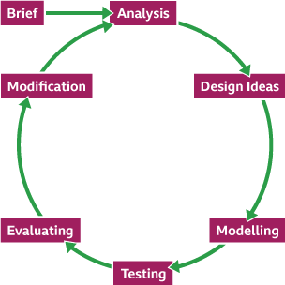
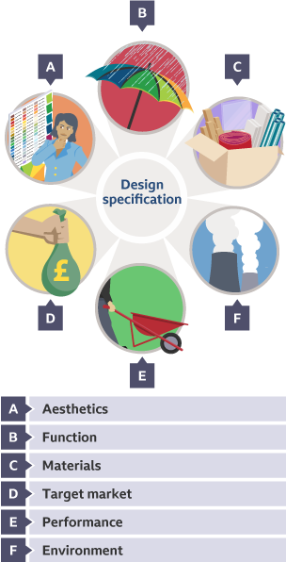
Design and Technology - RM
Year 7
Key Words | Definition
Aesthetic | How something looks e.g. this product is aesthetically pleasing
Analysis | Learn and evaluate designs to identify features that could be improved.
Anthropometrics | The practice of taking measurements of the human body and providing data that can be used by designers.
Design Brief | A short statement which outlines the problem to be solved and a set of instructions given to a designer by a client.
Design Process | provides us with a series of important stages during the design and development of a solution.
Ergonomics | The study of people in their working environment
Innovative | New and creative in approach.
Hazardous | dangerous and involving risk, especially to someone's health.
Market Research | when designers and businesses gather important information about the needs and preferences of people who might use their products.
PPE | Personal Protective Equipment must be worn when instructed to do so.
Risk Assessment | a careful examination of the things that could cause harm to people, and helps you to put precautions in place to prevent injury and ill-health.
Specification | Containing detail of a product's requirement or characteristic - processes, materials and other information needed to design the product.
Sustainability | Something that does not damage the environment e.g. plant based plastic
The 6 Rs | Rethink, Refuse, Reduce, Reuse, Recycle, Repair
The Design Process
15

Slide 18
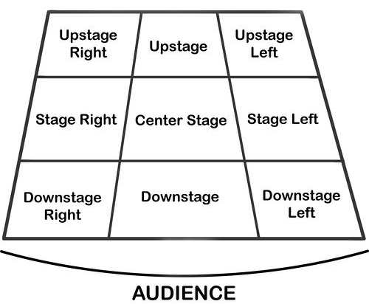
Performing Art
Key Word | Definition
Body Language | How an actor uses their body to communicate meaning. For example, crossing your arms could mean you are fed up
Gesture | a movement of the body, particularly the hands, arms, or head, that conveys meaning or expresses an idea, emotion, or intention
Levels | Levels can be used to show status, relationships, and even to indicate changes in location or time
Proxemics | The deliberate use of distance between you and other characters or objects to communicate something to an audience
Facial Expression | Using the face to express that characters feelings and emotions.
Key Word | Definition
Amphitheatre | Circular or oval open air theatre with a large ranked seating area
Apron | The apron is a section of the stage which the floor projects towards or into the auditorium
Black Box | A flexible studio theatre where the audience and actors are in the same room surrounded by black tabs
End On | Traditional audience seating layout where the audience is looking at the stage from the same direction.
Found Space | A performance space that wasn’t designed to be one e.g historic buildings
In the Round | Theatre in the Round is a form of audience seating layout where the acting area is surrounded on all sided by seating. There is often a number of entrances through the seating
Promenade | Form of staging where the audience moves around the performance space and sees the play at a variety of different locations
Proscenium Arch | The opening in the wall which stands between stage and auditorium in some theatres; the picture frame through the audience sees the play’ fourth wall’
Site-specific theatre | A piece of performance which has been deigned to work only in a particular non-theatre space
Stage Directions
Stage directions are from the performers perspective
16

Slide 19
Resilience definition: Grappling to get unstick
Reflecting on learning behaviours for thinking… | Experience log
 | Successful moment… | In hindsight… An example where you could have done better on reflection | At home…
I gave an idea and reasoned/justified.
I reflected on my idea and made it better after discussing with others
I used a revision strategy to help make the learning stick.
I made connections between what I am learning and the outside world.
17

Slide 20
Resilience definition: Grappling to get unstick
Reflecting on learning behaviours for thinking… | Experience log
 | Successful moment… | In hindsight… An example where you could have done better on reflection | At home…
I gave an idea and reasoned/justified.
I reflected on my idea and made it better after discussing with others
I used a revision strategy to help make the learning stick.
I made connections between what I am learning and the outside world.
18

Slide 21
Resilience definition: Grappling to get unstick
Reflecting on learning behaviours for thinking… | Experience log
 | Successful moment… | In hindsight… An example where you could have done better on reflection | At home…
I gave an idea and reasoned/justified.
I reflected on my idea and made it better after discussing with others
I used a revision strategy to help make the learning stick.
I made connections between what I am learning and the outside world.
19

Slide 22
Resilience definition: Grappling to get unstick
Reflecting on learning behaviours for thinking… | Experience log
 | Successful moment… | In hindsight… An example where you could have done better on reflection | At home…
I gave an idea and reasoned/justified.
I reflected on my idea and made it better after discussing with others
I used a revision strategy to help make the learning stick.
I made connections between what I am learning and the outside world.
20

Slide 23
Resilience definition: Grappling to get unstick
Reflecting on learning behaviours for thinking… | Experience log
 | Successful moment… | In hindsight… An example where you could have done better on reflection | At home…
I gave an idea and reasoned/justified.
I reflected on my idea and made it better after discussing with others
I used a revision strategy to help make the learning stick.
I made connections between what I am learning and the outside world.
21

Slide 24
Reading Log w/c 23rd February (20 mins reading per day – all five logs MUST be completed)
Date | Title of novel | Number of pages read | Summary about what I have read
 |  |  | • • •
 |  |  | • • •
 |  |  | • • •
 |  |  | • • •
 |  |  | • • •
Checked by form tutor:
22

Slide 25
Reading Log w/c 2rd March (20 mins reading per day – all five logs MUST be completed)
Date | Title of novel | Number of pages read | Summary about what I have read
 |  |  | • • •
 |  |  | • • •
 |  |  | • • •
 |  |  | • • •
 |  |  | • • •
Checked by form tutor:
23

Slide 26
Reading Log w/c 9th March (20 mins reading per day – all five logs MUST be completed)
Date | Title of novel | Number of pages read | Summary about what I have read
 |  |  | • • •
 |  |  | • • •
 |  |  | • • •
 |  |  | • • •
 |  |  | • • •
Checked by form tutor:
24

Slide 27
Reading Log w/c 16th March (20 mins reading per day – all five logs MUST be completed)
Date | Title of novel | Number of pages read | Summary about what I have read
 |  |  | • • •
 |  |  | • • •
 |  |  | • • •
 |  |  | • • •
 |  |  | • • •
Checked by form tutor:
25

Slide 28
Reading Log w/c 23rd March (20 mins reading per day – all five logs MUST be completed)
Date | Title of novel | Number of pages read | Summary about what I have read
 |  |  | • • •
 |  |  | • • •
 |  |  | • • •
 |  |  | • • •
 |  |  | • • •
Checked by form tutor:
26

Slide 29

Cursive Handwriting Practice – Week 1
27

Slide 30

Cursive Handwriting Practice – Week 2
28

Slide 31

29

Slide 32

Cursive Handwriting Practice – Week 3
30

Slide 33

Cursive Handwriting Practice – Week 4
31

Slide 34

32

