Slide 1

Year 7 Knowledge Organiser HT5
Knowledge is Power
Name: ______________________________
Form: _______

Slide 2
Contents Page
Subject | Page
English | 1
Maths | 2
Science | 3
Spanish | 4
History | 5
Geography | 6
PE | 7
Computing | 9
Art | 10
Performing Arts | 11
Cooking and Nutrition | 12
Music | 13
DT | 14
‘Resilience’ reflection log | 15
Reading log | 21
Cursive Handwriting Practice | 26

Slide 3
English
Week 3 – Themes
Identity | Poetry about family and community
Conflict | Poetry about the struggle between people or forces
Love | Expressing emotions of love through poetry
Cultural experiences | Cultural awareness and knowledge of customs
Loss | Poetry about losing someone / something close to you.
Week 5 – Poetic Structures
Ballad | A poem that tells a story.
Blank Verse | Verse with no rhyme—usually 10 syllable lines
Rhyme Scheme | The pattern of lines that rhyme in a poem.
Free Verse | No regular rhyme / rhythm
Rhyming Couplet | Pairs of lines that both end with words that rhyme with the other
Sonnet | 14 lined love poem.
Week 1 – Key Poetic Techniques
Rhythm | The beat and pace of a poem.
Simile | A comparison of two different objects using like or as.
Line Breaks | The point in a poem where one line ends and the next begins.
Metaphor | Comparing by referring to one thing as another.
Personification | Giving human characteristics to a nonhuman object.
Imagery | Words which helps the reader to reader to form a picture in their mind.
Week 4 – How To Respond To a Poem
1. Title: Does the title give you any clues to what the poem may be about?
2. Poetic Voice: Who is the speaker? How is their identity portrayed?
3. Language: Are there any features that are particularly effective?
4. Ideas: What are the key ideas in the poem (what is it about?)?
5. Structure: Is there anything interesting about the layout?
Week 6 – Types of poems
Ballad | Narrative poem that tells a story, usually in a musical form.
Haiku | A traditional Japanese poem consisting of 3 lines with a 5-7-5 syllable structure.
Acrostic | Where the first letter of each line spells out a word related to the poem
Limerick | A witty or humorous poem that usually has an AABBA rhyme scheme.
Free verse | Poetry that does not adhere to a specific rhyme or structure.
Week 2 – Key Terms
Poetic Conventions | Features used in poems to have a greater effect on the reader.
Culture | The beliefs and traditions celebrated by a group of people.
Identity | Who you are as a person – the characteristics and personality one may have.
Mother Tongue | The language a person has grown up speaking from early childhood.
1
Notes:
HT5

Slide 4
Maths
Angles
Key Word | Definition
Straight line | Angles on a straight line add up to 180˚
Triangle | Angles in a triangle add up to 180˚
Isosceles Triangle | Base angles in an isosceles triangle are equal
Intersecting lines | Vertically opposite angles are equal
Quadrilaterals | Angles in a quadrilateral add up to 360˚
Parallelograms | Diagonally opposite angles in a parallelogram are equal
Kites | One pair of opposite angles in a kite are equal
Tables, Charts and Graphs
Key Word | Definition
Discrete data | Data that can only take certain values. These values do not have to be whole numbers, but they are fixed values. e.g. shoe size, number of goals
Continuous data | Data that is measured and can take any value e.g. Height, time, temperature
Tally Chart | A way of keeping count by making marks
Frequency | Total
Pictogram | Uses pictures to represent data
Line graphs | A graph with points connected by lines
Bar Chart | A graph drawn using rectangular bars to show how large each value is
2

Slide 5

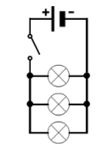
Science
Key Point | Definition
insulator | A material that does not allow current to flow through it easily, eg wood or glass.
electrostatic forces | Charged objects exert electrostatic forces on each other. These can be attractive forces or repulsive forces.
polarisation of charge | When charges move or separate in a neutral object, leaving areas of net positive or negative charge.
Static electricity | is a build-up of electrical charge on an object
electrical current | A flow of electrical charges (usually electrons) through a material.
resistance | This tells us how difficult it is for current to flow through a circuit. The more resistance there is, the harder it is for current to flow.
conduction | The process by which electrical current flows through a wire or another conductor.
potential difference (V) | Potential difference is the amount of energy transferred by each unit of charge passing between two points of a circuit. Potential difference is measure in volts (V).
component | A part of a circuit eg a battery, motor, lamp, switch or wire.
circuit | An electrical circuit is made up of components, which are connected together using wires.
Ammeters | This is a piece of equipment used to measure the current flowing through components.
voltmeter | This is a piece of equipment which is used to measure the potential difference across components.
Key Point | Definition
cell | Cells provide energy which enables electrons to flow through wires and components, when connected into an electrical circuit. Cells can be connected together to form batteries.
Series circuit | A series circuit has all the components in one loop connected by wires, so there is only one route for current to flow
Parallel circuit | A parallel circuit has components on separate branches, so the current can take different routes around the circuit.
In a series circuit:
current is…shared
if a bulb breaks…they all go out
In a parallel circuit:
current is…the same
if a bulb breaks…the others stay lit
3
Notes:
2025 HT5

Slide 6
Spanish
Spanish | English
En mi ciudad hay | In my city there is/are
Un aeropuerto | An airport
Una mezquita | A mosque
Una sinagoga | A café
Un castillo | A castle
Un cine | A cinema
Un estadio | A stadium
Un parque | a park
Un instituto | A secondary school
Un mercado | A market
Un museo | A museum
Un restaurante | A restaurant
Una bolera | A bowling alley
Está en el | It is in the
norte | north
sur | south
Este | east
Spanish | English
Oeste | west
antiguo | Old
enorme | Enormous
feo | Ugly
histórico | historic
Industrial | Industrial
Limpio | Clean
Animado | Modern
peligroso | Dangerous
moderno | modern
sucio | Dirty
tranquilo | Quiet
quiero | I want
Puedo | I can
Cuando hace sol / hace calor / hace frío / hace buen tiempo / llueve / hay tormenta / nieva | When it’s sunny / hot / cold / it’s nice weather / it rains / there is a storm / it snows
4

Slide 7
History
Key Terms
Conquer | To overcome and take control of a place or people by military force.
Trade | The act of buying and selling goods.
Merchant | A person who buys and sells things.
Charter | A list of conditions.
Empire | A group of countries or states ruled by a single monarch.
Viceroy | A ruler exercising authority in a colony on behalf of the King/Queen.
British Raj | The rule by the British Crown in India between 1585-1947.
Empress of India | 1877, Prime Minister, Disraeli, gave Queen Victoria this title. It was meant to bind India even closer to Britain
Massacre | An indiscriminate and brutal slaughter of many people.
Inevitable | Certain to happen. The event is unavoidable.
Indian National Congress (INC): | It had over 15 million members and over 70 million participants. It success also influenced other nationalist movements in colonies of the British Empire.
Partitioned | The action of dividing or being divided into two parts.
Key Events
1526 Mughal India | An empire in the Indian subcontinent which consolidated Islam and spread Muslim arts and culture as well as faith. It lasted until 1857.
1857-58 | The Indian Rebellion against the British rule. It is also known as the Indian Mutiny or the wars of Independence.
25th December 1885 | The Indian National Congress was created. It played a major role in Indian independence movement.
1914-1918 | Troops from all parts of the Empire, including India, fought for Britain and its allies during WWI.
13th April 1919 | The Amritsar Massacre occurred when British troops opened fire on Indian civilians including women and children.
1919 and 1935 | Government of India Acts (British) giving Indians more power and control in their country.
1939 | 2.5 million Indians join up to fight as part of the British force during WWII.
15th August 1947 | Britain stopped ruling India. India is partitioned and Pakistan is created.
5

Slide 8
Geography
Key Words - Weather and Climate
Weather | The short term day to day conditions in the atmosphere over a small/local area.
Climate | The weather conditions measured over a large region across an average of 30 years.
Precipitation | Water in any form that falls to Earth (eg rain, snow, sleet, hail).
Latitude | A measurement of distance north or south of the equator, which has a latitude of 0° .
Altitude | Height above sea level, normally measured in meters.
Air pressure | The weight of the air in the atmosphere pushing down to Earth.
Low pressure | Caused by warm, less dense air rising.
High pressure | Caused by cool, dense sinking air.
Drought | A long period of time with little to no rainfall, causing water shortages.
Extreme weather | Weather that is unseasonal, unusual or severe.
Key Words - Africa
Misconception | A view or opinion that is incorrect as it is based on faulty thinking or understanding.
Natural resources | Resources that exist or occur in nature and are not made or caused by people (e.g. wind, water, oil, metals).
Ethnic group | A community or population made up of people who share a common cultural background or descent.
Arid | Land or a climate that is dry because it receives very little or no rain.
Tourism | Traveling somewhere away from home for fun.
Colonialism | The forced control of one nation by another nation
Stereotype | A stereotype is a fixed set of characteristics that a lot of people believe represent a particular type of person or thing . An over-simplified view about something or someone.
6

Slide 9
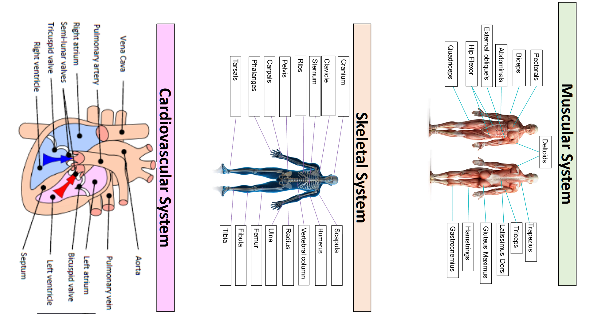
PE
7

Slide 10
PE
Health and Fitness
Muscular Strength | The amount of the force muscles can generate against a resistance
Muscular Endurance | The ability to use voluntary muscles, over long periods of time without getting tired
Flexibility | The range of movement at a joint
Cardiovascular Fitness (Aerobic Endurance) | The ability of the heart and circulatory system to meet the demands of the body for a long period of time
Body composition | The percentage of a body that is fat, muscle, bone and water
Coordination | The ability to move two or more body parts at the same time
Reaction Time | The time taken for a response to occur after a stimulus
Agility | The ability to change direction at speed
Balance | The ability to keep the body steady when in a static position or when moving
Speed | The time taken to cover a set distance/complete a movement
Power | The ability to combine speed and strength
Principles of training
Progressive Overload | Working the body harder than normal/gradually increasing the amount of exercise you do
Reversibility | If training is not regular, adaptations will be reversed. This can happen when suffering from illness, injury or after an off season
Specificity | Training showed be matched to the requirements of the sport or position the performer is in. Training must be specifically designed to develop the right muscles, type of fitness or skills
Individual needs | All PEP’s would differ depending on performers goals/target, strengths /weaknesses, age/gender and current health/fitness levels
Overtraining | Occurs when you train too hard and do not allow the body enough rest/recovery time Signs include extended muscle soreness, frequent illness & increase injuries
8

Slide 11
Computing
Processes
Decomposition | Breaking down a complex problem or system into smaller part
Algorithm | A step-by-step procedure that is created to solve a problem
Abstraction | Remove specific details and keeping the general relevant patterns.
Computational thinking | Computational Thinking is all about understanding how computers think and make decisions
Programming Features
Block-based programming | Any programming language that allows you to create programs by dragging blocks of scripts. E.g. Scratch
Sprites | A sprite is a character or object in your game or animation.
Stage | The stage is the background of the project. Different backgrounds can be imported or you can create your own.
Block menu | Helps users pick which scripts they need to control various aspects of a program
Variables | Are used to store data for use in your program. Variables can be used to store lots of different types of data such as names, numbers and scores.
Loops | Are used as a way of repeating instructions. Also known as iteration. Can loop a certain number of times or forever.
IF Statements | Can be used to select different scripts of a program depending on a condition.
Operators | Are used for changing or comparing data. They can add, subtract, multiply and divide data. They can also check if values are less than, greater than, or equal to other values.
Interface | What the user will see on screen when using Scratch.
Data | Assigned values which could include text or numbers for example.
Costume | The appearance of the sprite.
Flag | Will start and stop the application.
Sequence | Is the order of blocks of code are executed (run).
9

Slide 12
Art
Key Word | Definition
Tint | a shade or variety of a colour.
Shade | a colour, especially with regard to how light or dark it is or as distinguished from one nearly like it.
Blend | mix (a substance) with another substance so that they combine together.
Limited colour palette | it means limiting the number of colours you use in the painting to the bare essentials. A limited colour palette removes confusion as you only use the colours that you have chosen such as 3 colours, 4 colours etc. For example, if you’re using a limited colour palette of blue, white and red, you only have these three colours to choose from – making it simpler.
Natural | existing in or derived from nature; not made or caused by humankind.
Organic | Organic shapes are irregular and imperfect. Naturally these shapes will all be slightly different from one another. They are often curved and flowing and can seem unpredictable.
Wet into wet | Wet-on-wet is a direct painting technique that can be used with all wet paint mediums: watercolour, gouache, acrylic, and oil paints.
Burnishing | enhance or perfect (something such as a reputation or a skill).
Transparent | See-through (washes that are thinly applied).
Wash | A very watery mix applied with a large brush.
Harmonious colours | Harmonious colours sit beside each other on the colour wheel. These colours work well together and create an image which is pleasing to the eye. Harmonious colours may also be referred to as analogous colours.
Complimentary colours | is particular colour scheme draws from two colours on the opposite side of the colour wheel. When you do this, the result is a high-contrast colour combo that's bright and that pops. Examples of complementary colour combinations are: Red and green; yellow and purple; orange and blue; green and magenta.
Primary colours | any of a group of colours from which all other colours can be obtained by mixing
Secondary colours | a colour resulting from the mixing of two primary colours
Tertiary colours | A tertiary colour or intermediate colour is a colour made by mixing one part of a primary colour with half part of another primary
The Colour Wheel | a circle with different coloured sectors used to show the relationship between colours
10

Slide 13
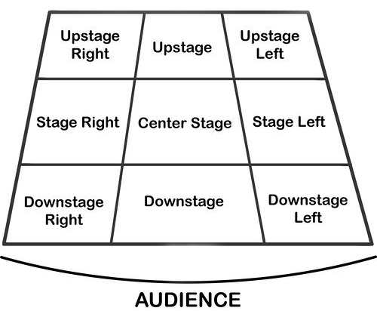
Performing Art
Key Word | Definition
Body Language | How an actor uses their body to communicate meaning. For example, crossing your arms could mean you are fed up
Gesture | a movement of the body, particularly the hands, arms, or head, that conveys meaning or expresses an idea, emotion, or intention
Levels | Levels can be used to show status, relationships, and even to indicate changes in location or time
Proxemics | The deliberate use of distance between you and other characters or objects to communicate something to an audience
Facial Expression | Using the face to express that characters feelings and emotions.
Key Word | Definition
Amphitheatre | Circular or oval open air theatre with a large ranked seating area
Apron | The apron is a section of the stage which the floor projects towards or into the auditorium
Black Box | A flexible studio theatre where the audience and actors are in the same room surrounded by black tabs
End On | Traditional audience seating layout where the audience is looking at the stage from the same direction.
Found Space | A performance space that wasn’t designed to be one e.g historic buildings
In the Round | Theatre in the Round is a form of audience seating layout where the acting area is surrounded on all sided by seating. There is often a number of entrances through the seating
Promenade | Form of staging where the audience moves around the performance space and sees the play at a variety of different locations
Proscenium Arch | The opening in the wall which stands between stage and auditorium in some theatres; the picture frame through the audience sees the play’ fourth wall’
Site-specific theatre | A piece of performance which has been deigned to work only in a particular non-theatre space
Stage Directions
Stage directions are from the performers perspective
11

Slide 14
Cooking and Nutrition
Key Word | Definition
Nutrition | A study of what people eat and how all the nutrients in foods work together in the body
Nutrients | Natural chemical substances in foods that are essential for body growth, function and health
Macro Nutrients | Nutrients needed by the body in large a mounts
Micro Nutrients | Nutrients needed in the body in smaller amounts
Amino acids | The building blocks of protein
Saturated fats | These fats usually come from animal sources and can be harmful to health
Unsaturated fats | These fats usually come from plant sources and can be good for health
Protein alternatives | Sources of protein other than meat that are suitable for vegetarians
Sensory evaluation | Judging food based on the appearance, taste, aroma and texture
Rubbing in | A technique in which fat is rubbed into flour and traps air in the mixture
pastry | A mixture of flour , fat and liquid which is made into a dough.
Boiling | Cooking in liquid at boiling point
simmering | Cooking food just below boiling point
baking | Placing food in dry heat in a hot oven, which cooks the food through
roasting | Cooking in the oven in hot fat
grilling | Cooking food under direct heat
Deep fat frying | Cooking by covering food in very hot oil
12

Slide 15
Music
13

Slide 16



Music
Key Word | Definition
Beat | The steady pulse of the music.
Tempo | How fast or slow the music is played (BPM, Beat Per Minute).
Rhythm | The pattern of long and short sounds in music.
Silence | A moment in music where no sound is played (a rest).
Melody | The main tune of a piece of music.
Structure | How different sections of music are organised.
Instrument | A sound used in the track (piano, drums, synth).
Loop | A short musical pattern that repeats.
Track | One layer of sound in a project (e.g., drums, bass, piano).
DAW | (Digital Audio Workstation) – Software used to create and edit music.
13

Slide 17
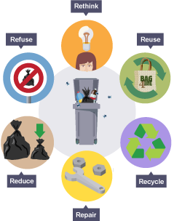
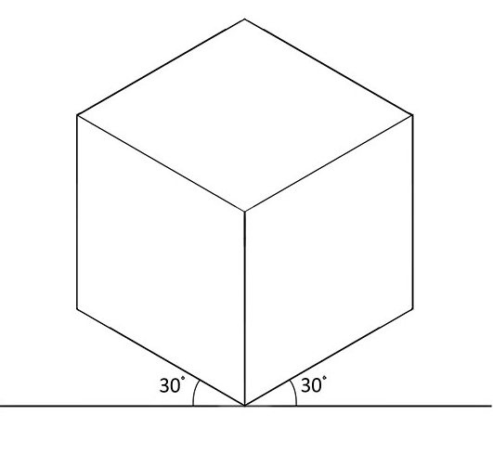
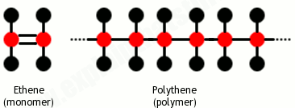
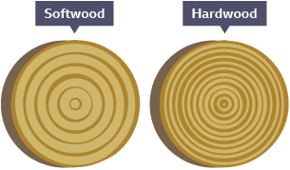
Design and Technology - RM
Key Words | Definition
Coniferous | Evergreen trees that bear cones.
Deciduous | Trees and shrubs that loose their leaves in the autumn
Deforestation | The chopping down and removal of trees to clear an area of forest.
Evergreen | A tree or plant that keeps its leaves all year round.
Hardwood | Mainly have large broad leaves, which usually produce a seed or fruit.
Isometric Drawing | A 3D representation of a design with no vanishing points.
Marking Out | Marks made on an item before cutting or forming.
Polymer | A large molecule formed from many identical smaller molecules (monomers), can be natural or synthetic.
Pollution | Contaminating the air, water or ground with harmful substances.
Key Words | Definition
Properties | The qualities a material possesses which suit its specific purpose.
Physical Properties | The traits a material has before it is used
Softwoods | Come from coniferous trees and often have pines or needles.
Sustainability | Does not damage the environment e.g. plant based plastic
Thermoforming | Can be heated and shaped, then heated and shaped again.
Thermosetting | Can only be heated and shaped once.
Tolerance | The amount of error you will allow a part to have.
Working Properties | The material behaves when it is manipulated.
Isometric Drawing
Wide Grain
Softwood
Polymer
Narrow Grain
Hardwood
14

Slide 18
W/c 13th April Thinking definition: Thinking is making connections, reasoning and asking questions to make the learning stick
Reflecting on learning behaviours for resilience … | Experience log
 | Successful moment… | In hindsight… Where you could have done better on reflection? | At home…
I gave an idea and reasoned/justified.
I reflected on my idea and made it better after discussing with others
I used a revision strategy to help make the learning stick.
I made connections between what I am learning and the outside world.
I asked questions to deepen my understanding.
15

Slide 19
W/c 20th April Thinking definition: Thinking is making connections, reasoning and asking questions to make the learning stick
Reflecting on learning behaviours for resilience …… | Experience log
 | Successful moment… | In hindsight… Where you could have done better on reflection? | At home…
I gave an idea and reasoned/justified.
I reflected on my idea and made it better after discussing with others
I used a revision strategy to help make the learning stick.
I made connections between what I am learning and the outside world.
I asked questions to deepen my understanding.
16

Slide 20
W/c 27th April Thinking definition: Thinking is making connections, reasoning and asking questions to make the learning stick
Reflecting on learning behaviours for resilience …… | Experience log
 | Successful moment… | In hindsight… Where you could have done better on reflection? | At home…
I gave an idea and reasoned/justified.
I reflected on my idea and made it better after discussing with others
I used a revision strategy to help make the learning stick.
I made connections between what I am learning and the outside world.
I asked questions to deepen my understanding.
17

Slide 21
W/c 4th May Thinking definition: Thinking is making connections, reasoning and asking questions to make the learning stick
Reflecting on learning behaviours for resilience … | Experience log
 | Successful moment… | In hindsight… Where you could have done better on reflection? | At home…
I gave an idea and reasoned/justified.
I reflected on my idea and made it better after discussing with others
I used a revision strategy to help make the learning stick.
I made connections between what I am learning and the outside world.
I asked questions to deepen my understanding.
18

Slide 22
W/c 11th May Thinking definition: Thinking is making connections, reasoning and asking questions to make the learning stick
Reflecting on learning behaviours for resilience … | Experience log
 | Successful moment… | In hindsight… Where you could have done better on reflection? | At home…
I gave an idea and reasoned/justified.
I reflected on my idea and made it better after discussing with others
I used a revision strategy to help make the learning stick.
I made connections between what I am learning and the outside world.
I asked questions to deepen my understanding.
19

Slide 23
W/c 18th May Thinking definition: Thinking is making connections, reasoning and asking questions to make the learning stick
Reflecting on learning behaviours for resilience … | Experience log
 | Successful moment… | In hindsight… Where you could have done better on reflection? | At home…
I gave an idea and reasoned/justified.
I reflected on my idea and made it better after discussing with others
I used a revision strategy to help make the learning stick.
I made connections between what I am learning and the outside world.
I asked questions to deepen my understanding.
20

Slide 24
Reading Log w/c 13th April (20 mins reading per day – all five logs MUST be completed)
Date | Title of novel | Number of pages read | Summary about what I have read
 |  |  | • • •
 |  |  | • • •
 |  |  | • • •
 |  |  | • • •
 |  |  | • • •
Checked by form tutor:
21

Slide 25
Reading Log w/c 20th April (20 mins reading per day – all five logs MUST be completed)
Date | Title of novel | Number of pages read | Summary about what I have read
 |  |  | • • •
 |  |  | • • •
 |  |  | • • •
 |  |  | • • •
 |  |  | • • •
Checked by form tutor:
22

Slide 26
Reading Log w/c 27th May (20 mins reading per day – all five logs MUST be completed)
Date | Title of novel | Number of pages read | Summary about what I have read
 |  |  | • • •
 |  |  | • • •
 |  |  | • • •
 |  |  | • • •
 |  |  | • • •
Checked by form tutor:
22

Slide 27
Reading Log w/c 4th May (20 mins reading per day – all five logs MUST be completed)
Date | Title of novel | Number of pages read | Summary about what I have read
 |  |  | • • •
 |  |  | • • •
 |  |  | • • •
 |  |  | • • •
 |  |  | • • •
Checked by form tutor:
23

Slide 28
Reading Log w/c 11th May (20 mins reading per day – all five logs MUST be completed)
Date | Title of novel | Number of pages read | Summary about what I have read
 |  |  | • • •
 |  |  | • • •
 |  |  | • • •
 |  |  | • • •
 |  |  | • • •
Checked by form tutor:
24

Slide 29
Reading Log w/c 18th May (20 mins reading per day – all five logs MUST be completed)
Date | Title of novel | Number of pages read | Summary about what I have read
 |  |  | • • •
 |  |  | • • •
 |  |  | • • •
 |  |  | • • •
 |  |  | • • •
Checked by form tutor:
25

Slide 30
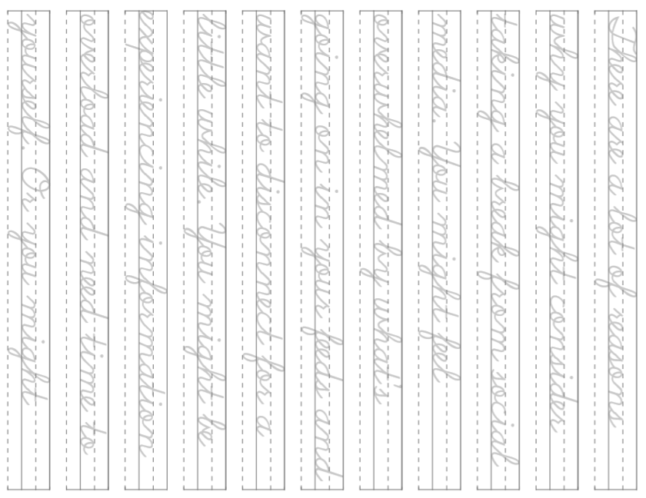
26

Slide 31
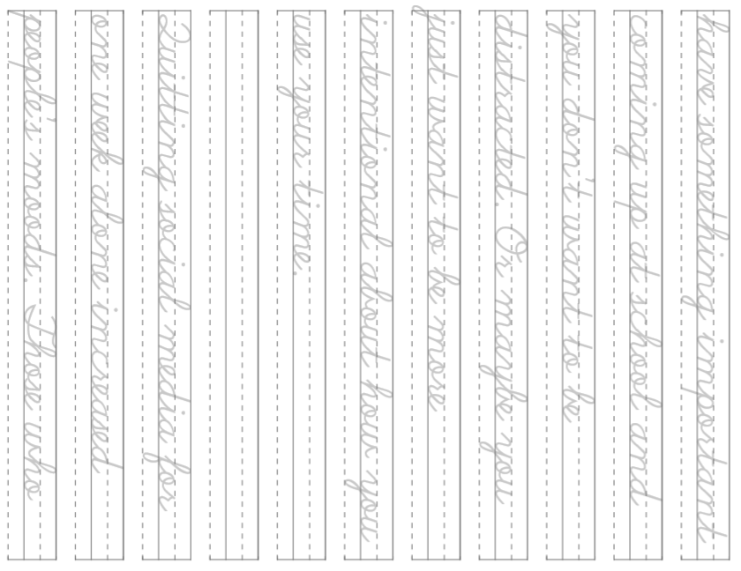
27

Slide 32
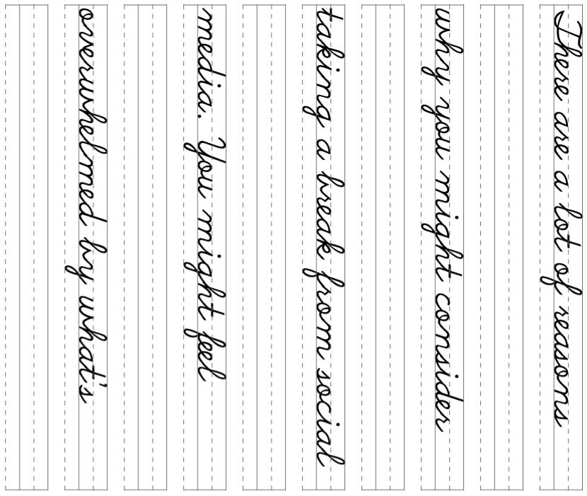
28

Slide 33
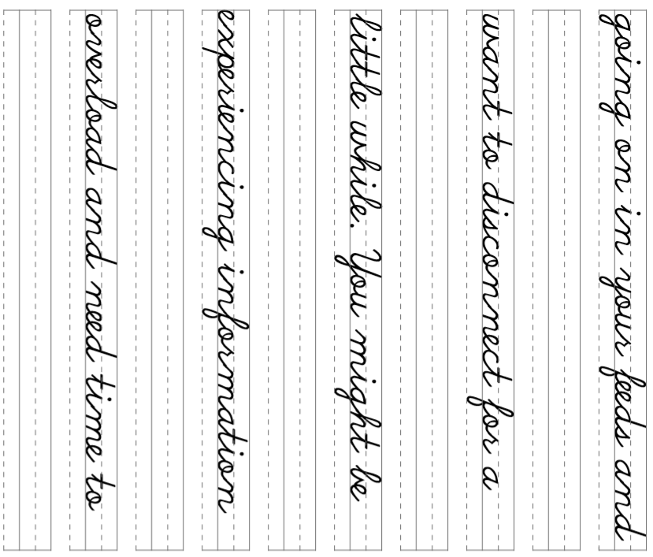
29

Slide 34
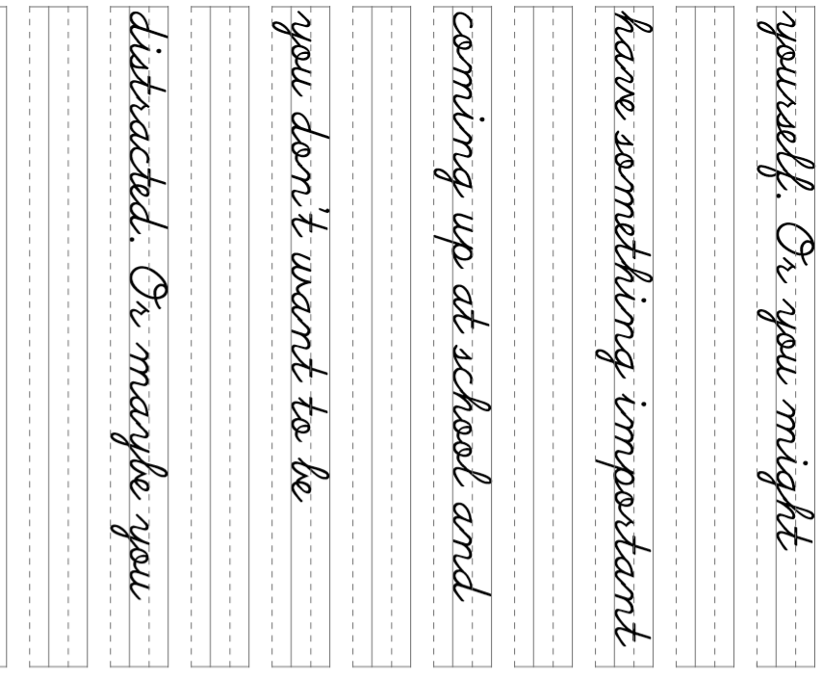
30

Slide 35


31

Slide 36
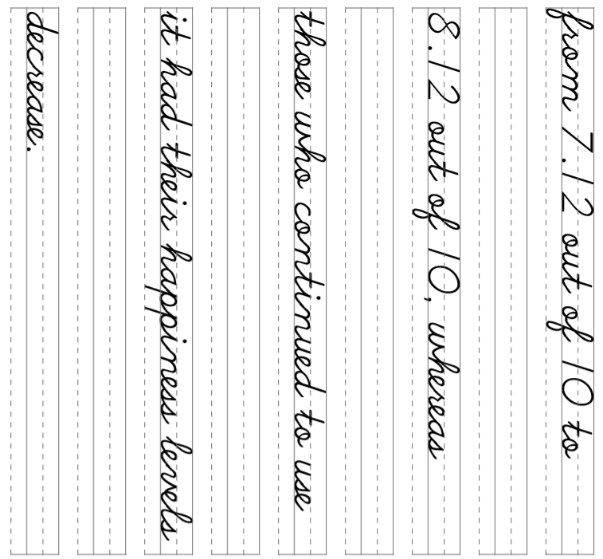
32

Slide 37
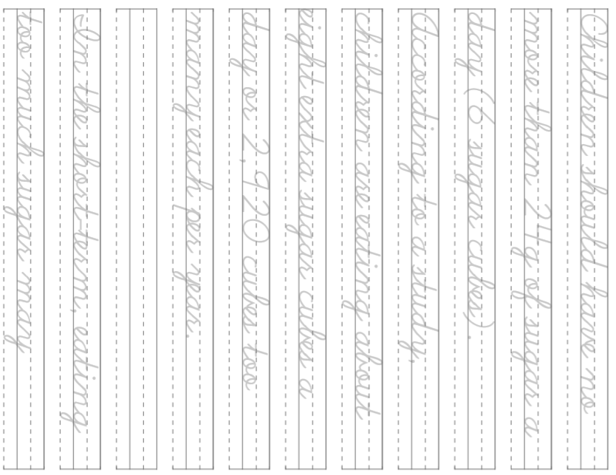
33

Slide 38
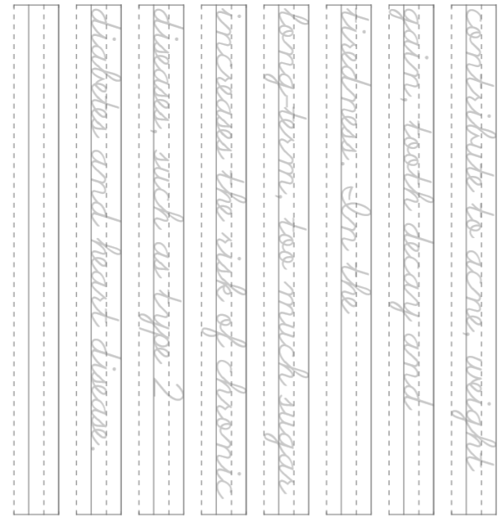
34

