Slide 1

Year 7 Knowledge Organiser HT6
Knowledge is Power
Name: ______________________________
Form: _______

Slide 2
Contents Page
Subject | Page
English | 1
Maths | 2
Science | 3
Spanish | 4
History | 5
Geography | 6
PE | 7
Computing | 9
Art | 10
Performing Arts | 11
Cooking and Nutrition | 12
Music | 13
DT | 14
‘Resilience’ reflection log | 15
Reading log | 22
Cursive Handwriting Practice | 29

Slide 3
English
Week 1 – Key Characters
Ferdinand | The son of the King of Naples
Prospero | The Duke of Milan
Caliban | A slave
Miranda | Prospero’s daughter
Antonio | Prospero’s brother
Ariel | Prospero’s spirit helper
Week 4 – Context
The Tempest is a play by William Shakespeare between 1610 - 1611
Before science and technology, there was a heavy belief in magic and the supernatural.
A Shakespearian society was a patriarchal one. This is where men were superior to women and had more power.
The Tempest was set in Italy
The play was written and performed during the Jacobean era
Week 6 – Plot Summary
Act 1 | A violent storm rages around the ship
Act 2 | Characters search for Ferdinand
Act 3 | Caliban is treated badly particularly by Prospero
Act 4 | Prospero gives his blessing for Ferdinand to marry Miranda
Act 5 | Prospero speaks to the prisoners and forgives each of them
Week 2 – Key Words
Tempest | A violent storm
Callous | When someone is cruel and does not care about other people
Treason | A crime that harms your country. Someone who commits treason is a traitor
Colonialism | When one country establishes itself in another country
Tragicomedy | A play that has some features of a tragedy and some features of a comedy
Week 7 – Language Devices
Foreshadowing | When events are a warning or indication of the future
Pathetic fallacy | When the weather reflects the mood
Oxymoron | Contradictory words appear close to each other
Dramatic irony | A statement that signifies the opposite of something or an event that has happened
Week 5 – Key Quotes
Prospero | “A devil, a born devil, on whose nature nurture can never stick”
Miranda | “Abhorred slave…vile race”
Caliban | “I’ll be wise hereafter and seek for grace”
Prospero | “At this hour, lies at my mercy all mine enemies”
Week 3 – Key Themes in The Tempest
Colonialism | Freedom
Betrayal | Forgiveness
Magic | Revenge
Power | Supernatural
1

Slide 4
Maths
Tables, Charts and Graphs
Key Word | Definition
Discrete data | Data that can only take certain values. These values do not have to be whole numbers, but they are fixed values. e.g. shoe size, number of goals
Continuous data | Data that is measured and can take any value e.g. Height, time, temperature
Tally Chart | A way of keeping count by making marks
Frequency | Total
Pictogram | Uses pictures to represent data
Line graphs | A graph with points connected by lines
Bar Chart | A graph drawn using rectangular bars to show how large each value is
Probability
Key Word | Definition
Probability | The chance something will happen
Event | What you want to happen e.g. pick a red, roll a six
Probability scale | The probability scale is a number line from 0 to 1. Events can range from impossible to certain.
Experimental probability | This is the probability calculated from an experiment
Relative Frequency | The probability of something relative to a number of trials or an experiment that has happened.
Mutually exclusive | an event that has two or more outcomes that cannot be true at the same time
Units
Key Word | Definition
Metric units | A system used globally for measuring distance, length, volume, weight and temperature.
Metric conversions | Length | Mass | Capacity
 | 1cm = 10mm | 1g = 1000mg | 1cm³ = 1ml
 | 1m = 100cm | 1kg = 1000g | 1L = 1000ml
 | 1km = 1000m | 1 tonne = 1000kg | 1L = 1000cm³
2

Slide 5
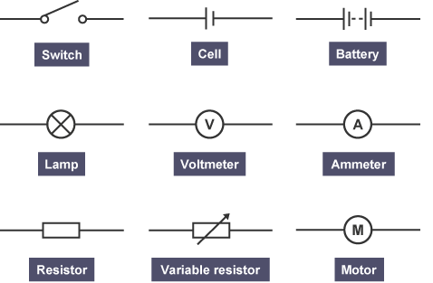
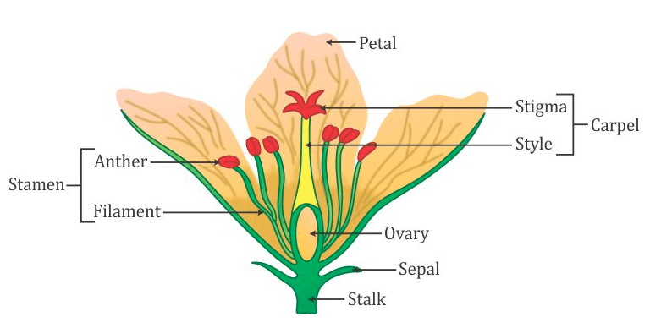
Science
Circuit Symbols
Physics Key Words | Definition
Current | The flow of charges
Potential Difference | The energy transferred to the charges
Voltmeter | The apparatus used to measure potential difference
Ammeter | The apparatus used to measure current
Insulator | A material that doesn’t transfer energy easily
Series | A circuit where components are one after the other
Parallel | A circuit where components have their own loop
Resistance | When the flow of current is reduced
Switch
Cell
Battery
Lamp
Voltmeter
Ammeter
Resistor
Variable Resistor
Motor
Biology Key Words | Definition
Fertilisation | When the egg and sperm fuse together
Zygote | The first cell made from the fertilisation of the egg and sperm
Nucleus | Contains the genetic material
Embryo | A ball of cells
Pollination | When pollen is transferred to another flower/plant
Pollen | The male sex cell of a plant
Ovule | The female sex cell of a plant
Gametes | Sex cells
Parts of a Flower
Petal
Stigma
Carpel
Style
stamen
anther
filament
Ovary
Sepal
Stalk
3

Slide 6
Spanish
Spanish | English
fácil | Easy
Difícil | Difficult
Gracioso | Funny
duro | Hard
Útil | Useful
Inútil | Useless
Práctico | Practical
complicado | Complicated
Emocionante | Exciting
entretenido | Entertaining
El insti(tuto) | Secondary school
las aulas | Classrooms
El patio | Playground
La biblioteca | Library
El edificio | Building
Los laboratorios | Laboratories
El gimnasio | Gym
El comedor | Canteen
La sala de informática | Computer room
Spanish | English
La piscina | Swimming pool
El campo de fútbol | Football pitch
La pista de tenis | Tennis court
Me despierto | I wake up
Me levanto | I get up
Me visto | I get dressed
Desayuno | I have breakfast
Me lavo los dientes | I brush my teeth
Me lavo | I wash myself
Salgo de casa | I leave home
Ceno | I have dinner
Me acuesto | I go to bed
A las… | At
De la mañana / tarde | In the morning / afternoon
y media | Half past
Y cuarto | Quarter past
Menos cuarto | Quarter to
Spanish | English
Asignatura | School subject
El español | Spanish
Las ciencias | Science
Las matemáticas | Maths
El inglés | English
La geografía | Geography
La historia | History
La educación física | P.E.
La informática | Computing
La música | Music
La religion | Religion
El teatro | Drama
El dibujo | Art
Divertido | Amusing
Aburrido | Boring
Genial | Great
interesante | Interesting
4

Slide 7
History
Key Terms
Conquer | To overcome and take control of a place or people by military force.
Trade | The act of buying and selling goods.
Merchant | A person who buys and sells things.
Charter | A list of conditions.
Empire | A group of countries or states ruled by a single monarch.
Viceroy | A ruler exercising authority in a colony on behalf of the King/Queen.
British Raj | The rule by the British Crown in India between 1585-1947.
Empress of India | 1877, Prime Minister, Disraeli, gave Queen Victoria this title. It was meant to bind India even closer to Britain
Massacre | An indiscriminate and brutal slaughter of many people.
Inevitable | Certain to happen. The event is unavoidable.
Indian National Congress (INC): | It had over 15 million members and over 70 million participants. It success also influenced other nationalist movements in colonies of the British Empire.
Partitioned | The action of dividing or being divided into two parts.
Key Events
1526 Mughal India | An empire in the Indian subcontinent which consolidated Islam and spread Muslim arts and culture as well as faith. It lasted until 1857.
1857-58 | The Indian Rebellion against the British rule. It is also known as the Indian Mutiny or the wars of Independence.
25th December 1885 | The Indian National Congress was created. It played a major role in Indian independence movement.
1914-1918 | Troops from all parts of the Empire, including India, fought for Britain and its allies during WWI.
13th April 1919 | The Amritsar Massacre occurred when British troops opened fire on Indian civilians including women and children.
1919 and 1935 | Government of India Acts (British) giving Indians more power and control in their country.
1939 | 2.5 million Indians join up to fight as part of the British force during WWII.
15th August 1947 | Britain stopped ruling India. India is partitioned and Pakistan is created.
5

Slide 8
Geography
Key Words | Definition
Natural resource | Materials found in nature which can be exploited for economic gain (money).
Energy | Power to provide light and heat or to work machines.
Renewable energy | Natural energy sources which can reused/ are infinite and do not run out.
Non- renewable energy | Energy which cannot be replaced or reuse.
Fossil fuels | A natural fuel such as coal or gas, formed in the geological past from the remains of living organisms.
Sustainable | Meeting the needs of today without compromising the needs of the future.
Dam | A barrier constructed to hold back water and raise its level, forming a reservoir used to generate electricity or as a water supply.
Reservoir | A large natural or artificial lake used as a source of water supply.
Afforestation | The planting of trees.
Supply | To make something available to a person or people.
Consumption | To using of resources.
Greenhouse gases | Gases which trap heat in the atmosphere, such as carbon dioxide.
Greenhouse effect | The trapping of the sun's warmth in a planet's lower atmosphere, due to the greater transparency of the atmosphere to visible radiation from the sun than to infrared radiation emitted from the planet's surface.
Water scarcity | Insufficient clean water resources to meet the human and environmental demands of a given area.
Minerals | A solid, naturally occurring inorganic substance such
Crops | Food planted for the purpose of human consumption.
6

Slide 9

PE
7

Slide 10
PE
Cardiovascular System – Components of blood
Red blood cells | Carry oxygen from the lungs to the working muscles + Removes CO2.
Haemoglobin | A protein that binds and carries oxygen molecules.
White blood cells | Are part of the immune system and fight disease and infection.
Platelets | Blood platelets are formed in the bone marrow and are essential in the clotting of blood. Platelets are the workhorses of the cardiovascular system.
Plasma | Blood plasma is made up of 90% water. It contains a range of substances that aids the circulation between cells and tissues.
Blood Vessels
Arteries | Carry blood away from the heart, Oxygenated blood (except pulmonary artery) Thick/elastic walls High pressure Small lumen
Veins | Carry blood back to the heart Deoxygenated blood (except pulmonary vein) Thin walls + larger lumen Lower pressure Valves
Capillaries | In the tissue Site of gaseous exchange Very thin walls
8

Slide 11
Computing
Spreadsheets
Spreadsheet | A computer program used for accounting and recording “data” using rows and columns, into which information can be entered
Cell reference | Is the intersection between a row and a column on a spreadsheet that starts with “cell” A1.
Absolute cell reference | Ensures that the cell always remains constant even when autofill is used. E.g. $E$4
Formula | Are usually simple calculations. They always start with an equals sign
Functions | Are predefined formulas and are already available in Excel
Merge | A tool that enables different nearby cells to be joined into a single larger cell
Wrap text | A tool that allows all text in a cell to be made visible
Operators | Are symbols used in a formula
Chart | Is a graphical representation of data entered in spreadsheet
Sort | Organises data in a specific way
Spreadsheets
Conditional formatting | Allows you to apply special formatting to cells that meet certain criteria
IF statement | Tests a given condition and returns one value for a TRUE result and another value for a FALSE result.
Find and select | Can be used to find a specific label or value from the entire spreadsheet
Border tool | Used to put lines around specific parts of the spreadsheet or cells. Makes it easier on the eye and separates sections of the spreadsheet
Accounting format | Used when you are dealing with money. Different currencies can be selected
V Lookup | ‘Vertical Lookup'. It is a function that makes Excel search for a certain value in a column (the so called 'table array'), in order to return a value from a different column in the same row.
9

Slide 12
Art
Key Word | Definition
Assemblage | A three-dimensional artwork made by joining materials and objects together
Balance | The arrangement of the elements in a work of art which create a sense of equilibrium. Balance is a principle of art.
Composition | describes the different ways elements of an artwork are arranged.
Continuous Line Drawing | a type of line drawing where the drawing implement is not taking off the page until the drawing is complete. It is often a fast paced way of working resulting in fluid mark making.
Line Drawing | A line drawing is a drawing made of only lines. It does not include any shading.
Media | A type of art material e.g. watercolour, charcoal, pastels
10

Slide 13
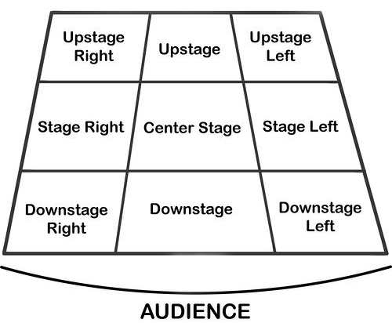
Performing Art
Key Word | Definition
Body Language | How an actor uses their body to communicate meaning. For example, crossing your arms could mean you are fed up
Gesture | a movement of the body, particularly the hands, arms, or head, that conveys meaning or expresses an idea, emotion, or intention
Levels | Levels can be used to show status, relationships, and even to indicate changes in location or time
Proxemics | The deliberate use of distance between you and other characters or objects to communicate something to an audience
Facial Expression | Using the face to express that characters feelings and emotions.
Key Word | Definition
Amphitheatre | Circular or oval open air theatre with a large ranked seating area
Apron | The apron is a section of the stage which the floor projects towards or into the auditorium
Black Box | A flexible studio theatre where the audience and actors are in the same room surrounded by black tabs
End On | Traditional audience seating layout where the audience is looking at the stage from the same direction.
Found Space | A performance space that wasn’t designed to be one e.g historic buildings
In the Round | Theatre in the Round is a form of audience seating layout where the acting area is surrounded on all sided by seating. There is often a number of entrances through the seating
Promenade | Form of staging where the audience moves around the performance space and sees the play at a variety of different locations
Proscenium Arch | The opening in the wall which stands between stage and auditorium in some theatres; the picture frame through the audience sees the play’ fourth wall’
Site-specific theatre | A piece of performance which has been deigned to work only in a particular non-theatre space
Stage Directions
Stage directions are from the performers perspective
11

Slide 14
Cooking and Nutrition
Key Word | Definition
Hazard | Anything that is dangerous
Kitchen Hygiene | Ensuring that everything is clean when preparing food
Kitchen Safety | Being safe in the kitchen
Cross contamination | Transfer of bacteria from one person, object or place to another
Eat Well Guide | A pictorial food guide showing the amounts and types of foods that are needed to make up a healthy balanced diet
Claw grip | A method of cutting food that ensures that the finger tips are tucked out of the way and will not get caught by the knife
Food poisoning | An illness caused by eating contaminated food
Bacteria | Microscopic living organisms which can be found everywhere
Salmonella | Food poisoning bacteria found in chicken, some dairy products and raw eggs
Food provenance | The origin of food. Knowing how food is grown, reared and caught
Recipe | A set of instructions used for preparing a food product
Food Miles | The distance food ravels from the farm to the fork
12

Slide 15

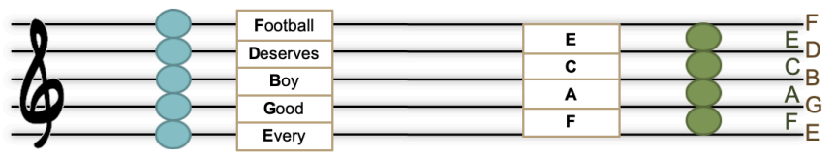
Music
Key Word | Definition
Call and response | one phrase in sung/played and an answering phrase completes the musical idea.
Structure | the order the different sections of a song or piece of music are played in.
Harmony | is the combination of different musical notes played simultaneously.
Tempo: | The speed of the beat.
Beat: | The regular, underlying pulse in the music.
Offbeat: | A beat that is normally weak or unstressed; beat 2 or 4 in 4/4 time.
Rhythm: | Patterns of long and short note durations.
Silence | Absence of sound
Tempo: | The speed of the beat.
Range: | The span of a melody, from the lowest note to the highest.
Register: | The pitch around which a melody is set relative to the range of the singer’s voice or the instrument, e.g. high or low.
Dynamic | How loud or quiet the piece is
13

Slide 16
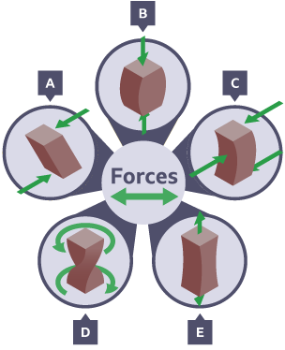
Design and Technology - RM
Year 7
Key Words | Definition
Automation | Using automatic equipment in production.
CAD | Computer Aided Design - use of computer software to design in 3D/2D
CAM | Computer Aided Manufacturing - use of software and computer-controlled machinery to automate a manufacturing process.
Conductor | Materials which allow an electrical current to flow through easily e.g. copper is a good conductor of electricity as it has a low resistance.
Design Fixation | When a designer finds it difficult, to produce a range of innovative solutions, to a design problem.
Forces | Act on materials all the time - even if a material appears stationary it still has a force acting on it.
Finishing Technique | Can be either to protect a product or to provide an aesthetic quality.
Idea Generation | The process of creating, developing, and communicating new ideas.
Key Words | Definition
Input Devices | An electronic component capable of passing information from the outside world into an electronic system for processing.
Insulator | Materials that do not allow an electrical current to flow through them e.g. rubber has a high resistance so it usually covers the copper wire.
Output Devices | A device used to output data or information from a computer, eg a monitor, printer or speakers.
PCB | Printed Circuit Board
Process Devices | A device, usually an integrated circuit, that controls the process functions of a system.
Resistors | Used to restrict the flow of current around a circuit and can prevent damage to components.
User Centred Design | (UCD) is a design approach that prioritizes the needs, wants, and limitations of the end-users throughout the entire design process.
Forces
Shearing
Compression
Bending
Torsion
Tension
Advantages of CAD | Disadvantages of CAD
Ideas can be drawn and developed quickly | Expensive to set up
Designs can be viewed from all angles and with a range of materials | Needs a skilled workforce
Some testing and consumer feedback can be done before costly production takes place | Difficult to keep up with constantly changing and improving technology
Advantages of CAM | Disadvantages of CAM
Fast and accurate production | Expensive to set up
Machines can run constantly on repetitive tasks | Needs a skilled workforce of engineers
14

Slide 17
W/c 1st June Thinking definition: Thinking is making connections, reasoning and asking questions to make the learning stick
Reflecting on learning behaviours for resilience….. | Experience log
 | Successful moment… | In hindsight… Where you could have done better on reflection? | At home…
I gave an idea and reasoned/justified.
I reflected on my idea and made it better after discussing with others
I used a revision strategy to help make the learning stick.
I made connections between what I am learning and the outside world.
I asked questions to deepen my understanding.
15

Slide 18
W/c 8th June Thinking definition: Thinking is making connections, reasoning and asking questions to make the learning stick
Reflecting on learning behaviours for resilience….. | Experience log
 | Successful moment… | In hindsight… Where you could have done better on reflection? | At home…
I gave an idea and reasoned/justified.
I reflected on my idea and made it better after discussing with others
I used a revision strategy to help make the learning stick.
I made connections between what I am learning and the outside world.
I asked questions to deepen my understanding.
16

Slide 19
W/c 15th June Thinking definition: Thinking is making connections, reasoning and asking questions to make the learning stick
Reflecting on learning behaviours for resilience….. | Experience log
 | Successful moment… | In hindsight… Where you could have done better on reflection? | At home…
I gave an idea and reasoned/justified.
I reflected on my idea and made it better after discussing with others
I used a revision strategy to help make the learning stick.
I made connections between what I am learning and the outside world.
I asked questions to deepen my understanding.
17

Slide 20
W/c 22nd June Thinking definition: Thinking is making connections, reasoning and asking questions to make the learning stick
Reflecting on learning behaviours for resilience….. | Experience log
 | Successful moment… | In hindsight… Where you could have done better on reflection? | At home…
I gave an idea and reasoned/justified.
I reflected on my idea and made it better after discussing with others
I used a revision strategy to help make the learning stick.
I made connections between what I am learning and the outside world.
I asked questions to deepen my understanding.
18

Slide 21
W/c 29th June Thinking definition: Thinking is making connections, reasoning and asking questions to make the learning stick
Reflecting on learning behaviours for resilience….. | Experience log
 | Successful moment… | In hindsight… Where you could have done better on reflection? | At home…
I gave an idea and reasoned/justified.
I reflected on my idea and made it better after discussing with others
I used a revision strategy to help make the learning stick.
I made connections between what I am learning and the outside world.
I asked questions to deepen my understanding.
19

Slide 22
W/c 6th July Thinking definition: Thinking is making connections, reasoning and asking questions to make the learning stick
Reflecting on learning behaviours for resilience….. | Experience log
 | Successful moment… | In hindsight… Where you could have done better on reflection? | At home…
I gave an idea and reasoned/justified.
I reflected on my idea and made it better after discussing with others
I used a revision strategy to help make the learning stick.
I made connections between what I am learning and the outside world.
I asked questions to deepen my understanding.
20

Slide 23
W/c 13th July Thinking definition: Thinking is making connections, reasoning and asking questions to make the learning stick
Reflecting on learning behaviours for resilience….. | Experience log
 | Successful moment… | In hindsight… Where you could have done better on reflection? | At home…
I gave an idea and reasoned/justified.
I reflected on my idea and made it better after discussing with others
I used a revision strategy to help make the learning stick.
I made connections between what I am learning and the outside world.
I asked questions to deepen my understanding.
21

Slide 24
Reading Log w/c 1st June (20 mins reading per day – all five logs MUST be completed)
Date | Title of novel | Number of pages read | Summary about what I have read
 |  |  | • • •
 |  |  | • • •
 |  |  | • • •
 |  |  | • • •
 |  |  | • • •
Checked by form tutor:
22

Slide 25
Reading Log w/c 8th June (20 mins reading per day – all five logs MUST be completed)
Date | Title of novel | Number of pages read | Summary about what I have read
 |  |  | • • •
 |  |  | • • •
 |  |  | • • •
 |  |  | • • •
 |  |  | • • •
Checked by form tutor:
23

Slide 26
Reading Log w/c 15th June (20 mins reading per day – all five logs MUST be completed)
Date | Title of novel | Number of pages read | Summary about what I have read
 |  |  | • • •
 |  |  | • • •
 |  |  | • • •
 |  |  | • • •
 |  |  | • • •
Checked by form tutor:
24

Slide 27
Reading Log w/c 22rd June (20 mins reading per day – all five logs MUST be completed)
Date | Title of novel | Number of pages read | Summary about what I have read
 |  |  | • • •
 |  |  | • • •
 |  |  | • • •
 |  |  | • • •
 |  |  | • • •
Checked by form tutor:
25

Slide 28
Reading Log w/c 29th June (20 mins reading per day – all five logs MUST be completed)
Date | Title of novel | Number of pages read | Summary about what I have read
 |  |  | • • •
 |  |  | • • •
 |  |  | • • •
 |  |  | • • •
 |  |  | • • •
Checked by form tutor:
26

Slide 29
Reading Log w/c 6th July (20 mins reading per day – all five logs MUST be completed)
Date | Title of novel | Number of pages read | Summary about what I have read
 |  |  | • • •
 |  |  | • • •
 |  |  | • • •
 |  |  | • • •
 |  |  | • • •
Checked by form tutor:
27

Slide 30
Reading Log w/c 13th July (20 mins reading per day – all five logs MUST be completed)
Date | Title of novel | Number of pages read | Summary about what I have read
 |  |  | • • •
 |  |  | • • •
 |  |  | • • •
 |  |  | • • •
 |  |  | • • •
Checked by form tutor:
28

Slide 31

29

Slide 32

30

Slide 33

31

Slide 34

32

Slide 35

33

Slide 36

34

Slide 37


35

Slide 38
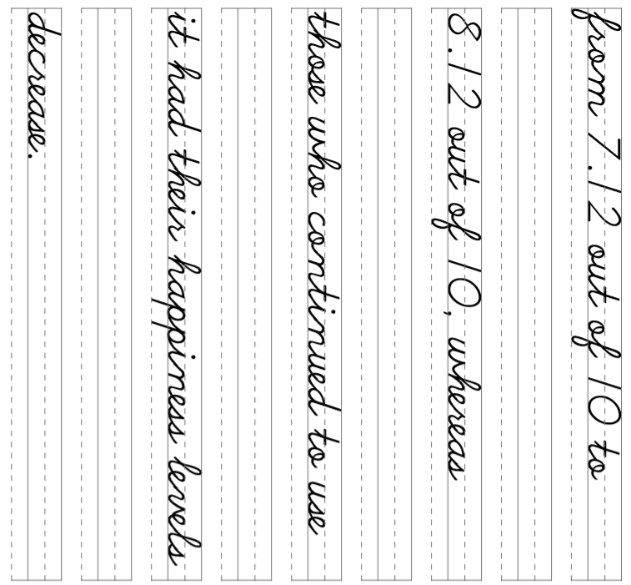
36

Slide 39
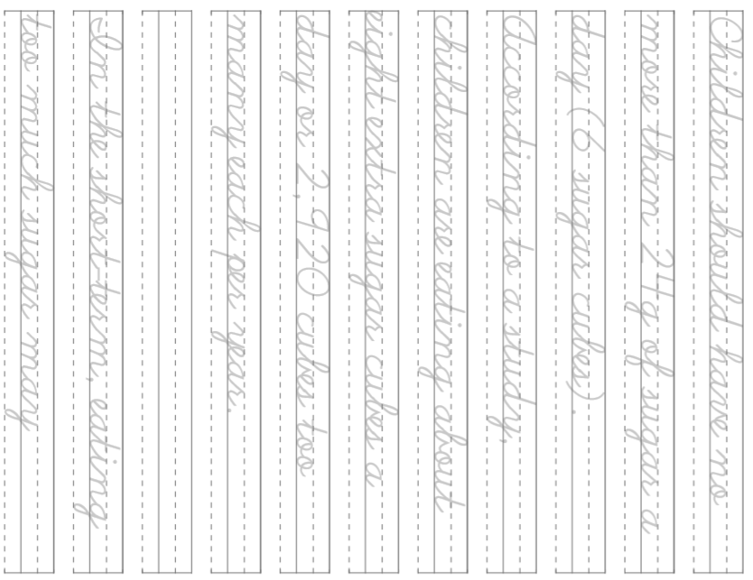
37

Slide 40
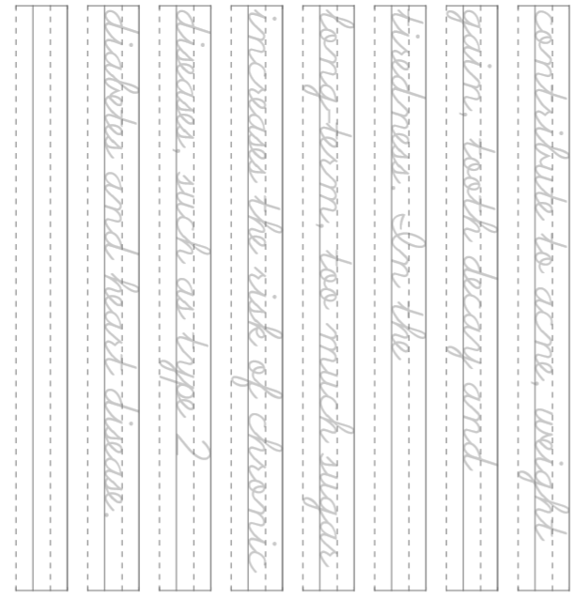
38

