Slide 1

Year 8 Knowledge Organiser HT1
Knowledge is Power
Name: ______________________________
Form: _______

Slide 2
Contents Page
Subject | Page
English | 1
Maths | 2
Science | 3
Spanish | 5
History | 7
Geography | 8
PE | 9
Computing | 10
Art | 11
Cooking and Nutrition | 12
Music | 13
Performing Art | 14
Design and Technology | 15
‘Thinking’ reflection log | 16
Reading log | 23
Reading for Pleasure Extracts | 30
Cursive Handwriting Practice | 37

Slide 3
English
Week 3 – Subject Terms
Racism | Prejudice, discrimination or hostility directed at people due to their race or ethnicity.
Soliloquy | When a character on stage speaks their thoughts to the audience only.
Dramatic Irony | When the audience knows something that some or all characters on stage do not.
Symbolism | The use of objects and language in the play to represent ideas
Tragic Hero | A noble but flawed character who is the focus of a tragedy.
Week 5 – Language techniques
Metaphor | Comparing something by saying it is something else.
Simile | Comparing something by saying it is like something else.
Imagery | Language that creates pictures in our minds and appeals to the senses.
Hyperbole | Exaggerating for a purpose
Week 1 - Key Terms
Context | Background information and circumstances that help us understand the play.
Tragedy | A genre of play focused around a noble character who has a downfall due to their character flaws.
Moor | Refers to Northern African people but in Shakespeare’s time used to mean African people in general.
Venice | Italian city famous for its canals where Othello is set.
Patriarchal | A society or government controlled by men and benefitted men.
Week 6 - Key Terms
Controversial | A topic that might shock people and cause a lot of disagreement and discussion
Downfall | Loss of one’s power, property, status and sometimes life.
Conflicted | Having or showing confused and contrasted feelings.
Tragic Villain | A character that places pressure on the tragic hero; often a scheming, Machiavellian character.
Tragic Victim | A character who suffers and is killed to evoke pity and sympathy in the audience.
Week 4 - Key Vocabulary
Lascivious | Crude or offensive sexual behaviour.
Knave | A dishonest and dishonourable person.
Barbary | A region of Northern Africa and also where the term ‘barbarian’/’barbaric’ is believed to have come from.
Iambic Pentameter | A line consisting of 5 iambs (2 syllable feet) totalling 10 syllables. This usually shows a character is of high status in society. Also known as speaking in ‘verse’.
Week 7 – Subject Terms
Monologue | A long speech by one actor in a play.
Soliloquy | When a character on stage speaks their thoughts to the audience only.
Dramatic Irony | When the audience knows something that some or all characters on stage do not.
Symbolism | The use of objects and language in the play to represent ideas
Week 2 - Key Vocabulary
Duplicitous | Deceitful, dishonest, two-faced
Manipulative | Exercising control over people or situations for personal benefit.
Unscrupulous | Without moral principles; not honest or fair.
Machiavellian | Cunning, unscrupulous and manipulative.
Antagonist | The main opponent of the hero of a play or story.
Week 8 – Characters in Othello
Othello | A Moorish general in the Venetian army, who is the tragic hero.
Desdemona | A beautiful Venetian noblewoman and Othello's wife.
Iago | Othello’s chief and the antagonist of the play.
Emilia | Iago’s wife and Desdemona’s servant.
1
Notes:
Year 8 HT2

Slide 4
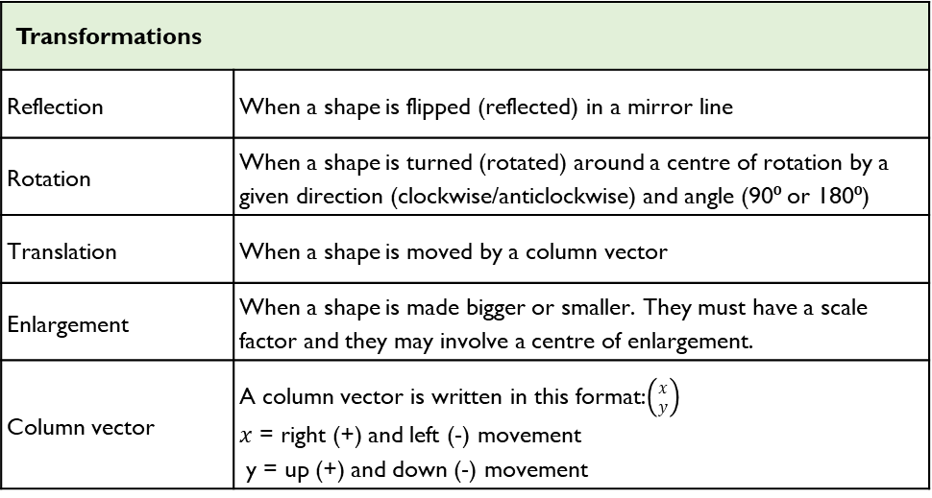
Maths
Algebra
Key Word | Definition
Sequence | A number or picture pattern with a specific rule
Term | Each value in a sequence is called a term
N | The position of a term within a sequence
Term to Term rule | Defines how to get from one term in a sequence to the next.
Nth term | The nth term rule in sequences is a formula that allows you to find any term in a sequence, given its position (also known as the position to term rule).
Substitute | Replacing variables with numbers, symbols or other algebraic expressions to equate, solve or simplify expressions and equations.
Generate | Work out the terms in the sequence using the nth term or rule
Arithmetic Sequence | An ordered set of numbers that have a common difference between each consecutive term.
Geometric Sequence | An ordered set of numbers that progresses by multiplying or dividing each term by a common number
X-axis | Horizontal axis (goes across)
Y-axis | Vertical axis (goes up)
Co-ordinate | Two numbers that locate a specific points on a grid (x, y)
Linear graph | A straight line that shows a relationship between the x and y co-ordinate.
Transformations
Reflection | When a shape is flipped (reflected) in a mirror line
Rotation | When a shape is turned (rotated) around a centre of rotation by a given direction (clockwise/anticlockwise) and angle (90⁰ or 180⁰)
Translation | When a shape is moved by a column vector
Enlargement | When a shape is made bigger or smaller. They must have a scale factor and they may involve a centre of enlargement.
Column vector | A column vector is written in this format:$\left({x \atop y}\right)$ $x$ = right (+) and left (-) movement y = up (+) and down (-) movement
Percentages
Percentage | Out of 100
Interest | The price you pay to borrow money or the cost you charge to lend money
Per annum | Each year
Simple interest | Same amount every year
Compound interest | Worked out yearly
2

Slide 5
Science
Food and Digestion
Key Word | Definition
Digestion | The breakdown of large insoluble food molecules into smaller soluble ones.
Digestive System | Organ system involved in breaking food down so that it can be absorbed into the bloodstream.
Absorbed | When a substance is taken in by something or moved across a barrier such as a cell membrane.
Amylase | An enzyme that can break down starch into simple sugars.
Enzyme | A protein which catalyses or speeds up a chemical reaction.
Surface Area | The area of the surface of an organism or membrane.
Villi | Finger-like projections in the small intestine that provide a large surface area for the absorption of food.
Capillary | Tiny blood vessels with walls one-cell thick where exchange of materials occurs.
Excretion | Process by which waste products from chemical reactions in an organism are removed.
Oesophagus | Also known as the gullet. Connects the mouth to the stomach. Food is pushed down using contractions of muscles.
Stomach | Churns and mixes the food with hydrochloric acid and enzymes.
Small Intestine | Absorption of digested food into the bloodstream, production of enzymes to aid digestion.
Large Intestine | Absorption of excess water.
Liver | Organ that is responsible for the Production of bile.
Bile | Substance produced in the liver. It emulsifies fats to prepare them for digestion.
Pancreas | Produces biological catalysts called enzymes which speeds up the digestive reactions.
Rectum | Storage of faeces (undigested material) before excretion.
Anus | Where faeces are excreted (removed from the body).
3

Slide 6
Science
Periodic Table
Key Word | Definition
Periodic Table | A tabular representation of all known elements in order based on atomic number.
Atomic Number | The number of protons in the nucleus of an atom. Also called the proton number.
Atom | a particle that can exist alone and that is smaller than any other.
Compound | A Substance where two or more elements have chemically joined together.
Metals | most of the known elements are metals. They are generally hard, shiny elements with high melting and boiling points. They all conduct electricity and heat well.
Pure | consisting of a single substance.
Electron | a particle present in the atom. It has a single negative charge and a very small mass - usually considered to be zero.
Element | A substance made of only one type of atom
Ion | A charged atom (it has lost or gained electrons)
Group | A column down the periodic table
Period | A row across the periodic table
Trend | A pattern in data
Alkali metal | A group 1 metal. They form hydroxides in water which is alkali
Halogens | A group 7 non-metal. They are very reactive
Noble Gases | A group 0 element. Sometimes called group 8. They’re unreactive.
Displacement | When a more reactive element takes the place of a less reactive element in a compound
4

Slide 7
Spanish
Spanish | English
De vacaciones | On holiday
Voy a | I go to
Va a | He/she goes to
Vamos a | We go to
Van a | They go to
Inglaterra | England
España | Spain
Portugal | Portugal
Grecia | Greece
Francia | France
Italia | Italy
Alemania | Germany
Escocia | Scotland
Croacia | Croatia
Los Estados Unidos | USA
Argentina | Argentina
México | Mexico
Spanish | English
En avión | By plane
En coche | By car
En barco | By boat
En tren | By train
En autobús | By bus
En autocar | By coach
En helicóptero | By helicopter
En bici | By bike
A pie | By foot
Normalmente | Normally
Durante las vacaciones | During the holidays
Los veranos | In the summer
Los inviernos | In the winter
Cada año | Each year
Todos los años | Every year
Siempre | Always
A veces | sometimes
5

Slide 8
Spanish
Spanish | English
Casi siempre | Almost always
Nunca | never
Comprar recuerdos | To buy souvenirs
Descansar | To relax
Tomar el sol | To sunbathe
Nadar en el mar | To swim in the sea
Probar platos típicos | To try typical dishes
Comer | To eat
Beber refrescos | To drink fizzy drinks
Viajar | To travel
Visitar monumentos | To visit monuments
Sacar fotos | To take potos
Practicar deportes acuáticos | To do water sports
Montar en bici | To bikeride
Dar un paseo | To go for a walk
Leer un libro | To read a book
Conocer a un/a chico/a guapo/a | To meet a good looking boy/girl
Spanish | English
Charlar con amigos | To chat with friends
Mandar mensajes | To send messages
Salir con amigos | To go out with friends
Me alojo / nos alojamos | I stay / we stay
En un hotel | In a hotel
En un albergue juvenil | In a youth hostel
En un hotel de cinco estrellas | In a five star hotel
En una pensión | In a hostel
En una casa | In a house
En un parador | traditional inn
En un camping | On a campsite
Llovió | It rained
Comí algo malo y vomité | I ate something bad and vomited
Perdí mi pasaporte | I lost my passport
Hizo calor | It was hot
Fue | It was
Me gustó | I liked it
6

Slide 9
History
Key Term | Definition
Industrial Revolution | A time of great change in Britain when people started to make things by machine in factories. It spans from 1750 to 1900.
Urban | Built-up areas in which people live in close proximity. This refers to either towns or cities.
Rural | Countryside areas in which the population is spread thinly.
Invention | Something new which is created, can be an idea or an object.
Workhouse | An institution which would house and look after the poor. In return for food and lodging inmates would be expected to work to produce goods.
Cholera | An infectious and often fatal bacterial disease of the small intestine typically contracted from infected water supplies.
Industrial | Processing raw materials or manufacturing goods in factories.
Manufacture | Making something on a large scale.
Entrepreneur | Someone who sets up a business hoping to make profit.
L’aissez faire | Meaning ‘leave well alone’. The attitude of the rich to the poor and the Government towards working conditions in factories.
Key Term | Definition
Destitute | To be extremely poor and not able to support yourself.
Black Gold | Coal. Coal became such a profitable industry, that many started calling it black gold.
Pauper Apprentice | Orphaned children who would be sent to work in factories to keep them off the streets.
Smog | Air pollution that reduces visibility. The term is used to describe a mix of smoke and fog usually from burning coal.
Textile | A flexible material made by creating an interlocking network of yarns or threads.
Enlightenment | An intellectual and philosophical movement that occurred in Europe in the 17th and the 18th centuries.
Rationalism | Any view appealing to reason as a source of knowledge or justification. The opposite of believing due to faith or tradition.
Empiricism | The view that true knowledge or justification comes only or primarily from what we experience.
7

Slide 10
Geography
Key Word | Definition
De-industrialisation | the decline of a country's traditional manufacturing industry due to exhaustion of raw materials, loss of markets and overseas competition
Employment structure | relative proportion of the workforce employed in different sectors of the economy
Exports | goods and service sold by a country and bought by another country
Financial services | the management of money within the service sector, including banking, insurance, securities dealing, and fund management
Globalisation | process creating a more connected world, with increases in the global movements of goods (trade) and people (migration & tourism)
Gross Domestic Product (GDP) | the total value of goods and services produced by a country in a year
Imports | goods and services bought by residents of a country from another country
Information technology | computer, internet, mobile phone and satellite technologies
Infrastructure | the basic equipment and structures (such as roads, utilities, water supply and sewage) that are needed for a country or region to function properly
Manufacturing | making goods by processing raw materials
Mining | extraction of raw materials from the ground
Newly-Emerging Economies (NEE) | countries that have begun to experience high rates of economic development, usually along with rapid industrialisation
Post-industrial economy | the shift of some HIC economies from producing goods to providing services
Primary product | unprocessed raw materials extracted from the earth or agricultural products
Primary sector | employment sector that includes farming, mining and other related activities
Quality of life | how good a person’s life is as measured by such things as quality of housing and environment, access to education, health care, security and levels of happiness
Quaternary sector | employment sector that includes jobs in hi-tech industries, research, information technology and the media
Secondary sector | employment sector that involves manufacturing
Tertiary sector | employment sector that includes service industries, such as health care, offices, financial services and retailing
Transnational corporation (TNC) | a company that has operations (factories, offices, research and development, shops) in more than one country
Trade | buying and selling of goods and services between countries
8

Slide 11


PE
Key Term | Definition
Muscular system | Works in conjunction with the skeleton to produce movement of the limbs and body
Antagonistic pairs | Muscles are arranged in antagonistic pairs. As one contracts, its partner relaxes
Agonist | The muscle that contracts to produce movement
Antagonist | The muscle that relaxes to allow the movement to occur
Skeleton | Is the central structure of the body
9

Slide 12
Computing
Copyright and plagiarism
Copyright | © Protects the rights of an author/creator of creative work. It means that someone else’s work cannot be copied without permission.
Plagiarism | Is using someone else’s creative work as if it is yours. This is not allowed.
Copyrighted material | online can be music, films or pictures. Sharing or downloading these illegally (without paying the owner of the copyright) is a copyright infringement. However, there are many sites, like amazon music or iTunes, where downloading music is legal because the owner has been paid.
Downloading media content | It is estimated that the illegal downloading of films, TV programmes and music could mean the loss of 30,000 British jobs
Data protection (GDPR) | Data about you must be accurate and up to date. The data must be physically locked away or protected by passwords/encryption. The data can only be held for as long as necessary by the organisation. After that it must be destroyed.
Passwords | Should always include at least 1 uppercase letter, 1 lowercase letter, 1 number AND a special character: *pa$$WorD_2070 Don’t include personal information Make it at least 8 characters long
Cybersecurity
E-mail scams | A deceptive way of getting you to part with money or trick you in to something you wouldn’t usually do. May also damage your computer and files.
Phishing | Tricks you into handing over sensitive details, such as security log-in details.
Virus generated | Opening it can generate a similar email to be sent to all your email contacts. Can contain a forged link, can contain a request for cash.
Advanced fee fraud | Usually accompanied by a long, emotional plea, promises a large sum of money in return for a small advanced fee.
Trojan horse/malware | Offers you something tempting to look at – like a funny video – and installs malware on your device
10

Slide 13
Art
Key Word | Definition
Gargoyle | A grotesque carved human or animal face or figure projecting from the gutter of a building, typically acting as a spout to carry water clear of a wall.
Green Man | The Green Man is a legendary being primarily interpreted as a symbol of rebirth, representing the cycle of new growth that occurs every spring. The Green Man is most commonly depicted in a sculpture, or other representation of a face which is made of, or completely surrounded by, leaves
Grotesque | A very ugly or comically distorted figure or image.
Gothic | A style of architecture prevalent in western Europe in the 12th–16th centuries (and revived in the mid 18th to early 20th centuries), characterized by pointed arches, rib vaults, and flying buttresses, together with large windows and elaborate tracery. English Gothic architecture is divided into Early English, Decorated, and Perpendicular.
Medieval | Resembling or likened to the Middle Ages, especially in being cruel, uncivilized, or primitive.
Architecture | The art or practice of designing and constructing buildings.
11

Slide 14
Cooking and Nutrition
Key Word | Definition
Hazard | Anything that is dangerous
Kitchen Hygiene | Ensuring that everything is clean when preparing food
Kitchen Safety | Being safe in the kitchen
Cross contamination | Transfer of bacteria from one person, object or place to another
4Cs | The four principles for food safety: clean, cook, chill, cross contamination
Bacteria | Small single celled organisms that can only be seen under a microscope
Claw grip | A method of cutting food that ensures that the finger tips are tucked out of the way and will not get caught by the knife
Bridge Hold | A method of cutting food that ensures that fingers are out of the way as the knife cuts through the food
Nutrients | Chemicals found in food that are needed for body functions
Macro-nutrients | Nutrients that are needed in the body in large amounts
Micro-nutrients | Nutrients that are needed in the body in small amounts
Yeast | A micro-organism used as a raising agent in bread making
Pastry | A dough made with flour, water and fat
Diet | All the foods that we eat
Balanced Diet | A diet that contains all the correct nutrients in the correct proportions to meet the health needs of an individual
Energy | The ability to do work or to be active
Energy Balance | The balance of calories consumed through eating and drinking compared to the energy we use.
12

Slide 15



Music
12-Bar Blues | A chord progression using 12 measures based on chords I, IV, and V.
Chord | A group of (typically three or more) notes played together.
Chord I, IV, V | The main chords used in blues (in C major: C, F, G).
Walking Bass | A style of bassline with a steady rhythm, often moving stepwise.
Improvisation | Creating music spontaneously, often using a scale like the blues scale.
Blues Scale | A scale used in blues music, often with flattened notes (e.g. C, Eb, F, Gb, G, Bb).
Swing Rhythm | A rhythm where the beat is divided unevenly to give a “long-short” feel.
Call and Response | A musical conversation between two parts.
12 Bars | Refers to the 12 measures that repeat throughout the structure.
Structure | The way a piece of music is organised (e.g. 12-bar form).
Melody | A sequence of single notes that is musically satisfying; the tune of the piece.
Bassline | The low-pitched part in music, often played by the left hand or bass instrument.
13

Slide 16
Performing Art
Key Word | Definition
Act | Subdivision between sections of a play
Antagonist | The opposite of the protagonist in drama
Anti-Climax | A climax is where everything comes together as a conclusion with a can be disappointing or unsatisfying
Character | A named individual within in the play
Genre | A way of categorizing different types of drama
Monologue | A speech within a plat delivered by a single character
Narration | Dialogue designed to tell a story or provide accompanying information. Narration can accompany on stage action or be presented in its own right
Plot | The basic story thread running through a performance/play which gives the reason for the characters actions
Prologue | Short scene or speech before the main action of the play to put it into context or set the scene
Protagonist | The leading character or ‘hero’ in a play who has to fight against/oppose the antagonist
Rising action | The events that’s build up the pace and perhaps the excitement in a plot/drama
Scene | A subdivision of a play
14

Slide 17
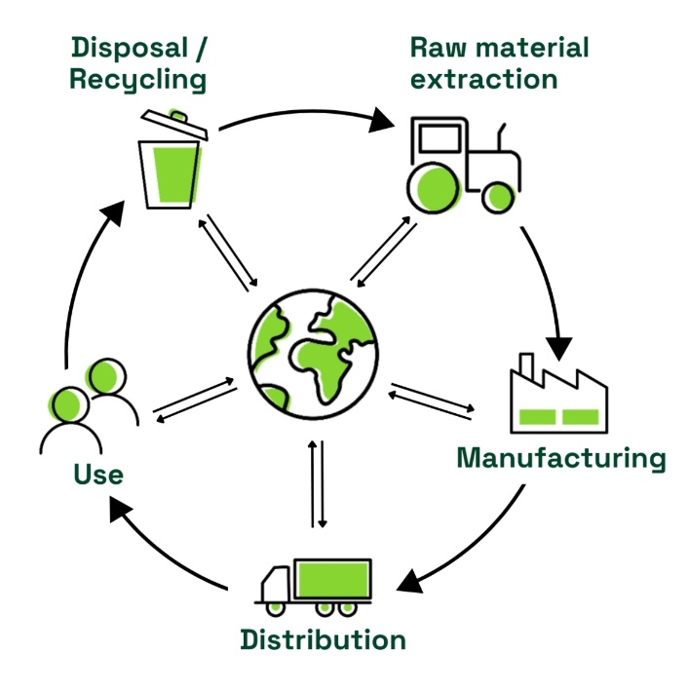
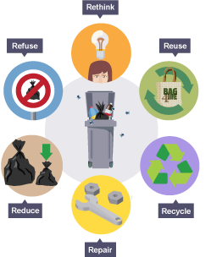
Design and Technology - RM
Key Words | Definition
Aesthetic | How something looks e.g. this product is aesthetically pleasing.
Analysis | Learn and evaluate designs to identify features that could be improved.
Anthropometrics | the practice of taking measurements of the human body and providing data that can be used by designers.
Alloy | A mixture of two or more elements, at least one of which is a metal.
Conductivity | The ability of a material to hold heat in or out (thermal) or the ability of electrical current to flow through a material (electrical).
Ductile | The ability of a material to deform by bending, twisting or stretching.
Environmental Challenges | Challenges raw materials cause - deforestation, pollution and global warming
Design Brief | A short statement which outlines the problem to be solved and a set of instructions given to a designer by a client.
Ergonomics | The study of people in their working environment
Ferrous | A type of metal containing iron, are magnetic and prone to rust, so will require a protective finish.
Fossil Fuels | A finite resource, which means they cannot be replaced once used.
Hazardous | dangerous and involving risk, especially to someone's health.
Mailability | The ability of a material to deform without cracking.
Mining | When natural resources are extracted from the ground.
Life Cycle Assessment | A 'cradle-to-grave' analysis of the impact of a manufactured product on the environment.
Key Words | Definition
Non-Ferrous | Metal that does not contain iron, is not magnetic and does not rust.
Specification | Containing detail of a product's requirement or characteristic - processes, materials and information needed to design the product.
Sustainability | Something that does not damage the environment e.g. plant based plastic
The 6 Rs | Rethink, Refuse, Reduce, Reuse, Recycle, Repair
Properties | The qualities a material possesses which suit its specific purpose.
Physical Properties | The traits a material has before it is used
Working Properties | The material behaves when it is manipulated.
15

Slide 18
W/c 8th September Thinking definition: Thinking is making connections, reasoning and asking questions to make the learning stick
Reflecting on learning behaviours for thinking… | Experience log
 | Successful moment… | In hindsight… Where you could have done better on reflection? | At home…
I gave an idea and reasoned/justified.
I reflected on my idea and made it better after discussing with others
I used a revision strategy to help make the learning stick.
I made connections between what I am learning and the outside world.
I asked questions to deepen my understanding.
16

Slide 19
W/c 15th September Thinking definition: Thinking is making connections, reasoning and asking questions to make the learning stick
Reflecting on learning behaviours for thinking… | Experience log
 | Successful moment… | In hindsight… Where you could have done better on reflection? | At home…
I gave an idea and reasoned/justified.
I reflected on my idea and made it better after discussing with others
I used a revision strategy to help make the learning stick.
I made connections between what I am learning and the outside world.
I asked questions to deepen my understanding.
17

Slide 20
W/c 22nd September Thinking definition: Thinking is making connections, reasoning and asking questions to make the learning stick
Reflecting on learning behaviours for thinking… | Experience log
 | Successful moment… | In hindsight… Where you could have done better on reflection? | At home…
I gave an idea and reasoned/justified.
I reflected on my idea and made it better after discussing with others
I used a revision strategy to help make the learning stick.
I made connections between what I am learning and the outside world.
I asked questions to deepen my understanding.
18

Slide 21
W/c 29th September Thinking definition: Thinking is making connections, reasoning and asking questions to make the learning stick
Reflecting on learning behaviours for thinking… | Experience log
 | Successful moment… | In hindsight… Where you could have done better on reflection? | At home…
I gave an idea and reasoned/justified.
I reflected on my idea and made it better after discussing with others
I used a revision strategy to help make the learning stick.
I made connections between what I am learning and the outside world.
I asked questions to deepen my understanding.
19

Slide 22
W/c 6th October Thinking definition: Thinking is making connections, reasoning and asking questions to make the learning stick
Reflecting on learning behaviours for thinking… | Experience log
 | Successful moment… | In hindsight… Where you could have done better on reflection? | At home…
I gave an idea and reasoned/justified.
I reflected on my idea and made it better after discussing with others
I used a revision strategy to help make the learning stick.
I made connections between what I am learning and the outside world.
I asked questions to deepen my understanding.
20

Slide 23
W/c 13th October Thinking definition: Thinking is making connections, reasoning and asking questions to make the learning stick
Reflecting on learning behaviours for thinking… | Experience log
 | Successful moment… | In hindsight… Where you could have done better on reflection? | At home…
I gave an idea and reasoned/justified.
I reflected on my idea and made it better after discussing with others
I used a revision strategy to help make the learning stick.
I made connections between what I am learning and the outside world.
I asked questions to deepen my understanding.
21

Slide 24
W/c 20th October Thinking definition: Thinking is making connections, reasoning and asking questions to make the learning stick
Reflecting on learning behaviours for thinking… | Experience log
 | Successful moment… | In hindsight… Where you could have done better on reflection? | At home…
I gave an idea and reasoned/justified.
I reflected on my idea and made it better after discussing with others
I used a revision strategy to help make the learning stick.
I made connections between what I am learning and the outside world.
I asked questions to deepen my understanding.
22

Slide 25
Reading Log w/c 8th September (20 mins reading per day – all five logs MUST be completed)
Date | Title of novel | Number of pages read | Summary about what I have read
 |  |  | • • •
 |  |  | • • •
 |  |  | • • •
 |  |  | • • •
 |  |  | • • •
Checked by form tutor:
23

Slide 26
Reading Log w/c 15th September (20 mins reading per day – all five logs MUST be completed)
Date | Title of novel | Number of pages read | Summary about what I have read
 |  |  | • • •
 |  |  | • • •
 |  |  | • • •
 |  |  | • • •
 |  |  | • • •
Checked by form tutor:
24

Slide 27
Reading Log w/c 22nd September (20 mins reading per day – all five logs MUST be completed)
Date | Title of novel | Number of pages read | Summary about what I have read
 |  |  | • • •
 |  |  | • • •
 |  |  | • • •
 |  |  | • • •
 |  |  | • • •
Checked by form tutor:
25

Slide 28
Reading Log w/c 29th September (20 mins reading per day – all five logs MUST be completed)
Date | Title of novel | Number of pages read | Summary about what I have read
 |  |  | • • •
 |  |  | • • •
 |  |  | • • •
 |  |  | • • •
 |  |  | • • •
Checked by form tutor:
26

Slide 29
Reading Log w/c 6th October (20 mins reading per day – all five logs MUST be completed)
Date | Title of novel | Number of pages read | Summary about what I have read
 |  |  | • • •
 |  |  | • • •
 |  |  | • • •
 |  |  | • • •
 |  |  | • • •
Checked by form tutor:
27

Slide 30
Reading Log w/c 13th October (20 mins reading per day – all five logs MUST be completed)
Date | Title of novel | Number of pages read | Summary about what I have read
 |  |  | • • •
 |  |  | • • •
 |  |  | • • •
 |  |  | • • •
 |  |  | • • •
Checked by form tutor:
28

Slide 31
Reading Log w/c 20th October (20 mins reading per day – all five logs MUST be completed)
Date | Title of novel | Number of pages read | Summary about what I have read
 |  |  | • • •
 |  |  | • • •
 |  |  | • • •
 |  |  | • • •
 |  |  | • • •
Checked by form tutor:
29

Slide 32
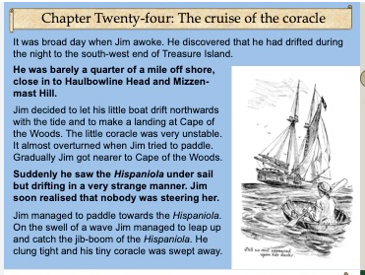
1. Treasure Island – Robert Louis Stevenson
Vocabulary:
Coracle – A small rounded, lightweight boat
Tide – the movement of the sea and ocean guided by the gravitational pull of the moon.
Jib-boom – a piece of wood or carbon- fibre material in modern boats that holds the main sail of the boat and can swing out in a 360° angle
30
Notes:
Ok, so let’s all have the extract in front of us. I am going to read now and you are going to follow with your finger or ruler.
READ THE EXTRACT. PAUSE ON THE WORDS THAT THE STUDENTS MAY NOT KNOW.

Slide 33
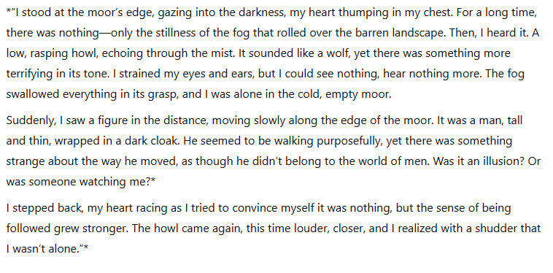
2. The Hound of the Baskervilles – Arthur Conan Doyle
Vocabulary:
barren – empty and desolate – nothing there.
Rasping – harsh sounding and unpleasant
Illusion – a trick, something that is not real – possibly magical , but fake.
Howl – a long doleful cry uttered by an animal such as a dog or a wolf
31
Notes:
Ok, so let’s all have the extract in front of us. I am going to read now and you are going to follow with your finger or ruler.
READ THE EXTRACT. PAUSE ON THE WORDS THAT THE STUDENTS MAY NOT KNOW.

Slide 34
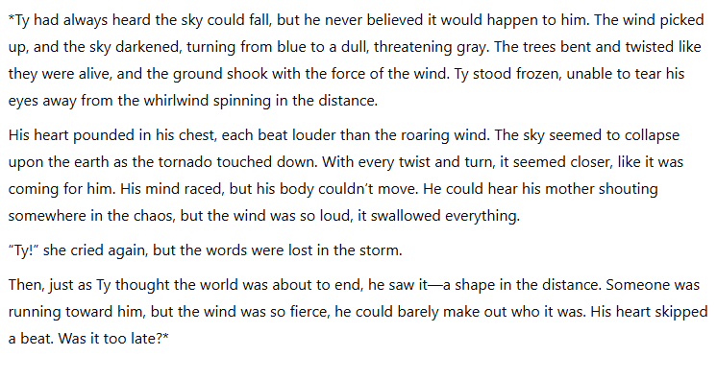
3. When the Sky Falls – Phil Earle
Vocabulary:
Whirlwind – A column of air moving rapidly around and round in a cyndrical or funnel shape
32
Notes:
Ok, so let’s all have the extract in front of us. I am going to read now and you are going to follow with your finger or ruler.
READ THE EXTRACT. PAUSE ON THE WORDS THAT THE STUDENTS MAY NOT KNOW.

Slide 35
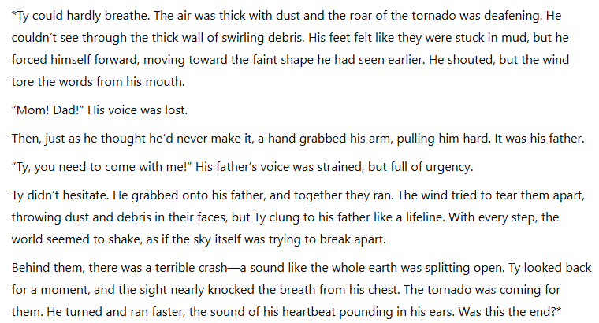
3. When the Sky Falls – Phil Earle
Vocabulary:
Debris – Loose natural material normally broken pieces of rock
Urgency – importance, requiring swift action.
33
Notes:
Ok, so let’s all have the extract in front of us. I am going to read now and you are going to follow with your finger or ruler.
READ THE EXTRACT. PAUSE ON THE WORDS THAT THE STUDENTS MAY NOT KNOW.

Slide 36
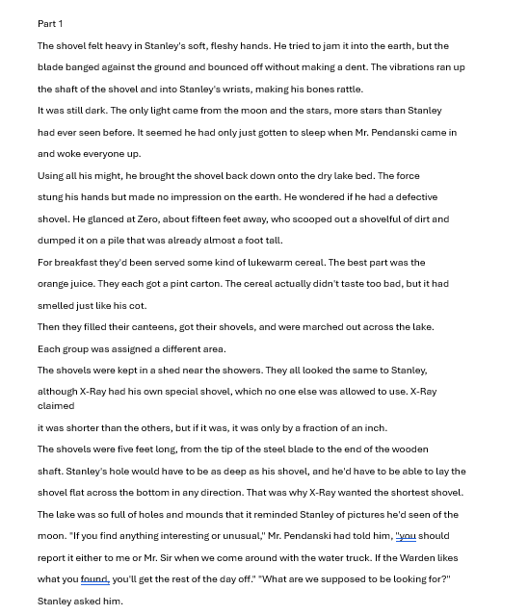
4. Holes – Louis Sachar
Vocabulary:
A shovel – A tool resembling a spade but with a wider blade
Canteen – A small water bottle used by soldiers or campers
34
Notes:
Ok, so let’s all have the extract in front of us. I am going to read now and you are going to follow with your finger or ruler.
READ THE EXTRACT. PAUSE ON THE WORDS THAT THE STUDENTS MAY NOT KNOW.

Slide 37
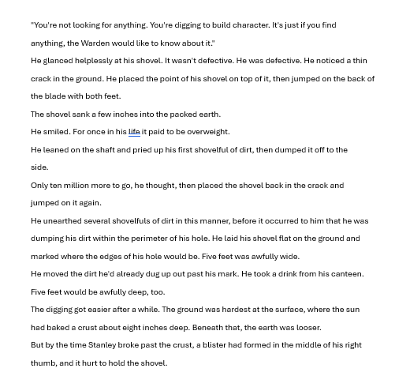
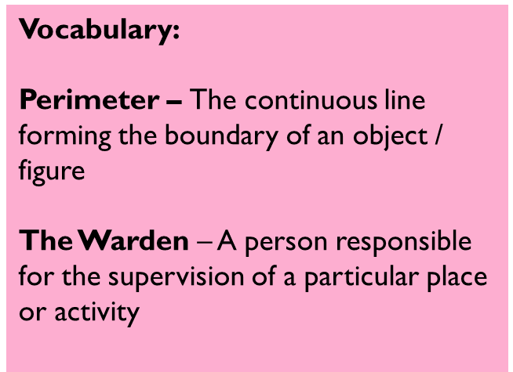
4. Holes – Louis Sachar
35
Notes:
Ok, so let’s all have the extract in front of us. I am going to read now and you are going to follow with your finger or ruler.
READ THE EXTRACT. PAUSE ON THE WORDS THAT THE STUDENTS MAY NOT KNOW.

Slide 38
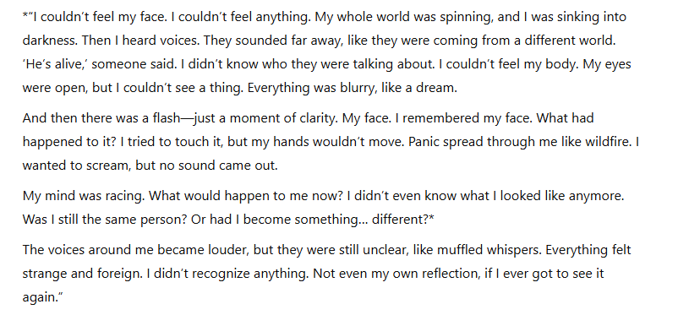
5. Face – Benjamin Zephaniah
Vocabulary:
Clarity – being clear and intelligible.
Pure and transparent
Wildfire – a large, destructive fire that spreads quickly over woodland or bush
36
Notes:
Ok, so let’s all have the extract in front of us. I am going to read now and you are going to follow with your finger or ruler.
READ THE EXTRACT. PAUSE ON THE WORDS THAT THE STUDENTS MAY NOT KNOW.

Slide 39

37

Slide 40

38

Slide 41

39

Slide 42

40

Slide 43

41

Slide 44

42

