Slide 1

Year 8 Knowledge Organiser HT2
Knowledge is Power
Name: ______________________________
Form: _______

Slide 2
Contents Page
Subject | Page
English | 1
Maths | 2
Science | 3
Spanish | 4
History | 6
Geography | 7
PE | 8
Computing | 10
Art | 11
Cooking and Nutrition | 12
Music | 13
Performing Arts | 14
Design and Technology | 15
‘Thinking’ reflection log | 16
Reading log | 23
Reading Extracts | 30
Cursive Handwriting Practice | 42

Slide 3
English
Week 3 - Key Terms
Transactional Writing | Writing to communicate something specific to a specific audience for a specific purpose. These are non-fictional texts.
Refugee | A person who has been forced to leave their country in order to escape war, persecution, or natural disaster.
FIT | Feel, Imagine, Think
TAP | Type of Text, Audience, Purpose
Week 6 – Speech
Speech | A final address to an audience A clear address to an audience Effective/ fluently linked section to indicate sequence Rhetorical indicators that an audience is being addressed throughout A clear sign off e.g. ‘Thank you for listening’]
Week 1 - Devices
D | Direct Address | Using pronouns to address the reader directly.
A | Alliteration | When a series of three or more words begin with the same sound.
p | Personal Pronouns | Using I, We, You to include the reader in your argument.
F | Facts | Something that is proven to be true and can be used as evidence.
O | Opinions | Information that a person believes in. It is a view or judgement formed about something.
Week 4 – Article
Article | Paragraphs A clear/ original title A strapline Subheadings An introductory (overview paragraph Effectively/ fluently sequenced paragraphs
Week 7 - Key Terms
Review | Gives an opinion about anything for example, books or films. They often give other people an impression of something before they try it for themselves.
Aims of a Review | To inform To describe To entertain To analyse To advise
Report | A nonfiction account that presents and/or summarises the facts about a particular event, topic, or issue.
Book Review | Discusses the contents of a book. This includes a larger summary of the book and focuses on the main themes and ideas.
Week 2 - Devices
R | Rhetorical Questions | A question that is unanswered and is used to make a point.
E | Emotive Language | Language used to evoke an emotional response from the reader.
S | Statistics | The collection, analysis, interpretation, and presentation of numerical data.
T | Triples (Rule of three | Use three related words or phrases to grab attention, encapsulate, summarize. This can be three single words, three phrases or three complete sentences
Week 5 - Letter
Letter | The use of addresses: an indication that someone is sending the letter to someone Paragraphs A date A formal more of address if required e.g. Dear Sir/Madam or a named recipient Effectively/ fluently sequenced paragraphs An appropriate more of signing off: Yours sincerely/ faithfully
1
Notes:
Year 8 HT2

Slide 4
Maths
Percentages
Percentage | Out of 100
Interest | The price you pay to borrow money or the cost you charge to lend money
Per annum | Each year
Simple interest | Same amount every year
Compound interest | Worked out yearly
Indices
Key Word | Definition
Power | The number of times a number is used as a factor in a multiplication problem e.g. 3⁴ = 3 x 3 x 3 x 3
Base | The number that gets multiplied when using a power
Index | Another word for ‘power’
Indices | Plural of ‘index’
Coefficient | A number used to multiply a variable e.g. 3 is the coefficient of a in the expression 3a
Simplify | Reducing the expression to write it in a simpler form (still includes a variable)
Evaluate | Find the numerical value of a calculation
Cancel | To remove or simplify an expression by dividing by a common term
Algebra
Variable | A symbol for a value we don't know yet
Expression | A combination of numbers and variables (no equal sign)
Equation | A mathematical statement with an 'equal to' symbol between two expressions that have equal values
Expand | Multiply out brackets
Factorise | Put an expression in brackets by taking out the highest common factors
2

Slide 5
Science
Key Word | Definition
dissipate | Spread out into the surroundings.
energy transfers | Changes from one form of energy to another form of energy.
conduction | The transfer of heat through a material by transferring kinetic energy from one particle to another.
conductor | A material which allows charge to move easily through it.
convection | The transfer of heat energy through a moving liquid or gas.
convection current | A movement within the Earth's mantle caused by the heat of the core.
insulate | To help maintain the temperature.
radiation | Energy carried by particles from a radioactive substance, or spreading out from a source.
Word | Definition
alveoli | Tiny air sacs in the lungs, where gas is exchanged during breathing.
blood plasma | The liquid part of the blood containing useful things like glucose, amino acids, minerals, vitamins (nutrients) and hormones, as well as waste materials such as urea.
circulatory system | Bodily system made up of the heart, blood vessels and blood that delivers nutrients and other essential materials to cells whilst removing waste products.
diaphragm | A large sheet of muscle that separates the lungs from the abdominal cavity.
epithelial cell | A cell that forms part of an epithelium.
haemoglobin | The red protein found in red blood cells that transports oxygen round the body
human thorax | The ribs and upper backbone, and the organs found in the chest.
intercostal muscles | Sets of muscles between the ribs which raise and lower the rib cage.
Word | Definition
respire | To engage in respiration, the energy-producing process inside living cells.
trachea | The major airway in the respiratory system, also known as the windpipe, connecting the pharynx and larynx to the lungs
glucose | A simple sugar used by cells for respiration.
mitochondria | Structures in the cytoplasm of all cells where aerobic respiration takes place (singular is mitochondrion).
aerobic respiration | Respiration that requires oxygen.
diffusion | The movement of molecules from an area of higher concentration to an area of lower concentration
lactic acid | A toxic chemical produced during anaerobic respiration.
3

Slide 6
Spanish
Spanish | English
Las patatas fritas | Chips
La carne | Meat
La ensalada | Salad
La fruta | Fruit
La hamburguesa | Hamburger
La leche | Milk
El arroz | Rice
El café | Coffee
Los caramelos | Sweets
El huevo | Egg
El pescado | Fish
El pollo | Chicken
El agua | Water
Tomar | To take (eat/drink)
Desayunar | To have breakfast
Comer | To eat
cenar | To have dinner
Spanish | English
beber | To drink
Por la mañana | In the morning
Al mediodía | At midday
Por la noche | At night
La paella | Spanish rice dish (typically with seafood)
Tapas | Small sharing plates
Jamón serrano | A Spanish type of ham
Pan con tomate | Bread with tomato on top
Prefiero | I prefer
Creo que/pienso que | I think that
Me molesta | It annoys me
Recomiendo | I recommend
Sano | healthy
Rico | Tasty
Saludable | Healthy
Sano | Healthy
vegetariano | vegetarian
4

Slide 7
Spanish
Spanish | English
Bueno | Good
malo | Bad
Ayer | Yesterday
El año pasado | Last year
La semana pasada | Last week
Cuando era pequeño | When I was little
Hoy | Today
Normalmente | Normally
ahora | Now
Tomar drogas | To take drugs
Hacer ejercicio | To do exercise
Estar en forma | To be fit
Comer sano | To eat healthily
Evitar los dulces | To avoid sweets
Fumar | To smoke
Beber alcohol | To drink alcohol
Evitar el azúcar | To avoid sugar
Spanish | English
Dormir ocho horas al día | To sleep eight hours a day
Beber dos litros de agua al día | To drink 2 litres of agua a day
Se debe | You must
No se debe | You mustn’t
Hay que | You must
En la foto hay | In the photo there is/are
5

Slide 8
History
Key Term | Definition
Tax | A time of great change in Britain when people started to make things by machine in factories. It spans from 1750 to 1900.
Popular | The people as a whole, especially of all citizens of a nation or state.
Uprising | An act of resistance or rebellion.
Revolt | Take violent action against an established government or ruler.
Independence | A nation, country, or state, that is allowed to exercise self-government after a period of control.
Tsar | Russian word for Emperor. Had total control over country.
Communism | A system where all property and business is owned by the government. Each person contributes and receives according to need and ability.
Socialism | A political and economic social organisation when production, distribution, and exchange are owned or regulated by the community.
Aristocracy | Being part of the ruling class or the nobility in France.
Bourgeoisie | A class of business owners and merchants.
Key Term | Definition
Colony | Country or area under the full or partial control of another country and occupied by settlers from that country.
Famine | Severe and prolonged hunger in a substantial proportion of the population of a region or country.
Slave Triangle | Three-part trading journey in which traders traded goods for slaves in Africa; slaves for different goods in America; and these good for money in Britain.
Insurrection | A violent uprising against an authority or government.
Duma | Advisory councils in Russia from the 10th to 17th centuries.
Abolition | The act of putting an end to something.
Inferior | Lower in rank, status, or quality.
Revolution | A rapid, fundamental transformation of a society's state, class, ethnic or religious structures
Economic | Relating to trade, industry, or money
Proletariat | The labouring class
6

Slide 9
Geography
Key Word | Definition
Ecosystem | An interconnected community of plants, animals and their surroundings.
Biome | A large scale, global ecosystem.
Abiotic | A non– living organism.
Biotic | A living organism.
Producer | An organism which produces its own food using energy from the sun.
Primary consumer | An organism which eats plant matter. Also known as a herbivore.
Secondary consumer | An organism which eats other animals. Also known as a carnivore.
Decomposer | An organism which breaks down dead organic (plant and animal) matter.
Food chain | The connections between different organisms that rely on one another as a food source.
Food web | A complex hierarchy of plants and animals relying on each other for food.
Biodiversity | The variety of plants and animals in a given ecosystem.
Adaptation | A change in an organism which has become better suited to its environment.
7

Slide 10
PE
Health and Fitness
Muscular Strength | The amount of the force muscles can generate against a resistance
Muscular Endurance | The ability to use voluntary muscles, over long periods of time without getting tired
Flexibility | The range of movement at a joint
Cardiovascular Fitness (Aerobic Endurance) | The ability of the heart and circulatory system to meet the demands of the body for a long period of time
Body composition | The percentage of a body that is fat, muscle, bone and water
Coordination | The ability to move two or more body parts at the same time
Reaction Time | The time taken for a response to occur after a stimulus
Agility | The ability to change direction at speed
Balance | The ability to keep the body steady when in a static position or when moving
Speed | The time taken to cover a set distance/complete a movement
Power | The ability to combine speed and strength
Principles of training
Progressive Overload | Working the body harder than normal/gradually increasing the amount of exercise you do
Reversibility | If training is not regular, adaptations will be reversed. This can happen when suffering from illness, injury or after an off season
Specificity | Training showed be matched to the requirements of the sport or position the performer is in. Training must be specifically designed to develop the right muscles, type of fitness or skills
Individual needs | All PEP’s would differ depending on performers goals/target, strengths /weaknesses, age/gender and current health/fitness levels
Overtraining | Occurs when you train too hard and do not allow the body enough rest/recovery time Signs include extended muscle soreness, frequent illness & increase injuries
8

Slide 11


PE
9

Slide 12
Computing
Websites
Web browser | These are programs used to access websites.
HTML | Hyper text mark up language: The language used to write and display web page documents
Hyperlink | A link in a document or webpage that connects to another location (Internal or external)
Working with HTML | HTML is typically written (or generated) in two ways: · using a plain text editor · using a What You See Is What You Get (WYSIWYG) editor
Plain text editor | An editor like Notepad offers greater control over the code because each and every character that forms the HTML and the resulting web page is hand typed
CSS (Cascading Style sheets) | Can be used to change the style of a whole website, one web page or a single occurrence of an element
Web browser | These are programs used to access websites.
HTML
<b> | BOLD TAG
</b> | CLOSING BOLD TAG
<i> | ITALIC
<html> | CODE USED IS HYPER TEXT MARKUP LANGUAGE
<h1> | HEADING
<title> | TITLE
</title> | CLOSING TITLE
</p> | PARAGRAPH
<b> | BOLD
10

Slide 13
Art
Key Word | Definition
Mythology | A collection of myths, especially one belonging to a particular religious or cultural tradition.
Medieval | Resembling or likened to the Middle Ages, especially in being cruel, uncivilized, or primitive.
Romanesque | Relating to a style of architecture which prevailed in Europe c. 900–1200, although sometimes dated back to the end of the Roman Empire
Representation | The description or portrayal of someone or something in a particular way.
Symbolism | An artistic and poetic movement or style using symbolic images and indirect suggestion to express mystical ideas, emotions, and states of mind.
Christianity | The religion based on the person and teachings of Jesus Christ, or its beliefs and practices.
Score & Slip Process | slip and score in pottery is a technique used to join two pieces of clay together. To slip and score clay, a potter scratches marks on the surface of the clay (score). The potter then applies a liquid mixture of clay in water (slip) to the scored surface.
Firing Clay | Firing clay changes the structure of the clay, bonding the clay particles together making it stronger, a more permanent ware. In the case of stoneware, the higher firing temperature causes the clay to become impervious to water, a useful quality in dinnerware.
11

Slide 14
Cooking and Nutrition
Key Word | Definition
Nutrition | A study of what people eat and how all the nutrients in foods work together in the body
Nutrients | Natural chemical substances in foods that are essential for body growth, function and health
Macro Nutrients | Nutrients needed by the body in large a mounts
Micro-Nutrients | Nutrients needed in the body in smaller amounts
Amino acids | Building blocks of protein
Essential amino acids | The essential amino acids that the body cannot make
Protein complementation | Eating a combination of LBV proteins to ensure the body gets all the essential amino acids
Cooks Knife | A large knife with a deep blade used for cutting, chopping, slicing and dicing
Paring knife/vegetable knife | A small knife mainly used for slicing and dicing
Bread knife | A large serrated knife-edged knife used to slice bread , cakes and pastry
Dough | A mixture of dry ingredients and liquid, that is mixed, kneaded, shaped and then baked.
Yeast | A single-celled plant fungus and a raising agent which needs time, food, warmth and liquid to ferment
Fermentation | The process in which yeast produces the gas carbon dioxide
Knead | The process of working a dough mixture to make it smooth and elastic
gluten | The protein in flour that is developed when water is added to flour and mixed.
prove | Leaving the dough to rise
steaming | Cooking in the steam that comes from boiling water
12

Slide 15



Music
Dotted note | A dot added after a note, adding an extra half to its length three beats per bar
Chord | A group of (typically three or more) notes played together.
Chord I, IV, V | The main chords used in blues (in C major: C, F, G).
12-Bar Blues | A chord progression using 12 measures based on chords I, IV, and V.
Walking Bass | A style of bassline with a steady rhythm, often moving stepwise.
Improvisation | Creating music spontaneously, often using a scale like the blues scale.
Blues Scale | A scale used in blues music, often with flattened notes (e.g. C, Eb, F, Gb, G, Bb).
Swing Rhythm | A rhythm where the beat is divided unevenly to give a “long-short” feel.
Call and Response | A musical conversation between two parts.
Structure | The way a piece of music is organised (e.g. 12-bar form).
Melody | A sequence of single notes that is musically satisfying; the tune of the piece.
Bassline | The low-pitched part in music, often played by the left hand or bass instrument.
13

Slide 16
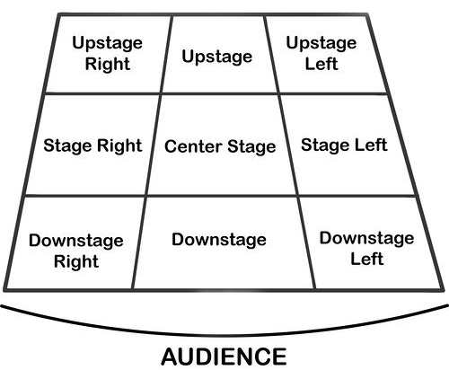
Performing Art
Key Word | Definition
Body Language | How an actor uses their body to communicate meaning. For example, crossing your arms could mean you are fed up
Gesture | a movement of the body, particularly the hands, arms, or head, that conveys meaning or expresses an idea, emotion, or intention
Levels | Levels can be used to show status, relationships, and even to indicate changes in location or time
Proxemics | The deliberate use of distance between you and other characters or objects to communicate something to an audience
Facial Expression | Using the face to express that characters feelings and emotions.
Key Word | Definition
Amphitheatre | Circular or oval open air theatre with a large ranked seating area
Apron | The apron is a section of the stage which the floor projects towards or into the auditorium
Black Box | A flexible studio theatre where the audience and actors are in the same room surrounded by black tabs
End On | Traditional audience seating layout where the audience is looking at the stage from the same direction.
Found Space | A performance space that wasn’t designed to be one e.g historic buildings
In the Round | Theatre in the Round is a form of audience seating layout where the acting area is surrounded on all sided by seating. There is often a number of entrances through the seating
Promenade | Form of staging where the audience moves around the performance space and sees the play at a variety of different locations
Proscenium Arch | The opening in the wall which stands between stage and auditorium in some theatres; the picture frame through the audience sees the play’ fourth wall’
Site-specific theatre | A piece of performance which has been deigned to work only in a particular non-theatre space
Stage Directions
Stage directions are from the performers perspective
14

Slide 17
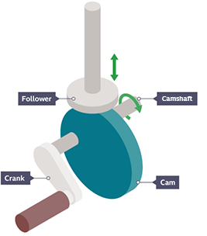
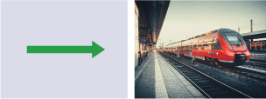
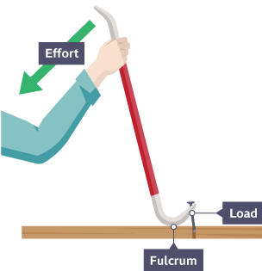

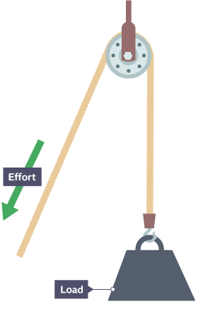
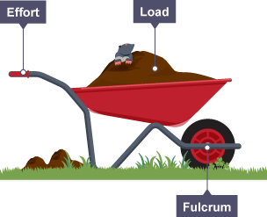
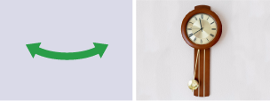
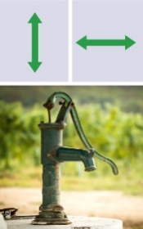
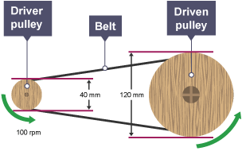
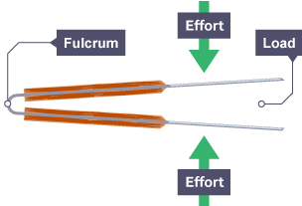

Design and Technology - RM
Year 8
Key Words | Definition
Allowances | The amount by which a measurement can vary without affecting the ability of the product to be manufactured accurately.
Annotation | Labelling of a diagram in detail – with sentences
Belt System | Transfers movement from one rotating pulley to another rotating pulley.
CAD | Computer Aided Design - use of computer software to design in 3D/2D
CAM | Computer Aided Manufacturing - use of software and computer-controlled machinery to automate a manufacturing process.
Cams | A wheel attached to a crankshaft.
Design Fixation | When a designer finds it difficult, to produce a range of innovative solutions, to a design problem.
Environmental Challenges | The challenges raw materials cause – deforestation, pollution and global warming
Gears | A wheel with teeth that can change the speed of a mechanism.
Followers | A bar that follows a cam around its circumference.
Innovative | New and creative in approach.
Iterative Process | A cyclic design process of modelling and testing to achieve gradual improvements to the design.
Levers | A bar featuring a pivot that can pushed/pulled to make moving of a load easier.
Marking Out | Marks made on an item before cutting or forming.
Prototyping | The first working model of a design used for testing, development and evaluation.
Perspective Drawing | Shows an object in 3D getting smaller in the distance.
Key Words | Definition
Pulley | A wheel with a grooved edge that a cord passes around.
Tolerance | The amount of error you will allow a part to have.
Types of Movements
Linear
Rotary
Oscillating
Types of Levers
First Order Levers
Second Order Levers
Third Order Levers
Cam Mechanism
Pulley System
Reciprocating
Belt System
15

Slide 18
W/c 3rd November Thinking definition: Thinking is making connections, reasoning and asking questions to make the learning stick
Reflecting on learning behaviours for thinking… | Experience log
 | Successful moment… | In hindsight… Where you could have done better on reflection? | At home…
I gave an idea and reasoned/justified.
I reflected on my idea and made it better after discussing with others
I used a revision strategy to help make the learning stick.
I made connections between what I am learning and the outside world.
I asked questions to deepen my understanding.
16

Slide 19
W/c 10th November Thinking definition: Thinking is making connections, reasoning and asking questions to make the learning stick
Reflecting on learning behaviours for thinking… | Experience log
 | Successful moment… | In hindsight… Where you could have done better on reflection? | At home…
I gave an idea and reasoned/justified.
I reflected on my idea and made it better after discussing with others
I used a revision strategy to help make the learning stick.
I made connections between what I am learning and the outside world.
I asked questions to deepen my understanding.
17

Slide 20
W/c 17th November Thinking definition: Thinking is making connections, reasoning and asking questions to make the learning stick
Reflecting on learning behaviours for thinking… | Experience log
 | Successful moment… | In hindsight… Where you could have done better on reflection? | At home…
I gave an idea and reasoned/justified.
I reflected on my idea and made it better after discussing with others
I used a revision strategy to help make the learning stick.
I made connections between what I am learning and the outside world.
I asked questions to deepen my understanding.
18

Slide 21
W/c 24th November Thinking definition: Thinking is making connections, reasoning and asking questions to make the learning stick
Reflecting on learning behaviours for thinking… | Experience log
 | Successful moment… | In hindsight… Where you could have done better on reflection? | At home…
I gave an idea and reasoned/justified.
I reflected on my idea and made it better after discussing with others
I used a revision strategy to help make the learning stick.
I made connections between what I am learning and the outside world.
I asked questions to deepen my understanding.
19

Slide 22
W/c 1st December Thinking definition: Thinking is making connections, reasoning and asking questions to make the learning stick
Reflecting on learning behaviours for thinking… | Experience log
 | Successful moment… | In hindsight… Where you could have done better on reflection? | At home…
I gave an idea and reasoned/justified.
I reflected on my idea and made it better after discussing with others
I used a revision strategy to help make the learning stick.
I made connections between what I am learning and the outside world.
I asked questions to deepen my understanding.
20

Slide 23
W/c 8th December Thinking definition: Thinking is making connections, reasoning and asking questions to make the learning stick
Reflecting on learning behaviours for thinking… | Experience log
 | Successful moment… | In hindsight… Where you could have done better on reflection? | At home…
I gave an idea and reasoned/justified.
I reflected on my idea and made it better after discussing with others
I used a revision strategy to help make the learning stick.
I made connections between what I am learning and the outside world.
I asked questions to deepen my understanding.
21

Slide 24
W/c 15th December Thinking definition: Thinking is making connections, reasoning and asking questions to make the learning stick
Reflecting on learning behaviours for thinking… | Experience log
 | Successful moment… | In hindsight… Where you could have done better on reflection? | At home…
I gave an idea and reasoned/justified.
I reflected on my idea and made it better after discussing with others
I used a revision strategy to help make the learning stick.
I made connections between what I am learning and the outside world.
I asked questions to deepen my understanding.
22

Slide 25
Reading Log w/c 3rd November (20 mins reading per day – all five logs MUST be completed)
Date | Title of novel | Number of pages read | Summary about what I have read
 |  |  | • • •
 |  |  | • • •
 |  |  | • • •
 |  |  | • • •
 |  |  | • • •
Checked by form tutor:
23

Slide 26
Reading Log w/c 10th November (20 mins reading per day – all five logs MUST be completed)
Date | Title of novel | Number of pages read | Summary about what I have read
 |  |  | • • •
 |  |  | • • •
 |  |  | • • •
 |  |  | • • •
 |  |  | • • •
Checked by form tutor:
24

Slide 27
Reading Log w/c 17th November (20 mins reading per day – all five logs MUST be completed)
Date | Title of novel | Number of pages read | Summary about what I have read
 |  |  | • • •
 |  |  | • • •
 |  |  | • • •
 |  |  | • • •
 |  |  | • • •
Checked by form tutor:
25

Slide 28
Reading Log w/c 24th November (20 mins reading per day – all five logs MUST be completed)
Date | Title of novel | Number of pages read | Summary about what I have read
 |  |  | • • •
 |  |  | • • •
 |  |  | • • •
 |  |  | • • •
 |  |  | • • •
Checked by form tutor:
26

Slide 29
Reading Log w/c 1st December (20 mins reading per day – all five logs MUST be completed)
Date | Title of novel | Number of pages read | Summary about what I have read
 |  |  | • • •
 |  |  | • • •
 |  |  | • • •
 |  |  | • • •
 |  |  | • • •
Checked by form tutor:
27

Slide 30
Reading Log w/c 8th December (20 mins reading per day – all five logs MUST be completed)
Date | Title of novel | Number of pages read | Summary about what I have read
 |  |  | • • •
 |  |  | • • •
 |  |  | • • •
 |  |  | • • •
 |  |  | • • •
Checked by form tutor:
28

Slide 31
Reading Log w/c 15th December (20 mins reading per day – all five logs MUST be completed)
Date | Title of novel | Number of pages read | Summary about what I have read
 |  |  | • • •
 |  |  | • • •
 |  |  | • • •
 |  |  | • • •
 |  |  | • • •
Checked by form tutor:
29

Slide 32
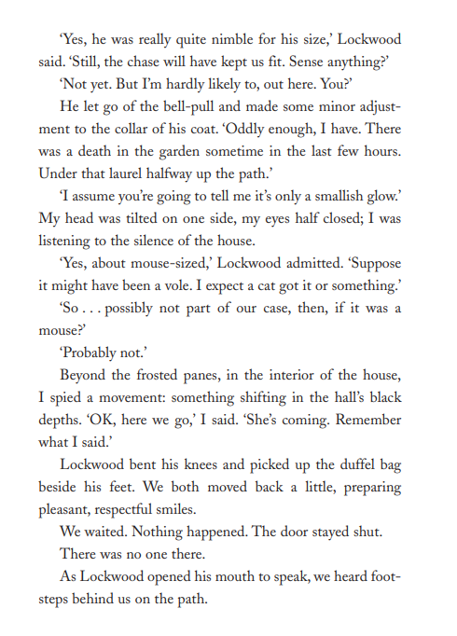
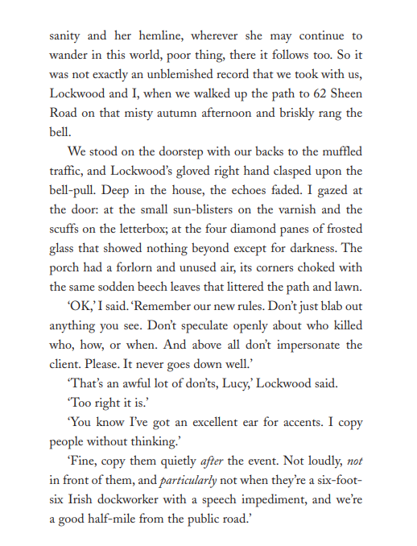
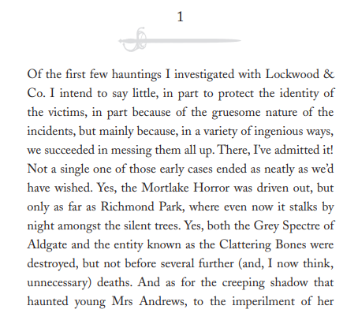
1. Lockwood & Co: The Screaming Staircase – Johnathan Stroud
30
Notes:
Ok, so let’s all have the extract in front of us. I am going to read now and you are going to follow with your finger or ruler.
READ THE EXTRACT. PAUSE ON THE WORDS THAT THE STUDENTS MAY NOT KNOW.

Slide 33
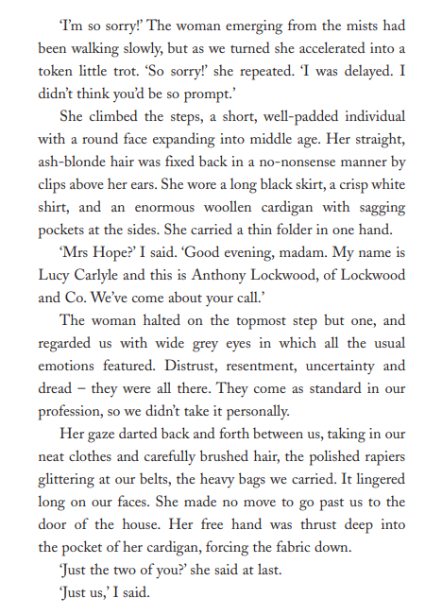
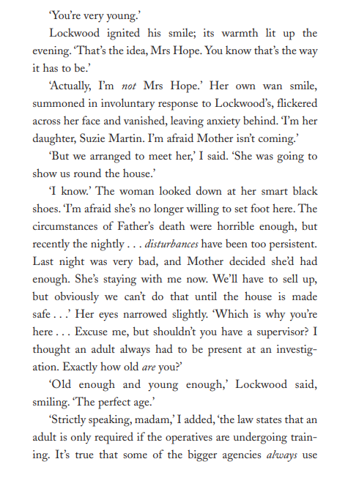
1. Lockwood & Co: The Screaming Staircase – Johnathan Stroud
Vocabulary:
Nimble – Quick and light in movement.
Smidgin – A very small amount.
31
Notes:
Ok, so let’s all have the extract in front of us. I am going to read now and you are going to follow with your finger or ruler.
READ THE EXTRACT. PAUSE ON THE WORDS THAT THE STUDENTS MAY NOT KNOW.

Slide 34
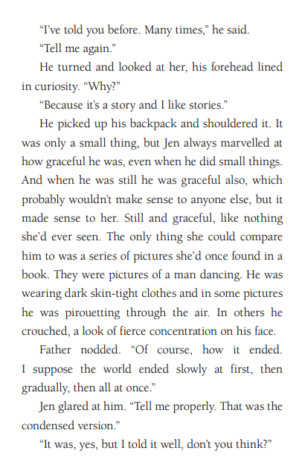
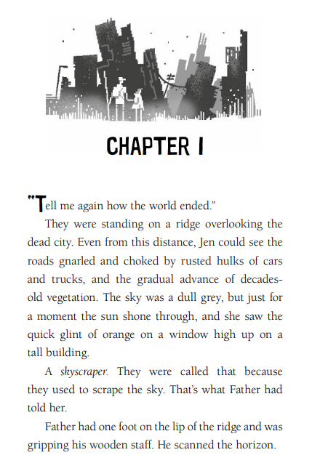
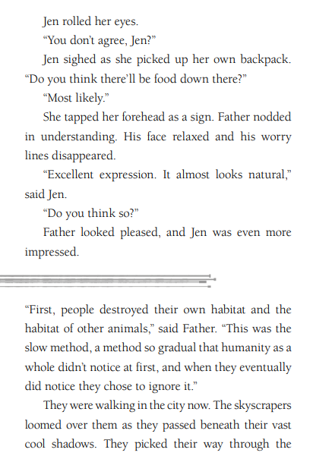
2. After – Padraig Kenny
32
Notes:
Ok, so let’s all have the extract in front of us. I am going to read now and you are going to follow with your finger or ruler.
READ THE EXTRACT. PAUSE ON THE WORDS THAT THE STUDENTS MAY NOT KNOW.

Slide 35
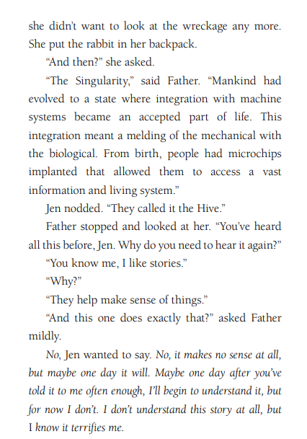
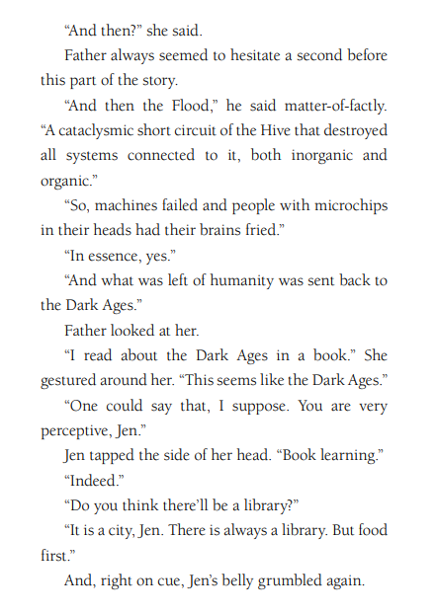
2. After – Padraig Kenny
Vocabulary:
Vegetation – Plants in general, especially in a particular area.
Singularity – A future point where technology and humans merge.
Cataclysmic – Causing sudden and violent change or disaster.
33
Notes:
Ok, so let’s all have the extract in front of us. I am going to read now and you are going to follow with your finger or ruler.
READ THE EXTRACT. PAUSE ON THE WORDS THAT THE STUDENTS MAY NOT KNOW.

Slide 36
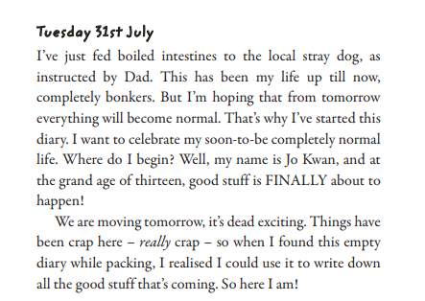
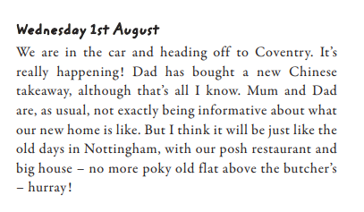
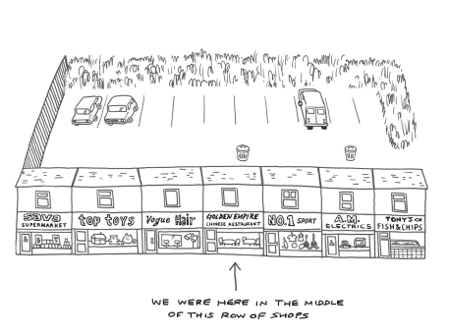
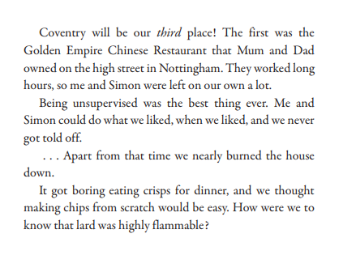
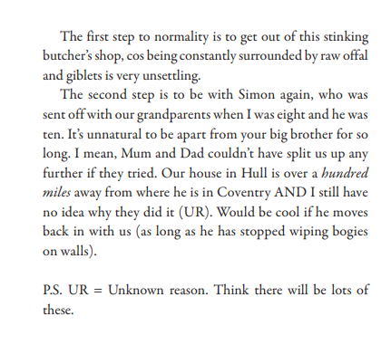
3. Chinglish – Sue Cheung
34
Notes:
Ok, so let’s all have the extract in front of us. I am going to read now and you are going to follow with your finger or ruler.
READ THE EXTRACT. PAUSE ON THE WORDS THAT THE STUDENTS MAY NOT KNOW.

Slide 37
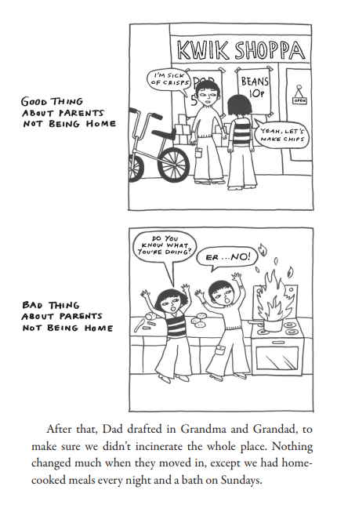
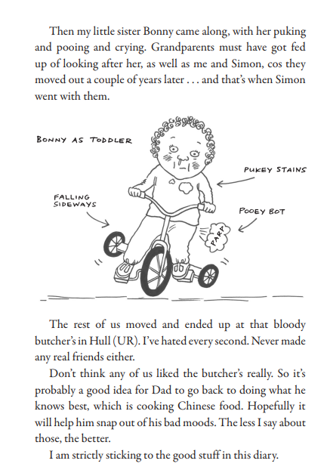
3.
3. Chinglish – Sue Cheung
Vocabulary:
Offal – The internal organs of an animal used as food.
Marvelled – Felt great surprise or admiration.
35
Notes:
Ok, so let’s all have the extract in front of us. I am going to read now and you are going to follow with your finger or ruler.
READ THE EXTRACT. PAUSE ON THE WORDS THAT THE STUDENTS MAY NOT KNOW.

Slide 38
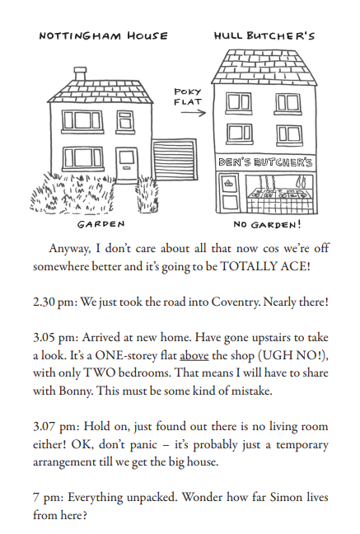
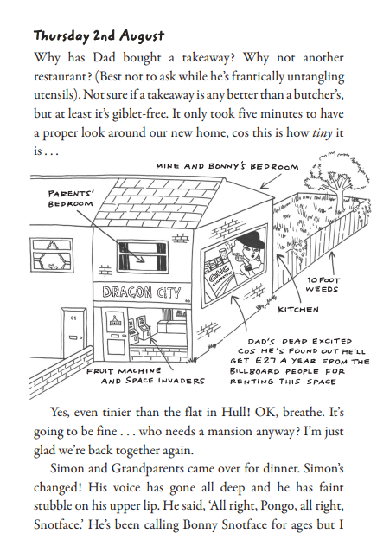
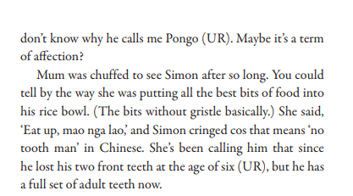
3. Chinglish – Sue Cheung
36
Notes:
Ok, so let’s all have the extract in front of us. I am going to read now and you are going to follow with your finger or ruler.
READ THE EXTRACT. PAUSE ON THE WORDS THAT THE STUDENTS MAY NOT KNOW.

Slide 39
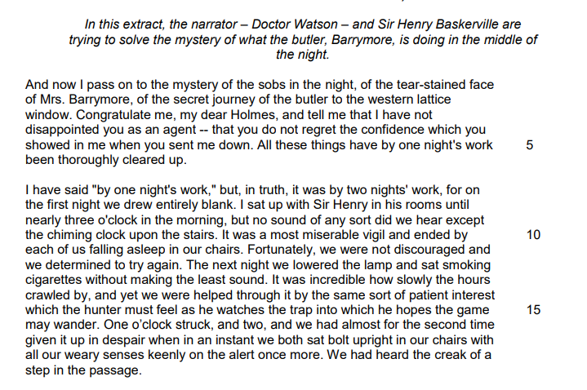
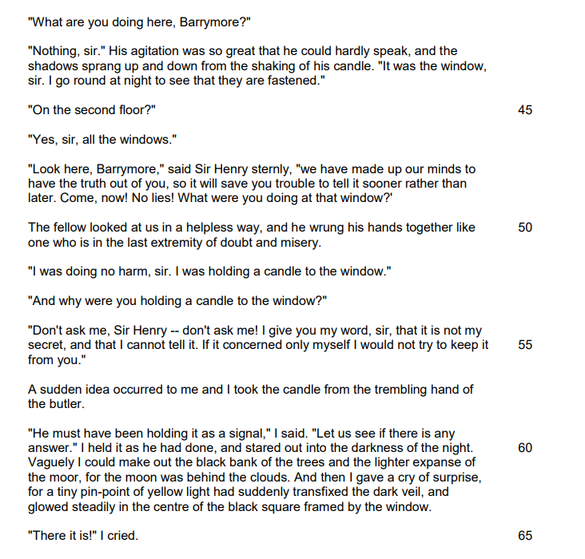
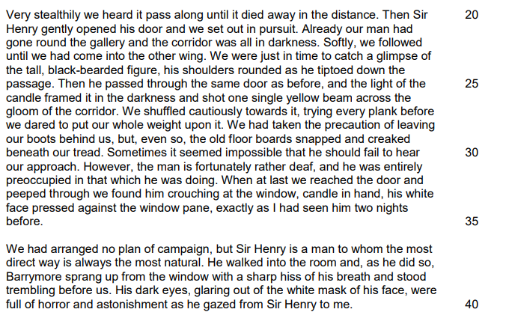
4. The Hounds of Baskerville – Arthur Conan Doyle
Vocabulary:
Agitation – A state of nervousness or anxiety.
Speculate – To guess or form an opinion without firm evidence
37
Notes:
Ok, so let’s all have the extract in front of us. I am going to read now and you are going to follow with your finger or ruler.
READ THE EXTRACT. PAUSE ON THE WORDS THAT THE STUDENTS MAY NOT KNOW.

Slide 40
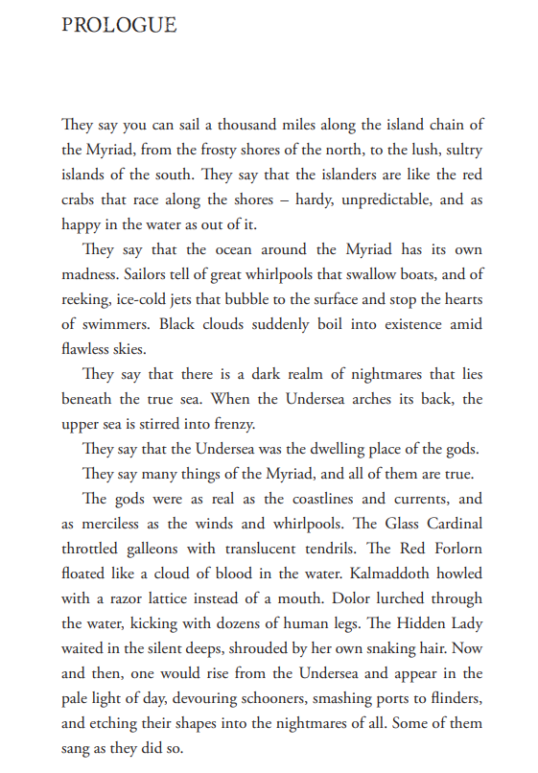
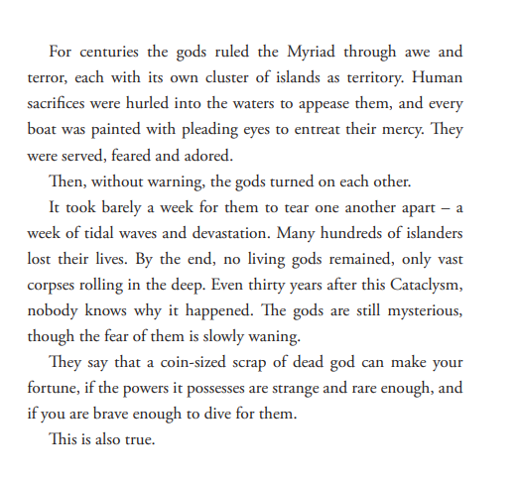
5. Deeplight – Frances Hardinge
Vocabulary:
Myriad – A countless or extremely large number.
Devouring – Eating or consuming something eagerly and completely.
Etching – Carving or cutting designs into a surface.
38
Notes:
Ok, so let’s all have the extract in front of us. I am going to read now and you are going to follow with your finger or ruler.
READ THE EXTRACT. PAUSE ON THE WORDS THAT THE STUDENTS MAY NOT KNOW.

Slide 41
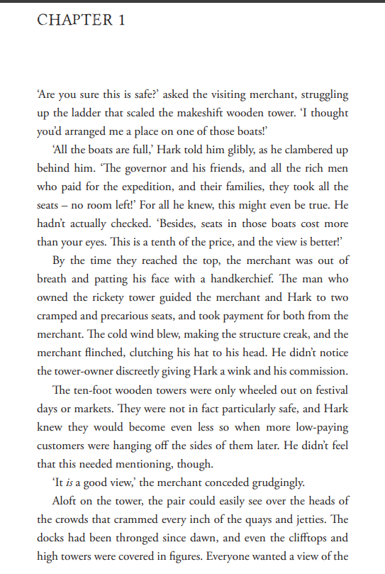
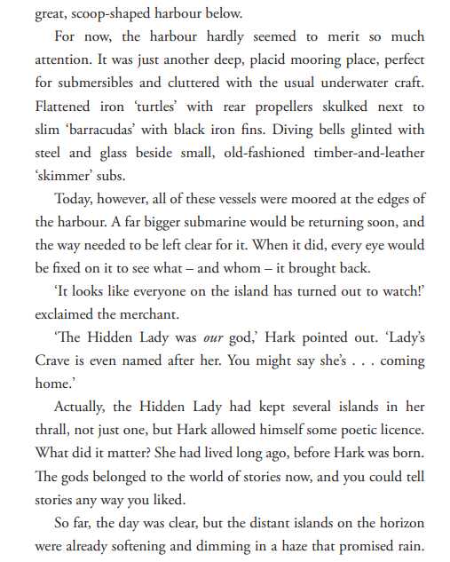
5. Deeplight – Frances Hardinge
39
Notes:
Ok, so let’s all have the extract in front of us. I am going to read now and you are going to follow with your finger or ruler.
READ THE EXTRACT. PAUSE ON THE WORDS THAT THE STUDENTS MAY NOT KNOW.

Slide 42
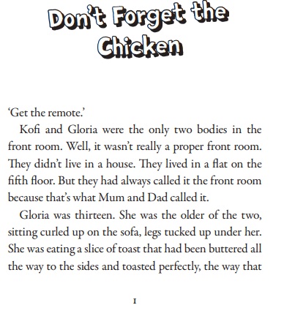
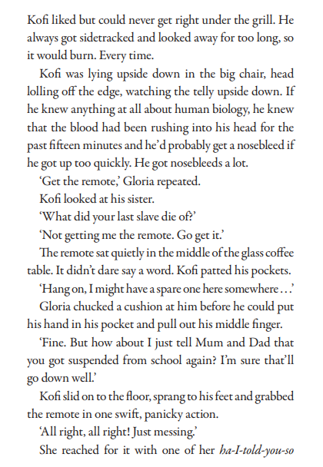
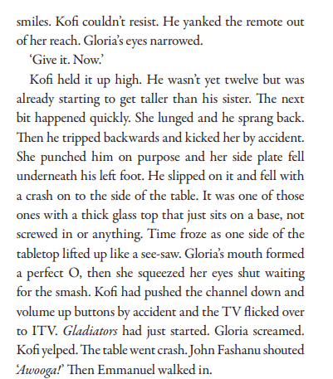
6. Kofi and the Rap Battle Summer – Jeffrey Boakye
40
Notes:
Ok, so let’s all have the extract in front of us. I am going to read now and you are going to follow with your finger or ruler.
READ THE EXTRACT. PAUSE ON THE WORDS THAT THE STUDENTS MAY NOT KNOW.

Slide 43
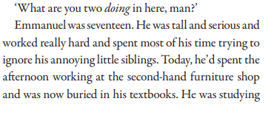
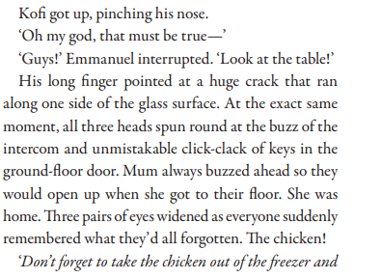
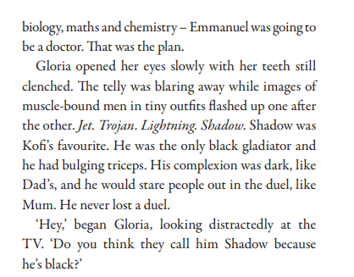
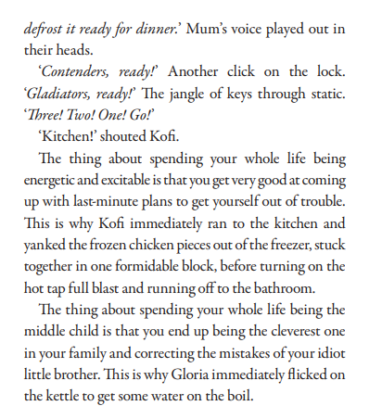
6. Kofi and the Rap Battle Summer – Jeffrey Boakye
Vocabulary:
Formidable – Very strong, large, or difficult to deal with.
41
Notes:
Ok, so let’s all have the extract in front of us. I am going to read now and you are going to follow with your finger or ruler.
READ THE EXTRACT. PAUSE ON THE WORDS THAT THE STUDENTS MAY NOT KNOW.

Slide 44
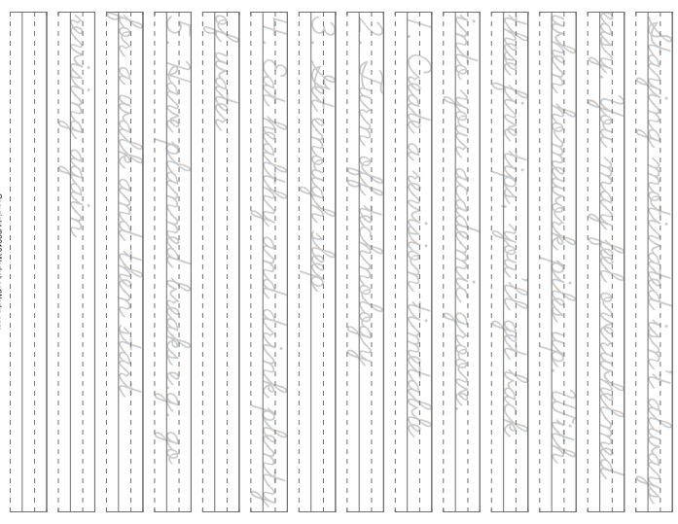
42

Slide 45
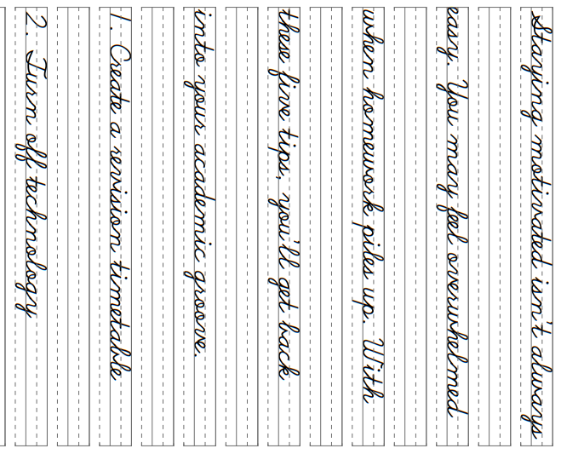
43

Slide 46
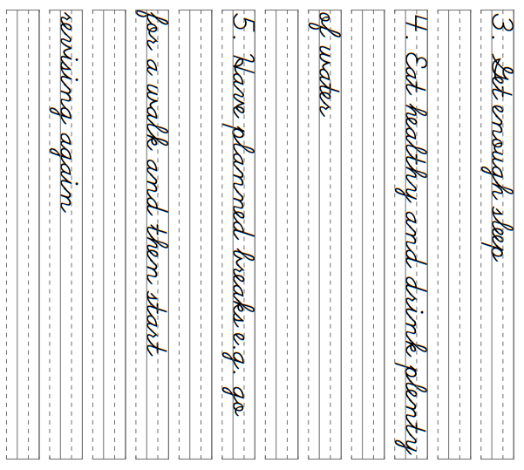
44

Slide 47
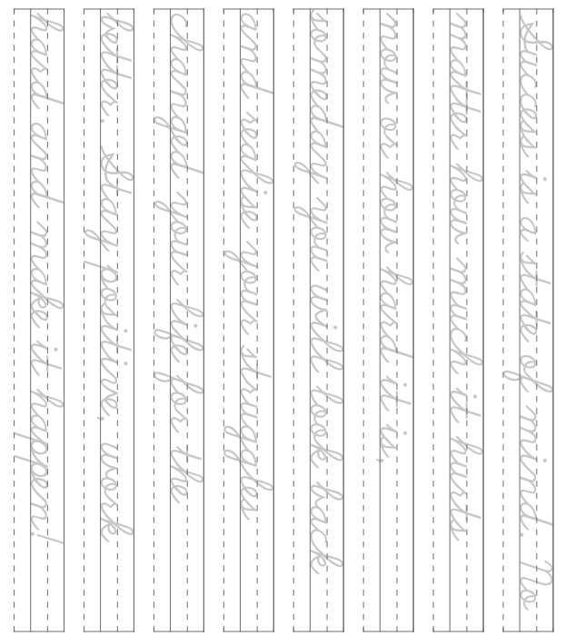
45

Slide 48
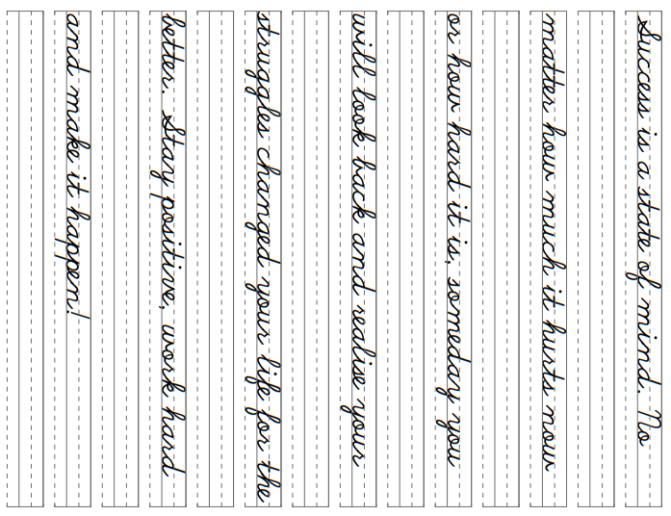
46

