Slide 1

Year 8 Knowledge Organiser HT3
Knowledge is Power
Name: ______________________________
Form: _______

Slide 2
Contents Page
Subject | Page
English | 1
Maths | 2
Science | 3
History | 4
Geography | 5
Spanish | 6
PE | 8
Performing Arts | 12
Computing | 13
Art | 14
Cooking and Nutrition | 15
Music | 16
DT | 17
‘Thinking’ reflection log | 18
Reading log | 24
Reading Extracts | 30
Cursive Handwriting Practice | 41

Slide 3
English
Week 3 – Language techniques
Term | Definition
Simile | A comparison using ‘like’ or ‘as’.
Metaphor | A comparison made without using ‘like’ or ‘as’.
Alliteration | The repetition of the same sounds at the beginning of words in a sentence.
Onomatopoeia | How the word sounds reflects its meaning.
Pathetic fallacy | The weather reflects the mood in a text.
Week 5 - Themes
Ambition | Both Walton and Frankenstein are driven to ruin by there desire for greatness.
Science versus Religion | Shelley was deeply religious but married to a famous atheist. The novel discusses the clash between science and a religious society.
Isolation and prejudice | Despite his intelligence the creature is treated badly by all due to his appearance.
Revenge | The creature’s behavior seems mostly driven by his desire for revenge against humanity.
Romanticism and nature | The novel frequently uses nature to represent the sublime as well as showing the perils of playing at creation.
Week 1 - Context
Mary Wollestencraft | British philosopher and early feminist. Mother of Mary Shelley.
Mary Shelley | Teenage author of Frankenstein.
Percy Shelley | Poet, political writer and husband of Mary Shelley.
Romanticism | An artistic movement focused on emotion and individualism as well as the glorification of nature.
Galvanism | A scientific theory that thought electricity was the source of life. Named after scientist Luigi Galvani.
Week 6 - Steps of an Analytical Paragraph
1. Point – create a point from the evidence, which answers the question directly and has an adjective
2. Evidence – select a piece of evidence from the text which helps you to answer the question and is relevant and interesting
3. Explain – explain how your evidence is relevant to the question and helps support your point
4. Device – identify a language device, dramatic technique or word type that is used in your quote
6. Analysis – zoom in on a key words and make relevant connotations
7. Link – link back to the context of your play and the original question
Week 2 – Characters in Frankenstein
Dr Victor Frankenstein | Protagonist of the novel and creator of The Creature,
The Creature | A creature manufactured and brought to life by Victor Frankenstein,
Captain Walton | A ship’s captain trying to find his way to Asia via the Northern Passage who finds Victor on the ice.
Henry Clerval | Victor’s childhood friend, obsessed with literature to contrast with Victor’s obsession with science,
Elizabeth Lavenza | Victor’s adopted sister and fiancée.
Week 4 - Key Vocabulary
Pathetic Fallacy | When the author uses the weather to reflect the atmosphere or mood of the book.
Foreshadowing | When an author gives clues and hints to future events in a story.
Symbolism | The use of symbols to represent ideas or qualities.
Metaphor | A description of something by comparison to something with similar qualities to highlight those qualities.
1
Notes:
Year 8 HT2

Slide 4
Maths
Averages
Key Word | Definition
Mode | Most frequent number
Median | The ‘middle value’ when numbers are in order.
Mean | Found by adding all numbers together and then dividing that by the number of numbers.
Range | The difference between the highest and lowest values.
Discrete Data | Data that can only take certain values. These values do not have to be whole numbers, but they are fixed values..
Continuous Data | Data that can take any value e.g. height, weight, temperature, length.
Grouped Data | Data grouped together into categories (class intervals)
Class interval | When data is collected and arranged in a class, and the width of this class is known as the class interval.
Ratio
Key Word | Definition
Ratio | Ratio compares the size of one part to another part. Written using the ‘:’ symbol.
Simplifying Ratios | To reduce a ratio to its lowest terms by dividing by a common factor
Ratios in the form 1:n | Divide both parts of the ratio by one of the numbers to make one part equal 1.
Sharing into a ratio | A method of sharing out an amount in a given ratio.
Proportion
Key Word | Definition
Proportion | A relationship between two quantities.
Direct Proportion | A relationship between two variables where as one increases, the other also increases.
Indirect Proportion | A relationship between two variables where as one increases, the other decreases.
2

Slide 5
Science
Key Word | Definition
dissipate | Spread out into the surroundings.
energy transfers | Changes from one form of energy to another form of energy.
conduction | The transfer of heat through a material by transferring kinetic energy from one particle to another.
conductor | A material which allows charge to move easily through it.
convection | The transfer of heat energy through a moving liquid or gas.
convection current | A movement within the Earth's mantle caused by the heat of the core.
insulate | To help maintain the temperature.
radiation | Energy carried by particles from a radioactive substance, or spreading out from a source.
Key Word | Definition
Alcohol | A Depressant class of drug. Short term effects include hangovers, while long term effects include liver disease
Caffeine | A Stimulant class of drug Too much causes a lack of disease
Paracetamol | A Painkiller Reduces pain without addressing the cause
Key Word | Definition
Antibiotic | A chemical that kills bacteria
Vaccination | A dead or weakened pathogen
Pathogen | A microorganism that causes harm
Antibody | Proteins made by white blood cells that are specific to an infection. They help to destroy the pathogen.
3
Notes:
HT3 2024-5

Slide 6
History
Key Term | Definition
Activist/s | A person who fights for political or social change
Bill | A proposed new law
Boycott | When you stop using a service or a product as a form of protest
Civil Rights | Political, economic, and social freedoms, and equality
Decriminalised | No longer treated as illegal
Demonstration/s | A form of protests involving lots of people gathering or marching for or against something
Desegregated | No longer separated
Disability | When the way society is organises creates barriers that prevent a person with an impairment from participating fully in daily life
Discrimination | Unjust treatment of people because they belong to a particular group
Feminists | People who believe in economic, social, and political equality between men and women
Impairment | When a person’s body or mind is different and they need additional support
Intersectionality | A term used to describe how individual characteristics connect with each other. It helps explain how people experience something differently
Legacy | A situation that exists now because of events that occurred in the past
Marriage Bar | Women were expected to quit their jobs when they got married, to focus on being wives and mothers
Key Term | Definition
Migrants | People who have moved from one place to another to live permanently
Militant | Violent
Misogyny | Hatred of women
Patriarchy | The system that gives men power and largely excludes women from power
Pop Culture | Popular culture expressed through mass media. Generally aimed at younger people
Race | A grouping of humans according to shared physical features, such as skin colour, hair texture, and facial features
Racism | Prejudice against people from a particular ethnic group, typically a minority group
Refugee | Someone forced to leave their home to escape war, persecution, or a natural disaster
Segregated | Separated, for example by race, gender, or religion
Social Injustice | The unequal and unfair treatment of different groups in society
Stereotype | A widely held but oversimplified belief about a particular group of people
Strike | Workers get together and refuse to work in hopes their employer meets their demands
Suffrage | The right to vote
Trade Union | A group of workers doing the same or similar jobs who join together to form an organisation that will protect their rights and interests

Slide 7
Geography
Key Word | Definition
Environmental concern | A serious threat to human beings and their environment is the continuous and accelerating overuse and destruction of natural
Global warming | the long-term warming of the planet's overall temperature
Climate change | to long-term shifts in temperatures and weather patterns.
Greenhouse effect | a process that occurs when gases in Earth's atmosphere trap the Sun's heat
Green house gas | a gas that contributes to the greenhouse effect by absorbing infrared radiation (suns heat)
Fossil fuel | a natural fuel such as coal or gas, formed in the geological past from the remains of living organisms
Climate refugee | a person who has been forced to leave their home as a result of the effects of climate change on their environment.
Drought | a prolonged period of abnormally low rainfall, leading to a shortage of water.
Coral bleaching | When water is too warm, corals will reject the algae living in their tissues causing the coral to turn completely white
Mitigation | the action of reducing the severity, seriousness, or painfulness of something
Deforestation | the action of clearing a wide area of trees
Commercial farming | when crops and animals are produced to sell at market for a profit on a larger scale
Subsistence farming | the practice of growing crops and raising livestock sufficient only for one's own use
Selective logging | the practice of cutting down a few species of trees while leaving the rest intact and unharmed
Invasive alien species | species usually introduced by humans by mistake or deliberately
Native species | a plant or animal living in an area/ ecosystem without any human intervention.
Endangered species | is a species of animal that only has a small number left on the planet.
Extinction | the complete disappearance of a species from Earth.
NGO | Non Governmental Organisation: are not for profit charities that deal with many different issues
5

Slide 8
Spanish
Spanish | English
El móvil | Phone
El ordernador | Computer
El portátil | laptop
La app | App
La tableta | Tablet
El videojuego | Videogame
La cámara | Camera
la televisión | Tv
La red social | Social network
El internet | Internet
El mensaje | Message
el usuario | User
Sacar fotos | To take potos
Chatear | To chat online
Mandar mensajes | To send messages
Jugar | To play
Leer e-books | To read e-books
Spanish | English
Descargar | To download
Ver | To watch
Compartir | To share
subir | To upload
Odio | I hate
Prefiero | I prefer
(no) me gusta | I (don’t) like
Me interesa(n) | I’m interested in
La telerrealidad | Reality tv
El concurso | Quiz/game show
Una comedia | Comedy
Una telenovela | Soap opera
El telediario | The news
El documental | Documentary
El programa de deporte | Sports programme
El programa de música | Music programme
Una serie policíaca | A detective series
6

Slide 9
Spanish
Spanish | English
Más que | More… than
Menos que | Less… than
Tan…como | As…as
aburrido | Boring
apropiado | Appropriate
Complicado | Complicated
Decepcionante | Disappointing
Educativo | Educational
Emocionante | Exciting
extraño | Strange
gracioso | Funny
interesante | Interesting
Lento | Slow
Peor | Worse
Mejor | Better
Caro | Expensive
barato | cheap
Spanish | English
Fácil | Easy
Peligroso | Dangerous
Grátis | Free
Popular | Popular
Seguro | Safe
El riesgo | Risk
El peligro | Danger
(no) se debe | You must (not)
Hay que | You must
Es importante | It is important
El joven | Young person
7

Slide 10
PE
Health and Fitness
Muscular Strength | The amount of the force muscles can generate against a resistance
Muscular Endurance | The ability to use voluntary muscles, over long periods of time without getting tired
Flexibility | The range of movement at a joint
Cardiovascular Fitness (Aerobic Endurance) | The ability of the heart and circulatory system to meet the demands of the body for a long period of time
Body composition | The percentage of a body that is fat, muscle, bone and water
Coordination | The ability to move two or more body parts at the same time
Reaction Time | The time taken for a response to occur after a stimulus
Agility | The ability to change direction at speed
Balance | The ability to keep the body steady when in a static position or when moving
Speed | The time taken to cover a set distance/complete a movement
Power | The ability to combine speed and strength
Principles of training
Progressive Overload | Working the body harder than normal/gradually increasing the amount of exercise you do
Reversibility | If training is not regular, adaptations will be reversed. This can happen when suffering from illness, injury or after an off season
Specificity | Training showed be matched to the requirements of the sport or position the performer is in. Training must be specifically designed to develop the right muscles, type of fitness or skills
Individual needs | All PEP’s would differ depending on performers goals/target, strengths /weaknesses, age/gender and current health/fitness levels
Overtraining | Occurs when you train too hard and do not allow the body enough rest/recovery time Signs include extended muscle soreness, frequent illness & increase injuries
8

Slide 11


PE
Cardiovascular System
Skeletal System
9

Slide 12

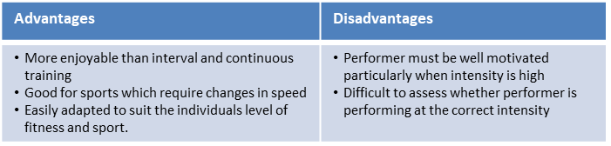
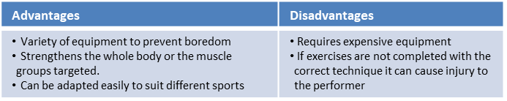
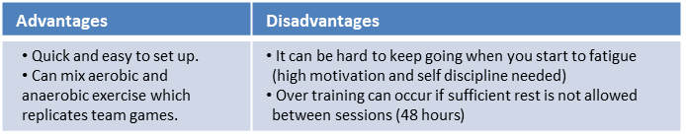
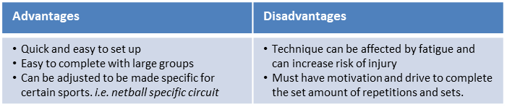
Key Word | Definition
Methods of training
Continuous training - | Involves a steady but regular pace at a moderate intensity (aerobic) which should last for at least 20 minutes. i.e. running, walking, swimming, rowing or cycling. Used by a marathon runner.
Fartlek training | Referred to as ‘speed play’ This is a form interval training but without rest. Involves a variety of changing intensities over different distances and terrains. i.e. 1 lap at 50% max, 1 lap walking, 1 lap at 80% (aerobic and anaerobic used) Used by games players – Hockey players
Weight/Resistance training | A form of training that uses progressive resistance against a muscle group. Used by cyclists. Muscular strength: High weight x low repetitions. Muscular endurance: Low weight x high repetitions
Interval training | Involves periods of work followed by periods of rest. i.e. Sprint for 20 metre + walk back to start. Used by a 200m sprinter
Plyometric training | Involves high-impact exercises that develop power. i.e. bounding/hopping, squat jumps. Used by long jumpers, 100 m sprinters or basketball players.
Circuit training | A series of exercises completed one after another. Each exercise is called a station. Each station should work a different area of the body to avoid fatigue. i.e. press ups, sit ups, squats, shuttle runs.
PE
10

Slide 13
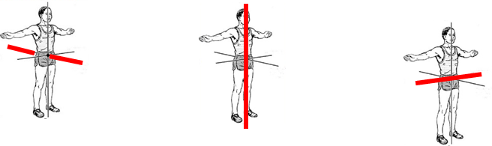
PE
BIOMECHANICS - Planes and axes for movement
PAxes for movement | An axis is an imaginary line at right angles to the plane
Sagittal axis (left picture) | Runs through the body horizontally from the back to front.
Vertical axis (middle picture) | Runs through the body vertically from the top to bottom.
Frontal axis (right picture) | Runs through the body horizontally from the left to right.
11

Slide 14
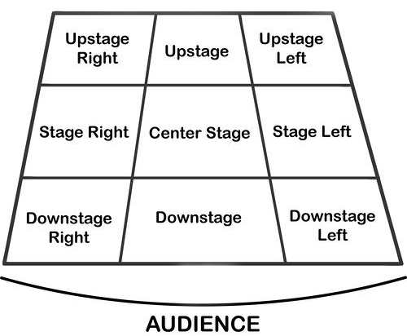
Performing Art
Key Word | Definition
Body Language | How an actor uses their body to communicate meaning. For example, crossing your arms could mean you are fed up
Gesture | a movement of the body, particularly the hands, arms, or head, that conveys meaning or expresses an idea, emotion, or intention
Levels | Levels can be used to show status, relationships, and even to indicate changes in location or time
Proxemics | The deliberate use of distance between you and other characters or objects to communicate something to an audience
Facial Expression | Using the face to express that characters feelings and emotions.
Key Word | Definition
Amphitheatre | Circular or oval open air theatre with a large ranked seating area
Apron | The apron is a section of the stage which the floor projects towards or into the auditorium
Black Box | A flexible studio theatre where the audience and actors are in the same room surrounded by black tabs
End On | Traditional audience seating layout where the audience is looking at the stage from the same direction.
Found Space | A performance space that wasn’t designed to be one e.g historic buildings
In the Round | Theatre in the Round is a form of audience seating layout where the acting area is surrounded on all sided by seating. There is often a number of entrances through the seating
Promenade | Form of staging where the audience moves around the performance space and sees the play at a variety of different locations
Proscenium Arch | The opening in the wall which stands between stage and auditorium in some theatres; the picture frame through the audience sees the play’ fourth wall’
Site-specific theatre | A piece of performance which has been deigned to work only in a particular non-theatre space
Stage Directions
Stage directions are from the performers perspective
12

Slide 15
Computing
Digital Animation
Digital animation | Digital animation includes all the animation techniques that are done exclusively with the use of computers.
Keyframes | Instructions telling objects where to be and how to act
Timeline | The sequence of events to make an animation, where the key frames are stored
Object | These are the graphics on the time line
Powtoon | Online Animation software used to create professional publications
Export Options
Export | Renders raw files of animation to a viewable format
MP4 | A digital multimedia container format most commonly used to store video and audio
Animated Gif | Sequence of images which look like a video
Tools and Design Terminology
Rotate | To turn an object about an axis or a centre
Scale | Refers to the relative size of a design element in comparison to another element
Audience | The group of people for whom you are developing your product for
Font style | Or typography is the art of arranging letters and text in a way that makes it visually appealing to the reader
Font Size | Refers to the measurement of a particular font in terms of its height e.g 14pt
Layout | The organisation of certain elements within a page. The 'elements' are usually images, text, animation or video. This organisation is called the 'layout
Background | A page has a background pattern or background colour
Transition | the special effect that occurs when you exit one slide and move on to the next during a presentation.
White space | Portions of a page layout or image left blank
Colour scheme | Consists of a combination of colours used in a range of design projects
13

Slide 16
Art
Key Word | Definition
Scale | The size of one whole object in relation to another whole object. Artists use large scale art and small scale art to create different effects on a viewer through their perception of size.
Proportion | Proportion refers to the relationship between the different sized components within one whole composition.
Eye line | A person's line of sight.
Tracing | A copy of a drawing, map, or design made by tracing.
Composition | The manner in which the parts of a thing are put together : makeup. the composition of a painting.
Perspective | The art of representing three-dimensional objects on a two-dimensional surface so as to give the right impression of their height, width, depth, and position in relation to each other.
Contour shading | Is similar to hatching and cross-hatching. The difference is that the lines are curved to follow the contours of the subject. So these lines can be drawn horizontally, vertically and even diagonally.
Outline | A line or set of lines enclosing or indicating the shape of an object in a sketch or diagram but not the detail.
14

Slide 17
Cooking and Nutrition
Key Word | Definition
Ragu | A meat based sauce that is commonly served with pasta
Kitchen Hygiene | Ensuring that everything is clean when preparing food
Kitchen Safety | Being safe in the kitchen
Cross contamination | Transfer of bacteria from one person, object or place to another
Eat Well Guide | A pictorial food guide showing the amounts and types of foods that are needed to make up a healthy balanced diet
Claw grip | A method of cutting food that ensures that the finger tips are tucked out of the way and will not get caught by the knife
Food poisoning | An illness caused by eating contaminated food
Bacteria | Microscopic living organisms which can be found everywhere
Salmonella | Food poisoning bacteria found in chicken, some dairy products and raw eggs
Seasonal foods | Foods that are only available at certain times of the year
cuisine | A style of cooking of a particular country or region
Bridge Hold | A method of cutting food that ensures that fingers are out of the way as the knife cuts through the food
15

Slide 18
Music
Key Word | Definition
Chords | A chord in music is a combination of three or more notes played simultaneously, forming the harmonic foundation of a piece.
Structure in pop | organization and arrangement of various song sections like verses, choruses, bridges, and the overall layout, creating the framework for the composition.
Harmony | is the combination of different musical notes played simultaneously, creating a rich and pleasing sound that adds depth and character to a musical piece.
Time signature | It tells you how many beats are in each measure and which note gets one beat, helping you keep track of the rhythm while playing or singing.
Dynamic | The volume of a sound or piece of music – loud/soft
A Round/Canon | A round, also called canon, is a musical composition with a minimum of three voices sing exactly the same melody at the unison (and may continue repeating it indefinitely), but with each voice beginning at different times so that different parts of the melody coincide in the different voices, but nevertheless fit harmoniously together.
Timbre | Each instrument own unique ‘tone quality’ and the voice as an instrument had different Timbre
The diaphragm | The diaphragm is basically the muscle below the human lungs and slightly above the stomach responsible for controlling inhalation and exhalation of breath. Most people have heard singers being advised to breathe using their diaphragm every time they sing
Texture | Sometimes voices sing different parts at the same time creating Harmony. Not all vocal music is accompanied by instruments, unaccompanied singing is called A Cappella.
Rhythm | Rhythm is the pattern of sounds and beats in music that creates a sense of movement and flow. It is like the heartbeat of a song that helps us feel the music and dance or sing along. Rhythm can be fast or slow, simple or complex, and is created by combining different beats and notes in a particular order. It is an essential element of music that makes it enjoyable and exciting to listen to.
Tempo | Tempo refers to the speed of music. It's how fast or slow a song sounds.
16

Slide 19
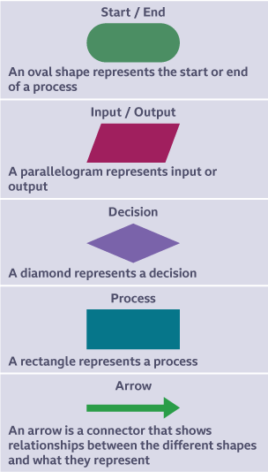
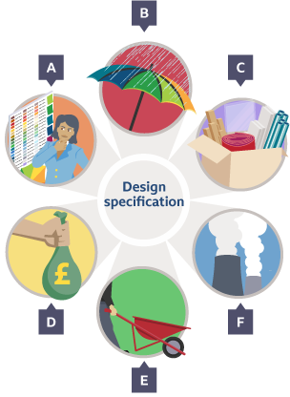
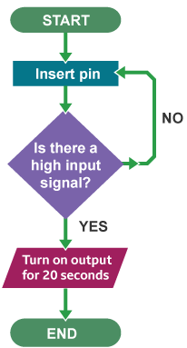
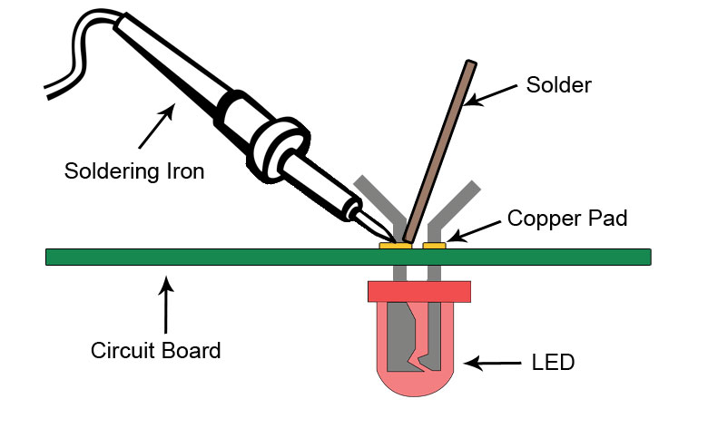
Design and Technology - RM
Key Words | Definition
Evaluation | To judge the quality and performance of a product.
Fit for Purpose | Something is suitable and capable of fulfilling its intended function or use.
Flowchart | Also known as a flow diagram. A diagram that shows the step-by-step flow of an algorithm.
Input Device | An electronic component capable of passing information from the outside world into an electronic system for processing.
Microcontrollers | A computer chip used instead of a CPU that contains a processor, memory and inputs/outputs.
Process Device | A device, usually an integrated circuit, that controls the process functions of a system.
Key Words | Definition
Output Device | A device used to output data or information from a computer, eg a monitor, printer or speakers.
Resistance | The opposition in an electrical component to the movement of electrical charge through it. Resistance is measured in ohms.
Solder | a fusible metal alloy, typically with a low melting point, used to create a permanent bond between metal workpieces.
Soldering | A method of joining, usually electrical components, by heating a filler metal called solder. When the solder cools, it fused the components together.
System Diagram | A block diagram that shows the inputs, processes and outputs of a system.
Voltage | The potential difference across a cell, electrical supply or electrical component. It is measured in volts (V).
Flowchart Program Example
Fit for Purpose
Aesthetic
Function
Material
Target Market
Environment
17

Slide 20
Resilience definition: Grappling to get unstick
Reflecting on learning behaviours for thinking… | Experience log
 | Successful moment… | In hindsight… An example where you could have done better on reflection | At home…
I gave an idea and reasoned/justified.
I reflected on my idea and made it better after discussing with others
I used a revision strategy to help make the learning stick.
I made connections between what I am learning and the outside world.
17

Slide 21
Resilience definition: Grappling to get unstick
Reflecting on learning behaviours for thinking… | Experience log
 | Successful moment… | In hindsight… An example where you could have done better on reflection | At home…
I gave an idea and reasoned/justified.
I reflected on my idea and made it better after discussing with others
I used a revision strategy to help make the learning stick.
I made connections between what I am learning and the outside world.
18

Slide 22
Resilience definition: Grappling to get unstick
Reflecting on learning behaviours for thinking… | Experience log
 | Successful moment… | In hindsight… An example where you could have done better on reflection | At home…
I gave an idea and reasoned/justified.
I reflected on my idea and made it better after discussing with others
I used a revision strategy to help make the learning stick.
I made connections between what I am learning and the outside world.
19

Slide 23
Resilience definition: Grappling to get unstick
Reflecting on learning behaviours for thinking… | Experience log
 | Successful moment… | In hindsight… An example where you could have done better on reflection | At home…
I gave an idea and reasoned/justified.
I reflected on my idea and made it better after discussing with others
I used a revision strategy to help make the learning stick.
I made connections between what I am learning and the outside world.
20

Slide 24
Resilience definition: Grappling to get unstick
Reflecting on learning behaviours for thinking… | Experience log
 | Successful moment… | In hindsight… An example where you could have done better on reflection | At home…
I gave an idea and reasoned/justified.
I reflected on my idea and made it better after discussing with others
I used a revision strategy to help make the learning stick.
I made connections between what I am learning and the outside world.
21

Slide 25
Reading Log w/c 23rd February (20 mins reading per day – all five logs MUST be completed)
Date | Title of novel | Number of pages read | Summary about what I have read
 |  |  | • • •
 |  |  | • • •
 |  |  | • • •
 |  |  | • • •
 |  |  | • • •
Checked by form tutor:
22

Slide 26
Reading Log w/c 2rd March (20 mins reading per day – all five logs MUST be completed)
Date | Title of novel | Number of pages read | Summary about what I have read
 |  |  | • • •
 |  |  | • • •
 |  |  | • • •
 |  |  | • • •
 |  |  | • • •
Checked by form tutor:
23

Slide 27
Reading Log w/c 9th March (20 mins reading per day – all five logs MUST be completed)
Date | Title of novel | Number of pages read | Summary about what I have read
 |  |  | • • •
 |  |  | • • •
 |  |  | • • •
 |  |  | • • •
 |  |  | • • •
Checked by form tutor:
24

Slide 28
Reading Log w/c 16th March (20 mins reading per day – all five logs MUST be completed)
Date | Title of novel | Number of pages read | Summary about what I have read
 |  |  | • • •
 |  |  | • • •
 |  |  | • • •
 |  |  | • • •
 |  |  | • • •
Checked by form tutor:
25

Slide 29
Reading Log w/c 23rd March (20 mins reading per day – all five logs MUST be completed)
Date | Title of novel | Number of pages read | Summary about what I have read
 |  |  | • • •
 |  |  | • • •
 |  |  | • • •
 |  |  | • • •
 |  |  | • • •
Checked by form tutor:
26

Slide 30

Cursive Handwriting Practice – Week 1
27

Slide 31

Cursive Handwriting Practice – Week 2
28

Slide 32

29

Slide 33

Cursive Handwriting Practice – Week 3
30

Slide 34

Cursive Handwriting Practice – Week 4
31

Slide 35

32

