Slide 1

Year 8 Knowledge Organiser HT4
Knowledge is Power
Name: ______________________________
Form: _______

Slide 2
Contents Page
Subject | Page
English | 1
Maths | 2
Science | 3
Spanish | 4
History | 5
Geography | 6
PE | 8
Computing | 12
Art | 13
Cooking and Nutrition | 14
Music | 15
Drama | 16
DT | 17
‘Resilience’ reflection log | 18
Reading log | 23
Cursive Handwriting Practice | 28

Slide 3
English
Week 3 – Key Terms 1
Simile | A comparison using like or as
Metaphor | A direct comparison between two ideas or objects
Enjambment | A line that ends with no punctuation.
Imagery | Visually descriptive language.
Personification | Giving human feelings or objects to an inanimate object.
Week 1 - Context
WWI | An international conflict that ran from 19-14-1918. Involved most countries in Europe and the US, Middle East and other regions. It was one of the most deadly conflicts ever seen.
Propaganda | Information, often inaccurate information, which a political organization publishes or broadcasts in order to influence people.
Conscription | Officially making people in a particular country join the armed forces.
Trench Warfare | Much of WWI took place in trenches. Conditions were cramped and dirty and many died as a result of exposure to the cold or disease.
Week 4 – Key Terms 2
Caesura | A pause or break within a line.
Stanza | A set of lines in a poem
Iambic pentameter | A rhythm n poetry consisting of 10 syllables. 5 stressed and 5 unstressed.
Symbolism | The use of imagery or recognisable symbols to represent a wider idea or quality.
Week 5 - SALSA
Subject | What does the title of the poem mean?
Attitude | What is the poet’s attitude towards war?
Language | What language devices are being used?
Structure | What structural techniques are being used?
Ambiguity | What questions does this poem want you to ask?
Week 2 – Key Vocabulary
Patriotic | Having or expressing devotion and vigorous support for your country.
Armistice | The laying down of arms that ended WWI.
Propaganda | Information that is used to promote a political cause that is usually biased or misleading.
Conscription | Compulsory enlistment to serve in the war, usually as a soldier.
1
Notes:
Year 8 HT2

Slide 4
Maths
Representing Data
Key Word | Definition
Discrete data | Data that can only take certain values. These values do not have to be whole numbers, but they are fixed values. e.g. shoe size, number of goals
Continuous data | Data that is measured and can take any value e.g. Height, time, temperature
Frequency | How many times an event occurs
Stem and leaf diagram | Is a table where the data is split into 'stems' and 'leaves'
Scatter graph | A graph to show to compare two variables
Outlier | Is a point that does not fit the data set
Line of best fit | A straight line that minimizes the distance between it and some data. It is also known as a trend line.
Pie chart | A pie chart is a type of graph representing data in a circular form, with each slice of the circle representing a fraction or proportionate part of the whole.
Venn Diagram | Are made up of two or more circles and are a way of grouping information
Probability
Key Word | Definition
Event | An event is something that happens that is recorded. For example throwing a coin is an event.
Outcome | An outcome is the result of an event.
Experimental probability | This is the probability calculated from an experiment
Mutually exclusive | an event that has two or more outcomes that cannot be true at the same time
Tree diagram | Shows the possible outcomes across the branches
2

Slide 5
Science
Key Word Chemical Reactions | Definition
Combustion | an oxidation reaction in which energy is released.
Corrosion | the apparent wearing away of a metal by air and water. Rust is formed when iron corrodes.
Displacement | a reaction in which an element is displaced from a compound by a more reactive element.
Equation (word equation) | a way of describing a chemical reaction, giving all the names of all the chemicals taking part.
Exothermic | a chemical reaction that gives out heat. The surroundings become warmer.
Endothermic | a chemical reaction that takes up heat. The surroundings become colder.
Fossil fuels | fuels preserved over millions of years; e.g. coal, oil. and natural gas.
Neutralisation | the reaction of an acid with a base.
Oxidation | a reaction that gives oxygen to, or takes hydrogen from, a substance.
Reduction | a reaction that takes oxygen from, or gives hydrogen to, a substance.
Key Word Inheritance | Definition
Species | A group of organisms with similar characteristics that can interbreed to have fertile offspring.
Variations | The differences in characteristics between individuals of the same species
Genes | A small section of DNA that gives a characteristic.
Inheritance | The passing of characteristics determined by genes from parents to offspring.
Environmental variation. | variation is the result of differences in the surroundings, or what an individual does
Genetic variation | The differences between individuals that are inherited from parents, such as the colour of your eyes, hair and skin.
Continuous variation | Variation that shows a wide range of values between two extremes. Examples : height and weight
Discontinuous variation | Differences between individuals in a characteristic that can only be put into different groups. Sometimes called discrete. Examples: blood type, eye colour
Evolution | The process by which small changes in organisms occur over long periods of time
3
Notes:
2025 HT4

Slide 6
Spanish
Spanish | English
El albañil | Builder/bricklayer
El/la camarero/a | Waiter/waitress
El/la periodista | Journalist
El/la panadero/a | Baker
El/la escritor(a) | Writer
el actor / la actriz | Actor/actress
El fontanero/a | Plumber
El/la profesor(a) | Teacher
El médico | Doctor
El/la enfermero/a | Nurse
el//la abogado/a | Lawyer
El/la cocinero/a | Chef
Pienso | I’m thinking of
Quiero | I want
Quisiera / me gustaría | I would like
Tengo la intención de | I have the intention of
casarme | To get married
Spanish | English
Conseguir un buen trabajo | To get a good job
Tener hijos | To have kids
Ir a la universidad | To go to university
Ganar mucho dinero | To earn lots of money
Viajar por el mundo | To travel around the world
Tener éxito | To be successful
Tomarme un año sabático | To take a gap year
Quiero ser | I want to be
En el futuro | In the future
Cuando sea mayor | When I’m older
Me gustaría trabajar en | I would like to work in
Un banco | A bank
Una escuela | A school
Una fábrica | A Factory
Una oficina | An office
Un hospital | A hospital
Un restaurante | A restaurant
4

Slide 7
History
WWI Key Concepts
Militarism | The desire of nations to build up their armies and navies so as to be militarily dominant.
Alliances | Pacts and agreements made between nations, often to support one another in the case of war breaking out.
Imperialism | The rush to conquer as much land as possible so as to grow a nation’s empire as large and powerful as possible.
Nationalism | The belief that one’s nation is superior to others and therefore has the right to be dominant and more influential.
Triple Entente | The Alliance formed between Britain, France, and Russia.
Triple Alliance | The Alliance formed between Germany, Italy, and, Austria-Hungry.
Western Front | Refers to where the German forces fought the British, French, etc. This was in Northern France and Belgium which is to the West of Germany. They were also fighting Russia on the Eastern front.
Front Line | Where the actual fighting took place.
No-Man’s Land | The stretch of land between the two enemy trenches which belonged to neither side.
WWI Key Words
Conscription | The compulsory requirement to join the armed forces
Boy Soldiers | A phrase used to describe the boys who lied about their age so as to join the army
Military Recruitment | Attracting people to try to join the army.
Morale | The enthusiasm/confidence of a group of people at a particular time
Conscientious Objector | Men who refused to fight in WWI because of their moral objection to war
Trench | A long ditch dug into the ground from which soldiers would fight.
Artillery | Large ranged weapons (like cannons)
Trench Foot | A disease caused by standing in water/mud for long periods of time. It causes the flesh to rot.
Trench Fever | A bacterial infection caught from louse-bites. It caused a fever, nausea, head ache, weakness, and rash.
Shell Shock | A mental health condition caused by witnessing something terrifying/shocking. The effects can be very different from patient to patient but can include panic at loud sounds, insomnia, inability to keep food down, etc.
5

Slide 8
Geography
Key Word | Definition
HIC | High income country
LIC | Low income country
NEE | Newly emerging economy
Development | Refers to a country’s level of growth, opportunity and wealth.
Development indicator | Also known as measures of development. Give a numerical value which we can use to compare countries and measure progress.
Quality of life | The general wellbeing of people which includes income, health, education, employment and the environment.
Birth rate | The number of babies born per 1,000 of the population.
Death rate | The number of people who die per 1,000 of the population.
Infant mortality rate | The number of children under the age of 5 that die per 1,000 live births.
Life expectancy | The average age a person can expect to live to.
Adult literacy rate | The percentage of adults who can read and write .
Doctors per 100.000 | The number of doctors there are per 1,000 people of the population
GNI per capita | (Gross national income) The average amount of money/ income per person in a country or region.
Poverty | Having few possessions or very little income which makes it difficult to live.
Employment sector | how the workforce is divided up between the four main employment sectors
Primary sector | Extracting raw materials from the ground e.g. farming, mining and fishing
Secondary sector | Refers to the processing and building of raw materials e.g. manufacturing
Tertiary sector | The employment sector which provides services e.g. banking, security, insurance
Informal sector | Part of the economy which is neither taxed nor monitored by the government. They may work cash in hand, be self employed and have no guaranteed hours or pay.
Formal sector | Refers to all economic activities operating within the official legal framework that are paying taxes on all money that is made.
6

Slide 9
Geography
Key Word | Definition
Pension | money paid to retired people
Tax | money that must be paid to the government by businesses and workers. Governments use this money to pay for services (schools, hospitals), infrastructure (roads, airports), and welfare payments (benefits, pensions).
Famine | an extreme shortage of food, which can cause illness and death.
Food insecurity | Being without reliable access to enough affordable and nutritious food.
Malnourished | supplied with less than the minimum amount of the nutrients or foods essential for sound health and growth.
Drought | an extended period of limited or no rain, causing a water shortage.
Inequality | the differences in access and quality of a resource across different populations.
Sanitation | conditions of public health eg clean drinking water, sewage disposal
Vaccination | use of a vaccine to prevent people from becoming sick with diseases
Development gap | the gap between the most developed countries (HICs) and the least developed countries in the world (LICs)
Natural hazard | natural event that can cause loss of life, extreme damage to property and disrupt human lives. Eg earthquake, volcanic eruptions, tropical storm.
Debt | money that is owed to someone else
Migration | the movement of people from one place to another
Push factor | forcing people to move away from a place
Pull factor | attracting people to move to a place
Aid | Assistance given to a country from either other countries or charities in the form of expertise, money or resources e.g. medicine, water.
NGO | An organisation that does not make a profit. Usually NGOs spend money collected by charities to help the poor, local communities and/or the environment.
Top-down aid | when large organisations (eg World Bank) or governments provide aid directly to a government, who then decide what to do with it.
Bottom-up aid | money given by NGOs directly to the people of a country, in order to help develop small scale projects.
7

Slide 10
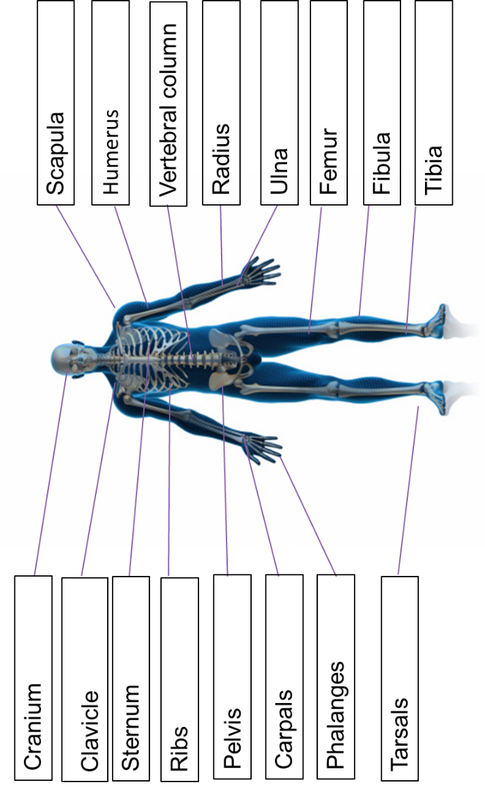
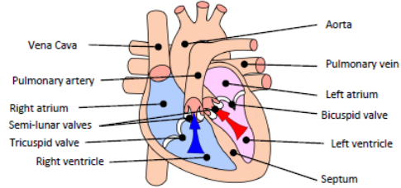
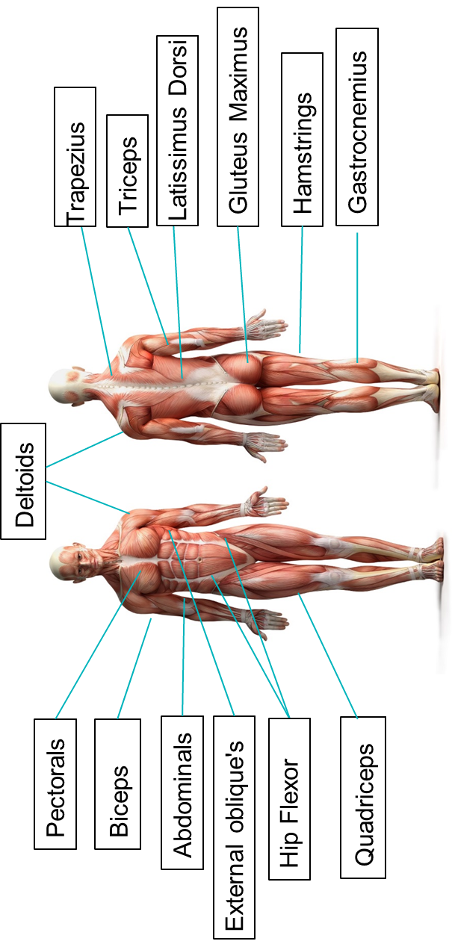
PE
Skeletal System
Cardiovascular System
Muscular System
8

Slide 11
PE
Muscular system - Antagonistic pairs
Tendons connect muscle to bone and ligaments connect bone to bone. Voluntary muscles allow for movement as they produce a force which causes the attached bones to move in a specific direction. Muscles which are attached via tendons work together to create this.
Antagonistic pairs | Is where two muscles work together to create movement. There are two main categories that outline how these muscles work together; agonist and the antagonist.
Agonist | Is the also known as the prime mover. This is the muscle that contracts and causes the movement.
Antagonist | This is the opposite muscle that relaxes and in most cases lengthens as the movement occurs.
Muscular system – Muscle fibre types
All skeletal muscle contains a mixture of Slow Twitch and Fast Twitch muscle fibres- this is based on their speed of contraction. There are 3 types of muscle fibre.
Fast Twitch | Is broken down into two types;Type 2 x & Type 2 b.
Fast twitch - Type 2 x/2b | Produces highest force, fast contracting, Low endurance, good for short distances – Sprint start
Type 2a | Produce high force, moderate speed of contraction, medium endurance, more resistant to fatigue, Sprinting over longer distances.
Slow Twitch | They contract slowly and with less force. Provide a low speed of contraction, high endurance, can keep going, don’t produce much power. These fibres have a rich blood (and oxygen) supply. This makes them red in colour. They are slower to fatigue, and so are used for more endurance events e.g. long distance swimming/ running.
9

Slide 12
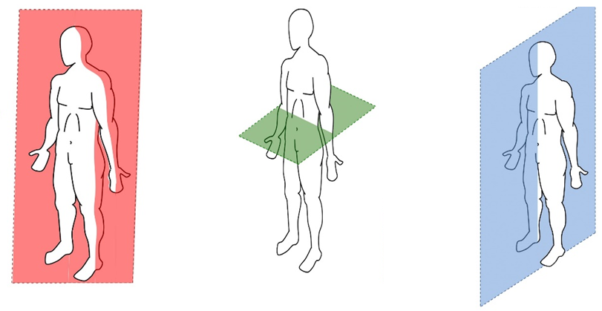
PE
BIOMECHANICS - Planes and axes for movement
Plane | An imaginary line that divides the body into two
Frontal Plane (left picture) | A vertical plane that divides the body into front and back.
Transverse plane (middle picture) | A horizontal plane that divides the body into upper and lower halves.
Sagittal plane (right picture) | A vertical plane that divides the body into right and left sides.
10

Slide 13
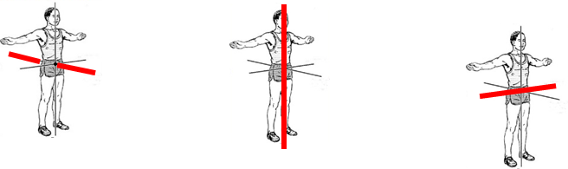
PE
BIOMECHANICS - Planes and axes for movement
PAxes for movement | An axis is an imaginary line at right angles to the plane
Sagittal axis (left picture) | Runs through the body horizontally from the back to front.
Vertical axis (middle picture) | Runs through the body vertically from the top to bottom.
Frontal axis (right picture) | Runs through the body horizontally from the left to right.
11

Slide 14
Computing
App development
Event | An action that causes something to happen
Event-driven program | A program designed to run or executes a blocks of code or functions in response to specified events (e.g. a mouse click)
Variable | A location that stores data
Interact | Responding to a users input or action i.e hover on a button, pressing play on a video.
User Interface | The visual elements of a program through which a user controls or communicates with the application. Often abbreviated UI.
GUI | Graphical User Interface
CLI | Command Line Interface
App development
Icon | Visual symbols to represent functions, tools, files or actions
Home screen | Main interface for a mobile/desktop app
Applications | A software program designed to help users perform specific tasks
12

Slide 15
Art
Key Word | Definition
Gargoyle | A grotesque carved human or animal face or figure projecting from the gutter of a building, typically acting as a spout to carry water clear of a wall.
Middle Ages | The period of European history from the fall of the Roman Empire in the West (5th century) to the fall of Constantinople (1453)
Expression | A look on someone's face that conveys a particular emotion.
Mood | Depiction that induces or suggests of a particular feeling or state of mind.
Grotesque | A very ugly or comically distorted figure or image.
Gothic | A style of architecture prevalent in western Europe in the 12th–16th centuries (and revived in the mid 18th to early 20th centuries), characterized by pointed arches, rib vaults, and flying buttresses, together with large windows and elaborate tracery. English Gothic architecture is divided into Early English, Decorated, and Perpendicular.
Architecture | The art or practice of designing and constructing buildings.
Mythology | A collection of myths, especially one belonging to a particular religious or cultural tradition.
Medieval | Resembling or likened to the Middle Ages, especially in being cruel, uncivilized, or primitive.
Romanesque | Relating to a style of architecture which prevailed in Europe c. 900–1200, although sometimes dated back to the end of the Roman Empire
Representation | The description or portrayal of someone or something in a particular way.
Symbolism | An artistic and poetic movement or style using symbolic images and indirect suggestion to express mystical ideas, emotions, and states of mind.
Christianity | The religion based on the person and teachings of Jesus Christ, or its beliefs and practices.
Score & Slip Process | slip and score in pottery is a technique used to join two pieces of clay together. To slip and score clay, a potter scratches marks on the surface of the clay (score). The potter then applies a liquid mixture of clay in water (slip) to the scored surface.
Firing Clay | Firing clay changes the structure of the clay, bonding the clay particles together making it stronger, a more permanent ware. In the case of stoneware, the higher firing temperature causes the clay to become impervious to water, a useful quality in dinnerware.
13

Slide 16
Cooking and Nutrition
Key Word | Definition
4Cs | The easy way to remember how to prevent food poisoning bacteria being introduced into food – chill, cook, clean, cross contamination
Kitchen Hygiene | Ensuring that everything is clean when preparing food
Kitchen Safety | Being safe in the kitchen
Cross contamination | Transfer of bacteria from one person, object or place to another
Eat Well Guide | A pictorial food guide showing the amounts and types of foods that are needed to make up a healthy balanced diet
Claw grip | A method of cutting food that ensures that the finger tips are tucked out of the way and will not get caught by the knife
Food poisoning | An illness caused by eating contaminated food
Bacteria | Microscopic living organisms which can be found everywhere
Salmonella | Food poisoning bacteria found in chicken, some dairy products and raw eggs
Sensory evaluation | Foods that are only available at certain times of the year
Cooking knives | Knives of different sizes that have specific uses in the kitchen
Bridge Hold | A method of cutting food that ensures that fingers are out of the way as the knife cuts through the food
14

Slide 17
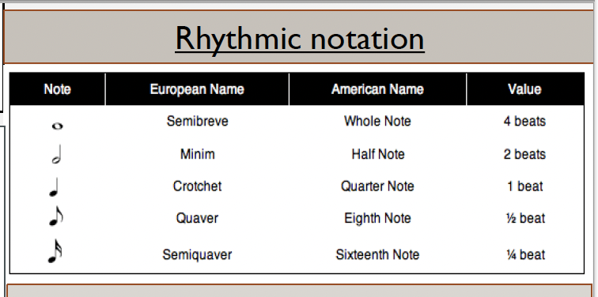
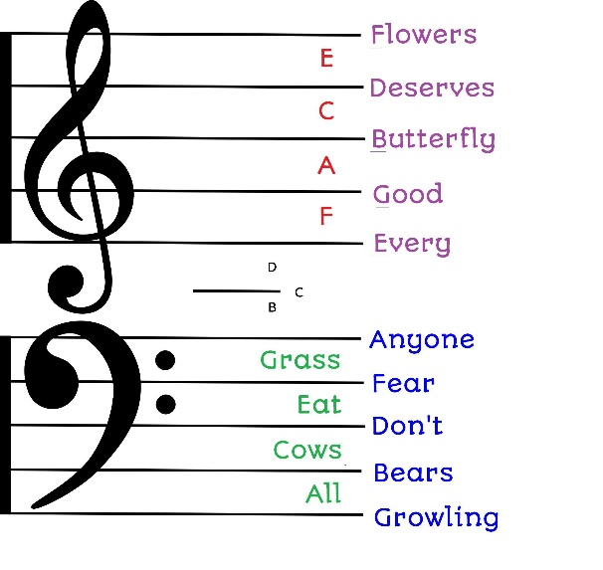
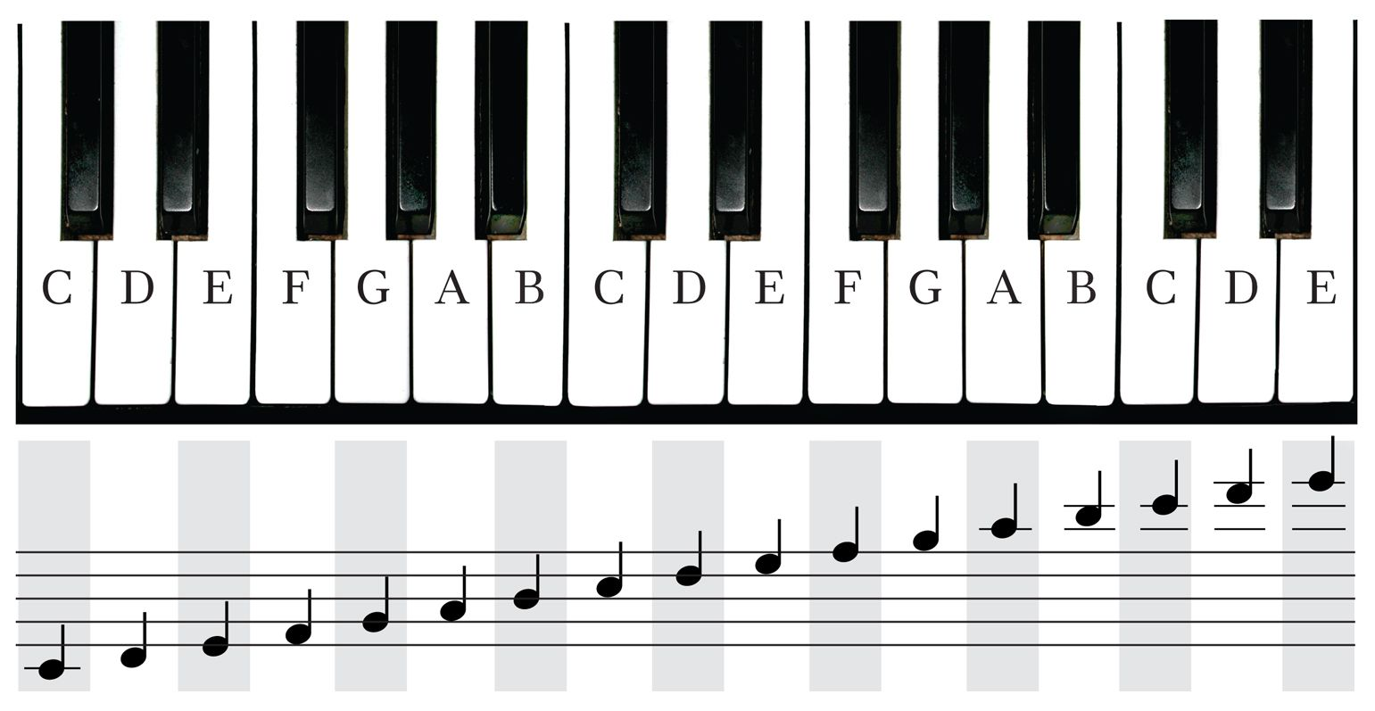
Music
Key Word | Definition
Chord: | A chord is two or more notes played together at the same time to create harmony in music.
Structure | Structure is the way a piece of music is organised into sections.
Harmony | Harmony is the sound created when two or more notes are played at the same time, usually to support the melody.
Metronome | A metronome is a tool that keeps a steady beat to help musicians play in time.
Dynamic | Dynamics describe how loud or quiet the music is.
Beat | The beat is the steady pulse of the music that you can count, tap, or clap along to.
Timbre | Timbre is the tone colour or quality of a sound – it’s what makes instruments sound different, even when they play the same note.
Loop | A loop is a short section of music that repeats over and over.
Texture | Texture describes how many layers of sound are happening at the same time in a piece of music.
Rhythm | Rhythm is the pattern of long and short sounds in music.
Tempo | Tempo is the speed of the music. It tells us how fast or slow the beat is and is measured in BPM (beats per minute).
15

Slide 18
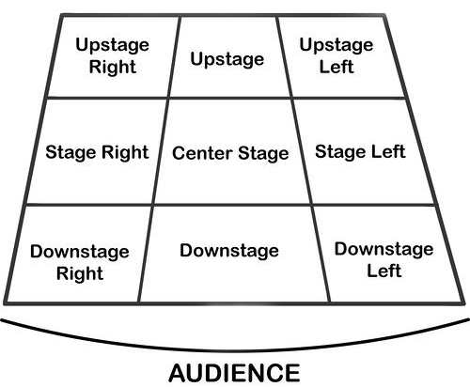
Performing Art
Key Word | Definition
Body Language | How an actor uses their body to communicate meaning. For example, crossing your arms could mean you are fed up
Gesture | a movement of the body, particularly the hands, arms, or head, that conveys meaning or expresses an idea, emotion, or intention
Levels | Levels can be used to show status, relationships, and even to indicate changes in location or time
Proxemics | The deliberate use of distance between you and other characters or objects to communicate something to an audience
Facial Expression | Using the face to express that characters feelings and emotions.
Key Word | Definition
Amphitheatre | Circular or oval open air theatre with a large ranked seating area
Apron | The apron is a section of the stage which the floor projects towards or into the auditorium
Black Box | A flexible studio theatre where the audience and actors are in the same room surrounded by black tabs
End On | Traditional audience seating layout where the audience is looking at the stage from the same direction.
Found Space | A performance space that wasn’t designed to be one e.g historic buildings
In the Round | Theatre in the Round is a form of audience seating layout where the acting area is surrounded on all sided by seating. There is often a number of entrances through the seating
Promenade | Form of staging where the audience moves around the performance space and sees the play at a variety of different locations
Proscenium Arch | The opening in the wall which stands between stage and auditorium in some theatres; the picture frame through the audience sees the play’ fourth wall’
Site-specific theatre | A piece of performance which has been deigned to work only in a particular non-theatre space
Stage Directions
Stage directions are from the performers perspective
16

Slide 19
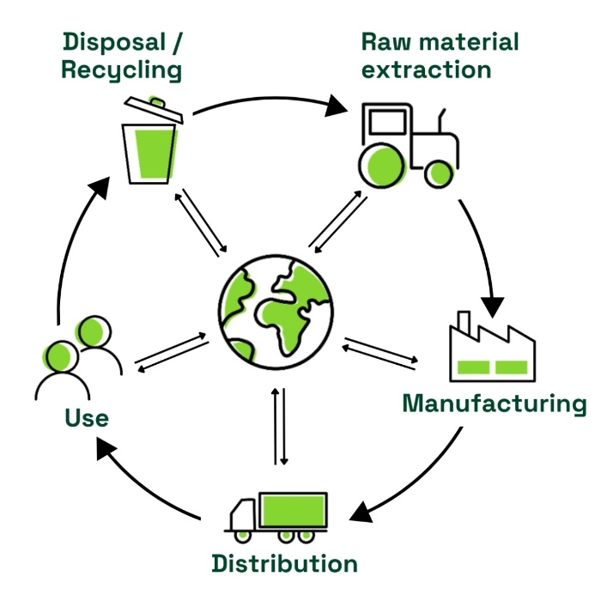
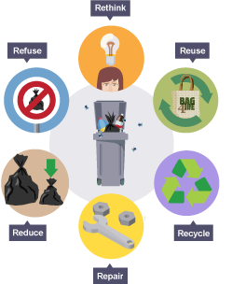
Design and Technology - RM
Year 8
Key Words | Definition
Aesthetic | How something looks e.g. this product is aesthetically pleasing.
Analysis | Learn and evaluate designs to identify features that could be improved.
Anthropometrics | the practice of taking measurements of the human body and providing data that can be used by designers.
Alloy | A mixture of two or more elements, at least one of which is a metal.
Conductivity | The ability of a material to hold heat in or out (thermal) or the ability of electrical current to flow through a material (electrical).
Ductile | The ability of a material to deform by bending, twisting or stretching.
Environmental Challenges | Challenges raw materials cause - deforestation, pollution and global warming
Design Brief | A short statement which outlines the problem to be solved and a set of instructions given to a designer by a client.
Ergonomics | The study of people in their working environment
Ferrous | A type of metal containing iron, are magnetic and prone to rust, so will require a protective finish.
Fossil Fuels | A finite resource, which means they cannot be replaced once used.
Hazardous | dangerous and involving risk, especially to someone's health.
Mailability | The ability of a material to deform without cracking.
Mining | When natural resources are extracted from the ground.
Life Cycle Assessment | A 'cradle-to-grave' analysis of the impact of a manufactured product on the environment.
Key Words | Definition
Non-Ferrous | Metal that does not contain iron, is not magnetic and does not rust.
Specification | Containing detail of a product's requirement or characteristic - processes, materials and information needed to design the product.
Sustainability | Something that does not damage the environment e.g. plant based plastic
The 6 Rs | Rethink, Refuse, Reduce, Reuse, Recycle, Repair
Properties | The qualities a material possesses which suit its specific purpose.
Physical Properties | The traits a material has before it is used
Working Properties | The material behaves when it is manipulated.
17

Slide 20
Resilience definition: Grappling to get unstick
Reflecting on learning behaviours for thinking… | Experience log
 | Successful moment… | In hindsight… An example where you could have done better on reflection | At home…
I gave an idea and reasoned/justified.
I reflected on my idea and made it better after discussing with others
I used a revision strategy to help make the learning stick.
I made connections between what I am learning and the outside world.
18

Slide 21
Resilience definition: Grappling to get unstick
Reflecting on learning behaviours for thinking… | Experience log
 | Successful moment… | In hindsight… An example where you could have done better on reflection | At home…
I gave an idea and reasoned/justified.
I reflected on my idea and made it better after discussing with others
I used a revision strategy to help make the learning stick.
I made connections between what I am learning and the outside world.
19

Slide 22
Resilience definition: Grappling to get unstick
Reflecting on learning behaviours for thinking… | Experience log
 | Successful moment… | In hindsight… An example where you could have done better on reflection | At home…
I gave an idea and reasoned/justified.
I reflected on my idea and made it better after discussing with others
I used a revision strategy to help make the learning stick.
I made connections between what I am learning and the outside world.
20

Slide 23
Resilience definition: Grappling to get unstick
Reflecting on learning behaviours for thinking… | Experience log
 | Successful moment… | In hindsight… An example where you could have done better on reflection | At home…
I gave an idea and reasoned/justified.
I reflected on my idea and made it better after discussing with others
I used a revision strategy to help make the learning stick.
I made connections between what I am learning and the outside world.
21

Slide 24
Resilience definition: Grappling to get unstick
Reflecting on learning behaviours for thinking… | Experience log
 | Successful moment… | In hindsight… An example where you could have done better on reflection | At home…
I gave an idea and reasoned/justified.
I reflected on my idea and made it better after discussing with others
I used a revision strategy to help make the learning stick.
I made connections between what I am learning and the outside world.
22

Slide 25
Reading Log w/c 23rd February (20 mins reading per day – all five logs MUST be completed)
Date | Title of novel | Number of pages read | Summary about what I have read
 |  |  | • • •
 |  |  | • • •
 |  |  | • • •
 |  |  | • • •
 |  |  | • • •
Checked by form tutor:
23

Slide 26
Reading Log w/c 2rd March (20 mins reading per day – all five logs MUST be completed)
Date | Title of novel | Number of pages read | Summary about what I have read
 |  |  | • • •
 |  |  | • • •
 |  |  | • • •
 |  |  | • • •
 |  |  | • • •
Checked by form tutor:
24

Slide 27
Reading Log w/c 9th March (20 mins reading per day – all five logs MUST be completed)
Date | Title of novel | Number of pages read | Summary about what I have read
 |  |  | • • •
 |  |  | • • •
 |  |  | • • •
 |  |  | • • •
 |  |  | • • •
Checked by form tutor:
25

Slide 28
Reading Log w/c 16th March (20 mins reading per day – all five logs MUST be completed)
Date | Title of novel | Number of pages read | Summary about what I have read
 |  |  | • • •
 |  |  | • • •
 |  |  | • • •
 |  |  | • • •
 |  |  | • • •
Checked by form tutor:
26

Slide 29
Reading Log w/c 23rd March (20 mins reading per day – all five logs MUST be completed)
Date | Title of novel | Number of pages read | Summary about what I have read
 |  |  | • • •
 |  |  | • • •
 |  |  | • • •
 |  |  | • • •
 |  |  | • • •
Checked by form tutor:
27

Slide 30
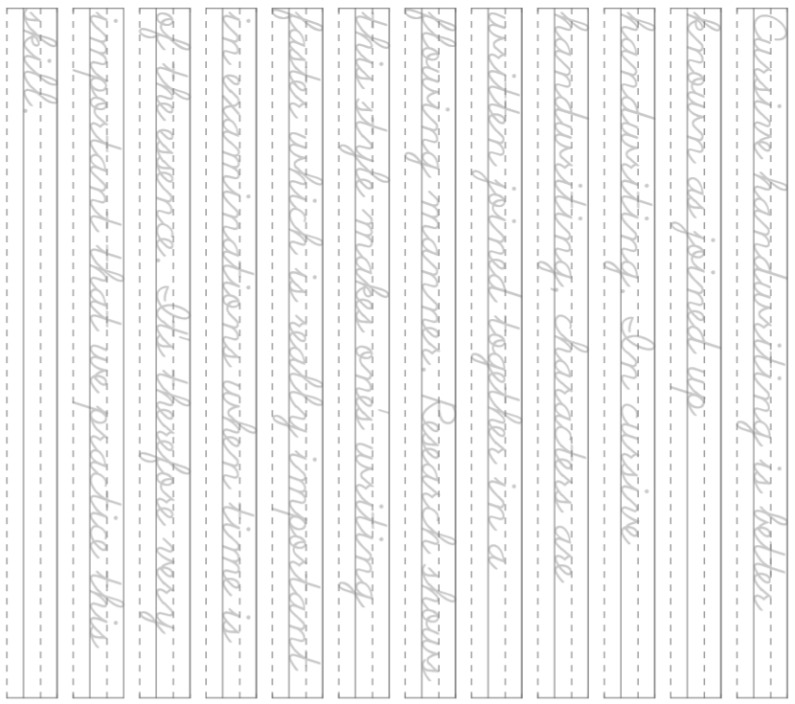
Cursive Handwriting Practice – Week 1
28

Slide 31
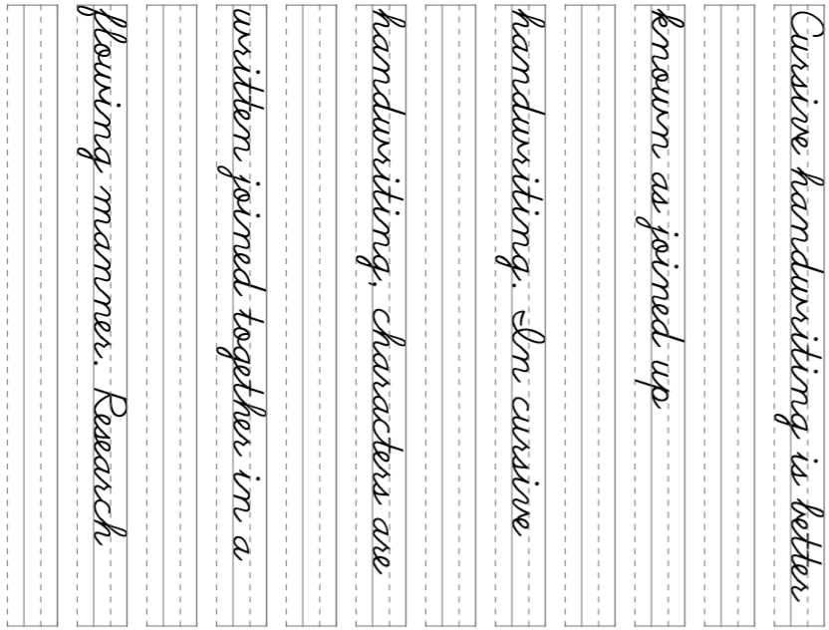
Cursive Handwriting Practice – Week 2
29

Slide 32
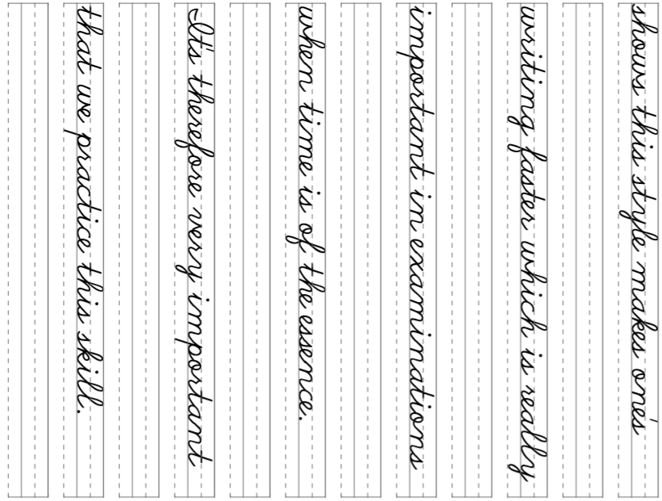
30

Slide 33
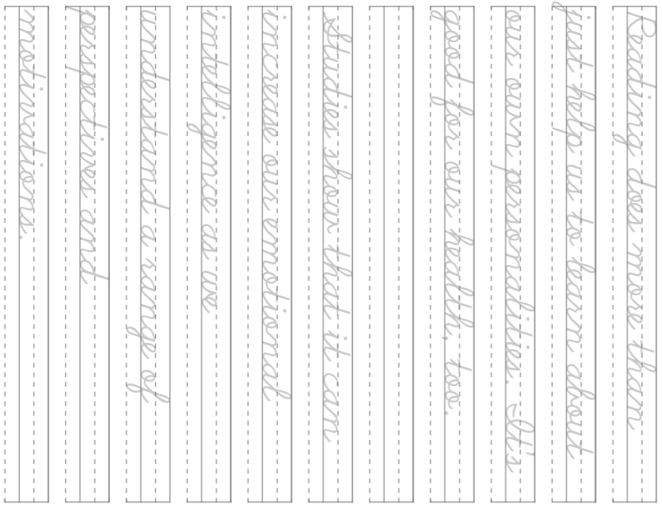
Cursive Handwriting Practice – Week 3
31

Slide 34
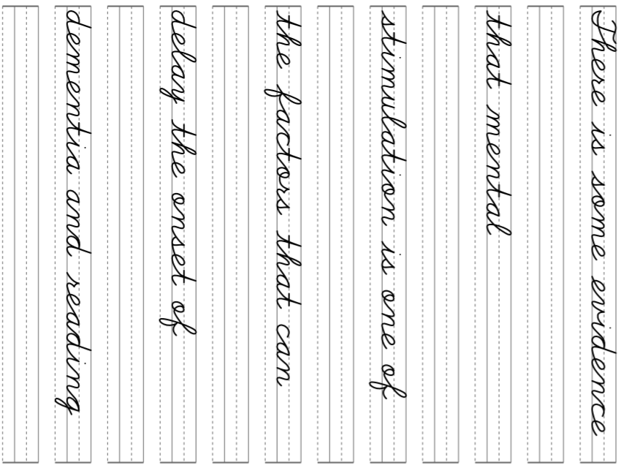
Cursive Handwriting Practice – Week 4
32

Slide 35
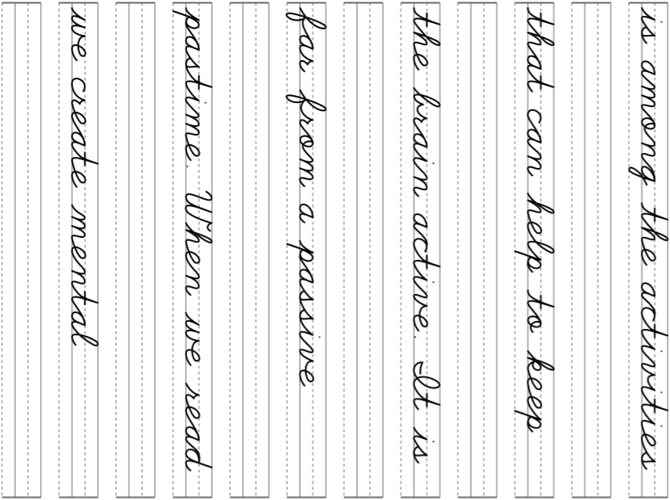
33

