Slide 1

Year 8 Knowledge Organiser HT5
Knowledge is Power
Name: ______________________________
Form: _______

Slide 2
Contents Page
Subject | Page
English | 1
Maths | 2
Science | 3
Spanish | 4
History | 5
Geography | 6
PE | 7
Computing | 9
Art | 10
Performing Arts | 11
Cooking and Nutrition | 12
Music | 13
DT | 14
‘Resilence’ reflection log | 15
Reading log | 21
Cursive Handwriting Practice | 25

Slide 3
English
Week 1 – Word Classes
Noun | A word that refers to a name. person (teacher), place (home), thing (ball). idea (justice), quality (softness).
Verb | A word that refers to an action (to run) or state (to be, to have). Can always change by adding ‘-ing’ or being in past tense.
Adjective | Describes a noun.
Adverb | Typically an –ly word that describes a verb e.g. slowly, quickly, quietly.
Week 3 – Descriptive Devices
Device | Definition
Personification | Giving human characteristics to a non human object.
Metaphor | Comparing by referring to one thing as another.
Simile | A comparison of two different objects using like or as.
Sensory Language | Words and phrases that refer to the five senses
Onomatopoeia | A word that imitates the sound it represents.
Week 5 – Sensory Terms
1. Visual imagery – description that refers to what is seen
2. Auditory imagery – description that refers to what is heard
3. Olfactory imagery – description that refers to smells
4. Gustatory imagery – description that refers to taste and flavors
Week 2 – Key Terms
Setting | Setting is the place or type of surroundings where something is positioned or where an event takes place.
Structure | Structure refers to the order of ideas in a piece of writing.
Tone | Tone is the general character or attitude of a place, piece of writing, situation.
Imagery | Imagery is visually descriptive or figurative language.
Week 6 – Genres
1. Fantasy: A genre of imaginative fiction involving magic and adventure, especially in a setting other than the real world.
2) Science Fiction: A type of fiction which deals with imaginative and futuristic concepts such as advanced science and technology.
3) Dystopian: An imagined state or society where there is great suffering or injustice.
Week 4 – Key Terms
Show, Not Tell | Description through actions, senses, thoughts and feelings rather than explicit description
Shift in Focus | When a writer changes the focus of the description
Zooming In | When the writer focuses on a particular area in detail.
Zooming Out | When a writer moves back from a detailed description to describe the wider scene.
1
Notes:
Year 8 HT2

Slide 4



Maths
Algebra
Key Word | Definition
Variable | A letter that represents a specific number
Term | A number, letter or combination of both which forms part of an expression
Expression | A collection of terms which can contain letters and numbers
Coefficient | The number that multiplies the variable
Simplify | Writing an expression in its simplest form by collecting like terms
Equation | Two expressions which have the same value, separated by an '=' sign.
Angles
Key Word | Definition
Straight line | Angles on a straight line add up to 180˚
Triangle | Angles in a triangle add up to 180˚
Isosceles Triangle | Base angles in an isosceles triangle are equal
Intersecting lines | Vertically opposite angles are equal
Alternate angels | Alternate angles are equal
Corresponding angles | Corresponding angles are equal
Co-interior angles | Co-interior angles add up to 180˚
Alternate angles
Corresponding angles
Co-interior angles
2

Slide 5
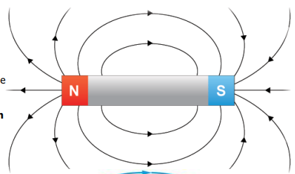
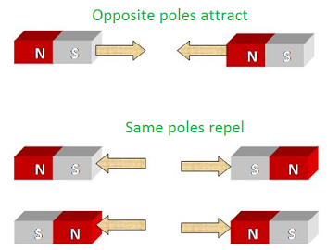
Science
Magnetic material is a material that feels a force when it’s in a magnetic field. These are:
Iron Steel
Cobalt nickel
Key Word | Definition
Force | a push or a pull. It can alter the position or direction of an object.
Gravity | the pull of one object on another. This force is only obvious when at least one of the objects is massive e.g. the Earth or the Moon.
Gram (g) | a unit for measuring mass. A thousand grams is a kilogram - kg.
Moment | the tendency of a force to rotate the object to which it is applied.
Newton (n) | the unit for measuring force.
Pivot | the point around which a lever turns.
Magnetic field around a bar magnet.
Field line go from north to south
Key Word | Definition
Permanent magnets | always magnetic. It has an invisible magnetic field.
magnetic field | The region around a magnet where a force will be experienced.
compass | A device with a magnetised needle. The needle turns to line up with a magnetic field.
electromagnet | A magnet formed by an electrical current. An electromagnet can be switched on and off.
solenoid | A coil of wire with many turns
iron core | A piece of iron that is placed inside a solenoid. It is used to increase the strength of an electromagnet.
poles | The ends of a magnet, where the magnetic field is strongest. Poles can be north or south.
Opposite poles attract
Same poles attract
3
Notes:
2025 HT5

Slide 6
Spanish
Spanish | English
La basura | rubbish
El cambio climático | Climate change
El daño | Damage
El cultivo | Crop
El fuego | Fire
La libertad | Freedom
El medio ambiente | Environment
medioambiental | Environmental
Los necesitados | People in need
El peligro | Danger
La pobreza | Poverty
Los productos químicos | Chemicals
El reciclaje | Recycling
El robo | Theft
La violencia | Violence
La enfermedad | Illness
Las drogas | drugs
Spanish | English
aumentar | To increase
beneficiar | To benefit
Dañar | To damage
Ducharse | To have a shower
encender | To turn on
apagar | To turn off
reciclar | To recycle
malgastar | To waste
proteger | To protect
reutilizar | To re-use
utilizar | To use
contribuir | To contribute
drogarse | To take drugs
Se debe | One must
Se puede | One can
Si pudiera | If I could
Me preocupa(n) | I am worried about
4

Slide 7
History
Key Terms
Emancipation | Process of being set free from legal, social, or political restrictions (liberation).
Anglican | A church/faith associated with the Church of England (Is Protestant)
Unionism | A political belief that wants to keep Britain and Ireland united politically.
Nationalist | A person who wants political independence for their country.
Autonomy | The right to self-government.
Ulster | An area in the North of Ireland.
Irish Republican Brotherhood (IRB): | A secret oath-bound organisation dedicated to creating an Independent Ireland between 1858 and 1924.
Royal Irish Constabulary (RIC): | The police force in Ireland from the early 19th C until 1922.
Guerrilla warfare | Type of combat that often involves surprise attacks such as ambushes, raids, or sabotage of a vulnerable target.
Republic | A state in which power is held by the people and their elected government.
The Irish Republican Army (IRA) | A paramilitary group in Ireland that wanted an independent Ireland and believed political violence was necessary to achieve this.
Sinn Fein | A political slogan by Irish nationalists. Has since become a left-wing political party in Ireland
Key Events
1798: The Irish Rebellion | This was a failed attempt to gain complete independence from British rule in Ireland.
1800: The Acts of Union | This law made Ireland a part of the United Kingdom.
1912: Home Rule Act | This law was to give Ireland more control and autonomy. However, it divided Ireland into two sides. The unionists (remain) and the nationalists.
1912: The Ulster Covenant | Signed by 500,000 people in Ulster and created an army of Ulster volunteers, which threatened to resist the act using violence.
24th-29th April 1916: The Easter Rising | This was an attempt by Irish nationalist rebels to make Ireland a Republic.
1919-21: The Irish Wars of Independence | Also known as the Anglo-Irish war between the IRA and British forces.
28th June 1922- 24th May 1923: The Irish Civil War | Broke out due to the Anglo-Irish Treaty which gave Ireland independent status but as a colony of the British Empire.
1960’s and 1970’s | The Troubles in Northern Ireland. The status of Northern Ireland caused conflict and violence at times.
30th January 1972: Bloody Sunday. | 13 Irish men were killed by British forces, all aged between seventeen and forty-one.
2nd December 1999: The Good Friday agreement | Political deal designed to bring an end to the Troubles. Approved by public votes in Northern Ireland and the Republic of Ireland.
5

Slide 8
Geography
Key Word | Definition
Coniferous | Trees that produce cones and have needles instead of leaves.
Deforestation | The removal of trees on a large scale.
Development | The progress a country makes socially and economically.
Economically active | The age at which you would be working.
Energy security | Uninterrupted availability of energy sources at an affordable price.
Evergreen | Any species of tree which does not lose its leaves in the autumn, but keeps them all year round.
Inaccessibility | Unable to be reached or entered.
Industrial development | The transformation from a largely farming based economy to a manufacturing based economy.
Indigenous people | The original people of the region.
Mineral extraction | The removal of solid mineral resources from the Earth.
Peninsula | A piece of land that is almost entirely surrounded by water but is connected to the mainland on one side.
Permafrost | The layer of frozen soil under the Earth’s surface.
Renewable | Energy, which is infinite, sustainable and easily replenished.
Steppe biome | A biome characterised by grasslands.
Taiga forest | Also known as a boreal forest; a cold and dry biome.
Tar sands | Fossil fuel which is thick in consistency and mixed with sands.
Temperate | Climates which are not too hot or too cold.
6

Slide 9
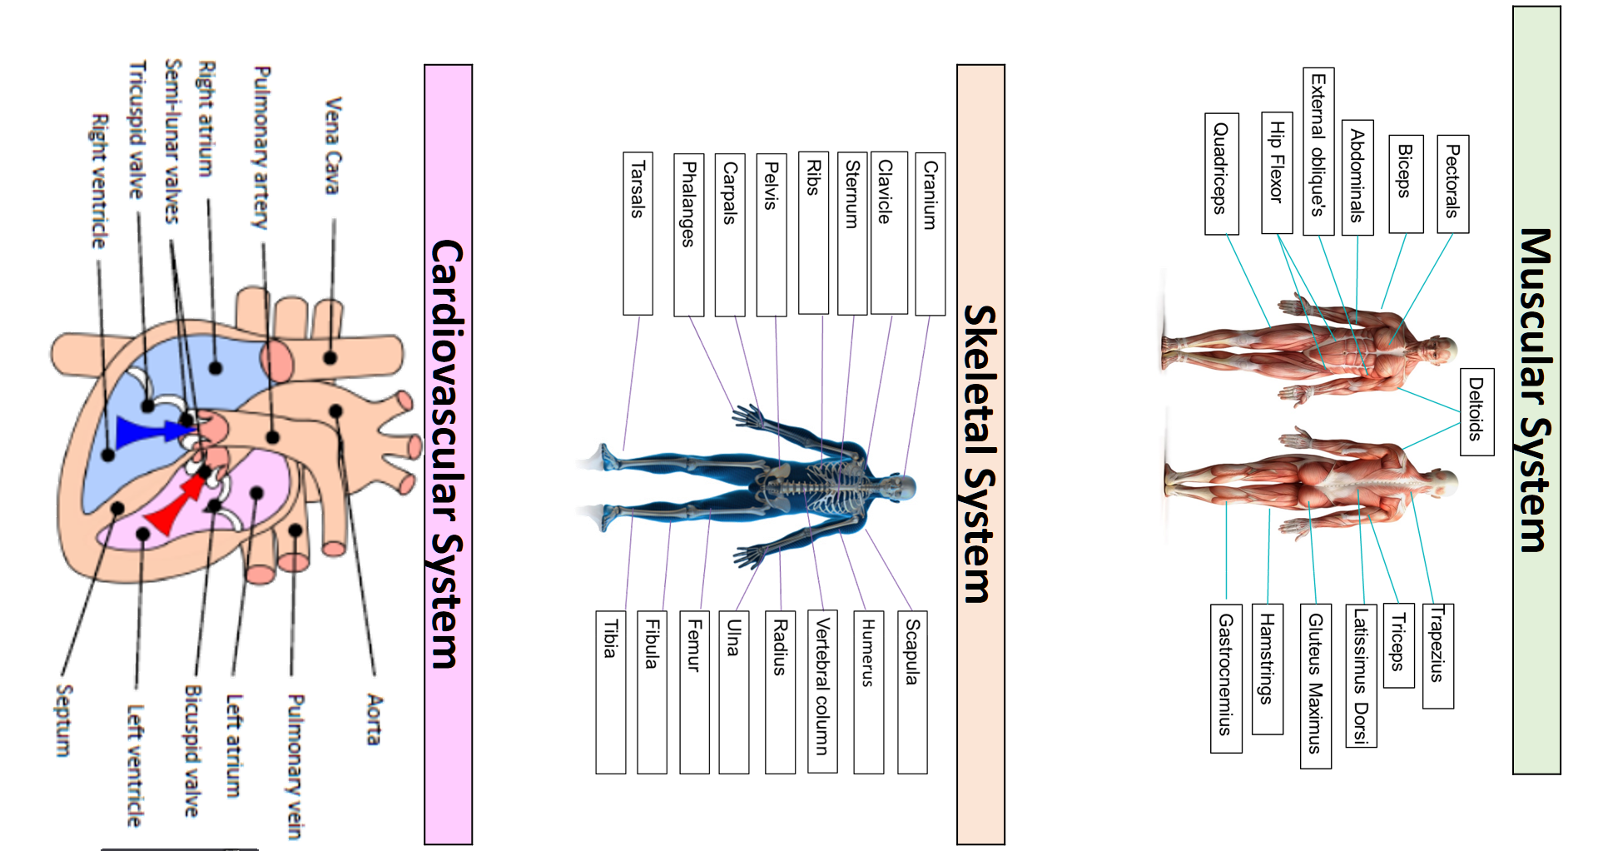
PE
7

Slide 10
PE
Health and Fitness
Muscular Strength | The amount of the force muscles can generate against a resistance
Muscular Endurance | The ability to use voluntary muscles, over long periods of time without getting tired
Flexibility | The range of movement at a joint
Cardiovascular Fitness (Aerobic Endurance) | The ability of the heart and circulatory system to meet the demands of the body for a long period of time
Body composition | The percentage of a body that is fat, muscle, bone and water
Coordination | The ability to move two or more body parts at the same time
Reaction Time | The time taken for a response to occur after a stimulus
Agility | The ability to change direction at speed
Balance | The ability to keep the body steady when in a static position or when moving
Speed | The time taken to cover a set distance/complete a movement
Power | The ability to combine speed and strength
Principles of training
Progressive Overload | Working the body harder than normal/gradually increasing the amount of exercise you do
Reversibility | If training is not regular, adaptations will be reversed. This can happen when suffering from illness, injury or after an off season
Specificity | Training showed be matched to the requirements of the sport or position the performer is in. Training must be specifically designed to develop the right muscles, type of fitness or skills
Individual needs | All PEP’s would differ depending on performers goals/target, strengths /weaknesses, age/gender and current health/fitness levels
Overtraining | Occurs when you train too hard and do not allow the body enough rest/recovery time Signs include extended muscle soreness, frequent illness & increase injuries
8

Slide 11
Computing
App development
Event | An action that causes something to happen
Event-driven program | A program designed to run or executes a blocks of code or functions in response to specified events (e.g. a mouse click)
Variable | A location that stores data
Interact | Responding to a users input or action i.e hover on a button, pressing play on a video.
User Interface | The visual elements of a program through which a user controls or communicates with the application. Often abbreviated UI.
9

Slide 12
Art
Key Word | Definition
Gargoyle | A grotesque carved human or animal face or figure projecting from the gutter of a building, typically acting as a spout to carry water clear of a wall.
Middle Ages | The period of European history from the fall of the Roman Empire in the West (5th century) to the fall of Constantinople (1453)
Expression | A look on someone's face that conveys a particular emotion.
Mood | Depiction that induces or suggests of a particular feeling or state of mind.
Grotesque | A very ugly or comically distorted figure or image.
Gothic | A style of architecture prevalent in western Europe in the 12th–16th centuries (and revived in the mid 18th to early 20th centuries), characterized by pointed arches, rib vaults, and flying buttresses, together with large windows and elaborate tracery. English Gothic architecture is divided into Early English, Decorated, and Perpendicular.
Architecture | The art or practice of designing and constructing buildings.
Mythology | A collection of myths, especially one belonging to a particular religious or cultural tradition.
Medieval | Resembling or likened to the Middle Ages, especially in being cruel, uncivilized, or primitive.
Romanesque | Relating to a style of architecture which prevailed in Europe c. 900–1200, although sometimes dated back to the end of the Roman Empire
Representation | The description or portrayal of someone or something in a particular way.
Symbolism | An artistic and poetic movement or style using symbolic images and indirect suggestion to express mystical ideas, emotions, and states of mind.
Christianity | The religion based on the person and teachings of Jesus Christ, or its beliefs and practices.
Score & Slip Process | slip and score in pottery is a technique used to join two pieces of clay together. To slip and score clay, a potter scratches marks on the surface of the clay (score). The potter then applies a liquid mixture of clay in water (slip) to the scored surface.
Firing Clay | Firing clay changes the structure of the clay, bonding the clay particles together making it stronger, a more permanent ware. In the case of stoneware, the higher firing temperature causes the clay to become impervious to water, a useful quality in dinnerware.
10

Slide 13
Performing Arts
Devising Drama – Key Words
Stimulus | A resourced used as a starting point to generate ideas for a piece of drama. This may be a poem, story, piece of music, historical event, a painting, a piece of artwork, a quote and more.
Direct Address | When an actor speaks directly to the audience, e.g. in pantomime.
Tableaux | A ‘frozen picture’ that tells a story. Costume and props are needed, and physicality used to show emotion.
Blocking | The staging and use of the space in drama, This may refer to the location of actors on the stage and the movements they make.
Multi-role | When an actor plays more than one role.
Exits and Entrances | Where a character enters and exits their scene.
Thought Tracking | An exercise that allows the inner thoughts of a character or role to be heard out loud. The participant is asked to say their characters thoughts and feelings at specific points during their acting.
Technical Rehearsal | Technical equipment and systems for example sound, lighting and computer generated effects.
Rehearsal | A practice or trial performance of a play.
Developing Ideas
Soundscape | The actors used their bodies to create sound effects for the performance
Transitions | The fluid and focused movement between scenes/images
Proxemics | Proxemics is how close or near you are to others on stage. This can help to communicate meaning e.g. if your character is scared of another character you might stand far away.
Storyboarding | Involves creating a series of images and/or text showing the sequence of the action planned for a devised drama.
Cue to Cue Rehearsal | This involves a rehearsal where the actors remove all of the action and dialogue between cues during a technical rehearsal.
Narrative | The narrative is the storyline or plot of a piece of drama. A narrative should be clear for the audience so that the storytelling makes sense - although there are different ways to structure a narrative which will explore in lessons
Semiotics | This refers to how meaning is created and communicated through the systems of signs and symbols of drama.
Movement in unison | All actors moves in the same way, at the same time.
11

Slide 14
Cooking and Nutrition
Key Word | Definition
Nutrition | A study of what people eat and how all the nutrients in foods work together in the body
Nutrients | Natural chemical substances in foods that are essential for body growth, function and health
Macro Nutrients | Nutrients needed by the body in large a mounts
Micro-Nutrients | Nutrients needed in the body in smaller amounts
Amino acids | Building blocks of protein
Essential amino acids | The essential amino acids that the body cannot make
Protein complementation | Eating a combination of LBV proteins to ensure the body gets all the essential amino acids
Cooks Knife | A large knife with a deep blade used for cutting, chopping, slicing and dicing
Paring knife/vegetable knife | A small knife mainly used for slicing and dicing
Bread knife | A large serrated knife-edged knife used to slice bread , cakes and pastry
Dough | A mixture of dry ingredients and liquid, that is mixed, kneaded, shaped and then baked.
Yeast | A single-celled plant fungus and a raising agent which needs time, food, warmth and liquid to ferment
Fermentation | The process in which yeast produces the gas carbon dioxide
Knead | The process of working a dough mixture to make it smooth and elastic
gluten | The protein in flour that is developed when water is added to flour and mixed.
prove | Leaving the dough to rise
steaming | Cooking in the steam that comes from boiling water
12

Slide 15
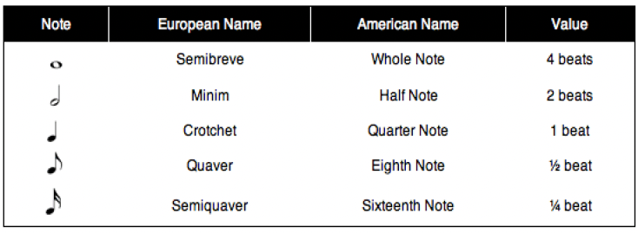
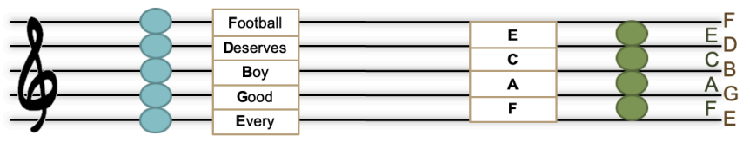
Music
Key Word | Definition
Timbre/sonority | Each instrument own unique ‘tone quality’ and the voice as an instrument had different Timbre
improvisation | Music made up on the spot
Harmony | is the combination of different musical notes played simultaneously.
Time signature | It tells how many beats are in each measure and which note gets one beat, helping you keep track of the rhythm while playing or singing.
Dynamic | The volume of a sound or piece of music – loud/soft
Beat | a regular, repeating pulse that underlies a musical pattern
Rhythm | Rhythm is the pattern of sounds and beats in music that creates a sense of movement and flow.
leitmotif | A recurring musical idea linked to a character, object or place.
Texture | How many layers the piece has
Structure | the order the different sections of a song or piece of music are played in.
Tempo | Tempo refers to the speed of music. It's how fast or slow a song sounds.
13

Slide 16
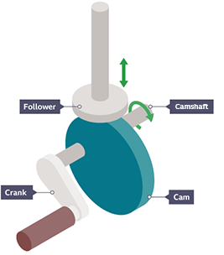
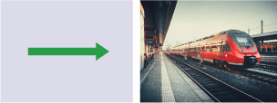
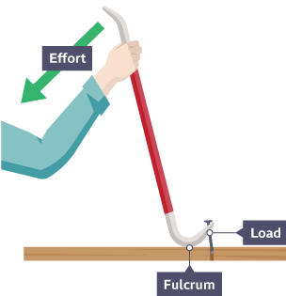

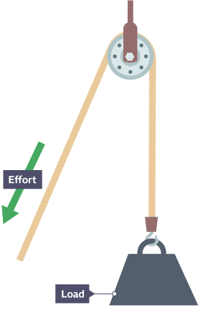
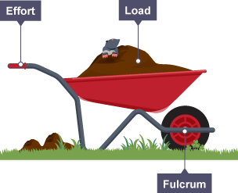
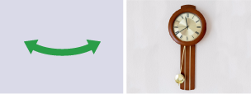
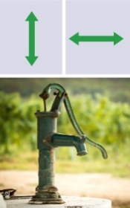
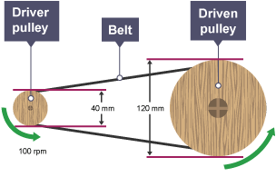
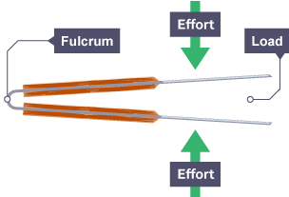
Design and Technology - RM
Key Words | Definition
Allowances | The amount by which a measurement can vary without affecting the ability of the product to be manufactured accurately.
Annotation | Labelling of a diagram in detail – with sentences
Belt System | Transfers movement from one rotating pulley to another rotating pulley.
CAD | Computer Aided Design - use of computer software to design in 3D/2D
CAM | Computer Aided Manufacturing - use of software and computer-controlled machinery to automate a manufacturing process.
Cams | A wheel attached to a crankshaft.
Design Fixation | When a designer finds it difficult, to produce a range of innovative solutions, to a design problem.
Environmental Challenges | The challenges raw materials cause – deforestation, pollution and global warming
Gears | A wheel with teeth that can change the speed of a mechanism.
Followers | A bar that follows a cam around its circumference.
Innovative | New and creative in approach.
Iterative Process | A cyclic design process of modelling and testing to achieve gradual improvements to the design.
Levers | A bar featuring a pivot that can pushed/pulled to make moving of a load easier.
Marking Out | Marks made on an item before cutting or forming.
Prototyping | The first working model of a design used for testing, development and evaluation.
Perspective Drawing | Shows an object in 3D getting smaller in the distance.
Key Words | Definition
Pulley | A wheel with a grooved edge that a cord passes around.
Tolerance | The amount of error you will allow a part to have.
Types of Movements
Linear
Rotary
Oscillating
Types of Levers
First Order Levers
Second Order Levers
Third Order Levers
Cam Mechanism
Pulley System
Reciprocating
Belt System
14

Slide 17
W/c 13th April Thinking definition: Thinking is making connections, reasoning and asking questions to make the learning stick
Reflecting on learning behaviours for resilience … | Experience log
 | Successful moment… | In hindsight… Where you could have done better on reflection? | At home…
I gave an idea and reasoned/justified.
I reflected on my idea and made it better after discussing with others
I used a revision strategy to help make the learning stick.
I made connections between what I am learning and the outside world.
I asked questions to deepen my understanding.
15

Slide 18
W/c 20th April Thinking definition: Thinking is making connections, reasoning and asking questions to make the learning stick
Reflecting on learning behaviours for resilience …… | Experience log
 | Successful moment… | In hindsight… Where you could have done better on reflection? | At home…
I gave an idea and reasoned/justified.
I reflected on my idea and made it better after discussing with others
I used a revision strategy to help make the learning stick.
I made connections between what I am learning and the outside world.
I asked questions to deepen my understanding.
16

Slide 19
W/c 27th April Thinking definition: Thinking is making connections, reasoning and asking questions to make the learning stick
Reflecting on learning behaviours for resilience …… | Experience log
 | Successful moment… | In hindsight… Where you could have done better on reflection? | At home…
I gave an idea and reasoned/justified.
I reflected on my idea and made it better after discussing with others
I used a revision strategy to help make the learning stick.
I made connections between what I am learning and the outside world.
I asked questions to deepen my understanding.
17

Slide 20
W/c 4th May Thinking definition: Thinking is making connections, reasoning and asking questions to make the learning stick
Reflecting on learning behaviours for resilience … | Experience log
 | Successful moment… | In hindsight… Where you could have done better on reflection? | At home…
I gave an idea and reasoned/justified.
I reflected on my idea and made it better after discussing with others
I used a revision strategy to help make the learning stick.
I made connections between what I am learning and the outside world.
I asked questions to deepen my understanding.
18

Slide 21
W/c 11th May Thinking definition: Thinking is making connections, reasoning and asking questions to make the learning stick
Reflecting on learning behaviours for resilience … | Experience log
 | Successful moment… | In hindsight… Where you could have done better on reflection? | At home…
I gave an idea and reasoned/justified.
I reflected on my idea and made it better after discussing with others
I used a revision strategy to help make the learning stick.
I made connections between what I am learning and the outside world.
I asked questions to deepen my understanding.
19

Slide 22
W/c 18th May Thinking definition: Thinking is making connections, reasoning and asking questions to make the learning stick
Reflecting on learning behaviours for resilience … | Experience log
 | Successful moment… | In hindsight… Where you could have done better on reflection? | At home…
I gave an idea and reasoned/justified.
I reflected on my idea and made it better after discussing with others
I used a revision strategy to help make the learning stick.
I made connections between what I am learning and the outside world.
I asked questions to deepen my understanding.
20

Slide 23
Reading Log w/c 13th April (20 mins reading per day – all five logs MUST be completed)
Date | Title of novel | Number of pages read | Summary about what I have read
 |  |  | • • •
 |  |  | • • •
 |  |  | • • •
 |  |  | • • •
 |  |  | • • •
Checked by form tutor:
21

Slide 24
Reading Log w/c 20th April (20 mins reading per day – all five logs MUST be completed)
Date | Title of novel | Number of pages read | Summary about what I have read
 |  |  | • • •
 |  |  | • • •
 |  |  | • • •
 |  |  | • • •
 |  |  | • • •
Checked by form tutor:
22

Slide 25
Reading Log w/c 27th May (20 mins reading per day – all five logs MUST be completed)
Date | Title of novel | Number of pages read | Summary about what I have read
 |  |  | • • •
 |  |  | • • •
 |  |  | • • •
 |  |  | • • •
 |  |  | • • •
Checked by form tutor:
22

Slide 26
Reading Log w/c 4th May (20 mins reading per day – all five logs MUST be completed)
Date | Title of novel | Number of pages read | Summary about what I have read
 |  |  | • • •
 |  |  | • • •
 |  |  | • • •
 |  |  | • • •
 |  |  | • • •
Checked by form tutor:
23

Slide 27
Reading Log w/c 11th May (20 mins reading per day – all five logs MUST be completed)
Date | Title of novel | Number of pages read | Summary about what I have read
 |  |  | • • •
 |  |  | • • •
 |  |  | • • •
 |  |  | • • •
 |  |  | • • •
Checked by form tutor:
24

Slide 28
Reading Log w/c 18th May (20 mins reading per day – all five logs MUST be completed)
Date | Title of novel | Number of pages read | Summary about what I have read
 |  |  | • • •
 |  |  | • • •
 |  |  | • • •
 |  |  | • • •
 |  |  | • • •
Checked by form tutor:
25

Slide 29
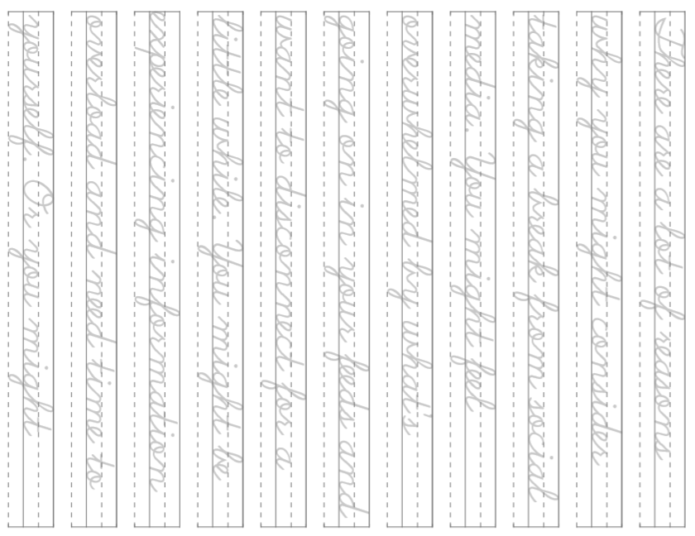
25

Slide 30
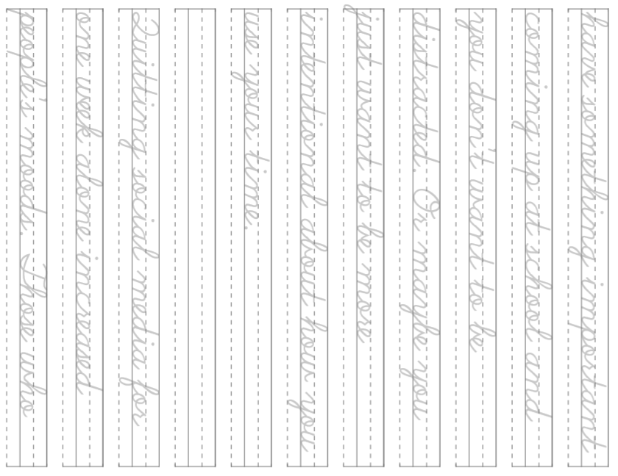
26

Slide 31
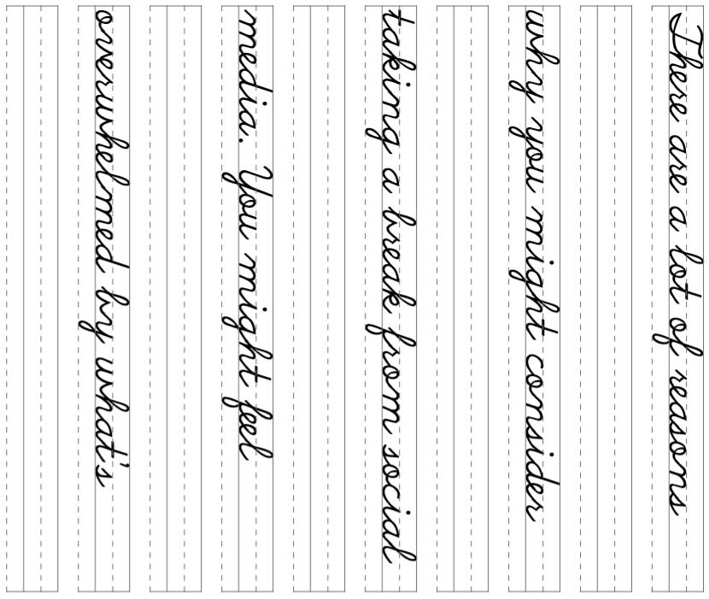
27

Slide 32
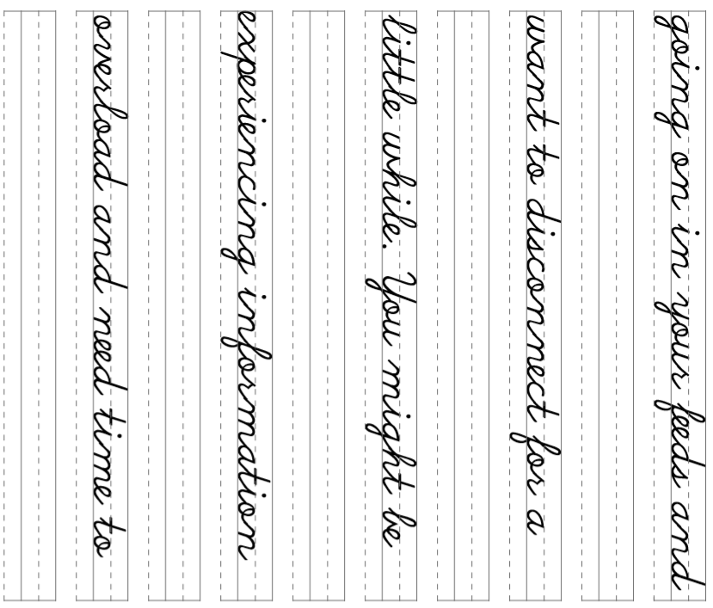
28

Slide 33
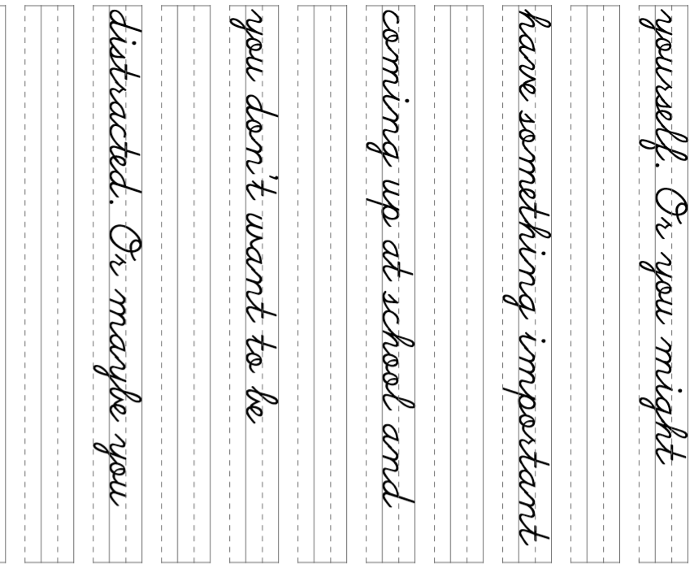
29

Slide 34
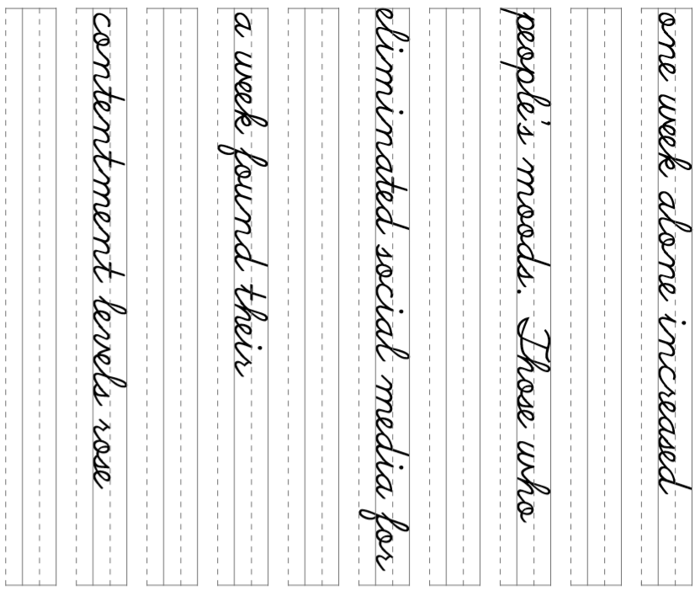
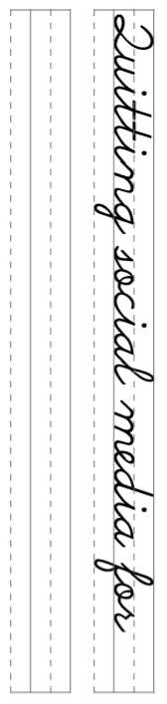
30

Slide 35
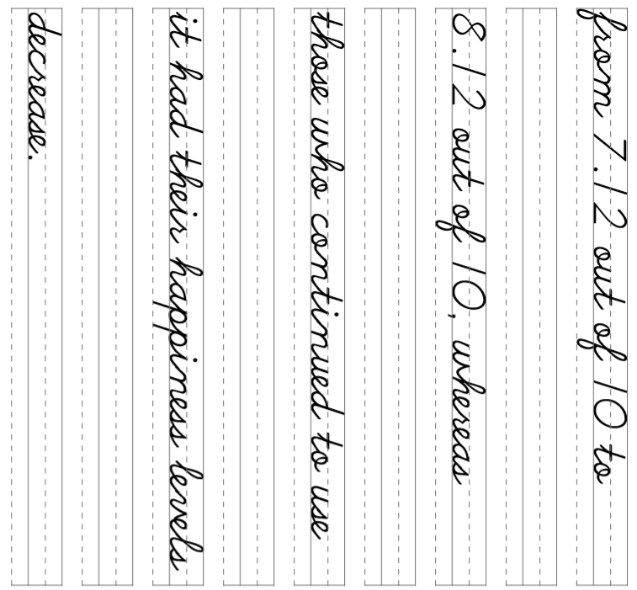
31

Slide 36
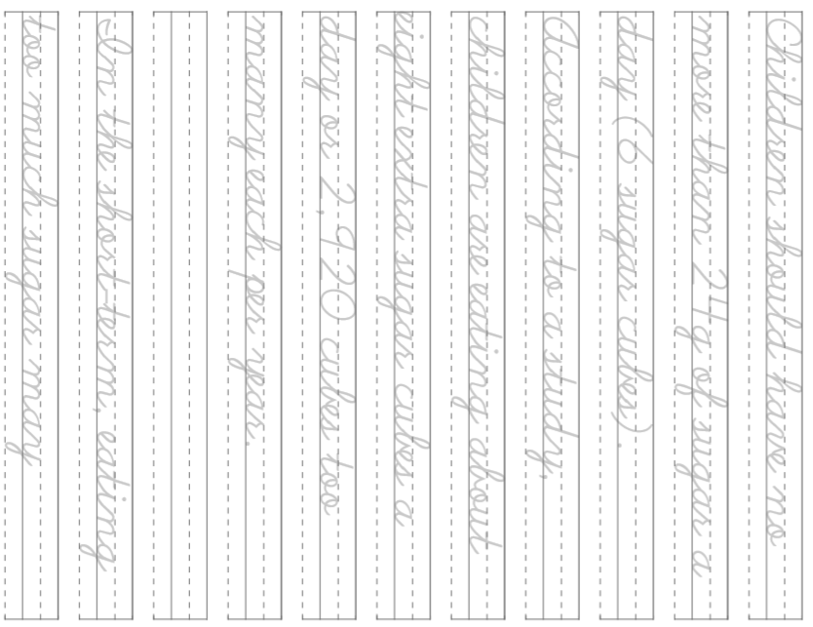
32

Slide 37
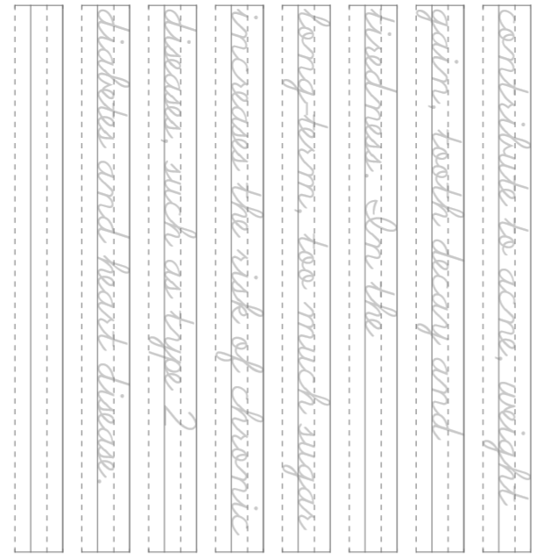
33

