Slide 1

Year 8 Knowledge Organiser HT6
Knowledge is Power
Name: ______________________________
Form: _______

Slide 2
Contents Page
Subject | Page
English | 1
Maths | 2
Science | 3
Spanish | 4
History | 5
Geography | 6
PE | 8
Computing | 10
Art | 11
Performing Arts | 12
Cooking and Nutrition | 13
Music | 14
DT | 15
‘Resilience’ reflection log | 16
Reading log | 23
Cursive Handwriting Practice | 30

Slide 3
English
Week 3 – Key Vocabulary
Obliterated | To completely destroy something to the point of non existence.
Euphoria | An extremely strong feeling of happiness and excitement.
Shrouded | To cover or hide something, usually with cloth.
Inconspicuous | Not attracting attention or being hard to notice.
Week 5 – Key Concepts
Refugee | A person who has been forced to leave their country or home, because there is a war or for political, religious or social reasons.
Asylum Seeker | A person who has left their home country as apolitical refugee and is seeking asylum (protection) in another.
People Trafficker | A person who illegally transports people from one country or area to another for payment.
Repatriation | The return of someone to their own country.
Granted Asylum | You have been given the legal right to live and work in the country in which you applied for asylum (protection).
Week 1 – Key Vocabulary
Device | Definition
Treacherous | Dangerous/Intending harm.
Asylum | Protection that a government gives people who have left their own country, usually because they were in danger.
Dehumanise | To treat somebody as if they are not human – like they are an object or an animal.
Squalid | Very dirty or unpleasant living conditions.
Arduous | Something that is very difficult and tiring, requiring a lot of effort.
Week 6 – The Journey
Afghanistan to Pakistan | His mother takes him on a Lorry with electricity poles.
Pakistan to Iran | Driven in a pick up truck by people traffickers.
Iran to Turkey | Treacherous hike over mountains with people traffickers.
Turkey to Greece | In an inflatable dinghy with 4 others.
Greece to Italy | In a shipping container.
Week 4– Key Devices and Techniques
Cyclical Structure | When a text starts and ends in the same place/mentions the same thing.
Simile | A comparison between like or as.
Personification | When a non-human object is given features or characteristics of a person.
Foreshadowing | When the writer hints at something that will happen later.
Foreboding | When the writer hints at something bad happening later in the story.
Week 2 – Key Devices and Techniques
Catharsis | Getting rid of unhappy memories or strong emotions by expressing them.
Symbolism | Where an idea or object represent a bigger idea or emotion.
Metaphor | A direct comparison of one thing to another.
Pathetic Fallacy | Where nature, often the weather, mirrors the mood of the text.
Week 7 – Paragraph structure
1. Point – create a point from the evidence, which answers the question directly and has an adjective.
2. Evidence – select a piece of evidence first which helps you to answer the question and is relevant and rich.
3. Explanation – explain what the quote means and zoom into specific words
4. Writer's Intentions – Link to the writer's reasons for writing the book..

Slide 4
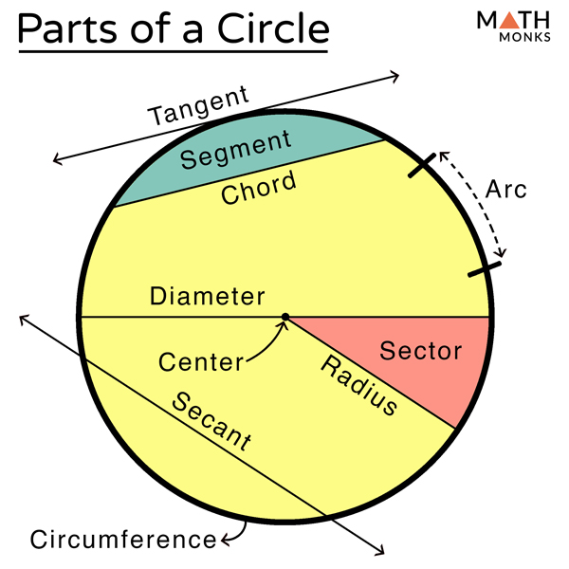
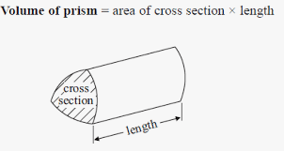
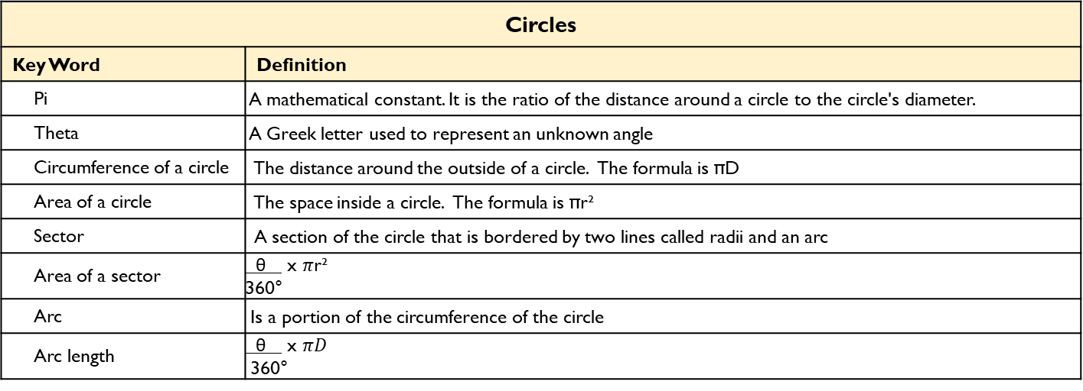
Maths
Circles
Key Word | Definition
Pi | A mathematical constant. It is the ratio of the distance around a circle to the circle's diameter.
Theta | A Greek letter used to represent an unknown angle
Circumference of a circle | The distance around the outside of a circle. The formula is πD
Area of a circle | The space inside a circle. The formula is πr²
Sector | A section of the circle that is bordered by two lines called radii and an arc
Area of a sector | θ x $π$r² 360°
Arc | Is a portion of the circumference of the circle
Arc length | θ x $πD$ 360°
Volume and Surface Area
Key Word | Definition
Plans and elevations | 2D representations of 3D shapes
Plan | Is the view from the top of the shape
Front elevation | Is the view from the front of the shape
Side elevation | Is the view from the side of the shape
Cross section | A cross section is the shape we get when cutting straight through an object
Prism | Is a 3D shape with the same cross section all the way through
Volume | The amount of 3-dimensional space something takes up
Surface Area | Is the area of all the faces on a 3D shape
2

Slide 5
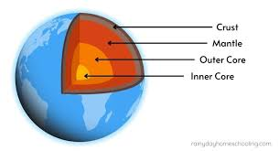
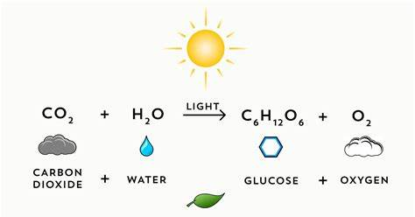
Science
Biology Key Words | Definition
Photosynthesis | A reaction that uses light energy to make glucose for the plant
Starch | The chemical glucose is stored as
Tissue | Many of the same cells carrying out a particular function
Palisade layer | A tissue layer containing cells with lots of chloroplasts
Spongey layer | A tissue layer containing cells with lots of air spaces
Chloroplasts | The organelle that carries out photosynthesis
Leaf | The plant organ that carries out photosynthesis
Xylem cells | Transport water and minerals from the roots to the leaves.
Phloem cells | Carry sugar solution from the leaves to the rest of the plant.
Iodine solution | Chemical used to detect the prescence of starch. Iodine is orange brown, it will change to blue/black is starch is found.
Earth Key Words | Definition
Inner core | Solid iron and nickel
Outer core | Liquid layer of iron and nickel
mantle | classed as a liquid.
Crust: | Land is made of continental crust, made mostly from granite. The layer beneath the ocean bed is made of oceanic crust, which is made mainly from basalt.
The atmosphere | A mixture of gases, with about 80% nitrogen, about 20% oxygen and small proportions of other gasses.
Greenhouse gases | Water vapour, carbon dioxide and methane are greenhouse gases.
Greenhouse effect | Increases in the amounts of greenhouse gases in the atmosphere cause the temperature of the Earths surface to rise
Photosynthesis
light
6 CO2
6 H2O
C6H12O6
6 O2
Carbon dioxide
water
glucose
oxygen
3

Slide 6
Spanish
Spanish | English
Recibir | To receive
Tirar | To throw / to pull
Día de muertos | Day of the Dead
Tomatina | Tomato Festival
Las Fallas | Valencian celebration involving burning of papier mâché models)
San Fermines | Where the bulls run
Pienso que / creo que | I think that
En mi opinion | In my opinion
Animado | Lively
Cultural | Cultural
Divertido | Amusing
Especial | Special
Histórico | Historic
Internacional | International
Peligroso | Dangerous
Nacional | national
Tradicional | Traditional
Ruidoso | Noisy
Plaza de toros | Bullring
Spanish | English
Banda | Band
Desfile | Procession / parade
Disfraz | Costume
Flamenco | Spanish dance
Fuego | Fire
Música | Music
Comida | Food
Tapas | Small sharing plates
Baile | Dance
Caballo | Horse
Juguete | Toy
Plato | Dish
Regalo | Present
Traje | Suit
Vestido | Dress
Fuegos artificiales | fireworks
Spanish | English
Navidad | Christmas
Nochebuena | Christmas Eve
Noche Vieja | New year’s eve
Semana Santa | Easter week
Cumpleaños | Birthday
Día de Reyes | Epiphany
Año nuevo | New year
Asistir | To attend
Atraer | To attract
Bailar | To dance
Caminar | To walk
Cantar | To sing
Comer | To eat
Compartir | To share
Quemar | To burn
Vestirse | To get dressed / wear
participar | To participate
4

Slide 7
History
Key Terms
Emancipation | Process of being set free from legal, social, or political restrictions (liberation).
Anglican | A church/faith associated with the Church of England (Is Protestant)
Unionism | A political belief that wants to keep Britain and Ireland united politically.
Nationalist | A person who wants political independence for their country.
Autonomy | The right to self-government.
Ulster | An area in the North of Ireland.
Irish Republican Brotherhood (IRB): | A secret oath-bound organisation dedicated to creating an Independent Ireland between 1858 and 1924.
Royal Irish Constabulary (RIC): | The police force in Ireland from the early 19th C until 1922.
Guerrilla warfare | Type of combat that often involves surprise attacks such as ambushes, raids, or sabotage of a vulnerable target.
Republic | A state in which power is held by the people and their elected government.
The Irish Republican Army (IRA) | A paramilitary group in Ireland that wanted an independent Ireland and believed political violence was necessary to achieve this.
Sinn Fein | A political slogan by Irish nationalists. Has since become a left-wing political party in Ireland
Key Events
1798: The Irish Rebellion | This was a failed attempt to gain complete independence from British rule in Ireland.
1800: The Acts of Union | This law made Ireland a part of the United Kingdom.
1912: Home Rule Act | This law was to give Ireland more control and autonomy. However, it divided Ireland into two sides. The unionists (remain) and the nationalists.
1912: The Ulster Covenant | Signed by 500,000 people in Ulster and created an army of Ulster volunteers, which threatened to resist the act using violence.
24th-29th April 1916: The Easter Rising | This was an attempt by Irish nationalist rebels to make Ireland a Republic.
1919-21: The Irish Wars of Independence | Also known as the Anglo-Irish war between the IRA and British forces.
28th June 1922- 24th May 1923: The Irish Civil War | Broke out due to the Anglo-Irish Treaty which gave Ireland independent status but as a colony of the British Empire.
1960’s and 1970’s | The Troubles in Northern Ireland. The status of Northern Ireland caused conflict and violence at times.
30th January 1972: Bloody Sunday. | 13 Irish men were killed by British forces, all aged between seventeen and forty-one.
2nd December 1999: The Good Friday agreement | Political deal designed to bring an end to the Troubles. Approved by public votes in Northern Ireland and the Republic of Ireland.
5

Slide 8
Geography
Key Word | Definition
Relief | The height and shape of the land.
Lowland | Flat land that is at, or not much higher, than sea level.
Upland | An area of high or hilly land.
Igneous | Magmatic rock which is formed by the cooling and solidifying of magma or lava.
Sedimentary | Rock that has formed through the deposition and solidification of sediment.
Metamorphic | Rock which has altered due to high temperatures and/or pressures.
Erosion | The wearing away of rocks. There are 4 different types of erosion.
Weathering | The breaking down of rocks where they are.
Biological | The breaking down of rock by plants and animals e.g. roots forcing rocks apart.
Mechanical | The breakdown of rock without changing its chemical composition e.g. freeze thaw weathering.
Glacier | As glaciers move through the landscape they turn V-shaped valleys into U– shaped valleys. They leave behind smoothed landscapes and large rocks known as erratics.
Deposition | Material that is dropped by a river or sea as it loses energy. The heaviest material is deposited first.
U– shaped valleys | Are formed as ice erodes the surrounding rocks to create a “U” shaped valley with a flat bottom and steep sides.
Ice Age | A period of time with low temperatures during which thick ice sheets cover vast areas of land.
Meltwater | Is the water released by the melting of snow and ice.
Striations | Is a groove or scratch eroded onto surrounding rock by glaciers as they move.
Corrie | Is a horseshoe– shaped valley which is formed by the erosion of glaciers.
6

Slide 9
Geography
Key Word | Definition
Arete | A narrow ridge of rock on top of a mountain which separates two valleys.
Headland | A narrow piece of land that projects from the land into the sea.
Bay | An area of water sheltered by land on three sides.
Meander | A bend in a river, usually found in the middle and lower course of a river.
Source | Start of a river.
Mouth | Where the river meets the sea.
Tributary | A smaller river or stream which feeds into another one.
Confluence | Where two rivers join.
Drainage basin | Area of land which is drained into a river.
7

Slide 10
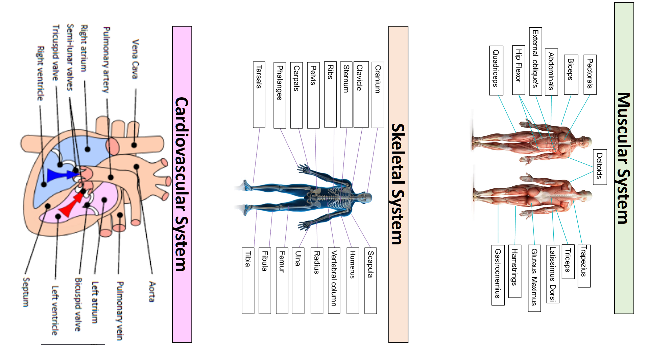
PE
8

Slide 11
PE
Muscular system - Antagonistic pairs
Tendons connect muscle to bone and ligaments connect bone to bone. Voluntary muscles allow for movement as they produce a force which causes the attached bones to move in a specific direction. Muscles which are attached via tendons work together to create this.
Antagonistic pairs | Is where two muscles work together to create movement. There are two main categories that outline how these muscles work together; agonist and the antagonist.
Agonist | Is the also known as the prime mover. This is the muscle that contracts and causes the movement.
Antagonist | This is the opposite muscle that relaxes and in most cases lengthens as the movement occurs.
Muscular system – Muscle fibre types
All skeletal muscle contains a mixture of Slow Twitch and Fast Twitch muscle fibres- this is based on their speed of contraction. There are 3 types of muscle fibre.
Fast Twitch | Is broken down into two types;Type 2 x & Type 2 b.
Fast twitch - Type 2 x/2b | Produces highest force, fast contracting, Low endurance, good for short distances – Sprint start
Type 2a | Produce high force, moderate speed of contraction, medium endurance, more resistant to fatigue, Sprinting over longer distances.
Slow Twitch | They contract slowly and with less force. Provide a low speed of contraction, high endurance, can keep going, don’t produce much power. These fibres have a rich blood (and oxygen) supply. This makes them red in colour. They are slower to fatigue, and so are used for more endurance events e.g. long distance swimming/ running.
9

Slide 12
Computing
Programming
Algorithm | A set of instructions or code used to solve a problem.
Syntax | The rules of the programming language that need to be followed in order for it to work.
Variables | Data that is stored in memory that is likely to change.
Program | Code compiled together to perform a specific function.
Print | A function used to print the desired message on a device's screen in a string format
Input | The information entered into a computer system
Output | What is produced by a computer after it has processed information
Data types
String | A Variable data type that can store a combination of letters, characters and numbers.
Integer | A Variable data type that can store whole numbers.
Float | A Variable data type that can store decimal numbers.
Boolean | A Variable data type that stores either TRUE or FALSE.
Selection
Iteration | Repeating code in a specific order
Selection | Used to allow the program to make a choice and take a different path.
If | Checks if the condition is true, if so the program runs the indented code below it.
Elif | If the first if fails then this elif condition is checked, there can be multiple of these.
Else | If all if and elif statements are not true the the code indented below else will run.
Example programme with selection | colour - input(“Enter your favourite colour”); if colour == “Red”: print(“Reminds me of tomatoes”); elif colour == “Blue”: print(“Reminds me of the sea!”); else: print(“If it ain’t Red or Blue then I ain’t interested”);
10

Slide 13
Art
Key Word | Definition
Two Point Perspective | is a type of linear perspective that uses two vanishing points on the horizon to create an illusion of depth and spatial organization in a two-dimensional image
Bird’s Eye View | A point of view looking down directly from above.
Composition | describes the different ways elements of an artwork are arranged
Foreground | The part of the artwork that seems to be closest to you
Horizon Line | The line in an artwork where the sky and land appear to meet
Middle Ground | The middle layer of an artwork that appears to be between the foreground and background
11

Slide 14
Performing Arts
Devising Drama – Key Words
Stimulus | A resourced used as a starting point to generate ideas for a piece of drama. This may be a poem, story, piece of music, historical event, a painting, a piece of artwork, a quote and more.
Direct Address | When an actor speaks directly to the audience, e.g. in pantomime.
Tableaux | A ‘frozen picture’ that tells a story. Costume and props are needed, and physicality used to show emotion.
Blocking | The staging and use of the space in drama, This may refer to the location of actors on the stage and the movements they make.
Multi-role | When an actor plays more than one role.
Exits and Entrances | Where a character enters and exits their scene.
Thought Tracking | An exercise that allows the inner thoughts of a character or role to be heard out loud. The participant is asked to say their characters thoughts and feelings at specific points during their acting.
Technical Rehearsal | Technical equipment and systems for example sound, lighting and computer generated effects.
Rehearsal | A practice or trial performance of a play.
Developing Ideas
Soundscape | The actors used their bodies to create sound effects for the performance
Transitions | The fluid and focused movement between scenes/images
Proxemics | Proxemics is how close or near you are to others on stage. This can help to communicate meaning e.g. if your character is scared of another character you might stand far away.
Storyboarding | Involves creating a series of images and/or text showing the sequence of the action planned for a devised drama.
Cue to Cue Rehearsal | This involves a rehearsal where the actors remove all of the action and dialogue between cues during a technical rehearsal.
Narrative | The narrative is the storyline or plot of a piece of drama. A narrative should be clear for the audience so that the storytelling makes sense - although there are different ways to structure a narrative which will explore in lessons
Semiotics | This refers to how meaning is created and communicated through the systems of signs and symbols of drama.
Movement in unison | All actors moves in the same way, at the same time.
11

Slide 15
Cooking and Nutrition
Key Word | Definition
Ragu | A meat based sauce that is commonly served with pasta
Kitchen Hygiene | Ensuring that everything is clean when preparing food
Kitchen Safety | Being safe in the kitchen
Cross contamination | Transfer of bacteria from one person, object or place to another
Eat Well Guide | A pictorial food guide showing the amounts and types of foods that are needed to make up a healthy balanced diet
Claw grip | A method of cutting food that ensures that the finger tips are tucked out of the way and will not get caught by the knife
Food poisoning | An illness caused by eating contaminated food
Bacteria | Microscopic living organisms which can be found everywhere
Salmonella | Food poisoning bacteria found in chicken, some dairy products and raw eggs
Seasonal foods | Foods that are only available at certain times of the year
cuisine | A style of cooking of a particular country or region
Bridge Hold | A method of cutting food that ensures that fingers are out of the way as the knife cuts through the food
13

Slide 16
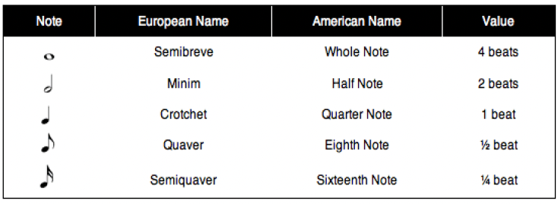
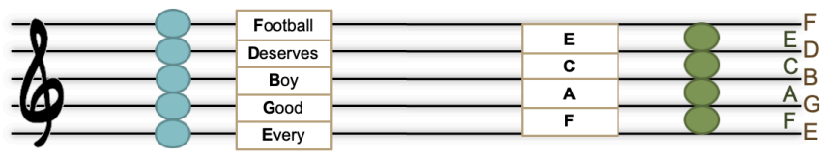
Music
Key Word | Definition
Call and response | one phrase in sung/played and an answering phrase completes the musical idea.
Verse and chorus | Also called verse and refrain, this is a musical vocal form in which a number of verses are each followed by the same chorus.
Hook | The memorable, “catchy” part of the song, usually in the chorus and often containing the title of the song.
Modulation | A change of key
Dynamic | The volume of a sound or piece of music – loud/soft
Beat | The regular, underlying pulse in the music.
Rhythm | Patterns of long and short note durations.
Harmony | The combination of two or more notes heard together, usually in chords.
Major triad | A three-note chord using the 1st, 3rd and 5th notes of the major scale.
Minor triad | A three-note chord using the 1st, 3rd and 5th note of the minor scale.
Chord: | Two or more notes, heard simultaneously or close together, that create the harmonic basis of a piece or song, often built on triads.
14

Slide 17
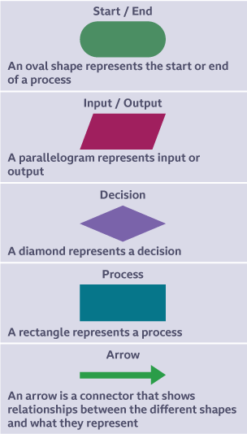
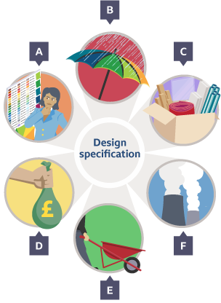
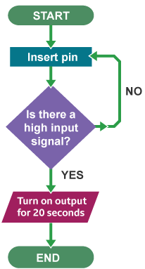
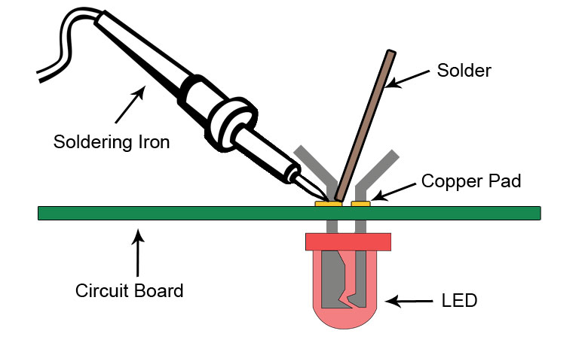
Design and Technology - RM
Year 8
Key Words | Definition
Evaluation | To judge the quality and performance of a product.
Fit for Purpose | Something is suitable and capable of fulfilling its intended function or use.
Flowchart | Also known as a flow diagram. A diagram that shows the step-by-step flow of an algorithm.
Input Device | An electronic component capable of passing information from the outside world into an electronic system for processing.
Microcontrollers | A computer chip used instead of a CPU that contains a processor, memory and inputs/outputs.
Process Device | A device, usually an integrated circuit, that controls the process functions of a system.
Key Words | Definition
Output Device | A device used to output data or information from a computer, eg a monitor, printer or speakers.
Resistance | The opposition in an electrical component to the movement of electrical charge through it. Resistance is measured in ohms.
Solder | a fusible metal alloy, typically with a low melting point, used to create a permanent bond between metal workpieces.
Soldering | A method of joining, usually electrical components, by heating a filler metal called solder. When the solder cools, it fused the components together.
System Diagram | A block diagram that shows the inputs, processes and outputs of a system.
Voltage | The potential difference across a cell, electrical supply or electrical component. It is measured in volts (V).
Flowchart Program Example
Fit for Purpose
Aesthetic
Function
Material
Target Market
Environment
15

Slide 18
W/c 1st June Thinking definition: Thinking is making connections, reasoning and asking questions to make the learning stick
Reflecting on learning behaviours for resilience….. | Experience log
 | Successful moment… | In hindsight… Where you could have done better on reflection? | At home…
I gave an idea and reasoned/justified.
I reflected on my idea and made it better after discussing with others
I used a revision strategy to help make the learning stick.
I made connections between what I am learning and the outside world.
I asked questions to deepen my understanding.
16

Slide 19
W/c 8th June Thinking definition: Thinking is making connections, reasoning and asking questions to make the learning stick
Reflecting on learning behaviours for resilience….. | Experience log
 | Successful moment… | In hindsight… Where you could have done better on reflection? | At home…
I gave an idea and reasoned/justified.
I reflected on my idea and made it better after discussing with others
I used a revision strategy to help make the learning stick.
I made connections between what I am learning and the outside world.
I asked questions to deepen my understanding.
17

Slide 20
W/c 15th June Thinking definition: Thinking is making connections, reasoning and asking questions to make the learning stick
Reflecting on learning behaviours for resilience….. | Experience log
 | Successful moment… | In hindsight… Where you could have done better on reflection? | At home…
I gave an idea and reasoned/justified.
I reflected on my idea and made it better after discussing with others
I used a revision strategy to help make the learning stick.
I made connections between what I am learning and the outside world.
I asked questions to deepen my understanding.
18

Slide 21
W/c 22nd June Thinking definition: Thinking is making connections, reasoning and asking questions to make the learning stick
Reflecting on learning behaviours for resilience….. | Experience log
 | Successful moment… | In hindsight… Where you could have done better on reflection? | At home…
I gave an idea and reasoned/justified.
I reflected on my idea and made it better after discussing with others
I used a revision strategy to help make the learning stick.
I made connections between what I am learning and the outside world.
I asked questions to deepen my understanding.
19

Slide 22
W/c 29th June Thinking definition: Thinking is making connections, reasoning and asking questions to make the learning stick
Reflecting on learning behaviours for resilience….. | Experience log
 | Successful moment… | In hindsight… Where you could have done better on reflection? | At home…
I gave an idea and reasoned/justified.
I reflected on my idea and made it better after discussing with others
I used a revision strategy to help make the learning stick.
I made connections between what I am learning and the outside world.
I asked questions to deepen my understanding.
20

Slide 23
W/c 6th July Thinking definition: Thinking is making connections, reasoning and asking questions to make the learning stick
Reflecting on learning behaviours for resilience….. | Experience log
 | Successful moment… | In hindsight… Where you could have done better on reflection? | At home…
I gave an idea and reasoned/justified.
I reflected on my idea and made it better after discussing with others
I used a revision strategy to help make the learning stick.
I made connections between what I am learning and the outside world.
I asked questions to deepen my understanding.
21

Slide 24
W/c 13th July Thinking definition: Thinking is making connections, reasoning and asking questions to make the learning stick
Reflecting on learning behaviours for resilience….. | Experience log
 | Successful moment… | In hindsight… Where you could have done better on reflection? | At home…
I gave an idea and reasoned/justified.
I reflected on my idea and made it better after discussing with others
I used a revision strategy to help make the learning stick.
I made connections between what I am learning and the outside world.
I asked questions to deepen my understanding.
22

Slide 25
Reading Log w/c 1st June (20 mins reading per day – all five logs MUST be completed)
Date | Title of novel | Number of pages read | Summary about what I have read
 |  |  | • • •
 |  |  | • • •
 |  |  | • • •
 |  |  | • • •
 |  |  | • • •
Checked by form tutor:
23

Slide 26
Reading Log w/c 8th June (20 mins reading per day – all five logs MUST be completed)
Date | Title of novel | Number of pages read | Summary about what I have read
 |  |  | • • •
 |  |  | • • •
 |  |  | • • •
 |  |  | • • •
 |  |  | • • •
Checked by form tutor:
24

Slide 27
Reading Log w/c 15th June (20 mins reading per day – all five logs MUST be completed)
Date | Title of novel | Number of pages read | Summary about what I have read
 |  |  | • • •
 |  |  | • • •
 |  |  | • • •
 |  |  | • • •
 |  |  | • • •
Checked by form tutor:
25

Slide 28
Reading Log w/c 22rd June (20 mins reading per day – all five logs MUST be completed)
Date | Title of novel | Number of pages read | Summary about what I have read
 |  |  | • • •
 |  |  | • • •
 |  |  | • • •
 |  |  | • • •
 |  |  | • • •
Checked by form tutor:
25

Slide 29
Reading Log w/c 29th June (20 mins reading per day – all five logs MUST be completed)
Date | Title of novel | Number of pages read | Summary about what I have read
 |  |  | • • •
 |  |  | • • •
 |  |  | • • •
 |  |  | • • •
 |  |  | • • •
Checked by form tutor:
26

Slide 30
Reading Log w/c 6th July (20 mins reading per day – all five logs MUST be completed)
Date | Title of novel | Number of pages read | Summary about what I have read
 |  |  | • • •
 |  |  | • • •
 |  |  | • • •
 |  |  | • • •
 |  |  | • • •
Checked by form tutor:
27

Slide 31
Reading Log w/c 13th July (20 mins reading per day – all five logs MUST be completed)
Date | Title of novel | Number of pages read | Summary about what I have read
 |  |  | • • •
 |  |  | • • •
 |  |  | • • •
 |  |  | • • •
 |  |  | • • •
Checked by form tutor:
28

Slide 32
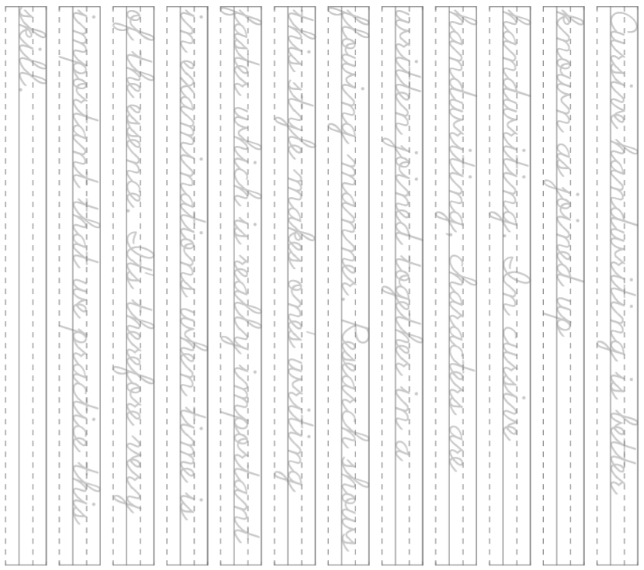
30

Slide 33
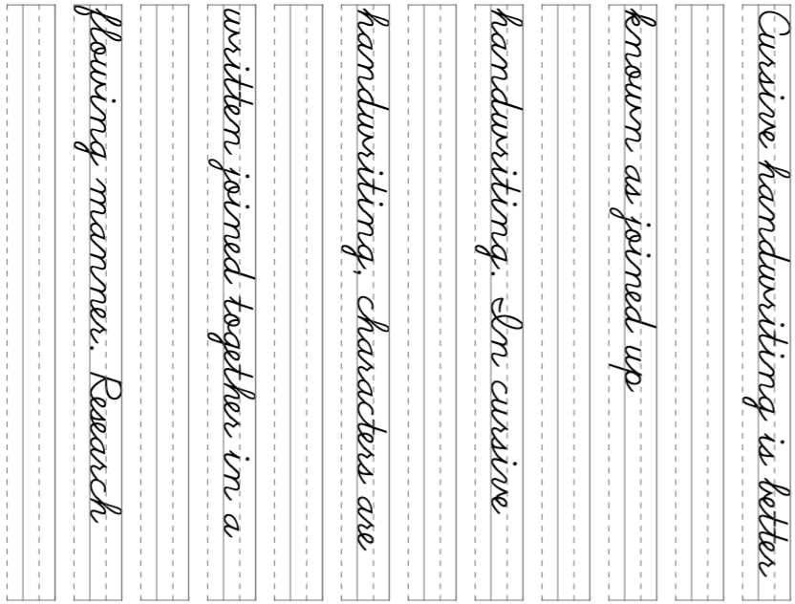
31

Slide 34
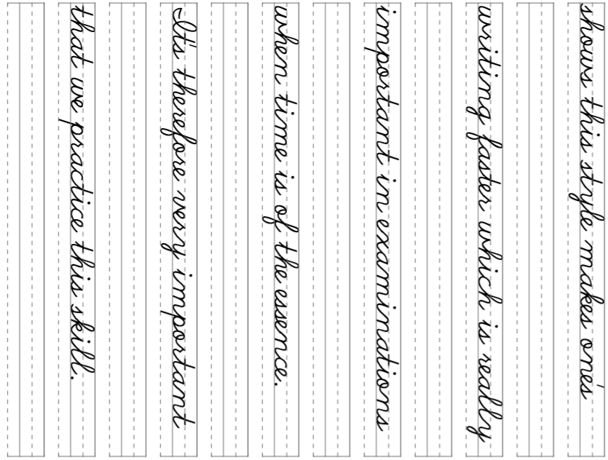
32

Slide 35
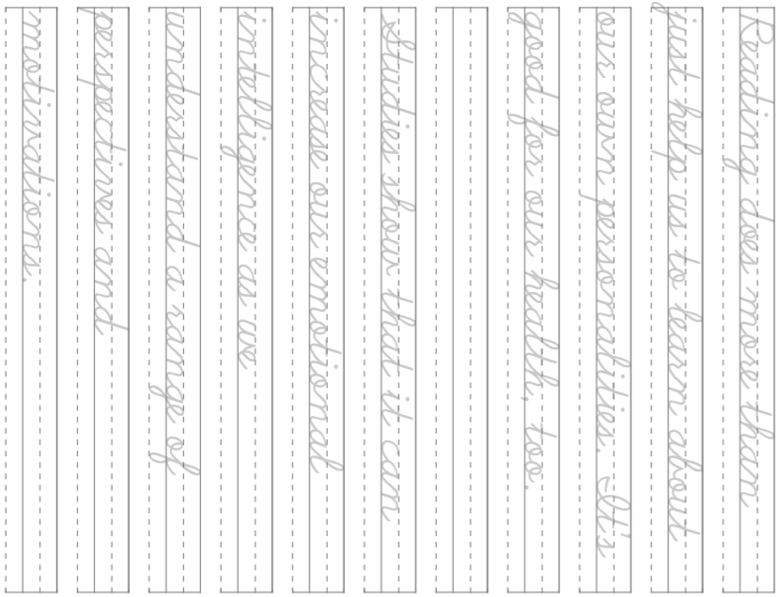
33

Slide 36
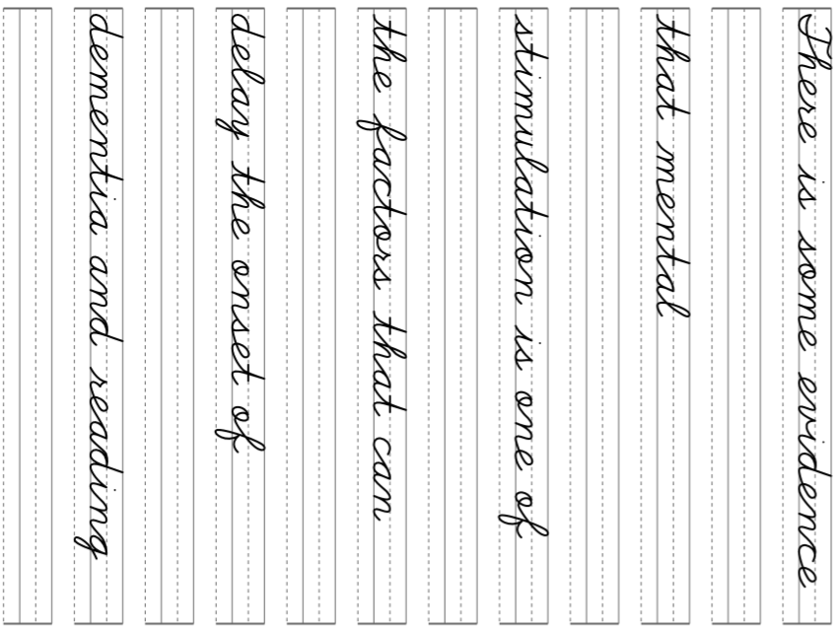
34

Slide 37
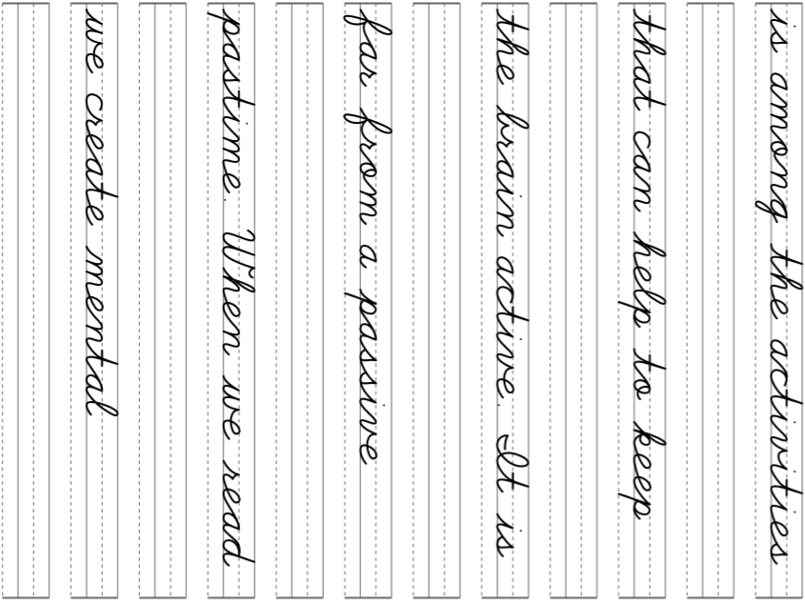
35

Slide 38
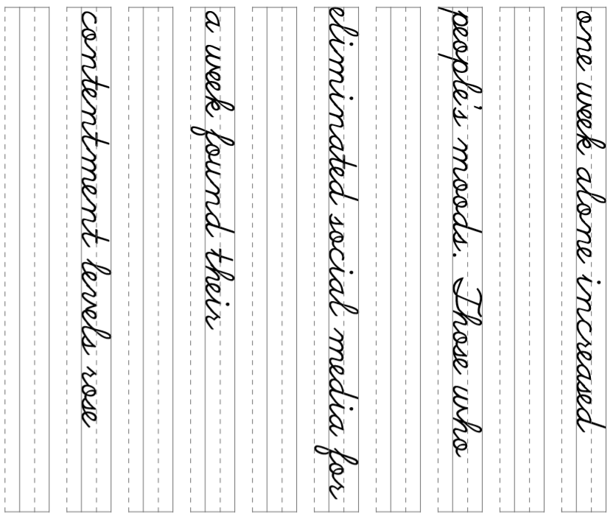
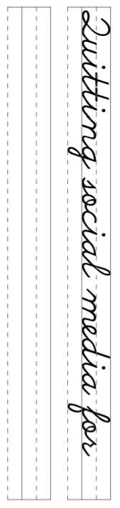
36

Slide 39
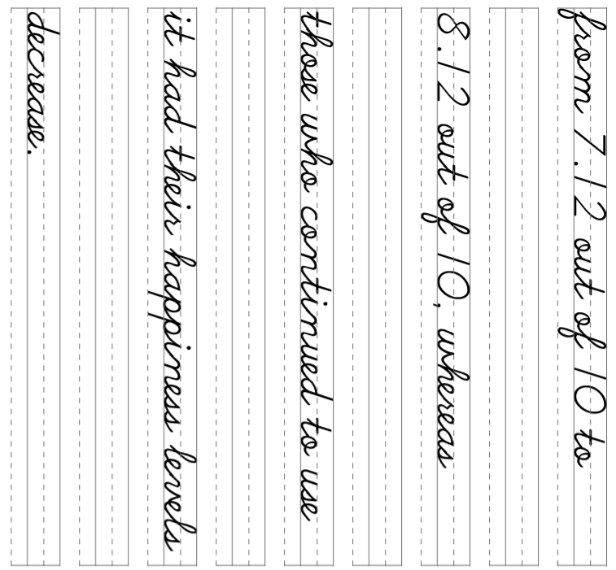
37

Slide 40
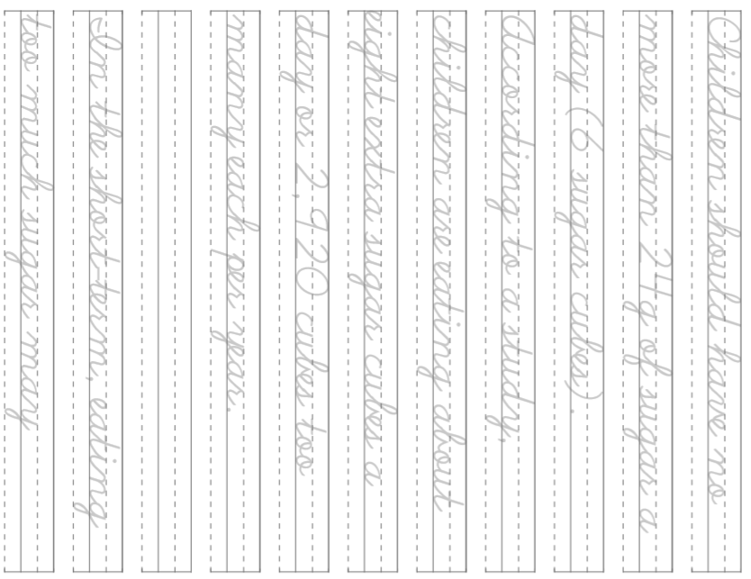
38

Slide 41
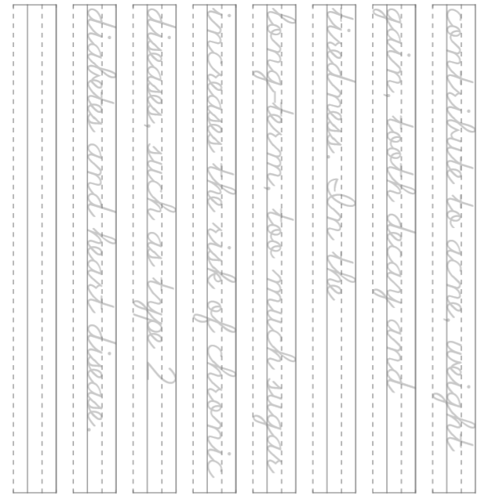
39

