Slide 1

Year 9 Knowledge Organiser HT2
Knowledge is Power
Name: ______________________________
Form: _______

Slide 2
Contents Page
Subject | Page
English | 1
Maths | 2
Science | 3
Spanish | 4
History | 5
Geography | 6
PE | 7
Computing | 9
Art | 10
Cooking and Nutrition | 11
Music | 12
Performing Arts | 13
Design and Technology | 14
‘Thinking’ reflection log | 15
Reading log | 22
Reading Extracts | 27
Cursive Handwriting Practice | 37

Slide 3
English
Week 6- Language Devices
Imagery | Imagery provides the reader with descriptive detail.
Hyperbole | Hyperbole is exaggerated statements or claims not meant to be taken literally.
Rhetorical question | A question asked in order to create a dramatic effect or to make a point rather than to get an answer.
Emotive language | Emotive language is the use of specific words and phrases used to evoke emotion in the reader.
Triplets (rule of three) | Triples is the listing of three things (commonly adjectives) for effect.
Week 1 - Key Terms
Viewpoint | Viewpoint is a person's opinion or point of view.
Perspective | Perspective is a particular attitude towards or way of regarding something.
Comparison | Comparison is the similarity or difference between two things.
Tone | Tone is the general character or attitude of a piece of writing.
Week 4 - Structure/Steps
Comparative Point Source A point Evidence Language analysis Effect on the reader Comparative connective Source B point Evidence Language analysis Effect on the reader Summary comparative sentence
Week 2 - Key Terms
Inference | When you reach a conclusion using evidence and reasoning rather than just being told. Reading between the lines.
Explicit | What something means, literally.
Implicit | What is implied by something, what we can infer.
Week 5 - Language Devices
Juxtapose | Two things being seen or placed close together with contrasting effect.
Metaphor | When one thing is described as being equal to something else.
Antithesis | Words that are deliberately chosen to contrast with one another.
Statistics | A statistic is a fact or piece of data obtained from a study of data.
Symbolism | Symbolism is the use of symbols to represent ideas or qualities.
Week 7 - Vocabulary
Aberration | A state or condition markedly different from the norm.
Circumspect | Careful to consider potential consequences and avoid risk.
Erudite | Having or showing profound knowledge.
Gratuitous | Unnecessary and unwarranted.
Explicit | Stated clearly and in detail, leaving no room for confusion or doubt.
Implicit | Strongly suggested or implied though not directly expressed.
Week 3 - Comparative Connectives
Similarities | Differences
Similarly, | Contrastingly,
Equally, | Differently,
Likewise, | On the other hand,
Correspondingly, | On the contrary,
Equivalently, | Alternatively,
1
Notes:
Year 8 HT2

Slide 4
Maths
Bearings and map scales
Bearings | An angle measured clockwise from the north line (must have three digits).
Map scales | The ratio between the distance on a map and the corresponding distance on the ground.
Simple scale | A ratio that expresses the relationship between the dimensions on a drawing or model and the corresponding actual dimensions
Ratio scale | A proportional relationship between two quantities.
Angle facts
Angles on a straight line add up to 180˚
Angles in a triangle add up to 180˚
Base angles in an isosceles triangle are equal
Vertically opposite angles are equal
Angles in a quadrilateral add up to 360˚
Diagonally opposite angles in a parallelogram are equal
Alternate angles are equal
Corresponding angles are equal
Co-interior angles add up to 180˚
Accuracy and bounds
Decimal places | The digits located to the right of the decimal point in a number
Significant figures | The digits in a number that carry meaning contributing to its precision
Bounds | The upper and lower limits of a value, often when a number has been rounded or approximated
Upper bound | The largest possible value that would round to the given rounded value
Lower bound | The smallest possible value that would round to the given rounded value
Error intervals | The range of possible values for a number that has been rounded or truncated to a specific degree of accuracy
Truncation | Shortening a number by dropping digits after a specific place value, without rounding
Polygons
Polygon | A closed 2D shape with 3 or more straight sides
Interior angles | Inside angle
Exterior angle | Outside angle
Sum of interior angles in a polygon | (Number of sides - 2 ) x 180˚
Sum of exterior angles in polygons | Always add up to 360˚
Interior and exterior angles add up to 180˚
Equations
Term | A single number or variable
Variable | A symbol used to represent an unknown number
Equation | Two expressions which have the same value, separated by an '=' sign.
Formula | A rule or relationship that uses more than one letter variable
Subject | The variable that is being isolated on one side of the equation or formula
Changing the subject | Rearranging a formula to isolate a specific variable
2

Slide 5
Science
Atomic structure and periodic table
Key term | Definition
Atom | The smallest part of an element that can exist
Element | Contains only one type of atom
Compound | Two or more elements chemically combined
Mixtures | Two or more elements or compounds not chemically combined together
Isotopes | Atoms of the same element with the same number of protons and different numbers of neutrons
Molecule | When two or more of the same element are joined together
Electron Shell | Electrons fit in shells around the nucleus in an order. The inner first shell is filled after 2 electrons, all the next shells take 8.
Periodic Table | A table showing the 100 or so elements arranged in an order
Atomic Number | The number of protons in an atom.
Atomic Mass | The number of protons and neutrons in an atoms nucleus
Metal | Shiny, hard elements that are found on the left of the periodic table
Non-Metals | Brittle elements that are found on the right of the periodic table
Alloys | Mixture of two or more elements at least one of which is a metal
Boiling point | Temperature at which substance changes from a liquid to a gas
Melting point | Temperature at which substance changes from a solid to a liquid
Key term | Definition
Delocalised electrons | Free moving electrons from the outer shell of metal atoms. Form a strong attraction with metal ions
Covalent bond | A shared pair of electrons between atoms
Simple covalent molecule | Substance that contains only a few non-metal atoms held together by covalent bonds
Ion | Particle with a charge, positive or negative
Ionic bond | Forms between metals and non-metals. Oppositely charged ions attract to form an ionic bond.
Ionic lattice | Regular arrangement of positive ions surrounded by negative ions
Electrostatic attraction | Force of attraction between oppositely charged ions
Intermolecular force | Relatively weak force of attraction between molecules that keeps them together
3

Slide 6
Spanish
Spanish | English
la capital | Capital
casa | House
ciudad | City
costa | Coast
España | Spain
montaña | Mountain
playa | Beach
región | Region
zona | Zone
alrededores | Outskirts
afueras | Outskirts
barrio | Neighbourhood
campo | Countryside
centro | Sentre
pueblo | Town
norte | North
sur | south
Spanish | English
este | East
oeste | West
está | Is (location)
animado | Busy
antiguo | Old
bonito | Pretty
feo | Ugly
histórico | Historic
moderno | Modern
sucio | Dirty
tranquilo | Quiet
calle | street
piso | Flat
estación de tren/autobús | Train/Bus station
fábrica | Factory
iglesia | Church
mezquita | mosque
Spanish | English
piscina | Swimming pool
tienda | Shop
castillo | Castle
cine | Cinema
edificio | Building
mercado | Market
parque | Park
restaurante | restaurant
tenía | It had
había | There was
me gustaba | I liked
odiaba | I hated
vivía | I lived
en el pasado | In the past
ahora | now
antes | before
Me gustaría | I would like
4

Slide 7
History
Key Term | Definition
Democracy | A system of government by the whole population or all the eligible members of a state, typically through elected representatives.
Dictatorship | A government led by a ruler with total power over a country, typically one who obtained control by force.
Blitzkrieg “Lightning War” | Tactic used by Nazi Germany in the early years of World War II, as German forces swept through Poland, Norway, Belgium, Holland and France with astonishing speed and force.
Axis | The main Axis powers were Germany, Italy, and Japan
Treaty of Versailles (T.O.V) | Signed on the 28th June 1919. There were 440 Articles setting out the terms for Germany's punishment after WWI. 4 main articles (LAMB)
Stormtroopers (SA) | Hitler’s brown-shirted supporters, employed to beat up opponents and guard meetings.
Dictator | Ruler with total control over how a country is governed.
Gestapo | Part of the SS and Nazi Germany’s secret police force, created by Herman Goering in 1933 and controlled by Heinrich Himmler.
Schutzstaffel | The SS. Originally Hitler’s elite personal bodyguards, became one of the main instruments of terror in Nazi Germany. Led by Heinrich Himmler, the responsibilities gradually expanded to include the suppression of Hitler’s political opponents and the persecution of Jews.
Key Term | Definition
Holocaust | Systematic, state-sponsored persecution and murder of six million Jews by the Nazi regime and its allies and collaborators.
Antisemitism | Hatred for or persecution of Jewish people as an ethnic, religious, or racial group.
Einsatzgruppen | SS mobile death squads responsible for the murder of those thought by the Nazis to be racial or political enemies.
Concentration Camp | Camp in which people are held under harsh conditions and without the freedoms of the rest of society.
Eugenics | The unscientific and racist belief that the mental and physical characteristics of the human race can be improved by choosing who may become parents.
Euthanasia | Deliberate killing of a person.
Aryan | Person of German or Scandinavian origin, usually fair-haired and blue-eyed; the Nazis believed that Aryans were superior to all other races.
Master Race | Elite race of people, to which Hitler believed the Germans belonged.
Death Camp | Extermination camp where prisoners, mainly Jews, were put to death.
Kristallnacht | Night of Broken Glass, in November 1938, when Jews and their shops and businesses were attacked throughout Germany.
Final Solution | Term used by the Nazis to refer to their plan to destroy Europe’s Jewish population between 1942-1945.
5

Slide 8
Geography
Key Word | Definition
The Himalayas | are mountains reaching across northern India and bordering countries.
Deccan Plateau | an area of raised land occupying much of central India.
Western Ghats | are hills that are often called the ‘backbone of India’.
Monsoon | is the name of the wind system which dominates the Indian climate, bringing persistent rainfall during the months of June to October
Caste system | a class structure that is determined by birth
Inequality | extreme differences between poverty and wealth, as well as in peoples' wellbeing
Quality of life | The general wellbeing of people which includes income, health, education, employment and the environment.
Squatter settlement | low-quality housing, occupied by the poor, usually on the edge of cities
Global city | the most important cities in the world in terms of economic and cultural impacts
Informal economy | Part of the economy which is neither taxed nor monitored by the government. They may work cash in hand, be self employed and have no guaranteed hours or pay.
Sweat shops | workplace in which workers are employed at low wages and under unhealthy or oppressive conditions
Sanitation | the process of keeping places clean and healthy, especially by providing a sewage system and a clean water supply
Rupee | the currency of India
Bollywood | the Indian popular film industry, based in Mumbai. It is the second largest film industry in the world after Hollywood.
Thar Desert | is also known as the ‘Great Indian Desert’. It forms the border between India and south eastern Pakistan
Hinduism | a major religious and cultural tradition of South Asia
6

Slide 9



PE
Skeletal System
Cardiovascular System
Muscular System
7

Slide 10
PE
Health and Fitness
Muscular Strength | The amount of the force muscles can generate against a resistance
Muscular Endurance | The ability to use voluntary muscles, over long periods of time without getting tired
Flexibility | The range of movement at a joint
Cardiovascular Fitness (Aerobic Endurance) | The ability of the heart and circulatory system to meet the demands of the body for a long period of time
Body composition | The percentage of a body that is fat, muscle, bone and water
Coordination | The ability to move two or more body parts at the same time
Reaction Time | The time taken for a response to occur after a stimulus
Agility | The ability to change direction at speed
Balance | The ability to keep the body steady when in a static position or when moving
Speed | The time taken to cover a set distance/complete a movement
Power | The ability to combine speed and strength
Principles of training
Progressive Overload | Working the body harder than normal/gradually increasing the amount of exercise you do
Reversibility | If training is not regular, adaptations will be reversed. This can happen when suffering from illness, injury or after an off season
Specificity | Training showed be matched to the requirements of the sport or position the performer is in. Training must be specifically designed to develop the right muscles, type of fitness or skills
Individual needs | All PEP’s would differ depending on performers goals/target, strengths /weaknesses, age/gender and current health/fitness levels
Overtraining | Occurs when you train too hard and do not allow the body enough rest/recovery time Signs include extended muscle soreness, frequent illness & increase injuries
8

Slide 11
Computing
Spreadsheets
Spreadsheet | A computer program used for accounting and recording “data” using rows and columns, into which information can be entered
Worksheet | The page you are currently working on
Cell reference | Is the intersection between a row and a column on a spreadsheet that starts with “cell” A1.
Absolute cell reference | Ensures that the cell always remains constant even when autofill is used. E.g. $E$4
Active cell | The cell which is currently being used and it is highlighted
Text labels | A cell which contains text
Format | Characteristics such as fonts, font size, number formats, cell borders and cell shading
Formula | Are usually simple calculations. They always start with an equals sign
Functions | Are predefined formulas and are already available in Excel
Merge | Is a function that enables different nearby cells to be joined into a single larger cell
Operators | Are symbols used in a formula
Chart | Is a graphical representation of data entered in spreadsheet
Sort | Organises it in a specific way
Conditional formatting | Allows you to apply special formatting to cells that meet certain criteria
IF statement | Tests a given condition and returns one value for a TRUE result and another value for a FALSE result.
Finance
Revenue/Inflow | Money coming in to a business. Usually through sales of the product or service. Can also be from investors or a bank loan
Outflow/Costs/Expenses | Money leaving the business. May be payment for stock and materials, wages, rent, repayment of money borrowed
Profit | Is calculated using this formula Total revenue — Total costs
Cash flow forecast | This is a business accounting method used to predict future sales
Net cash flow | The difference between inflow and outflow in a given month
9

Slide 12
Art
Key Word | Definition
Mark-making techniques | describes the different lines, dots, marks, patterns and textures created in a drawing. It can apply to any drawing materials. It can be loose and expressive or controlled and neat. The results will depend on your choice of media, tools and techniques
Graduated Tone | is a tone that fades smoothly from one shade to another across an area. They are often made by varying the pressure on the tool used to make the tone, but can also be made by using overlapping layers of the medium used to make the tone.
Tonal contrast | the range of tones used in a drawing. A wider range means a greater contrast. You can manipulate the contrast depending on how much you want the object or specific part of the art work to stand out. If you are drawing from observation, the contrast can depend on how bright your light source.
Highlight | the area of an object where the light effects is most intense. In painting the highlight of an object should not be pure white as it should contain some of the local colour of the object. White highlights refer to pure reflected light as for example occur on a metal object, but do not occur on or are reflected from coloured glass.
Proportion | refers to the relationship between the different sized components within one whole composition. Proportion can be used to make a composition appear more realistic or more stylised depending on the type of proportion used.
Texture | concerns the surface quality of a piece of work. In three-dimensional artwork, the term refers to how the piece feels when it's touched. In two-dimensional artwork, texture invokes the visual 'feeling' the piece gives off.
Outline | Lines that are used to define the shape or form of an object or to show key details are called outlines.
Mixed-Media | refers to a visual art form that combines a variety of media in a single artwork.
10

Slide 13
Cooking and Nutrition
Key Word | Definition
Cholesterol | A type of fatty substance made in the liver
Coeliac disease | A disease which develops from an intolerance to gluten
Allergen | A substance that causes an allergic reaction
Anaphylaxis | A serious allergic reaction that is very rapid in onset and can cause death if the throat swells and the person cannot breathe
Food Allergy | A condition where the body’s immune system reacts unusually to specific foods and causes a range of mild to severe symptoms
Food intolerance | A long term condition where certain foods cause someone to feel unwell and have a range of symptoms: it is usually not life threatening
Obesity | Abnormal or excessive fat accumulation that presents a health risk.
Life stages | Stages of development that people through during their life i.e infancy, childhood, adolescence, adulthood and later adulthood
Vegan | A person who chooses to eat only plant foods and no animal foods
Peak Bone Mass | When bones have the maximum amount of minerals and are at their strongest
Yeast | A single-celled plant fungus and a raising agent which needs time, food, warmth and liquid to ferment
Fermentation | The process in which yeast produces the gas carbon dioxide
Knead | The process of working a dough mixture to make it smooth and elastic
gluten | The protein in flour that is developed when water is added to flour and mixed.
shortening | When fats or oils coat flour proteins and prevent gluten forming. This gives the product a crumbly texure
gelatinisation | This happens when starch granules are heated in a liquid, and they swell and burst when the liquid boils, absorbing the liquid and causing the liquid to thicken
roux | A mixture of fat and flour cooked together and used to thicken sauces
11

Slide 14



Music
Dotted note | A dot added after a note, adding an extra half to its length three beats per bar
Chord | A group of (typically three or more) notes played together.
Chord I, IV, V | The main chords used in blues (in C major: C, F, G).
12-Bar Blues | A chord progression using 12 measures based on chords I, IV, and V.
Walking Bass | A style of bassline with a steady rhythm, often moving stepwise.
Improvisation | Creating music spontaneously, often using a scale like the blues scale.
Blues Scale | A scale used in blues music, often with flattened notes (e.g. C, Eb, F, Gb, G, Bb).
Swing Rhythm | A rhythm where the beat is divided unevenly to give a “long-short” feel.
Call and Response | A musical conversation between two parts.
Structure | The way a piece of music is organised (e.g. 12-bar form).
Melody | A sequence of single notes that is musically satisfying; the tune of the piece.
Bassline | The low-pitched part in music, often played by the left hand or bass instrument.
12

Slide 15
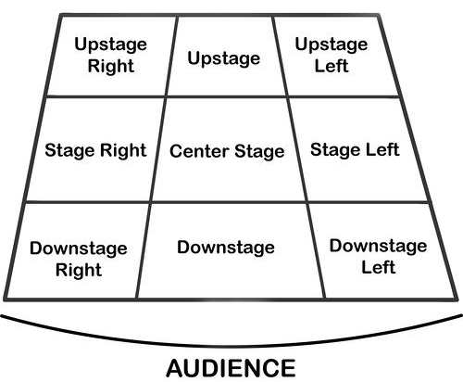
Performing Art
Key Word | Definition
Body Language | How an actor uses their body to communicate meaning. For example, crossing your arms could mean you are fed up
Gesture | a movement of the body, particularly the hands, arms, or head, that conveys meaning or expresses an idea, emotion, or intention
Levels | Levels can be used to show status, relationships, and even to indicate changes in location or time
Proxemics | The deliberate use of distance between you and other characters or objects to communicate something to an audience
Facial Expression | Using the face to express that characters feelings and emotions.
Key Word | Definition
Amphitheatre | Circular or oval open air theatre with a large ranked seating area
Apron | The apron is a section of the stage which the floor projects towards or into the auditorium
Black Box | A flexible studio theatre where the audience and actors are in the same room surrounded by black tabs
End On | Traditional audience seating layout where the audience is looking at the stage from the same direction.
Found Space | A performance space that wasn’t designed to be one e.g historic buildings
In the Round | Theatre in the Round is a form of audience seating layout where the acting area is surrounded on all sided by seating. There is often a number of entrances through the seating
Promenade | Form of staging where the audience moves around the performance space and sees the play at a variety of different locations
Proscenium Arch | The opening in the wall which stands between stage and auditorium in some theatres; the picture frame through the audience sees the play’ fourth wall’
Site-specific theatre | A piece of performance which has been deigned to work only in a particular non-theatre space
Stage Directions
Stage directions are from the performers perspective
13

Slide 16
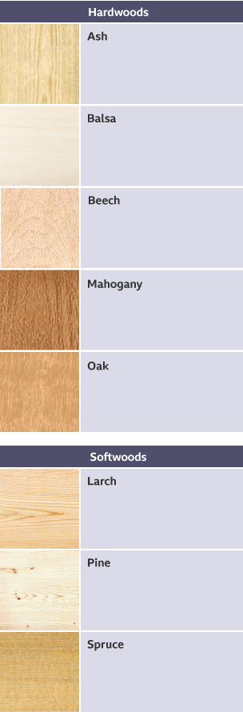
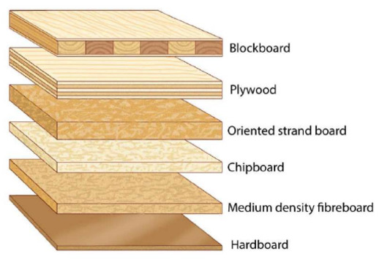
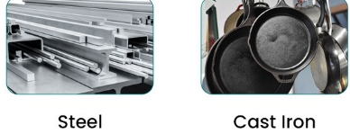
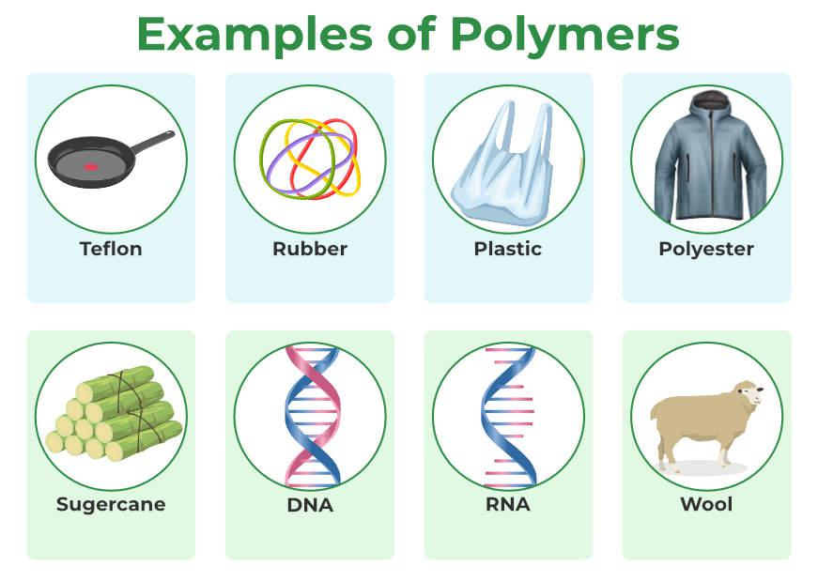
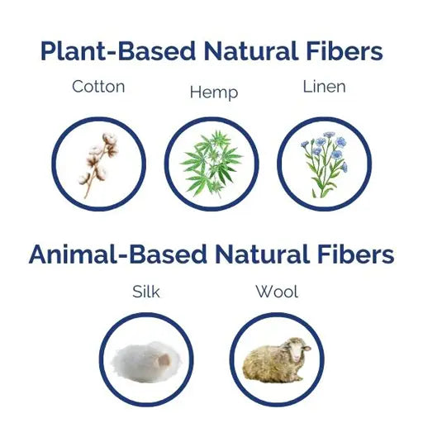
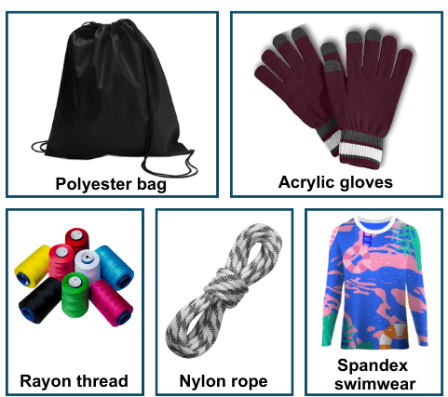
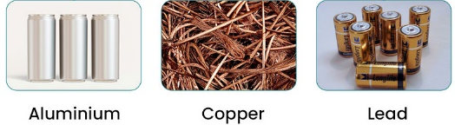
Design and Technology - RM
Year 9
Key Words | Definition
Alloys | A mixture of two or more metals to create a new material with improved properties.
Design Brief | A set of instructions given to a designer by a client.
Composite Materials | Made up of different materials which are combined to improve their properties.
Coniferous | Evergreen trees that bear cones.
Deciduous | Trees and shrubs that loose their leaves in the autumn.
Deforestation | The chopping down and removal of trees to clear an area of forest.
Evergreen | A tree or plant that keeps its leaves all year round.
Ferrous Metal | Metals that contain iron, are magnetic and rust.
Hardwood | Mainly have large broad leaves, which usually produce a seed or fruit.
Manufactured Boards | Man-made timber made from timber waste and adhesive.
Modern Materials | Material that have been engineered to have improved properties.
Polymer | Large molecule formed from many identical smaller molecules (monomers), can be natural or synthetic.
Key Words | Definition
Physical Properties | The traits a material has before it is used
Natural Fibres | Materials that come from animals or plants e.g. cotton - harvested from cotton plants.
Non-Ferrous Metal | Metals that do not contain iron, are not magnetic and do not rust.
Smart Material | Exhibit a physical change in response to some external stimuli.
Specifications | Document containing details of a product's required characteristics, processes, materials and other information needed to design product.
Softwoods | Come from coniferous trees and often have pines or needles.
Stimuli | A thing or event that evokes a specific functional reaction.
Synthetic Fibres | Man-made textile fibres created through chemical synthesis.
Technical textiles | Engineered materials designed for performance and functionality, rather than aesthetics, and are used across various industries.
Thermoforming | Can be heated and shaped, then heated and shaped again.
Thermosetting | Can only be heated and shaped once.
Working Properties | The material behaves when it is manipulated.
Hardwood
Softwood
Manufactured Boards
Ferrous Metals
Synthetic Polymer
Natural Plant Fibres
Man-Made Fibres
Non-Ferrous Metals
Natural Polymer
Natural Animal Fibres
14

Slide 17
W/c 3rd November Thinking definition: Thinking is making connections, reasoning and asking questions to make the learning stick
Reflecting on learning behaviours for thinking… | Experience log
 | Successful moment… | In hindsight… Where you could have done better on reflection? | At home…
I gave an idea and reasoned/justified.
I reflected on my idea and made it better after discussing with others
I used a revision strategy to help make the learning stick.
I made connections between what I am learning and the outside world.
I asked questions to deepen my understanding.
15

Slide 18
W/c 10th November Thinking definition: Thinking is making connections, reasoning and asking questions to make the learning stick
Reflecting on learning behaviours for thinking… | Experience log
 | Successful moment… | In hindsight… Where you could have done better on reflection? | At home…
I gave an idea and reasoned/justified.
I reflected on my idea and made it better after discussing with others
I used a revision strategy to help make the learning stick.
I made connections between what I am learning and the outside world.
I asked questions to deepen my understanding.
16

Slide 19
W/c 17th November Thinking definition: Thinking is making connections, reasoning and asking questions to make the learning stick
Reflecting on learning behaviours for thinking… | Experience log
 | Successful moment… | In hindsight… Where you could have done better on reflection? | At home…
I gave an idea and reasoned/justified.
I reflected on my idea and made it better after discussing with others
I used a revision strategy to help make the learning stick.
I made connections between what I am learning and the outside world.
I asked questions to deepen my understanding.
17

Slide 20
W/c 24th November Thinking definition: Thinking is making connections, reasoning and asking questions to make the learning stick
Reflecting on learning behaviours for thinking… | Experience log
 | Successful moment… | In hindsight… Where you could have done better on reflection? | At home…
I gave an idea and reasoned/justified.
I reflected on my idea and made it better after discussing with others
I used a revision strategy to help make the learning stick.
I made connections between what I am learning and the outside world.
I asked questions to deepen my understanding.
18

Slide 21
W/c 1st December Thinking definition: Thinking is making connections, reasoning and asking questions to make the learning stick
Reflecting on learning behaviours for thinking… | Experience log
 | Successful moment… | In hindsight… Where you could have done better on reflection? | At home…
I gave an idea and reasoned/justified.
I reflected on my idea and made it better after discussing with others
I used a revision strategy to help make the learning stick.
I made connections between what I am learning and the outside world.
I asked questions to deepen my understanding.
19

Slide 22
W/c 8th December Thinking definition: Thinking is making connections, reasoning and asking questions to make the learning stick
Reflecting on learning behaviours for thinking… | Experience log
 | Successful moment… | In hindsight… Where you could have done better on reflection? | At home…
I gave an idea and reasoned/justified.
I reflected on my idea and made it better after discussing with others
I used a revision strategy to help make the learning stick.
I made connections between what I am learning and the outside world.
I asked questions to deepen my understanding.
20

Slide 23
W/c 15th December Thinking definition: Thinking is making connections, reasoning and asking questions to make the learning stick
Reflecting on learning behaviours for thinking… | Experience log
 | Successful moment… | In hindsight… Where you could have done better on reflection? | At home…
I gave an idea and reasoned/justified.
I reflected on my idea and made it better after discussing with others
I used a revision strategy to help make the learning stick.
I made connections between what I am learning and the outside world.
I asked questions to deepen my understanding.
21

Slide 24
Reading Log w/c 3rd November (20 mins reading per day – all five logs MUST be completed)
Date | Title of novel | Number of pages read | Summary about what I have read
 |  |  | • • •
 |  |  | • • •
 |  |  | • • •
 |  |  | • • •
 |  |  | • • •
Checked by form tutor:
22

Slide 25
Reading Log w/c 10th November (20 mins reading per day – all five logs MUST be completed)
Date | Title of novel | Number of pages read | Summary about what I have read
 |  |  | • • •
 |  |  | • • •
 |  |  | • • •
 |  |  | • • •
 |  |  | • • •
Checked by form tutor:
22

Slide 26
Reading Log w/c 17th November (20 mins reading per day – all five logs MUST be completed)
Date | Title of novel | Number of pages read | Summary about what I have read
 |  |  | • • •
 |  |  | • • •
 |  |  | • • •
 |  |  | • • •
 |  |  | • • •
Checked by form tutor:
23

Slide 27
Reading Log w/c 24th November (20 mins reading per day – all five logs MUST be completed)
Date | Title of novel | Number of pages read | Summary about what I have read
 |  |  | • • •
 |  |  | • • •
 |  |  | • • •
 |  |  | • • •
 |  |  | • • •
Checked by form tutor:
27

Slide 28
Reading Log w/c 1st December (20 mins reading per day – all five logs MUST be completed)
Date | Title of novel | Number of pages read | Summary about what I have read
 |  |  | • • •
 |  |  | • • •
 |  |  | • • •
 |  |  | • • •
 |  |  | • • •
Checked by form tutor:
24

Slide 29
Reading Log w/c 8th December (20 mins reading per day – all five logs MUST be completed)
Date | Title of novel | Number of pages read | Summary about what I have read
 |  |  | • • •
 |  |  | • • •
 |  |  | • • •
 |  |  | • • •
 |  |  | • • •
Checked by form tutor:
25

Slide 30
Reading Log w/c 15th December (20 mins reading per day – all five logs MUST be completed)
Date | Title of novel | Number of pages read | Summary about what I have read
 |  |  | • • •
 |  |  | • • •
 |  |  | • • •
 |  |  | • • •
 |  |  | • • •
Checked by form tutor:
26

Slide 31
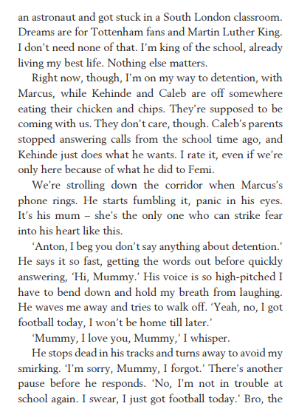
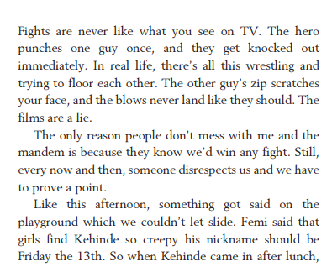
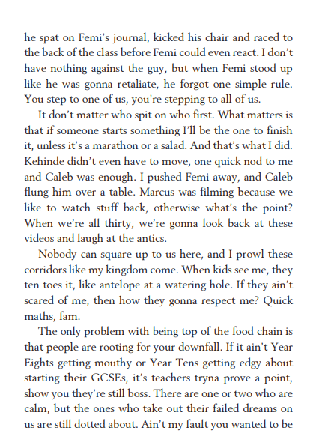
1. King of Nothing – Nathaniel Lessore
27

Slide 32
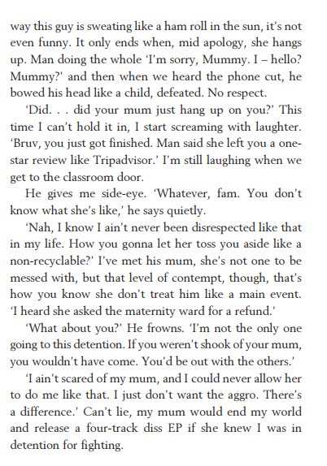
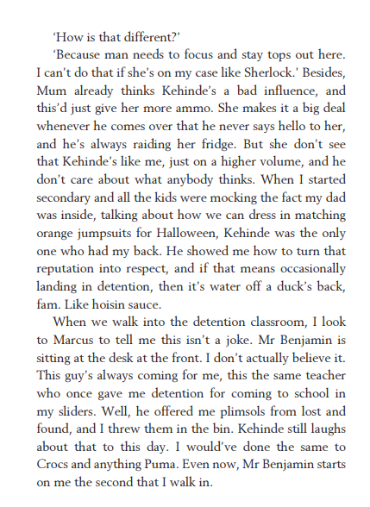
1. King of Nothing – Nathaniel Lessore
28

Slide 33
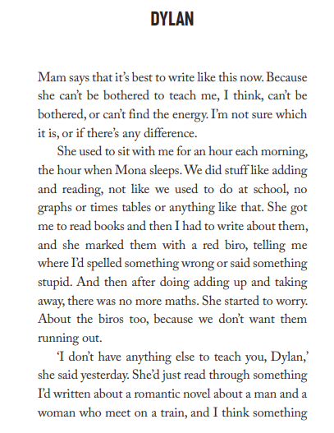
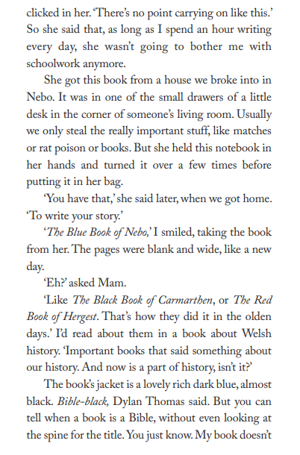
2. The Blue Book of Nebo – Manom Steffan Ros
Vocabulary:
Tarpaulin – A large sheet of strong, waterproof material used for covering things
Bonsai – A small tree grown in a pot and trained to stay miniature
29

Slide 34
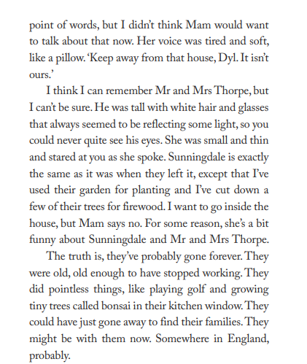
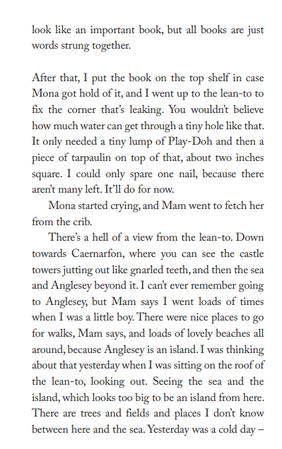
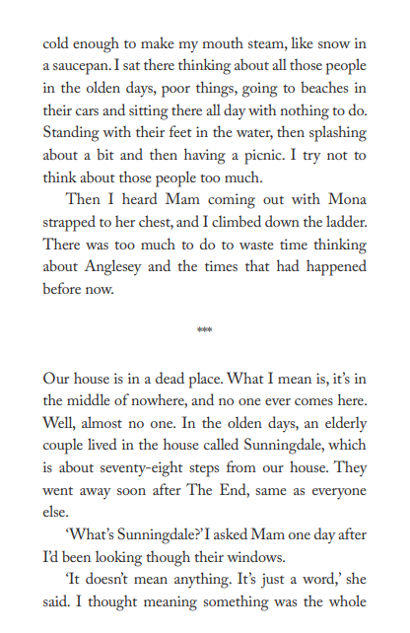
2. The Blue Book of Nebo – Manom Steffan Ros
30

Slide 35
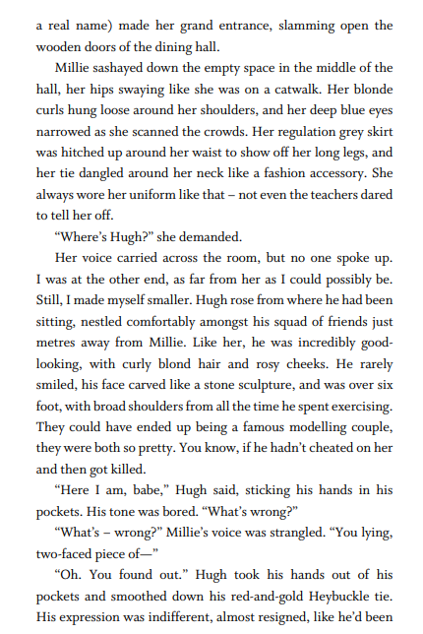
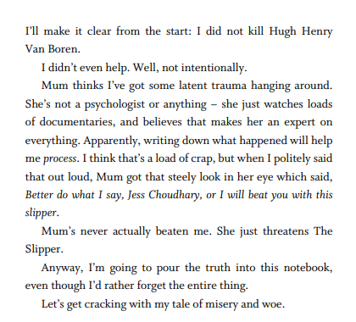
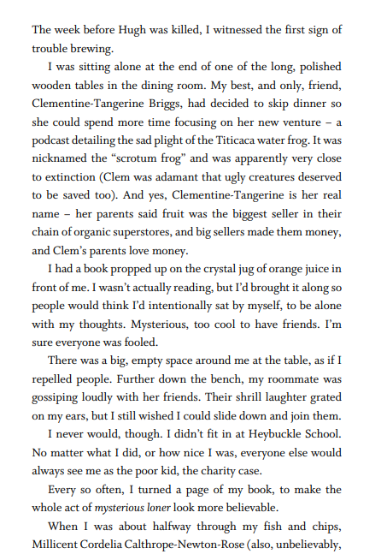
3. This Book Kills – Ravens Guron
31

Slide 36
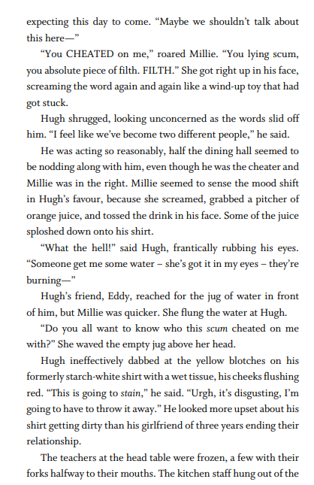
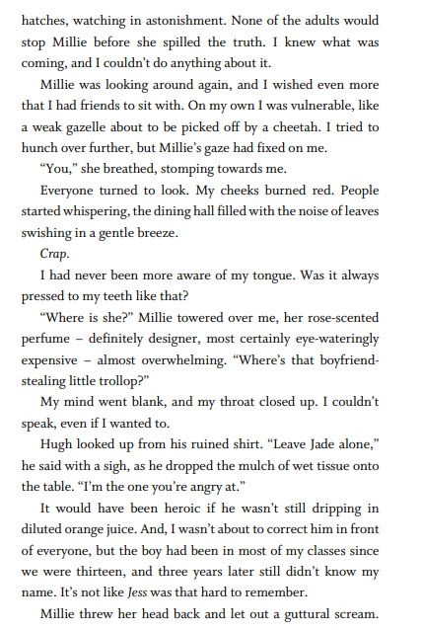
3. This Book Kills – Ravens Guron
Vocabulary:
Guttural – A deep, harsh sound made in the throat.
Tollpop – A sweet treat
31

Slide 37
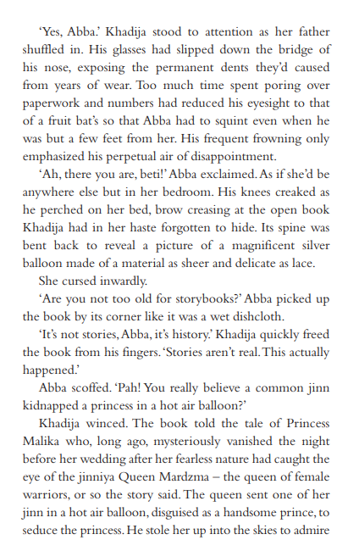
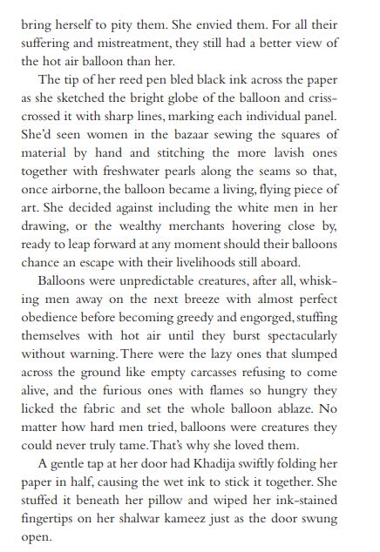
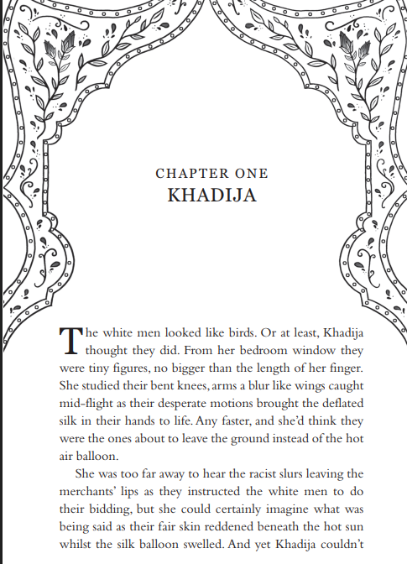
4. The Balloon Theif – Need Marafu
32

Slide 38
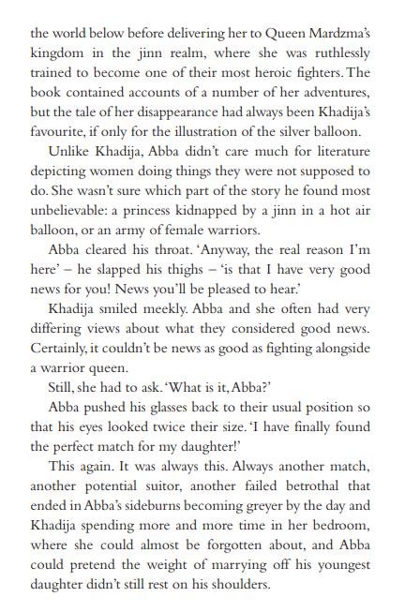
4. The Balloon Theif – Need Marafu
Vocabulary:
Faltered – Hesitated or lost strength.
Entrust – To give responsibility for something valuable.
Adorned – Decorated or made more beautiful.
33

Slide 39
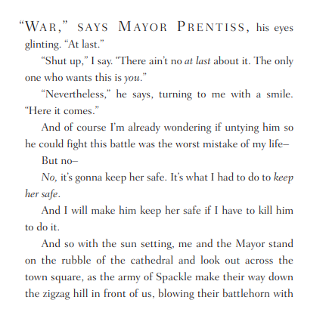
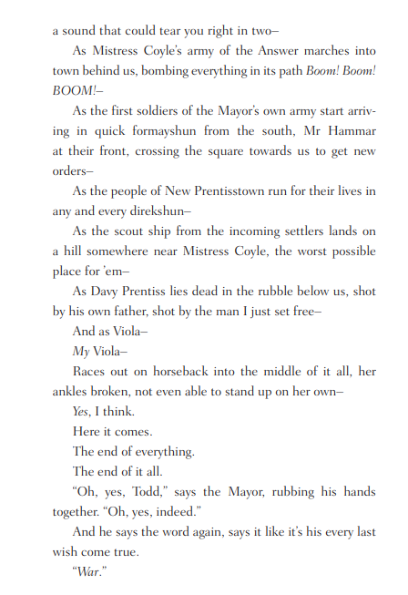
5. Monsters of Men – Patrick Ness
Vocabulary:
Glinting – Shining with small flashes of light
Unifying – Bringing together or making into one.
34

Slide 40
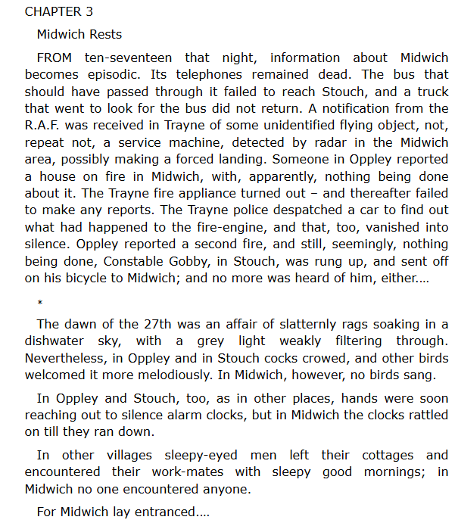
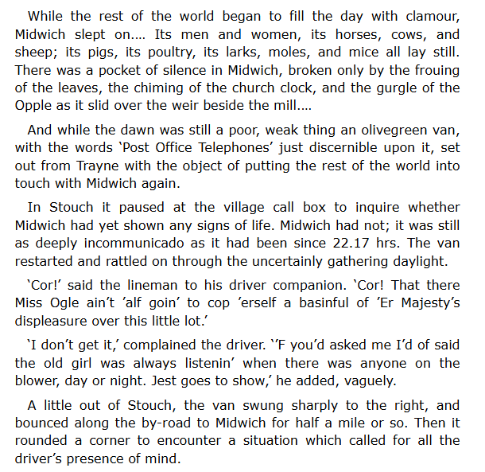
6. The Midwich Cuckoos – John Wyndham
35

Slide 41
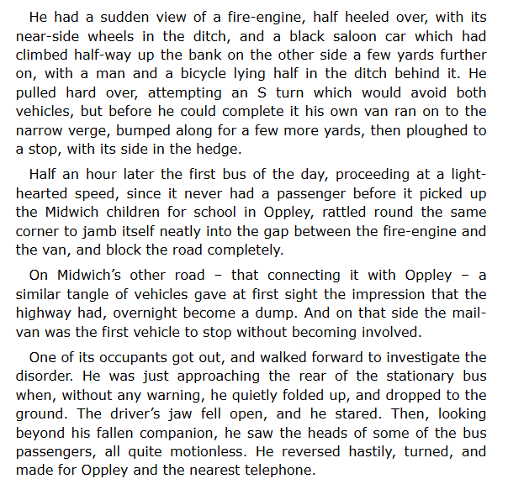
6. The Midwich Cuckoos – John Wyndham
Vocabulary:
Slatternly – Untidy or dirty in appearance.
Clamour – A loud and continuous noise.
Discernible – Able to be seen or recognized.
36

Slide 42
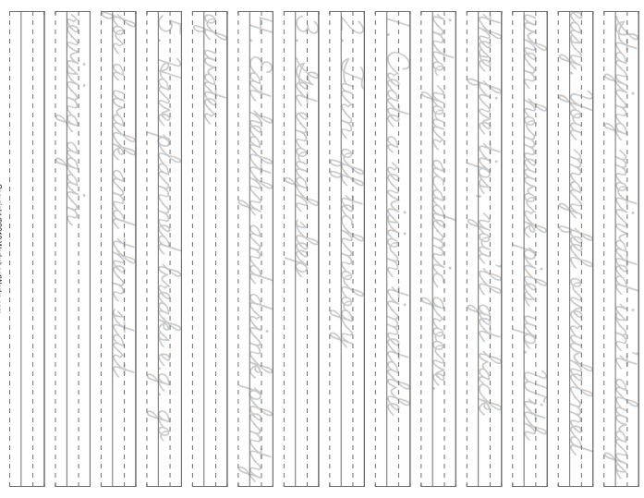
37

Slide 43
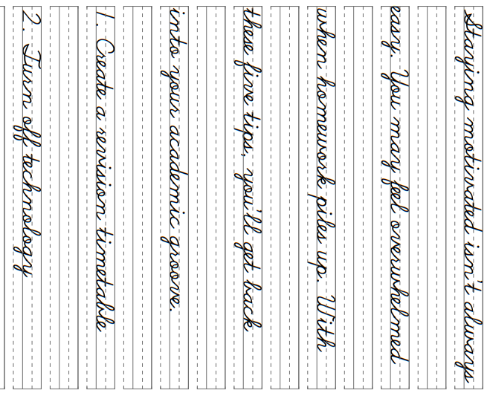
38

Slide 44
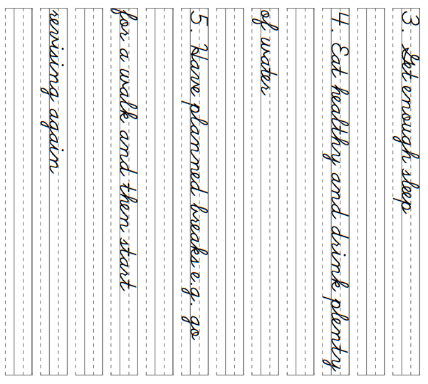
39

Slide 45
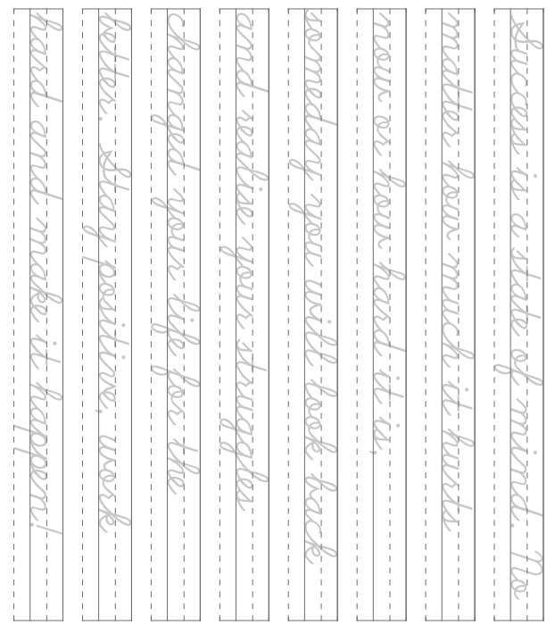
40

Slide 46
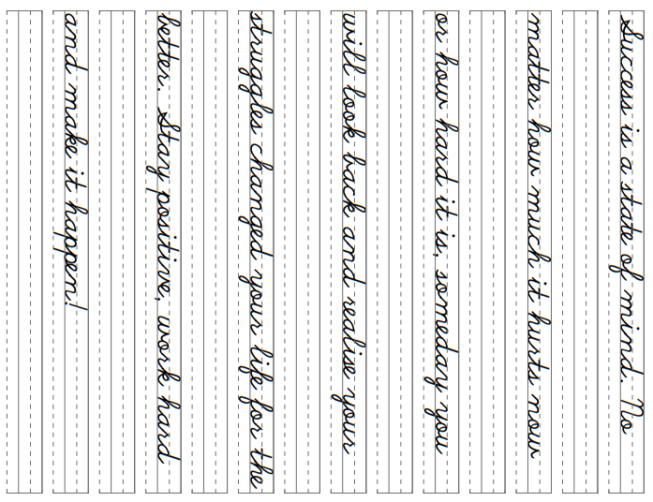
41

