Slide 1

Year 9 Knowledge Organiser HT3
Knowledge is Power
Name: ______________________________
Form: _______

Slide 2
Contents Page
Subject | Page
English | 1
Maths | 2
Science | 3
History | 4
Geography | 5
Spanish | 6
PE | 7
Performing Arts | 11
Computing | 12
Art | 13
Cooking and Nutrition | 14
Music | 15

Slide 3
English
Week 3 - Structure
5 Act play | A drama is often divided into five parts, or acts, which some refer to as a dramatic arc.
Exposition | The opening section where the setting is fixed in a particular place and time, the mood is set, and characters are introduced.
Rising Action | An exciting force or inciting event.
Climax | The climax is the turning point, which changes the protagonist's fate.
Falling Action | The tension decreases and it wraps up the narrative, resolves its loose ends, and leads toward the closure.
Denouement | The ending with some sort of resolution and the tying up of loose ends.
Week 5 – Literary Devices 2
Repetition | Repeated words or ideas.
Imagery | Creating a mental picture for the reader through appealing to the senses (smell, touch, taste, see, hear).
Simile | Comparing one thing to another.
Metaphor | Describes an object or action in a way that isn't literally true, but helps explain an idea or make a comparison.
Week 1- Form (Play)
Scene | A brief moment in a play consisting of dialogue and action.
Act | Several scenes following on from each other. Each act forms the different parts of the plot.
Stage Directions | An instruction in the script of a play, directing the movements of the actors, arrangement of scenery and details of any special effects.
Playwright | The writer of the play.
Soliloquy /Monologue | An act of speaking one’s thoughts aloud when by oneself or regardless of any hearers, especially by a character in a play.
Week 6 – Shakespeare’s Style
Verse | Speech written in poetic form.
Blank Verse | a formal poetic form where each foot of a line is stressed on the second syllable (de-DUM) and each has five feet creating IAMBIC PENTAMETER.
Prose | A form of written speech that reflects the style of ordinary speech without a rhythmic structure.
Iambic Pentameter | Usually spoken by characters who have a high status in society.
Genre | Shakespeare wrote his plays in three main categories: Comedies, Tragedies and Histories.
Week 4 – Literary Devices 1
Connotation | What a word makes the reader feel, think or imagine.
Symbolism | The way an object is given greater meaning within the novel so it has added importance.
Motif | A recurring symbol within the novel
Personification | Giving human characteristics to an inanimate object.
Allusion | A reference to a person, place or event without mentioning it directly. These are usually towards the bible, mythology or historical events.
Week 2 – Dramatic Devices
Foreshadowing | A device in which the writer gives a warning or indication about what will happen in the future.
Dramatic Tension | A sense of excitement or anticipation that the audience feels.
Dramatic Irony | When the audience are aware of a detail that the characters are not.
Low Comedy | A funny scene in an otherwise serious play that acts as comic relief for the audience.
1

Slide 4
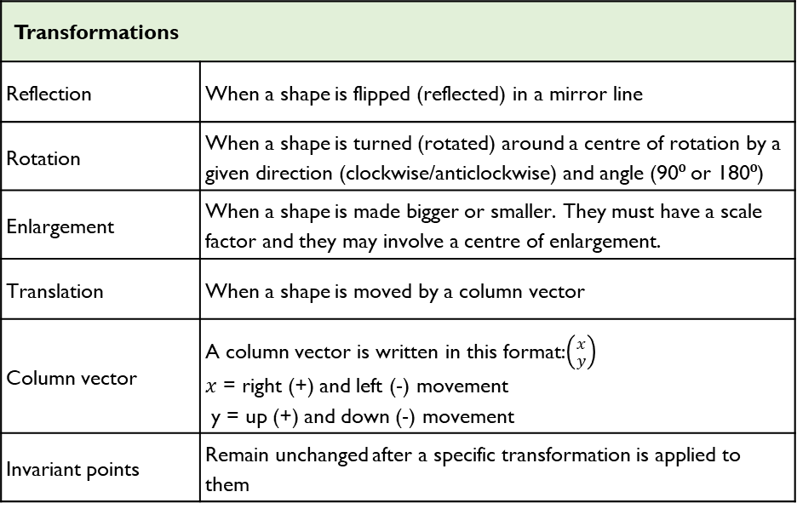
Maths
Transformations
Reflection | When a shape is flipped (reflected) in a mirror line
Rotation | When a shape is turned (rotated) around a centre of rotation by a given direction (clockwise/anticlockwise) and angle (90⁰ or 180⁰)
Enlargement | When a shape is made bigger or smaller. They must have a scale factor and they may involve a centre of enlargement.
Translation | When a shape is moved by a column vector
Column vector | A column vector is written in this format:$\left({x \atop y}\right)$ $x$ = right (+) and left (-) movement y = up (+) and down (-) movement
Invariant points | Remain unchanged after a specific transformation is applied to them
Straight Line Graphs
Table of values | A systematic way to represent the relationship between variables
X-axis | Horizontal axis (goes across)
Y-axis | Vertical axis (goes up)
Co-ordinate | Two numbers that locate a specific points on a grid (x, y)
Linear graph | A straight line on a graph
y = mx + c | This is the format of a linear graph (straight line). m = gradient, y = y-intercept
Gradient | The steepness of a line. The steeper the line, the higher the gradient.
Positive gradient | Line slopes upwards
Negative gradient | Line slopes downwards
y – intercept | Where the line crosses the y-axis
2

Slide 5
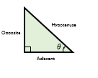
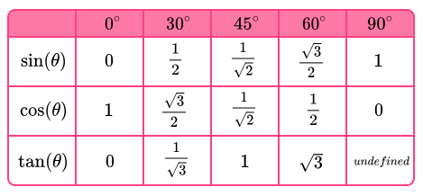
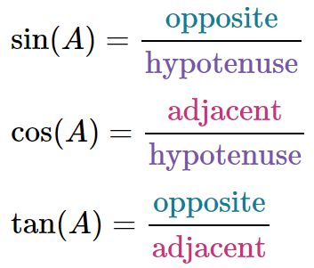
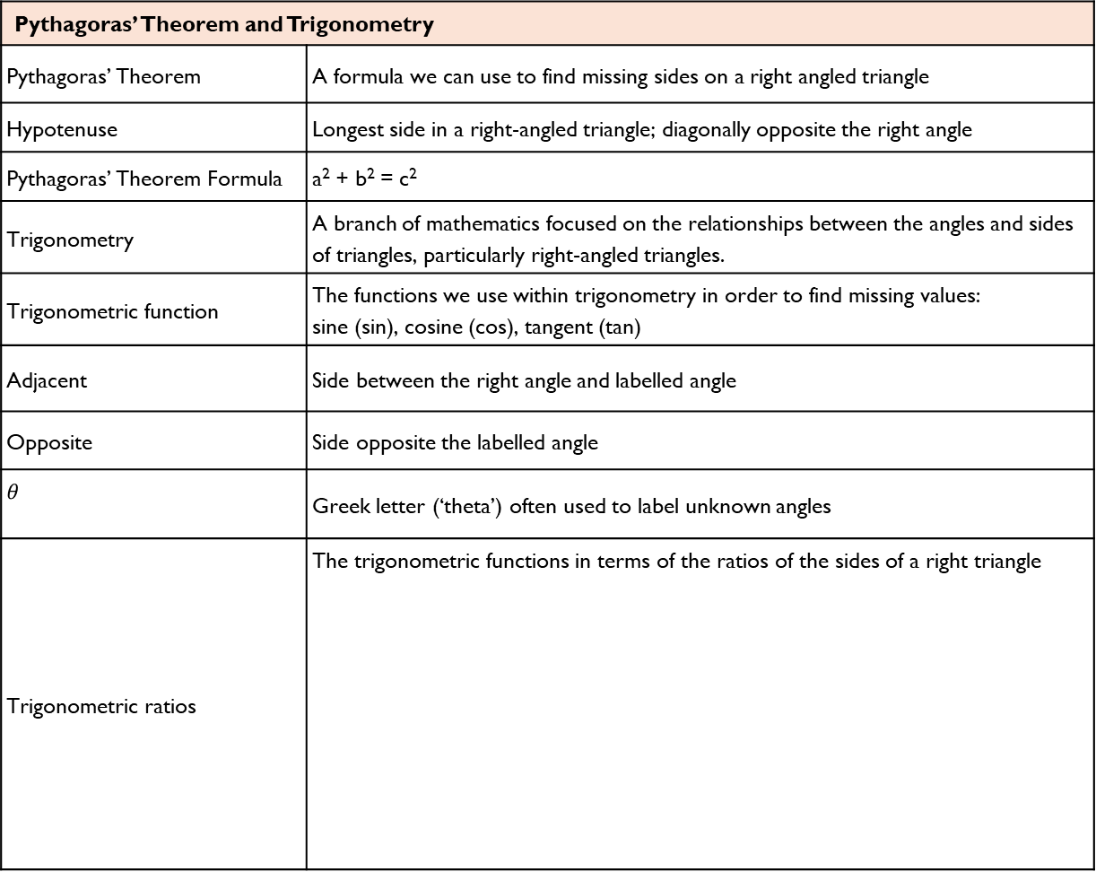
Maths
Pythagoras’ Theorem and Trigonometry
Pythagoras’ Theorem | A formula we can use to find missing sides on a right angled triangle
Hypotenuse | Longest side in a right-angled triangle; diagonally opposite the right angle
Pythagoras’ Theorem Formula | a² + b² = c²
Trigonometry | A branch of mathematics focused on the relationships between the angles and sides of triangles, particularly right-angled triangles.
Trigonometric function | The functions we use within trigonometry in order to find missing values: sine (sin), cosine (cos), tangent (tan)
Adjacent | Side between the right angle and labelled angle
Opposite | Side opposite the labelled angle
$$θ$$ | Greek letter (‘theta’) often used to label unknown angles
Trigonometric ratios | The trigonometric functions in terms of the ratios of the sides of a right triangle
Exact trigonometric values
Exact trig values | Are the exact trigonometric values for certain angles that you are expected to know
3

Slide 6
Science
Key Terms
Atom | The smallest part of an element that can exist
Element | Contains only one type of atom
Compound | Two or more elements chemically combined
Mixtures | Two or more elements or compounds not chemically combined together
Isotopes | Atoms of the same element with the same number of protons and different numbers of neutrons
Molecule | When two or more of the same element are joined together
Electron Shell | Electrons fit in shells around the nucleus in an order. The inner first shell is filled after 2 electrons, all the next shells take 8.
Periodic Table | A table showing the 100 or so elements arranged in an order
Atomic Number | The number of protons in an atom.
Atomic Mass | The number of protons and neutrons in an atoms nucleus
Metal | Shiny, hard elements that are found on the left of the periodic table
Non-Metals | Brittle elements that are found on the right of the periodic table
Alloys | Mixture of two or more elements at least one of which is a metal
Boiling point | Temperature at which substance changes from a liquid to a gas
Melting point | Temperature at which substance changes from a solid to a liquid
Key term | Definition
Delocalised electrons | Free moving electrons from the outer shell of metal atoms. Form a strong attraction with metal ions
Covalent bond | A shared pair of electrons between atoms
Simple covalent molecule | Substance that contains only a few non-metal atoms held together by covalent bonds
Ion | Particle with a charge, positive or negative
Ionic bond | Forms between metals and non-metals. Oppositely charged ions attract to form an ionic bond.
Ionic lattice | Regular arrangement of positive ions surrounded by negative ions
Electrostatic attraction | Force of attraction between oppositely charged ions
Intermolecular force | Relatively weak force of attraction between molecules that keeps them together
3

Slide 7
History
Key Terms
Ideology | A set of shared beliefs. In 1941, the USA and the Soviet Union had different ideologies concerning how a country should be governed and how its society should work.
Capitalism | Capitalists believe everyone should be free to own property and business and make money. The USAs economic ideology was capitalist.
Communism | Political system of the USSR (Russia). All property is owned by the community and each person contributes and receives according to their ability and needs.
Democracy | A system of government by the whole population or all the eligible members of a state, typically through elected representatives.
Satellite State | A nation that was once independent but is now under the control of another.
Colonialism | Economic, political, and cultural control of another country.
Veto | Forbid or refuse. Permanent members of the United Nations Security Council could stop resolutions being passed with a single ‘no’ vote.
Isolationism | Staying apart, not getting involved in the affairs of others. The USA followed this policy following World War One.
Containment | Limiting the spread of something. The USA used this policy to stop the spread of communism.
Key Terms
Conventional Weapons | Defined by the International Committee of the Red Cross as any weapons that are not nuclear, chemical or biological.
Nuclear Deterrent | Politicians thought countries would not use nuclear weapons if their enemy could reply with an equally devastating nuclear attack.
Ultimatum | A final demand, often backed up with a threat to take action.
Free City | A city with its own independent government.
Brinkmanship | Pushing disagreements to the point where there is a risk of war.
Non-Proliferation | Stopping the spread of something, usually weapons or armaments.
Doctrine | A belief or philosophy.
Detente | A period of peace between two groups that were previously at war or hostile to each other.
4

Slide 8
Geography
Key Word | Definition
Cold desert | Regions that have very short summers with long cold winters and low levels of precipitation (dry).
Glacier | A large body of compressed snow and ice that move s slowly.
Ice Sheet | Large continental mass of glacial ice.
Expedition | A journey undertaken by a group of people with the purpose of research, education or exploration.
Plankton | Microscopic organisms floating in the sea.
Extinct | Species which no longer exist.
Conservation | The preservation or protection of something e.g. a species, habitat etc.
Research Station | Purpose built facilities to conduct scientific investigations via collection and analysis of data.
Endangered species | A species of plant or animal which is at serious risk of extinction.
Isolines | lines drawn on a map connecting data points of the same value.
Invasive species | a species which has been introduced by humans but harms the environment.
Exploitation | treating something/one unfairly in order to gain a benefit.
Commercial fishing | catching fish and other seafood for large profits.
Natural resource | materials which occur naturally and used to make a financial gain/ profit.
Treaty | an agreement between two or more countries.
5

Slide 9
Spanish
Spanish | English
El español | Spanish
El inglés | English
Las ciencias | Science
Las matemáticas | Maths
Mi profe (de inglés) es… | My English teacher is…
joven | young
viejo/a | old
severo/a | strict
tolerante | easy-going
impaciente | impatient
paciente | patient
gracioso/a | funny
serio/a | serious
simpático/a | nice / friendly
antipático/a | unfriendly
más divertido/a que | more fun than
menos creativo/a que | less creative than
tan interesante como | as interesting as
Tengo que llevar… | I have to wear…
El uniforme | uniform
Cómodo/incómodo | Comfortable/uncomfortable
Spanish | English
Está prohibido… | It is forbidden…
No se permite… | You are not allowed…
No se debe… | You / One must not…
el estrés de los exámenes | exam stress
el acoso escolar | bullying
la presión del grupo | peer pressure
Mi instituto / colegio es… | My school is…
Mixto/ femenino/masculino | Mixed/ all girls / all boys
En mi escuela primaria… | In my primary school…
(no) había… | there was/were (not any)…
Las clases empiezan ... | Lessons start at…
y terminan a las… | and finish at…
Tenemos… clases | We have… lessons
al día /por la mañana /por la tarde | per day /in the morning/ in the afternoon
Cada clase dura… | Each lesson lasts...
el recreo/ la hora de comer | Break/lunch
lo bueno / malo es que… | the good / bad thing is that
lo mejor / peor es que… | the best /worst thing is that
mejora la disciplina | improves discipline
limita la individualidad | limits individuality
6

Slide 10
PE
Health and Fitness
Muscular Strength | The amount of the force muscles can generate against a resistance
Muscular Endurance | The ability to use voluntary muscles, over long periods of time without getting tired
Flexibility | The range of movement at a joint
Cardiovascular Fitness (Aerobic Endurance) | The ability of the heart and circulatory system to meet the demands of the body for a long period of time
Body composition | The percentage of a body that is fat, muscle, bone and water
Coordination | The ability to move two or more body parts at the same time
Reaction Time | The time taken for a response to occur after a stimulus
Agility | The ability to change direction at speed
Balance | The ability to keep the body steady when in a static position or when moving
Speed | The time taken to cover a set distance/complete a movement
Power | The ability to combine speed and strength
Principles of training
Progressive Overload | Working the body harder than normal/gradually increasing the amount of exercise you do
Reversibility | If training is not regular, adaptations will be reversed. This can happen when suffering from illness, injury or after an off season
Specificity | Training showed be matched to the requirements of the sport or position the performer is in. Training must be specifically designed to develop the right muscles, type of fitness or skills
Individual needs | All PEP’s would differ depending on performers goals/target, strengths /weaknesses, age/gender and current health/fitness levels
Overtraining | Occurs when you train too hard and do not allow the body enough rest/recovery time Signs include extended muscle soreness, frequent illness & increase injuries
7

Slide 11



PE
Skeletal System
Cardiovascular System
Muscular System
8

Slide 12
Key Word | Definition
Health and Fitness
Muscular Strength | The amount of the force muscles can generate against a resistance
Muscular Endurance | The ability to use voluntary muscles, over long periods of time without getting tired
Flexibility | The range of movement at a joint
Cardiovascular Fitness (Aerobic Endurance) | The ability of the heart and circulatory system to meet the demands of the body for a long period of time
Body composition | The percentage of a body that is fat, muscle, bone and water
Coordination | The ability to move two or more body parts at the same time
Reaction Time | The time taken for a response to occur after a stimulus
Agility | The ability to change direction at speed
Balance | The ability to keep the body steady when in a static position or when moving
Speed | The time taken to cover a set distance/complete a movement
Power | The ability to combine speed and strength
Principles of training
Progressive Overload | Working the body harder than normal/gradually increasing the amount of exercise you do
Reversibility | If training is not regular, adaptations will be reversed. This can happen when suffering from illness, injury or after an off season
Specificity | Training showed be matched to the requirements of the sport or position the performer is in. Training must be specifically designed to develop the right muscles, type of fitness or skills
Individual needs | All PEP’s would differ depending on performers goals/target, strengths /weaknesses, age/gender and current health/fitness levels
Overtraining | Occurs when you train too hard and do not allow the body enough rest/recovery time Signs include extended muscle soreness, frequent illness & increase injuries
PE
9

Slide 13

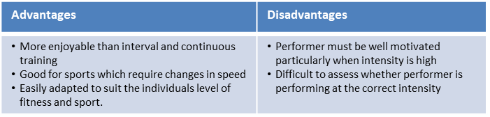
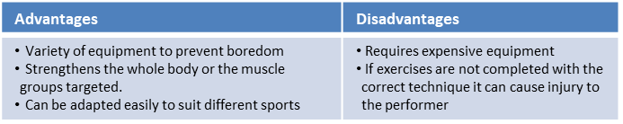
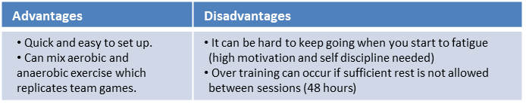
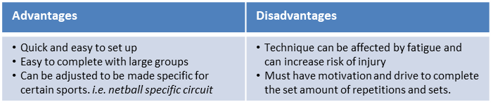
Key Word | Definition
Methods of training
Continuous training - | Involves a steady but regular pace at a moderate intensity (aerobic) which should last for at least 20 minutes. i.e. running, walking, swimming, rowing or cycling. Used by a marathon runner.
Fartlek training | Referred to as ‘speed play’ This is a form interval training but without rest. Involves a variety of changing intensities over different distances and terrains. i.e. 1 lap at 50% max, 1 lap walking, 1 lap at 80% (aerobic and anaerobic used) Used by games players – Hockey players
Weight/Resistance training | A form of training that uses progressive resistance against a muscle group. Used by cyclists. Muscular strength: High weight x low repetitions. Muscular endurance: Low weight x high repetitions
Interval training | Involves periods of work followed by periods of rest. i.e. Sprint for 20 metre + walk back to start. Used by a 200m sprinter
Plyometric training | Involves high-impact exercises that develop power. i.e. bounding/hopping, squat jumps. Used by long jumpers, 100 m sprinters or basketball players.
Circuit training | A series of exercises completed one after another. Each exercise is called a station. Each station should work a different area of the body to avoid fatigue. i.e. press ups, sit ups, squats, shuttle runs.
PE
10

Slide 14
Performing Arts
Blood Brothers
Themes
Social Class | Family and friendship for characters from two different social classes form the heart of the play.
Example | Russell shows how wealth brings privilege, even down to the way the Johnstone's and the Lyons are treated differently by the law.
Nature vs Nurture | The debate is about how much a life is determined by inherited genetics (their 'nature') and how much is determined by the environment ('nurture').
Example | The boys are identical twins and so the difference in the way their lives turn out must be a result of their different upbringings/social positions.
Money | Materialism as a theme. Mrs. Johnstone’s life in debt leads to problems. Mrs Lyons’ wealthy existence fails to bring her contentment.
Example | Once Edward returns from university as a wealthy, he cannot appreciate Mickey's reaction to being jobless. And nor can Mickey's pride allow him to accept financial help from Edward.
Growing Up | Life, for the children, is shown to be a carefree game in Act One. But the pressures of growing up are evident in Act Two.
Fate and Destiny | Mrs Lyons manipulates Mrs Johnstone’s superstitious character. Each of the leading characters are trapped by misfortune.
Drama Techniques
Dramatic Irony | The audience are aware throughout the entire play that both Mickey and Edward are twins, but the characters do not find out until the very last scene,
Monologue | a speech presented by a single character, most often to express their mental thoughts aloud
Split Scene | the term is used to describe two or more scenes which are performed on stage at the same time
Improvisation | something created spontaneously
Foreshadowing | be a warning or an indication of future events
The fourth wall | The Narrator and Mrs Johnstone break the fourth wall when they speak to the audience directly.
The features of tragedy | The tragic hero Hamartia - The fatal character flaw of the tragic hero Catharsis - The release of the audience's emotions through empathy with the characters. Internal Conflict - The struggle characters engage with over incidents/flaws
11

Slide 15
Computing
Promotional Designs
Promotion | A very important element of the Marketing Mix (4 P’s). How you will make the public aware of your product/service
Sales promotions | Can be used to: to get people into the shop, To sell off old stock, To boost sales, To attract new customers, increase market share
Digital Marketing
Direct mail | Brochures, flyers, letters sent directly to customers
Telemarketing | Phoning customers to tell them about the latest products
Digital | E-mails directly to existing customers—photos, descriptions etc. (Websites, emails, texts, social media Radio adverts, Spotify, adverts TV, adverts YouTube )
Catalogues | Latest products in the range and most up to date prices
Magazines | In-house magazines with products and stories relating to products, stores, locations
Methods
Coupons | A token or voucher in the packaging that can be traded for a discount
BOGOF | Buy one get one free (2 for the price of one)
Loyalty cards | Rewards for repeat custom. Customer build up points or stamps which can be exchanged for good later
Free samples | Encouraging to buy by giving small samples
Discounts | Money off the original price, e.g. 10% off
Branding | Using your recognised name, colours, font style, logo to help sales of new products
Celebrity endorsement | Using celebrities to be seen wearing, driving, using the product will make the public aware and push sales.
Advertising | Is used to: Persuade the customers to buy your product/ service b) To inform people about your products/ services
Print | Posters, newspapers, magazines
12

Slide 16
Art
Key Word | Definition
Clay | Clay is a natural earthy material (made from earth and water) that is sticky and easily moulded when wet and hard when baked to make bricks, pottery, and ceramics.
Kneading | Kneading is a step in preparing clay for shaping. It ensures the even distribution of moisture in the body of the clay and eliminates air bubbles.
Stages of Clay | There are six stages of clay: Slip, Plastic, Leather hard, Bone dry, Bisqueware and Glazeware.
Slip | Watered down clay that can be used as pottery glue.
Plastic | Clay you can easily mold and model.
Leather Hard | Clay that is somewhat dry. Good for carving.
Bone Dry | Clay that is dry and ready to be fired. It is very fragile. It can also be called greenware.
Bisqueware | Clay that has been fired once in the kiln. It can never be turned back into wet clay.
Glazeware | Clay that has been fired again with glaze.
Score | Using a tool to scratch and hatch over clay.
Slip and Score | Using slip as a “clay cement” between two scored pieces of clay.
Incised | Clay that is pushed in, carved out or decorated.
Applied | Clay that has been added .
Hand building | A ceramics technique that involves creating forms without a pottery wheel, using the hands, fingers, and simple tools.
Coil | created by combining different elements.
Pinch-pot | collection of images, materials, colour palettes, text and other elements that help to communicate your art and design concepts and ideas.
13

Slide 17
Cooking and Nutrition
Key Word | Definition
Sauce | A well flavoured liquid which has been thickened
Reduction | Simmering a liquid over heat until it thickens
Simmer | To cook food in a liquid that is just below boiling point, where the water is bubbling gently but not boiling
Cross contamination | Transfer of bacteria from one person, object or place to another
Eatwell Guide | A pictorial food guide showing the amounts and types of foods that are needed to make up a healthy balanced diet
Claw grip | A method of cutting food that ensures that the finger tips are tucked out of the way and will not get caught by the knife
Food poisoning | An illness caused by eating contaminated food
En papillote | When food is placed in a paper bag made with greaseproof or baking paper and baked in the oven
Recipe Amendment | Changing or altering a recipe eg changing some ingredients and/ or cooking methods
Seasonality | Foods that grow at certain times of the year and are dependent on the seasons for the correct weather and temperature required for growth
Ramadan | The month of fasting that is set by the Muslim calendar
Diwali | A Hindu feast that takes place in October or November
Kosher food | Food that is specified for a Jewish Diet
Vegan | Someone who does not eat meat or fish, or any animal products
14

Slide 18
Music
Key Word | Definition
Chords | A chord in music is a combination of three or more notes played simultaneously, forming the harmonic foundation of a piece.
Structure in pop | organization and arrangement of various song sections like verses, choruses, bridges, and the overall layout, creating the framework for the composition.
Harmony | is the combination of different musical notes played simultaneously, creating a rich and pleasing sound that adds depth and character to a musical piece.
Time signature | It tells you how many beats are in each measure and which note gets one beat, helping you keep track of the rhythm while playing or singing.
Dynamic | The volume of a sound or piece of music – loud/soft
A Round/Canon | A round, also called canon, is a musical composition with a minimum of three voices sing exactly the same melody at the unison but with each voice beginning at different times so that different parts of the melody coincide in the different voices, but nevertheless fit harmoniously together
Timbre | Each instrument own unique ‘tone quality’ and the voice as an instrument had different Timbre
The diaphragm | The diaphragm is basically the muscle below the human lungs and slightly above the stomach responsible for controlling inhalation and exhalation of breath. Most people have heard singers being advised to breathe using their diaphragm every time they sing
Texture | Sometimes voices sing different parts at the same time creating Harmony. Not all vocal music is accompanied by instruments, unaccompanied singing is called A Cappella.
Rhythm | Rhythm is the pattern of sounds and beats in music that creates a sense of movement and flow. It is like the heartbeat of a song that helps us feel the music and dance or sing along. Rhythm can be fast or slow, simple or complex, and is created by combining different beats and notes in a particular order. It is an essential element of music that makes it enjoyable and exciting to listen to.
Tempo | Tempo refers to the speed of music. It's how fast or slow a song sounds.
15

Slide 19
W/c 4th November Thinking definition: Thinking is making connections, reasoning and asking questions to make the learning stick
Reflecting on learning behaviours for thinking… | Experience log
 | Successful moment… | In hindsight… Where you could have done better on reflection? | At home…
I gave an idea and reasoned/justified.
I reflected on my idea and made it better after discussing with others
I used a revision strategy to help make the learning stick.
I made connections between what I am learning and the outside world.
I asked questions to deepen my understanding.

Slide 20
W/c 11th November Thinking definition: Thinking is making connections, reasoning and asking questions to make the learning stick
Reflecting on learning behaviours for thinking… | Experience log
 | Successful moment… | In hindsight… Where you could have done better on reflection? | At home…
I gave an idea and reasoned/justified.
I reflected on my idea and made it better after discussing with others
I used a revision strategy to help make the learning stick.
I made connections between what I am learning and the outside world.
I asked questions to deepen my understanding.

Slide 21
W/c 18th November Thinking definition: Thinking is making connections, reasoning and asking questions to make the learning stick
Reflecting on learning behaviours for thinking… | Experience log
 | Successful moment… | In hindsight… Where you could have done better on reflection? | At home…
I gave an idea and reasoned/justified.
I reflected on my idea and made it better after discussing with others
I used a revision strategy to help make the learning stick.
I made connections between what I am learning and the outside world.
I asked questions to deepen my understanding.

Slide 22
W/c 25th November Thinking definition: Thinking is making connections, reasoning and asking questions to make the learning stick
Reflecting on learning behaviours for thinking… | Experience log
 | Successful moment… | In hindsight… Where you could have done better on reflection? | At home…
I gave an idea and reasoned/justified.
I reflected on my idea and made it better after discussing with others
I used a revision strategy to help make the learning stick.
I made connections between what I am learning and the outside world.
I asked questions to deepen my understanding.

Slide 23
W/c 2nd December Thinking definition: Thinking is making connections, reasoning and asking questions to make the learning stick
Reflecting on learning behaviours for thinking… | Experience log
 | Successful moment… | In hindsight… Where you could have done better on reflection? | At home…
I gave an idea and reasoned/justified.
I reflected on my idea and made it better after discussing with others
I used a revision strategy to help make the learning stick.
I made connections between what I am learning and the outside world.
I asked questions to deepen my understanding.

Slide 24
W/c 9th December Thinking definition: Thinking is making connections, reasoning and asking questions to make the learning stick
Reflecting on learning behaviours for thinking… | Experience log
 | Successful moment… | In hindsight… Where you could have done better on reflection? | At home…
I gave an idea and reasoned/justified.
I reflected on my idea and made it better after discussing with others
I used a revision strategy to help make the learning stick.
I made connections between what I am learning and the outside world.
I asked questions to deepen my understanding.

Slide 25
W/c 16th December Thinking definition: Thinking is making connections, reasoning and asking questions to make the learning stick
Reflecting on learning behaviours for thinking… | Experience log
 | Successful moment… | In hindsight… Where you could have done better on reflection? | At home…
I gave an idea and reasoned/justified.
I reflected on my idea and made it better after discussing with others
I used a revision strategy to help make the learning stick.
I made connections between what I am learning and the outside world.
I asked questions to deepen my understanding.

Slide 26
Reading Log w/c 4th November (20 mins reading per day – all five logs MUST be completed)
Date | Title of novel | Number of pages read | Summary about what I have read
 |  |  | • • •
 |  |  | • • •
 |  |  | • • •
 |  |  | • • •
 |  |  | • • •
Checked by form tutor:

Slide 27
Reading Log w/c 11th November(20 mins reading per day – all five logs MUST be completed)
Date | Title of novel | Number of pages read | Summary about what I have read
 |  |  | • • •
 |  |  | • • •
 |  |  | • • •
 |  |  | • • •
 |  |  | • • •
Checked by form tutor:

Slide 28
Reading Log w/c 18th November (20 mins reading per day – all five logs MUST be completed)
Date | Title of novel | Number of pages read | Summary about what I have read
 |  |  | • • •
 |  |  | • • •
 |  |  | • • •
 |  |  | • • •
 |  |  | • • •
Checked by form tutor:

Slide 29
Reading Log w/c 25th November (20 mins reading per day – all five logs MUST be completed)
Date | Title of novel | Number of pages read | Summary about what I have read
 |  |  | • • •
 |  |  | • • •
 |  |  | • • •
 |  |  | • • •
 |  |  | • • •
Checked by form tutor:

Slide 30
Reading Log w/c 2nd December (20 mins reading per day – all five logs MUST be completed)
Date | Title of novel | Number of pages read | Summary about what I have read
 |  |  | • • •
 |  |  | • • •
 |  |  | • • •
 |  |  | • • •
 |  |  | • • •
Checked by form tutor:

Slide 31
Reading Log w/c 9th December (20 mins reading per day – all five logs MUST be completed)
Date | Title of novel | Number of pages read | Summary about what I have read
 |  |  | • • •
 |  |  | • • •
 |  |  | • • •
 |  |  | • • •
 |  |  | • • •
Checked by form tutor:

Slide 32
Reading Log w/c 16th December (20 mins reading per day – all five logs MUST be completed)
Date | Title of novel | Number of pages read | Summary about what I have read
 |  |  | • • •
 |  |  | • • •
 |  |  | • • •
 |  |  | • • •
 |  |  | • • •
Checked by form tutor:

Slide 33


Slide 34


Slide 35


Slide 36


Slide 37


Slide 38


Slide 39



Slide 40
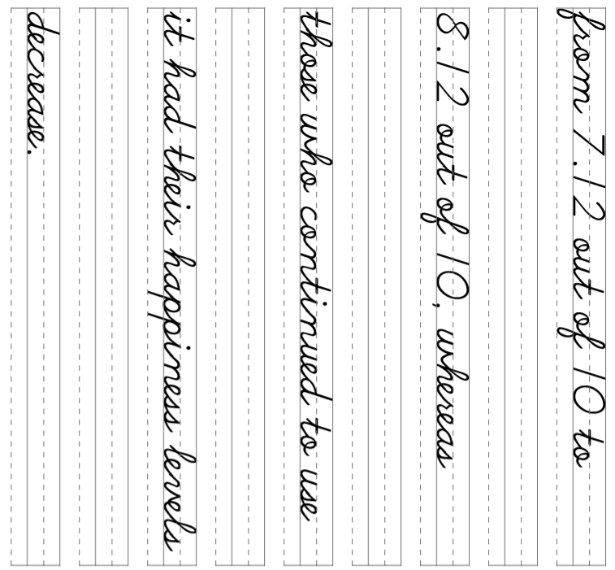

Slide 41
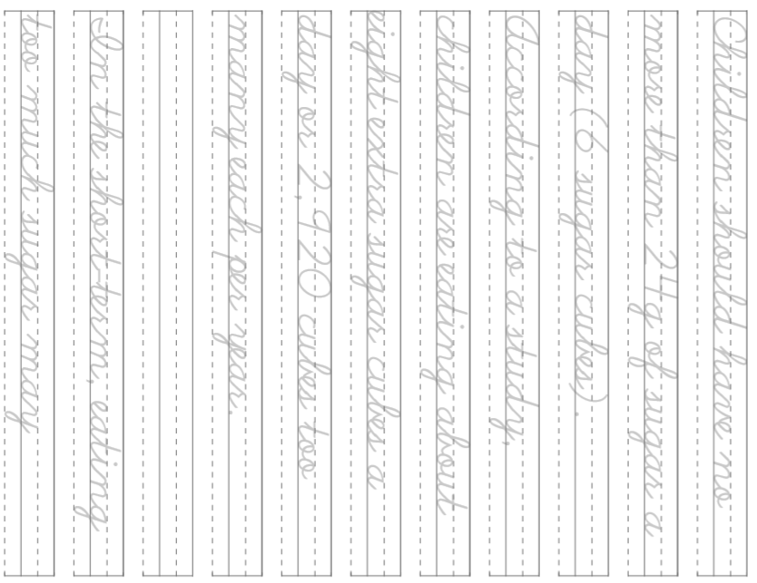

Slide 42
