Slide 1

Year 9 Knowledge Organiser HT4
Knowledge is Power
Name: ______________________________
Form: _______

Slide 2
Contents Page
Subject | Page
English | 1
Maths | 2
Science | 3
Spanish | 5
History | 6
Geography | 7
PE | 8
Computing | 12
Art | 13
Performing Arts | 14
Cooking and Nutrition | 15
Music | 16
DT | 17
‘Resilence’ reflection log | 18
Reading log | 23
Cursive Handwriting Practice | 28

Slide 3
English
Week 3 – Characters in AVFTB
Eddie Carbone | Main character, a working-class 'everyman' character.
Alfieri | A lawyer who represents the Italian community. He is the narrator and a 'bridge' between the Italian community and the rest of the US.
Beatrice | Eddie's wife and Catherine's mother's sister.
Catherine | Beatrice's niece who has been raised by Eddie and Beatrice
Rodolpho | A young and flamboyant immigrant from Italy.
Marco | Rodolpho's serious and hardworking older brother.
Week 5 – Spoken and Narrative Devices
Colloquial | Language used in conversation; not formal or literary.
Double negative | When a speaker uses two negatives for emphasis eg. 'you'll never get nowhere'.
Elision | When a sound or letter is left out, usually indicated with an apostrophe, eg 'I'm', 'let's'.
Interruption | When one character speaks over another character, usually cutting them off mid-line. Usually in order to suggest something about the relationship between the two characters.
Week 1 - Context
Arthur Miller | American playwright famous for Death of a Salesman, The Crucible and A View From The Bridge.
Red Hook | A suburb of Brooklyn in New York CIiy. A working-class neighbourhood with many immigrants.
Longshoremen | Workers who load and unload cargo ships often without a long-term contract.
Social Drama | A genre of play writing that tries to deal with common social problems.
Week 2 – Themes
Honour | Respect and regard in a community.
Loyalty | A strong feeling of support and allegiance to another person or group.
Omerta | A southern Italian code of silence and honour.
Community | A group of people who either live in the same place or have a characteristic in common.
Monologue | a speech presented by a single character.
Symbolism | a figure of speech in which a person, situation, word, or object is used to represent another thing
Dialect | a particular form of a language which is specific to a region or social group.
Frame story | a narrative that frames or surrounds another story or set of stories.
Week 4 – Modern Drama Terms
Term | Definition
Set design | The design of the physical space on stage where the action takes place.
Stage Directions | Sections of the script where the author states how it should be performed. Usually written in italics.
Dramatic Pause | When silence rather than speech is used to heighten tension.
Dramatic Irony | When the audience are aware of something a character on stage is not.
1
Notes:
Year 8 HT2

Slide 4
Maths
Compound Measures
Key Word | Definition
Compound Measures | Are types of measure that involve two or more different units.
Speed | Distance x time
Surface area and Volume
Key Word | Definition
Cross section | A cross section is the shape we get when cutting straight through an object
Prism | Is a 3D shape with the same cross section all the way through
Volume | The amount of 3-dimensional space something takes up
Surface Area | Is the area of all the faces on a 3D shape
Quadratic Graphs
Key Word | Definition
Table of values | Used to generate the co-ordinates for the graph
Quadratic equation | Has an x² in the equation as the highest power
Quadratic graphs | Is a curve with a vertical line of symmetry
Parabola | The name of the curved shaped made by the graph
Turning point | The maximum of minimum point of the curve given as a co-ordinate
Roots | The x values where the parabola crosses the x axis
2

Slide 5
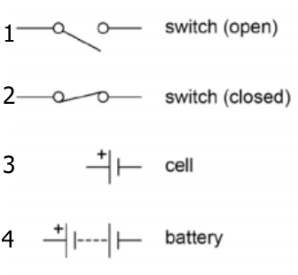
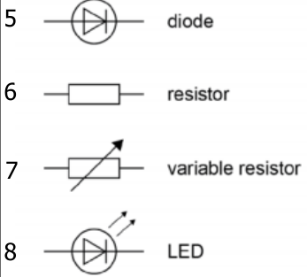
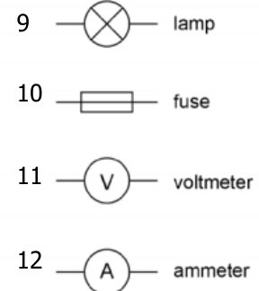
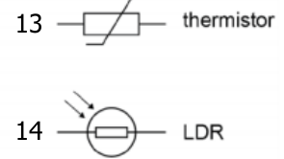
Science
Equations to learn
Q = I x t | Charge flow = current x time | Charge flow - coulomb (C) Current – amperes (A) Time – seconds (s)
V = I x R | Potential difference = current x resistance | Potential difference – volts (V) Current – amperes (A) Resistance – ohms (Ω)
P = V x I | Power = potential difference x current | Power – watt (W) Potential difference – volts (V) Current – amperes (A)
P = I² x R | Power = current2 x resistance | Power – watt (W) Current – amperes (A) Resistance – ohms (Ω
E = P x t | Energy transferred = power x time | Energy = joules (J) Power – watt (W) Time – seconds (s)
E = Q x V | Energy transferred = charge flow x potential difference | Energy = joules (J) Charge flow - coulomb (C) Potential difference – volts (V)
Definitions
Potential difference | The potential difference between two points in an electric circuit is the work done when a coulomb of charge passes between the points. Potential difference causes charge to flow
Resistance | Resistance is caused by anything that opposes the flow of electric charge.
Charge | Anything charged that is able to move within a circuit. Electrons or ions
Alternating current | The current regularly changes direction e.g. mains electricity
Direct current | The current flows in one direction only e.g. batteries.
Mains electricity | UK mains is an alternating current of 230V and at a frequency of 50Hz.
National grid | A series of cables and transformers linking power stations to consumers.
Step up transformer | Increases the potential difference for transmission across power cables. This reduces the current and therefore less heat is lost from the cables. This makes the National Grid efficient.
Step down transformer | Reduces the potential difference from the cables to 230V for use by consumers.
Circuit Symbols
3

Slide 6
Science
Definitions
Tissue | A group of cells with a similar structure and function e.g. muscle tissue
Organ | A group of tissues performing a specific function e.g. heart, leaf
Organ system | A group of organs that perform a specific function e.g. digestive system.
Enzyme | A biological catalyst that can speed up the rate of reaction without being used itself. Made of a large protein molecule.
Substrate | The chemical that fits into the active site of an enzyme.
Lock and key model | Only one type of substrate can fit into the active site of an enzyme, like a key fits into a lock.
Denatured | When the active site of an enzyme changes shape and the substrate can no longer fit in. Can be caused by pH or temperature.
Chemical involved in digestion you must learn:
Hydrochloric acid | Acid with pH of 2 produced by the stomach. Unravels proteins.
Bile | Emulsifies fats (turns them into droplets to give a greater surface area). It is alkaline so neutralises acid from the stomach. Produced in liver, stored in gall bladder and is released into the small intestine.
Human Digestive Enzymes
Enzyme | Function | Sites of production | Sites of action
Amylase | Breaks starch into sugars. | Salivary glands Pancreas Small intestine | Mouth Small intestine
Protease | Breaks proteins into amino acids. | Stomach Pancreas Small intestine | Stomach Small intestine
Lipase | Breaks lipids (fats) into fatty acids and glycerol. | Pancreas Small intestine | Small intestine
Chemical Tests
Biological molecule | Chemical test that is carried out: | Positive result will show:
Starch | Add orange/brown iodine solution. | Colour turns to blue/black.
Sugar (glucose) | Add blue Benedict’s solution. Place in a boiling water bath for 5 minutes. | Colour turns green/ yellow/ orange/ brick red.
Protein | Add blue Biuret solution. | Colour turns to lilac/ purple.
Lipid | Add ethanol and decant into water. | Cloudy white emulsion.
4

Slide 7
Yr 9 Spanish
Spanish | English
personalidad | personality
alegre | cheerful
gracioso | funny
listo | clever
nervioso | nervous
perezoso | lazy
serio | serious
simpático | nice, friendly
tonto | Silly
paciente | Patient
contento/a | happy
tímido/a | shy
bonito | pretty
delgado | slim
deportivo | sporty
feo | ugly
gordo | fat
Spanish | English
guapo | Good-looking
hermoso | Beautiful
joven | Young
largo | Long
pequeño | Small
rubio | Blonde
gafas | Glasses
ojos | Eyes
pelo | hair
familia | Family
menor | Younger
mayor | older
Abuelo/a | Grandfather/grandmother
hermano/ | Brother
hermana | sister
Hijo | Son
hija | daughter
5

Slide 8
History
Key Terms
Ideology | A set of shared beliefs. In 1941, the USA and the Soviet Union had different ideologies concerning government and society.
Capitalism | Capitalists believe everyone should be free to own property and business and make money. The USA was capitalist.
Communism | All property is owned by the community and each person contributes and receives according to their ability and needs.
Democracy | A system of government by the whole population or all the eligible members of a state, typically through elected representatives.
Satellite State | A nation that was once independent but is now under the control of another.
Isolationism | Staying apart, not getting involved in the affairs of others. The USA followed this policy following World War One.
Containment | Limiting the spread of something. The USA used this policy to stop the spread of communism.
Conventional Weapons | Defined by the International Committee of the Red Cross as any weapons that are not nuclear, chemical or biological.
Nuclear Deterrent | In the Cold War, many politicians believed countries would not use nuclear weapons if their enemy could do the same
Ultimatum | A final demand, often backed up with a threat to take action.
Free City | A city with its own independent government.
Brinkmanship | Pushing disagreements to the point where there is a risk of war.
Doctrine | A belief or philosophy.
Key Events/ Individuals
Long and Novikov Telegrams 1946 | USA and USSR used ambassadors to secretly report on the other country. Both reported fears that they were building up their armies.
Truman Doctrine 1947 | President Truman said communism was a threat to freedom - the USA had the right to use its military and economy to fight the spread of communism.
Marshall Plan 1947 | USA offered $13 billion of aid to Europe to stop communism. This upset the USSR who thought USA was trying to bride its satellite states.
The Berlin Blockade (1947-1948) | USSR worried the Western allies were trying to unite West Germany into Trizonia. Blocked all road, rail and canal access to force them out of West Berlin. USA airlift supplies for 11 months.
The Berlin Wall | 12 August 1961 East German Leader Ulbricht ordered a barbed wire fence around West Berlin. Soon grew to 165km, cutting through streets and even buildings.
The Cuban Missile Crisis 1962 | Khrushchev sent nuclear missiles to Cuba to help defend from future US attacks. USA discovers them in 1962 and Kennedy decides to blockade Cuba to stop missiles arriving from USSR
Joseph Stalin | Leader of the Soviet Union from 1924 until 1953. He was instrumental in the Soviet Union’s becoming a superpower.
Harry Truman | President of the USA and best known for establishing the policy of “containment” to prevent the spread of communism.
Nikita Khrushchev | Leader of the Soviet Union after Stalin who wanted to improve relations with the West in order to avoid nuclear war.
John F Kennedy | USA President remembered for his strong stance against Soviet expansionism, massive military build-up to counter Soviet aggression
6

Slide 9
Geography
Key Word | Definition
Agribusiness | intensive farming aimed at maximizing the amount of food produced
Carbon footprint | measurement of the greenhouse gases individuals produce, through burning fossil fuels
Development | the progress of a country in terms of economic growth, the use of technology and human welfare
Energy conservation | reducing energy consumption by using less energy and existing sources more efficiently
Energy mix | the range of energy sources of a region or country, both renewable and non-renewable
Energy security | uninterrupted availability of energy sources at an affordable price
Food miles | the distance covered supplying food to consumers
Fossil fuels | a natural fuel such as coal or gas, formed in the geological past from the remains of living organisms
Fracking | the process of extracting gas from gas shale where fluids at high pressure are injected to fracture the shale rock, allowing the gas to escape
Grey water | recycled domestic waste water
Organic produce | food produced without the use of chemicals such as fertilisers and pesticides
Renewable energy | a resource that cannot be exhausted, e.g. wind, solar and tidal energy
Resources | a stock or supply of something that has value or a purpose
Resource management | control and monitoring of resources so that they do not become exhausted
Undernourishment | a food intake below that needed to sustain a healthy life
Undernutrition | when people do not eat enough nutrients to cover their needs for energy and growth, or to maintain a healthy immune system
Water deficit | when demand for water is greater than supply
Water quality | measured in terms of the chemical, physical and biological content of the water
Water stress | when the demand for water exceeds supply in a certain period, or when poor quality restricts its use
Water surplus | when the supply of water is greater than demand for water
Water transfer | matching supply with demand by moving water from an area with water surplus to another area with water deficit
7

Slide 10
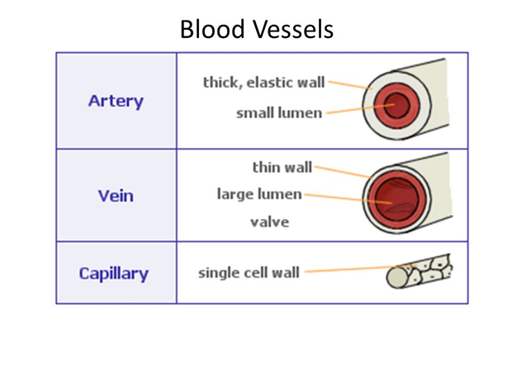
PE
Cardiovascular system – Blood vessels
There are three types of blood vessels found in the body:
Artery | It’s structure is; thick, muscular elastic walls, small lumen, high pressure. It’s function is to take blood away from the heart
Vein | It’s structure is; Thin, little muscle in walls, non elastic, large lumen, pocket valves, low pressure. . It’s function is to bring blood into the heart
Capillary | It’s structure is; Very thin walls (1 cell), very small lumen. It’s function is to Form networks around muscle and tissue and allow gaseous exchange
8

Slide 11



PE
Skeletal System
Cardiovascular System
Muscular System
9

Slide 12
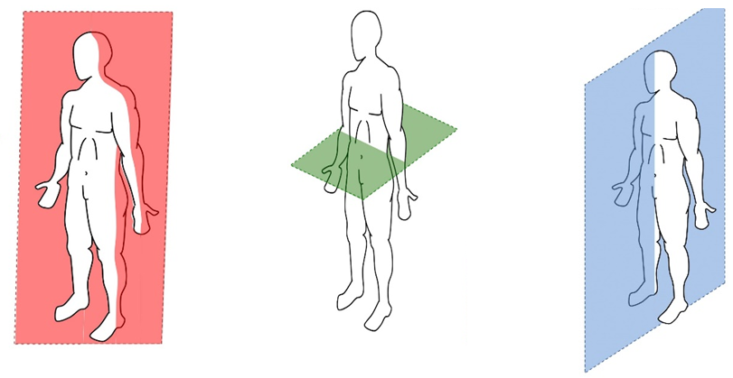
PE
BIOMECHANICS - Planes and axes for movement
Plane | An imaginary line that divides the body into two
Frontal Plane (left picture) | A vertical plane that divides the body into front and back.
Transverse plane (middle picture) | A horizontal plane that divides the body into upper and lower halves.
Sagittal plane (right picture) | A vertical plane that divides the body into right and left sides.
10

Slide 13
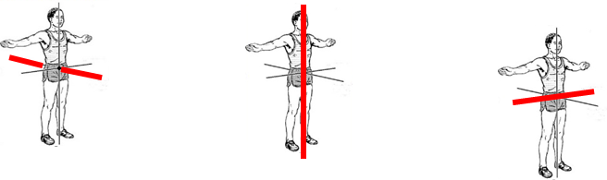
PE
BIOMECHANICS - Planes and axes for movement
PAxes for movement | An axis is an imaginary line at right angles to the plane
Sagittal axis (left picture) | Runs through the body horizontally from the back to front.
Vertical axis (middle picture) | Runs through the body vertically from the top to bottom.
Frontal axis (right picture) | Runs through the body horizontally from the left to right.
11

Slide 14
Computing
Key Word | Definition
Algorithm | A set of instructions presented in a logical sequence.
IDE | Integrated Development Environment. Provides programmers with tools to help create programs.
Syntax | A set of rules for writing code correctly.
Sequence | Structuring code into a logical, sequential order.
Selection | Decision making using IF statements.
Iterations | Repeating code using FOR or WHILE loops.
Variables | A named location used to store data. They can be change as the program runs.
Key Word | Definition
Data types | Instructions to tell the computer what kind of data is being stored.
Casting | Changing a variable from one data type to another.
IF statement | Used to check if a condition is true.
ELIF statement | It checks another condition if the previous was false.
ELSE statement | A condition that runs when none of the previous conditions are true.
FOR loop | Code that repeats a set number of times. Also known as count-controlled loop.
WHILE loop | Code that repeats while a condition is true. Also known as condition-controlled loop.

Slide 15
Art
Key Word | Definition
Mark-making techniques | describes the different lines, dots, marks, patterns and textures created in a drawing. It can apply to any drawing materials. It can be loose and expressive or controlled and neat. The results will depend on your choice of media, tools and techniques
Graduated Tone | is a tone that fades smoothly from one shade to another across an area. They are often made by varying the pressure on the tool used to make the tone, but can also be made by using overlapping layers of the medium used to make the tone.
Tonal contrast | the range of tones used in a drawing. A wider range means a greater contrast. You can manipulate the contrast depending on how much you want the object or specific part of the art work to stand out. If you are drawing from observation, the contrast can depend on how bright your light source.
Highlight | the area of an object where the light effects is most intense. In painting the highlight of an object should not be pure white as it should contain some of the local colour of the object. White highlights refer to pure reflected light as for example occur on a metal object, but do not occur on or are reflected from coloured glass.
Proportion | refers to the relationship between the different sized components within one whole composition. Proportion can be used to make a composition appear more realistic or more stylised depending on the type of proportion used.
Texture | concerns the surface quality of a piece of work. In three-dimensional artwork, the term refers to how the piece feels when it's touched. In two-dimensional artwork, texture invokes the visual 'feeling' the piece gives off.
Outline | Lines that are used to define the shape or form of an object or to show key details are called outlines.
Mixed-Media | refers to a visual art form that combines a variety of media in a single artwork.
Graphite | a form of carbon and is useful as a writing and drawing tool, as only the slightest pressure is needed to leave a mark. It leaves a shiny metallic grey colour on a surface when moved across it and can be removed with an eraser.
Fine Liner | pens with plastic or fine fibre needle-point tips that generally use water-based ink but sometimes use oil-based. Tips come in various thicknesses but are all relatively thin — hence the name 'fineliner'. They are ideal for drawing, sketching, illustration, technical drawing.
Opaque | not able to be seen through; not transparent.
Mono Printing | The monoprint is a form of printmaking where the image can only be made once, unlike most printmaking which allows for multiple originals
Exquisite Corpse | Cadavre exquis (exquisite corpse) is a collaborative drawing approach first used by surrealist artists to create bizarre and intuitive drawings
Hybrid | created by combining different elements.
Mood board | collection of images, materials, colour palettes, text and other elements that help to communicate your art and design concepts and ideas.
Design ideas | the core idea (s) driving the design of a product or final outcome, explained through a sketches, images, and annotation.
13

Slide 16
Performing Arts
Blood Brothers
Themes
Social Class | Family and friendship for characters from two different social classes form the heart of the play.
Example | Russell shows how wealth brings privilege, even down to the way the Johnstone's and the Lyons are treated differently by the law.
Nature vs Nurture | The debate is about how much a life is determined by inherited genetics (their 'nature') and how much is determined by the environment ('nurture').
Example | The boys are identical twins and so the difference in the way their lives turn out must be a result of their different upbringings/social positions.
Money | Materialism as a theme. Mrs. Johnstone’s life in debt leads to problems. Mrs Lyons’ wealthy existence fails to bring her contentment.
Example | Once Edward returns from university as a wealthy, he cannot appreciate Mickey's reaction to being jobless. And nor can Mickey's pride allow him to accept financial help from Edward.
Growing Up | Life, for the children, is shown to be a carefree game in Act One. But the pressures of growing up are evident in Act Two.
Fate and Destiny | Mrs Lyons manipulates Mrs Johnstone’s superstitious character. Each of the leading characters are trapped by misfortune.
Drama Techniques
Dramatic Irony | The audience are aware throughout the entire play that both Mickey and Edward are twins, but the characters do not find out until the very last scene,
Monologue | a speech presented by a single character, most often to express their mental thoughts aloud
Split Scene | the term is used to describe two or more scenes which are performed on stage at the same time
Improvisation | something created spontaneously
Foreshadowing | be a warning or an indication of future events
The fourth wall | The Narrator and Mrs Johnstone break the fourth wall when they speak to the audience directly.
The features of tragedy | The tragic hero Hamartia - The fatal character flaw of the tragic hero Catharsis - The release of the audience's emotions through empathy with the characters. Internal Conflict - The struggle characters engage with over incidents/flaws
14

Slide 17
Cooking and Nutrition
Year 9
Key Word | Definition
Food contamination | The presence of unwanted foreign body in food that can cause illness or harm
Physical contamination | When something that can be seen visibly, falls into the food
Chemical contamination | When chemicals such as cleaning agents or pest control products get into the food
Cross contamination | Transfer of bacteria from one person, object or place to another
Eatwell Guide | A pictorial food guide showing the amounts and types of foods that are needed to make up a healthy balanced diet
Claw grip | A method of cutting food that ensures that the finger tips are tucked out of the way and will not get caught by the knife
Food poisoning | An illness caused by eating contaminated food
Nutrients | Chemicals found in food that are needed for body functions
Recipe Amendment | Changing or altering a recipe eg changing some ingredients and/ or cooking methods
Macro Nutrients | Nutrients that are needed in the body in large amounts – Protein, carbohydrates, fats
Micro Nutrients | Nutrients that are needed in the body in small amounts – Minerals and vitamins
Boning Knife | A knife that is used to remove bones from poultry, meat and fish. It tend to have a narrow blade that ends at a sharp tip.
15

Slide 18



Music
Key Word | Definition
Drop | a point in a music track where a sudden change of rhythm or bass line occurs, which is preceded by a build-up section and break.
Structure | the order the different sections of a song or piece of music are played in.
Harmony | is the combination of different musical notes played simultaneously.
Time signature | It tells how many beats are in each measure and which note gets one beat, helping you keep track of the rhythm while playing or singing.
Dynamic | The volume of a sound or piece of music – loud/soft
Beat | a regular, repeating pulse that underlies a musical pattern
Timbre | Each instrument own unique ‘tone quality’ and the voice as an instrument had different Timbre
Loop | In music, a loop is a repeating section of sound material.
Texture | How many layers the piece has
Rhythm | Rhythm is the pattern of sounds and beats in music that creates a sense of movement and flow.
Tempo | Tempo refers to the speed of music. It's how fast or slow a song sounds.
16

Slide 19
Design and Technology - RM
Year 9
Key Words | Definition
Continuous Improvement | A process of making small changes to improve the way a company works.
Co-operative | An organisation with lots of people working together towards common goals, run and owned by members.
Crowd Funding | Using websites to advertise products as investment opportunities, people can choose to invest in a project with a financial donation.
Efficient Working | Increasing the speed of production, reducing errors and reducing waste, which can be done by utilising automation or CAM.
Energy Storage | the ability to capture energy at one time for use at a later time.
Enterprise | A project or undertaking that is especially difficult, complicated, or risky
Fair Trade | Trade in which fair prices are paid to the farmers and workers who create products.
Life Cycle Assessment | A 'cradle-to-grave' analysis of the impact of a manufactured product on the environment, also know as life-cycle analysis.
Market Pull | When consumer demand forces the invention or development of a new product.
Smart Technology | Technology that uses a chip to store information.
Technology Push | When technology advances enough to invent or develop new products.
Key Words | Definition
Automation | Using automatic equipment in production.
CAD | The process of creating a 2D or 3D design using computer software.
CAM | The manufacture of a part or product from a computer aided design (CAD) using computer-controlled machinery, such as a 3D printer.
Ecological Footprint | An analytical measurement of the amount of global resources used.
Fossil Fuel | Natural, finite fuel formed from the remains of living organisms, eg oil, coal and natural gas.
Finite | Resource that can only be used once and is in limited supply. For example, oil is a finite resource.
Just-In-Time | Materials or parts are delivered just before they are needed.
Lean Manufacturing | A systematic approach to minimising waste within a manufacturing system.
Mechanical Device | A device that transforms input forces and movement into a desired set of output forces and movement.
Non-Finite | A renewable energy that harnesses the earth's natural resources.
Renewable | Power that is generated using natural resources that will not run out, eg wind and wave power.
Sustainability | A sustainable resource can be replaced once used.
The 6 Rs | Applied to the design of new products or when a product is finished with, used up or no longer wanted. – Reduce, reuse, repair, rethink, refuse and recycle
17

Slide 20
Resilience definition: Grappling to get unstick
Reflecting on learning behaviours for thinking… | Experience log
 | Successful moment… | In hindsight… An example where you could have done better on reflection | At home…
I gave an idea and reasoned/justified.
I reflected on my idea and made it better after discussing with others
I used a revision strategy to help make the learning stick.
I made connections between what I am learning and the outside world.
18

Slide 21
Resilience definition: Grappling to get unstick
Reflecting on learning behaviours for thinking… | Experience log
 | Successful moment… | In hindsight… An example where you could have done better on reflection | At home…
I gave an idea and reasoned/justified.
I reflected on my idea and made it better after discussing with others
I used a revision strategy to help make the learning stick.
I made connections between what I am learning and the outside world.
19

Slide 22
Resilience definition: Grappling to get unstick
Reflecting on learning behaviours for thinking… | Experience log
 | Successful moment… | In hindsight… An example where you could have done better on reflection | At home…
I gave an idea and reasoned/justified.
I reflected on my idea and made it better after discussing with others
I used a revision strategy to help make the learning stick.
I made connections between what I am learning and the outside world.
20

Slide 23
Resilience definition: Grappling to get unstick
Reflecting on learning behaviours for thinking… | Experience log
 | Successful moment… | In hindsight… An example where you could have done better on reflection | At home…
I gave an idea and reasoned/justified.
I reflected on my idea and made it better after discussing with others
I used a revision strategy to help make the learning stick.
I made connections between what I am learning and the outside world.
21

Slide 24
Resilience definition: Grappling to get unstick
Reflecting on learning behaviours for thinking… | Experience log
 | Successful moment… | In hindsight… An example where you could have done better on reflection | At home…
I gave an idea and reasoned/justified.
I reflected on my idea and made it better after discussing with others
I used a revision strategy to help make the learning stick.
I made connections between what I am learning and the outside world.
22

Slide 25
Reading Log w/c 23rd February (20 mins reading per day – all five logs MUST be completed)
Date | Title of novel | Number of pages read | Summary about what I have read
 |  |  | • • •
 |  |  | • • •
 |  |  | • • •
 |  |  | • • •
 |  |  | • • •
Checked by form tutor:
23

Slide 26
Reading Log w/c 2rd March (20 mins reading per day – all five logs MUST be completed)
Date | Title of novel | Number of pages read | Summary about what I have read
 |  |  | • • •
 |  |  | • • •
 |  |  | • • •
 |  |  | • • •
 |  |  | • • •
Checked by form tutor:
24

Slide 27
Reading Log w/c 9th March (20 mins reading per day – all five logs MUST be completed)
Date | Title of novel | Number of pages read | Summary about what I have read
 |  |  | • • •
 |  |  | • • •
 |  |  | • • •
 |  |  | • • •
 |  |  | • • •
Checked by form tutor:
25

Slide 28
Reading Log w/c 16th March (20 mins reading per day – all five logs MUST be completed)
Date | Title of novel | Number of pages read | Summary about what I have read
 |  |  | • • •
 |  |  | • • •
 |  |  | • • •
 |  |  | • • •
 |  |  | • • •
Checked by form tutor:
26

Slide 29
Reading Log w/c 23rd March (20 mins reading per day – all five logs MUST be completed)
Date | Title of novel | Number of pages read | Summary about what I have read
 |  |  | • • •
 |  |  | • • •
 |  |  | • • •
 |  |  | • • •
 |  |  | • • •
Checked by form tutor:
27

Slide 30

Cursive Handwriting Practice – Week 1
28

Slide 31

Cursive Handwriting Practice – Week 2
29

Slide 32

30

Slide 33

Cursive Handwriting Practice – Week 3
31

Slide 34

Cursive Handwriting Practice – Week 4
32

Slide 35

33

