Slide 1

Year 9 Knowledge Organiser HT5
Knowledge is Power
Name: ______________________________
Form: _______

Slide 2
Contents Page
Subject | Page
English | 1
Maths | 2
Science | 3
Spanish | 5
History | 6
Geography | 7
PE | 9
Computing | 12
Art | 13
Performing Arts | 14
Cooking and Nutrition | 15
Music | 16
DT | 17
‘Resilience’ reflection log | 18
Reading log | 24
Cursive Handwriting Practice | 30

Slide 3
English
Week 5 – Mood & Atmosphere
Pathetic Fallacy | The weather reflects emotions (e.g., stormy skies indicating anger or sadness).
Symbolism | Objects, colours, or actions represent deeper meanings (e.g., a red rose symbolising love).
Juxtaposition | Placing contrasting ideas or descriptions close together to highlight differences.
Dissonance | Harsh, clashing sounds or ideas that create tension or discomfort.
Sensory Imagery | Descriptive language appealing to the five senses to create vivid experiences.
Week 1 – Freytag’s Pyramid
Exposition | Introduction of setting and characters
Rising Action | Builds tension and conflict
Climax | Most intense turning point, usually where the tension breaks.
Falling action | Event’s leading to the resolution of the conflict.
Denouement | The end of story that wraps up the loose ends of the story.
Week 3 – Structural Features
Chronological | Events are told in the order they happened, from beginning to end.
Non-linear | The story jumps in time, using flashbacks or time shifts to reveal important details.
Foreshadowing | Hints or clues about future events create suspense or anticipation.
Zooming In | The narrative moves from a broad view to a close, detailed focus on a person, object, or scene.
Cliff-hanger | The story ends suddenly or unresolved, leaving the reader wanting more.
Week 2 – Narrative Perspective
First Person | “I” Perspective where a character shares their thoughts and feelings directly.
Second Person | The narrator speaks directly to the reader using “you” making them feel like part of the story.
Third person | A narrator outside the story describes characters and events using “he,” “she,” or “they.”
Omniscient Narrator | The narrator knows everything, including the thoughts and feelings of all characters.
Limited Narrator | The narrator only knows the thoughts and feelings of one character.
Unreliable Narrator | A biased or deceptive narrator whose perspective may not be trustworthy.
Week 6 – Pace and Paragraphing
Imagery | Used to build tension and pace within a description.
Repetition | Used to establish a tone or create mystery or intrigue. Best used to break tension or at the start of a description.
Emotive Language | Placing contrasting ideas or descriptions close together to highlight differences.
Pathetic Fallacy | Giving weather or nature human emotions to reflect mood.
Oxymoron | Two contrasting words placed together to create an interesting effect.
Week 4 – Language Devices 1
Metaphor | A direct comparison between two things (e.g., “The world is a stage”) to create deeper meaning.
Simile | A comparison using “like” or “as” (e.g., “Her smile was as bright as the sun”).
Personification | Giving human qualities to non-human things (e.g., “The wind whispered through the trees”).
Alliteration | The repetition of initial consonant sounds (e.g., “Dark, dreary, and desolate”).
Hyperbole | Extreme exaggeration for effect (e.g., “I’ve told you a million times!”).
1

Slide 4
Maths
Inequalities
Key Word | Definition
Inequalities | Compare two values
Inequality notation | = is the same as | ≠ Is not the same as
 | < is less than | > is greater than
 | ≤ is less than or equal to | ≥ is more than or equal to
Ratio
Key Word | Definition
Ratio | Ratio compares the size of one part to another part. Written using the ‘:’ symbol.
Simplifying Ratios | To reduce a ratio to its lowest terms by dividing by a common factor
Ratios in the form 1:n | Divide both parts of the ratio by one of the numbers to make one part equal 1.
Sharing into a ratio | A method of sharing out an amount in a given ratio.
Compound Measures
Key Word | Definition
Compound Measures | Are types of measure that involve two or more different units.
Speed | Distance x time
Pressure | Force ÷ Area
Density | Mass ÷ Volume
Proportion
Key Word | Definition
Proportion | A relationship between two quantities.
Direct Proportion | A relationship between two variables where as one increases, the other also increases.
Indirect Proportion | A relationship between two variables where as one increases, the other decreases.
2

Slide 5
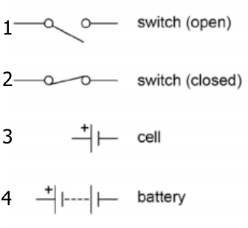
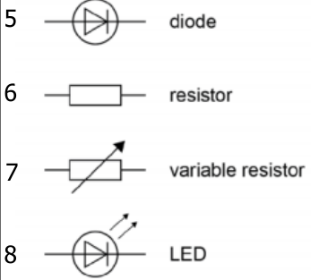
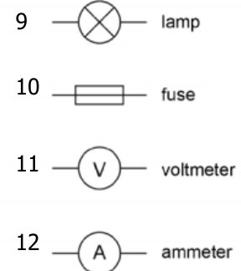
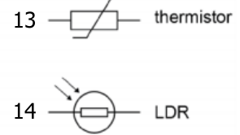
Science
Equations to learn
Q = I x t | Charge flow = current x time | Charge flow - coulomb (C) Current – amperes (A) Time – seconds (s)
V = I x R | Potential difference = current x resistance | Potential difference – volts (V) Current – amperes (A) Resistance – ohms (Ω)
P = V x I | Power = potential difference x current | Power – watt (W) Potential difference – volts (V) Current – amperes (A)
P = I² x R | Power = current² x resistance | Power – watt (W) Current – amperes (A) Resistance – ohms (Ω
E = P x t | Energy transferred = power x time | Energy = joules (J) Power – watt (W) Time – seconds (s)
E = Q x V | Energy transferred = charge flow x potential difference | Energy = joules (J) Charge flow - coulomb (C) Potential difference – volts (V)
Definitions
Potential difference | The potential difference between two points in an electric circuit is the work done when a coulomb of charge passes between the points. Potential difference causes charge to flow
Resistance | Resistance is caused by anything that opposes the flow of electric charge.
Charge | Anything charged that is able to move within a circuit. Electrons or ions
Alternating current | The current regularly changes direction e.g. mains electricity
Direct current | The current flows in one direction only e.g. batteries.
Mains electricity | UK mains is an alternating current of 230V and at a frequency of 50Hz.
National grid | A series of cables and transformers linking power stations to consumers.
Step up transformer | Increases the potential difference for transmission across power cables. This reduces the current and therefore less heat is lost from the cables. This makes the National Grid efficient.
Step down transformer | Reduces the potential difference from the cables to 230V for use by consumers.
Circuit Symbols
3

Slide 6
Science
Definitions
Tissue | A group of cells with a similar structure and function e.g. muscle tissue
Organ | A group of tissues performing a specific function e.g. heart, leaf
Organ system | A group of organs that perform a specific function e.g. digestive system.
Enzyme | A biological catalyst that can speed up the rate of reaction without being used itself. Made of a large protein molecule.
Substrate | The chemical that fits into the active site of an enzyme.
Lock and key model | Only one type of substrate can fit into the active site of an enzyme, like a key fits into a lock.
Denatured | When the active site of an enzyme changes shape and the substrate can no longer fit in. Can be caused by pH or temperature.
Chemical involved in digestion you must learn:
Hydrochloric acid | Acid with pH of 2 produced by the stomach. Unravels proteins.
Bile | Emulsifies fats (turns them into droplets to give a greater surface area). It is alkaline so neutralises acid from the stomach. Produced in liver, stored in gall bladder and is released into the small intestine.
Human Digestive Enzymes
Enzyme | Function | Sites of production | Sites of action
Amylase | Breaks starch into sugars. | Salivary glands Pancreas Small intestine | Mouth Small intestine
Protease | Breaks proteins into amino acids. | Stomach Pancreas Small intestine | Stomach Small intestine
Lipase | Breaks lipids (fats) into fatty acids and glycerol. | Pancreas Small intestine | Small intestine
Chemical Tests
Biological molecule | Chemical test that is carried out: | Positive result will show:
Starch | Add orange/brown iodine solution. | Colour turns to blue/black.
Sugar (glucose) | Add blue Benedict’s solution. Place in a boiling water bath for 5 minutes. | Colour turns green/ yellow/ orange/ brick red.
Protein | Add blue Biuret solution. | Colour turns to lilac/ purple.
Lipid | Add ethanol and decant into water. | Cloudy white emulsion.
4

Slide 7
Spanish
Spanish | English
los alimentos /. | foods
lácteos | milk products
carne | Meat
pescados | Fish
huevos | eggs
frutas | fruit
verduras | vegetables
cereales | cereals
grasas | fats
dulces | sugars
nutrientes | los nutrients
proteínas | proteins
minerales | minerals
sal | salt
vitaminas | vitamins
azúcar | sugar
Llevo una dieta sana | I have a healthy diet
Mi dieta es variada | My diet is varied.
Es fácil engancharse. | It’s easy to get hooked
Spanish | English
Suelo comer / beber | I tend to eat/drink
el sabor | taste
sano / malsano | Healthy/unhealthy
llevo una dieta sana | I have a healthy diet
evito la comida basura | I avoid junk food
soy adicto/a a | I’m addicted to
soy alérgico/a a | I’m allergic to
cambiar mi dieta | change my diet
mejorar mi dieta | Improve my diet
Beber alcohol | Drinking alcohol
Fumar cigarrillos / porros | Smoking cigarettes / joints
Tomar drogas blandas / duras | Taking soft / hard drugs
Emborracharse | Get drunk
te relaja bien / | it relaxes you
causa el fracaso escolar | it causes failure at school
te hace sentir… | it makes you feel…
más adulto | More adult
A partir de ahora | From now on
5

Slide 8
History
Key Individuals
Elizabeth I | Last Tudor Queen of England 1558-1603. Protestant.
Henry VIII | Elizabeth’s father. He changed the religion of the country from Catholic to Protestant during the English Reformation in 1533.
Anne Boleyn | Elizabeth’s mother and Henry’s second wife. She was beheaded by Henry.
Mary I | Elizabeth’s Catholic sister. She was the ruler before Elizabeth and had been unpopular.
Sir William Cecil | Secretary of State and person in government closest to Elizabeth.
Robert Dudley, Earl of Leicester | One of Elizabeth’s favorites at Court. Possible suitor.
Thomas Howard Duke of Norfolk | England’s most senior protestant nobleman. Close links to northern Catholic families. Disliked Cecil and Dudley.
Robert Devereux, Earl of Essex | Courtier and royal favourite in the court of Elizabeth I. Led rebellion against Elizabeth in 1601 and was executed.
Phillip II of Spain | King of Spain. Was married to Queen Mary I until her death. He proposed marriage to Elizabeth
Mary, Queen of Scots | Elizabeth’s second cousin. Catholic with a strong claim to the English throne.
Key Terms
Inherit | To gain possessions after someone has died.
Treason | An attempt to kill or overthrow the Monarch or betray the country; punishable by death.
Royal Court | The nobles, advisors and others who surrounded the Monarch.
Nobility | The most respected members of society; they were given special rights and privileges and owned most of the land.
Secretary of State | The leader of the Privy Council; a very powerful position.
Militia | A non-professional army raised to defeat a rebellion or fight a war.
Privy Council | A Monarch’s private councillors.
Gentry | High social class ranked below the nobility; they might be local JPs or hold similar office.
Patronage | Land, titles or power given to ensure an individual’s support.
Mass | A Catholic church service.
Monopoly | The exclusive right to trade in a particular product.
Ruff | An item of clothing worn around the neck.
Succeed | To take over the throne.
Exile | Being sent to live in another country that is not your own.
6

Slide 9
Geography
Key Word | Definition
Abrasion | rocks carried along a river wear down the river bed and banks
Alluvium | a sediment deposited by a river when it floods
Attrition | rocks being carried by the river smash together and break into smaller, smoother and rounder particles
Channel | the main water course
Channel straightening | removing meanders from a river to make it straighter
Confluence | where a tributary joins a larger river
Cross profile | a cross section of a river channel or its valley
Deposition | occurs when material being transported by the sea is dropped due to the sea losing energy
Discharge | quantity of water that passes a given point on a stream or riverbank within a given period of time
Drainage basin | an area of land drained by a river and its tributaries
Embankment | artificially raised river banks often using concrete walls
Estuary | tidal mouth of a river where it meets the sea – wide banks of deposited mud are exposed at low tide
Flood | where river discharge exceeds river channel capacity and water spills onto the floodplain
Flood relief channel | artificial channels that are used when a river is close to maximum discharge; they take the pressure off the main channels when floods are likely
Flood storage areas | water is deliberately allowed to flood wetlands to reduce the risk of flooding further downstream
Floodplain | relatively flat area forming the valley floor either side of a river channel that is sometimes flooded
Floodplain zoning | identifying how a floodplain can be developed for human uses
Gorge | a narrow steep-sided valley – often formed as a waterfall retreats upstream
Hydraulic action | power of the water eroding the bed and banks of a river
Hydrograph | a graph which shows the discharge of a river, related to rainfall, over a period of time
Interlocking spurs | outcrops of land along the river course in a valley
Lateral erosion | erosion of river banks rather than the bed – helps to form the floodplain
7

Slide 10
Geography
Key Word | Definition
Levee | raised bank found on either side of a river, formed naturally by regular flooding or built up by people to protect the area against flooding
Load | material transported by a river
Long profile | the gradient of a river, from its source to its mouth
Meander | a wide bend in a river
Mudflats | areas of fine sediment deposits which over time can develop in saltmarshes
Ox-bow lake | an arc-shaped lake on a floodplain formed by a cut-off meander
Plunge pool | a deep and turbulent area of water where the river ‘plunges’ over a waterfall
Saltation | hopping movement of pebbles along a river or sea bed
Saltmarshes | important natural habitats often found in sheltered river estuaries behind spits where there is very little flow of water
Solution | dissolved rocks and minerals often derived from limestone or chalk
Suspension | small particles carried in river flow or sea water, i.e. sands, silts and clays
Thalweg | the course of the fastest flow (velocity) within a river
Time lag | the time in hours between the highest rainfall and the highest (peak) discharge
Traction | where material is rolled along a river bed or by waves
Transportation | the movement of eroded material
Tributary | a small stream that joins a larger river
Velocity | rate of the river flow
Vertical erosion | downward erosion of the river bed
V-shaped valley | steep-sided valley
Waterfall | a step in the long profile of a river usually formed when a river crosses over a hard (resistant) band of rock
Watershed | the edge of the river basin
Wetlands | saturated areas of land, often found on river floodplains
8

Slide 11
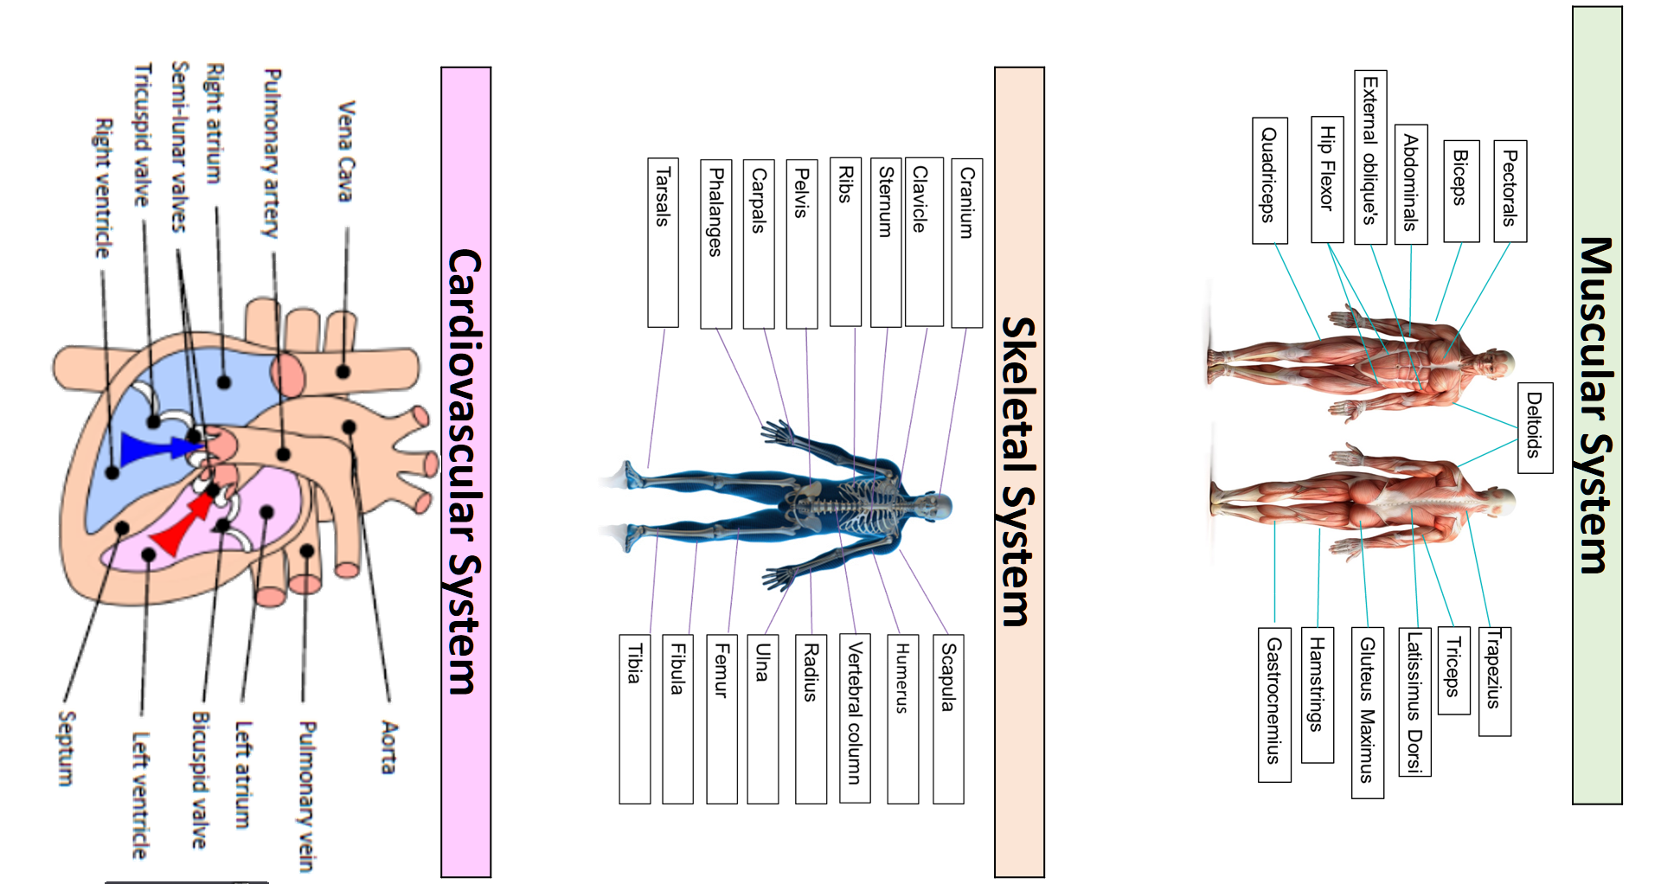
PE
9

Slide 12
PE
Health and Fitness
Muscular Strength | The amount of the force muscles can generate against a resistance
Muscular Endurance | The ability to use voluntary muscles, over long periods of time without getting tired
Flexibility | The range of movement at a joint
Cardiovascular Fitness (Aerobic Endurance) | The ability of the heart and circulatory system to meet the demands of the body for a long period of time
Body composition | The percentage of a body that is fat, muscle, bone and water
Coordination | The ability to move two or more body parts at the same time
Reaction Time | The time taken for a response to occur after a stimulus
Agility | The ability to change direction at speed
Balance | The ability to keep the body steady when in a static position or when moving
Speed | The time taken to cover a set distance/complete a movement
Power | The ability to combine speed and strength
Principles of training
Progressive Overload | Working the body harder than normal/gradually increasing the amount of exercise you do
Reversibility | If training is not regular, adaptations will be reversed. This can happen when suffering from illness, injury or after an off season
Specificity | Training showed be matched to the requirements of the sport or position the performer is in. Training must be specifically designed to develop the right muscles, type of fitness or skills
Individual needs | All PEP’s would differ depending on performers goals/target, strengths /weaknesses, age/gender and current health/fitness levels
Overtraining | Occurs when you train too hard and do not allow the body enough rest/recovery time Signs include extended muscle soreness, frequent illness & increase injuries
10

Slide 13
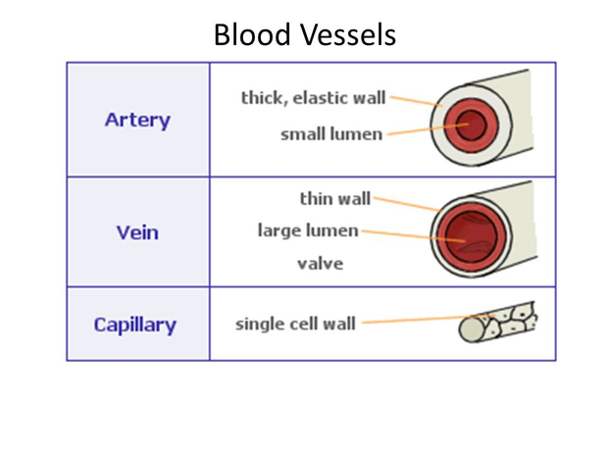
PE
Cardiovascular system – Blood vessels
There are three types of blood vessels found in the body:
Artery | It’s structure is; thick, muscular elastic walls, small lumen, high pressure. It’s function is to take blood away from the heart
Vein | It’s structure is; Thin, little muscle in walls, non elastic, large lumen, pocket valves, low pressure. . It’s function is to bring blood into the heart
Capillary | It’s structure is; Very thin walls (1 cell), very small lumen. It’s function is to Form networks around muscle and tissue and allow gaseous exchange
11

Slide 14
Computing
Key Word | Definition
2-D | Flat, 2 dimensional images
3-D | 3 dimensional, rounded and defined image features
4-D | 3-D but with movement and action
5-D | Realistic view, flesh tone, full movement
CAD | Computer Aided Design. To mock real life situations
Model | A 3 dimensional representation of an object
Technology | Devices or Apps used for a specific purpose
Key Word | Definition
Spreadsheet | This is software used for calculations or modelling
Formula | Perform calculations within the spreadsheet. Must start with =
Budget | The total amount of finance/money allocated to a project
Dimensions | Measurements of a specific room or object. Height, width, depth
Interior | Objects inside the house e.g. Table, bed, chair
Exterior | Objects outside the house e.g. Tree, car, patio furniture
Rotate | 90 degrees 180 degrees etc to fit
Scale | Change the size of objects to fit real life expectations
Objects | Visual element. In your project will be a tree or a door
Brush tool | Appears as a paint roller and allows you to change the colour of the objects or floor
12

Slide 15
Art
Key Word | Definition
Mark-making techniques | describes the different lines, dots, marks, patterns and textures created in a drawing. It can apply to any drawing materials. It can be loose and expressive or controlled and neat. The results will depend on your choice of media, tools and techniques
Graduated Tone | is a tone that fades smoothly from one shade to another across an area. They are often made by varying the pressure on the tool used to make the tone, but can also be made by using overlapping layers of the medium used to make the tone.
Tonal contrast | the range of tones used in a drawing. A wider range means a greater contrast. You can manipulate the contrast depending on how much you want the object or specific part of the art work to stand out. If you are drawing from observation, the contrast can depend on how bright your light source.
Highlight | the area of an object where the light effects is most intense. In painting the highlight of an object should not be pure white as it should contain some of the local colour of the object. White highlights refer to pure reflected light as for example occur on a metal object, but do not occur on or are reflected from coloured glass.
Proportion | refers to the relationship between the different sized components within one whole composition. Proportion can be used to make a composition appear more realistic or more stylised depending on the type of proportion used.
Texture | concerns the surface quality of a piece of work. In three-dimensional artwork, the term refers to how the piece feels when it's touched. In two-dimensional artwork, texture invokes the visual 'feeling' the piece gives off.
Outline | Lines that are used to define the shape or form of an object or to show key details are called outlines.
Mixed-Media | refers to a visual art form that combines a variety of media in a single artwork.
13

Slide 16
Performing Arts
Blood Brothers
Themes
Social Class | Family and friendship for characters from two different social classes form the heart of the play.
Example | Russell shows how wealth brings privilege, even down to the way the Johnstone's and the Lyons are treated differently by the law.
Nature vs Nurture | The debate is about how much a life is determined by inherited genetics (their 'nature') and how much is determined by the environment ('nurture').
Example | The boys are identical twins and so the difference in the way their lives turn out must be a result of their different upbringings/social positions.
Money | Materialism as a theme. Mrs. Johnstone’s life in debt leads to problems. Mrs Lyons’ wealthy existence fails to bring her contentment.
Example | Once Edward returns from university as a wealthy, he cannot appreciate Mickey's reaction to being jobless. And nor can Mickey's pride allow him to accept financial help from Edward.
Growing Up | Life, for the children, is shown to be a carefree game in Act One. But the pressures of growing up are evident in Act Two.
Fate and Destiny | Mrs Lyons manipulates Mrs Johnstone’s superstitious character. Each of the leading characters are trapped by misfortune.
Drama Techniques
Dramatic Irony | The audience are aware throughout the entire play that both Mickey and Edward are twins, but the characters do not find out until the very last scene,
Monologue | a speech presented by a single character, most often to express their mental thoughts aloud
Split Scene | the term is used to describe two or more scenes which are performed on stage at the same time
Improvisation | something created spontaneously
Foreshadowing | be a warning or an indication of future events
The fourth wall | The Narrator and Mrs Johnstone break the fourth wall when they speak to the audience directly.
The features of tragedy | The tragic hero Hamartia - The fatal character flaw of the tragic hero Catharsis - The release of the audience's emotions through empathy with the characters. Internal Conflict - The struggle characters engage with over incidents/flaws
14

Slide 17
Cooking and Nutrition
Key Word | Definition
Cholesterol | A type of fatty substance made in the liver
Coeliac disease | A disease which develops from an intolerance to gluten
Allergen | A substance that causes an allergic reaction
Anaphylaxis | A serious allergic reaction that is very rapid in onset and can cause death if the throat swells and the person cannot breathe
Food Allergy | A condition where the body’s immune system reacts unusually to specific foods and causes a range of mild to severe symptoms
Food intolerance | A long term condition where certain foods cause someone to feel unwell and have a range of symptoms: it is usually not life threatening
Obesity | Abnormal or excessive fat accumulation that presents a health risk.
Life stages | Stages of development that people through during their life i.e infancy, childhood, adolescence, adulthood and later adulthood
Vegan | A person who chooses to eat only plant foods and no animal foods
Peak Bone Mass | When bones have the maximum amount of minerals and are at their strongest
Yeast | A single-celled plant fungus and a raising agent which needs time, food, warmth and liquid to ferment
Fermentation | The process in which yeast produces the gas carbon dioxide
Knead | The process of working a dough mixture to make it smooth and elastic
gluten | The protein in flour that is developed when water is added to flour and mixed.
shortening | When fats or oils coat flour proteins and prevent gluten forming. This gives the product a crumbly texture
gelatinisation | This happens when starch granules are heated in a liquid, and they swell and burst when the liquid boils, absorbing the liquid and causing the liquid to thicken
roux | A mixture of fat and flour cooked together and used to thicken sauces
15

Slide 18
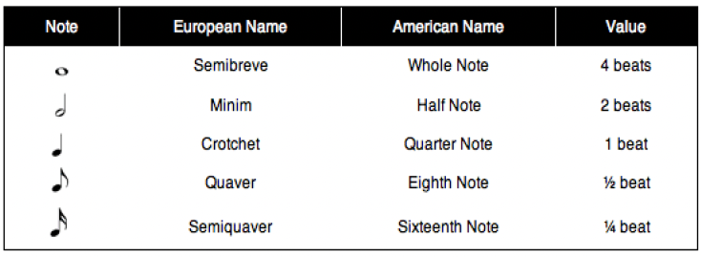
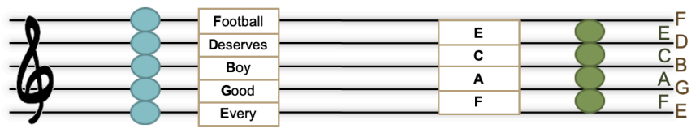
Music
Key Word | Definition
Texture | How many layers the piece has
Structure | the order the different sections of a song or piece of music are played in.
Harmony | is the combination of different musical notes played simultaneously.
Time signature | It tells how many beats are in each measure and which note gets one beat, helping you keep track of the rhythm while playing or singing.
Dynamic | The volume of a sound or piece of music – loud/soft
Beat | a regular, repeating pulse that underlies a musical pattern
Rhythm | Rhythm is the pattern of sounds and beats in music that creates a sense of movement and flow.
Tempo | Tempo refers to the speed of music. It's how fast or slow a song sounds.
Timbre/Sonority | Each instrument own unique ‘tone quality’ and the voice as an instrument had different Timbre
duet | A song for two singers or players
Ensemble | A song sung or played by a small group.
16

Slide 19
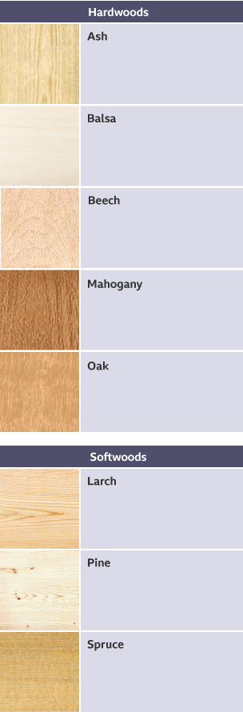
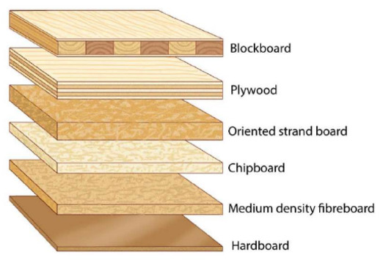
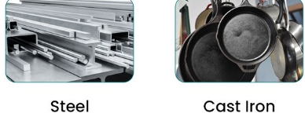
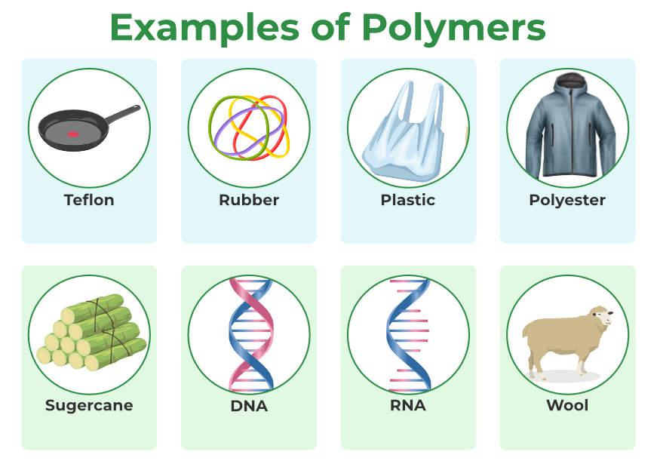
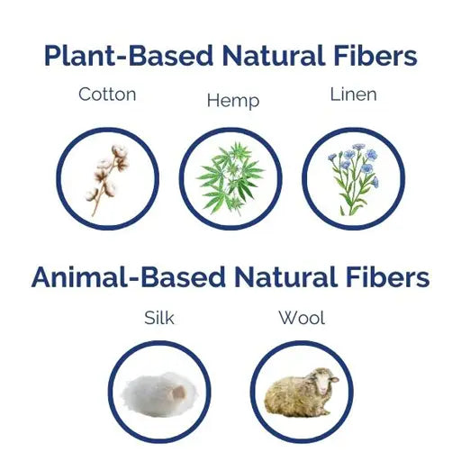
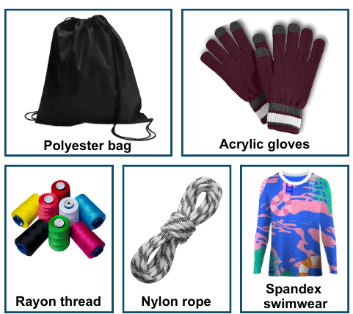
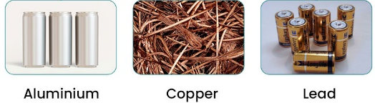
Design and Technology - RM
Year 9
Key Words | Definition
Alloys | A mixture of two or more metals to create a new material with improved properties.
Design Brief | A set of instructions given to a designer by a client.
Composite Materials | Made up of different materials which are combined to improve their properties.
Coniferous | Evergreen trees that bear cones.
Deciduous | Trees and shrubs that loose their leaves in the autumn.
Deforestation | The chopping down and removal of trees to clear an area of forest.
Evergreen | A tree or plant that keeps its leaves all year round.
Ferrous Metal | Metals that contain iron, are magnetic and rust.
Hardwood | Mainly have large broad leaves, which usually produce a seed or fruit.
Manufactured Boards | Man-made timber made from timber waste and adhesive.
Modern Materials | Material that have been engineered to have improved properties.
Polymer | Large molecule formed from many identical smaller molecules (monomers), can be natural or synthetic.
Key Words | Definition
Physical Properties | The traits a material has before it is used
Natural Fibres | Materials that come from animals or plants e.g. cotton - harvested from cotton plants.
Non-Ferrous Metal | Metals that do not contain iron, are not magnetic and do not rust.
Smart Material | Exhibit a physical change in response to some external stimuli.
Specifications | Document containing details of a product's required characteristics, processes, materials and other information needed to design product.
Softwoods | Come from coniferous trees and often have pines or needles.
Stimuli | A thing or event that evokes a specific functional reaction.
Synthetic Fibres | Man-made textile fibres created through chemical synthesis.
Technical textiles | Engineered materials designed for performance and functionality, rather than aesthetics, and are used across various industries.
Thermoforming | Can be heated and shaped, then heated and shaped again.
Thermosetting | Can only be heated and shaped once.
Working Properties | The material behaves when it is manipulated.
Hardwood
Softwood
Manufactured Boards
Ferrous Metals
Synthetic Polymer
Natural Plant Fibres
Man-Made Fibres
Non-Ferrous Metals
Natural Polymer
Natural Animal Fibres
17

Slide 20
W/c 13th April Thinking definition: Thinking is making connections, reasoning and asking questions to make the learning stick
Reflecting on learning behaviours for resilience … | Experience log
 | Successful moment… | In hindsight… Where you could have done better on reflection? | At home…
I gave an idea and reasoned/justified.
I reflected on my idea and made it better after discussing with others
I used a revision strategy to help make the learning stick.
I made connections between what I am learning and the outside world.
I asked questions to deepen my understanding.
18

Slide 21
W/c 20th April Thinking definition: Thinking is making connections, reasoning and asking questions to make the learning stick
Reflecting on learning behaviours for resilience …… | Experience log
 | Successful moment… | In hindsight… Where you could have done better on reflection? | At home…
I gave an idea and reasoned/justified.
I reflected on my idea and made it better after discussing with others
I used a revision strategy to help make the learning stick.
I made connections between what I am learning and the outside world.
I asked questions to deepen my understanding.
19

Slide 22
W/c 27th April Thinking definition: Thinking is making connections, reasoning and asking questions to make the learning stick
Reflecting on learning behaviours for resilience …… | Experience log
 | Successful moment… | In hindsight… Where you could have done better on reflection? | At home…
I gave an idea and reasoned/justified.
I reflected on my idea and made it better after discussing with others
I used a revision strategy to help make the learning stick.
I made connections between what I am learning and the outside world.
I asked questions to deepen my understanding.
20

Slide 23
W/c 4th May Thinking definition: Thinking is making connections, reasoning and asking questions to make the learning stick
Reflecting on learning behaviours for resilience … | Experience log
 | Successful moment… | In hindsight… Where you could have done better on reflection? | At home…
I gave an idea and reasoned/justified.
I reflected on my idea and made it better after discussing with others
I used a revision strategy to help make the learning stick.
I made connections between what I am learning and the outside world.
I asked questions to deepen my understanding.
21

Slide 24
W/c 11th May Thinking definition: Thinking is making connections, reasoning and asking questions to make the learning stick
Reflecting on learning behaviours for resilience … | Experience log
 | Successful moment… | In hindsight… Where you could have done better on reflection? | At home…
I gave an idea and reasoned/justified.
I reflected on my idea and made it better after discussing with others
I used a revision strategy to help make the learning stick.
I made connections between what I am learning and the outside world.
I asked questions to deepen my understanding.
22

Slide 25
W/c 18th May Thinking definition: Thinking is making connections, reasoning and asking questions to make the learning stick
Reflecting on learning behaviours for resilience … | Experience log
 | Successful moment… | In hindsight… Where you could have done better on reflection? | At home…
I gave an idea and reasoned/justified.
I reflected on my idea and made it better after discussing with others
I used a revision strategy to help make the learning stick.
I made connections between what I am learning and the outside world.
I asked questions to deepen my understanding.
23

Slide 26
Reading Log w/c 13th April (20 mins reading per day – all five logs MUST be completed)
Date | Title of novel | Number of pages read | Summary about what I have read
 |  |  | • • •
 |  |  | • • •
 |  |  | • • •
 |  |  | • • •
 |  |  | • • •
Checked by form tutor:
24

Slide 27
Reading Log w/c 20th April (20 mins reading per day – all five logs MUST be completed)
Date | Title of novel | Number of pages read | Summary about what I have read
 |  |  | • • •
 |  |  | • • •
 |  |  | • • •
 |  |  | • • •
 |  |  | • • •
Checked by form tutor:
25

Slide 28
Reading Log w/c 27th May (20 mins reading per day – all five logs MUST be completed)
Date | Title of novel | Number of pages read | Summary about what I have read
 |  |  | • • •
 |  |  | • • •
 |  |  | • • •
 |  |  | • • •
 |  |  | • • •
Checked by form tutor:
26

Slide 29
Reading Log w/c 4th May (20 mins reading per day – all five logs MUST be completed)
Date | Title of novel | Number of pages read | Summary about what I have read
 |  |  | • • •
 |  |  | • • •
 |  |  | • • •
 |  |  | • • •
 |  |  | • • •
Checked by form tutor:
27

Slide 30
Reading Log w/c 11th May (20 mins reading per day – all five logs MUST be completed)
Date | Title of novel | Number of pages read | Summary about what I have read
 |  |  | • • •
 |  |  | • • •
 |  |  | • • •
 |  |  | • • •
 |  |  | • • •
Checked by form tutor:
28

Slide 31
Reading Log w/c 18th May (20 mins reading per day – all five logs MUST be completed)
Date | Title of novel | Number of pages read | Summary about what I have read
 |  |  | • • •
 |  |  | • • •
 |  |  | • • •
 |  |  | • • •
 |  |  | • • •
Checked by form tutor:
29

Slide 32
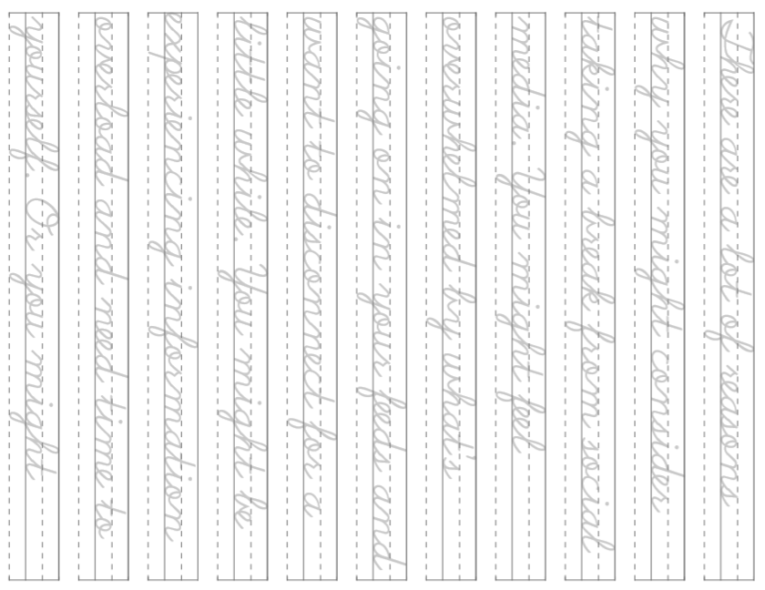
30

Slide 33
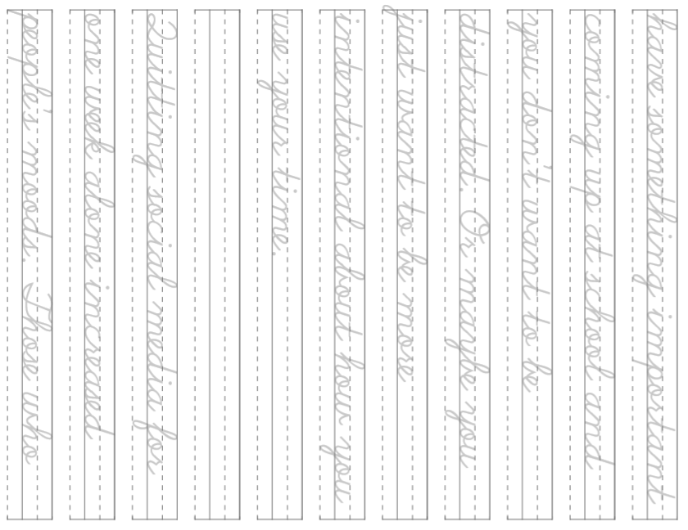
31

Slide 34
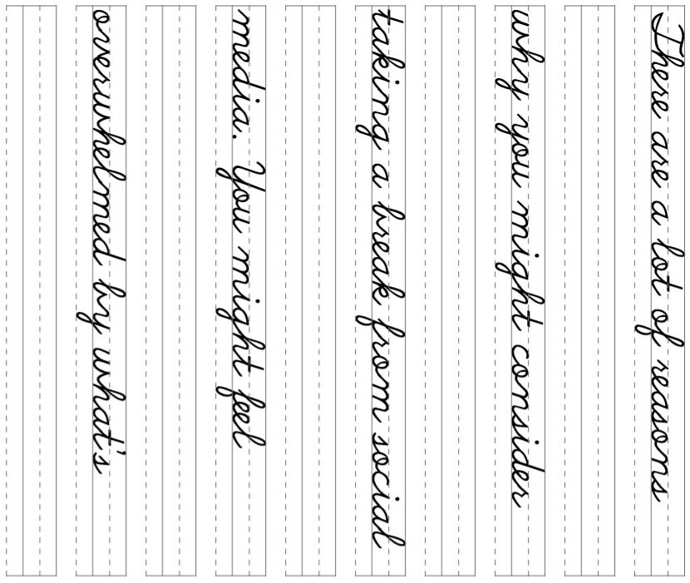
32

Slide 35
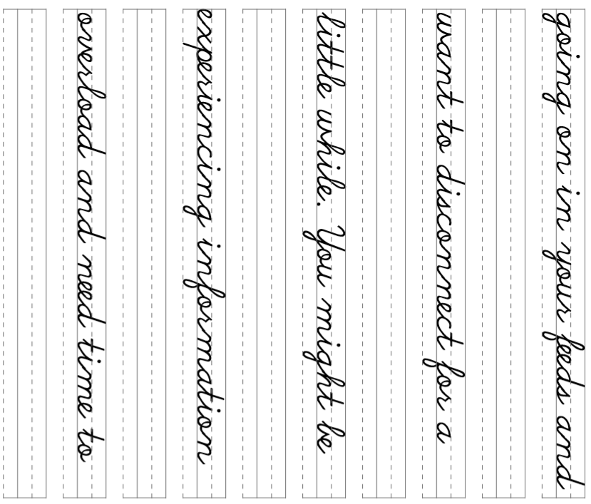
33

Slide 36
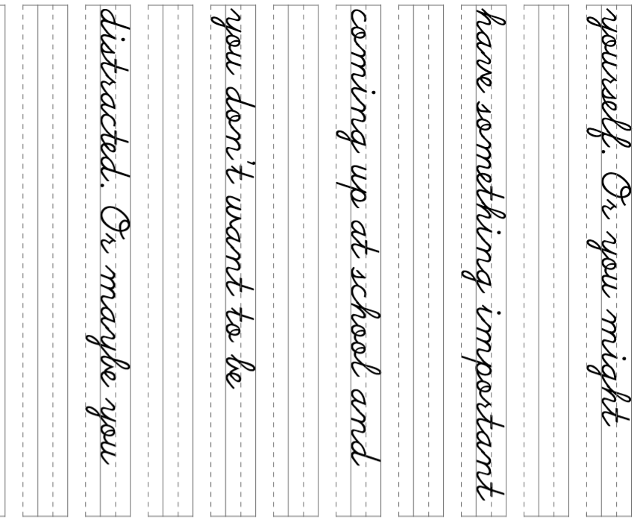
34

Slide 37
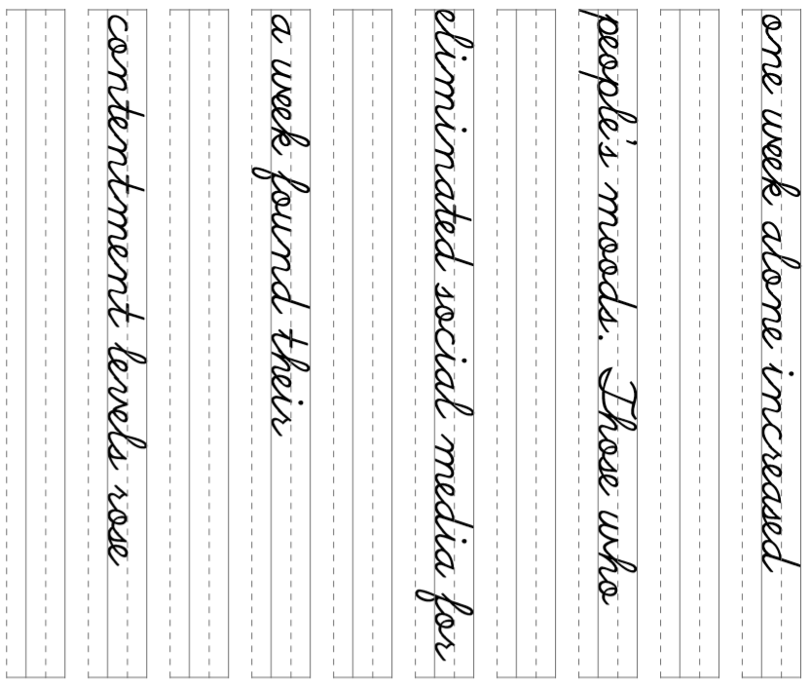
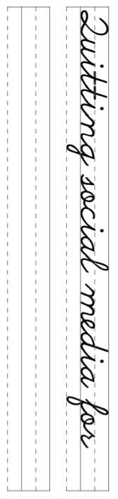
35

