Slide 1

Year 9 Knowledge Organiser HT6
Knowledge is Power
Name: ______________________________
Form: _______

Slide 2
Contents Page
Subject | Page
English | 1
Maths | 2
Science | 3
Spanish | 6
History | 7
Geography | 8
PE | 10
Computing | 13
Art | 14
Performing Arts | 15
Cooking and Nutrition | 16
Music | 17
DT | 18
‘Resilience’ reflection log | 19
Reading log | 26
Cursive Handwriting Practice | 33

Slide 3
English
Week 3 – Emotive Language & Tone
Emotive Language | Words or phrases used to evoke an emotional response.
Tone | The writer's attitude toward the subject (e.g. joyful, bitter, melancholic).
Mood | The atmosphere or feeling created for the reader.
Hyperbole | Exaggeration for effect (e.g. I would die for you).
Euphemism | A mild or indirect way of expressing something harsh (e.g. passed away for died).
Week 5 – Poetic Structures & Forms
Sonnet | A 14-line poem often about love, traditionally in iambic pentameter.
Quatrain | A four-line stanza, often with a rhyme scheme.
Couplet | Two lines of poetry that usually rhyme.
Iambic Pentameter | A line with ten syllables, alternating unstressed and stressed.
Week 1 – Key Poetic Techniques
Simile | A comparison using "like" or "as" (e.g. love is like a rose).
Metaphor | A direct comparison without using "like" or "as" (e.g. love is a battlefield).
Personification | Giving human qualities to something non-human (e.g. love whispered in my ear).
Alliteration | Repetition of the same sound at the start of words (e.g. silent, soft, sweet).
Enjambment | A line of poetry that continues without pause onto the next line.
Stanza | A grouped set of lines in a poem, like a paragraph.
Rhyme Scheme | The pattern of rhyme at the end of each line (e.g. ABAB).
Week 6 – Comparative/Analytical Vocabulary
Similarity | A feature or quality shared between two poems or texts.
Contrast | A difference that is noticeable between two poems or ideas.
Juxtaposition | Placing two contrasting ideas close together for effect.
Symbolism | When an object or idea stands for something beyond its literal meaning (e.g. a rose = love).
Connotation | The implied meaning or feeling of a word (e.g. “red” = passion/danger).
Week 4 – Context & Historical Influences
Courtly Love | A medieval tradition of expressing admiration and devotion, often from afar.
Patriarchy | A social system where men hold power over women, often seen in older poetry.
Chivalry | The code of conduct for knights, linked with respectful and noble love.
Romanticism | A literary movement valuing emotion, nature, and individualism (18th-19th century).
Victorian Era | Time of Queen Victoria's reign (1837–1901), known for strict social rules and repressed emotions.
Week 2 – Themes of Love
Romantic Love | Love based on passion, attraction, and deep emotional connection.
Unrequited Love | Love that is not returned or acknowledged.
Forbidden Love | Love that is disapproved of by society or family.
Familial Love | Love between family members.
Obsessive Love | Overpowering love that can become unhealthy or controlling.
Week 7 – Porphyria’s Lover
Genre | A category of literature; love poetry focuses on emotions, relationships, and affection..
Poetic Voice | The distinct style or personality that comes through the poem’s language and tone.
Speaker | The narrative voice in the poem—not always the poet themselves.
Purpose | The reason the poem was written (e.g. to express love, to mourn, to persuade).
1
Notes:
Year 8 HT2

Slide 4
Maths
Constructions and Loci
Key Word | Definition | Definition
Construction | Means to draw shapes, angles or lines accurately. Using only compass, ruler and a pencil | Means to draw shapes, angles or lines accurately. Using only compass, ruler and a pencil
Bisector | To divide into two equal parts | To divide into two equal parts
Perpendicular | Lines that intersect at right angles | Lines that intersect at right angles
Loci | The path that an object follows | The path that an object follows
Similarity and congruence
Key Word |  | Definition
Congruent shapes |  | Exactly the same shapes
Similar shapes |  | One shape is an enlargement of the other
Proving Similarity |  | Either - The corresponding angles are equal
 |  | or - The corresponding sides are enlarged by the same scale factor
2

Slide 5
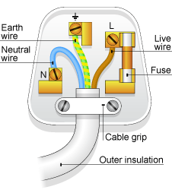
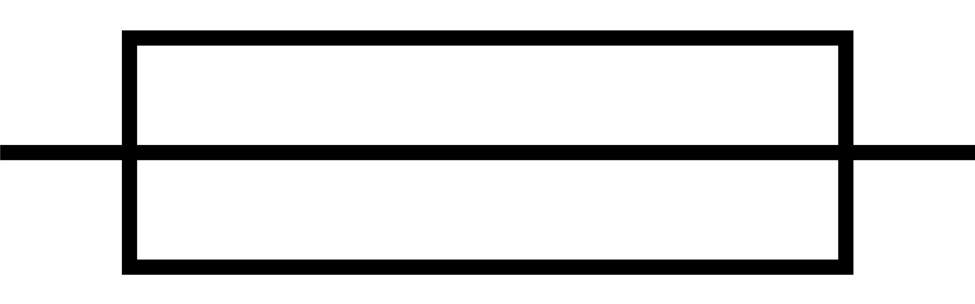
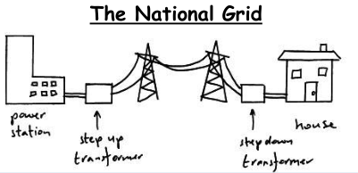
Science
Key terms Mains Electricity
Alternating Current | The current regularly changes direction e.g. mains electricity
Direct Current | The current flows in one direction only e.g. batteries.
Mains Electricity | UK mains is an alternating current of 230V and at a frequency of 50Hz.
National Grid | A series of cables and transformers linking power stations to consumers
Step-up Transformer | Increases the potential difference for transmission across power cables. This reduces the current and therefore less heat is lost from the cables. This makes the National Grid efficient.
Step-down Transformer | Reduces the potential difference from the cables to 230V for use by consumers.
The 3 pin plug
Name | Colour | Function | Potential Difference (V)
Live | Brown | Carries alternating potential difference from the supply. | 230
Neutral | Blue | Completes the circuit. | 0
Earth | Green and yellow stripes | A safety wire to stop the appliance becoming live. | 0
Fuses are safety devices.
If current is dangerously high, the wire in the fuse melts.
This breaks the circuit and current is cut so it is unable to flow through the appliance.
This prevents electrocution and prevents appliances from damage.
Energy sources
Non-renewable | A resource that cannot be replaced after it has been used
renewable | Resources that can replenish themselves
3

Slide 6
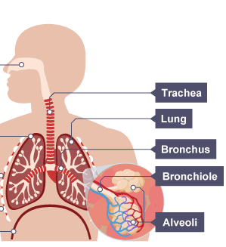
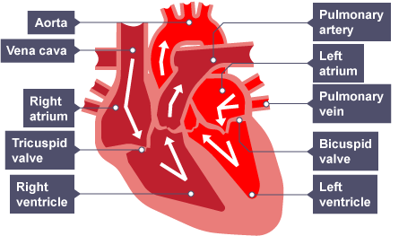
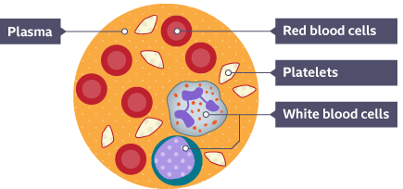
Science
Structures in the Heart
Pacemaker | Group of cells in the right atrium that controls resting heart rate.
Right ventricle | Pumps deoxygenated blood to the lungs for gas exchange.
Left ventricle | Pumps oxygenated blood to the body. Thick, muscular wall.
Valve | Stops blood flowing the wrong way / leaking.
Structures in the Lungs
Alveoli | Small sacs where gas exchange occurs. Surrounded by capillaries. Oxygen moves from the alveoli into the capillaries, carbon dioxide moves from the capillaries into the alveoli
Trachea and Bronchi | Tubes through which gases move. Lined with cartilage so they don’t collapse.
Components of the Blood
Plasma | Liquid part of the blood. Transports blood cells as well as carbon dioxide, proteins, glucose, hormones and urea.
Red Blood Cells | Carries oxygen. Packed with haemoglobin, a protein that binds to oxygen. No nucleus to create extra space for haemoglobin. Biconcave shape to give a large surface area.
White Blood Cells | Destroy pathogens. Some can produce antibodies.
Platelets | Cell fragments that help to clot wounds.
Heart Disease
Coronary Heart Disease | Build up of fatty material in coronary arteries. Can lead to a blood clot and a heart attack.
Stent | Wire mesh that opens up a blocked artery
Statin | Drug that reduces cholesterol
4

Slide 7
Science
Structures in the Heart
Pacemaker | Group of cells in the right atrium that controls resting heart rate.
Right ventricle | Pumps deoxygenated blood to the lungs for gas exchange.
Left ventricle | Pumps oxygenated blood to the body. Thick, muscular wall.
Valve | Stops blood flowing the wrong way / leaking.
Structures in the Lungs
Alveoli | Small sacs where gas exchange occurs. Surrounded by capillaries. Oxygen moves from the alveoli into the capillaries, carbon dioxide moves from the capillaries into the alveoli
Trachea and Bronchi | Tubes through which gases move. Lined with cartilage so they don’t collapse.
Heart Disease
Coronary Heart Disease | Build up of fatty material in coronary arteries. Can lead to a blood clot and a heart attack.
Stent | Wire mesh that opens up a blocked artery
Statin | Drug that reduces cholesterol
Components of the Blood
Plasma | Liquid part of the blood. Transports blood cells as well as carbon dioxide, proteins, glucose, hormones and urea.
Red Blood Cells | Carries oxygen. Packed with haemoglobin, a protein that binds to oxygen. No nucleus to create extra space for haemoglobin. Biconcave shape to give a large surface area.
White Blood Cells | Destroy pathogens. Some can produce antibodies.
Platelets | Cell fragments that help to clot wounds.
5

Slide 8
Spanish
Spanish | English
Enhorabuena! | Congratulations!
especial | Special
calle | Street
decoran | They decorate
preparan | They prepare
globo | Balloon
pastel | Cake
vela | Candle
banda | Music group
canción | Song
comida | Food
invitado | Invite
música | Music
desfile | Parade
animado | lively
Cultural | Cultural
histórico | historic
nacional | National
Se celebra | It is celebrated
Spanish | English
Día de Muertos | Day of the Dead
Día de Reyes | Day of the Kings
Nochebuena | Christmas Eve
Semana Santa | Easter week
Tomatina | Tomato festival
Las Fallas | Las fallas day
San Fermines | Saint Fermines day
católico | Catholic
cristiano | Christian
judío | jewish
musulmán | muslim
religioso | religious
¿qué? | What?
¿quién? | Who?
¿cuándo? | When?
¿A qué hora? | At what time?
¿por qué? | Why?
¿cómo? | How?
Spanish | English
Celebrar | To celebrate
Navidad | Christmas
cumpleaños | Birthday
celebración | Celebration
boda | Wedding
matrimonio | Matimony
fiesta | Party
aniversario | Anniversary
asistir | To attend
Bailar | To dance
Cantar | To sing
Invitar | To invite
Recibir | To receive
Vestirse | To dress
Regalos | Gifts
Un traje | A suit
Un vestido | A dress
6

Slide 9
History
Key Individuals
Elizabeth I | Last Tudor Queen of England 1558-1603. Protestant.
Henry VIII | Elizabeth’s father. He changed the religion of the country from Catholic to Protestant during the English Reformation in 1533.
Anne Boleyn | Elizabeth’s mother and Henry’s second wife. She was beheaded by Henry.
Mary I | Elizabeth’s Catholic sister. She was the ruler before Elizabeth and had been unpopular.
Sir William Cecil | Secretary of State and person in government closest to Elizabeth.
Robert Dudley, Earl of Leicester | One of Elizabeth’s favorites at Court. Possible suitor.
Thomas Howard Duke of Norfolk | England’s most senior protestant nobleman. Close links to northern Catholic families. Disliked Cecil and Dudley.
Robert Devereux, Earl of Essex | Courtier and royal favourite in the court of Elizabeth I. Led rebellion against Elizabeth in 1601 and was executed.
Phillip II of Spain | King of Spain. Was married to Queen Mary I until her death. He proposed marriage to Elizabeth
Mary, Queen of Scots | Elizabeth’s second cousin. Catholic with a strong claim to the English throne.
Key Terms
Inherit | To gain possessions after someone has died.
Treason | An attempt to kill or overthrow the Monarch or betray the country; punishable by death.
Royal Court | The nobles, advisors and others who surrounded the Monarch.
Nobility | The most respected members of society; they were given special rights and privileges and owned most of the land.
Secretary of State | The leader of the Privy Council; a very powerful position.
Militia | A non-professional army raised to defeat a rebellion or fight a war.
Privy Council | A Monarch’s private councillors.
Gentry | High social class ranked below the nobility; they might be local JPs or hold similar office.
Patronage | Land, titles or power given to ensure an individual’s support.
Mass | A Catholic church service.
Monopoly | The exclusive right to trade in a particular product.
Ruff | An item of clothing worn around the neck.
Succeed | To take over the throne.
Exile | Being sent to live in another country that is not your own.
7

Slide 10
Geography
Key Word | Definition
Aid | when a country or non-governmental organization (NGO) donates resources to another country to help it develop or improve people’s lives
Birth rate | the number of births a year per 1000 of the total population
Death rate | the number of deaths in a year per 1000 of the total population
Debt crisis | when a country cannot pay its debts, often leading to calls to other countries for assistance
Debt relief | cancellation of debts to a country by a global organisation such as the World Bank
Dependency ratio | the proportion of people below (aged 0-14) and above (over 65) normal working age
Development | the progress of a country in terms of economic growth, the use of technology and human welfare
Development gap | difference in standards of living and wellbeing between the world’s richest and poorest countries
Displaced person | a person who is forced to move from home but stays in his/her country of origin
Economic migrant | a person who moves voluntarily to seek a better life, such as a better-paid job or benefits like education and health care
Ecotourism | nature tourism usually involving small groups with minimal impact on the environment
Fairtrade | producers in LICs given a better price for their goods such as cocoa, coffee and cotton
Free trade | when countries do not use tariffs or quotas to restrict trade
Gross National Income (GNI) | measurement of economic activity calculated by dividing the gross (total) national income by the size of the population
Human Development Index (HDI) | a method of measuring development where GDP per capita, life expectancy and adult literacy are combined to give an overview
Immigration | the migration of people in to a country
Infant mortality rate | the number of babies that die under a year of age, per 1000 live births
Infrastructure | the basic equipment and structures (such as roads, utilities, water supply and sewage) that are needed for a country or region to function properly
Intermediate technology | simple, easily learned and maintained technology used in LICs for a range of economic activities
8

Slide 11
Geography
Life expectancy | the average number of years a person is expected to live.
Microfinance loans | very small loans which are given to people in the LICs to help them start a small business
Migration | when people move from one area to another; in many LICS people move from rural to urban areas (rural–urban migration)
Multiplier effect | a series of consequences where one development makes another one possible, such as an increase in money available
Newly-Emerging Economies (NEE) | countries that have begun to experience high rates of economic development, usually along with rapid industrialisation
Population pyramid | a graph showing the age and sex of a population
Population structure | the number of each sex in each age group, usually displayed in a population pyramid diagram
Primary products | unprocessed raw materials extracted from the earth or agricultural products
Quality of life | how good a person’s life measured by such things of housing and environment, access to education, healthcare, how secure people feel and how happy they are with their lifestyle
Sustainability | actions that meet the needs of the present without reducing the ability of future generations to meet their needs
Standard of living | the level of wealth, comfort, material goods and necessities available to a certain group of people in a certain geographic area
Tariff | taxes or customs dues paid on imports
Tourism | the commercial organisation of attracting non-resident people to areas of interest
Trade | buying and selling of goods and services between countries
Trading group | countries which have grouped together to increase trade between them by cutting tariffs to discourage trade with non-members
9

Slide 12

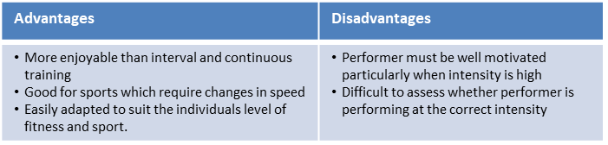
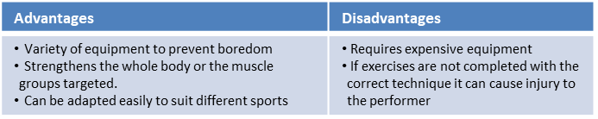
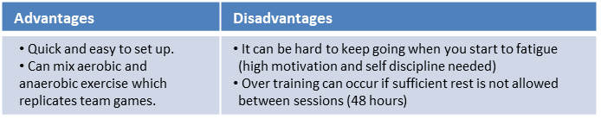
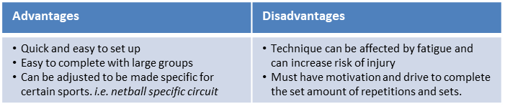
Methods of training
Continuous training - | Involves a steady but regular pace at a moderate intensity (aerobic) which should last for at least 20 minutes. i.e. running, walking, swimming, rowing or cycling. Used by a marathon runner.
Fartlek training | Referred to as ‘speed play’ This is a form interval training but without rest. Involves a variety of changing intensities over different distances and terrains. i.e. 1 lap at 50% max, 1 lap walking, 1 lap at 80% (aerobic and anaerobic used) Used by games players – Hockey players
Weight/Resistance training | A form of training that uses progressive resistance against a muscle group. Used by cyclists. Muscular strength: High weight x low repetitions. Muscular endurance: Low weight x high repetitions
Interval training | Involves periods of work followed by periods of rest. i.e. Sprint for 20 metre + walk back to start. Used by a 200m sprinter
Plyometric training | Involves high-impact exercises that develop power. i.e. bounding/hopping, squat jumps. Used by long jumpers, 100 m sprinters or basketball players.
Circuit training | A series of exercises completed one after another. Each exercise is called a station. Each station should work a different area of the body to avoid fatigue. i.e. press ups, sit ups, squats, shuttle runs.
PE
10

Slide 13
PE
Health and Fitness
Muscular Strength | The amount of the force muscles can generate against a resistance
Muscular Endurance | The ability to use voluntary muscles, over long periods of time without getting tired
Flexibility | The range of movement at a joint
Cardiovascular Fitness (Aerobic Endurance) | The ability of the heart and circulatory system to meet the demands of the body for a long period of time
Body composition | The percentage of a body that is fat, muscle, bone and water
Coordination | The ability to move two or more body parts at the same time
Reaction Time | The time taken for a response to occur after a stimulus
Agility | The ability to change direction at speed
Balance | The ability to keep the body steady when in a static position or when moving
Speed | The time taken to cover a set distance/complete a movement
Power | The ability to combine speed and strength
Principles of training
Progressive Overload | Working the body harder than normal/gradually increasing the amount of exercise you do
Reversibility | If training is not regular, adaptations will be reversed. This can happen when suffering from illness, injury or after an off season
Specificity | Training showed be matched to the requirements of the sport or position the performer is in. Training must be specifically designed to develop the right muscles, type of fitness or skills
Individual needs | All PEP’s would differ depending on performers goals/target, strengths /weaknesses, age/gender and current health/fitness levels
Overtraining | Occurs when you train too hard and do not allow the body enough rest/recovery time Signs include extended muscle soreness, frequent illness & increase injuries
11

Slide 14
PE
Muscular system - Antagonistic pairs
Tendons connect muscle to bone and ligaments connect bone to bone. Voluntary muscles allow for movement as they produce a force which causes the attached bones to move in a specific direction. Muscles which are attached via tendons work together to create this.
Antagonistic pairs | Is where two muscles work together to create movement. There are two main categories that outline how these muscles work together; agonist and the antagonist.
Agonist | Is the also known as the prime mover. This is the muscle that contracts and causes the movement.
Antagonist | This is the opposite muscle that relaxes and in most cases lengthens as the movement occurs.
Muscular system – Muscle fibre types
All skeletal muscle contains a mixture of Slow Twitch and Fast Twitch muscle fibres- this is based on their speed of contraction. There are 3 types of muscle fibre.
Fast Twitch | Is broken down into two types; Type 2 x & Type 2 b.
Fast twitch - Type 2 x/2b | Produces highest force, fast contracting, Low endurance, good for short distances – Sprint start
Type 2a | Produce high force, moderate speed of contraction, medium endurance, more resistant to fatigue, Sprinting over longer distances.
Slow Twitch | They contract slowly and with less force. Provide a low speed of contraction, high endurance, can keep going, don’t produce much power. These fibres have a rich blood (and oxygen) supply. This makes them red in colour. They are slower to fatigue, and so are used for more endurance events e.g. long distance swimming/ running.
12

Slide 15
Computing
Programming
Algorithm | A set of instructions or code used to solve a problem.
Syntax | The rules of the programming language that need to be followed in order for it to work.
Variables | Data that is stored in memory that is likely to change.
Program | Code compiled together to perform a specific function.
Print | A function used to print the desired message on a device's screen in a string format
Input | The information entered into a computer system
Output | What is produced by a computer after it has processed information
Data types
String | A Variable data type that can store a combination of letters, characters and numbers.
Integer | A Variable data type that can store whole numbers.
Float | A Variable data type that can store decimal numbers.
Boolean | A Variable data type that stores either TRUE or FALSE.
Graphics
Vector | is the use of polygons to represent images
Bitmap | is the use of pixels to represent images
Coordinates | is the group of numbers used to indicate the position of a point or line
Pixel | is the smallest unit of programmable color in a bitmap image
Resolution | is the amount of pixels per inch
Scalable | able to be changed in size without losing quality
DPI | dots per inch- a measure of printing resolution
Gradient | is a gradual change from one colour to another
Saturation | is the intensity of colour in a bitmap image
Brightness | is the brightness of light in a bitmap image
Contrast | is the amount of difference between light and dark tones
Layer | Images or effects overlaid on top of one another
13

Slide 16
Art
Key Word | Definition
Balance | The arrangement of the elements in a work of art which create a sense of equilibrium. Balance is a principle of art
Collage | An artwork made of paper, picture, fabric or other materials that have been glued to a flat surface
Continuous Line Drawing | is a type of line drawing where the drawing implement is not taking off the page until the drawing is complete. It is often a fast paced way of working resulting in fluid mark making.
Cross Hatching | is a drawing technique where sets of parallel lines are placed over each other to create different tones/values.
Frottage | is the technique of taking a rubbing from a textured surface to create an artwork or parts of an artwork.
Media | A type of art material e.g. watercolour, charcoal, pastels.
14

Slide 17
Performing Arts
Improvisation and Live Theatre Evaluation
Acting Skills
Accepting Ideas | Responding positively to another performer’s suggestion for a line of dialogue or action within the drama. Allowing the drama to flow.
Body Language | How a performer uses their posture and positioning to display how a character behaves or feels.
Characterisation | Physical and vocal skills that are used to portray a role
Blocking Ideas | Not allowing the drama to flow or be added to.
Stimulus | A thing that acts as a starting point. In drama it could be a word, phrase, music or script.
Style | The genre or type of improvisation that is being created.
Facial Expressions | The different moods and emotions of a character shown facially
Gesture | The hand movements made by the actor to accompany emotions or language.
Dialogue | The words or speech that a character says
Improvisation | To perform quickly in response to something, without previous planning.
Off Stage | The area ‘back stage’ where the audience can’t see the actors
Multi-role | When an actor plays more than one role
Plot | The storyline of a piece of drama.
Tableaux | A ‘frozen picture’ that tells a story. Costume and props are needed, and physicality used to show emotion.
Language Register | The level of formality with which you speak. Different people and situations call for different registers. For example talking to a teacher and your friends.
Listening and Responding | Vital skills when improvising. You listen to your group members, respond and work together with them.
Corpsing | Laughing due to embarrassment, or becoming distracted, whilst playing a role. The biggest “CRIME” in acting.
Action Narration | Actors respond to a narrator, by acting out what they are describing to their audience.
15

Slide 18
Cooking and Nutrition
Key Word | Definition
Sauce | A well flavoured liquid which has been thickened
Reduction | Simmering a liquid over heat until it thickens
Simmer | To cook food in a liquid that is just below boiling point, where the water is bubbling gently but not boiling
Cross contamination | Transfer of bacteria from one person, object or place to another
Eatwell Guide | A pictorial food guide showing the amounts and types of foods that are needed to make up a healthy balanced diet
Claw grip | A method of cutting food that ensures that the finger tips are tucked out of the way and will not get caught by the knife
Food poisoning | An illness caused by eating contaminated food
En papillote | When food is placed in a paper bag made with greaseproof or baking paper and baked in the oven
Recipe Amendment | Changing or altering a recipe e.g. changing some ingredients and/ or cooking methods
Seasonality | Foods that grow at certain times of the year and are dependent on the seasons for the correct weather and temperature required for growth
Ramadan | The month of fasting that is set by the Muslim calendar
Diwali | A Hindu feast that takes place in October or November
Kosher food | Food that is specified for a Jewish Diet
Vegan | Someone who does not eat meat or fish, or any animal products
16

Slide 19

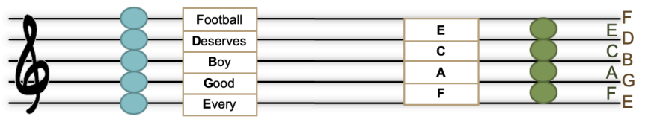
Music
Key Word | Definition
Call and response | one phrase in sung/played and an answering phrase completes the musical idea.
Verse and chorus | Also called verse and refrain, this is a musical vocal form in which a number of verses are each followed by the same chorus.
Hook | The memorable, “catchy” part of the song, usually in the chorus and often containing the title of the song.
Modulation | A change of key
Metre | the way the beat is organised, often into two, three or four beats per bar.
Beat | The regular, underlying pulse in the music.
Rhythm | Patterns of long and short note durations.
Harmony | The combination of two or more notes heard together, usually in chords.
Major triad | A three-note chord using the 1st, 3rd and 5th notes of the major scale.
Minor triad | A three-note chord using the 1st, 3rd and 5th note of the minor scale.
Chord | Two or more notes, heard simultaneously or close together, that create the harmonic basis of a piece or song, often built on triads.
17

Slide 20
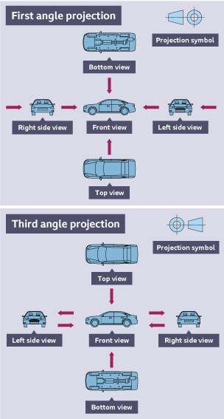
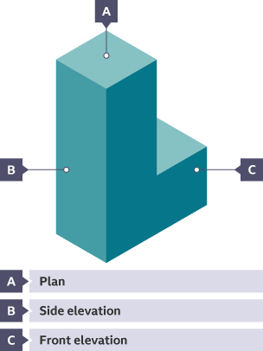
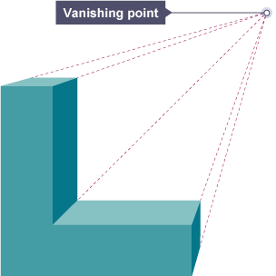
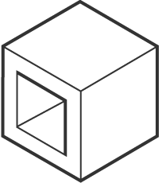
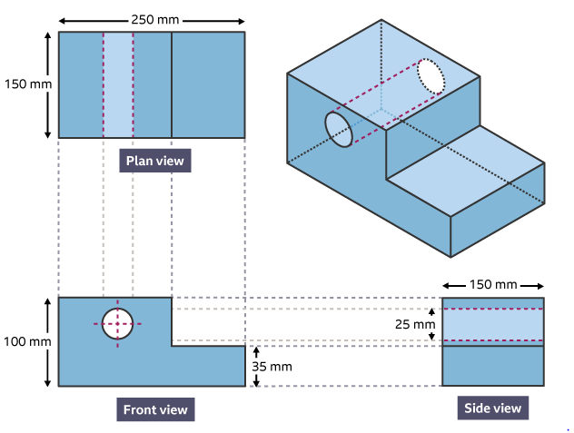
Design and Technology - RM
Year 9
Key Words | Definition
Elevations | The different sides of an item you can see on the drawing.
Isometric Drawing | A 3D representation of a design with horizontal edges drawn at 30 degrees, vertical edges drawn as vertical lines and parallel edges appear as parallel lines
Marking Out | Marks made on an item before cutting or forming.
Perspective Drawing | Shows an object from the front in a realistic way as it gets smaller going into the distance.
Prototyping | The first working model of a design used for testing, development and evaluation.
Orthographic projection | Working drawings in either a first or third angle projection and to show an object from every angle to help manufacturers plan production.
Vanishing Point | The point at which parallel lines meet in the distance.
Working Drawings | An accurate line drawing to show the back and front views of a product, used on a manufacturing specification sheet.
Elevations
In first angle, the view from the right would be projected through and drawn on the left.
Perspective Drawing
Isometric Drawing
Orthographic Projection
In third angle, what you see from the right would be drawn on the right.
18

Slide 21
W/c 1st June Thinking definition: Thinking is making connections, reasoning and asking questions to make the learning stick
Reflecting on learning behaviours for resilience….. | Experience log
 | Successful moment… | In hindsight… Where you could have done better on reflection? | At home…
I gave an idea and reasoned/justified.
I reflected on my idea and made it better after discussing with others
I used a revision strategy to help make the learning stick.
I made connections between what I am learning and the outside world.
I asked questions to deepen my understanding.
19

Slide 22
W/c 8th June Thinking definition: Thinking is making connections, reasoning and asking questions to make the learning stick
Reflecting on learning behaviours for resilience….. | Experience log
 | Successful moment… | In hindsight… Where you could have done better on reflection? | At home…
I gave an idea and reasoned/justified.
I reflected on my idea and made it better after discussing with others
I used a revision strategy to help make the learning stick.
I made connections between what I am learning and the outside world.
I asked questions to deepen my understanding.
20

Slide 23
W/c 15th June Thinking definition: Thinking is making connections, reasoning and asking questions to make the learning stick
Reflecting on learning behaviours for resilience….. | Experience log
 | Successful moment… | In hindsight… Where you could have done better on reflection? | At home…
I gave an idea and reasoned/justified.
I reflected on my idea and made it better after discussing with others
I used a revision strategy to help make the learning stick.
I made connections between what I am learning and the outside world.
I asked questions to deepen my understanding.
21

Slide 24
W/c 22nd June Thinking definition: Thinking is making connections, reasoning and asking questions to make the learning stick
Reflecting on learning behaviours for resilience….. | Experience log
 | Successful moment… | In hindsight… Where you could have done better on reflection? | At home…
I gave an idea and reasoned/justified.
I reflected on my idea and made it better after discussing with others
I used a revision strategy to help make the learning stick.
I made connections between what I am learning and the outside world.
I asked questions to deepen my understanding.
22

Slide 25
W/c 29th June Thinking definition: Thinking is making connections, reasoning and asking questions to make the learning stick
Reflecting on learning behaviours for resilience….. | Experience log
 | Successful moment… | In hindsight… Where you could have done better on reflection? | At home…
I gave an idea and reasoned/justified.
I reflected on my idea and made it better after discussing with others
I used a revision strategy to help make the learning stick.
I made connections between what I am learning and the outside world.
I asked questions to deepen my understanding.
23

Slide 26
W/c 6th July Thinking definition: Thinking is making connections, reasoning and asking questions to make the learning stick
Reflecting on learning behaviours for resilience….. | Experience log
 | Successful moment… | In hindsight… Where you could have done better on reflection? | At home…
I gave an idea and reasoned/justified.
I reflected on my idea and made it better after discussing with others
I used a revision strategy to help make the learning stick.
I made connections between what I am learning and the outside world.
I asked questions to deepen my understanding.
24

Slide 27
W/c 13th July Thinking definition: Thinking is making connections, reasoning and asking questions to make the learning stick
Reflecting on learning behaviours for resilience….. | Experience log
 | Successful moment… | In hindsight… Where you could have done better on reflection? | At home…
I gave an idea and reasoned/justified.
I reflected on my idea and made it better after discussing with others
I used a revision strategy to help make the learning stick.
I made connections between what I am learning and the outside world.
I asked questions to deepen my understanding.
25

Slide 28
Reading Log w/c 1st June (20 mins reading per day – all five logs MUST be completed)
Date | Title of novel | Number of pages read | Summary about what I have read
 |  |  | • • •
 |  |  | • • •
 |  |  | • • •
 |  |  | • • •
 |  |  | • • •
Checked by form tutor:
26

Slide 29
Reading Log w/c 8th June (20 mins reading per day – all five logs MUST be completed)
Date | Title of novel | Number of pages read | Summary about what I have read
 |  |  | • • •
 |  |  | • • •
 |  |  | • • •
 |  |  | • • •
 |  |  | • • •
Checked by form tutor:
27

Slide 30
Reading Log w/c 15th June (20 mins reading per day – all five logs MUST be completed)
Date | Title of novel | Number of pages read | Summary about what I have read
 |  |  | • • •
 |  |  | • • •
 |  |  | • • •
 |  |  | • • •
 |  |  | • • •
Checked by form tutor:
28

Slide 31
Reading Log w/c 22rd June (20 mins reading per day – all five logs MUST be completed)
Date | Title of novel | Number of pages read | Summary about what I have read
 |  |  | • • •
 |  |  | • • •
 |  |  | • • •
 |  |  | • • •
 |  |  | • • •
Checked by form tutor:
29

Slide 32
Reading Log w/c 29th June (20 mins reading per day – all five logs MUST be completed)
Date | Title of novel | Number of pages read | Summary about what I have read
 |  |  | • • •
 |  |  | • • •
 |  |  | • • •
 |  |  | • • •
 |  |  | • • •
Checked by form tutor:
30

Slide 33
Reading Log w/c 6th July (20 mins reading per day – all five logs MUST be completed)
Date | Title of novel | Number of pages read | Summary about what I have read
 |  |  | • • •
 |  |  | • • •
 |  |  | • • •
 |  |  | • • •
 |  |  | • • •
Checked by form tutor:
31

Slide 34
Reading Log w/c 13th July (20 mins reading per day – all five logs MUST be completed)
Date | Title of novel | Number of pages read | Summary about what I have read
 |  |  | • • •
 |  |  | • • •
 |  |  | • • •
 |  |  | • • •
 |  |  | • • •
Checked by form tutor:
32

Slide 35

33

Slide 36

34

Slide 37

35

Slide 38

36

Slide 39

37

Slide 40

38

Slide 41


39

Slide 42
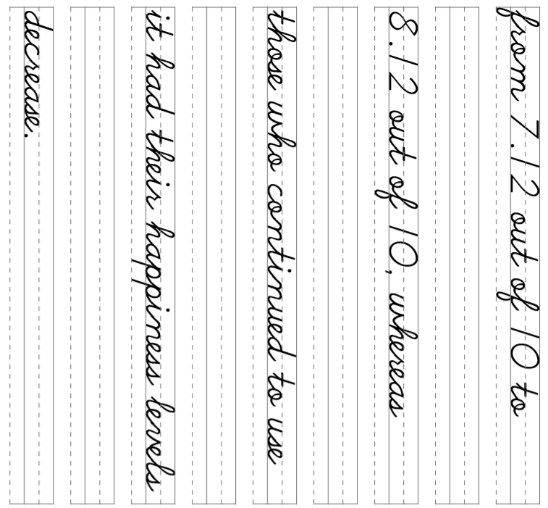
40

Slide 43
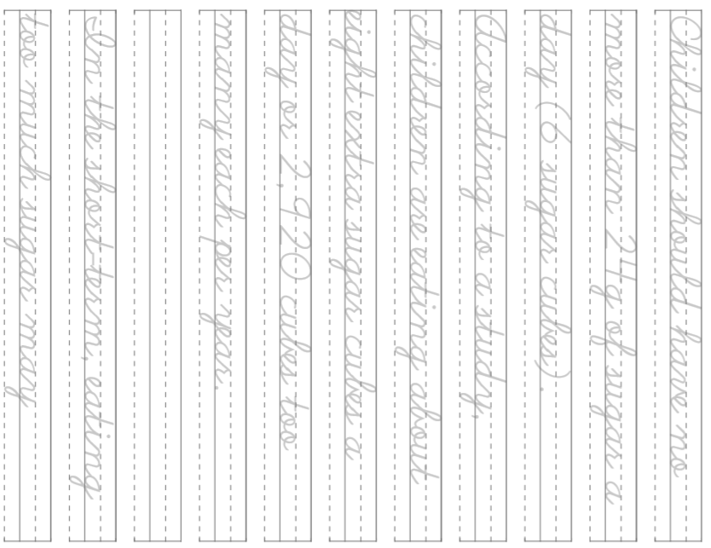
41

Slide 44
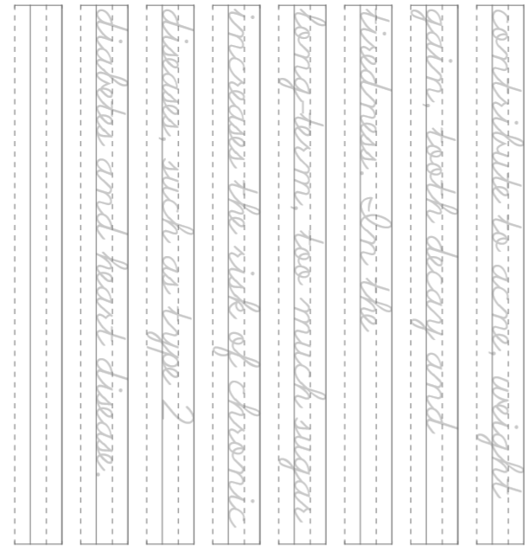
41

