Slide 1

Year 10 Knowledge Organiser HT1
Knowledge is Power
Name: ______________________________
Form: _______

Slide 2
Contents Page
Subject | Page
English | 1
Maths | 2
Science | 4
Spanish | 6
History | 8
Geography | 9
PE | 11
Computing | 14
Art | 16
Performing Arts | 17
Cooking and Nutrition | 18
Psychology | 19
‘Thinking’ reflection log | 21
Reading log | 28
Reading Extracts | 35
Cursive Handwriting Practice | 44

Slide 3
English
Week 3 - Characters
Macbeth | A. loyal warrior who becomes disloyal as he becomes obsessed with the witches’ prophecies of power
Lady Macbeth | Macbeth’s wife who drives his ambition in the beginning but loses her control and sanity by the end.
Banquo | Macbeth’s close friend and ally who also receives prophecies from the witches. He is a foil to Macbeth.
Duncan | King of Scotland at the beginning of the play who is portrayed as a strong and respected leader.
Malcolm | Duncan’s oldest son and next in line to the throne. Joins the English army to defeat Macbeth at the end of the play.
Macduff | Macbeth’s antagonist: A brave warrior who is loyal to Duncan and is consistently suspicious of Macbeth.
Week 5 – Key Terms
Soliloquy | Dramatic device whereby a character stands alone on stage and addresses the audience, giving voice to their deepest thoughts and feelings.
Hubris | An exaggerated self-pride or self-confidence which often leads to a fatal retaliation.
Peripeteia | A sudden turn of events or an unexpected reversal.
Week 1 - Context
Superstition | At the time Shakespeare was writing, many people believed in Witchcraft and so would have seemed believable and frightening to an audience in
Role of Women | Women were expected to obey all men, not be violent or powerful, and be religious. Lady Macbeth defies these gender expectations through her powerful and manipulative ways.
The Real Macbeth | Macbeth is loosely based on true events in Scotland in the 11th Century and would have been known to King James (the monarch after Elizabeth I).
Week 6 – Key Terms
Microcosm | Using a place, group of people or event in the small-scale to represent something larger. For example, the battle at the start of the play is a microcosm for the whole play.
Fate | The belief that all our actions are pre-determined and there is nothing we can do to change our destiny.
Free Will | The belief that we have control over our actions and behaviour and we choose the direction of our lives.
Week 7 - Quotes
Witches | Fair is foul and foul is fair (1.1)
Macbeth | Stars, hide your fires/Let not light see my black and deep desires (1.4)
Lady Macbeth | Come, you spirits… Unsex me here (1.5)
Macbeth | ‘this Duncan/Hath borne his faculties so meek, hath been/ so clear in his great office. (1.7)
Week 2 - Key Literary terms
Tragedy | A serious drama with an unhappy ending, usually resulting in the death of the main characters. This usually evokes sympathy.
Tragic Hero | A character who is usually depicted as perfect and honorable, yet has one ‘fatal flaw’, hamartia.
Foil | A character with qualities that are in contrast with another character.
Catharsis | The process of letting go of or providing liberation from strong or suppressed emotions.
Hamartia | A character’s tragic flaw.
Week 4 - Quotes
Lady Macbeth | When you durst do it, then you were a man (1.7)
Macbeth | Is this a dagger I see before me? (2.1)
Macbeth | Full of scorpions is my mind dear wife (3.2)
Lady Macbeth | All the perfumes of Arabia will not sweeten this little hand (5.1)
Lady Macbeth | Out damned spot (5.1)
Week 8 - Quotes
Witches | Fair is foul, and foul is fair
Lady Macbeth | Screw your courage to the sticking-place
Macbeth | Macbeth shall sleep no more!
1
Notes:
1 and 2

Slide 4
Maths
Percentages
Percentage | Out of 100
Increase | Make bigger
Decrease | Make smaller
Percentage multiplier | A number you multiply by to increase or decrease in one calculation
Per annum | Each year
Simple interest | Same amount every year
Compound interest | Worked out yearly
Percentage change | The percentage increase, decrease or profit
Reverse percentages | Working backwards to fins the original amount after an increase or decrease
Expanding and factorising
Term | A single number or variable
Variable | A symbol used to represent an unknown number
Expression | A minimum of two terms containing numbers or variables
Equation | Two expressions which have the same value, separated by an '=' sign.
Expand | To multiply out brackets in an expression.
Factorise | To put an expression into brackets by taking out a common factor or factors.
Coefficient | A number used to multiply a variable
Quadratic | An expression or equation where its highest exponent is 2
2

Slide 5
Maths
Types of Number
Prime number | A number which has exactly two factors. The number one and itself.
Factor | A number that divides another number exactly.
Multiple | A number which is part of another number's times table.
HCF | Highest Common Factor. It is the largest factor common to a set of numbers.
LCM | Lowest Common Multiple'. It is the smallest multiple common to a set of numbers.
Prime factor | A factor of a number that is a prime number
Surds
Surds | Surds are irrational numbers which cannot be represented accurately so we leave them with the square root sign
Irrational numbers | Are fractions or decimals that do not terminate
Rational numbers | Are integers, fractions or decimals that terminate
Simplifying surds | When we write the surd as two numbers that multiply together, one of which is the highest square number
Multiplying surds | You multiply the numbers and leave them under one square root sign
Adding Surds | You can only add surds if the number under the square root is the same
Rationalising the denominator | Changing the denominator of a fraction from an irrational number to a rational number- removing any surd from the denominator
3

Slide 6
Atomic structure and radiation
Science
Key word | Definition
Atom | The smallest particle substances are made from with a radius of about 1 x 10-10
Atomic number | The number of protons in an element
Proton | A positive particle found in the atoms nucleus
Neutron | A neutral particle found in the atoms nucleus
Electron | A negative particle found in the atoms electron shells around the nucleus
Electron configuration | The way electrons are arranged in shells around the nucleus
Ion | Particle with a charge, positive or negative
Isotope | Different form of an element with a different mass number
Mass number | Number of protons and neutrons in an element
Neutron | Neutral subatomic particle
Nucleus | Central part of an atom compound the nucleus containing neutrons and protons
Outer shell | Shell furthest from nucleus, contains the electrons most likely to take part in a chemical reaction
Proton | Positively charged subatomic particle
Rutherford, Ernest | Scientist who used evidence to support the idea that atoms contain a central nucleus
Shell | Orbit followed by electrons
Subatomic particle | Small particle from which atoms are made
Thomson, J.J. | Scientist who discovered that atoms contain electrons
Key term | Definition
Nuclear Atomic Model | Proposed by Ernest Rutherford after the alpha scattering experiment which suggested the atom had lots of empty space
Bohr, Niels | Scientist who used evidence to support the idea that electrons are found in orbits called energy shells
Chadwick, James | Scientist who discovered the neutron
Dalton, John | Scientist who discovered atoms cannot be broken into anything smaller
Plum Pudding Atomic Model | Proposed by JJ Thompson suggesting atom was a ball of positive charge with negative electrons embedded in it
Radioactive Decay | When radioactive isotopes decay by a random process
Alpha Radiation | Highly ionising, not very penetrating, helium nuclei, positively charged, stopped in air.
Beta Radiation | Quite ionising and penetrating, high speed electron negatively charged, stopped by thin sheet of aluminium
Gamma Radiation | Most penetrating not a particle but an E-M wave
Contamination | When radiation is inside something so that it becomes radioactive.
Irradiation | Exposing an object to radiation. Suitable precautions can be taken to protect yourself
Half Life | The time taken for half the radioactive is
Ionisation | High likely the radiation is to knock of an electron. If happens in a living body it may cause chemical reactions / DNA mutations.
4

Slide 7
Particle Model
Science
Key word | Definition
State of matter | The way in which the particles are arranged – solid, liquid or gas.
Change of state | When a substance changes from one state of matter to another (e.g. melting is the change from a solid to a liquid). Energy changes the state, not the temperature.
Physical change | change that can be reversed to recover the original material. E.g. a change of state
Chemical change | A change that creates new products. It cannot be revered. E.g. a chemical reaction.
Internal energy | The energy stored inside a system by the particles (atoms and molecules) that make up the system. Internal energy is the total kinetic energy and potential energy of all the particles.
Kinetic energy | Energy stored within moving objects (e.g. particles).
Potential energy | Energy stored in particles because of their position. The further apart particles are, the greater the potential energy.
Specific heat capacity | The specific heat capacity of a substance is the amount of energy required to raise the temperature of one kilogram of the substance by one degree Celsius.
Temperature | The average kinetic energy of the particles.
Specific latent heat | The amount of energy required to change the state of one kilogram of the substance with no change in temperature.
Latent heat of fusion | Energy required to change state from solid to liquid.
Latent heat of vaporisation | Energy required to change state from liquid to vapour.
Key word | Definition
Solid | Particles are closely packed, fixed and arranged in regular layers. As more energy is absorbed the kinetic energy and therefore the internal energy of the material increases.
Melting | Temperature doesn’t change. Energy is used to weaken the forces between particles. As more energy is absorbed the potential energy and therefore the internal energy of the material increases.
Liquid | Particles are touching but no longer arranged regularly. They are above to move. As more energy is absorbed the kinetic energy and therefore the internal energy of the material increases.
Gas Pressure | The force exerted by gases on surface as the particles collide with it. As temperature increases, gas pressure increases if the volume stays constant.
Density | How much mass a substance contains compared to its volume. Solids are usually dense because the particles are closely packed
Evaporation | Temperature doesn’t change. Energy is used to weaken the forces between particles. As more energy is absorbed the potential energy and therefore the internal energy of the material increases.
5

Slide 8
Spanish
Spanish | English
A menudo | Often
frecuentemente | Frequently
por la tarde | In the afternoon
por la mañana | In the morning
cada noche | Each night
jámas | Never again
cada fin de semana | Every weekend
barato | Cheap
divertido | Fun
útil | Useful
Lento | Slow
bueno | Good
pelgiroso | Dangerous
Fácil | Easy
aburrido | Boring
caro | Expensive
seguro | secure
Spanish | English
inútil | useless
dificíl | difficult
malo | Bad
rápido | Fast
popular | Popular
apropiado | Appropriate
digital | Digital
un documental sobre … | A documentary about …
el tiempo | The weather
una serie de aventuras | Adventure series
las noticias | News
un programa de cocina | Cooking programme
una telenovela | Soap
un programa de entrevistas | talkshow
un concurso cultura | gameshow
La película | film
El cine | cinema
6

Slide 9
Spanish
Spanish | English
la red social | Social media
el mensaje | Message
La página | Webpage
las noticias | News
la pantalla | Screen
el teclado | Keyboard
el portatíl | Laptop
El móvil | Mobile
una cámara | Camera
la llamada | Call
la televisión | TV
medios de comunicación | Means of communication
el ordenador | Computer
velocidad | Speed
seguiridad | Security
víctima | Victim
protección | protection
Spanish | English
ciberacoso | Cyberbullying
prensa | Press
apropriado | Appropriate
desconocido | Unknown
gratis | Free
influencer | Influencer
riesgo | Risk
seguidor | Follower
resultado | Result
salud | Health
cultura | Culture
sonido | Sound
molesto | Annoy
realidad | Reality
influencia | Influence
mundial | World
nacional | National
7

Slide 10
History
Key Term | Definition
Militia | A non-professional army raised to fight for a particular cause, e.g. to defeat a rebellion or fight a war.
Gentry | High social class ranked below the nobility; they might be local JPs or hold similar office.
Poor Laws | Laws introduced from 1601 to deal with the growing problem of poverty.
Monopoly | The exclusive right to trade in a particular product.
Ruff | An item of clothing worn around the neck.
Monastery | A building occupied by Monks.
Enclosure | An area surrounded by a barrier.
Rack Renting | Demanding an excessive or extortionate rent from a tenant or for a property.
Inflation | A currency becoming worth less, shown through rapidly rising prices.
Urban | Relating to a town or city.
Deserving Poor | People who were poor through no fault of their own; the old, sick or wounded or people who tried to find work but could not.
Key Term | Definition
Almshouse | Charity building set up to provide food and rest for the poor.
Undeserving Poor | Dishonest poor people who tried to trick others out of their money.
Stocks | Punishment for begging; criminals would be held by the hands and feet while people threw things at them.
House of Correction | Where beggars would be forced to spend the night as punishment.
Flogged | To be whipped, a punishment used for begging and other crimes.
Vagrant | A person without a settled home or work who wanders and lives by begging.
Privateer | A ship’s captain with royal permission to attack foreign ships.
Armada | The fleet of Spanish ships sent to attack England in 1588.
Lateen | A triangular sail that allowed ships to move much quicker.
Astrolabe | A navigation tool that allowed for much more accuracy at sea.
Colony | Land controlled by another country.
8

Slide 11
Key Word | Definition
African Union | an organisation of 54 countries formed to encourage co-operation between African nations
Commercial farming | growing crops or raising livestock for profit, often involving vast areas of land
Commonwealth | a voluntary association of 53 independent and equal sovereign states, most being former British colonies
Developmental aid | long-term support given by charities, governments and multi-lateral organisations, which aims to improve quality of life
ECOWAS | (Economic Community of West African States) - a trading group of West African countries
Gross Domestic Product (GDP) | the total value of goods and services produced by a country in a year
Employment structure | relative proportion of the workforce employed in different sectors of the economy
International aid | money, goods and services given by single governments or an organisation like the World Bank or IMF to help the quality of life and economy of another country
Manufacturing | making goods by processing raw materials
Mining | extraction of raw materials from the ground
Newly-Emerging Economies | (NEE) - countries that have begun to experience high rates of economic development, usually along with rapid industrialisation
Oil spills | the accidental leakage of oil from rigs or refineries into the surrounding area, resulting in severe environmental damage and pollution
Primary product | unprocessed raw materials extracted from the earth or agricultural products
Primary sector | employment sector that includes farming, mining and other related activities
Quality of life | how good a person’s life is as measured by such things as quality of housing and environment, access to education, health care, security and levels of happiness
Secondary sector | employment sector that involves manufacturing
Tertiary sector | employment sector that includes service industries, such as health care, offices, financial services and retailing
Transnational corporation | (TNC) - a company that has operations (factories, offices, research and development, shops) in more than one country
Trade | buying and selling of goods and services between countries
Geography
9

Slide 12
Geography
Key Word | Definition
Trading group | countries which have grouped together to increase trade between them by cutting tariffs to discourage trade with non-members
Quaternary sector | employment sector that includes jobs in hi-tech industries, research, information technology and the media
Business park | an area of land occupied by a number of businesses
Commonwealth | the Commonwealth is a voluntary association of 53 independent and equal sovereign states, most being former British colonies
De-industrialisation | the decline of a country's traditional manufacturing industry due to exhaustion of raw materials, loss of markets and overseas competition
Enterprise zones | a scheme supported by the government to encourage new businesses and new jobs in areas where there were no pre-existing businesses
European Union (EU) | a politico-economic union of a number of European countries
Exports | goods and service sold by a country and bought by another country
Financial services | the management of money within the service sector, including banking, insurance, securities dealing, and fund management
Globalisation | process creating a more connected world, with increases in the global movements of goods (trade) and people (migration & tourism)
Imports | goods and services bought by residents of a country from another country
Information technology | computer, internet, mobile phone and satellite technologies
Infrastructure | the basic equipment and structures (such as roads, utilities, water supply and sewage) that are needed for a country or region to function properly
Local Enterprise Partnerships (LEPs) | voluntary partnerships between local authorities and businesses that aim to identify the business needs in the local areas and encourage companies to invest
North–South divide | economic and cultural differences between southern England and the rest of the UK
Post-industrial economy | the shift of some HIC economies from producing goods to providing services
Science park | a collection of scientific and technical knowledge-based businesses located on a single site
Sustainable | actions that meet the needs of the present without compromising the ability of future generations to meet their needs
10

Slide 13
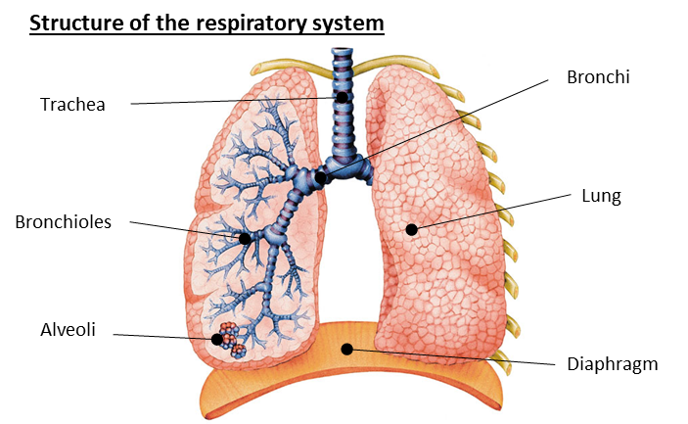
PE
Trachea | The tube that takes air into the chest, also known as the windpipe
Bronchi | Tube along which air passes from the trachea into the lungs
Bronchioles | Smaller branches coming from the bronchi
Alveoli | Tiny air sacs at the end of bronchioles where gaseous exchange takes place
Diaphragm | The primary muscle used in the process of inspiration. A dome-shaped sheet of muscles that separates the chest from the rest of the body cavity.
Respiratory values
Tidal Volume | the amount of air inhaled and exhaled per breath. Resting value = 500ml
Vital Capacity | The maximum amount of air exhaled following a maximal breath in.
Residual volume | The amount of air remaining in the lungs after maximal expiration
Oxygen debt | The amount of oxygen required to remove the lactic acid, and replace the body's reserves of oxygen
Gaseous exchange and diffusion
Gaseous exchange | The movement of oxygen and carbon dioxide between the lungs and the blood at the alveoli
Diffusion | Occurs when gases move from a high concentration to a low concentration
11

Slide 14

PE
Function of the skeleton | Classification of joints
Protection of vital organs | Pivot (neck – atlas and axis)
Muscle attachment | Hinge (elbow and knee)
Joints for movement | Ball and socket (hip and shoulder)
Blood cell production (platelets, red and white) | Condyloid (wrist)
Storage of calcium and phosphorus
Key Term | Definition
Flexion | Decreasing the angle at a joint (bending)
Extension | Increasing the angle at a joint (straightening)
Adduction | Limbs moving towards the midline of the body
Abduction | Limbs moving away from the midline of the body
Rotation | A twisting/turning action around a joint
Circumduction | A combination of flexion, extension, adduction & abduction
Dorsi-Flexion (ankle joint) | When the toes are turned up to the body
Planter-Flexion (ankle joint) | When the toes are pointed away from the body
12

Slide 15

PE
Deoxygenated blood = BLUE (Right side) Oxygenated = RED (Left side)
Components of blood
Red blood cells | Carry oxygen from the lungs to the working muscles + Removes CO2.
Haemoglobin | A protein that binds and carries oxygen molecules.
White blood cells | Are part of the immune system and fight disease and infection.
Platelets | Blood platelets are formed in the bone marrow and are essential in the clotting of blood. Platelets are the workhorses of the cardiovascular system.
Plasma | Blood plasma is made up of 90% water. It contains a range of substances that aids the circulation between cells and tissues.
Arteries | Carry blood away from the heart, Oxygenated blood (except pulmonary artery) Thick/elastic walls High pressure Small lumen
Veins | Carry blood back to the heart Deoxygenated blood (except pulmonary vein) Thin walls + larger lumen Lower pressure Valves
Capillaries | In the tissue Site of gaseous exchange Very thin walls
13

Slide 16
Computing
Real or Float | A decimal number.
Char | A single characters, such as letters, numbers or punctuation symbol.
Concatenate | Joining two strings together using the + symbol.
Casting | Converting the value of a variable from one data type into another.
Flowcharts | A visual representation of an algorithm.
Computer Systems
Embedded System | A computer system built into a larger machine to provide a means of control.
CPU | Main processing unit of the computer, comprising of the Arithmetic and Logic Unit, the Control Unit and the immediate access store.
RAM | The computer’s main memory that holds the data, programs and files while they are being used.
ROM | Stores the boot program / BIOS for when the computer is switched on.
Hard Drive | The storage hardware which stores data permanently.
BIOS | Basic input/output system. This is the program a computer's microprocessor uses to start the computer system after it is powered on.
Operating Systems | The software that manages the hardware and software resources in a computer system.
Programming
Translators | Changing a program written in one language into another language
High-Level Language | Code written in a way that is similar to human language, such as English, making it easier to understand and use the language.
Low-Level Language | This does not closely resemble human language, making it harder for humans to understand and write in.
Assemblers | Turns assembly language into machine code
Compilers | Translates all of the code in one go to create an executable file.
Interpreters | Translates the code one instruction at a time.
IDE | Integrated Development Environment. Helps programmers to create programs with the help of tools.
Syntax Error | Something which doesn’t fit the rules or grammar of the programming language.
Sequence | Programming steps that are carried out one after another.
Variables | A value which may change while the program is running.
Data | A unit of information without context, measured in bits
String | A sequence of characters, including letters, numbers and punctuation.
Integer | A whole number.
Boolean | An answers that only has two possible values e.g. True and False.
14

Slide 17
Computing
Utility Software | A program which performs important maintenance tasks to improve the performance of a computer system.
Input Device | A device which introduced data to the computer.
Output Device | A device which displays data from the computer.
Computer Architecture | The way a computer is designed and structured.
Control Unit | Executes instructions and controls the flow of data in the CPU.
ALU | Does all of the calculations and logical operations.
Registers | A small storage space for temporary data in the CPU.
Buses | Data transferred between components on pathways.
FDE Cycle | Fetch Decode Execute. This is performed by the CPU millions of times every second. This cycle is how the CPU processes data and instructions for each program or service that requires its attention.
Volatile | Data lost whenever the power is turned off.
Non-Volatile | Data is saved even when not being powered.
Virtual Memory | Programs must be stored in RAM to be processed by the CPU. Even if there is insufficient space in RAM for all programs the computer can use the hard disk drive (HDD) as an extension of RAM.
Cache | Very fast memory that stores regularly used data so that the CPU can access it quickly.
Secondary Storage | Storage used to save and store data that can be accessed repeatedly.
Optical | Portable and generally used to store music, videos, movies. Uses photo-sensitive materials and effects of light (laser light) to store data.
Magnetic | Used to hold data, instructions and software applications. Stores data using magnetic field.
Cloud Storage | Networks of servers accessed on the internet.
Clock Speed | The measure of how quickly a CPU can process information.
Cache Memory | Temporary storage for frequently accessed data.
Cores | A complete set of CPU components.
Operating System | The software that controls the hardware components.
Logic Gates | Symbols used to represent circuits of transistors within a computer
Truth Table | A table used to show all possible inputs and the associated output for each input.
Pseudocode | A simple way of describing a set of instructions that does not have to use specific syntax.
15

Slide 18
Art
Key Word | Definition
Identity | Identity is the qualities, beliefs, personality traits, appearance, and/or expressions that characterize a person or group
Gender | either of the two sexes (male and female), especially when considered with reference to social and cultural differences rather than biological ones. The term is also used more broadly to denote a range of identities that do not correspond to established ideas of male and female.
Artist Analysis | An Artist study is the breakdown of the artistic elements in an artwork to discover how it portrays meaning. Analysing art is an aspect that many students find difficult, practicing it will help you develop your language and skills.
Artist Transcription | Transcription in painting is copying, but often with a different purpose than to produce a replica. Artists use transcription to learn how another artist worked: how she constructed her painting, produced brush strokes and visual effects, and how they mixed colours
Critic | a person who judges the merits of literary or artistic works, especially one who does so professionally.
Context | Specific to artwork, context consists of all of the things about the artwork that might have influenced the artwork or the maker (artist) but which are not actually part of the artwork.
Culture | the ideas, customs, and social behaviour of a particular people or society
16

Slide 19
Performing Arts
Blood Brothers
Themes
Social Class | Family and friendship for characters from two different social classes form the heart of the play. Russell shows how wealth brings privilege, even down to the way the Johnstone's and the Lyons are treated differently by the law. The four main characters can be seen to be social stereotypes, presented dramatically in order to emphasise certain important differences in social class. Russell does this to show the unfairness that results.
Nature vs Nurture | The 'nature versus nurture' debate is about how much a persons life is determined by their inherited genetics (their 'nature') and how much is determined by the environment they grow up in ('nurture'). The boys are identical twins and so the difference in the way their lives turn out must be a result of their different upbringings and social positions. Russell uses the twins idea to persuade us that attitudes in society influence peoples lives more than their individual efforts at wanting to do well.
Money | Materialism as a theme. Mrs. Johnstone’s life in debt, buying things on the ‘never-never’, leads to problems. Mrs Lyons’ wealthy existence fails to bring her contentment. Money controls the relationship of Edward and Mickey too – once Edward returns from university as a wealthy, he cannot appreciate Mickey's reaction to being jobless. And nor can Mickey's pride allow him to accept financial help from Edward.
Growing Up | Life, for the children, is shown to be a carefree game in Act One. But the pressures of growing up in different backgrounds/ educational systems bring problems later
Fate & Destiny | Mrs Lyons manipulates Mrs Johnstone’s superstitious character. Each of the leading characters are trapped by misfortune. Is there such a thing as fate or destiny or does whether life pan out because of the way we are educated and live.
Drama Techniques
Dramatic Irony | The audience are aware throughout the entire play that both Mickey and Edward are twins, but the characters do not find out until the very last scene,
Monologue | a speech presented by a single character, most often to express their mental thoughts aloud
Split Scene | in drama and theatre the term is used to describe two or more scenes which are performed on stage at the same time
Improvisation | something created spontaneously
Foreshadowing | be a warning or an indication of future events
The fourth wall | The Narrator and Mrs Johnstone break the fourth wall when they speak to the audience directly at the beginning and end of the play
The features of tragedy | The tragic hero Hamartia - The fatal character flaw of the tragic hero Catharsis - The release of the audience's emotions through empathy with the characters. Internal Conflict - The struggle characters engage with over incidents/flaws
17

Slide 20
Cooking and Nutrition
Key Word | Definition
Food Contamination | The presence of unwanted foreign body in food that can cause illness or harm
Physical Contamination | When something that can be seen visibly falls into the food
Chemical contamination | When chemicals such as cleaning agents or pest control products get into the food
Cross contamination | Transfer of bacteria from one person, object or place to another
4Cs | The four principles for food safety: clean, cook, chill, cross contamination
Bacteria | Small single celled organisms that can only be seen under a microscope
High Risk Food | Food that provides the ideal conditions for bacterial growth
Pathogens | Harmful bacteria that cause food poisoning
Hazard | Something that is dangerous and likely to cause damage
Risk | How likely it is that someone may be harmed or injured by a hazard
Risk Assessment | A process that is used to identify and evaluate the level of risk of a hazard causing harm or injury
Control Measure | An activity or action that is put in place to prevent or reduce the risk of a hazard causing harm or injury
HACCP | Hazard Analysis Critical Control Point This is a food safety management system to identify hazards to food safety
18

Slide 21
Psychology
Week 1 – Aims & Hypotheses
Aim | General purpose of the study/investigation
Hypothesis | A hypothesis is a precise, testable statement of what the researcher predicts will be the outcome of the study.
Independent Variable (IV) | The variable that the experimenter manipulates (changes)
Dependent Variable (DV) | The variable which is measured by the experimenter after they have manipulated the IV.
Operationalise | Clearly defining the variables so they are measurable (e.g intelligence would be operationalised to ‘scores on IQ test’)
Alternative Hypothesis | Predicts a difference or correlation in the findings.
Null Hypothesis | Predicts no difference or correlation in the findings
Week 3 – Overcoming Extraneous Variables
Standardised instructions | Instructions should be either be written down or read aloud to participants by the same experimenter, each time.
Standardised procedures | All participants should receive the same information throughout the experiment. Only the IV should change.
Randomisation | Randomly allocate participants to the experimental group or control group to reduce bias.
Week 4 – Types of Experiment
Type | Lab | Field | Natural
Setting | Controlled environment | Natural setting | Natural setting
IV | Manipulated by researcher | Manipulated by researcher | Varies naturally e.g sex or age
Strengths | Easier to control Evs, easier to identify cause and effect . Controlled and standardised so easy to replicate by other researchers | Participants act more naturally so higher validity May not know they are being observed | High validity involving real life changes Participants are likely to act naturally
Weaknesses | May not represent every day life – decreasing validity Demand characteristics are more likely | Less control over EV’s, decreasing the validity Ethical issues regarding consent | Less control over EV’s – decreasing validity Research carried out in a natural setting is very difficult to replicate, due to the changing nature of the setting.
Week 2 – Extraneous Variables (EV’s)
Extraneous variables | Extra variables that may interfere with the relationship between the IV and DV.
Situational variables | Lighting, noise, environment, time of day.
Participant variables | Age, IQ, eyesight, personality
Investigator effects | The investigators bias towards one group
Order effects | Practice or boredom
Demand characteristics | Participants guessing the aim of the experiments and changing their behaviour accordingly
Social Desirability bias | Participants changing their behaviour to be more socially favourable
19

Slide 22



Psychology
Week 5 – Experimental Design
Experimental Design | Experiments design refers to which conditions the participants will take part in
Independent groups | Each participant is only assigned to one condition of the IV.
Repeated Measures | Each participant takes part in both conditions of the experiment.
Matches pairs | You have different participants in two different conditions, but you match them according to certain variables, such as age, personality, gender, IQ etc.
Week 6 – Sampling Methods
1.Target population | The large group of people the researcher wishes to study
2. Random sample | Every member of the target population has an equal chance of being selected for the sample.
3. Opportunity sample | People who are members of the target population and are available and willing to take part in research.
5. Systematic sample | Every ‘nth’ member of the target population is selected for the sample.
5. Stratified sample | The different subgroups in the target population are identified; then people are selected randomly from these subgroups in proportion to their numbers in the target population.
20

Slide 23
W/c 8th September Thinking definition: Thinking is making connections, reasoning and asking questions to make the learning stick
Reflecting on learning behaviours for thinking… | Experience log
 | Successful moment… | In hindsight… Where you could have done better on reflection? | At home…
I gave an idea and reasoned/justified.
I reflected on my idea and made it better after discussing with others
I used a revision strategy to help make the learning stick.
I made connections between what I am learning and the outside world.
I asked questions to deepen my understanding.
21

Slide 24
W/c 15th September Thinking definition: Thinking is making connections, reasoning and asking questions to make the learning stick
Reflecting on learning behaviours for thinking… | Experience log
 | Successful moment… | In hindsight… Where you could have done better on reflection? | At home…
I gave an idea and reasoned/justified.
I reflected on my idea and made it better after discussing with others
I used a revision strategy to help make the learning stick.
I made connections between what I am learning and the outside world.
I asked questions to deepen my understanding.
22

Slide 25
W/c 22nd September Thinking definition: Thinking is making connections, reasoning and asking questions to make the learning stick
Reflecting on learning behaviours for thinking… | Experience log
 | Successful moment… | In hindsight… Where you could have done better on reflection? | At home…
I gave an idea and reasoned/justified.
I reflected on my idea and made it better after discussing with others
I used a revision strategy to help make the learning stick.
I made connections between what I am learning and the outside world.
I asked questions to deepen my understanding.
23

Slide 26
W/c 29th September Thinking definition: Thinking is making connections, reasoning and asking questions to make the learning stick
Reflecting on learning behaviours for thinking… | Experience log
 | Successful moment… | In hindsight… Where you could have done better on reflection? | At home…
I gave an idea and reasoned/justified.
I reflected on my idea and made it better after discussing with others
I used a revision strategy to help make the learning stick.
I made connections between what I am learning and the outside world.
I asked questions to deepen my understanding.
24

Slide 27
W/c 6th October Thinking definition: Thinking is making connections, reasoning and asking questions to make the learning stick
Reflecting on learning behaviours for thinking… | Experience log
 | Successful moment… | In hindsight… Where you could have done better on reflection? | At home…
I gave an idea and reasoned/justified.
I reflected on my idea and made it better after discussing with others
I used a revision strategy to help make the learning stick.
I made connections between what I am learning and the outside world.
I asked questions to deepen my understanding.
25

Slide 28
W/c 13th October Thinking definition: Thinking is making connections, reasoning and asking questions to make the learning stick
Reflecting on learning behaviours for thinking… | Experience log
 | Successful moment… | In hindsight… Where you could have done better on reflection? | At home…
I gave an idea and reasoned/justified.
I reflected on my idea and made it better after discussing with others
I used a revision strategy to help make the learning stick.
I made connections between what I am learning and the outside world.
I asked questions to deepen my understanding.
26

Slide 29
W/c 20th October Thinking definition: Thinking is making connections, reasoning and asking questions to make the learning stick
Reflecting on learning behaviours for thinking… | Experience log
 | Successful moment… | In hindsight… Where you could have done better on reflection? | At home…
I gave an idea and reasoned/justified.
I reflected on my idea and made it better after discussing with others
I used a revision strategy to help make the learning stick.
I made connections between what I am learning and the outside world.
I asked questions to deepen my understanding.
27

Slide 30
Reading Log w/c 8th September (20 mins reading per day – all five logs MUST be completed)
Date | Title of novel | Number of pages read | Summary about what I have read
 |  |  | • • •
 |  |  | • • •
 |  |  | • • •
 |  |  | • • •
 |  |  | • • •
Checked by form tutor:
28

Slide 31
Reading Log w/c 15th September (20 mins reading per day – all five logs MUST be completed)
Date | Title of novel | Number of pages read | Summary about what I have read
 |  |  | • • •
 |  |  | • • •
 |  |  | • • •
 |  |  | • • •
 |  |  | • • •
Checked by form tutor:
29

Slide 32
Reading Log w/c 22nd September (20 mins reading per day – all five logs MUST be completed)
Date | Title of novel | Number of pages read | Summary about what I have read
 |  |  | • • •
 |  |  | • • •
 |  |  | • • •
 |  |  | • • •
 |  |  | • • •
Checked by form tutor:
30

Slide 33
Reading Log w/c 29th September (20 mins reading per day – all five logs MUST be completed)
Date | Title of novel | Number of pages read | Summary about what I have read
 |  |  | • • •
 |  |  | • • •
 |  |  | • • •
 |  |  | • • •
 |  |  | • • •
Checked by form tutor:
31

Slide 34
Reading Log w/c 6th October (20 mins reading per day – all five logs MUST be completed)
Date | Title of novel | Number of pages read | Summary about what I have read
 |  |  | • • •
 |  |  | • • •
 |  |  | • • •
 |  |  | • • •
 |  |  | • • •
Checked by form tutor:
32

Slide 35
Reading Log w/c 13th October (20 mins reading per day – all five logs MUST be completed)
Date | Title of novel | Number of pages read | Summary about what I have read
 |  |  | • • •
 |  |  | • • •
 |  |  | • • •
 |  |  | • • •
 |  |  | • • •
Checked by form tutor:
33

Slide 36
Reading Log w/c 20th October (20 mins reading per day – all five logs MUST be completed)
Date | Title of novel | Number of pages read | Summary about what I have read
 |  |  | • • •
 |  |  | • • •
 |  |  | • • •
 |  |  | • • •
 |  |  | • • •
Checked by form tutor:
34

Slide 37
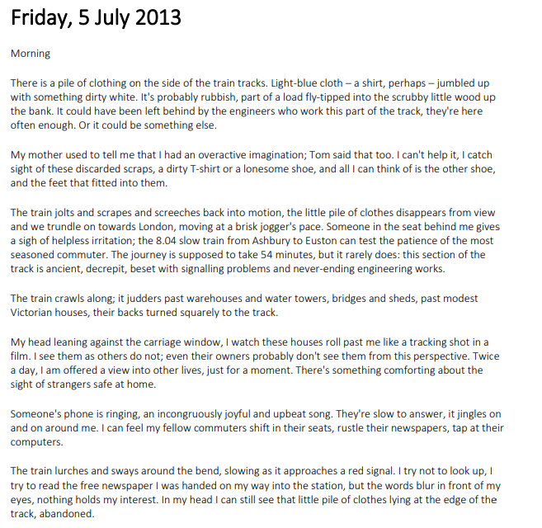
1. The Girl on the Train – Paula Hawkins
Vocabulary:
Jolts / Judders – sudden shaking movements
Trundle – to move slowly and heavily
Seasoned commuter – someone experienced in daily travel
Decrepit – old and falling apart
Beset – troubled or affected by something constantly
35
Notes:
Ok, so let’s all have the extract in front of us. I am going to read now and you are going to follow with your finger or ruler.
READ THE EXTRACT. PAUSE ON THE WORDS THAT THE STUDENTS MAY NOT KNOW.

Slide 38
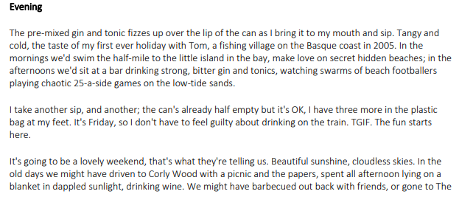
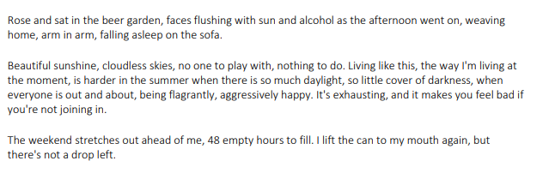
1. The Girl on the Train – Paula Hawkins
Vocabulary:
Jolts / Judders – sudden shaking movements
Trundle – to move slowly and heavily
Seasoned commuter – someone experienced in daily travel
Decrepit – old and falling apart
Beset – troubled or affected by something constantly
36

Slide 39
2. Legend – Marie Lu
Vocabulary:
JumboTrons – very large outdoor digital screens used in cities for advertising or news
Disrepair – bad condition because something has not been taken care of
Elector Primo – a fictional title, likely a ruler or political leader
Newsboy cap – a flat, rounded cap with a small stiff brim
PART ONE
THE BOY WHO WALKS IN THE LIGHT
MY MOTHER THINKS I’M DEAD.
Obviously I’m not dead, but it’s safer for her to think so.
At least twice a month, I see my Wanted poster flashed on the JumboTrons scattered throughout downtown Los Angeles. It looks out of place up there. Most of the pictures on the screens are of happy things: smiling children standing under a bright blue sky, tourists posing before the Golden Gate Ruins, Republic commercials in neon colors. There’s also anti-Colonies propaganda. “The Colonies want our land,” the ads declare. “They want what they don’t have. Don’t let them conquer your homes! Support the cause!”
Then there’s my criminal report. It lights up the JumboTrons in all its multicolored glory:
WANTED BY THE REPUBLIC
FILE NO: 462178-3233 “DAY”
------------------------------------–
WANTED FOR ASSAULT, ARSON, THEFT,
DESTRUCTION OF MILITARY PROPERTY,
AND HINDERING THE WAR EFFORT
200,000 REPUBLIC NOTES FOR
INFORMATION LEADING TO ARREST
They always have a different photo running alongside the report. One time it was a boy with glasses and a head full of thick copper curls. Another time it was a boy with black eyes and no hair at all. Sometimes I’m black, sometimes white, sometimes olive or brown or yellow or red or whatever else they can think of.
In other words, the Republic has no idea what I look like. They don’t seem to know much of anything about me, except that I’m young and that when they run my fingerprints they don’t find a match in their databases. That’s why they hate me, why I’m not the most dangerous criminal in the country, but the most wanted. I make them look bad.
37
Notes:
Ok, so let’s all have the extract in front of us. I am going to read now and you are going to follow with your finger or ruler.
READ THE EXTRACT. PAUSE ON THE WORDS THAT THE STUDENTS MAY NOT KNOW.

Slide 40
Legend – Marie Lu
Vocabulary:
JumboTrons – very large outdoor digital screens used in cities for advertising or news
Disrepair – bad condition because something has not been taken care of
Elector Primo – a fictional title, likely a ruler or political leader
Newsboy cap – a flat, rounded cap with a small stiff brim
It’s early evening, but it’s already pitch-black outside, and the JumboTrons’ reflections are visible in the street’s puddles. I sit on a crumbling window ledge three stories up, hidden from view behind rusted steel beams. This used to be an apartment complex, but it’s fallen into disrepair. Broken lanterns and glass shards litter the floor of this room, and paint is peeling from every wall. In one corner, an old portrait of the Elector Primo lies faceup on the ground. I wonder who used to live here—no one’s cracked enough to let their portrait of the Elector sit discarded on the floor like that.
My hair, as usual, is tucked inside an old newsboy cap. My eyes are fixed on the small one-story house across the road. My hands fiddle with the pendant tied around my neck.
Tess leans against the room’s other window, watching me closely. I’m restless tonight and, as always, she can sense it.
The plague has hit the Lake sector hard. In the glow of the JumboTrons, Tess and I can see the soldiers at the end of the street as they inspect each home, their black capes shiny and worn loose in the heat. Each of them wears a gas mask. Sometimes when they emerge, they mark a house by painting a big red X on the front door. No one enters or leaves the home after that—at least, not when anyone’s looking.
“Still don’t see them?” Tess whispers. Shadows conceal her expression.
In an attempt to distract myself, I’m piecing together a makeshift slingshot out of old PVC pipes. “They haven’t eaten dinner. They haven’t sat down by the table in hours.” I shift and stretch out my bad knee.
“Maybe they’re not home?”
38
Notes:
Ok, so let’s all have the extract in front of us. I am going to read now and you are going to follow with your finger or ruler.
READ THE EXTRACT. PAUSE ON THE WORDS THAT THE STUDENTS MAY NOT KNOW.

Slide 41
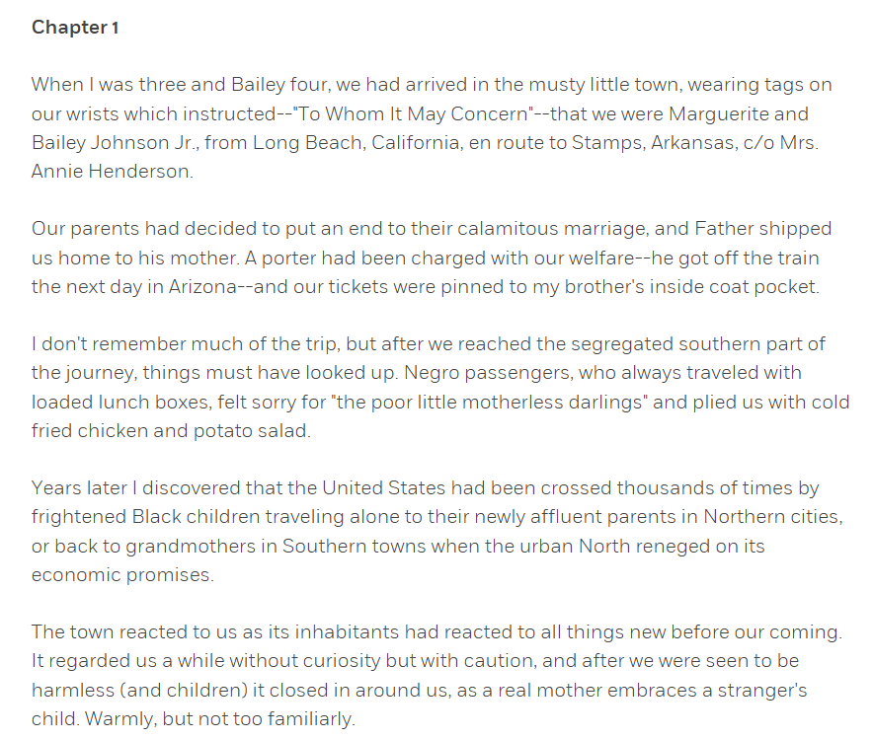
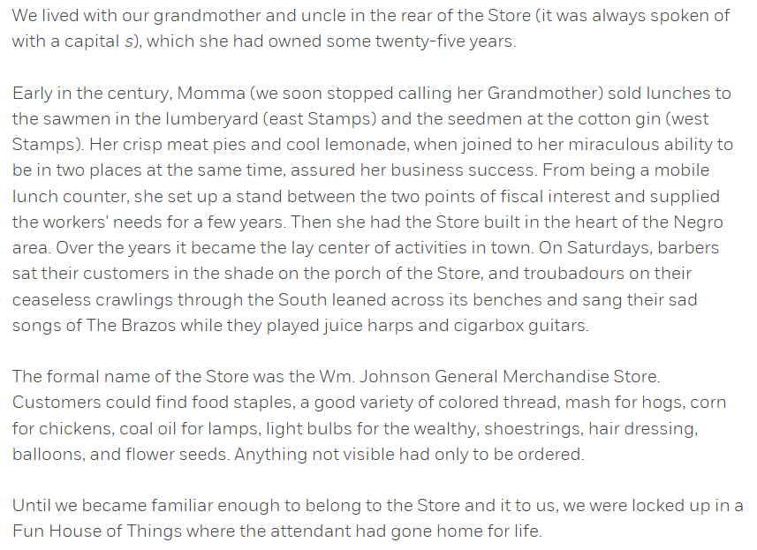
3. I know Why the Caged Bird Sings – Maya Angelou
Vocabulary:
Calamitous - causing great damage, disaster, or suffering.
Segregated -Separated or kept apart, based on race, gender, or class
Affluent - Having a lot of money and wealth; rich.
Inhabitants - People (or animals) who live in a particular place.
Fiscal - Related to money, taxes, or government finances.
39
Notes:
Ok, so let’s all have the extract in front of us. I am going to read now and you are going to follow with your finger or ruler.
READ THE EXTRACT. PAUSE ON THE WORDS THAT THE STUDENTS MAY NOT KNOW.

Slide 42
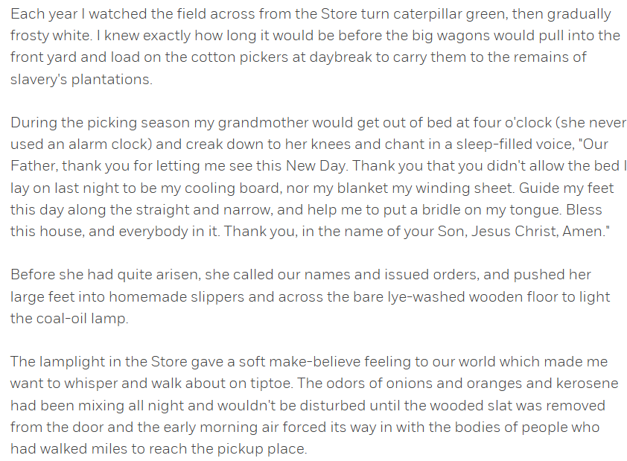
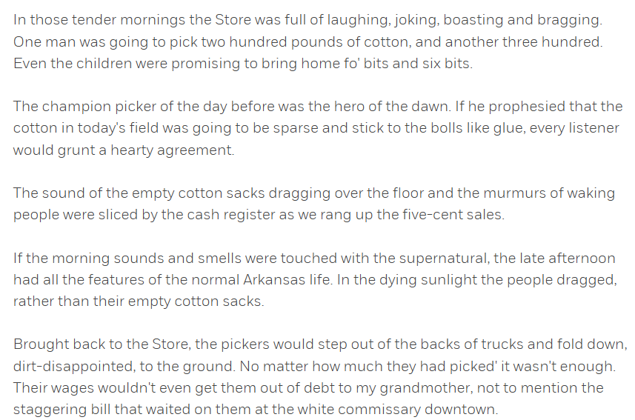
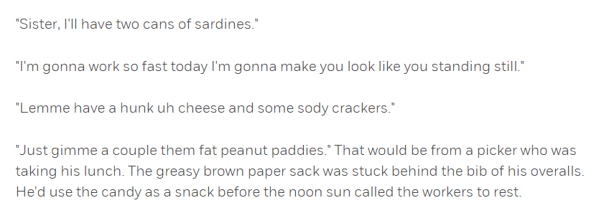
3. I know Why the Caged Bird Sings – Maya Angelou
Vocabulary:
Bridle - A set of straps put around a horse’s head to control it, usually attached to a bit and reins
Lye-washed -Washed or cleaned with lye, a strong alkaline chemical that was historically used in soap-making.
Prophesied - Predicted or foretold something
40
Notes:
Ok, so let’s all have the extract in front of us. I am going to read now and you are going to follow with your finger or ruler.
READ THE EXTRACT. PAUSE ON THE WORDS THAT THE STUDENTS MAY NOT KNOW.

Slide 43
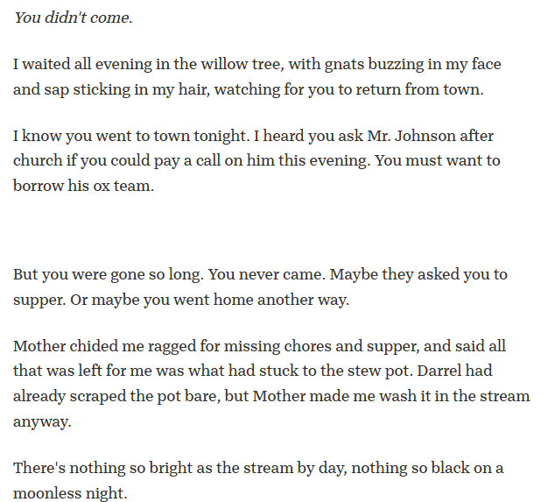
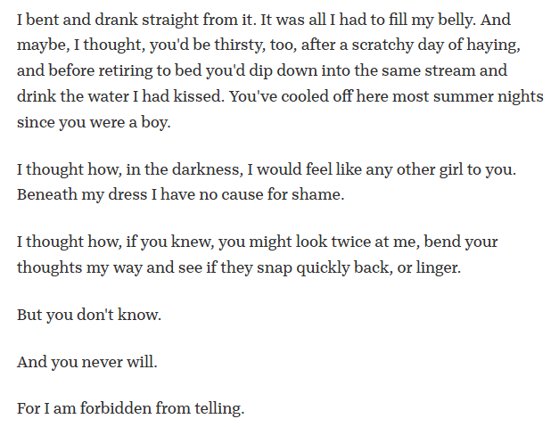
4. All the Truth that’s in Me – Julie Berry
Vocabulary:
Moonless – a night with no visible moon, very dark
Ox team – a pair or group of oxen used for farming or pulling loads
Chided – scolded or told off gently but firmly
41
Notes:
Ok, so let’s all have the extract in front of us. I am going to read now and you are going to follow with your finger or ruler.
READ THE EXTRACT. PAUSE ON THE WORDS THAT THE STUDENTS MAY NOT KNOW.

Slide 44
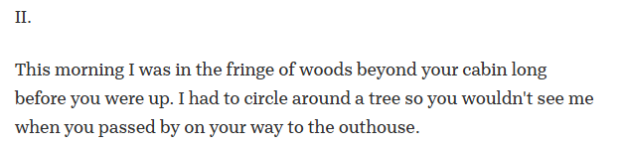
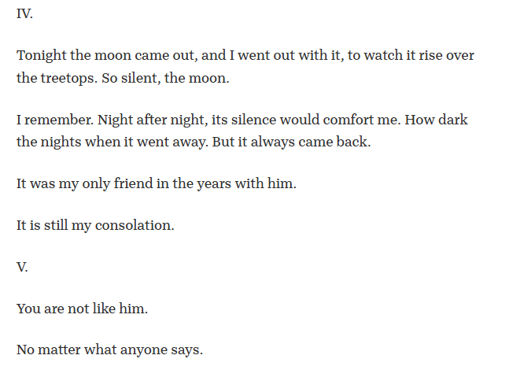
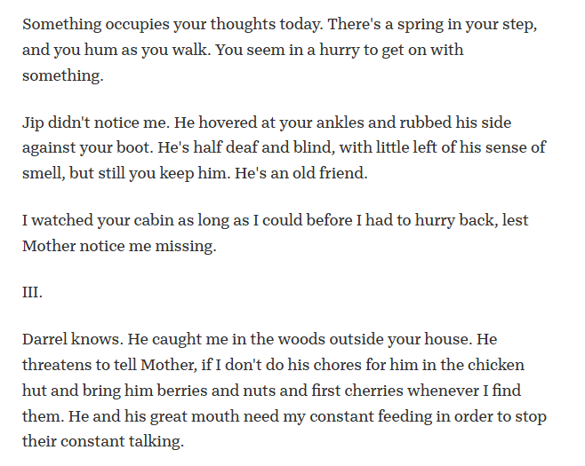
4. All the Truth that’s in Me – Julie Berry
42
Notes:
Ok, so let’s all have the extract in front of us. I am going to read now and you are going to follow with your finger or ruler.
READ THE EXTRACT. PAUSE ON THE WORDS THAT THE STUDENTS MAY NOT KNOW.

Slide 45
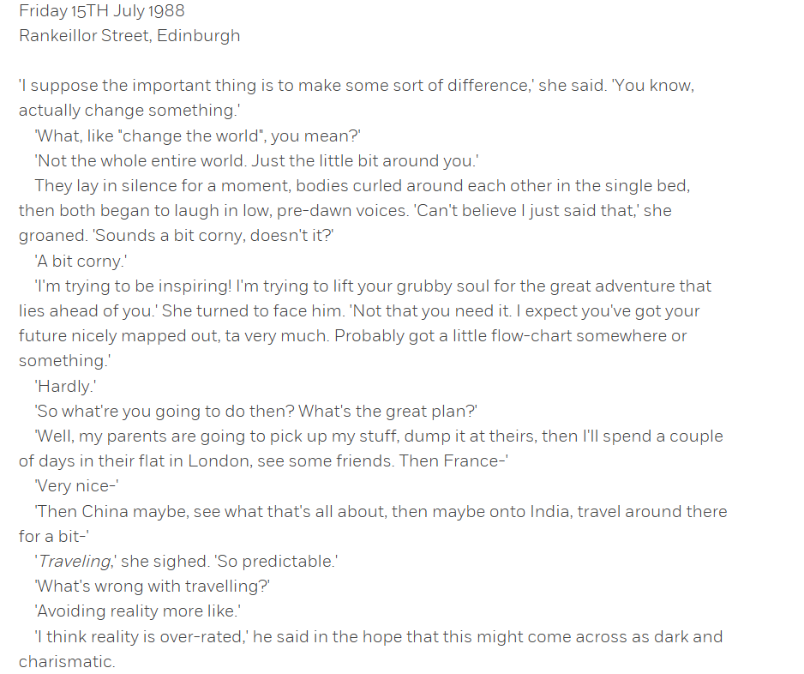
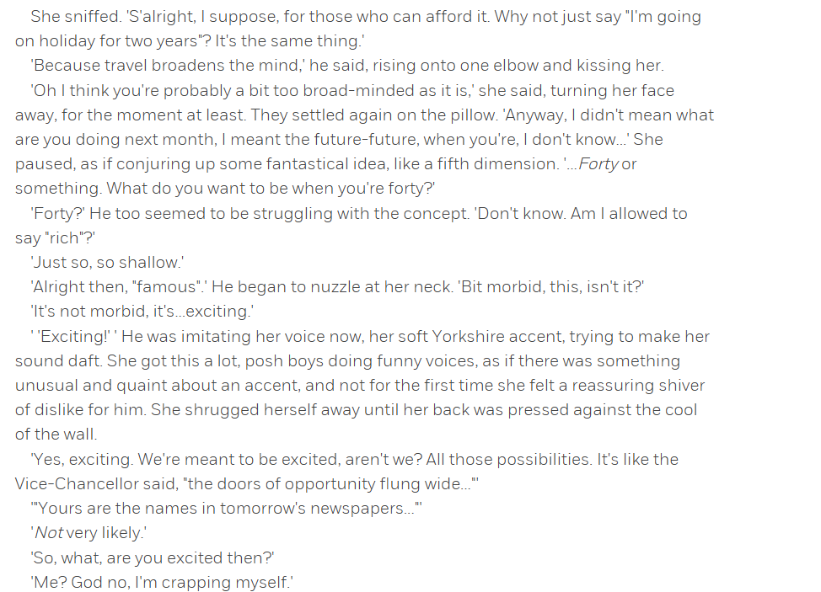
5. One Day – David Nicholls
Vocabulary:
Morbid – focused on death, gloom, or something disturbing
43
Notes:
Ok, so let’s all have the extract in front of us. I am going to read now and you are going to follow with your finger or ruler.
READ THE EXTRACT. PAUSE ON THE WORDS THAT THE STUDENTS MAY NOT KNOW.

Slide 46

44

Slide 47

45

Slide 48

46

Slide 49

47

Slide 50

48

Slide 51

49

