Slide 1

Year 10 Knowledge Organiser HT2
Knowledge is Power
Name: ______________________________
Form: _______

Slide 2
Contents Page
Subject | Page
English | 1
Maths | 2
Science | 4
Spanish | 6
History | 7
Geography | 8
PE | 10
Computing | 14
Art | 15
Cooking and Nutrition | 16
Performing Arts | 17
Psychology | 18
‘Thinking’ reflection log | 18
‘Thinking’ reflection log | 19
Reading log | 26
Reading Extracts | 33
Cursive Handwriting Practice | 42

Slide 3
English
Week 3 - Characters
Scrooge | The protagonist of the Novella, The miserly owner of a London counting-house who the ghosts try to help change.
Marley’s Ghost | Ebenezer Scrooge's partner. Marley died seven years before the narrative opens. He appears to Scrooge as a ghost condemned to wander the world bound in heavy chains.
Ghost of Christmas Past | The first spirit to visit Scrooge, a curiously childlike apparition with a glowing head. He takes Scrooge on a tour of Christmases in his past.
Ghost of Christmas Present | The second spirit to visit Scrooge, a majestic giant clad in a green robe. His lifespan is restricted to Christmas Day.
Ghost of Christmas Yet to Come | The third and final spirit to visit Scrooge, a silent phantom clad in a hooded black robe, that shows Scrooge his future.
Bob Cratchit | Scrooge's clerk, a kind, mild, and very poor man with a large family. Though treated harshly by his boss, Cratchit remains a humble and dedicated employee.
Week 5 – Key Terms
Benevolent | Being kind, generous and willing to help people.
Antithesis | A person or thing that is the direct opposite of someone of something else.
Didactic | A moral message, meaning to give instructions.
Novella | A short novel.
Redemption | The act of saving or being saved from sin, error or evil.
Misanthropic | A person who dislikes other people.
Stave | A set of 5 horizontal lines where music is written.
Purgatory | A medieval Christian belief which is a limbo between hell and life which gives you another chance to change and be ready for heaven.
Week 1 - Context
Charles Dickens 1812-1870 | Dickens was born into a middle class family, however, his father experienced financial difficulty which meant he was put into a debtor’s prison.
Workhouses | In 1834 ‘The New Poor Law’ was introduces which stated that for the poor to receive money or support they were to go to the workhouses, which were harsh and unforgiving prisons.
The Industrial Revolution | Dickens wrote ACC at the end of the Industrial Revolution. The mechanisation of industry meant less demand for workers, therefore many found themselves in poverty.
Week 2 - Key Literary Terms
Allegory | An allegory is a simple story that represents a larger point about society or human nature.
Socialist | Someone who advocates the rights of the working class and having society’s income redistributed to public services.
Capitalist | Someone who advocates for assets to be owned by private firms and limited government spending on public services.
Proletariat | Working class people whose only economical power is their manual labour.
Bourgeoisie | Middle and upper class of society who own most of society’s wealth and means of production.
Week 4 - Quotes
About Scrooge | ‘As solitary as an oyster.’
Marley’s Ghost | ‘Mankind was my business.’
Belle | ‘Another idol has displaced me.’
About Ignorance and Want | The boy is ignorance. The girl is want. Beware them both and all of their degree, but most of all, beware this boy’.
Week 6 - Quotes
About Tiny Tim | ‘If these shadows remain unaltered by the future, the child will die.’
About Scrooge’s Grave | ‘overrun by grass and weeds.’
Scrooge | ‘The Spirits of all Three shall strive within me.’
Scrooge | ‘I am as light as a feather, I am a happy as an angel, I am as merry as a school-boy. I am as giddy as a drunken man.’
Week 7 – Key themes
Social injustice | The Christmas spirit
Responsibility | Social responsibility
Greed | Charity
Family | Isolation
Redemption | Supernatural
Poverty | Transformation
1
Notes:
1 and 2

Slide 4
Straight Line Graphs
X-axis | Horizontal axis (goes across)
Y-axis | Vertical axis (goes up)
Co-ordinate | Two numbers that locate a specific points on a grid (x, y)
Linear graph | A straight line on a graph
y = mx + c | This is the format of a linear graph (straight line). m = gradient, y = y-intercept
Gradient | The steepness of a line. The steeper the line, the higher the gradient.
Positive gradient | Line slopes upwards
Negative gradient | Line slopes downwards
y – intercept | Where the line crosses the y-axis
Quadratic graphs
Table of values | Used to generate the co-ordinates for the graph
Quadratic equation | Has an x² in the equation
Quadratic graphs | Is a curve with a vertical line of symmetry
Parabola | The name of the curved shaped made by the graph
Turning point | The maximum of minimum point of the curve given as a co-ordinate
Roots | The x values where the parabola crosses the x axis
Maths
Indices
Indices | Powers. Indices is the plural of index
Exponent | A mathematical notation that represents how many times a number, called the base, is multiplied by itself
Base | The number that gets multiplied when using an exponent.
Reciprocal | The reciprocal of a number is the number you would have to multiply it by to get the answer 1
Algebra
Term | A single number or variable
Variable | A symbol used to represent an unknown number
Equation | Two expressions which have the same value, separated by an '=' sign.
Formula | A rule or relationship that uses more than one letter variable
Subject | The variable that is being isolated on one side of the equation or formula
Changing the subject | Rearranging a formula to isolate a specific variable
2

Slide 5
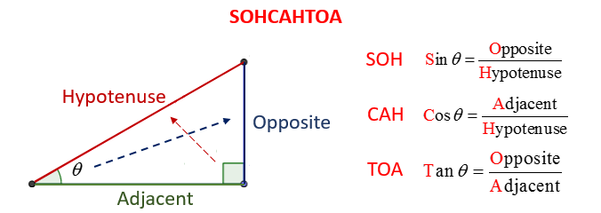
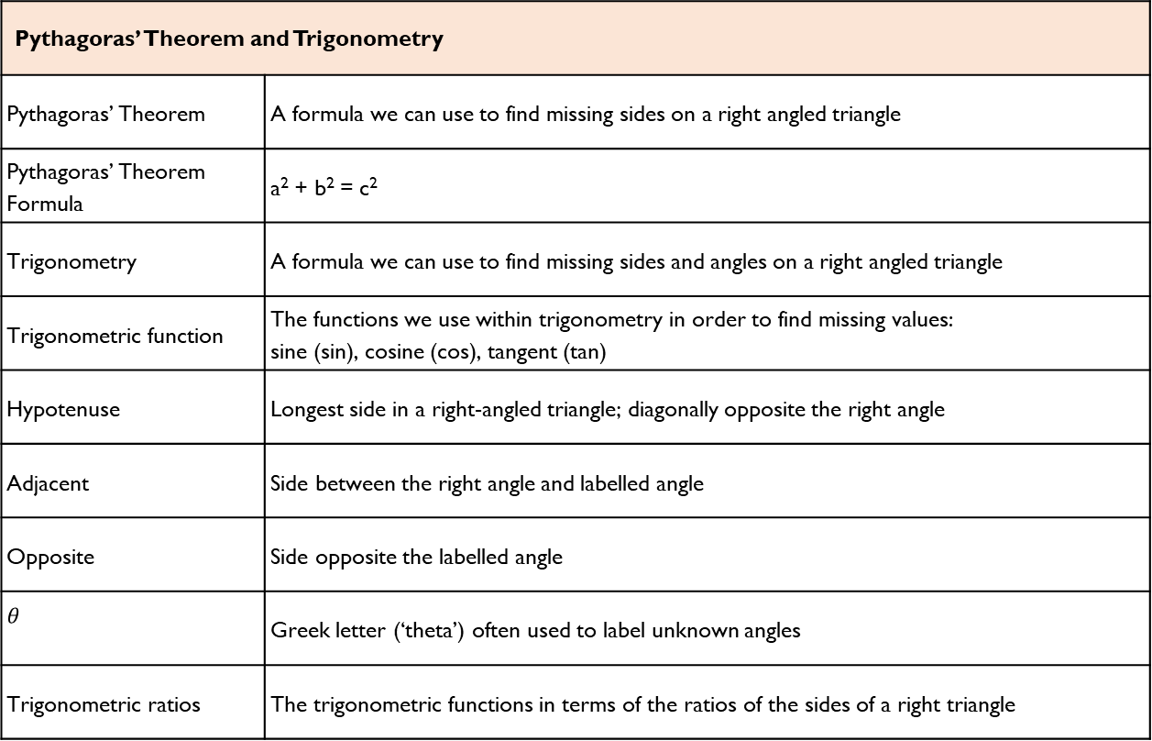
Maths
Pythagoras’ Theorem and Trigonometry
Pythagoras’ Theorem | A formula we can use to find missing sides on a right angled triangle
Pythagoras’ Theorem Formula | a² + b² = c²
Trigonometry | A formula we can use to find missing sides and angles on a right angled triangle
Trigonometric function | The functions we use within trigonometry in order to find missing values: sine (sin), cosine (cos), tangent (tan)
Hypotenuse | Longest side in a right-angled triangle; diagonally opposite the right angle
Adjacent | Side between the right angle and labelled angle
Opposite | Side opposite the labelled angle
$$θ$$ | Greek letter (‘theta’) often used to label unknown angles
Trigonometric ratios | The trigonometric functions in terms of the ratios of the sides of a right triangle
3

Slide 6
Quantitative Chemistry
Science
Key Word | Definition
Law of conservation of mass | No atoms are lost or gained during a chemical reaction. The mass of the products is the same as the mass of the reactants. Some reactions appear to give a change in mass, but this is because a gas may have escaped from the reaction container.
Relative atomic mass (Ar) | The average mass of an atom of an element compared to Carbon-12.
Relative formula mass (Mr | The sum of all the atomic masses of the atoms in a formula (e.g. H2O).
Uncertainty | The interval within which the true value can be expected to lie. E.g. 25oC + 2oC – the true value lies between 23oC and 27oC.
Concentration | A measure of the number of particles of a chemical in a volume. Can be measured in g/dm3.
Decimetre3 (dm3) | A measurement of volume. Contains 1000cm³
Percentage composition | The amount of an element in a compound is called its percentage composition
Chemical symbol | A one or two letter code for an element that is used by scientists in all countries
Chemical formula | A formula that shows the relative number of atoms of each element in a compound
Word equation | A way of representing a chemical reaction simply
Reactant | the substances that react together
Product | the substances formed at the end of the reaction
Key Word | Definition
Mole (HT) | A measurement for the amount of a chemical. It is the mass (in grams) of 6.02 x 10²³ (the Avogadro constant) atoms of an element. Symbol: mol
Balanced equation (HT) | Balanced symbol equations show the number of moles that react.
Limiting reactant (HT) | The reactant that is completely used up in a chemical reaction. It limits the amount of product formed.
Excess reactant (HT) | The reactant that is not completely used up in a chemical reaction. There is some reactant left at the end.
Reacting masses | The mass of a product or reactant can be determined from having a balanced symbol equation.
4

Slide 7
Science
Chemical Changes
Key Terms | Definitions
Metal oxide | Metals react with oxides to produce metal oxides. This is an oxidation reaction.
Displacement reaction | A more reactive metal can displace a less reactive metal from a compound.
Oxidation | Two definitions: Chemicals are oxidised if they gain oxygen in a reaction. Chemicals are oxidised if they lose electrons in a reaction. (HT)
Reduction | Two definitions: Chemicals are oxidised if they lose oxygen in a reaction. Chemicals are oxidised if they gain electrons in a reaction. (HT)
Acid | A chemical that dissolves in water to produce H⁺ ions.
Base | A chemical that reacts with acids and neutralise them. E.g. metal oxides, metal hydroxides, metal carbonate
Alkali | A base that dissolves in water. It produces OH- ions in solution.
Neutralisation | When a neutral solution is formed from reacting an acid and alkali. General equation: H⁺ + OH⁻ →H₂O
pH | A scale to measure acidity/ alkalinity. A decrease of one pH unit causes a 10x increase in H+ ions. (HT)
Strong acid (HT) | A strong acid is completely ionised in solution. E.g. hydrochloric, nitric and sulfuric acids.
Weak acid (HT) | A weak acid is only partially ionised in solution. E.g. ethanoic, citric and carbonic acids.
Energy Changes
Key Terms | Definitions
Conservation of energy | Energy is not created or destroyed, only transferred from one store to another
Exothermic | A reaction that transfers energy to the surroundings so the temperature of the surroundings increases, e.g. combustion and neutralisation reactions. Used in self-heating cans and hand warmers.
Endothermic | A reaction that takes in energy from the surroundings so the temperature of the surroundings decreases, e.g. thermal decomposition. Used in sports injury packs.
Activation energy | The energy needed for particles to successfully react.
Breaking bonds | Energy is needed to break bonds.
Forming bonds | Energy is released when bonds are formed.
5

Slide 8
Spanish
Spanish | English
¿Qué haces en verano? | What do you do in summer?
En verano/invierno… | In summer/winter…
chateo en la red | I chat online
cocino para mi familia | I cook for my family
descargo canciones | I download songs
escribo correos | I write emails
hago natación/esquí | I go swimming/skiing
juego al baloncesto/fútbol | I play basketball/football
monto a caballo/en bici | I go horseriding/cycling
nado en el mar | I swim in the sea
salgo con mis amigos/as | I go out with my friends
toco la guitarra | I play the guitar
veo la tele | I watch TV
¿Qué tiempo hace? . . . | What’s the weather like?
Hace buen/mal tiempo. | It’s good/bad weather.
Hace calor/frío/sol/viento | It’s hot/cold/sunny/windy.
Llueve/Nieva. | It’s raining/snowing
Hay niebla/tormenta. | It’s foggy/stormy.
¿Adónde fuiste de vacaciones? | Where did you go on holiday?
hace una semana/un mes/un año | a week/month/year ago
I went on holiday to… | fui de vacaciones a…
¿Con quién fuiste? | Who did you go with?
Spanish | English
con mi familia/insti | with my family/school
con mi mejor amigo/a | with my best friend
solo/a | alone
¿Cómo viajaste? | How did you travel?
Viajé… | I travelled…
en autocar/avión/barco/coche/tren | by coach/plane/boat/car/train
¿Qué hiciste? | What did you do?
primero /luego/más tarde /después/finalmente | first / then /later / after /finally
comí muchos helados | I ate lots of ice creams
Lo mejor fue cuando… | The best thing was when…
Lo peor fue cuando… | The worst thing was when…
comí muchos helados | I ate lots of ice creams
compré recuerdos | I bought souvenirs
descansé | I rested
fui al acuario | I went to the aquarium
hice turismo | I went sightseeing
visité | I visited
saqué fotos | I took photos
tomé el sol | I sunbathed
Me gustaría ir a ... | I would like to go to
Iría a ... /Viajaría a … Sería | I would go/ travel/ It would be
6

Slide 9
History
Key Individuals/ Groups
Kaiser | The German Emperor.
Chancellor | In Germany, the chief minister, or Prime Minister in the government.
SPD | The Social Democratic Party, one of the largest political parties in Germany.
November Criminals | Nickname given to the German politicians who ended World War One and signed the hated Treaty of Versailles on Germany’s behalf.
Spartacus League | Group of German communists who wanted a revolution similar to the one that had taken place in Russia in 1917.
Free Corps | Right-wing German paramilitary group that was active in the early years of the Weimar Republic.
Weimar Republic | Name given to Germany’s democratic system between 1913 and 1933.
Stormtroopers (SA) | Hitler’s brown-shirted supporters who were employed to beat up opponents and guard meetings.
League of Nations | International peace-keeping organisation set up after World War One; Germany joined in 1926.
Key Term | Definition
Militarism | Belief that a country should maintain a strong armed forces and be prepared to use it aggressively.
Bundesrat | Group made up of representatives who supported the Kaiser (unlike the Reichstag, who were elected politicians who challenged the Kaiser).
Reichstag | The main, elected German parliament.
Industrialisation | Process by which a country transforms from a mainly agricultural society to one based on manufacturing and factories.
Trade Union | Association of workers formed to protect their interests.
Socialism | System of government which supports democracy and greater involvement in the economy and society.
Weltpolitik | Literally meaning ‘world policy’, this was the Kaiser’s plan to turn Germany into a global power.
Patriotic | Supporting your country, especially against its enemies.
Mutiny | Rebellion by soldiers or sailors who refuse to take orders.
Abdicate | Give up the throne of a country.
7

Slide 10
Geography
Key Word | Definition
Atmospheric hazards | natural hazards associated with Earth’s atmosphere, such as hurricanes, tornadoes, wind, snow, drought, lightning and rain
Drought | a long, continuous period of dry weather
Earthquake | a sudden or violent movement within the Earth’s crust followed by a series of shocks
Fatalities | deaths caused by disasters or accidents
Geological hazards | natural hazards associated with Earth’s geological processes, such as volcanoes, landslides, mudflows, avalanches and earthquakes
Hazard risk | the probability or chance that a natural hazard may take place
Landslides | the movement of rock, earth or debris down the slope of a hill
Mudflow | when saturated soil and weak rock flow down a slope
Natural disaster | when a natural event, or hazard, impacts on human activities
Natural hazard | a natural event that a poses a threat to humans and/or property
Poverty | deprivation in well-being, such as lack of access to wealth, food, shelter, water and education
Social impact | the effect of an event on the lives of people or community
Tropical storm (hurricane, cyclone, typhoon) | an area of low pressure with winds moving in a spiral around a calm central point called the eye of the storm – winds are powerful and rainfall is heavy
Tsunami | huge waves caused by earthquakes
Urbanisation | when an increasing percentage of a country's population comes to live in towns and cities
Volcano | a large landform, typically conical in shape, formed by a series of volcanic eruptions over a long period of time
8

Slide 11
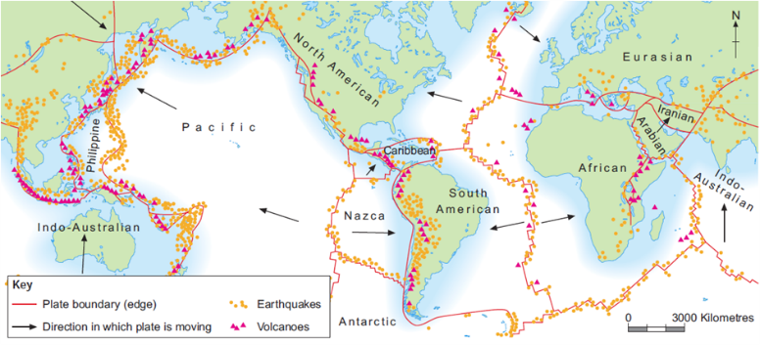
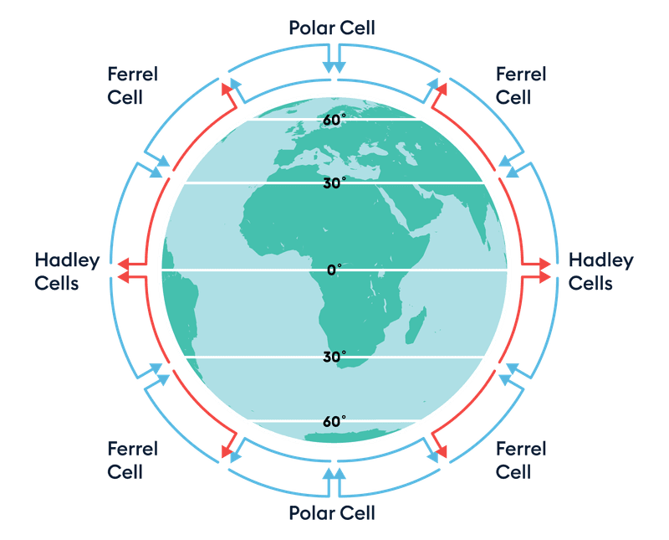
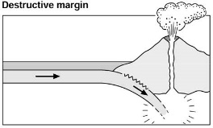
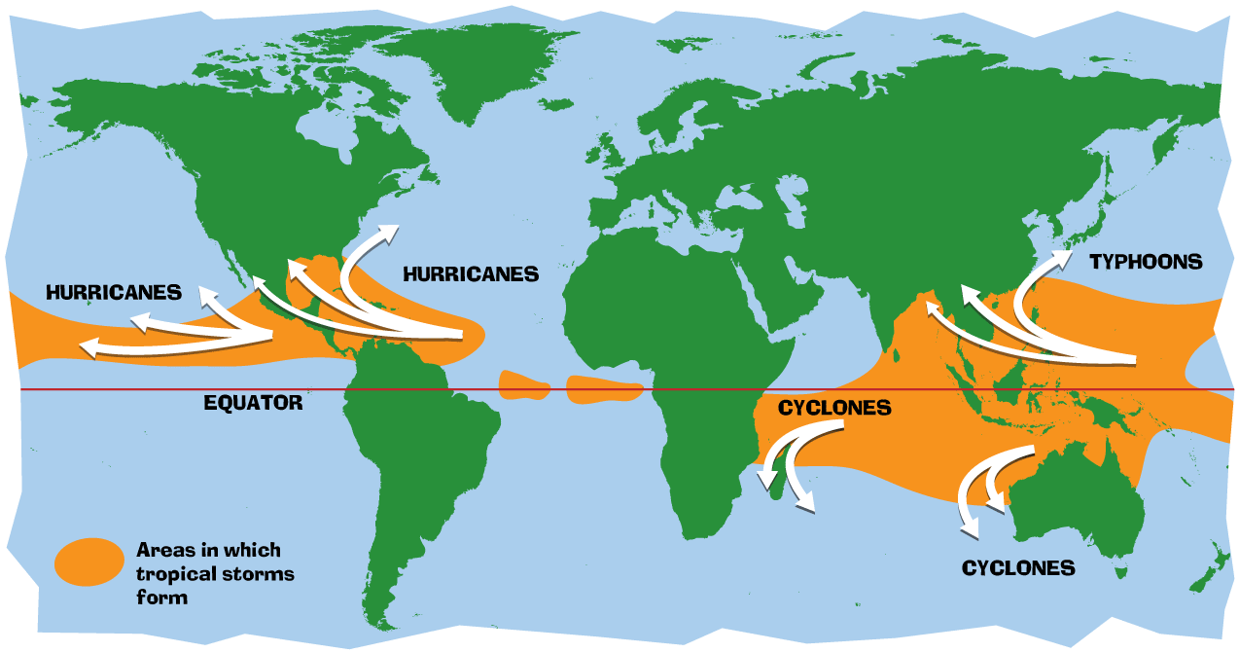
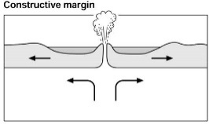
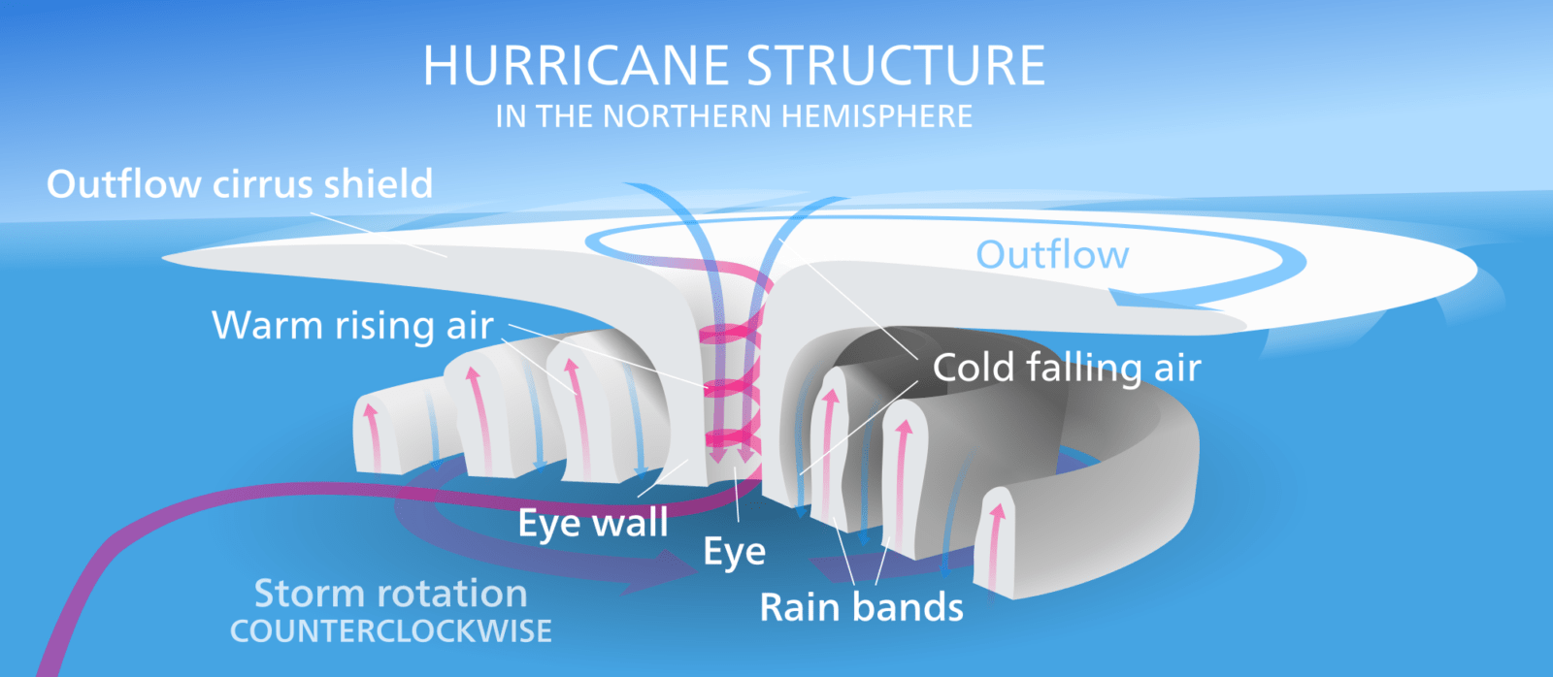
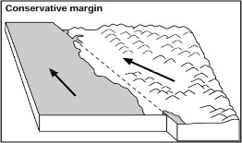
Geography
Tectonic Hazards
Distribution of plate margins
 | Destructive margin= two plates move towards each other Oceanic crust = outer part of earth under oceans Continental crust = outer part of earth that make up the earths continents Subduction zone = where two plates collide underneath Magma chamber = a large pool of liquid rock beneath the surface of the Earth
 | Constructive margin = two plates moving a part
 | Conservative margin = two plates that move side by side
Atmospheric hazards
Global atmospheric circulation model
Distribution of tropical storms
Structure of tropical storms
9

Slide 12



PE
Skeletal System
Cardiovascular System
Muscular System
10

Slide 13
PE
Cardiovascular System – Components of blood
Red blood cells | Carry oxygen from the lungs to the working muscles + Removes CO2.
Haemoglobin | A protein that binds and carries oxygen molecules.
White blood cells | Are part of the immune system and fight disease and infection.
Platelets | Blood platelets are formed in the bone marrow and are essential in the clotting of blood. Platelets are the workhorses of the cardiovascular system.
Plasma | Blood plasma is made up of 90% water. It contains a range of substances that aids the circulation between cells and tissues.
Blood Vessels
Arteries | Carry blood away from the heart, Oxygenated blood (except pulmonary artery) Thick/elastic walls High pressure Small lumen
Veins | Carry blood back to the heart Deoxygenated blood (except pulmonary vein) Thin walls + larger lumen Lower pressure Valves
Capillaries | In the tissue Site of gaseous exchange Very thin walls
11

Slide 14
PE - GCSE
Types of practice
Massed practice | When no rest intervals are given
Distributed practice | When a rest interval is given to allow recovery, feedback & coaching
Fixed practice | Uses repetition of the same activity to develop consistency in performance
Variable practice | Involves performing a skill in different situations where conditions are changeable
Goal Setting
Goal Setting | Done to motivate performances
Short term goals | A goal you want to accomplish soon
Long term goals | A goal you want to accomplish in the future
Outcome goal | Helps the performer to focus on the big picture of what they are trying to achieve.
Performance goal | Allows the athlete to focus in on details of the performance, not just winning and losing
SMART Targets | Are used to help guide goal setting. SMART is an acronym for Specific, Measureable, Achievable, Realistic and Time bound
Specific | Targets must be concise
Measureable | Must be measured and compared
Achievable | Target must be challenging but yet reachable
Realistic | Matched to the performers skill level
Time bound | Set for a particular time to be completed.
12

Slide 15
PE - GCSE
Mental preparation
Mental Preparation | Involves the athlete imagining themselves in an environment performing a specific activity using all of their senses
Feedback
Feedback | Vital part of information processing which provides confidence, motivation and improves performance
Intrinsic feedback | This comes from within the performer. Kinaesthetic senses provide feelings from muscles/joints about the action
Extrinsic feedback | This comes from results and match analysis
Concurrent feedback | Information provided to the athlete during the performance
Terminal feedback | Information provided to the athlete before or after the performance
13

Slide 16
Computing
Selection
Module | In Python, a module is a file containing Python definitions and statements. The functionality of these definitions and statements is then available for use.
Import | The keyword that enables a module to be brought into your programs.
MOD/modulo | Calculates the remainder of a division. For example 7 MOD 3 will calculate as 1.
Integer division | In integer division there can be remainders because the resulting value will be a whole number. For example 7 ÷ 3 will calculate as 2.
Operator | A symbol or function that performs an operation. For example +.
Condition | Used to control the flow of execution in a program. A condition contains a logical expression.
Selection | Controlling the flow of execution in programs using if statements.
Execution | Carrying out the instructions for a computer program.
Logical expression | An expression that results in either True or False.
Boolean expression | An expression that evaluates as True or False. Also known as a logical expression.
Iteration
Iteration | Repetition of code blocks. For example, a while loop.
While loop | A loop that will continue to iterate whilst its condition evaluates as True.
Variable | A value held under one name.
Function | A subroutine that returns a value.
Return value | A value that is returned by a function.
Data validation | A check performed on data input to ensure that it can be accepted by the program without causing an error.
Robustness | A program is robust when it does not produce any errors during execution.
14

Slide 17
Art
Key Words | Definition
Art styles | In the visual arts, style is a "... distinctive manner which permits the grouping of works into related categories" or "... any distinctive, and therefore recognizable, way in which an act is performed or an artefact made or ought to be performed and made".
Contemporary | Contemporary art is the art of today, produced in the second half of the 20th century or in the 21st century. Contemporary artists work in a globally influenced, culturally diverse, and technologically advancing world.
Mood | Mood is the atmosphere in a painting, or the feeling expressed. Is the art tranquil, or is it dark and disturbing? Tone refers to the lightness or darkness of colours used, which can help to create a sense of depth or distance in art.
Movement | An art movement is a tendency or style in art with a specific common philosophy or goal, followed by a group of artists during a specific period of time.
Concept | Concepts are defined as abstract ideas
Theme | Theme relates to the meaning of a painting, rather than the subject, which is specific and basic. A theme is deeper and broader and conveys something more universal.
Interpret | explain the meaning of (information or actions)
Annotation | A note by way of explanation or comment added to a text or diagram
Surrealism | Surrealism is a cultural movement that developed in Europe in the aftermath of World War I in which artists depicted unnerving, illogical scenes and developed techniques to allow the unconscious mind to express itself.
15

Slide 18
Food and Cookery
Key Word | Definition
Eatwell Guide | A diagram produced by the UK government to show the recommended percentage of each food group that should be consumed at mealtimes
Reference Intake (RI) | The recommended quantity of a nutrient that an adult should eat every day
Rickets | A disease caused by poor bone strength where the bones bend during formation
Antioxidant | A substance which helps prevent harmful chemicals such as pollutants from the air, entering the body and causing harm
Amino acids | The building blocks of protein
Saturated fats | These fats usually come from animal sources and can be harmful to health
Unsaturated fats | These fats usually come from plant sources and can be good for health
Protein alternatives | Sources of protein other than meat that are suitable for vegetarians
Nutrition | A study of what people eat and how all the nutrients in foods work together in the body
Nutrients | Natural chemical substances in foods that are essential for body growth, function and health
Macro-Nutrients | Nutrients needed by the body in large a mounts
Micro-Nutrients | Nutrients needed in the body in smaller amounts
Balanced Diet | A balanced diet is one that contains the correct nutrients in the correct proportions, plus the correct amount of water and dietary fibre to meet the body’s needs
Osteoporosis | A disease caused by lack of vitamin D and calcium where the bone degenerates and new bone is not created. The bones become weak and break easily
Anaemia | A disease caused by lack of Vitamin C and iron which means insufficient red blood cells are formed, so not enough oxygen can be carried around the body in the blood, causing tiredness
Soluble Fibre | This slows down the digestive process and can help lower blood sugar and cholesterol levels
Insoluble fibre | This absorbs water and helps prevent constipation
16

Slide 19
Performing Arts
Devising Drama
Devising Drama – Key Words
Stimulus | A resourced used as a starting point to generate ideas for a piece of drama. This may be a poem, story, piece of music, historical event, a painting, a piece of artwork, a quote and more.
Intentions | This is the overarching aim of the devised piece.
Contribution | The impact you have had on the creation of the Drama piece and your ideas and input during the creative and rehearsal process.
Blocking | The staging and use of the space in drama, This may refer to the location of actors on the stage and the movements they make.
Script | The written drama piece/script. The dialogue of the actors is recorded here, as well as, stage directions, key movement and staging, cues, the scene names and number and the location and time of the scene. Where and a character enters and exits their scene is also recorded here.
Scene | A sequence of continuous action in a play.
Plot | The storyline of a piece of drama.
Structure | The structure is how the plot or story of a play is presented, including a beginning, a middle and an end. Dramatic structure is typically broken up into acts, scenes, and plot points. There can be flashbacks and flash-forwards, the story may not always be told chronologically.
Developing Ideas
Hot Seating | One character sits in the designated ‘hot seat’ and the class ask questions to the character with the actor in the hot seat replying as the character. The aim is to gain some insight into the character, their thoughts and their feelings.
Improvisation | To perform quickly in response to something, without previous planning.
Role on the wall | Is a technique designed to allow an actor to explore their character. This involves drawing a figure of the character, information about the character is included within the inside of the character and opinions and views from others about the character are around the outside of the figure.
Storyboarding | Involves creating a series of images and/or text showing the sequence of the action planned for a devised drama.
Cue to Cue Rehearsal | This involves a rehearsal where the actors remove all of the action and dialogue between cues during a technical rehearsal.
The Exposition | The opening scene of the plot which provides essential background information about the characters, setting and sets the mood of the piece.
Semiotics | This refers to how meaning is created and communicated through the systems of signs and symbols of drama.
17

Slide 20
Memory - Key Terms
1. Encoding | Taking information into memory and changing it into a form that can be stored.
2. Storage | Holding information in the memory’s system.
3. Retrieval | Recovering information from storage.
4. Recall | To give details of a memory that has been retrieved
5. Episodic memory | Unique memories which are concerned with personal experiences or events.
6. Procedural memory | Our memory for carrying out actions.
7. Semantic memory | Memories which are concerned with shared general knowledge.
8. Capacity | How much information can be stored in memory.
9. Coding | The way that information is represented to be stored.
10. Duration | How long information can be stored for.
11. Multi Store model of memory | The theory of memory that suggests information passes through a series of memory stores.
12. Sensory store | Memory store that holds information received from the senses for a very short time.
13. Short-term store | The memory store that holds approximately 7 chunks of information for a limited amount of time.
14. Long-term store | The memory store that holds a vast amount of information for a very long period of time.
15. Primacy effect | More of the first information received is recalled that subsequent later information.
16. Recency effect | More of the information received later is recalled than earlier information.
17. Serial position effect | The chances of recalling any item depending on its position on a list which results in a serial position curve.
18. Reconstructive memory | Altering our recollection of things so that they make more sense to us.
19. Effort after meaning | Putting the effort into making sense of something unfamiliar after we’ve put our own meaning to it.
20. Context | The general environment in which activities happen.
21. False memories | Remembering something that has never happened.
22. Interference | The difficulty in recalling information when other memories get in the way.
Psychology
Key Studies
1. Murdock’s (1962) Serial position curve study | 2. Bartlett’s (1932) War of the Ghosts’ study
Aim: To provide evidence for the existence of separate short-term and long-term memory stores. Method: – Lab study, 16 Ps, presented with 20 words (1 word/sec). Ps given 90 seconds to recall words. This was repeated 80 times over several days (different list of words each time). Results – Words at end of list = recalled first, words at beginning of lists = recalled quite well, words in middle = poor recall Conclusion – Study provides evidence for existence of separate memory stores. Evaluation: + well controlled lab study: reliability high as extraneous variables were well controlled. - Lacks ecological validity as remembering lists of words does not reflect the complex use of our memories in day to day life. All of the Ps were a similar age so results cannot be generalised. | Aim: To see if people, when given something unfamiliar to remember, would alter the information. Method: Lab study, Ps = undergraduates at Cambridge University. Ps asked to read War of the Ghosts’ twice. 15 minutes later Ps had to retell the story to another person (and so on like Chinese whispers. Results: After the story had been passed on 10 times; story went from 330 to 150 words, omissions made (ghosts left out), changes in detail (canoes to boats), order of events changed. Conclusion: Our memory is not an exact copy of what we hear. It is influenced by our own beliefs. Evaluation: + Study is important and tested memory in a more meaningful way than previous research - Sample of Ps unrepresentative (University students studying English) likely to be much better at reading and verbalising a story than general population; this limits generalisabilty of findings.
Features of memory according to the MSM
Store | Coding | Capacity | Duration
Sensory | The same way in which it is received from the senses | Unlimited | Less than one second
Short-term | Mainly acoustic | Approximately 7 pieces of information | 18-30 seconds
Long-term | Mainly semantic | Unlimited | Unlimited
18

Slide 21
W/c 3rd November Thinking definition: Thinking is making connections, reasoning and asking questions to make the learning stick
Reflecting on learning behaviours for thinking… | Experience log
 | Successful moment… | In hindsight… Where you could have done better on reflection? | At home…
I gave an idea and reasoned/justified.
I reflected on my idea and made it better after discussing with others
I used a revision strategy to help make the learning stick.
I made connections between what I am learning and the outside world.
I asked questions to deepen my understanding.
19

Slide 22
W/c 10th November Thinking definition: Thinking is making connections, reasoning and asking questions to make the learning stick
Reflecting on learning behaviours for thinking… | Experience log
 | Successful moment… | In hindsight… Where you could have done better on reflection? | At home…
I gave an idea and reasoned/justified.
I reflected on my idea and made it better after discussing with others
I used a revision strategy to help make the learning stick.
I made connections between what I am learning and the outside world.
I asked questions to deepen my understanding.
20

Slide 23
W/c 17th November Thinking definition: Thinking is making connections, reasoning and asking questions to make the learning stick
Reflecting on learning behaviours for thinking… | Experience log
 | Successful moment… | In hindsight… Where you could have done better on reflection? | At home…
I gave an idea and reasoned/justified.
I reflected on my idea and made it better after discussing with others
I used a revision strategy to help make the learning stick.
I made connections between what I am learning and the outside world.
I asked questions to deepen my understanding.
21

Slide 24
W/c 24th November Thinking definition: Thinking is making connections, reasoning and asking questions to make the learning stick
Reflecting on learning behaviours for thinking… | Experience log
 | Successful moment… | In hindsight… Where you could have done better on reflection? | At home…
I gave an idea and reasoned/justified.
I reflected on my idea and made it better after discussing with others
I used a revision strategy to help make the learning stick.
I made connections between what I am learning and the outside world.
I asked questions to deepen my understanding.
22

Slide 25
W/c 1st December Thinking definition: Thinking is making connections, reasoning and asking questions to make the learning stick
Reflecting on learning behaviours for thinking… | Experience log
 | Successful moment… | In hindsight… Where you could have done better on reflection? | At home…
I gave an idea and reasoned/justified.
I reflected on my idea and made it better after discussing with others
I used a revision strategy to help make the learning stick.
I made connections between what I am learning and the outside world.
I asked questions to deepen my understanding.
23

Slide 26
W/c 8th December Thinking definition: Thinking is making connections, reasoning and asking questions to make the learning stick
Reflecting on learning behaviours for thinking… | Experience log
 | Successful moment… | In hindsight… Where you could have done better on reflection? | At home…
I gave an idea and reasoned/justified.
I reflected on my idea and made it better after discussing with others
I used a revision strategy to help make the learning stick.
I made connections between what I am learning and the outside world.
I asked questions to deepen my understanding.
24

Slide 27
W/c 15th December Thinking definition: Thinking is making connections, reasoning and asking questions to make the learning stick
Reflecting on learning behaviours for thinking… | Experience log
 | Successful moment… | In hindsight… Where you could have done better on reflection? | At home…
I gave an idea and reasoned/justified.
I reflected on my idea and made it better after discussing with others
I used a revision strategy to help make the learning stick.
I made connections between what I am learning and the outside world.
I asked questions to deepen my understanding.
25

Slide 28
Reading Log w/c 3rd November (20 mins reading per day – all five logs MUST be completed)
Date | Title of novel | Number of pages read | Summary about what I have read
 |  |  | • • •
 |  |  | • • •
 |  |  | • • •
 |  |  | • • •
 |  |  | • • •
Checked by form tutor:
26

Slide 29
Reading Log w/c 10th November (20 mins reading per day – all five logs MUST be completed)
Date | Title of novel | Number of pages read | Summary about what I have read
 |  |  | • • •
 |  |  | • • •
 |  |  | • • •
 |  |  | • • •
 |  |  | • • •
Checked by form tutor:
27

Slide 30
Reading Log w/c 17th November (20 mins reading per day – all five logs MUST be completed)
Date | Title of novel | Number of pages read | Summary about what I have read
 |  |  | • • •
 |  |  | • • •
 |  |  | • • •
 |  |  | • • •
 |  |  | • • •
Checked by form tutor:
28

Slide 31
Reading Log w/c 24th November (20 mins reading per day – all five logs MUST be completed)
Date | Title of novel | Number of pages read | Summary about what I have read
 |  |  | • • •
 |  |  | • • •
 |  |  | • • •
 |  |  | • • •
 |  |  | • • •
Checked by form tutor:
29

Slide 32
Reading Log w/c 1st December (20 mins reading per day – all five logs MUST be completed)
Date | Title of novel | Number of pages read | Summary about what I have read
 |  |  | • • •
 |  |  | • • •
 |  |  | • • •
 |  |  | • • •
 |  |  | • • •
Checked by form tutor:
30

Slide 33
Reading Log w/c 8th December (20 mins reading per day – all five logs MUST be completed)
Date | Title of novel | Number of pages read | Summary about what I have read
 |  |  | • • •
 |  |  | • • •
 |  |  | • • •
 |  |  | • • •
 |  |  | • • •
Checked by form tutor:
31

Slide 34
Reading Log w/c 15th December (20 mins reading per day – all five logs MUST be completed)
Date | Title of novel | Number of pages read | Summary about what I have read
 |  |  | • • •
 |  |  | • • •
 |  |  | • • •
 |  |  | • • •
 |  |  | • • •
Checked by form tutor:
32

Slide 35
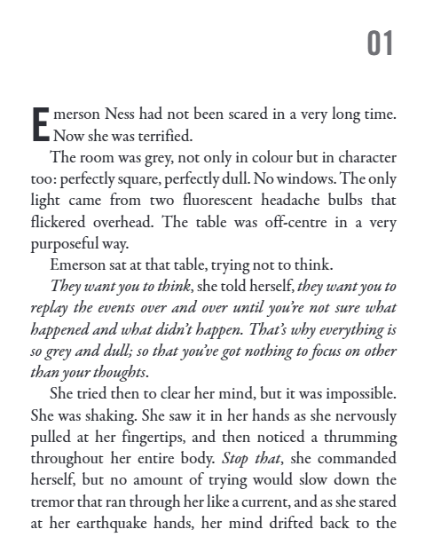
1. The Kill Factor – Ben Oliver
Vocabulary:
Arson – the criminal act of deliberately setting fire to property.
Pneumonia – a lung infection causing inflammation and fluid buildup.
33
Notes:
Ok, so let’s all have the extract in front of us. I am going to read now and you are going to follow with your finger or ruler.
READ THE EXTRACT. PAUSE ON THE WORDS THAT THE STUDENTS MAY NOT KNOW.

Slide 36
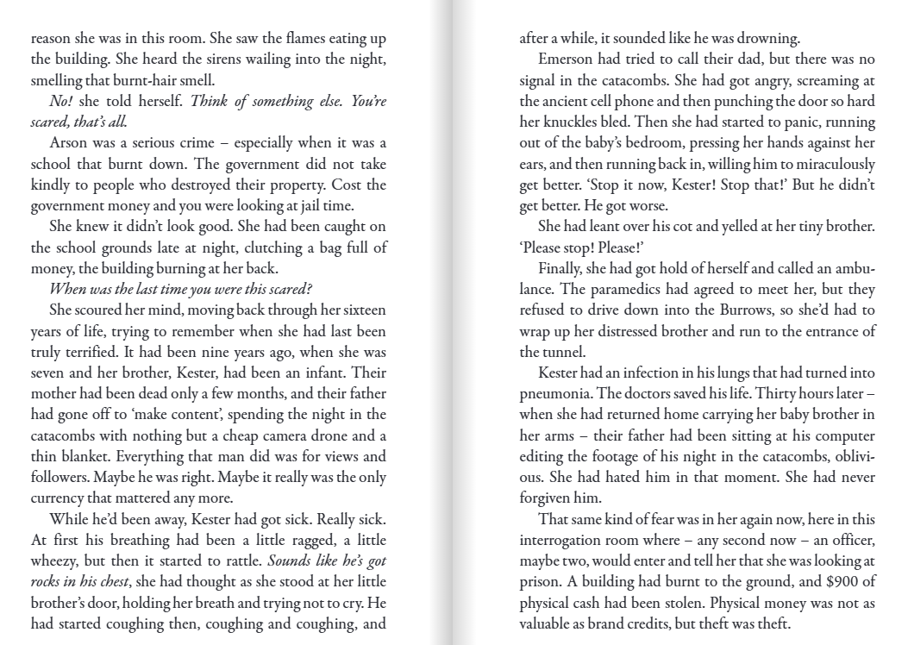
1. The Kill Factor – Ben Oliver
34
Notes:
Ok, so let’s all have the extract in front of us. I am going to read now and you are going to follow with your finger or ruler.
READ THE EXTRACT. PAUSE ON THE WORDS THAT THE STUDENTS MAY NOT KNOW.

Slide 37
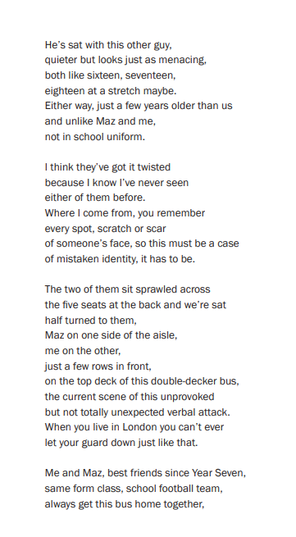
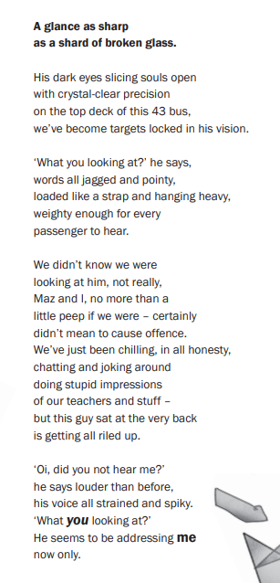
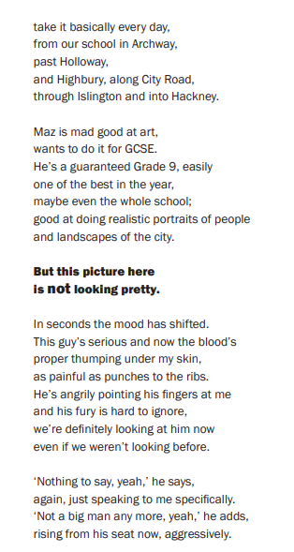
2. Wild East – Ashley Hickson Lovence
Vocabulary:
Sprawled – spread out in an awkward or relaxed way.
35
Notes:
Ok, so let’s all have the extract in front of us. I am going to read now and you are going to follow with your finger or ruler.
READ THE EXTRACT. PAUSE ON THE WORDS THAT THE STUDENTS MAY NOT KNOW.

Slide 38
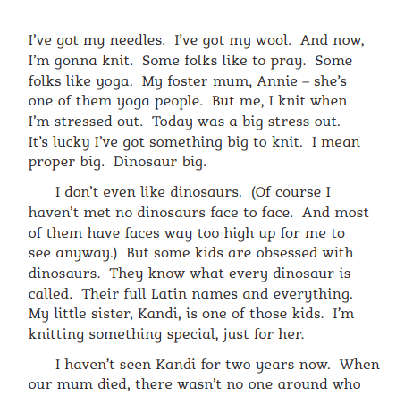
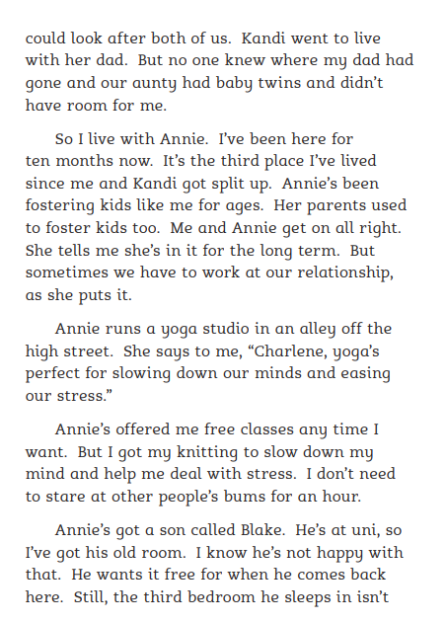
3. Needle – Patrick Lawrence
36
Notes:
Ok, so let’s all have the extract in front of us. I am going to read now and you are going to follow with your finger or ruler.
READ THE EXTRACT. PAUSE ON THE WORDS THAT THE STUDENTS MAY NOT KNOW.

Slide 39
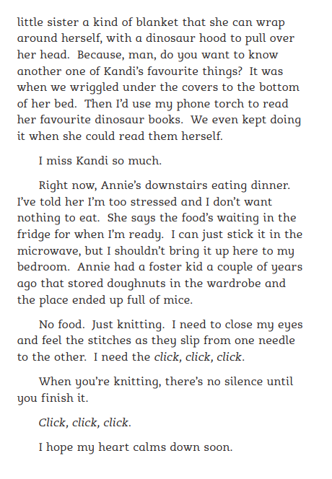
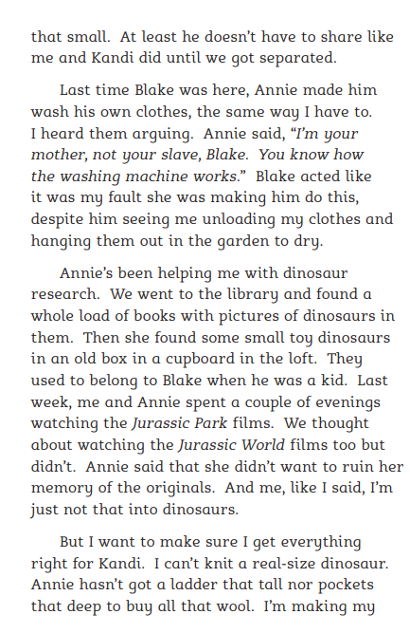
3. Needle – Patrick Lawrence
37
Notes:
Ok, so let’s all have the extract in front of us. I am going to read now and you are going to follow with your finger or ruler.
READ THE EXTRACT. PAUSE ON THE WORDS THAT THE STUDENTS MAY NOT KNOW.

Slide 40
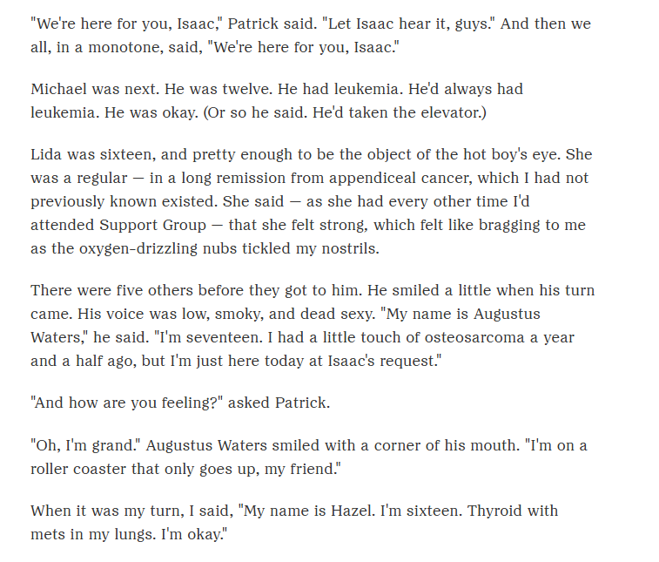
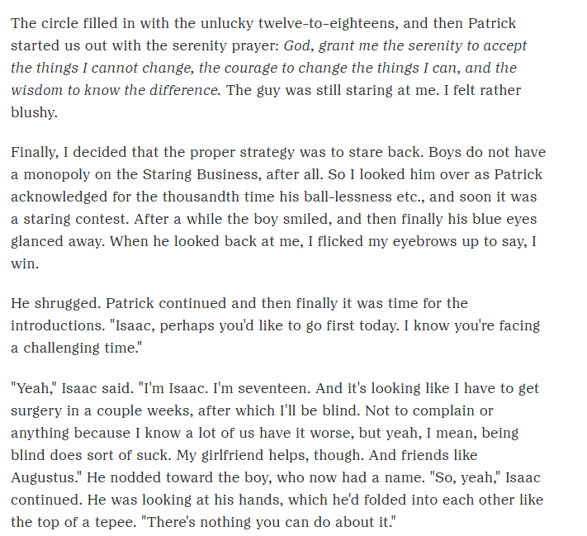
4. The Fault in our Stars – John Green
38
Notes:
Ok, so let’s all have the extract in front of us. I am going to read now and you are going to follow with your finger or ruler.
READ THE EXTRACT. PAUSE ON THE WORDS THAT THE STUDENTS MAY NOT KNOW.

Slide 41
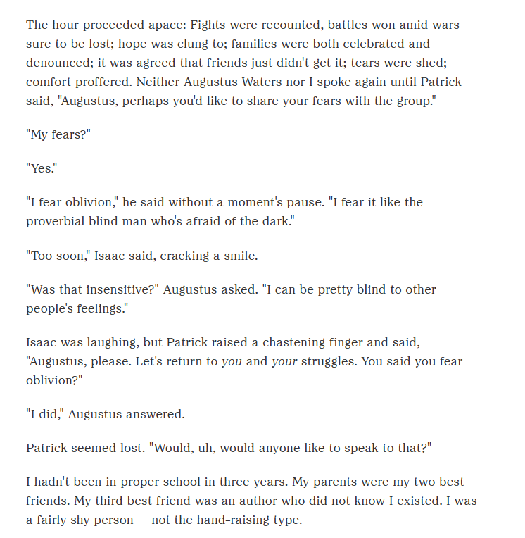
4. The Fault in our Stars – John Green
Vocabulary:
Proverbial – commonly referred to or well-known.
Chastening – intended to correct or discipline.
Denounced – publicly declared to be wrong or evil.
39
Notes:
Ok, so let’s all have the extract in front of us. I am going to read now and you are going to follow with your finger or ruler.
READ THE EXTRACT. PAUSE ON THE WORDS THAT THE STUDENTS MAY NOT KNOW.

Slide 42
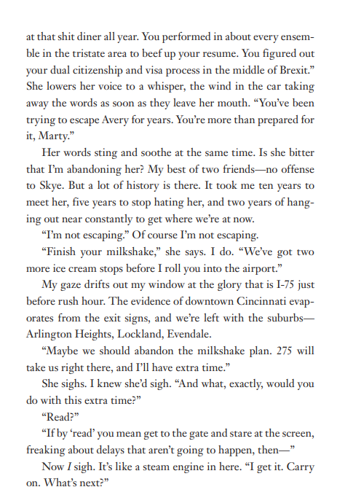
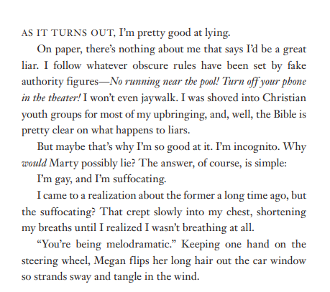
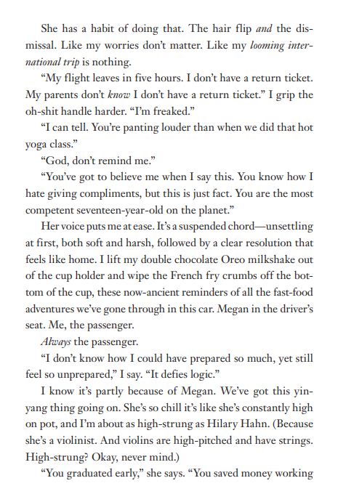
5. As far as you’ll take me – Phil Stamper
40
Notes:
Ok, so let’s all have the extract in front of us. I am going to read now and you are going to follow with your finger or ruler.
READ THE EXTRACT. PAUSE ON THE WORDS THAT THE STUDENTS MAY NOT KNOW.

Slide 43
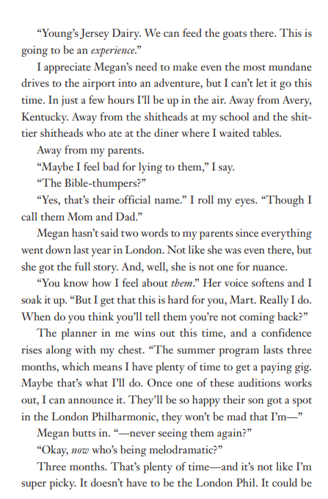
5. As far as you’ll take me – Phil Stamper
Vocabulary:
Incognito – in disguise or concealing one’s identity.
Suffocating – feeling trapped or unable to breathe (literal or figurative).
Melodramatic – exaggerated or overly emotional.
41
Notes:
Ok, so let’s all have the extract in front of us. I am going to read now and you are going to follow with your finger or ruler.
READ THE EXTRACT. PAUSE ON THE WORDS THAT THE STUDENTS MAY NOT KNOW.

Slide 44
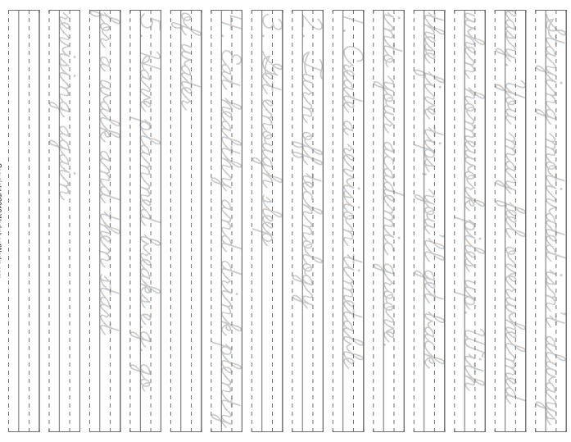
42

Slide 45
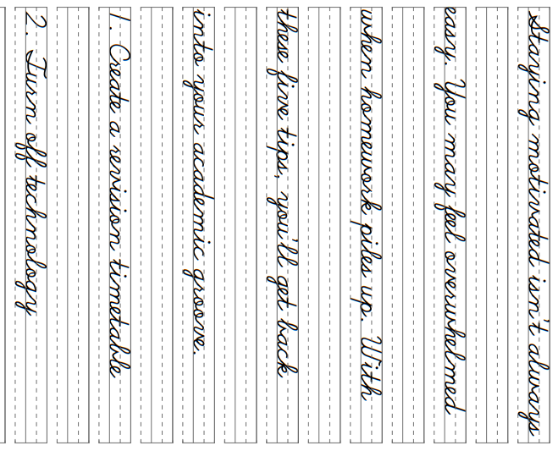
43

Slide 46
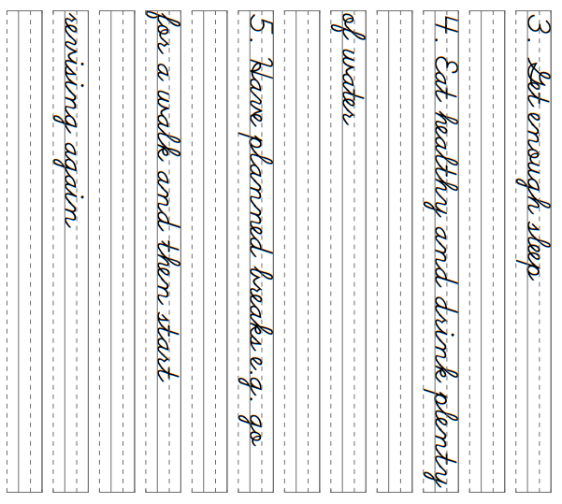
44

Slide 47
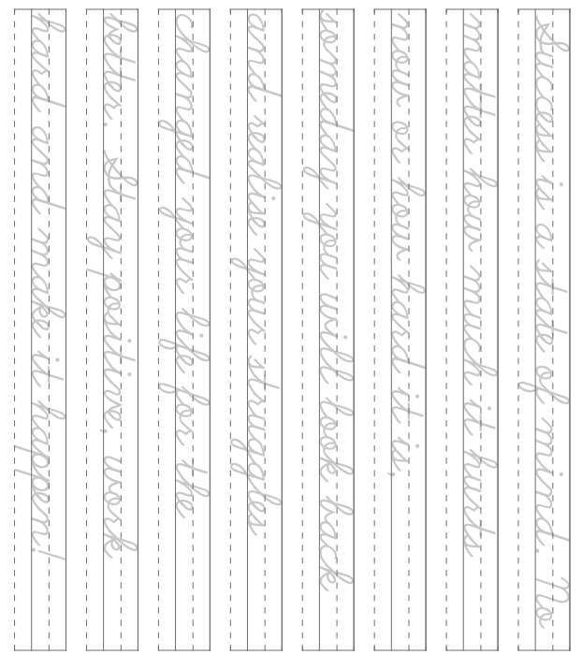
45

Slide 48
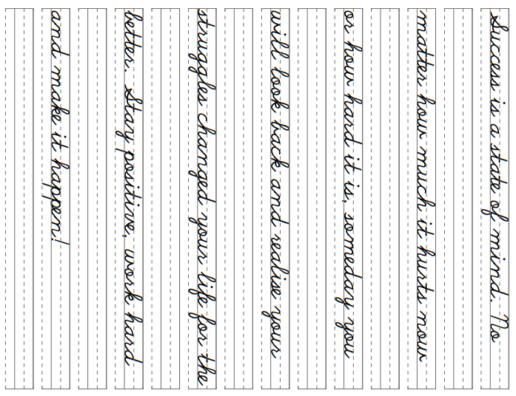
46

