Slide 1

Year 10 Knowledge Organiser HT3
Knowledge is Power
Name: ______________________________
Form: _______

Slide 2
Contents Page
Subject | Page
English | 1
Maths | 2
Science | 4
History | 5
Geography | 6
Spanish | 8
PE | 9
Performing Arts | 14
Computing | 15
Business | 16
iMedia | 18
Cooking and Nutrition | 19
Art | 20
Graphic Design | 21

Slide 3
English
Week 5 – Key Terms
Superlative | An adjective showing the highest quality or degree.
Juxtaposition | Two things placed together to highlight the contrast between them.
Symbolism | The use of symbols to represent ideas or qualities.
Narrative Voice | 1st / 2nd / 3rd person.
Fragment Sentence | Contains three or less words.
Week 1 – Key Terms
Simile | Comparing something using like or as.
Metaphor | Saying something is something else; a direct comparison.
Personification | Applying human characteristics to objects.
Pathetic Fallacy | When the weather reflects the mood.
Alliteration | When the first letter of a word is repeated more than once.
Week 3 – Key terms
Semantic Field | When a group of words all link to one overall theme.
Sensory Language | Description that appeals to the senses. Sight, sound, taste, touch, smell.
Hyperbole | Extreme exaggeration.
Imperative sentence | A sentence that commands or demands.
Exclamatory Sentence | A sentence that exclaims and ends with an exclamation mark.
Week 6 – Question overview
Q1 | What you learn/understand from a text. Specific lines to focus on. Simple and straightforward extraction of facts. 4 marks.
Q2 | Analysis focuses on language devices, the importance of words and sentence structures. The focus is on the effect of language on the reader. 8 marks.
Q3 | Analysis focuses on structural devices, the importance of sequence – when things happen in the extract and why - and how things change or develop. The focus is on how structure is used to create a certain effect. 8 marks.
Q4 | This question asks you to do two things: Form an opinion about the extract in response to a statement Analyse the writer’s methods (of both language and structure). 20 Marks.
Week 2 – Key Structural Terms
Exposition | This is the reader’s introduction to the story. Who/what/when/when.
Rising Action | All the events that happen in a story on the way to the climax.
Climax | This is the highest point of tension in your storyline.
Falling Action | During the falling action, the conflict gives way to resolution and tension begins to dissipate.
Denouement | This is how a story ends, the resolution of the plot.
Week 4 – Structural Terms
Zooming In and Out | The narrowing or widening of the narrative focus.
Flashback/ Flash-forward | Set earlier or later than the main narrative.
Repetition | A word or phrase that is used more than once.
Foreshadowing | An advance hint of what is to come later.
Chronological structure. | Arranged in the order of time.
1
Notes:
1 and 2

Slide 4
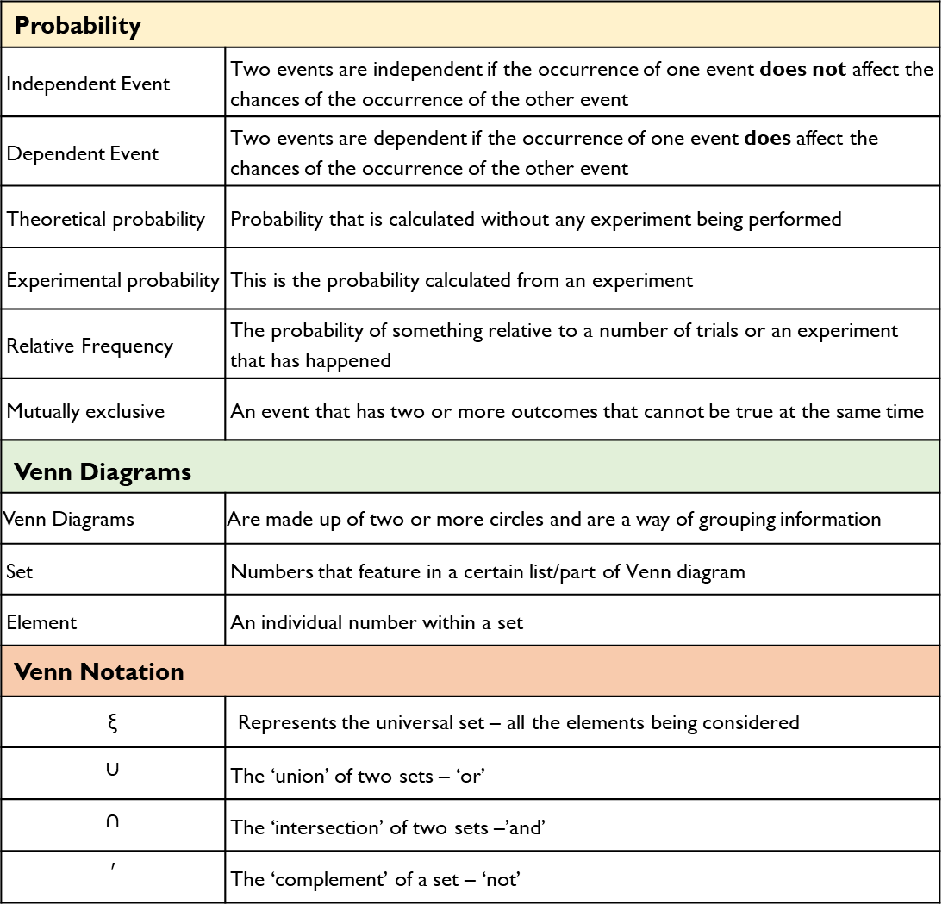
Maths
Probability
Independent Event | Two events are independent if the occurrence of one event does not affect the chances of the occurrence of the other event
Dependent Event | Two events are dependent if the occurrence of one event does affect the chances of the occurrence of the other event
Theoretical probability | Probability that is calculated without any experiment being performed
Experimental probability | This is the probability calculated from an experiment
Relative Frequency | The probability of something relative to a number of trials or an experiment that has happened
Mutually exclusive | An event that has two or more outcomes that cannot be true at the same time
Venn Diagrams
Venn Diagrams | Are made up of two or more circles and are a way of grouping information
Set | Numbers that feature in a certain list/part of Venn diagram
Element | An individual number within a set
Venn Notation
ξ | Represents the universal set – all the elements being considered
$$∪$$ | The ‘union’ of two sets – ‘or’
$$∩$$ | The ‘intersection’ of two sets –’and’
$$′$$ | The ‘complement’ of a set – ‘not’
Inequalities
Inequalities | Compare two values
Inequality notation | = is the same as | ≠ Is not the same as
 | < is less than | > is greater than
 | ≤ is less than or equal to | ≥ is more than or equal to
Simultaneous Equations
Term | A single number or variable
Variable | A symbol used to represent an unknown number
Equation | Two expressions which have the same value, separated by an '=' sign.
Simultaneous | When two things happen at the same time
Simultaneous equation | Two or more algebraic equations that share common variables and are solved at the same time
2

Slide 5
Science
Chemical Changes
Key Terms | Definitions
Metal oxide | Metals react with oxides to produce metal oxides. This is an oxidation reaction.
Displacement reaction | A more reactive metal can displace a less reactive metal from a compound.
Oxidation | Two definitions: Chemicals are oxidised if they gain oxygen in a reaction. Chemicals are oxidised if they lose electrons in a reaction. (HT)
Reduction | Two definitions: Chemicals are oxidised if they lose oxygen in a reaction. Chemicals are oxidised if they gain electrons in a reaction. (HT)
Acid | A chemical that dissolves in water to produce H⁺ ions.
Base | A chemical that reacts with acids and neutralise them. E.g. metal oxides, metal hydroxides, metal carbonate
Alkali | A base that dissolves in water. It produces OH- ions in solution.
Neutralisation | When a neutral solution is formed from reacting an acid and alkali. General equation: H⁺ + OH⁻ →H₂O
pH | A scale to measure acidity/ alkalinity. A decrease of one pH unit causes a 10x increase in H+ ions. (HT)
Strong acid (HT) | A strong acid is completely ionised in solution. E.g. hydrochloric, nitric and sulfuric acids.
Weak acid (HT) | A weak acid is only partially ionised in solution. E.g. ethanoic, citric and carbonic acids.
Key term
Photosynthesis | Process in which plants convert the suns energy in to carbohydrates (glucose.) Photosynthesis takes place in the chlorophyll
Photosynthesis Word Equation: | carbon dioxide + water → glucose + oxygen + energy
Photosynthesis Symbol Equation: | 6CO₂ + 6H₂O → C₆H₁₂O₆ + 6O₂ + energy
Limiting factor (of photosynthesis) | The factor that stops the rate of photosynthesis from increasing; could be light intensity, CO₂ concentration, temperature or amount of chlorophyll
Transpiration | The loss of water vapour from the leaves by evaporation from cells and then out through the stomata.
Transpiration Stream | The movement of water from the roots, up the stem to the leaves.
Translocation | The movement of dissolved sugars around the plant.
Leaf structure key terms
Xylem | Carries water and minerals from the roots around the plant.
Phloem | Carries dissolved sugars made through photosynthesis around the plant.
Palisade mesophyll | Where most photosynthesis takes place. Cells contain many chloroplasts. Absorbs light.
Spongy mesophyll | Some photosynthesis. Has air spaces for diffusion of CO₂ and O₂.
Guard cells | Cells that open and close stomata.
Stoma | Opening that allows CO₂ and O₂ to diffuse in and out of the leaf.
4
Notes:
HT3 2024_5

Slide 6
History
Key Individuals/ Groups
Constitution | Set of rules by which a country is governed.
Proportional Representation | Political system in which the number of politicians for a particular party is in proportion with the number of votes they win; it can lead to lots of small parties gaining seats and an unstable government.
Majority | Over half of the votes or politicians in a parliament.
Article 48 | Part of the Weimar Constitution that gave the President the right to rule in a time of crisis without requiring the support of the Reichstag.
Reparations | Payments made by Germany to some of the winning nations of World war One for the damage done by the fighting.
Diktat | Nickname given by many Germans to the hated Treaty of Versailles; ‘dictated peace’.
Hyperinflation | Sudden, dramatic rise in prices.
Passive Resistance | Protesting against government or laws by using non-violent acts.
League of Nations | International peace-keeping organisation set up after World War One; Germany joined in 1926.
Putsch | Attempt to seize power or to take control by force.
Red Rising | Left-wing voters’ revolt in March 1920, in the Ruhr region of Germany.
Swastika | The crooked cross symbol adopted by the Nazi Party as their emblem.
Key Term | Definition
Stormtroopers (SA) | Hitler’s brown-shirted supporters who were employed to beat up opponents and guard meetings.
Rentenmark | German currency, introduced in 1924.
Dawes Plan | Agreement between the USA and European countries, allowing for US loans to be given to European countries (especially Germany) in order for them to build factories and roads, and stimulate the economy.
Young Plan | Agreement to reduce reparations, made in 1929 between Germany and the countries they owed money to after World War One.
League of Nations | International peace-keeping organisation set up after WWI; Germany joined in 1926.
Culture | The values, morals, traditions and attitudes of a group or society; it relates to the msuci and films people watch and listen to, the art they create, the buildings they design and the behaviours they display.
Avante-Garde | New and experimental ideas and methods in art, music, or literature.
Bauhaus | School of design originating in Weimar Germany, which focused on modern, simple and practical designs, rather than the more elaborate, ‘fancy’ designs of long ago.
Subversion | Trying to destroy or damage a system or a government.
Depression | Time during the 1930s when many banks and businesses failed and millions lost their jobs.
Wall St Crash | October 1929 when millions of people tried to sell their shares in companies at the same time, resulting in a huge drop in share prices.
5

Slide 7
Geography
Key Word | Definition
Economic opportunities | chances for people to improve their standard of living through employment
Formal economy | the type of employment where people receive a regular wage, pay tax, and have certain rights such as paid holidays and sick leave
Global city | urban area with an important role in the global economy
Inequalities | differences between people, in terms of factors such as; poverty, wealth, wellbeing, employment opportunities, housing, education etc.
Informal economy | employment outside the official knowledge of the government
Land use | the way in which land is used, or has been modified or managed by people
Megacities | an urban area with a total population of more than ten million people
Migration | when people move from one area to another
Natural increase | birth rate minus the death rate of a population
Pull factors | the attractions and opportunities of a place that encourage people to move there
Push factors | the negative aspects of a place that encourage people to move away
Quality of life | how good a person’s life is, measured by such things of housing and environment, access to education, healthcare, how secure people feel and how happy they are with their lifestyle
Rural–urban migration | when people move from rural to urban areas
Sanitation | measures designed to protect public health, such as providing clean water and disposing of sewage and waste
Service industries | the economic activities that provide various services − commercial, professional, social, entertainment and personal
Squatter settlement | an area of (often illegal) poor-quality housing, lacking in services like water supply, sewerage and electricity
Urban growth | the increase in the area covered by cities
Urbanisation | when an increasing percentage of a country's population live in towns and cities
6

Slide 8
Geography
Key Word | Definition
Brownfield site | land that has been used, abandoned and now awaits reuse; often found in urban areas
Dereliction | abandoned buildings and wasteland
Enterprise zone | a scheme supported by the government to encourage new businesses and new jobs in areas where there were no pre-existing businesses
Gentrification | when a decaying area is modernised and improved, the cost of living there increases and the original inhabitants are forced out
Green belt | the area of countryside around the edge of a city with strict planning controls to stop houses being built
Greenfield site | a plot of land, often in a rural or on the edge of an urban area that has not been built on before
Integrated transport system | different forms of transport are linked together to make it easy to transfer from one to another
Migration | when people move from one area to another
Quaternary sector | employment sector that includes jobs in hi-tech industries, research, information technology and the media
Regeneration | improving run down areas by improving the housing and the environment
Rural-urban fringe | a zone of transition between a built-up area and the countryside, where there is often competition for land use
Social deprivation | the extent to which an individual (or an area) lacks services and adequate housing, income or employment
Social opportunities | the chances available to improve quality of life, i.e. access to education, health care, etc.
Tertiary sector | employment sector that includes service industries, such as health care, offices, financial services and retailing
Traditional industries | industries such as coal mining, engineering and manufacturing
Urban greening | process of increasing and preserving open space in urban areas, i.e. public parks and gardens
Urban regeneration | reversing the urban decline by modernising or redeveloping, aiming to improve the local economy
Urban sprawl | unplanned growth of urban areas into the surrounding rural areas
Waste recycling | process of extracting and reusing useful substances found in waste
7

Slide 9
Spanish
Spanish | English
trabajo | job
aceptar | to accept
apoyar | to support
aprender I | to learn
gritar | to shout
grabar | to record
estudiar | to study
escribir | to write
enviar | to send
enseñar | To teach
diseñar | To design
continuar | To continue
construir | To build
comunicar | To communicate
comer | To eat
cantar | To sing
callarse | To be quiet
buscar | To look for
aprobar | To pass exams
jugar | To play
leer | To read
Spanish | English
ambicioso | ambitious
internacional | international
nacional | national
obligatorio | compulsory
profesional | professional
universitario | university
vago | lazy
estricto | strict
artista | artist, performer
cantante | singer
cliente | client, customer
estudiante | student
(influencer | influencer
médico | doctor
modelo | model
periodista | journalist
policía | police, police officer
8

Slide 10
Spanish
Spanish | English
llamar | to call
mandar | To send
mejorar | To improve
organizar | To organise
participar | To participate
pedir | To ask for
pelearse | To fight
votar | To vote
viajar | To travel
tocar | To play an instrument
soñar | To dream
servir | To serve
sacar | To take out
respetar | To respect
repasar | To revise
pintar | To paint
permitir | To allow
castellano | Spanish
comentario | Commentary
comercio | Business
conflicto | conflict
Spanish | English
conocimiento | knowledge)
derecho | right
diálogo | speech
diario | diary
diseño | design
documento | document
experto | expert
género | gender
gobierno | government
huelga | Strike
turismo | Tourism
título | University degree
silencio | Silence
recurso | resource
obrero | worker
nivel | level
lujo | luxury
lenguaje | language
laboratorio | lab
impuesto | tax
9

Slide 11
PE
Health and Fitness
Muscular Strength | The amount of the force muscles can generate against a resistance
Muscular Endurance | The ability to use voluntary muscles, over long periods of time without getting tired
Flexibility | The range of movement at a joint
Cardiovascular Fitness (Aerobic Endurance) | The ability of the heart and circulatory system to meet the demands of the body for a long period of time
Body composition | The percentage of a body that is fat, muscle, bone and water
Coordination | The ability to move two or more body parts at the same time
Reaction Time | The time taken for a response to occur after a stimulus
Agility | The ability to change direction at speed
Balance | The ability to keep the body steady when in a static position or when moving
Speed | The time taken to cover a set distance/complete a movement
Power | The ability to combine speed and strength
Principles of training
Progressive Overload | Working the body harder than normal/gradually increasing the amount of exercise you do
Reversibility | If training is not regular, adaptations will be reversed. This can happen when suffering from illness, injury or after an off season
Specificity | Training showed be matched to the requirements of the sport or position the performer is in. Training must be specifically designed to develop the right muscles, type of fitness or skills
Individual needs | All PEP’s would differ depending on performers goals/target, strengths /weaknesses, age/gender and current health/fitness levels
Overtraining | Occurs when you train too hard and do not allow the body enough rest/recovery time Signs include extended muscle soreness, frequent illness & increase injuries
10

Slide 12



PE
Skeletal System
Cardiovascular System
Muscular System
11

Slide 13

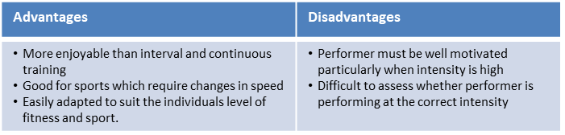
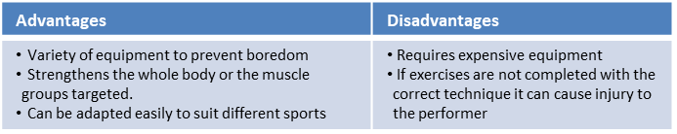
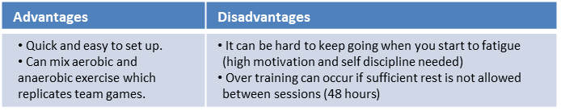
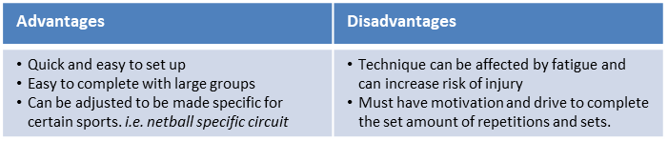
Key Word | Definition
Methods of training
Continuous training - | Involves a steady but regular pace at a moderate intensity (aerobic) which should last for at least 20 minutes. i.e. running, walking, swimming, rowing or cycling. Used by a marathon runner.
Fartlek training | Referred to as ‘speed play’ This is a form interval training but without rest. Involves a variety of changing intensities over different distances and terrains. i.e. 1 lap at 50% max, 1 lap walking, 1 lap at 80% (aerobic and anaerobic used) Used by games players – Hockey players
Weight/Resistance training | A form of training that uses progressive resistance against a muscle group. Used by cyclists. Muscular strength: High weight x low repetitions. Muscular endurance: Low weight x high repetitions
Interval training | Involves periods of work followed by periods of rest. i.e. Sprint for 20 metre + walk back to start. Used by a 200m sprinter
Plyometric training | Involves high-impact exercises that develop power. i.e. bounding/hopping, squat jumps. Used by long jumpers, 100 m sprinters or basketball players.
Circuit training | A series of exercises completed one after another. Each exercise is called a station. Each station should work a different area of the body to avoid fatigue. i.e. press ups, sit ups, squats, shuttle runs.
PE
12

Slide 14
PE GCSE
Types of practice
Massed practice | When no rest intervals are given
Distributed practice | When a rest interval is given to allow recovery, feedback & coaching
Fixed practice | Uses repetition of the same activity to develop consistency in performance
Variable practice | Involves performing a skill in different situations where conditions are changeable
Goal Setting
Goal Setting | Done to motivate performances
Short term goals | A goal you want to accomplish soon
Long term goals | A goal you want to accomplish in the future
Outcome goal | Helps the performer to focus on the big picture of what they are trying to achieve.
Performance goal | Allows the athlete to focus in on details of the performance, not just winning and losing
SMART Targets | Are used to help guide goal setting. SMART is an acronym for Specific, Measureable, Achievable, Realistic and Time bound
Specific | Targets must be concise
Measureable | Must be measured and compared
Achievable | Target must be challenging but yet reachable
Realistic | Matched to the performers skill level
Time bound | Set for a particular time to be completed.
13

Slide 15
PE GCSE
Mental preparation
Mental Preparation | Involves the athlete imagining themselves in an environment performing a specific activity using all of their senses
Feedback
Feedback | Vital part of information processing which provides confidence, motivation and improves performance
Intrinsic feedback | This comes from within the performer. Kinaesthetic senses provide feelings from muscles/joints about the action
Extrinsic feedback | This comes from results and match analysis
Concurrent feedback | Information provided to the athlete during the performance
Terminal feedback | Information provided to the athlete before or after the performance
14

Slide 16
Performing Arts
Devising Drama
Devising Drama – Key Words
Stimulus | A resourced used as a starting point to generate ideas for a piece of drama.
Intentions | This is the overarching aim of the devised piece.
Contribution | The impact you have had on the creation of the Drama piece and your ideas and input during the creative and rehearsal process.
Blocking | The staging and use of the space in drama, This may refer to the location of actors on the stage and the movements they make.
Script | The dialogue of the actors is recorded here, as well as, stage directions, key movement and staging.
Scene | A sequence of continuous action in a play.
Plot | The storyline of a piece of drama.
Structure | The structure is how the plot or story of a play is presented, including a beginning, a middle and an end.
Dramatic Structure | Dramatic structure is typically broken up into acts, scenes, and plot points.
Developing Ideas
Hot Seating | One character sits in the designated ‘hot seat’ and the class ask questions to the character with the actor in the hot seat replying as the character.
Improvisation | To perform quickly in response to something, without previous planning.
Role on the wall | This involves drawing a figure of the character, information about the character and opinions and views from others written down.
Storyboarding | Involves creating a series of images and/or text showing the sequence of the action planned for a devised drama.
Cue to Cue Rehearsal | This involves a rehearsal where the actors remove all of the action and dialogue between cues during a technical rehearsal.
The Exposition | The opening scene of the plot which provides essential background information.
Semiotics | This refers to how meaning is created and communicated through the systems of signs and symbols of drama.
15

Slide 17
Computing
Number bases
Denary (or decimal) | base-10 and is the number system we are most familiar with. We have the columns of units, tens, hundreds, thousands and so on. Base-10 means that we have 10 possible values (0, 1, 2, 3, 4, 5, 6, 7, 8, 9) in each column
Binary | base-2 and has 2 values, 0 and 1. It requires a greater number of digits in binary to represent a number than denary. This is how data and instructions are stored in a computer.
Hexadecimal | base-16. To make up the 16 values we use the ten denary numbers in addition to 6 letters (A, B, C, D, E, F).
Strings and lists
GUI | Acronym for graphical user interface. It is an event-driven program that allows the user to interact with it in a variety of ways. For example, buttons and icons.
Concatenate | When two or more strings are joined together.
String | A value that is text. This can include numbers but they will be read as text.
Array | A fixed (static) data structure that holds items of the same data type under one name.
Index | The location of items or elements in a list, array, or string.
Append | Adding to an existing data structure.
Data structure | Used to store data in an organised and accessible way.
Operator | A symbol or function that performs an operation. For example, +.
Denary | Hex. | Binary |  | Denary | Hex. | Binary
0₁₀ | 0₁₆ | 0000₂ |  | 8₁₀ | 8₁₆ | 1000₂
1₁₀ | 1₁₆ | 0001₂ |  | 9₁₀ | 9₁₆ | 1001₂
2₁₀ | 2₁₆ | 0010₂ |  | 10₁₀ | A₁₆ | 1010₂
3₁₀ | 3₁₆ | 0011₂ |  | 11₁₀ | B₁₆ | 1011₂
4₁₀ | 4₁₆ | 0100₂ |  | 12₁₀ | C₁₆ | 1100₂
5₁₀ | 5₁₆ | 0101₂ |  | 13₁₀ | D₁₆ | 1101₂
6₁₀ | 6₁₆ | 0110₂ |  | 14₁₀ | E₁₆ | 1110₂
7₁₀ | 7₁₆ | 0111₂ |  | 15₁₀ | F₁₆ | 1111₂
16

Slide 18
Business
Ownership types
Key Word | Definition
LIMITED LIABILITY | The level of risk is limited to the amount of money that has been invested in the business or promised as an investment.
ASSETS | Property such as a house or a car.
UNLIMITED LIABILITY | The level of risk goes beyond the amount invested, so the personal assets of the business owner can be used to pay off the business’s debts.
SOLE TRADER | A type of UNINCORPORATED business that is owned by just one person.
PARTNERSHIP | A business that is owned by a group of two or more people who share the financial risk, the decision-making & the profits.
DEED OF PARTNERSHIP | A legal document that defines the terms of a PARTNERSHIP.
PRIVATE LIMITED COMPANY (Ltd) | An INCORPORATED business that is owned by SHAREHOLDERS.
SHAREHOLDERS | Investors who are part-owners of a company. They invest in return for a share of the profits & voting rights at the AGM.
FRANCHISE | When one business gives another business permission to trade using its name & products in return for a fee & share of its profits.
FRANCHISOR | An established business that gives permission to an entrepreneur to trade using its name & products.
FRANCHISEE | An entrepreneur who pays a fee to trade using the name & products of an established business.
Location
Key Word | Definition
LABOUR | Includes the number of workers in an area & the availability of workers with the right skills in that area.
MARKET | This means how close a business is to its customers.
MATERIALS | Locating close to the raw materials that it uses to produce its finished products.
COMPETITORS | Some businesses want to be close to competitors & others want to be away from competitors.
FOOTFALL | The number of people passing a particular location within a given time period.
DEMOGRAPHICS | The characteristics of the population, such as gender, age, religion & wealth.
NATIONAL LIVING WAGE | The minimum amount that a business is legally allowed to pay its employees.
BULK-GAINING PRODUCT | An end product that is bigger than the raw materials used to make it eg. A bike
17

Slide 19
Business
The Marketing Mix
Key Word | Definition
MARKETING MIX | The combination of the 4Ps of marketing:
PRICE | The amount of money a customer will need to pay to receive the product.
PRODUCT | The actual good or service that the business is offering for sale.
PROMOTION | The range of activities used by a business to improve customer awareness.
PLACE | Where the customer can purchase the product.
UNDERCUT | Sell the same product for a lower price than competitors.
PRICE WAR | When businesses try to undercut each other.
DIFFERENTIATION | Designing a product with unique features
BRAND LOYALTY | A customer’s willingness to buy products repeatedly from one business
PROMOTIONAL MIX | The combination of promotional activities that a business uses.
Business Plans
Key Word | Definition
BUSINESS PLAN | A document that outlines how an entrepreneur is going to set up a business
SMART OBJECTIVES | Objectives that are SPECIFIC, MEASURABLE, ACHIEVABLE, REALISTIC, TIMED
BUDGETS | Financial targets for a business to achieve eg. sales & expenditure budget
NEGATIVE CASH FLOW | Occurs if the business’s OPENING BALANCE results in a negative amount.
BUSINESS PLANS consists of: a. THE IDEA b. AIMS C. BUDGETS d. CASH FLOW FORECAST e. SOURCES OF FINANCE f. LOCATION g. MARKETING MIX.
18

Slide 20
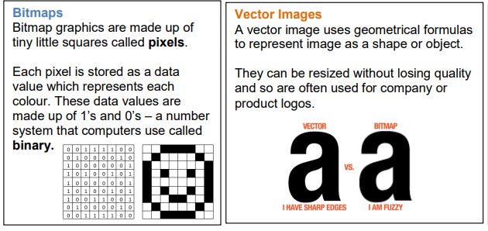
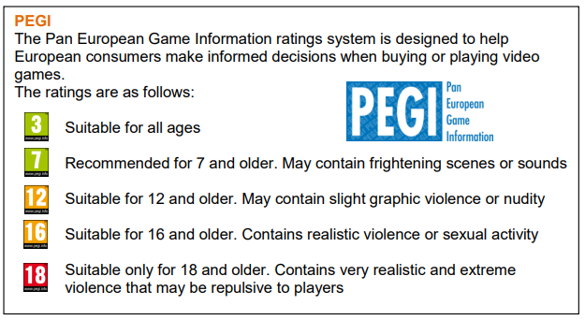
iMedia
R094
Visual Identity | Logo, Brand, Slogan, House style (Font, Colour scheme, Layout)
Elements of Design | Layout, colour, font size/style (typography), symbols, Shapes
Properties of Graphics | Bitmap, Pixels, Colour depth, Bits, Vector, Scalability, Transparency Compression
Pre planning Documents | Moodboard, Mind Map, Visualisation diagram,, Concept sketch
Assets Table | Source, Internet, Stock library Licence, Royalties, Watermark Properties, Size, File type, description, how did you change it, location, Copyright
Target Audience | A particular group at which a product such as a film or advertisement is aimed at.
Client Brief | The project brief which is produced for a design team detailing detailed requirements from the client.
Copyright | A form of intellectual property law, that protects original works of authorship including literary, dramatic, musical, and artistic works.
Watermark | Is a message (usually a logo, stamp, or signature) superimposed onto an image, with a great deal of transparency.
Stock library | The photographer or author of a stock photo makes it available for licensing, meaning you can pay a fee to get the right to use it in your designs legally.
19

Slide 21
Cooking and Nutrition
Key Word | Definition
Nutrition | A study of what people eat and how all the nutrients in foods work together in the body
Balanced Diet | A balanced diet is one that contains the correct nutrients in the correct proportions, plus the correct amount of water and dietary fibre to meet the body’s needs
Cholesterol | A type of fatty substance made in the liver
Coeliac Disease | A disease which develops from an intolerance to gluten
Eatwell Guide | A pictorial food guide showing the amounts and types of foods that are needed to make up a healthy balanced diet
Allergen | A substance that causes an allergic reaction
Anaphylaxis | A serious allergenic reaction that is very rapid in onset and can cause death if the throat swells and the person cannot breathe
Reference Intake (RI) | The recommended quantity of a nutrient that an adult should eat every day
Recipe Amendment | Changing or altering a recipe eg changing some ingredients and/ or cooking methods
Food Poisoning | Illness caused by bacteria or other toxins in food
Bacteria | Extremely small single celled organisms that can only be seen under a microscope.
Salmonella | Food poisoning bacteria found in chicken, some dairy foods and raw eggs
Staphylococcus | Food poisoning bacteria found in egg products , chicken, salad, tuna and eggs
Temperature probe | Device used to check the temperature in the centre of cooked food.
20

Slide 22
Art
Key Word | Definition
Identity | Identity is the qualities, beliefs, personality traits, appearance, and/or expressions that characterize a person or group
Gender | either of the two sexes (male and female), especially when considered with reference to social and cultural differences rather than biological ones. The term is also used more broadly to denote a range of identities that do not correspond to established ideas of male and female.
Artist Analysis | An Artist study is the breakdown of the artistic elements in an artwork to discover how it portrays meaning. Analysing art is an aspect that many students find difficult, practicing it will help you develop your language and skills.
Artist Transcription | Transcription in painting is copying, but often with a different purpose than to produce a replica. Artists use transcription to learn how another artist worked: how she constructed her painting, produced brush strokes and visual effects, and how they mixed colours
Critic | a person who judges the merits of literary or artistic works, especially one who does so professionally.
Context | Specific to artwork, context consists of all of the things about the artwork that might have influenced the artwork or the maker (artist) but which are not actually part of the artwork.
Culture | the ideas, customs, and social behaviour of a particular people or society
Impasto | An oil painting technique that might require a little more practice, Impasto painting was a key feature of many of Van Gogh’s works. Requiring deliberate strokes of thick paint, each mark of the paintbrush is clearly visible in the finished piece.
Chiaroscuro | Offering a significant contrast between the lighter and darker aspects of a painting, Chiaroscuro was used a lot by renaissance artists such as Rembrant and Caravaggio.
Under painting | Underpainting removes that fear factor, as it involves ‘sketching’ the subject in one very thin layer of paint and blocking out any background so that you’ll know where to put this later in the creative process.
Dry Brushing | The secret to dry brush painting is to apply the paint with the very tip of your brush. Work with a clean, dry brush and scrub it over the surface you're painting. Use a stabbing motion to really push the paint into any crevices. You want to work quickly to brush the paint out well.
Concept | Concepts are defined as abstract ideas
Theme | Theme relates to the meaning of a painting, rather than the subject, which is specific and basic. A theme is deeper and broader and conveys something more universal.
Interpret | explain the meaning of (information or actions)
Annotation | A note by way of explanation or comment added to a text or diagram
21

Slide 23
Music
Key Word | Definition
Syncopation | Emphasis placed on a note that is not normally stressed, or between beats music with a steady beat.
Dotted note | A dot added after a note, adding an extra half to its lenght three beats per bar
Chords | A chord in music is a combination of three or more notes played simultaneously, forming the harmonic foundation of a piece.
Triplet | Three notes played in the time of two.
Structure in pop | organization and arrangement of various song sections like verses, choruses, bridges, and the overall layout, creating the framework for the composition.
Harmony | is the combination of different musical notes played simultaneously, creating a rich and pleasing sound that adds depth and character to a musical piece.
Time signature | It tells you how many beats are in each measure and which note gets one beat, helping you keep track of the rhythm while playing or singing.
Dynamic | The volume of a sound or piece of music – loud/soft
pulse | The steady beat in music
Timbre | Each instrument own unique ‘tone quality’ and the voice as an instrument had different Timbre
accent | Extra stress placed on a note or chord
Texture | Sometimes voices sing different parts at the same time creating Harmony. Not all vocal music is accompanied by instruments, unaccompanied singing is called A Cappella.
Rhythm | Rhythm is the pattern of sounds and beats in music that creates a sense of movement and flow. It is like the heartbeat of a song that helps us feel the music and dance or sing along. Rhythm can be fast or slow, simple or complex, and is created by combining different beats and notes in a particular order. It is an essential element of music that makes it enjoyable and exciting to listen to.
Tempo | Tempo refers to the speed of music. It's how fast or slow a song sounds.
22

Slide 24
W/c 4th November Thinking definition: Thinking is making connections, reasoning and asking questions to make the learning stick
Reflecting on learning behaviours for thinking… | Experience log
 | Successful moment… | In hindsight… Where you could have done better on reflection? | At home…
I gave an idea and reasoned/justified.
I reflected on my idea and made it better after discussing with others
I used a revision strategy to help make the learning stick.
I made connections between what I am learning and the outside world.
I asked questions to deepen my understanding.

Slide 25
W/c 11th November Thinking definition: Thinking is making connections, reasoning and asking questions to make the learning stick
Reflecting on learning behaviours for thinking… | Experience log
 | Successful moment… | In hindsight… Where you could have done better on reflection? | At home…
I gave an idea and reasoned/justified.
I reflected on my idea and made it better after discussing with others
I used a revision strategy to help make the learning stick.
I made connections between what I am learning and the outside world.
I asked questions to deepen my understanding.

Slide 26
W/c 18th November Thinking definition: Thinking is making connections, reasoning and asking questions to make the learning stick
Reflecting on learning behaviours for thinking… | Experience log
 | Successful moment… | In hindsight… Where you could have done better on reflection? | At home…
I gave an idea and reasoned/justified.
I reflected on my idea and made it better after discussing with others
I used a revision strategy to help make the learning stick.
I made connections between what I am learning and the outside world.
I asked questions to deepen my understanding.

Slide 27
W/c 25th November Thinking definition: Thinking is making connections, reasoning and asking questions to make the learning stick
Reflecting on learning behaviours for thinking… | Experience log
 | Successful moment… | In hindsight… Where you could have done better on reflection? | At home…
I gave an idea and reasoned/justified.
I reflected on my idea and made it better after discussing with others
I used a revision strategy to help make the learning stick.
I made connections between what I am learning and the outside world.
I asked questions to deepen my understanding.

Slide 28
W/c 2nd December Thinking definition: Thinking is making connections, reasoning and asking questions to make the learning stick
Reflecting on learning behaviours for thinking… | Experience log
 | Successful moment… | In hindsight… Where you could have done better on reflection? | At home…
I gave an idea and reasoned/justified.
I reflected on my idea and made it better after discussing with others
I used a revision strategy to help make the learning stick.
I made connections between what I am learning and the outside world.
I asked questions to deepen my understanding.

Slide 29
W/c 9th December Thinking definition: Thinking is making connections, reasoning and asking questions to make the learning stick
Reflecting on learning behaviours for thinking… | Experience log
 | Successful moment… | In hindsight… Where you could have done better on reflection? | At home…
I gave an idea and reasoned/justified.
I reflected on my idea and made it better after discussing with others
I used a revision strategy to help make the learning stick.
I made connections between what I am learning and the outside world.
I asked questions to deepen my understanding.

Slide 30
W/c 16th December Thinking definition: Thinking is making connections, reasoning and asking questions to make the learning stick
Reflecting on learning behaviours for thinking… | Experience log
 | Successful moment… | In hindsight… Where you could have done better on reflection? | At home…
I gave an idea and reasoned/justified.
I reflected on my idea and made it better after discussing with others
I used a revision strategy to help make the learning stick.
I made connections between what I am learning and the outside world.
I asked questions to deepen my understanding.

Slide 31
Reading Log w/c 4th November (20 mins reading per day – all five logs MUST be completed)
Date | Title of novel | Number of pages read | Summary about what I have read
 |  |  | • • •
 |  |  | • • •
 |  |  | • • •
 |  |  | • • •
 |  |  | • • •
Checked by form tutor:

Slide 32
Reading Log w/c 11th November(20 mins reading per day – all five logs MUST be completed)
Date | Title of novel | Number of pages read | Summary about what I have read
 |  |  | • • •
 |  |  | • • •
 |  |  | • • •
 |  |  | • • •
 |  |  | • • •
Checked by form tutor:

Slide 33
Reading Log w/c 18th November (20 mins reading per day – all five logs MUST be completed)
Date | Title of novel | Number of pages read | Summary about what I have read
 |  |  | • • •
 |  |  | • • •
 |  |  | • • •
 |  |  | • • •
 |  |  | • • •
Checked by form tutor:

Slide 34
Reading Log w/c 25th November (20 mins reading per day – all five logs MUST be completed)
Date | Title of novel | Number of pages read | Summary about what I have read
 |  |  | • • •
 |  |  | • • •
 |  |  | • • •
 |  |  | • • •
 |  |  | • • •
Checked by form tutor:

Slide 35
Reading Log w/c 2nd December (20 mins reading per day – all five logs MUST be completed)
Date | Title of novel | Number of pages read | Summary about what I have read
 |  |  | • • •
 |  |  | • • •
 |  |  | • • •
 |  |  | • • •
 |  |  | • • •
Checked by form tutor:

Slide 36
Reading Log w/c 9th December (20 mins reading per day – all five logs MUST be completed)
Date | Title of novel | Number of pages read | Summary about what I have read
 |  |  | • • •
 |  |  | • • •
 |  |  | • • •
 |  |  | • • •
 |  |  | • • •
Checked by form tutor:

Slide 37
Reading Log w/c 16th December (20 mins reading per day – all five logs MUST be completed)
Date | Title of novel | Number of pages read | Summary about what I have read
 |  |  | • • •
 |  |  | • • •
 |  |  | • • •
 |  |  | • • •
 |  |  | • • •
Checked by form tutor:

Slide 38


Slide 39


Slide 40


Slide 41


Slide 42


Slide 43


Slide 44



Slide 45
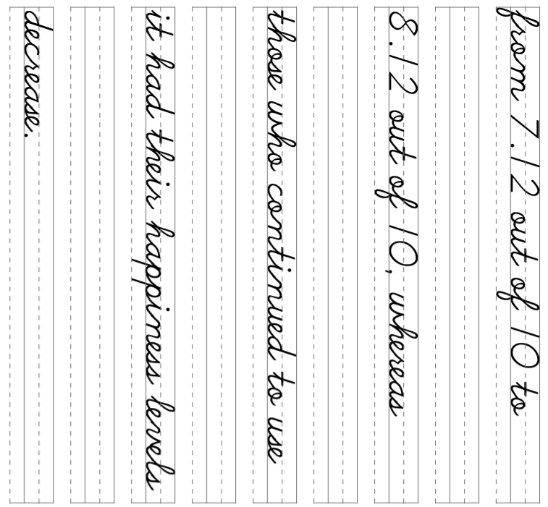

Slide 46
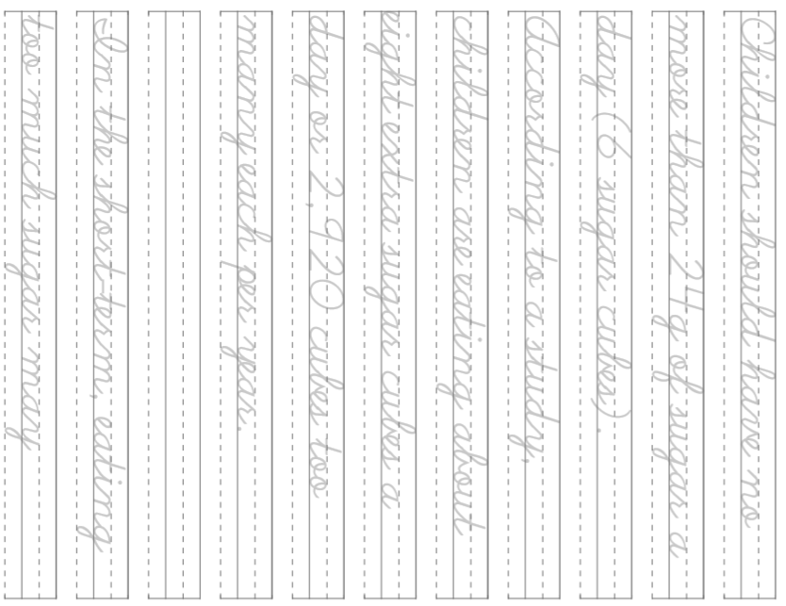

Slide 47
