Slide 1

Year 10 Knowledge Organiser HT4
Knowledge is Power
Name: ______________________________
Form: _______

Slide 2
Contents Page
Subject | Page
English | 1
Maths | 2
Science | 3
Spanish | 5
History | 6
Geography | 8
PE | 10
Computing | 13
Art | 14
Drama | 15
Cooking and Nutrition | 17
Psychology | 18
‘Resilience’ reflection log | 20
Reading log | 25
Cursive Handwriting Practice | 30

Slide 3
English
Week 2 – Structural devices
Repetition | Repeated words or phrases.
Enjambment | A sentence that runs onto the next line.
Caesura | Using punctuation to create pauses or stops.
Volta | A turning point in a poem.
Stanza | A group of lines in a poem.
Rhyming couplet | A pair of rhyming lines next to each other.
Week 4 – Love’s Philosophy
Context | Written by Percy Shelly Shelley was a part of the Romantic Period. This movement originated in the late 18th century.
Key themes | Nature Passion Longing
Key quotes | “why not I with thine?” “nothing in the world is single; All things by a law divine.”
Key devices | Natural imagery Repetition Rhetorical question
Week 1 – Poetic devices
Tone | The mood or feelings created in a poem.
Personification | Giving human characteristics to non-human things/objects.
Pathetic fallacy | When the weather creates a mood within the poem.
Metaphor | Making a direct comparison between one thing and another.
Simile | Comparing two things using ‘like’ or ‘as.’
Sibilance | The repetition of ‘s’ or ‘sh’ sounds.
Week 3 – When We Two Parted
Context | Written by Lord Byron in 1816. Lord Byron was having an affair with a married woman. Lord Byron had a reputation of having affairs.
Key themes | Separation Loss Memory
Key quotes | “When we two parted/In silence and tears” “Pale grew thy cheek and cold,/Colder thy kiss”
Key devices | Emotive language Death imagery Pathetic fallacy Repetition
Week 5 – Porphyria’s Lover
Context | Written in the Victorian Era. Porphyria is the name of an illness that has side effects of madness.
Key themes | Control Possession Madness
Key quotes | “When glided in Porphyria.” “Happy and proud; at last I knew/Porphyria worshipped me:” “And yet God has not said a word.”
Key devices | Pathetic fallacy Violent verbs Anaphora
1

Slide 4
Maths
Representing data
Key Word | Definition
Two-way table | A table that shows information from more than one category
Frequency polygon | A graph that uses lines to join the mid points of each interval
Pie chart | A circular chart that shows proportion of each group
Scatter graph | A graph to show to compare two variables
Correlation | Shows whether there is a relationship between the two variables
Line of best fit | A straight line that bests fits the data. It may pass through some or none of the points
Outlier | Is a point that does not fit the data set
Sampling | A statistical methodology that uses a portion of a total population to represent the full population
Stratified sampling | Stratified sampling is when the sample is proportional to the population
Capture recapture | Capture recapture is a sampling technique used to estimate population size
Histograms | Display frequency data using bars of unequal width. Histograms show frequency density on the y axis
 | Frequency Density = Frequency ÷ class width
 | Frequency = Frequency density x class width
Accuracy and bounds
Key Word | Definition
Upper bound | The largest value that a number can be (to a specified degree of accuracy)
Lower bound | The smallest value that a number can be (to a specified degree of accuracy)
Error interval | The range of values (between the upper and lower bounds) in which the precise value could be.
Truncation | Truncation is shortening a number at a particular place value. It can be thought of as rounding down
Sequences
Key Word | Definition
Sequence | A set of numbers that follow a rule
nth term | The 'nth' term is a formula which enables you to find any term of a sequence
Arithmetic sequence | An arithmetic sequence is a sequence of numbers with the same difference between each term
Quadratic sequence | A quadratic sequence is a sequence of numbers where the second differences between each term is the same
Geometric progression | A sequence in which any element after the first is obtained by multiplying the preceding element by a constant called the common ratio
2

Slide 5
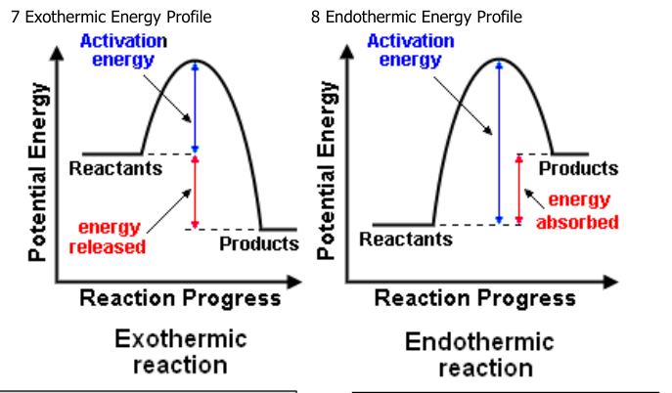
Science
Ecology: Key terms
Ecosystem | The interaction of a community of living organisms (biotic) with the non-living (abiotic) parts of their environment.
Habitat | The area in which an organism lives.
Community | Two or more different species in an ecosystem. A stable community is one where all the species and environmental factors are in balance so that population sizes remain fairly constant.
Population | The total number of organisms of one species in an ecosystem.
Competition | Plants often compete for light, space, water and mineral ions. Animals often compete for food, mates and territory
Interdependence | Within a community each species depends on other species for food, shelter, pollination etc.
Adaptations | A feature that an organism has that allows it to survive in its ecosystem.
Biodiversity | The variety of all the different species of organisms on Earth, or within an ecosystem.
Photosynthesis | Plants absorb CO₂ from atmosphere.
Respiration | Animals, plants and micro-organisms respire, releasing CO₂ into the atmosphere.
Decay | The carbon in dead organisms is released to the atmosphere by micro-organisms respiring.
Combustion | Carbon locked in fossil fuels is released as CO₂ when fuels are burned.
Evaporation | Liquid water is turned into water vapour in the atmosphere.
Condensation | Water vapour condenses to form clouds.
Precipitation | Water is deposited from clouds as rain.
transpiration | The loss of water vapour from the leaves by evaporation from cells and then out through the stomata
Energy Changes Key Terms
1 Conservation of energy | Energy is not created or destroyed, only transferred from one store to another
2 Exothermic | A reaction that transfers energy to the surroundings so the temperature of the surroundings increases, e.g. combustion and neutralisation reactions. Used in self-heating cans and hand warmers.
3 Endothermic | A reaction that takes in energy from the surroundings so the temperature of the surroundings decreases, e.g. thermal decomposition. Used in sports injury packs.
4 Activation energy | The energy needed for particles to successfully react.
5 Breaking bonds | Energy is needed to break bonds.
6 Forming bonds | Energy is released when bonds are formed.
Learn how to draw these from memory:
3
Notes:
2025 HT4

Slide 6
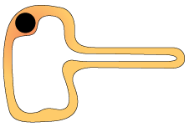
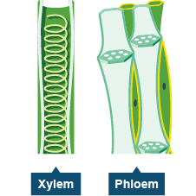
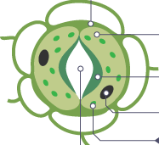
Science
Plant cells
Root hair cell Extension gives a large surface area to absorb water and minerals. | Xylem Vessels are strengthened by lignin to withstand pressure. Cell walls are waterproof. | Phloem End of cells contain pores to allow dissolved sugars to move between cells. | Guard Cells and Stoma Guard cells can open the stoma to allow gas exchange or close to prevent water loss.
Photosynthesis
Photosynthesis | Photosynthesis takes place in the chlorophyll Word Equation: carbon dioxide + water → glucose + oxygen + energy Symbol Equation: 6CO₂ + 6H₂O → C₆H₁₂O₆ + 6O₂ + energy
Uses of glucose from photosynthesis | Energy source in respiration Converted in to insoluble starch for storage Produce fats or oils for storage Produce cellulose to strengthen cell walls Produce amino acids for protein synthesis
Limiting factor (of photosynthesis) | The factor that stops the rate of photosynthesis from increasing; could be light intensity, CO₂ concentration, temperature or amount of chlorophyll
Movement within Plants
Transpiration | The loss of water vapour from the leaves by evaporation from cells and then out through the stomata.
Transpiration Stream | The movement of water from the roots, up the stem to the leaves.
Translocation | The movement of dissolved sugars around the plant.
Leaf structure and plant tissues
Leaf part | Function
Epidermis | Cover the surfaces of the leaf; lets light penetrate.
Xylem | Carries water and minerals from the roots around the plant.
Phloem | Carries dissolved sugars made through photosynthesis around the plant.
Palisade mesophyll | Where most photosynthesis takes place. Cells contain many chloroplasts. Absorbs light.
Spongy mesophyll | Some photosynthesis. Has air spaces for diffusion of CO₂ and O₂.
Guard cells | Cells that open and close stomata.
Stoma | Opening that allows CO₂ and O₂ to diffuse in and out of the leaf.
4

Slide 7
Spanish
Spanish | English
Está situado/a… | It is situated
en un valle | In a valley
al lado del río / mar | By the river/sea
pasar mucho tiempo al aire libre | Spend a lot of time outside
apreciar la naturaleza | Appreciate nature
disfrutar de las vistas | Enjoy the views
practicar ciclismo y senderismo | Do cycling and hiking
Vivo en una ciudad | I live in the city
Está en… | It is in…
el norte / el sur /el este / el oeste | North/south/east/west
Quiero comprar… | I want to buy
De acuerdo. | I agree
¿Tiene uno/a más barato/a? | I have one cheaper
¿Cuánto es? | How much is it?
Lo mejor de mi ciudad es que… | The best thing of the city is that…
hay tantas diversiones | There are so many entertainment
el transporte público | Public transport
Spanish | English
las tiendas están tan cerca | Shops are so near
hay muchas posibilidades de trabajo | There are many job prospects
Lo peor es que… | The worst thing is…
es tan ruidoso/a | It is so noisy
En el campo… | In the countryside
la vida es más relajada | Life is more relaxed
hay tantas fábricas | There are so many factories
hay pocos espacios verdes | There are few green spaces
no hay tanta industria | There isn’t so much industry
hay bastante desempleo | There is enough unemployment
la red de transporte público | The transport network
no hay tantos atascos | There aren’t so many traffic jams
es muy bueno | It’s very good
Está rodeado/a de sierra / volcanes | It is surrounded by mountains/ volcanoes
entre | between
los bosques/las selvas subtropicales/lagos | the woods /subtropical forests /lakes
Tiene… un paisaje impresionante | It has an impressive landscape
5

Slide 8
History
Key Individuals/ Groups
Kaiser | The German Emperor.
Chancellor | In Germany, the chief minister, or Prime Minister in the government.
SPD | The Social Democratic Party, one of the largest political parties in Germany.
November Criminals | Nickname given to the German politicians who ended World War One and signed the hated Treaty of Versailles on Germany’s behalf.
Spartacus League | Group of German communists who wanted a revolution similar to the one that had taken place in Russia in 1917.
Free Corps | Right-wing German paramilitary group that was active in the early years of the Weimar Republic.
Weimar Republic | Name given to Germany’s democratic system between 1913 and 1933.
Stormtroopers (SA) | Hitler’s brown-shirted supporters who were employed to beat up opponents and guard meetings.
League of Nations | International peace-keeping organisation set up after World War One; Germany joined in 1926.
Key Terms
Militarism | Belief that a country should maintain a strong armed forces and be prepared to use it aggressively.
Bundesrat | Group made up of representatives who supported the Kaiser (unlike the Reichstag, who were elected politicians who challenged the Kaiser).
Reichstag | The main, elected German parliament.
Industrialisation | Process by which a country transforms from a mainly agricultural society to one based on manufacturing and factories.
Trade Union | Association of workers formed to protect their interests.
Socialism | System of government which supports democracy and greater involvement in the economy and society.
Weltpolitik | Literally meaning ‘world policy’, this was the Kaiser’s plan to turn Germany into a global power.
Patriotic | Supporting your country, especially against its enemies.
Mutiny | Rebellion by soldiers or sailors who refuse to take orders.
Abdicate | Give up the throne of a country.
6

Slide 9
History
Key Individuals/ Groups
Article 48 | Part of the Weimar Constitution that gave the President the right to rule in a time of crisis without requiring the support of the Reichstag.
Reparations | Payments made by Germany to some of the winning nations of World war One for the damage done by the fighting.
Diktat | Nickname given by many Germans to the hated Treaty of Versailles; ‘dictated peace’.
Hyperinflation | Sudden, dramatic rise in prices.
Passive Resistance | Protesting against government or laws by using non-violent acts.
Putsch | Attempt to seize power or to take control by force.
Red Rising | Left-wing voters’ revolt in March 1920, in the Ruhr region of Germany.
Swastika | The crooked cross symbol adopted by the Nazi Party as their emblem.
Rentenmark | German currency, introduced in 1924.
Dawes Plan | Agreement allowing for US loans to be given to European countries (especially Germany) in order for them to build factories and roads, and stimulate the economy.
Young Plan | Agreement to reduce reparations, made in 1929 between Germany and the countries they owed money to after WWI.
Key Terms
Armistice | Agreement, or truce, to stop fighting.
Democratic Republic | System of running a country in which all adults have the right to vote for the government they want.
Communism | Political system where all property is owned by the government; people are equal and they are paid by the government according to their needs.
Left-Wing | Political belief that promotes equality, high taxation for the rich, and the redistribution of wealth.
Constitution | Set of rules by which a country is governed.
Proportional Representation | Political system in which the number of seats for a party is in proportion with the number of votes they win; it can lead to lots of small parties gaining seats and an unstable government.
Majority | Over half of the votes or politicians in a parliament.
Culture | The values, morals, traditions and attitudes of a group or society; relates to the music, films, art they create, building design and the behaviours they display.
Avante-Garde | New and experimental ideas and methods in art, music, or literature.
Bauhaus | School of design originating in Weimar Germany, which focused on modern, simple and practical designs, rather than the more elaborate, ‘fancy’ designs of long ago.
Subversion | Trying to destroy or damage a system or a government.
7

Slide 10
Geography
Key Word | Definition
Agribusiness | intensive farming aimed at maximizing the amount of food produced
Carbon footprint | measurement of the greenhouse gases individuals produce, through burning fossil fuels
Development | the progress of a country in terms of economic growth, the use of technology and human welfare
Energy conservation | reducing energy consumption by using less energy and existing sources more efficiently
Energy mix | the range of energy sources of a region or country, both renewable and non-renewable
Energy security | uninterrupted availability of energy sources at an affordable price
Food miles | the distance covered supplying food to consumers
Fossil fuels | a natural fuel such as coal or gas, formed in the geological past from the remains of living organisms
Fracking | the process of extracting gas from gas shale where fluids at high pressure are injected to fracture the shale rock, allowing the gas to escape
Grey water | recycled domestic waste water
Organic produce | food produced without the use of chemicals such as fertilisers and pesticides
Renewable energy | a resource that cannot be exhausted, e.g. wind, solar and tidal energy
Resources | a stock or supply of something that has value or a purpose
Resource management | control and monitoring of resources so that they do not become exhausted
Undernourishment | a food intake below that needed to sustain a healthy life
Undernutrition | when people do not eat enough nutrients to cover their needs for energy and growth, or to maintain a healthy immune system
Water deficit | when demand for water is greater than supply
Water quality | measured in terms of the chemical, physical and biological content of the water
Water stress | when the demand for water exceeds supply in a certain period, or when poor quality restricts its use
Water surplus | when the supply of water is greater than demand for water
Water transfer | matching supply with demand by moving water from an area with water surplus to another area with water deficit
8

Slide 11
Geography
Key Word | Definition
Aeroponics | growing plants in an air or mist environment without the use of soil
Appropriate technology | technology suited to the needs, skills, knowledge and wealth of local people and their environment
Biotechnology | the use of living organisms to make or modify products or processes
Food deficit | where the demand for food exceeds the supply of supply
Food insecurity | without reliable access to a sufficient quantity of affordable, nutritious food
Food security | access to sufficient, safe, nutritious food to maintain a healthy and active life
Food surplus | where the supply of food exceeds the demand for food
Genetically modified crops | a type of biotechnology that alters the DNA of crops to produce higher yields, use fewer chemicals and reduce carbon dioxide emissions
Green revolution | an increase in crop production, especially in poorer countries, using high-yielding varieties (mainly cereal), artificial fertilisers and pesticides
Hydroponics | growing plants in water using nutrient solutions, without soil
Irrigation | artificial application of water to the land or soil, to supply crops and other plants
Local food sourcing | food production and distribution that is local, rather than national and/or international
Organic farming | food produced without the use of chemicals such as fertilisers and pesticides
Overgrazing | feeding too many livestock for too long on the land, so it is unable to recover its vegetation
Permaculture | (formed from ‘permanent agriculture’ and ‘permanent culture’) food production which follows the patterns and features of natural ecosystems
Seasonal produce | food (often produced locally) that is ‘in season’, such as strawberries in the summer and apples in the autumn
Soil erosion | the removal of soil by wind and rain
Sustainable fishing | fishing that avoids damaging supplies by setting catch limits and monitoring fish breeding and fishing practices
Sustainable food supply | food production that avoids damaging natural resources, providing good quality produce as well as social and economic benefits to local people
Undernutrition | when people do not eat enough nutrients to cover their needs for energy and growth
Urban farming | growing food and raising animals in towns and cities, as well as processing and distributing food, and collecting and re-using food waste
Water security | a reliable source of clean water for drinking, watering crops keeping livestock
9

Slide 12
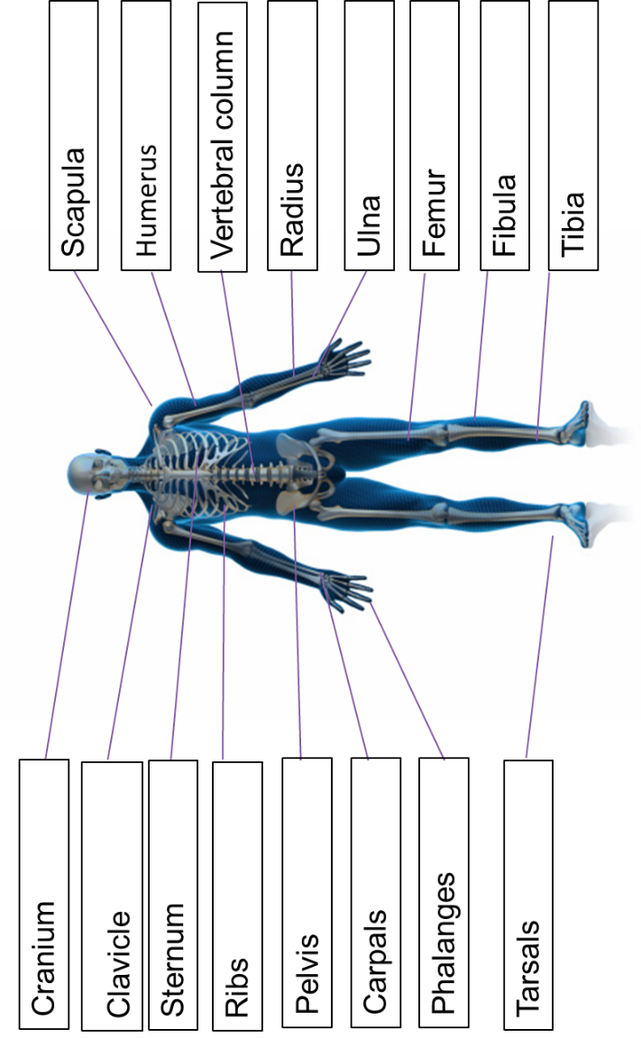
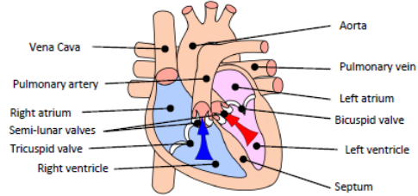
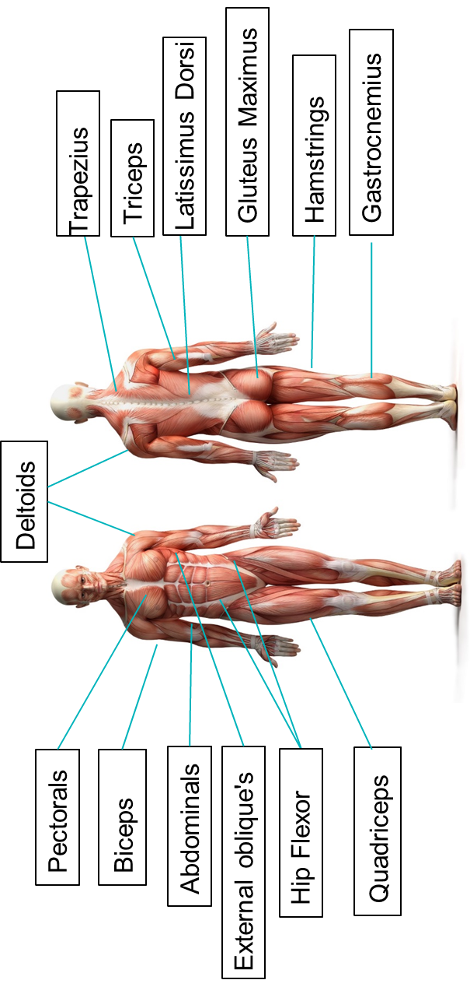
PE
Skeletal System
Cardiovascular System
Muscular System
10

Slide 13
PE
Type of muscle found in the body
The muscular system is made up of 3 types of muscle which serve different functions within the body.
Smooth | This is otherwise known as involuntary muscle as they are not under our conscious control. They are unstriated and do not fatigue. Functions: Help hollow organs contract.
Cardiac | Involuntary as it is not under our conscious control. They have striations and do not fatigue. Functions: Contract the heart chambers to move blood to the body and lungs
Skeletal | Which are voluntary as it is under our conscious control. They have some striations and they fatigue. They attach to bones via tendons. When they shorten and lengthen, movement occurs
Muscular contractions
There are two types of contraction that occur on skeletal muscles; Isotonic and Isometric contraction.
1. Isometric contraction | Involves contractions where the muscle remains the same length.
2. Isotonic contraction | Involves contractions when muscle length contraction to either become shorter or longer. The two types of isotonic contractions are; Concentric and Eccentric contraction.
Isotonic – Concentrix contraction | Contractions are those where the muscles shortens as it contracts.
Eccentric | Contractions where the muscle lengthens.
11

Slide 14
PE
Cardiovascular System – Components of blood
Red blood cells | Carry oxygen from the lungs to the working muscles + Removes CO2.
Haemoglobin | A protein that binds and carries oxygen molecules.
White blood cells | Are part of the immune system and fight disease and infection.
Platelets | Blood platelets are formed in the bone marrow and are essential in the clotting of blood. Platelets are the workhorses of the cardiovascular system.
Plasma | Blood plasma is made up of 90% water. It contains a range of substances that aids the circulation between cells and tissues.
Blood Vessels
Arteries | Carry blood away from the heart, Oxygenated blood (except pulmonary artery) Thick/elastic walls High pressure Small lumen
Veins | Carry blood back to the heart Deoxygenated blood (except pulmonary vein) Thin walls + larger lumen Lower pressure Valves
Capillaries | In the tissue Site of gaseous exchange Very thin walls
12

Slide 15
Computing
Processes
Decomposition | Breaking down a complex problem or system into smaller parts
Algorithm | A step-by-step procedure that is created to solve a problem
Abstraction | The process of removing details and patterns that will not help us to solve a problem
Computational thinking | Computational thinking is a way to solve problems by thinking and making decisions like a computer
Pattern recognition | Looking for things that repeat or are the same.
Strings and lists
GUI | Acronym for Graphical User Interface. It is an event-driven program that allows the user to interact with it in a variety of ways. For example, buttons and icons.
Concatenate | When two or more strings are joined together
String | A value that is text. This can include numbers but they will be read as text
String handling | Performing operations on string
Substring | Part of a string
ASCII | Used to represent characters with a numerical value.
List | A dynamic data structure that holds items under one name.
Array | A fixed (static) data structure that holds items of the same data type under one name
Index | The location of items or elements in a list, array, or string
Append | Adding to an existing data structure
Data structure | Used to store data in an organised and accessible way
Operator | A symbol or function that performs an operation. For example, +.
2D array | A static data structure that holds data both horizontally and vertically. The structure is fixed and each element has the same data type.
2D list | A dynamic data structure that holds data both horizontally and vertically. The structure can change during program execution and the data types of the elements can be different.

Slide 16
Art
Key Word | Definition
Identity | Identity is the qualities, beliefs, personality traits, appearance, and/or expressions that characterize a person or group
Gender | either of the two sexes (male and female), especially when considered with reference to social and cultural differences rather than biological ones. The term is also used more broadly to denote a range of identities that do not correspond to established ideas of male and female.
Artist Analysis | An Artist study is the breakdown of the artistic elements in an artwork to discover how it portrays meaning. Analysing art is an aspect that many students find difficult, practicing it will help you develop your language and skills.
Artist Transcription | Transcription in painting is copying, but often with a different purpose than to produce a replica. Artists use transcription to learn how another artist worked: how she constructed her painting, produced brush strokes and visual effects, and how they mixed colours
Critic | a person who judges the merits of literary or artistic works, especially one who does so professionally.
Context | Specific to artwork, context consists of all of the things about the artwork that might have influenced the artwork or the maker (artist) but which are not actually part of the artwork.
Culture | the ideas, customs, and social behaviour of a particular people or society
Impasto | An oil painting technique that might require a little more practice, Impasto painting was a key feature of many of Van Gogh’s works. Requiring deliberate strokes of thick paint, each mark of the paintbrush is clearly visible in the finished piece.
Chiaroscuro | Offering a significant contrast between the lighter and darker aspects of a painting, Chiaroscuro was used a lot by renaissance artists such as Rembrant and Caravaggio.
Under painting | Underpainting removes that fear factor, as it involves ‘sketching’ the subject in one very thin layer of paint and blocking out any background so that you’ll know where to put this later in the creative process.
Dry Brushing | The secret to dry brush painting is to apply the paint with the very tip of your brush. Work with a clean, dry brush and scrub it over the surface you're painting. Use a stabbing motion to really push the paint into any crevices. You want to work quickly to brush the paint out well.
Concept | Concepts are defined as abstract ideas
Theme | Theme relates to the meaning of a painting, rather than the subject, which is specific and basic. A theme is deeper and broader and conveys something more universal.
Interpret | explain the meaning of (information or actions)
Annotation | A note by way of explanation or comment added to a text or diagram
15

Slide 17
Performing Arts
Year 10
Devising Drama
Devising Drama – Key Words
Stimulus | A resourced used as a starting point to generate ideas for a piece of drama. This may be a poem, story, piece of music, historical event, a painting, a piece of artwork, a quote and more.
Direct Address | When an actor speaks directly to the audience, e.g. in pantomime.
Tableaux | A ‘frozen picture’ that tells a story. Costume and props are needed, and physicality used to show emotion.
Blocking | The staging and use of the space in drama, This may refer to the location of actors on the stage and the movements they make.
Multi-role | When an actor plays more than one role.
Exits and Entrances | Where a character enters and exits their scene.
Thought Tracking | An exercise that allows the inner thoughts of a character or role to be heard out loud. The participant is asked to say their characters thoughts and feelings at specific points during their acting.
Technical Rehearsal | Technical equipment and systems for example sound, lighting and computer generated effects.
Rehearsal | A practice or trial performance of a play.
Developing Ideas
Soundscape | The actors used their bodies to create sound effects for the performance
Transitions | The fluid and focused movement between scenes/images
Proxemics | Proxemics is how close or near you are to others on stage. This can help to communicate meaning e.g. if your character is scared of another character you might stand far away.
Storyboarding | Involves creating a series of images and/or text showing the sequence of the action planned for a devised drama.
Cue to Cue Rehearsal | This involves a rehearsal where the actors remove all of the action and dialogue between cues during a technical rehearsal.
Narrative | The narrative is the storyline or plot of a piece of drama. A narrative should be clear for the audience so that the storytelling makes sense - although there are different ways to structure a narrative which will explore in lessons
Semiotics | This refers to how meaning is created and communicated through the systems of signs and symbols of drama.
Movement in unison | All actors moves in the same way, at the same time.
16

Slide 18
Food and Cookery
Key Word | Definition
Nutrition | A study of what people eat and how all the nutrients in foods work together in the body
Balanced Diet | A balanced diet is one that contains the correct nutrients in the correct proportions, plus the correct amount of water and dietary fibre to meet the body’s needs
Seasonality | Foods that grow at certain times of the year and are dependent on the seasons for the correct weather and temperature required for growth
Ramadan | The month of fasting that is set by the Muslim calendar
Passover | Jewish holiday that is usually in March or April
Diwali | A Hindu feast that takes place in October or November
Halal Food | Food that is set out in the Muslim holy book, the Quran, and is slaughtered in a certain way
Kosher Food | Food that is specified for a Jewish diet by Judaism’s religious rules.
Recipe Amendment | Changing or altering a recipe eg changing some ingredients and/ or cooking methods
Lacto-ovo vegetarians | People who choose not to eat meat or fish, but they will eat other animal products such as eggs, milk, milk products like cheese and butter
Lacto vegetarians | People who choose to eat the same food as lacto-ovo vegetarians but will not eat eggs.
Organic foods | Foods that are grown or raised without using pesticides or artificial fertilisers and are produced with high standards of animal welfare.
Food miles | The total number of miles that food has travelled during transportation from the field or food producer to the plate or the consumer
Carbon emissions | The total amount of carbon dioxide produced from growing, processing and transporting a product.
17

Slide 19
Psychology – Research Methods
Ethical Issues
Issue | Informed Consent | Deception | Protection from Harm | Privacy | Confidentiality
Describe | Participants should be given information about the purpose of the study and their role in it. | Participants should not be lied to or mislead about a study, or they can’t give consent. | Participants should not be placed at risk of psychology or psychological harm | Participants should be able to control information about themselves | Participants identity and personal details should be protected
Overcome | Sign a consent form before the study. Retrospective consent after the study. | Debrief: true purpose, right to withdraw information, reassurance | Debrief: reassure ppts that their behaviour was normal, offer counselling if required. | All ppts should be kept anonymous. Refer to participants as PPT 1, PPT 2 etc. All ppts to be told their data will remain protected and confidential.
Interviews
Type | Structured | Semi-Structured | Unstructured
Describe | Pre-prepared questions | Pre-prepared questions and follow up questions/ | Develop questions based on answer given.
Strengths | Can produce extensive information. Can provide detailed insights and rich quality data.
Weaknesses | Can be difficult to analyse, drawing conclusions can be complex. Researcher bias. Some PPTs may feel uncomfortable in an interview compared to a questionnaire.
Observations
Type | Naturalistic vs Controlled | Overt vs Covert | Participant vs Non-participant
Describe | N: Behaviour is recorded in the place that it would naturally occur C: Some aspects of the environment are controlled. | Overt: Participants are aware they are being observed Covert: Participants not aware of their behaviour being observes | P: Researcher becomes part of the group NP: Researcher remains separate to the group
Strengths | May provide a better indication of behaviour than interviews/questionnaires. Looks at real life behaviour, increased validity of findings.
Weaknesses | Ethical issues around privacy. Observer bias can influence what is seen or heard. Overcome this by establishing inter-observer reliability
Questionnaires
Open Questions - No fixed range of answers | Closed Questions – Fixed Response
Strengths: Can gather lots of information quickly. Easier to analyse.
Weaknesses: Social desirability bias, reduced validity
18

Slide 20
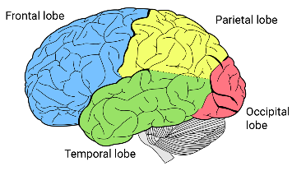
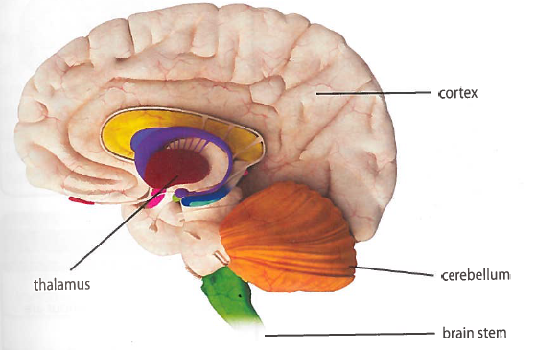
Paper 1 – Development Key terms and definitions
Autonomic function | Involuntary bodily functions such as breathing and heart rate | Mindset theory | A theory of motivation that describes how students can achieve success in their learning through the way they approach challenges and deal with failure.
Brain stem | The part of the brain that controls basic functions such as breathing and heart rate | Fixed mindset | The belief that ability is genetic and unchanging.
 |  | Growth mindset | The belief that ability comes from hard work and can be increased.
Cerebellum | A small, wrinkled structure at the back of the brain which coordinates movement and balance | Praise | Giving feedback to students with regards to their ability (person orientated) or effort (process orientated)
Cognition | The mental processes involved in gaining knowledge; these include thinking, planning and problem solving | Self-efficacy | The belief in your own ability to succeed and achieve a goal.
 |  | Learning styles | The different ways that a person can process information.
Cortex | The outer layer of the brain where higher cognitions take place, e.g. understanding and producing speech | Verbaliser | Someone who prefers to process information by speaking and listening (auditory processing)
Thalamus | The part of the brain that passes information from the sense organs to the cortex | Visualiser | Someone who prefers to process information by looking at it (visual processing)
Sensory processing | The brain receives messages from the senses and turns them into appropriate motor and behavioural responses | Key Theories
Cognitive development | The changes that take place over time in a person’s thinking and intellect | 1. Piaget’s Theory of Cognitive Development: 4 stages (Sensorimotor, pre-operational, concrete operational, formal operational), assimilation, accommodation, readiness, child centred learning, egocentrism, conservation
Synapse | The small gap between two neurons which allows signals to pass between them | 2. Dweck’s Mindset theory of Learning: Fixed vs growth, praise, self-efficacy
Nature | The influence of genetics on behaviour | 3. Willingham’s Learning Theory: Criticises learning styles, advocates: praise, knowledge, practise & self-regulation
Nurture | The influence of the environment on behaviour
 |  | Key Studies
Schema | A cognitive unit of information about the world based on previous information and experiences which helps us to perceive, organise and understand new information | 1. Hughes’ (1978) Policeman Doll Study: Asked children to place a boy doll in a zone where two policeman could not see him due to being hidden behind walls. Found that had a reduction in egocentrism at an earlier age than Piaget’s theory suggested, if it is put into terms they understand.
Accommodation | Changing a schema, or developing a new schema to cope with a new situation
Assimilation | Adding new information to an existing schema | 2. McGarrigle and Donaldson’s (1974) Naughty Teddy study: Asked children if a row of counters had the same amount to an identical row that had been spread out by a Teddy running through them. Found that children developed conservation skills at an earlier age than Piaget found, if the change to the materials was accidental.
Sensorimotor | A stage where you learn through the senses and by physical (motor) activities
Pre-operational | A stage where you are unable to apply reason to solve problems: you lack conservation and are egocentric | Key Diagrams
Concrete operational | A stage demonstrating the ability to apply logic to physical (concrete) objects to solve problems. Conservation develops and egocentrism reduces.
Formal operational | A stage where you can apply logic in an abstract (non-physical) way to solve problems, for example applying hypothetical rules to situations.
Conservation | Knowing the amount of something stays the same, even though its appearance may change
Egocentric | Not being able to see things from another person’s point of view
19

Slide 21
Resilience definition: Grappling to get unstick
Reflecting on learning behaviours for thinking… | Experience log
 | Successful moment… | In hindsight… An example where you could have done better on reflection | At home…
I gave an idea and reasoned/justified.
I reflected on my idea and made it better after discussing with others
I used a revision strategy to help make the learning stick.
I made connections between what I am learning and the outside world.
20

Slide 22
Resilience definition: Grappling to get unstick
Reflecting on learning behaviours for thinking… | Experience log
 | Successful moment… | In hindsight… An example where you could have done better on reflection | At home…
I gave an idea and reasoned/justified.
I reflected on my idea and made it better after discussing with others
I used a revision strategy to help make the learning stick.
I made connections between what I am learning and the outside world.
21

Slide 23
Resilience definition: Grappling to get unstick
Reflecting on learning behaviours for thinking… | Experience log
 | Successful moment… | In hindsight… An example where you could have done better on reflection | At home…
I gave an idea and reasoned/justified.
I reflected on my idea and made it better after discussing with others
I used a revision strategy to help make the learning stick.
I made connections between what I am learning and the outside world.
22

Slide 24
Resilience definition: Grappling to get unstick
Reflecting on learning behaviours for thinking… | Experience log
 | Successful moment… | In hindsight… An example where you could have done better on reflection | At home…
I gave an idea and reasoned/justified.
I reflected on my idea and made it better after discussing with others
I used a revision strategy to help make the learning stick.
I made connections between what I am learning and the outside world.
23

Slide 25
Resilience definition: Grappling to get unstick
Reflecting on learning behaviours for thinking… | Experience log
 | Successful moment… | In hindsight… An example where you could have done better on reflection | At home…
I gave an idea and reasoned/justified.
I reflected on my idea and made it better after discussing with others
I used a revision strategy to help make the learning stick.
I made connections between what I am learning and the outside world.
24

Slide 26
Reading Log w/c 23rd February (20 mins reading per day – all five logs MUST be completed)
Date | Title of novel | Number of pages read | Summary about what I have read
 |  |  | • • •
 |  |  | • • •
 |  |  | • • •
 |  |  | • • •
 |  |  | • • •
Checked by form tutor:
25

Slide 27
Reading Log w/c 2rd March (20 mins reading per day – all five logs MUST be completed)
Date | Title of novel | Number of pages read | Summary about what I have read
 |  |  | • • •
 |  |  | • • •
 |  |  | • • •
 |  |  | • • •
 |  |  | • • •
Checked by form tutor:
26

Slide 28
Reading Log w/c 9th March (20 mins reading per day – all five logs MUST be completed)
Date | Title of novel | Number of pages read | Summary about what I have read
 |  |  | • • •
 |  |  | • • •
 |  |  | • • •
 |  |  | • • •
 |  |  | • • •
Checked by form tutor:
27

Slide 29
Reading Log w/c 16th March (20 mins reading per day – all five logs MUST be completed)
Date | Title of novel | Number of pages read | Summary about what I have read
 |  |  | • • •
 |  |  | • • •
 |  |  | • • •
 |  |  | • • •
 |  |  | • • •
Checked by form tutor:
28

Slide 30
Reading Log w/c 23rd March (20 mins reading per day – all five logs MUST be completed)
Date | Title of novel | Number of pages read | Summary about what I have read
 |  |  | • • •
 |  |  | • • •
 |  |  | • • •
 |  |  | • • •
 |  |  | • • •
Checked by form tutor:
29

Slide 31
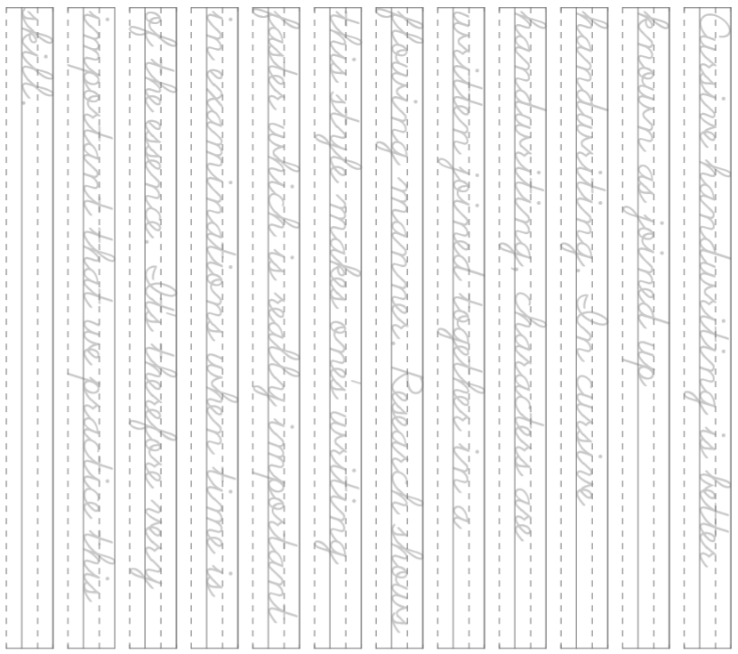
Cursive Handwriting Practice – Week 1
30

Slide 32
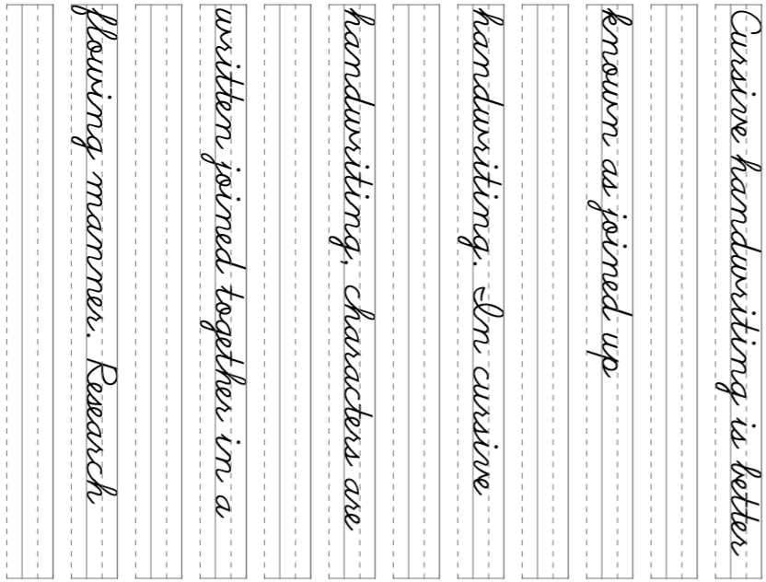
Cursive Handwriting Practice – Week 2
31

Slide 33
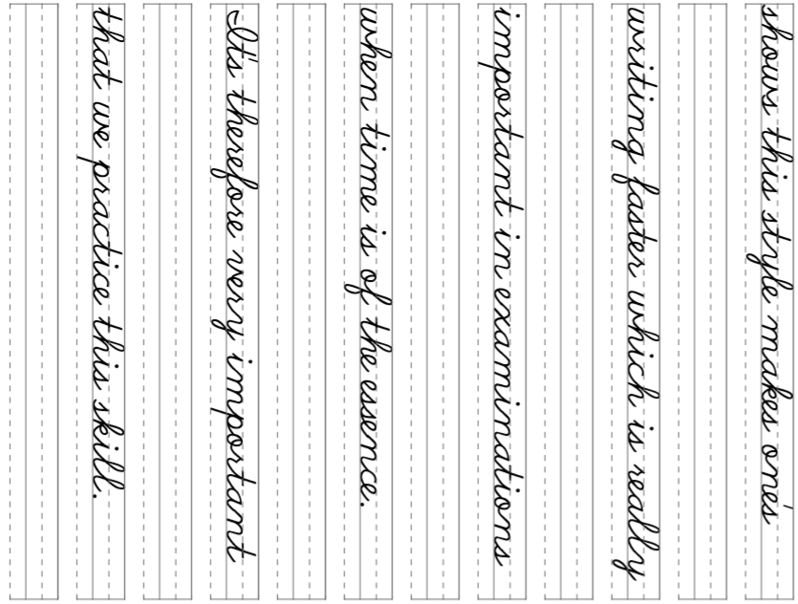
32

Slide 34
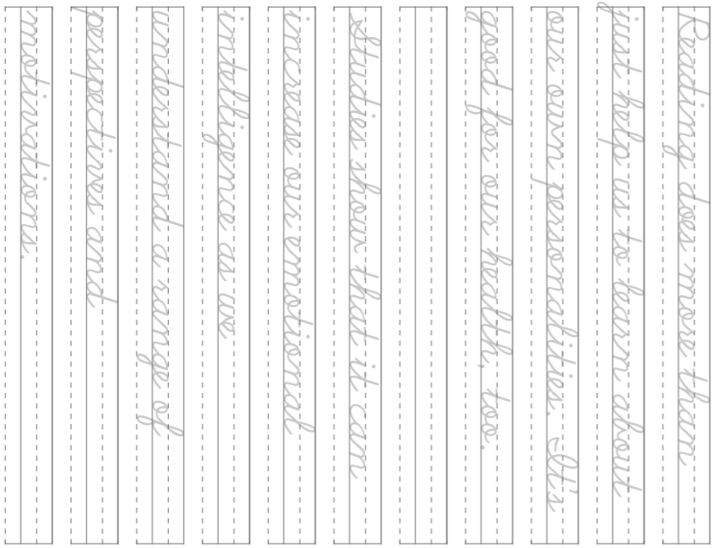
Cursive Handwriting Practice – Week 3
33

Slide 35
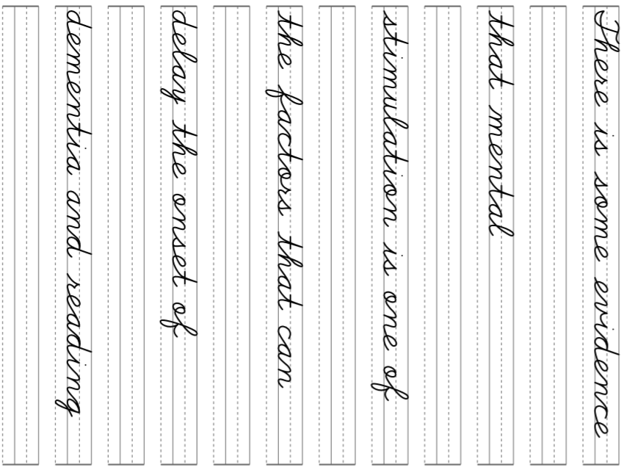
Cursive Handwriting Practice – Week 4
34

Slide 36
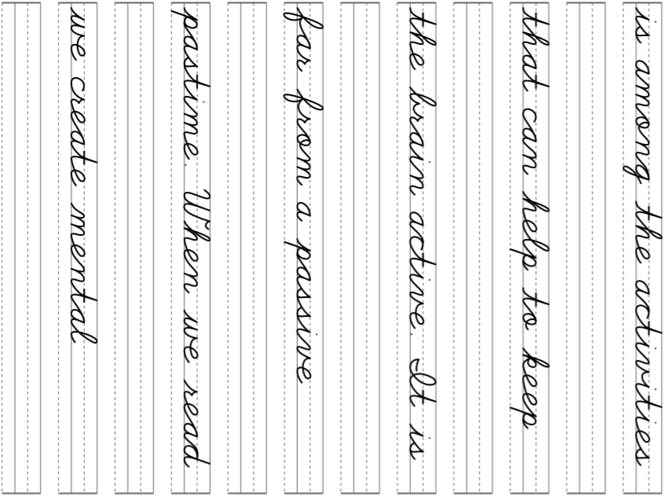
34

