Slide 1

Year 10 Knowledge Organiser HT5
Knowledge is Power
Name: ______________________________
Form: _______

Slide 2
Contents Page
Subject | Page
English | 1
Maths | 2
Science | 4
Spanish | 6
History | 7
Geography | 8
PE | 10
Computing | 13
Art | 14
Performing Arts | 15
Cooking and Nutrition | 16
Psychology | 17
‘Thinking’ reflection log | 18
Reading log | 22
Cursive Handwriting Practice | 28

Slide 3
English
Week 2 – Key Devices
Adjacency Pairs | These are pairs of utterances in a conversation that follow on from each other e.g. greeting and greeting, question & answer.
False Start | This is where someone starts then breaks off (because they are uncomfortable or confused).
Overlap | This is where turn-taking goes wrong, and both participants message at the same time.
Back Tracking | Going back to something in the conversation that's already been started or has already been said.
Fillers | Items in speech that allow time to think, or create a pause, e.g. ‘erm.
Week 4 – Themes in the play
Bullying | Happiness
Gang membership | Science
Social responsibility | Alienation
Morality | Death
Leadership | Cruelty and violence
Week 1 – Key Terms
Gangs | The plot deals with a gang’s reaction to the aftermath of a crime. Kelly explores the interrelationships within the group responsible.
Bullying | Psychological bullying as well as the physical abuse of Adam is a predominant theme. The play explores the different effects bullying can have on people.
Responsibility | The play makes the audience question who is ultimately responsible for the callous behaviour of the group.
Power | Kelly investigates different kinds of power relationships within the group and how different characters exert their power to control the gang.
Loyalty | The audience are prompted to consider the different kinds of loyalty; to individuals, to the group, and to our own personal beliefs.
Week 5 - Quotes
Mark | We were having a laugh, weren't we…
Richard | You shouldn’t threaten me, John.
Cathy | They might even give me money for it, do you think I should as for money?
John Tate | You crying piece of filth.
Leah | It’s Adam, Phil, Adam! We used to go to his birthday parties, he used to have that cheap ice cream and we used to take the piss, remember?
Brian | Beat. Brian stops crying. Looks up. I think we should tell someone.
Week 3 - Characters
Phil | Menacing, Cold, Sinister
John Tate | Controlling, Manipulative, Tyrannical
Leah | Insecure, Loyal, Insightful, Inferior
Mark | Cruel, Malicious, Blunt, Ruthless
Jan | Bullying, Intimidating, Gullible,
Adam | Victim, confused, scared
Richard | Insecure, Confident, Sycophant (flatterer)
Week 6 – Key context
London riots | What began as a protest turned violent in London led to 5 days of civil unrest, looting and violent clashes with authorities.
Jamie Bulger murder case | Two ten-year-old boys abducted and murdered a two-year-old boy
ASBO’s and yobs | In the early 2000s many teenagers, especially in urban centres were branded as ‘yobs’ or ‘ASBO’s’.
1
Notes:
1 and 2

Slide 4

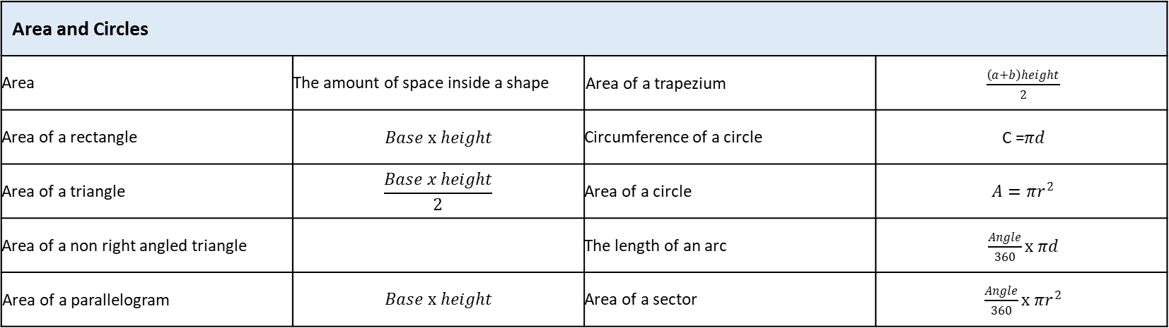


Mean | sum of data ÷ number of pieces of data
Estimated mean
Mean | sum of data ÷ number of pieces of data
Estimated mean
Mean | sum of data ÷ number of pieces of data
Estimated mean
Maths
Area and Circles
Area | The amount of space inside a shape | Area of a trapezium | $\frac{\left(a+b\right)height}{2}$
Area of a rectangle | $$Base x height$$ | Circumference of a circle | C =𝜋𝑑
Area of a triangle | $$\frac{Base x height}{2}$$ | Area of a circle | $A=πr^{2}$
Area of a non right angled triangle |  | The length of an arc | $\frac{Angle}{360}x πd$
Area of a parallelogram | $$Base x height$$ | Area of a sector | $\frac{Angle}{360}x πr^{2}$
$$\frac{1}{2}absinC$$
Volume and Surface Area
Cross section | A cross section is the shape we get when cutting straight through an object
Prism | Is a 3D shape with the same cross section all the way through
Volume | The amount of 3-dimensional space something takes up
Surface Area | Is the area of all the faces on a 3D shape
2
$$\frac{1}{2}absinC$$
$$\frac{mid point x Frequency}{Total frequency}$$
$$\frac{mid point x Frequency}{Total frequency}$$
$$\frac{mid point x Frequency}{Total frequency}$$

Slide 5

Maths
Averages and the Range
Key Word | Definition
Mode | Most common
Median | Middle, when the data is in order
Range | Largest value - smallest value
Mean | sum of data ÷ number of pieces of data
Estimated mean
Cumulative Frequency and Boxplots
Key Word | Definition
Cumulative frequency | The cumulative frequency is found by adding up the frequencies as you go along, to give a 'running total'
Cumulative frequency graph | Is drawn by plotting the upper class boundary with the cumulative frequency.
Boxplot | Is a diagram which shows the median, upper and lower quartiles, maximum and minimum values of the data
Median | Is the middle value, when in order
Lower quartile | Is the median of the lower half of the values
Upper Quartile | Is the median of the upper half of the values
Interquartile range | Upper quartile - lower quartile . This shows the spread of the data around the median
Range | Maximum value - minimum value. This shows the spread of the data
$$\frac{mid point x Frequency}{Total frequency}$$
3

Slide 6
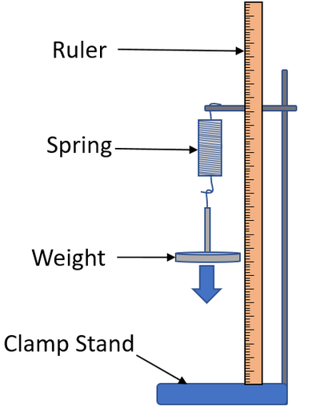
Science
Ecology: Key terms
Ecosystem | The interaction of a community of living organisms (biotic) with the non-living (abiotic) parts of their environment.
Habitat | The area in which an organism lives.
Community | Two or more different species in an ecosystem. A stable community is one where all the species and environmental factors are in balance so that population sizes remain fairly constant.
Population | The total number of organisms of one species in an ecosystem.
Competition | Plants often compete for light, space, water and mineral ions. Animals often compete for food, mates and territory
Interdependence | Within a community each species depends on other species for food, shelter, pollination etc.
Adaptations | A feature that an organism has that allows it to survive in its ecosystem.
Biodiversity | The variety of all the different species of organisms on Earth, or within an ecosystem.
Photosynthesis | Plants absorb CO₂ from atmosphere.
Respiration | Animals, plants and micro-organisms respire, releasing CO₂ into the atmosphere.
Decay | The carbon in dead organisms is released to the atmosphere by micro-organisms respiring.
Combustion | Carbon locked in fossil fuels is released as CO₂ when fuels are burned.
Evaporation | Liquid water is turned into water vapour in the atmosphere.
Condensation | Water vapour condenses to form clouds.
Precipitation | Water is deposited from clouds as rain.
transpiration | The loss of water vapour from the leaves by evaporation from cells and then out through the stomata
Forces: Key terms
1 Scalar | A value with magnitude (size) only, e.g. speed, distance.
2 Vector | A value with magnitude (size) and direction, e.g. all forces, displacement, velocity.
3 Contact force | Force between objects that are touching e.g. friction, air resistance.
4 Non-contact force | Force between separate objects e.g. gravitational force, magnetic force.
5 Weight | The force of gravity acting on an object’s mass. Measured using a newtonmeter.
6 Centre of mass | The single point at which the object’s weight appears to act.
7 Resultant force | A resultant force is a single force that has the same effect as all the forces acting on an object.
8 Work done | Work is done when an object is moved through a distance. When work is done against friction there is a temperature rise.
Forces and elasticity
Elastic deformation | The object has been stretched but returns to its original length
Inelastic deformation | The object has been stretched but does not return to its original length
Extension | The difference between stretched and unstretched lengths
Elastic Potential energy (EPE) | Energy stored in a stretched spring
4
Notes:
2025 HT5

Slide 7
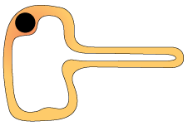
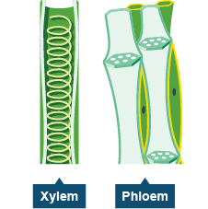
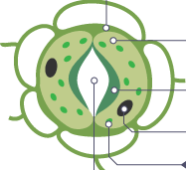
Science
Plant cells
Root hair cell Extension gives a large surface area to absorb water and minerals. | Xylem Vessels are strengthened by lignin to withstand pressure. Cell walls are waterproof. | Phloem End of cells contain pores to allow dissolved sugars to move between cells. | Guard Cells and Stoma Guard cells can open the stoma to allow gas exchange or close to prevent water loss.
Photosynthesis
Photosynthesis | Photosynthesis takes place in the chlorophyll Word Equation: carbon dioxide + water → glucose + oxygen + energy Symbol Equation: 6CO₂ + 6H₂O → C₆H₁₂O₆ + 6O₂ + energy
Uses of glucose from photosynthesis | Energy source in respiration Converted in to insoluble starch for storage Produce fats or oils for storage Produce cellulose to strengthen cell walls Produce amino acids for protein synthesis
Limiting factor (of photosynthesis) | The factor that stops the rate of photosynthesis from increasing; could be light intensity, CO₂ concentration, temperature or amount of chlorophyll
Movement within Plants
Transpiration | The loss of water vapour from the leaves by evaporation from cells and then out through the stomata.
Transpiration Stream | The movement of water from the roots, up the stem to the leaves.
Translocation | The movement of dissolved sugars around the plant.
Leaf structure and plant tissues
Leaf part | Function
Epidermis | Cover the surfaces of the leaf; lets light penetrate.
Xylem | Carries water and minerals from the roots around the plant.
Phloem | Carries dissolved sugars made through photosynthesis around the plant.
Palisade mesophyll | Where most photosynthesis takes place. Cells contain many chloroplasts. Absorbs light.
Spongy mesophyll | Some photosynthesis. Has air spaces for diffusion of CO₂ and O₂.
Guard cells | Cells that open and close stomata.
Stoma | Opening that allows CO₂ and O₂ to diffuse in and out of the leaf.
5

Slide 8
Spanish
Spanish | English
artístico (married) | artistic)
conocido | Known
especial | Special
famoso | Famous
guapo | Good-looking
inglés | English
joven | Young
muerto | Dead
popular | Popular
rico | Rich
soltero | Single
casado | married
actriz | Actress
canción | Song
carrera | Career
droga | Drug
entrevista | Interview
estrella | Star
identidad | Identity
imagen | Image/picture
Spanish | English
moda; de moda | Fashion
novela | Novel
pareja | Couple
película | Film
red | Network/internet
relación | Relationship
serie | Series
voz | voice
carácter | Character
comportamiento | Behaviour
dinero | Money
equipo | Team
espectáculo | Show
éxito | Success
marido | Husband
matrimonio | Marriage
mundo | World
miembro | Member
Novio/a | Boy/girlfriend
6

Slide 9
History
Key Terms
Inherit | To gain possessions after someone has died.
Treason | An attempt to kill or overthrow the Monarch or betray the country; punishable by death.
Royal Court | The nobles, advisors and others who surrounded the Monarch.
Nobility | The most respected members of society; they were given special rights and privileges and owned most of the land.
Secretary of State | The leader of the Privy Council; a very powerful position.
Militia | A non-professional army raised to defeat a rebellion or fight a war.
Privy Council | A Monarch’s private councillors.
Gentry | High social class ranked below the nobility; they might be local JPs or hold similar office.
Patronage | Land, titles or power given to ensure an individual’s support.
Mass | A Catholic church service.
Monopoly | The exclusive right to trade in a particular product.
Ruff | An item of clothing worn around the neck.
Succeed | To take over the throne.
Exile | Being sent to live in another country that is not your own.
Key Individuals
Elizabeth I | Last Tudor Queen of England 1558-1603. Protestant.
Henry VIII | Elizabeth’s father. He changed the religion of the country from Catholic to Protestant during the English Reformation in 1533.
Anne Boleyn | Elizabeth’s mother and Henry’s second wife. She was beheaded by Henry.
Mary I | Elizabeth’s Catholic sister. She was the ruler before Elizabeth and had been unpopular.
Sir William Cecil | Secretary of State and person in government closest to Elizabeth.
Robert Dudley, Earl of Leicester | One of Elizabeth’s favorites at Court. Possible suitor.
Thomas Howard Duke of Norfolk | England’s most senior protestant nobleman. Close links to northern Catholic families. Disliked Cecil and Dudley.
Robert Devereux, Earl of Essex | Courtier and royal favourite in the court of Elizabeth I. Led rebellion against Elizabeth in 1601 and was executed.
Phillip II of Spain | King of Spain. Was married to Queen Mary I until her death. He proposed marriage to Elizabeth
Mary, Queen of Scots | Elizabeth’s second cousin. Catholic with a strong claim to the English throne.
7

Slide 10
Geography
Key Word | Definition
Abrasion | rocks carried along a river wear down the river bed and banks
Alluvium | a sediment deposited by a river when it floods
Attrition | rocks being carried by the river smash together and break into smaller, smoother and rounder particles
Channel | the main water course
Channel straightening | removing meanders from a river to make it straighter
Confluence | where a tributary joins a larger river
Cross profile | a cross section of a river channel or its valley
Deposition | occurs when material being transported by the sea is dropped due to the sea losing energy
Discharge | quantity of water that passes a given point on a stream or riverbank within a given period of time
Drainage basin | an area of land drained by a river and its tributaries
Embankment | artificially raised river banks often using concrete walls
Estuary | tidal mouth of a river where it meets the sea – wide banks of deposited mud are exposed at low tide
Flood | where river discharge exceeds river channel capacity and water spills onto the floodplain
Flood relief channel | artificial channels that are used when a river is close to maximum discharge; they take the pressure off the main channels when floods are likely
Flood storage areas | water is deliberately allowed to flood wetlands to reduce the risk of flooding further downstream
Floodplain | relatively flat area forming the valley floor either side of a river channel that is sometimes flooded
Floodplain zoning | identifying how a floodplain can be developed for human uses
Gorge | a narrow steep-sided valley – often formed as a waterfall retreats upstream
Hydraulic action | power of the water eroding the bed and banks of a river
Hydrograph | a graph which shows the discharge of a river, related to rainfall, over a period of time
Interlocking spurs | outcrops of land along the river course in a valley
Lateral erosion | erosion of river banks rather than the bed – helps to form the floodplain
8

Slide 11
Key Word | Definition
Levee | raised bank found on either side of a river, formed naturally by regular flooding or built up by people to protect the area against flooding
Load | material transported by a river
Long profile | the gradient of a river, from its source to its mouth
Meander | a wide bend in a river
Mudflats | areas of fine sediment deposits which over time can develop in saltmarshes
Ox-bow lake | an arc-shaped lake on a floodplain formed by a cut-off meander
Plunge pool | a deep and turbulent area of water where the river ‘plunges’ over a waterfall
Saltation | hopping movement of pebbles along a river or sea bed
Saltmarshes | important natural habitats often found in sheltered river estuaries behind spits where there is very little flow of water
Solution | dissolved rocks and minerals often derived from limestone or chalk
Suspension | small particles carried in river flow or sea water, i.e. sands, silts and clays
Thalweg | the course of the fastest flow (velocity) within a river
Time lag | the time in hours between the highest rainfall and the highest (peak) discharge
Traction | where material is rolled along a river bed or by waves
Transportation | the movement of eroded material
Tributary | a small stream that joins a larger river
Velocity | rate of the river flow
Vertical erosion | downward erosion of the river bed
V-shaped valley | steep-sided valley
Waterfall | a step in the long profile of a river usually formed when a river crosses over a hard (resistant) band of rock
Watershed | the edge of the river basin
Wetlands | saturated areas of land, often found on river floodplains
9

Slide 12



PE
Skeletal System
Cardiovascular System
Muscular System
10

Slide 13
PE
Muscular system - Antagonistic pairs
Tendons connect muscle to bone and ligaments connect bone to bone. Voluntary muscles allow for movement as they produce a force which causes the attached bones to move in a specific direction. Muscles which are attached via tendons work together to create this.
Antagonistic pairs | Is where two muscles work together to create movement. There are two main categories that outline how these muscles work together; agonist and the antagonist.
Agonist | Is the also known as the prime mover. This is the muscle that contracts and causes the movement.
Antagonist | This is the opposite muscle that relaxes and in most cases lengthens as the movement occurs.
Muscular system – Muscle fibre types
All skeletal muscle contains a mixture of Slow Twitch and Fast Twitch muscle fibres- this is based on their speed of contraction. There are 3 types of muscle fibre.
Fast Twitch | Is broken down into two types;Type 2 x & Type 2 b.
Fast twitch - Type 2 x/2b | Produces highest force, fast contracting, Low endurance, good for short distances – Sprint start
Type 2a | Produce high force, moderate speed of contraction, medium endurance, more resistant to fatigue, Sprinting over longer distances.
Slow Twitch | They contract slowly and with less force. Provide a low speed of contraction, high endurance, can keep going, don’t produce much power. These fibres have a rich blood (and oxygen) supply. This makes them red in colour. They are slower to fatigue, and so are used for more endurance events e.g. long distance swimming/ running.
11

Slide 14
PE
Type of muscle found in the body
The muscular system is made up of 3 types of muscle which serve different functions within the body.
Smooth | This is otherwise known as involuntary muscle as they are not under our conscious control. They are unstriated and do not fatigue. Functions: Help hollow organs contract.
Cardiac | Involuntary as it is not under our conscious control. They have striations and do not fatigue. Functions: Contract the heart chambers to move blood to the body and lungs
Skeletal | Which are voluntary as it is under our conscious control. They have some striations and they fatigue. They attach to bones via tendons. When they shorten and lengthen, movement occurs
Muscular contractions
There are two types of contraction that occur on skeletal muscles; Isotonic and Isometric contraction.
1. Isometric contraction | Involves contractions where the muscle remains the same length.
2. Isotonic contraction | Involves contractions when muscle length contraction to either become shorter or longer. The two types of isotonic contractions are; Concentric and Eccentric contraction.
Isotonic – Concentrix contraction | Contractions are those where the muscles shortens as it contracts.
Eccentric | Contractions where the muscle lengthens.
12

Slide 15
Computing
Processes
Decomposition | Breaking down a complex problem or system into smaller part
Algorithm | A step-by-step procedure that is created to solve a problem
Abstraction | Remove specific details and keeping the general relevant patterns
Computational thinking | Computational Thinking is all about understanding how computers think and make decisions
Sorting and Searching
Bubble sort | Bubble Sort is the simplest sorting algorithm that works by repeatedly swapping the adjacent elements if they are in the wrong order
Merge sort | Merge sort continuously cuts down a list into multiple sub-lists until each has only one item, then merges those sub-lists into a sorted list
Insertion sort | An insertion sort compares values in turn, starting with the second value in the list. If this value is greater than the value to the left of it, no changes are made
Linear search | Starting at the beginning of the data set, each item of data is examined until a match is made
Strings and lists
GUI | Acronym for graphical user interface. It is an event-driven program that allows the user to interact with it in a variety of ways. For example, buttons and icons
Concatenate | When two or more strings are joined together
String | A value that is text. This can include numbers but they will be read as text
Array | A fixed (static) data structure that holds items of the same data type under one name
Index | The location of items or elements in a list, array, or string
Append | Adding to an existing data structure
Data structure | Used to store data in an organised and accessible way
Operator | A symbol or function that performs an operation. For example, +.
13

Slide 16
Art
Key Word | Definition
Identity | Identity is the qualities, beliefs, personality traits, appearance, and/or expressions that characterize a person or group
Gender | either of the two sexes (male and female), especially when considered with reference to social and cultural differences rather than biological ones. The term is also used more broadly to denote a range of identities that do not correspond to established ideas of male and female.
Artist Analysis | An Artist study is the breakdown of the artistic elements in an artwork to discover how it portrays meaning. Analysing art is an aspect that many students find difficult, practicing it will help you develop your language and skills.
Artist Transcription | Transcription in painting is copying, but often with a different purpose than to produce a replica. Artists use transcription to learn how another artist worked: how she constructed her painting, produced brush strokes and visual effects, and how they mixed colours
Critic | a person who judges the merits of literary or artistic works, especially one who does so professionally.
Context | Specific to artwork, context consists of all of the things about the artwork that might have influenced the artwork or the maker (artist) but which are not actually part of the artwork.
Culture | the ideas, customs, and social behaviour of a particular people or society
Impasto | An oil painting technique that might require a little more practice, Impasto painting was a key feature of many of Van Gogh’s works. Requiring deliberate strokes of thick paint, each mark of the paintbrush is clearly visible in the finished piece.
Chiaroscuro | Offering a significant contrast between the lighter and darker aspects of a painting, Chiaroscuro was used a lot by renaissance artists such as Rembrant and Caravaggio.
Under painting | Underpainting removes that fear factor, as it involves ‘sketching’ the subject in one very thin layer of paint and blocking out any background so that you’ll know where to put this later in the creative process.
Dry Brushing | The secret to dry brush painting is to apply the paint with the very tip of your brush. Work with a clean, dry brush and scrub it over the surface you're painting. Use a stabbing motion to really push the paint into any crevices. You want to work quickly to brush the paint out well.
Concept | Concepts are defined as abstract ideas
Theme | Theme relates to the meaning of a painting, rather than the subject, which is specific and basic. A theme is deeper and broader and conveys something more universal.
Interpret | explain the meaning of (information or actions)
Annotation | A note by way of explanation or comment added to a text or diagram
14

Slide 17
Performing Arts
Devising Drama – Key Words
Stimulus | A resourced used as a starting point to generate ideas for a piece of drama. This may be a poem, story, piece of music, historical event, a painting, a piece of artwork, a quote and more.
Direct Address | When an actor speaks directly to the audience, e.g. in pantomime.
Tableaux | A ‘frozen picture’ that tells a story. Costume and props are needed, and physicality used to show emotion.
Blocking | The staging and use of the space in drama, This may refer to the location of actors on the stage and the movements they make.
Multi-role | When an actor plays more than one role.
Exits and Entrances | Where a character enters and exits their scene.
Thought Tracking | An exercise that allows the inner thoughts of a character or role to be heard out loud. The participant is asked to say their characters thoughts and feelings at specific points during their acting.
Technical Rehearsal | Technical equipment and systems for example sound, lighting and computer generated effects.
Rehearsal | A practice or trial performance of a play.
Developing Ideas
Soundscape | The actors used their bodies to create sound effects for the performance
Transitions | The fluid and focused movement between scenes/images
Proxemics | Proxemics is how close or near you are to others on stage. This can help to communicate meaning e.g. if your character is scared of another character you might stand far away.
Storyboarding | Involves creating a series of images and/or text showing the sequence of the action planned for a devised drama.
Cue to Cue Rehearsal | This involves a rehearsal where the actors remove all of the action and dialogue between cues during a technical rehearsal.
Narrative | The narrative is the storyline or plot of a piece of drama. A narrative should be clear for the audience so that the storytelling makes sense - although there are different ways to structure a narrative which will explore in lessons
Semiotics | This refers to how meaning is created and communicated through the systems of signs and symbols of drama.
Movement in unison | All actors moves in the same way, at the same time.
15

Slide 18
Food and Cookery
Key Word | Definition
Creaming | Mixing two ingredients together, normally fat and sugar
Rubbing in | The process of rubbing fat ( butter, margarine, lard) into flour with fingertips
Kneading | A cooking technique used when making bread or dough. It is used to combine the flour and water together so that the protein in the flour (gluten) is developed.
Marinading | Soaking a piece of meat, fish or vegetables in a flavoured liquid before cooking.
Basting | Cooking meat in its own juices or in the marinade
Blanching | Partially cooking vegetables in boiling water for 2 – 3 minutes. They are then plunged into ice cold water to stop the cooking process.
Reducing | Making a liquid more concentrated by rapidly boiling it in an uncovered pan. This thickens the liquid and intensified the flavour eg tomato sauce.
Simmering | Cooking food in a liquid that is just below boiling point
Poaching | Food is submerged in a liquid that is very hot but not boiling
Braising | Meat or vegetables is lightly fried before being put in a casserole or stewed in a liquid.
En Papillote | Food is placed in a paper bag made of greaseproof paper before being baked in the oven
Recipe | A list of ingredients and the correct method to create a dish successfully
Lamination | Dough is folded and rolled to create laminated layers of fat and dough
Umami | Meaty, savoury taste of food
Plasticity | Different types of fat melt at different temperatures
Caramelisation | When complex sugars are broken down into simple sigars by heat, changing the colour to brown
Dextrinisation | When starch is converted to sugar when heated and turns brown
16

Slide 19
Psychology Paper 1 Perception - Key terms and definitions
1.Perception | How we interpret or make sense of the sensory information that we receive.
2. Sensation | The information that we receive through our senses.
3. Depth cue | A feature of an image which indicates distance.
4. Monocular depth cue | A way of detecting depth or distance, which will work with just one eye.
5. Height in plane | How high the object appears in the image.
6. Relative size | How large an object appears in an image.
7. Occlusion | When one object seems to cover part of another object.
8. Linear perspective | When straight lines are angled so that they would come together at a point on the horizon.
9. Binocular depth cue | A way of detecting depth or distance, which requires two eyes in order to work.
10. Convergence | A form of depth perception which uses how eye muscles focus on images.
11. Retinal display | A form of depth perception which compares the images from two eyes, side by side.
12. Motion parallax | The way that the visual field changes with movement, with close objects seeming to move more than objects that are further away.
13. Inference | A conclusion reached on the basis of past experience or knowledge.
14. Nature | The idea that our characteristics ad behaviour are inherited.
15. Nurture | The idea that characteristics and behaviour are influenced by our environment.
16. Misinterpreted depth cues | When a depth cue is used inappropriately.
17. Ambiguity | Having more than one possible meaning or interpretation
18. Fiction | The perception of an object or movement that is not present in the stimulus.
19. Size constancy | The way we keep our original perception of the size of an object, even when the information received by the eye changes.
20. Visual illusion | A visual perception which is wrong or misinterprets what is actually there in reality.
21. Perceptual set | A state of readiness to perceive certain kinds of stimuli rather than others.
22. Culture | A group of people who share similar customs, beliefs and behaviour.
23. Expectation | The beliefs we have about what we are going to experience
24. Emotion | The moods and feelings that a person experiences.
25. Motivation | The drives and needs that cause a person to act in particular way.
Theories of Perception
1. Gibson’s direct theory of perception – the influence of nature. Perception is innate Sensation and perception are the same thing The eyes detect everything we need without making inferences
2. Gregory’s constructivist theory of perception – the influence of nurture Perception is learned from experience Proposes that sensation and perception are different processes The brain uses incoming information and past knowledge to form a hypothesis/guess about information
Key Studies
Gilchrist & Nesberg’s (1952) Need and perceptual change study. Investigated how motivation affects perception. Hunger and brightness perception study. | Bruner & Minturn’s (1955) Perceptual set study. Investigated how expectations can direct perception. 13 or B study.
17
Notes:
12. Motion parallax
The way that the visual field changes with movement, with close objects seeming to move more than objects that are further away.

Slide 20
W/c 13th April Thinking definition: Thinking is making connections, reasoning and asking questions to make the learning stick
Reflecting on learning behaviours for resilience … | Experience log
 | Successful moment… | In hindsight… Where you could have done better on reflection? | At home…
I gave an idea and reasoned/justified.
I reflected on my idea and made it better after discussing with others
I used a revision strategy to help make the learning stick.
I made connections between what I am learning and the outside world.
I asked questions to deepen my understanding.
18

Slide 21
W/c 20th April Thinking definition: Thinking is making connections, reasoning and asking questions to make the learning stick
Reflecting on learning behaviours for resilience …… | Experience log
 | Successful moment… | In hindsight… Where you could have done better on reflection? | At home…
I gave an idea and reasoned/justified.
I reflected on my idea and made it better after discussing with others
I used a revision strategy to help make the learning stick.
I made connections between what I am learning and the outside world.
I asked questions to deepen my understanding.
19

Slide 22
W/c 27th April Thinking definition: Thinking is making connections, reasoning and asking questions to make the learning stick
Reflecting on learning behaviours for resilience …… | Experience log
 | Successful moment… | In hindsight… Where you could have done better on reflection? | At home…
I gave an idea and reasoned/justified.
I reflected on my idea and made it better after discussing with others
I used a revision strategy to help make the learning stick.
I made connections between what I am learning and the outside world.
I asked questions to deepen my understanding.
20

Slide 23
W/c 4th May Thinking definition: Thinking is making connections, reasoning and asking questions to make the learning stick
Reflecting on learning behaviours for resilience … | Experience log
 | Successful moment… | In hindsight… Where you could have done better on reflection? | At home…
I gave an idea and reasoned/justified.
I reflected on my idea and made it better after discussing with others
I used a revision strategy to help make the learning stick.
I made connections between what I am learning and the outside world.
I asked questions to deepen my understanding.
21

Slide 24
W/c 11th May Thinking definition: Thinking is making connections, reasoning and asking questions to make the learning stick
Reflecting on learning behaviours for resilience … | Experience log
 | Successful moment… | In hindsight… Where you could have done better on reflection? | At home…
I gave an idea and reasoned/justified.
I reflected on my idea and made it better after discussing with others
I used a revision strategy to help make the learning stick.
I made connections between what I am learning and the outside world.
I asked questions to deepen my understanding.
22

Slide 25
W/c 18th May Thinking definition: Thinking is making connections, reasoning and asking questions to make the learning stick
Reflecting on learning behaviours for resilience … | Experience log
 | Successful moment… | In hindsight… Where you could have done better on reflection? | At home…
I gave an idea and reasoned/justified.
I reflected on my idea and made it better after discussing with others
I used a revision strategy to help make the learning stick.
I made connections between what I am learning and the outside world.
I asked questions to deepen my understanding.
23

Slide 26
Reading Log w/c 13th April (20 mins reading per day – all five logs MUST be completed)
Date | Title of novel | Number of pages read | Summary about what I have read
 |  |  | • • •
 |  |  | • • •
 |  |  | • • •
 |  |  | • • •
 |  |  | • • •
Checked by form tutor:
22

Slide 27
Reading Log w/c 20th April (20 mins reading per day – all five logs MUST be completed)
Date | Title of novel | Number of pages read | Summary about what I have read
 |  |  | • • •
 |  |  | • • •
 |  |  | • • •
 |  |  | • • •
 |  |  | • • •
Checked by form tutor:
23

Slide 28
Reading Log w/c 27th May (20 mins reading per day – all five logs MUST be completed)
Date | Title of novel | Number of pages read | Summary about what I have read
 |  |  | • • •
 |  |  | • • •
 |  |  | • • •
 |  |  | • • •
 |  |  | • • •
Checked by form tutor:
24

Slide 29
Reading Log w/c 4th May (20 mins reading per day – all five logs MUST be completed)
Date | Title of novel | Number of pages read | Summary about what I have read
 |  |  | • • •
 |  |  | • • •
 |  |  | • • •
 |  |  | • • •
 |  |  | • • •
Checked by form tutor:
25

Slide 30
Reading Log w/c 11th May (20 mins reading per day – all five logs MUST be completed)
Date | Title of novel | Number of pages read | Summary about what I have read
 |  |  | • • •
 |  |  | • • •
 |  |  | • • •
 |  |  | • • •
 |  |  | • • •
Checked by form tutor:
26

Slide 31
Reading Log w/c 18th May (20 mins reading per day – all five logs MUST be completed)
Date | Title of novel | Number of pages read | Summary about what I have read
 |  |  | • • •
 |  |  | • • •
 |  |  | • • •
 |  |  | • • •
 |  |  | • • •
Checked by form tutor:
27

Slide 32
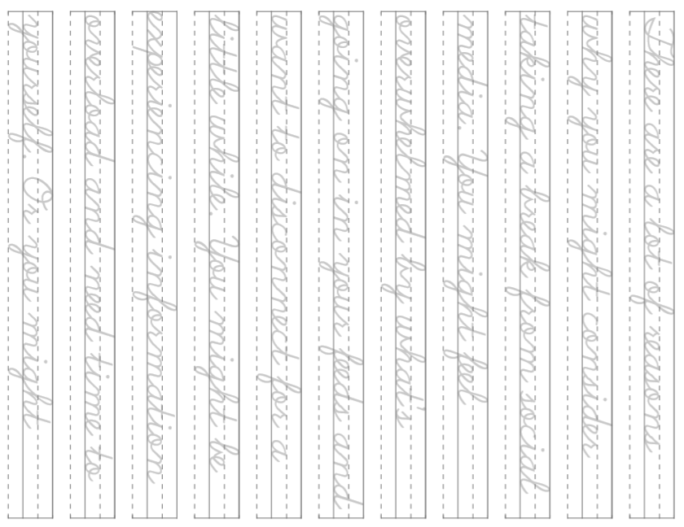
28

Slide 33
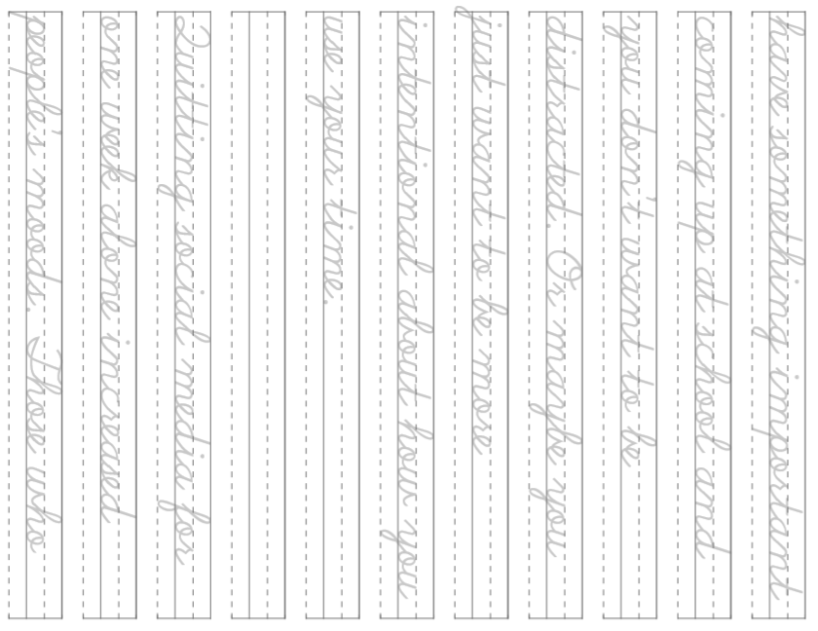
29

Slide 34
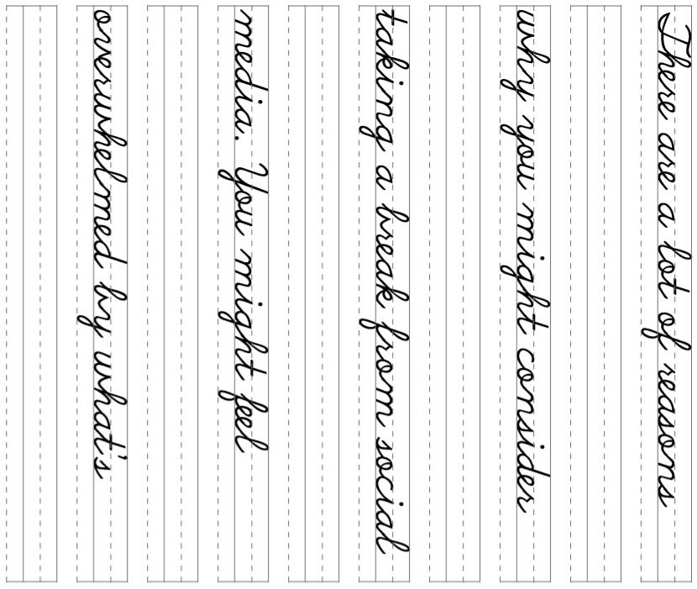
30

Slide 35
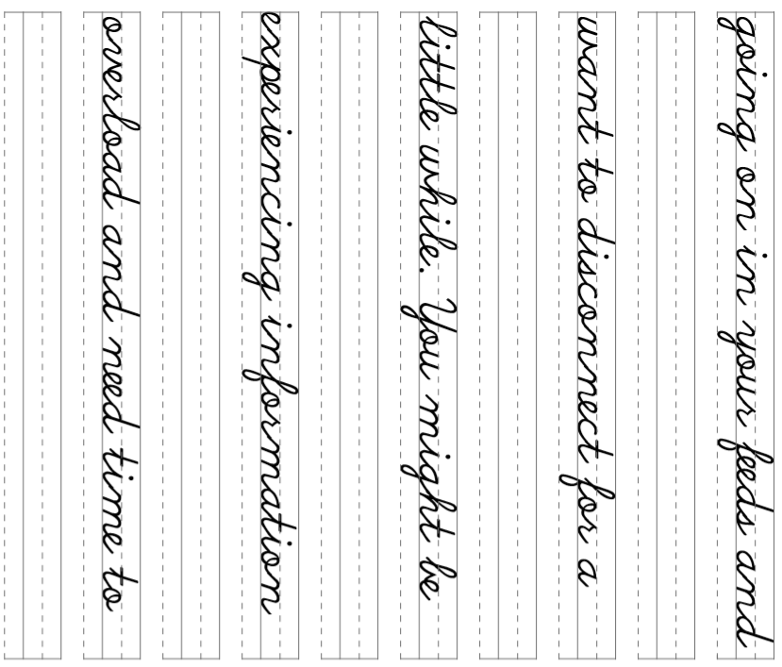
31

Slide 36
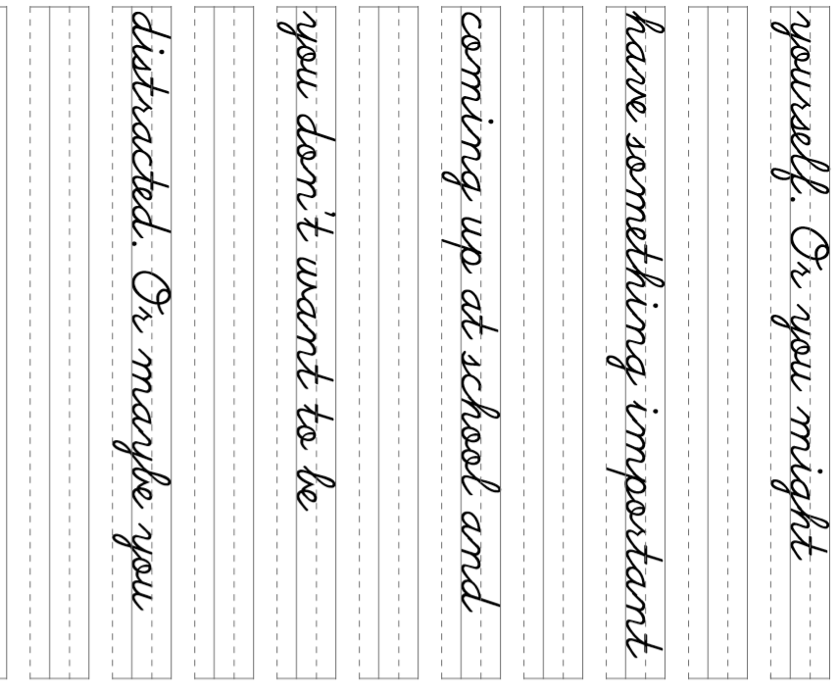
32

Slide 37


33

