Slide 1

Year 10 Knowledge Organiser HT6
Knowledge is Power
Name: ______________________________
Form: _______

Slide 2
Contents Page
Subject | Page
English | 1
Maths | 2
Science | 3
Spanish | 7
History | 8
Geography | 9
PE | 10
Computing | 14
Art | 15
Performing Arts | 16
Cooking and Nutrition | 17
Psychology | 18
‘Resilience’ reflection log | 20
Reading log | 27
Cursive Handwriting Practice | 38

Slide 3
English
Week 3 – DAPFORREST
D | Direct address
A | Anecdotes
P | Personal pronouns
F | Facts
O | Opinions
R | Rhetorical questions/ repetition
E | Emotive language
S | Statistics
T | Triples/rule of three
Week 5 – TAP
Topic | What is the topic of your writing? Will it engage an audience?
Audience | Who will read/listen to your writing? How will you engage your audience?
Purpose | What is the purpose/ To argue? To advise? To inform? To entertain?
Week 1 – Features of a speech
Engaging opening | The opening of the speech should be highly engaging and set the tone for the rest of the speech.
Well structured argument | The body of the speech should present a well-structured argument with several main points.
Clear message | The message should be specific and relevant.
Persuasive techniques | Persuasive techniques should be used in the speech to engage the audience.
Conclusion | The conclusion is your final chance to leave a lasting impression on your audience.
Week 6 – Public speaking skills
Start strong: Grab the audience's attention with a compelling hook
Speak clearly and concisely: Use a comfortable pace, vary your tone, and avoid filler words like "um" or "like,"
Maintain confidence: Project confidence through your body language and voice.
Engage the audience: Make eye contact, use gestures, and consider asking questions or incorporating interactive elements.
Week 4 – Effective speech writing
Start with a strong opening Grab your audience's attention immediately.
2. Engage with the audience. Make your speech relatable.
3. Ensure your speech is structured and organised. When you present your main arguments, organise it logically.
Week 2 – Purposes
Persuade – The author tries to convince the reader to believe a specific point of view.
Inform – The author tries to teach the reader to believe a point of view on a topic.
Argue – The author tries to argue both sides to come to a conclusion
Entertain – The author tries to entertain the reader to make them enjoy the story.
Week 7 – Connectives
Meanwhile | In particular
Subsequently | Additionally
To summarise | As well as
In conclusion | Importantly
1
Notes:
1 and 2

Slide 4

Maths
Averages and the Range
Key Word | Definition
Mode | Most common
Median | Middle, when the data is in order
Range | Largest value - smallest value
Mean | sum of data ÷ number of pieces of data
Estimated mean
Cumulative Frequency and Boxplots
Key Word | Definition
Cumulative frequency | The cumulative frequency is found by adding up the frequencies as you go along, to give a 'running total'
Cumulative frequency graph | Is drawn by plotting the upper class boundary with the cumulative frequency.
Boxplot | Is a diagram which shows the median, upper and lower quartiles, maximum and minimum values of the data
Median | Is the middle value, when in order
Lower quartile | Is the median of the lower half of the values
Upper Quartile | Is the median of the upper half of the values
Interquartile range | Upper quartile - lower quartile . This shows the spread of the data around the median
Range | Maximum value - minimum value. This shows the spread of the data
Similar shapes
Key Word | Definition
Congruent | Exactly the same
Similar shapes | One shape is an enlargement of the other
Proving Similarity | Either - The corresponding angles are equal
 | or - The corresponding sides are enlarged by the same scale factor
$$\frac{mid point x Frequency}{Total frequency}$$
2

Slide 5
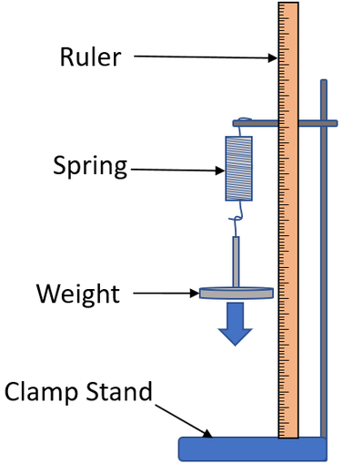
Forces and elasticity
Science
Section 1: Key terms
1 Scalar | A value with magnitude (size) only, e.g. speed, distance.
2 Vector | A value with magnitude (size) and direction, e.g. all forces, displacement, velocity.
3 Contact force | Force between objects that are touching e.g. friction, air resistance.
4 Non-contact force | Force between separate objects e.g. gravitational force, magnetic force.
5 Weight | The force of gravity acting on an object’s mass. Measured using a newtonmeter.
6 Centre of mass | The single point at which the object’s weight appears to act.
7 Resultant force | A resultant force is a single force that has the same effect as all the forces acting on an object.
8 Work done | Work is done when an object is moved through a distance. When work is done against friction there is a temperature rise.
9 Momentum (HT) | Moving objects with mass have momentum. Momentum is “mass in motion”.
10 Conservation of momentum (HT) | In a closed system, the total momentum before an event is equal to the total momentum after the event.
Elastic deformation | The object has been stretched but returns to its original length
Inelastic deformation | The object has been stretched but does not return to its original length
Extension | The difference between stretched and unstretched lengths
Limit of proportionality
Beyond this point the spring is permanently deformed
3

Slide 6
Science
Organic chemistry key words
Crude oil | A mixture of hydrocarbons formed over millions of years from dead plankton subjected to pressure
Hydrocarbon | A molecule containing hydrogen and carbon atoms only.
Alkane | A hydrocarbon containing only single bonds. Follows the formula CnH2n+2.
Fractional distillation | The method of separating hydrocarbons based on their boiling point.
Intermolecular force | Weak forces of attraction that exist between molecules.
Boiling point | The temperature at which a liquid turns into a gas.
Viscosity | The ability of a substance to flow.
Flammability | The ability of a substance to burn or ignite.
Combustion | A reaction between a fuel and oxygen that produces heat
Complete combustion | Combustion in adequate oxygen. Complete combustion of a hydrocarbon will produce carbon dioxide and water.
Incomplete combustion | Combustion in inadequate oxygen. Incomplete combustion of a hydrocarbon produces water and carbon monoxide or carbon particulates.
Alkene | A hydrocarbon containing at least one double bond. If they contain one double bond only they follow the formula CnH2n. Used to make polymers.
Bromine water | A chemical that is brown/ orange in colour. If added to an alkene it reacts and changes to colourless. Alkanes do not produce a change in colour.
Cracking | The process by which less-useful long-chain hydrocarbons are split to produce an alkane and an alkene
Chemical analysis key words
Pure | A pure substance is a single element or compound, not mixed with any other substance.
Formulation | A mixture that has been designed as a useful product. Formulations are made by mixing the components in carefully measured quantities. Formulations include fuels, cleaning agents, paints, medicines, alloys, fertilisers and foods.
Melting point | The temperature at which a substance turns from a solid to a liquid.
Hydrogen | Hold a lit splint at the end of a test tube producing gas. Hydrogen burns with a pop noise
Oxygen | Hold a glowing splint in a test tube of the gas. The splint relights if oxygen is present.
Carbon dioxide | Bubble gas through a solution of limewater. Carbon dioxide causes the limewater to turn milky.
Chlorine | Place damp litmus paper in the gas. The litmus is bleached white if chlorine is present.
Chromatography | A method used to separate mixtures into their different chemicals.
Solvent | The chemical that dissolves the sample in chromatography.
Solvent front | The maximum distance the solvent moves up the paper.
Stationary phase | The medium (e.g. paper) through which the mobile phase passes in chromatography.
Mobile phase | The solvent (e.g. water) that carries the sample (e.g. ink) in chromatography.
4

Slide 7
Science
Paper 1 Biology
Embryonic stem cell | Can divide into most types of cell.
Adult stem cell | Can divide into a limited number of cells e.g. bone marrow stem cells can form various blood cells.
Meristem | Found in plants. Can differentiate (divide) into any type of plant cell.
Diffusion | Spreading out of the particles (gas/ solution) resulting in a net movement from an area of higher concentration to an area of lower concentration.
Osmosis | The diffusion of water from a dilute solution to a concentrated solution through a partially permeable membrane.
Active Transport | The movement of substances from a more dilute solution to a more concentrated solution (against a concentration gradient). Requires energy from respiration.
Enzyme | A biological catalyst that can speed up the rate of reaction without being used itself. Made of a large protein molecule.
Denatured | When the active site of an enzyme changes shape and the substrate can no longer fit in. Can be caused by pH or temperature.
Antibodies | Some white blood cells (lymphocytes) produce antibodies. These bind to pathogens and destroy them or stick them together.
Antitoxins | Some white blood cells (lymphocytes) produce antitoxins. Antitoxins neutralise toxins.
Antibiotics | Antibiotics kill bacteria. Specific antibiotics should be used for specific bacteria. Some bacteria are resistant to antibiotics. Do not kill viruses.
Paper 1 Biology
Mitochondria | Provides energy from aerobic respiration.
Ribosome | Synthesises (makes) proteins.
Chloroplast | Where photosynthesis occurs.
Xylem cell | Waterproofed cell wall; cells are hollow to allow water to move through.
Phloem cell | Some cells have lots of mitochondria for active transport; some cells have very little cytoplasm for sugars to move through easily.
Light microscope | Basic microscope with a maximum magnification of 1500x. Low resolution.
Electron microscope | Microscope with a much higher magnification (up to 500 000x) and resolving power than a light microscope. This means that it can be used to study cells in much finer detail.
Resolution | The ability of a microscope to distinguish detail.
Magnification | The degree by which an object is enlarged. Magnification = size of image__ size of real object
5

Slide 8
Science
Paper 1 Physics
Conservation of energy | energy can not be created or destroyed, only transferred from one form to another
Renewable energy | comes from natural sources or processes that won’t run out
Work done | energy has been transferred from one energy store to another
Specific heat capacity | the amount of energy needed to raise the temperature of 1kg of a substance by 1o Celsius
Alternating current | The current regularly changes direction e.g. mains electricity
Direct current | The current flows in one direction only e.g. batteries.
Mains electricity | UK mains is an alternating current of 230V and at a frequency of 50Hz.
National grid | A series of cables and transformers linking power stations to consumers.
Step up transformer | Increases the potential difference for transmission across power cables. This reduces the current and therefore less heat is lost from the cables. This makes the National Grid efficient.
Step down transformer | Reduces the potential difference from the cables to 230V for use by consumers.
Isotope | An atom of the same element with different numbers of neutrons.
Half life | The time it takes for the number of nuclei of the isotope in a sample to halve Or, The time it takes for the count rate (or activity) from a sample containing the isotope to fall to half its initial level.
Paper 1 Chemistry
Mixtures | Two or more elements or compounds not chemically combined together
Element | Contains only one type of atom
Compound | Two or more elements chemically combined
Filtration | Separating an insoluble solid from a liquid
Crystallisation | To separate a solid from a solution
Simple distillation | To separate a solvent from a solution
Fractional distillation | Separating a mixture of liquids each with different boiling points
Chromatography | Separating substances that move at different rates through a medium
7
Li
3
Mass number | The sum of the protons and neutrons in the nucleus
Atomic number | The number of protons in the atom | Number of electrons = number of protons
6

Slide 9
Spanish
Spanish | English
Cada día/Todos los días | Every day
A menudo | Often
Generalmente/Normalmente | Generally/ Normally
De vez en cuando | From time to time
Una vez a la semana | Once a week
Dos veces a la semana/ al mes | Twice a week/ a month
Nunca | Never
¿Qué hiciste? | What did you do?
primero /luego/más tarde /después/finalmente | first / then /later / after /finally
comí muchos helados | I ate lots of ice creams
Lo mejor fue cuando… | The best thing was when…
Lo peor fue cuando… | The worst thing was when…
comí muchos helados | I ate lots of ice creams
compré recuerdos | I bought souvenirs
descansé | I rested
fui al acuario | I went to the aquarium
hice turismo | I went sightseeing
visité | I visited
saqué fotos | I took photos
tomé el sol | I sunbathed
Spanish | English
Lo peor es que… | The worst thing is…
es tan ruidoso/a | It is so noisy
hay pocos espacios verdes | There are few green spaces
no hay tanta industria | There isn’t so much industry
hay bastante desempleo | There is enough unemployment
la red de transporte público | The transport network
no hay tantos atascos | There aren’t so many traffic jams
es muy bueno | It’s very good
lo bueno / malo es que… | the good / bad thing is that…
lo mejor / peor es que… | the best / worst thing is that
ni…ni… | (n)either…nor…
tampoco | not either
severo/a | strict
tolerante | easy-going
impaciente | impatient
paciente | patient
gracioso/a | funny
serio/a | serious
simpático/a | nice / friendly
antipático/a | unfriendly
Spanish | English
Mi familia | My family
El padre/la madre | Father/mother
El hermano | Brother
La hermana | Sister
El abuelo/la abuela | Grandfather/grandmother
Uso…para… | I use … for …
Es una aplicación para | It’s an application for
Una red social | A social network
chateo en la red | I chat online
cocino para mi familia | I cook for my family
descargo canciones | I download songs
escribo correos | I write emails
hago natación/esquí | I go swimming/skiing
juego al baloncesto/fútbol | I play basketball/football
monto a caballo/en bici | I go horseriding/cycling
nado en el mar | I swim in the sea
salgo con mis amigos/as | I go out with my friends
toco la guitarra | I play the guitar
7

Slide 10
History
Key Individuals
Elizabeth I | Last Tudor Queen of England 1558-1603. Protestant.
Henry VIII | Elizabeth’s father. He changed the religion of the country from Catholic to Protestant during the English Reformation in 1533.
Anne Boleyn | Elizabeth’s mother and Henry’s second wife. She was beheaded by Henry.
Mary I | Elizabeth’s Catholic sister. She was the ruler before Elizabeth and had been unpopular.
Sir William Cecil | Secretary of State and person in government closest to Elizabeth.
Robert Dudley, Earl of Leicester | One of Elizabeth’s favorites at Court. Possible suitor.
Thomas Howard Duke of Norfolk | England’s most senior protestant nobleman. Close links to northern Catholic families. Disliked Cecil and Dudley.
Robert Devereux, Earl of Essex | Courtier and royal favourite in the court of Elizabeth I. Led rebellion against Elizabeth in 1601 and was executed.
Phillip II of Spain | King of Spain. Was married to Queen Mary I until her death. He proposed marriage to Elizabeth
Mary, Queen of Scots | Elizabeth’s second cousin. Catholic with a strong claim to the English throne.
Key Terms
Inherit | To gain possessions after someone has died.
Treason | An attempt to kill or overthrow the Monarch or betray the country; punishable by death.
Royal Court | The nobles, advisors and others who surrounded the Monarch.
Nobility | The most respected members of society; they were given special rights and privileges and owned most of the land.
Secretary of State | The leader of the Privy Council; a very powerful position.
Militia | A non-professional army raised to defeat a rebellion or fight a war.
Privy Council | A Monarch’s private councillors.
Gentry | High social class ranked below the nobility; they might be local JPs or hold similar office.
Patronage | Land, titles or power given to ensure an individual’s support.
Mass | A Catholic church service.
Monopoly | The exclusive right to trade in a particular product.
Ruff | An item of clothing worn around the neck.
Succeed | To take over the throne.
Exile | Being sent to live in another country that is not your own.
8

Slide 11
Geography
Key Word | Definition
Assess | To judge the importance /significant of using evidence provided/
Calculate | Work out the value of something. Sometimes, the command ‘calculate’ may not be used, but the question will require a calculation, eg ‘What is the total…’
Compare | Identify similarities and differences.
Define | To give the meaning of something without using the word in question
Describe | Set out characteristics – to say what something is, is like, or appears like.
Discuss | Present key points about different sides of an argument, issue or the strengths and weaknesses of an idea.
Evaluate | Judge from evidence, the effectiveness of something or weighing up both sides of an argument.
Explain | Set out purposes or reasons – say why or how.
Identify | To find something. To provide a simple work or statement
Justify | Support a case with evidence – give detailed reasons for an idea.
Outline | Set out main characteristics – to give a brief account or summary.
Suggest | Present a possible case, to propose an idea, solution or answer in an unfamiliar situation
To what extent | Judge the importance or success of (strategy, scheme, project) and to show scale of importance
9

Slide 12



PE
Skeletal System
Cardiovascular System
Muscular System
10

Slide 13
PE
Muscular system - Antagonistic pairs
Tendons connect muscle to bone and ligaments connect bone to bone. Voluntary muscles allow for movement as they produce a force which causes the attached bones to move in a specific direction. Muscles which are attached via tendons work together to create this.
Antagonistic pairs | Is where two muscles work together to create movement. There are two main categories that outline how these muscles work together; agonist and the antagonist.
Agonist | Is the also known as the prime mover. This is the muscle that contracts and causes the movement.
Antagonist | This is the opposite muscle that relaxes and in most cases lengthens as the movement occurs.
Muscular system – Muscle fibre types
All skeletal muscle contains a mixture of Slow Twitch and Fast Twitch muscle fibres- this is based on their speed of contraction. There are 3 types of muscle fibre.
Fast Twitch | Is broken down into two types;Type 2 x & Type 2 b.
Fast twitch - Type 2 x/2b | Produces highest force, fast contracting, Low endurance, good for short distances – Sprint start
Type 2a | Produce high force, moderate speed of contraction, medium endurance, more resistant to fatigue, Sprinting over longer distances.
Slow Twitch | They contract slowly and with less force. Provide a low speed of contraction, high endurance, can keep going, don’t produce much power. These fibres have a rich blood (and oxygen) supply. This makes them red in colour. They are slower to fatigue, and so are used for more endurance events e.g. long distance swimming/ running.
11

Slide 14
PE
Type of muscle found in the body
The muscular system is made up of 3 types of muscle which serve different functions within the body.
Smooth | This is otherwise known as involuntary muscle as they are not under our conscious control. They are unstriated and do not fatigue. Functions: Help hollow organs contract.
Cardiac | Involuntary as it is not under our conscious control. They have striations and do not fatigue. Functions: Contract the heart chambers to move blood to the body and lungs
Skeletal | Which are voluntary as it is under our conscious control. They have some striations and they fatigue. They attach to bones via tendons. When they shorten and lengthen, movement occurs
Muscular contractions
There are two types of contraction that occur on skeletal muscles; Isotonic and Isometric contraction.
1. Isometric contraction | Involves contractions where the muscle remains the same length.
2. Isotonic contraction | Involves contractions when muscle length contraction to either become shorter or longer. The two types of isotonic contractions are; Concentric and Eccentric contraction.
Isotonic – Concentrix contraction | Contractions are those where the muscles shortens as it contracts.
Eccentric | Contractions where the muscle lengthens.
12

Slide 15
PE
Types of joint found in the body
A joint is a place where two or more bones meet. There are 3 types of joints found in the body
Fixed | Joints are immoveable and their function is for protection e.g. cranium, pelvis
Cartilaginous | Are slightly moveable joints e.g. the 33 bones in the vertebral column
Synovial | Are freely moveable joints. There are 6 types of synovial joint found in the body; Pivot, hinge, ball & socket, condyloid, gliding and saddle.
The 6 types of synovial joint
Synovial joints are freely moveable joints. There are 6 types of synovial joint:
Ball & Socket | This is found in either the shoulder or the hip. A round bone fits into a cup shaped socket. This allows for all types of movement.
Hinge | A hinge joint can be found in either the knee or the elbow. This allows for one plane of movement. The type of movement is flexion and extension.
Pivot | This type of joint can only be found in the neck. This type of joint only allows for rotation.
Condyloid | This can be found in the wrist and is very similar to ball and socket joint. It allows for flexion, extension, abduction and adduction. Ligaments in the wrist prevent rotation
Saddle | This is where the bones forming the joint are shaped like a saddle with other bones resting on it. This can be found in the thumb where the carpals meet the metacarpals.
Gliding | This type of joint is formed between bones that meet at flat or nearly flat articular surfaces. For example where the clavicle and scapulae (flat bone)
13

Slide 16
Computing
Data representation
Data | Numbers or text that, on their own, have no meaning.
Instructions | Information on how to carry out a specific task.
Binary | A way to describe something that has two states. In computing, a binary number is a 1 or a 0.
Hexadecimal | A number from the base-16 number system. Letters A, B, C, D, E, and F are used to represent 10, 11, 12, 13, 14, and 15.
Base 2 | A number system that has 2 digits: 1 and 0.
Base 10 | A number system that has 10 digits: 1, 2, 3, 4, 5, 6, 7, 8, 9, 0.
Decimal | A number from the base-10 number system. Also known as denary.
Overflow/ Underflow | When the result of a calculation is too large/ small to be stored in the allocated number of bits.
Integer | A whole number, eg 1, 2, or 3.
Real (floating-point) | A number with a decimal point, eg 1.1, 2.3, or 3.514.
Signed integers | These can be positive or negative numbers. The first bit in a binary representation is used to show if the integer is positive or negative.
ASCII | A character set that provides an encoding table for all of the characters on a standard English keyboard.
Bit | A storage term used to describe a 1 or a 0 in computer science.
Byte | A storage term used to describe 8 bits.
Bitmap | A bitmap is a map of all of those bit patterns that make up an image
Pixel | A pixel is a block of colour that forms part of an image.
Image resolution | Image resolution refers to the dimensions of an image in pixels..
Colour depth | Colour depth refers to the number of bits available per pixel.
Metadata | Metadata means ‘data about data’.
Compression | Reducing the size of an item.
Lossy | A compression type that results in a loss of data.
Lossless | A compression type that does not result in a loss of data.
14

Slide 17
Art
Key Word | Definition
Experimentation | The action or process of trying out new ideas, methods, or activities.
Photomontage | The action or process of trying out new ideas, methods, or activities.
Reflective practioner | A image or montage constructed from a collection of photographic images.
Mixed media | A variety of mediums used in one piece of work.
Assemblage | A collection or gathering of things or people.
Artist response | Responding to the work of other artists. Understanding of the ideas and aesthetic of an artist, that can later be used for inspiration.
15

Slide 18
Performing Arts
Devising Drama – Key Words
Stimulus | A resourced used as a starting point to generate ideas for a piece of drama. This may be a poem, story, piece of music, historical event, a painting, a piece of artwork, a quote and more.
Direct Address | When an actor speaks directly to the audience, e.g. in pantomime.
Tableaux | A ‘frozen picture’ that tells a story. Costume and props are needed, and physicality used to show emotion.
Blocking | The staging and use of the space in drama, This may refer to the location of actors on the stage and the movements they make.
Multi-role | When an actor plays more than one role.
Exits and Entrances | Where a character enters and exits their scene.
Thought Tracking | An exercise that allows the inner thoughts of a character or role to be heard out loud. The participant is asked to say their characters thoughts and feelings at specific points during their acting.
Technical Rehearsal | Technical equipment and systems for example sound, lighting and computer generated effects.
Rehearsal | A practice or trial performance of a play.
Developing Ideas
Soundscape | The actors used their bodies to create sound effects for the performance
Transitions | The fluid and focused movement between scenes/images
Proxemics | Proxemics is how close or near you are to others on stage. This can help to communicate meaning e.g. if your character is scared of another character you might stand far away.
Storyboarding | Involves creating a series of images and/or text showing the sequence of the action planned for a devised drama.
Cue to Cue Rehearsal | This involves a rehearsal where the actors remove all of the action and dialogue between cues during a technical rehearsal.
Narrative | The narrative is the storyline or plot of a piece of drama. A narrative should be clear for the audience so that the storytelling makes sense - although there are different ways to structure a narrative which will explore in lessons
Semiotics | This refers to how meaning is created and communicated through the systems of signs and symbols of drama.
Movement in unison | All actors moves in the same way, at the same time.
16

Slide 19
Food and Cookery
Key Word | Definition
Nutrition | A study of what people eat and how all the nutrients in foods work together in the body
Balanced Diet | A balanced diet is one that contains the correct nutrients in the correct proportions, plus the correct amount of water and dietary fibre to meet the body’s needs
Dovetailing | Carrying out cooking tasks at the same time , so while one dish is cooking, cooling or resting, you are beginning the next task or dish.
Coeliac Disease | A disease which develops from an intolerance to gluten
Eatwell Guide | A pictorial food guide showing the amounts and types of foods that are needed to make up a healthy balanced diet
Allergen | A substance that causes an allergic reaction
Sensory Attributes | The taste, smell, appearance and texture of food.
Reference Intake (RI) | The recommended quantity of a nutrient that an adult should eat every day
Recipe Amendment | Changing or altering a recipe eg changing some ingredients and/ or cooking methods
Food Poisoning | Illness caused by bacteria or other toxins in food
Bacteria | Extremely small single celled organisms that can only be seen under a microscope.
Salmonella | Food poisoning bacteria found in chicken, some dairy foods and raw eggs
Staphylococcus | Food poisoning bacteria found in egg products , chicken, salad, tuna and eggs
Temperature probe | Device used to check the temperature in the centre of cooked food.
17

Slide 20
Psychology
Week 3 – Overcoming Extraneous Variables
Standardised instructions | Instructions should be either be written down or read aloud to participants by the same experimenter, each time.
Standardised procedures | All participants should receive the same information throughout the experiment. Only the IV should change.
Randomisation | Randomly allocate participants to the experimental group or control group to reduce bias.
Week 1 – Aims & Hypotheses
Aim | General purpose of the study/investigation
Hypothesis | A hypothesis is a precise, testable statement of what the researcher predicts will be the outcome of the study.
Independent Variable (IV) | The variable that the experimenter manipulates (changes)
Dependent Variable (DV) | The variable which is measured by the experimenter after they have manipulated the IV.
Operationalise | Clearly defining the variables so they are measurable (e.g intelligence would be operationalised to ‘scores on IQ test’)
Alternative Hypothesis | Predicts a difference or correlation in the findings.
Null Hypothesis | Predicts no difference or correlation in the findings
Week 4 – Types of Experiment
Type | Lab | Field | Natural
Setting | Controlled environment | Natural setting | Natural setting
IV | Manipulated by researcher | Manipulated by researcher | Varies naturally e.g sex or age
Strengths | Easier to control Evs, easier to identify cause and effect . Controlled and standardised so easy to replicate by other researchers | Participants act more naturally so higher validity May not know they are being observed | High validity involving real life changes Participants are likely to act naturally
Weaknesses | May not represent every day life – decreasing validity Demand characteristics are more likely | Less control over EV’s, decreasing the validity Ethical issues regarding consent | Less control over EV’s – decreasing validity Research carried out in a natural setting is very difficult to replicate, due to the changing nature of the setting.
Week 2 – Extraneous Variables (EV’s)
Extraneous variables | Extra variables that may interfere with the relationship between the IV and DV.
Situational variables | Lighting, noise, environment, time of day.
Participant variables | Age, IQ, eyesight, personality
Investigator effects | The investigators bias towards one group
Order effects | Practice or boredom
Demand characteristics | Participants guessing the aim of the experiments and changing their behaviour accordingly
Social Desirability bias | Participants changing their behaviour to be more socially favourable
18

Slide 21



Psychology
Week 6 – Sampling Methods
1.Target population | The large group of people the researcher wishes to study
2. Random sample | Every member of the target population has an equal chance of being selected for the sample.
3. Opportunity sample | People who are members of the target population and are available and willing to take part in research.
5. Systematic sample | Every ‘nth’ member of the target population is selected for the sample.
5. Stratified sample | The different subgroups in the target population are identified; then people are selected randomly from these subgroups in proportion to their numbers in the target population.
Week 5 – Experimental Design
Experimental Design | Experiments design refers to which conditions the participants will take part in
Independent groups | Each participant is only assigned to one condition of the IV.
Repeated Measures | Each participant takes part in both conditions of the experiment.
Matches pairs | You have different participants in two different conditions, but you match them according to certain variables, such as age, personality, gender, IQ etc.
19

Slide 22
W/c 1st June Thinking definition: Thinking is making connections, reasoning and asking questions to make the learning stick
Reflecting on learning behaviours for resilience….. | Experience log
 | Successful moment… | In hindsight… Where you could have done better on reflection? | At home…
I gave an idea and reasoned/justified.
I reflected on my idea and made it better after discussing with others
I used a revision strategy to help make the learning stick.
I made connections between what I am learning and the outside world.
I asked questions to deepen my understanding.
20

Slide 23
W/c 8th June Thinking definition: Thinking is making connections, reasoning and asking questions to make the learning stick
Reflecting on learning behaviours for resilience….. | Experience log
 | Successful moment… | In hindsight… Where you could have done better on reflection? | At home…
I gave an idea and reasoned/justified.
I reflected on my idea and made it better after discussing with others
I used a revision strategy to help make the learning stick.
I made connections between what I am learning and the outside world.
I asked questions to deepen my understanding.
21

Slide 24
W/c 15th June Thinking definition: Thinking is making connections, reasoning and asking questions to make the learning stick
Reflecting on learning behaviours for resilience….. | Experience log
 | Successful moment… | In hindsight… Where you could have done better on reflection? | At home…
I gave an idea and reasoned/justified.
I reflected on my idea and made it better after discussing with others
I used a revision strategy to help make the learning stick.
I made connections between what I am learning and the outside world.
I asked questions to deepen my understanding.
22

Slide 25
W/c 22nd June Thinking definition: Thinking is making connections, reasoning and asking questions to make the learning stick
Reflecting on learning behaviours for resilience….. | Experience log
 | Successful moment… | In hindsight… Where you could have done better on reflection? | At home…
I gave an idea and reasoned/justified.
I reflected on my idea and made it better after discussing with others
I used a revision strategy to help make the learning stick.
I made connections between what I am learning and the outside world.
I asked questions to deepen my understanding.
23

Slide 26
W/c 29th June Thinking definition: Thinking is making connections, reasoning and asking questions to make the learning stick
Reflecting on learning behaviours for resilience….. | Experience log
 | Successful moment… | In hindsight… Where you could have done better on reflection? | At home…
I gave an idea and reasoned/justified.
I reflected on my idea and made it better after discussing with others
I used a revision strategy to help make the learning stick.
I made connections between what I am learning and the outside world.
I asked questions to deepen my understanding.
24

Slide 27
W/c 6th July Thinking definition: Thinking is making connections, reasoning and asking questions to make the learning stick
Reflecting on learning behaviours for resilience….. | Experience log
 | Successful moment… | In hindsight… Where you could have done better on reflection? | At home…
I gave an idea and reasoned/justified.
I reflected on my idea and made it better after discussing with others
I used a revision strategy to help make the learning stick.
I made connections between what I am learning and the outside world.
I asked questions to deepen my understanding.
25

Slide 28
W/c 13th July Thinking definition: Thinking is making connections, reasoning and asking questions to make the learning stick
Reflecting on learning behaviours for resilience….. | Experience log
 | Successful moment… | In hindsight… Where you could have done better on reflection? | At home…
I gave an idea and reasoned/justified.
I reflected on my idea and made it better after discussing with others
I used a revision strategy to help make the learning stick.
I made connections between what I am learning and the outside world.
I asked questions to deepen my understanding.
26

Slide 29
Reading Log w/c 1st June (20 mins reading per day – all five logs MUST be completed)
Date | Title of novel | Number of pages read | Summary about what I have read
 |  |  | • • •
 |  |  | • • •
 |  |  | • • •
 |  |  | • • •
 |  |  | • • •
Checked by form tutor:
27

Slide 30
Reading Log w/c 8th June (20 mins reading per day – all five logs MUST be completed)
Date | Title of novel | Number of pages read | Summary about what I have read
 |  |  | • • •
 |  |  | • • •
 |  |  | • • •
 |  |  | • • •
 |  |  | • • •
Checked by form tutor:
28

Slide 31
Reading Log w/c 15th June (20 mins reading per day – all five logs MUST be completed)
Date | Title of novel | Number of pages read | Summary about what I have read
 |  |  | • • •
 |  |  | • • •
 |  |  | • • •
 |  |  | • • •
 |  |  | • • •
Checked by form tutor:
29

Slide 32
Reading Log w/c 22rd June (20 mins reading per day – all five logs MUST be completed)
Date | Title of novel | Number of pages read | Summary about what I have read
 |  |  | • • •
 |  |  | • • •
 |  |  | • • •
 |  |  | • • •
 |  |  | • • •
Checked by form tutor:
30

Slide 33
Reading Log w/c 29th June (20 mins reading per day – all five logs MUST be completed)
Date | Title of novel | Number of pages read | Summary about what I have read
 |  |  | • • •
 |  |  | • • •
 |  |  | • • •
 |  |  | • • •
 |  |  | • • •
Checked by form tutor:
31

Slide 34
Reading Log w/c 6th July (20 mins reading per day – all five logs MUST be completed)
Date | Title of novel | Number of pages read | Summary about what I have read
 |  |  | • • •
 |  |  | • • •
 |  |  | • • •
 |  |  | • • •
 |  |  | • • •
Checked by form tutor:
32

Slide 35
Reading Log w/c 13th July (20 mins reading per day – all five logs MUST be completed)
Date | Title of novel | Number of pages read | Summary about what I have read
 |  |  | • • •
 |  |  | • • •
 |  |  | • • •
 |  |  | • • •
 |  |  | • • •
Checked by form tutor:
33

Slide 36

38

Slide 37

39

Slide 38

40

Slide 39

41

Slide 40

42

Slide 41

43

Slide 42


44

Slide 43
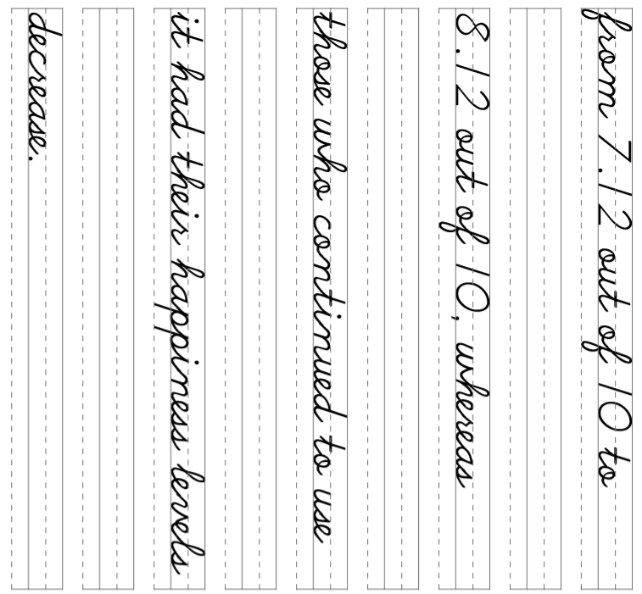
45

Slide 44
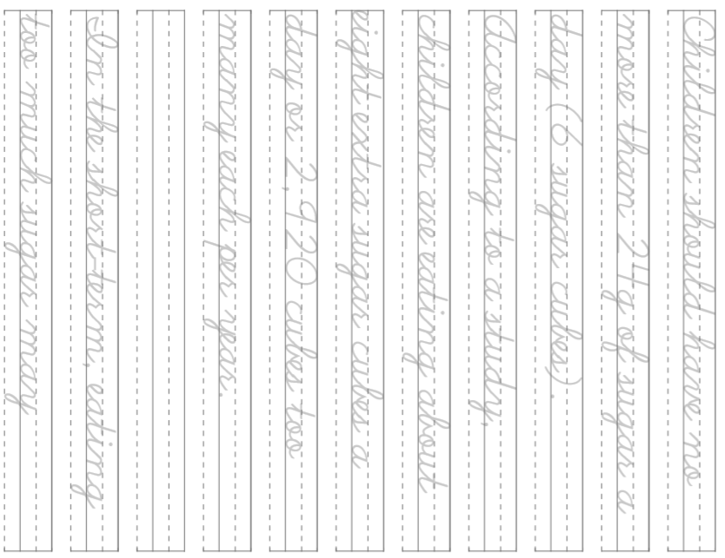
46

Slide 45
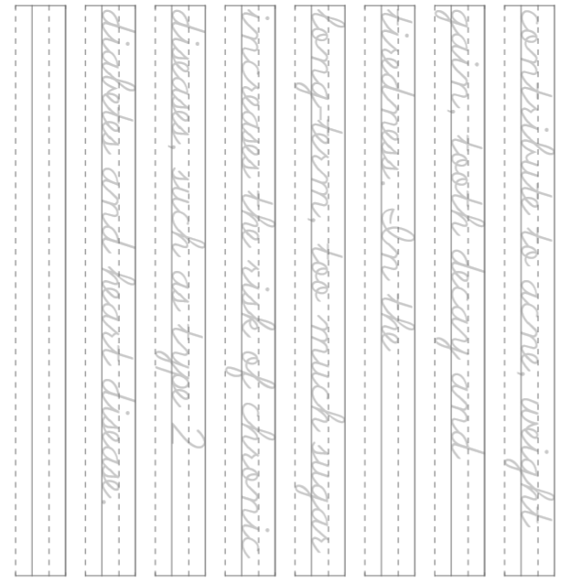
47

