Slide 1

Year 11 Knowledge Organiser HT2
Knowledge is Power
Name: ______________________________
Form: _______

Slide 2
Contents Page
Subject | Page
English | 1
Maths | 2
Science | 5
Spanish | 8
History | 9
Geography | 10
PE | 11
Computing | 17
Business | 18
iMedia | 20
Art | 21
Performing Arts | 22
Cooking and Nutrition | 23
Music | 24
‘Thinking’ reflection log | 25
Reading log | 32
Cursive Handwriting Practice | 39

Slide 3
English
Week 3 - Characters
Phil | Menacing, Cold, Sinister
John Tate | Controlling, Manipulative, Tyrannical
Leah | Insecure, Loyal, Insightful, Inferior
Mark | Cruel, Malicious, Blunt, Ruthless
Jan | Bullying, Intimidating, Gullible,
Adam | Victim, confused, scared
Richard | Insecure, Confident, Sycophant (flatterer)
Week 1 – Key Terms
Gangs | The plot deals with a gang’s reaction to the aftermath of a crime. Kelly explores the interrelationships within the group responsible.
Bullying | Psychological bullying as well as the physical abuse of Adam is a predominant theme. The play explores the different effects bullying can have on people.
Responsibility | The play makes the audience question who is ultimately responsible for the callous behaviour of the group.
Power | Kelly investigates different kinds of power relationships within the group and how different characters exert their power to control the gang.
Loyalty | The audience are prompted to consider the different kinds of loyalty; to individuals, to the group, and to our own personal beliefs.
Week 2 – Key Devices
Adjacency Pairs | These are pairs of utterances in a conversation that follow on from each other e.g. greeting and greeting, question & answer.
False Start | This is where someone starts then breaks off (because they are uncomfortable or confused).
Overlap | This is where turn-taking goes wrong, and both participants message at the same time.
Back Tracking | Going back to something in the conversation that's already been started or has already been said.
Fillers | Items in speech that allow time to think, or create a pause, e.g. ‘erm.
Week 4 - Quotes
Mark | We were having a laugh, weren't we…
Richard | You shouldn’t threaten me, John.
Cathy | They might even give me money for it, do you think I should as for money?
John Tate | You crying piece of filth.
Leah | It’s Adam, Phil, Adam! We used to go to his birthday parties, he used to have that cheap ice cream and we used to take the piss, remember?
Brian | Beat. Brian stops crying. Looks up. I think we should tell someone.
1
Notes:
1 and 2

Slide 4
English
Week 5 – Themes in the play
Bullying | The play shows how peer pressure and intimidation trap individuals into harmful actions.
Gang membership | Belonging to the group demands loyalty at the cost of morality and independence.
Social responsibility | The play questions whether individuals will take responsibility or hide behind the group.
Morality | Characters wrestle with right and wrong but often choose self-preservation over ethics.
Leadership | Leaders like John Tate and Phil use fear or silence to control and manipulate the group.
Week 6 – Themes in the play
Happiness | True happiness is absent, as characters seek control or survival rather than joy.
Science | Scientific logic is used by Phil to plan the cover-up, showing its power when stripped of morality.
Alienation | Outsiders like Adam and weaker members are isolated, exposing the group’s cruelty.
Death | Adam’s supposed death becomes the central event that forces moral and practical decisions.
Violence | Violence underpins the group’s power and drives the plot through intimidation and murder.
Week 7 - Quotes
Phil | ‘I’m in charge. Everyone is happier. What’s more important, one person or everyone?’ ‘We'll take you up the grille now. Well get you by the arms. By the legs. And we'll swing you onto the grille. We'll throw rocks at you until you drop through.’
Cathy | ‘I threatened to gouge one of his eyes out’
John Tate | ‘Alright, new rule; that word is banned.’
Leah | ‘Chimps are evil. They murder each other... they kill and sometimes torture each other to find a better position within the social structure.’ ‘It's life that upsets the natural order. It's us that's the anomaly.’
2

Slide 5
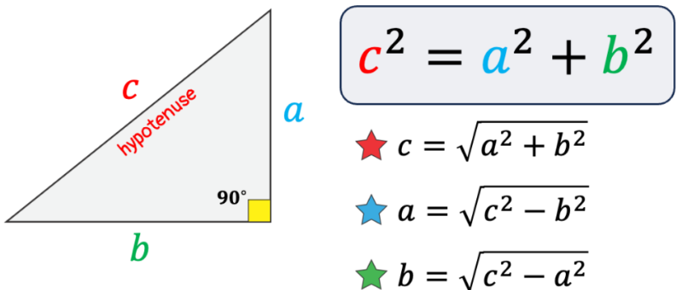
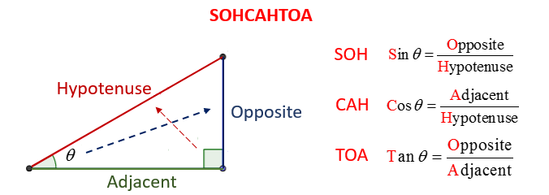
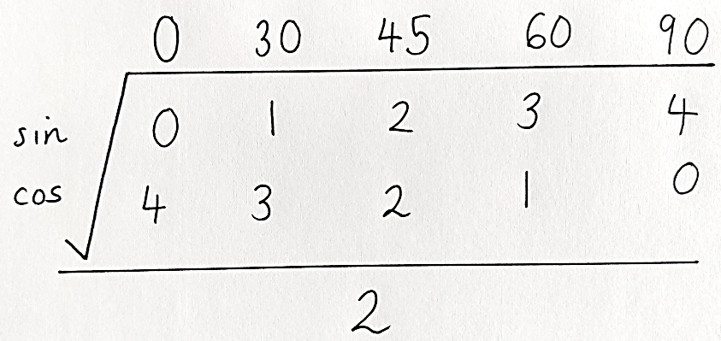
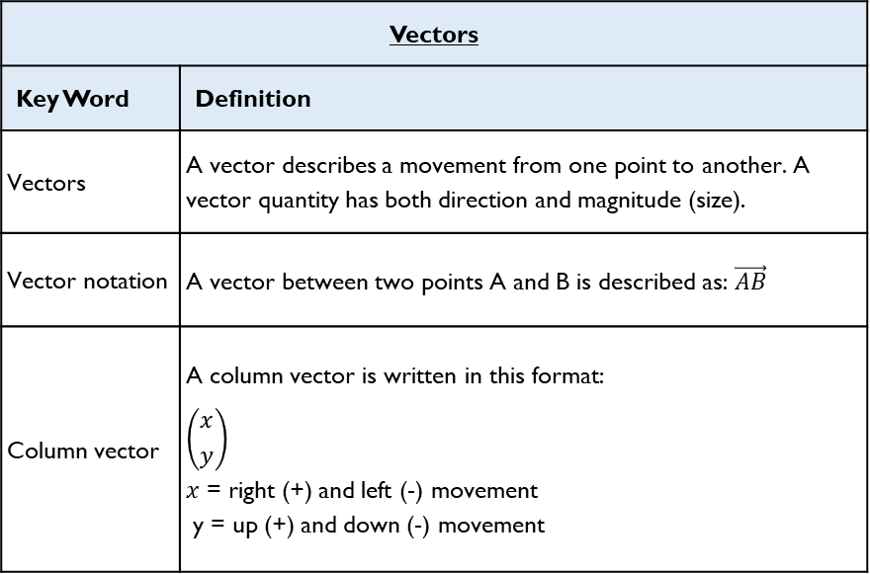
Maths – Foundation and Higher
Vectors
Key Word | Definition
Vectors | A vector describes a movement from one point to another. A vector quantity has both direction and magnitude (size).
Vector notation | A vector between two points A and B is described as: $\vec{AB}$
Column vector | A column vector is written in this format: $$\left({x \atop y}\right)$$ $x$ = right (+) and left (-) movement y = up (+) and down (-) movement
Key Term | Definition | Method
Pythagoras’ Theorem | A method we use to find missing sides in right angled triangles.
Trigonometry | A method we use to find missing sides and angles in right angled triangles.
Exact trigonometric values | Exact trig values are the exact trigonometric values for certain angles that you are expected to know for GCSE mathematics.
Transformations
Reflection | When a shape is flipped (reflected) in a mirror line
Rotation | When a shape is turned (rotated) around a centre of rotation by a given direction (clockwise/anticlockwise) and angle (90⁰ or 180⁰)
Translation | When a shape is moved by a column vector
Enlargement | When a shape is made bigger or smaller. They must have a scale factor and they may involve a centre of enlargement.
3

Slide 6
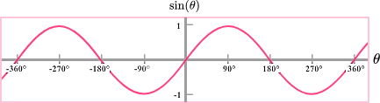
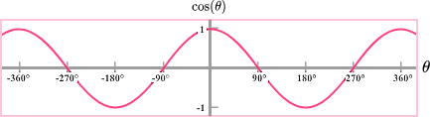
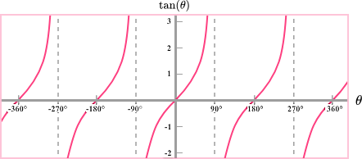
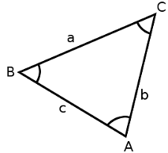
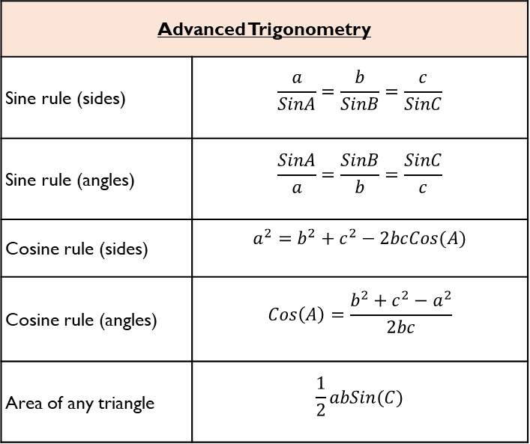
Maths – Higher only
Trigonometric Graphs
y = sin(x) | - Graph is a continuous curve and repeats every 360⁰ - Passes through (0, 0) - Maximum point of 1, minimum point of -1
y = cos(x) | - Graph is a continuous curve and repeats every 360⁰ - Passes through (0, 1) - Maximum point of 1, minimum point of -1
y = tan(x)
Advanced Trigonometry
Sine rule (sides) | $$\frac{a}{SinA}=\frac{b}{SinB}=\frac{c}{SinC}$$
Sine rule (angles) | $$\frac{SinA}{a}=\frac{SinB}{b}=\frac{SinC}{c}$$
Cosine rule (sides) | $$a^{2}=b^{2}+c^{2}−2bcCos(A)$$
Cosine rule (angles) | $$Cos\left(A\right)=\frac{b^{2}+c^{2}−a^{2}}{2bc}$$
Area of any triangle | $$\frac{1}{2}abSin(C)$$
- Repeats every 180⁰
- Not a continuous curve
- Vertical aysmptotes (lines where it is not allowed to touch) at 90⁰ and 180⁰
4

Slide 7
Science
Forces
Word | Definition
Displacement | The distance an object moves and the direction in which it occurs. A vector quantity.
Velocity | The speed of an object in a particular direction.
Acceleration | The change of an object’s speed in a certain amount of time. If an object is falling near the surface of the Earth its acceleration will be 9.8m/s2.
Terminal velocity | The maximum speed of a moving object. Occurs when the force moving an object (e.g. gravity) is balanced by frictional forces (e.g. air resistance).
Circular motion (HT) | An object moving in a circle has constant speed but changing velocity. This is because the direction in which the object is moving is constantly changing, and velocity is a vector quantity that measures direction and speed.
Newton’s First Law | The velocity of an object will only change if a resultant force is acting on the object. If there is no resultant force the object will: - Remain stationary if it was not moving. - Continue at a constant speed if it was already moving.
Newton’s Second Law | The acceleration of an object is proportional to the resultant force acting on the object, and inversely proportional to the mass of the object, i.e. Force = mass x acceleration.
Newton’s Third Law | Whenever two objects interact, the forces they exert on each other are equal and opposite.
Inertia (HT) | The tendency of objects to continue in their state of rest or of uniform motion.
Word | Definition
Stopping distance | The stopping distance of a vehicle is the sum of the distance the vehicle travels during the driver’s reaction time (thinking distance) and the distance it travels under the braking force (braking distance).
Thinking distance | The distance a vehicle travels while a driver is reacting.
Reaction time | The distance a vehicle travels under braking. Affected by weather conditions (e.g. rain or ice) and the conditions of the brakes and tyres of a vehicle.
Braking force | When the brakes are pressed, work done by the friction force between the brakes and the wheel reduces the kinetic energy of the vehicle and the temperature of the brakes increases. The greater the speed of a vehicle, the greater the force needed to stop the vehicle. Large declarations may lead to loss of control or overheating of the brakes.
5

Slide 8
Science
Rates of reaction
Word | Definition
Rate of chemical reaction | This can be calculated by measuring the quantity of reactant used or product formed in a given time. Rate = quantity of reactant used time taken Rate = quantity of product formed time taken
Collision theory | Reactions occur only when particles collide with enough energy.
Activation energy | The amount of energy particles need in order to react.
Catalyst | A chemical (or enzyme) that increases the rate of reaction without being used itself (therefore they are not included in an equation). They provide an alternative pathway for the reaction with a lower activation energy.
Enzymes | These are biological catalysts.
Temperature | Increasing the temperature increases the frequency of collisions and makes the collisions more energetic, therefore increasing the rate of reaction.
Concentration | The number of particles in a certain volume.
Changing concentration | Increasing the concentration, pressure (gases) and surface area (solids) of reactions increases the frequency of collisions, therefore increasing the rate of reaction.
Surface area of solid reactants | Increasing the surface area increases the rate of reaction. Exposes more of the solid so that there isa greater chance of collisions occurring
Key words
Reversible reaction | A reaction in which the products can also form the reactants. Shown as: A + B ⇌ C + D
Exothermic | A reaction that releases heat to the environment.
Endothermic | A reaction that takes in heat from the environment.
Equilibrium (HT) | Equilibrium is reached when the forward and reverse reactions occur at exactly the same rate. Needs a sealed container.
Le Chatelier’s Principle (HT) | If a system is at equilibrium and a change is made to any of the conditions, then the system responds to counteract the change
Changing concentration | If the concentration of a reactant is increased, more products will be formed . If the concentration of a product is decreased, more reactants will react.
Changing temperature | If the temperature of a system at equilibrium is increased: Exothermic reaction = products decrease Endothermic reaction = products increase
Changing pressure (gaseous reactions) | For a gaseous system at equilibrium: Pressure increase = equilibrium position shifts to side of equation with smaller number of molecules. Pressure decrease = equilibrium position shifts to side of equation with larger number of molecules.
6

Slide 9
Science
Inheritance
Word | Definition
Sexual reproduction | Reproduction involving the fusion of gametes.
Gamete | A sex cell that contains half the genetic information of a body cell. E.g. sperm and egg in animals, pollen and ovaries in plants.
Meiosis | The type of cell division that produces gametes. Four daughter cells are produced from one original cell. Each cell is genetically different. Each daughter cell has half the genetic information of a body cell.
Fertilisation | Fusion of gametes. Restores the full number of chromosomes.
Asexual reproduction | Reproduction involving only one parent and no gametes. No mixing of genetic information so genetically identical clones are produced. Only mitosis is involved.
Mitosis | Cell division that produces two identical daughter cells with the full amount of chromosomes.
Word | Definition
DNA | Genetic material. DNA is a polymer made up of two strands forming a double helix. The DNA makes up chromosomes.
Gene | A gene is a small section of DNA on a chromosome. Each gene codes for a particular sequence of amino acids, which make a protein.
Chromosome | A long coil of DNA. Found in the nucleus.
Genome | The entire genetic material of that organism.
Allele | Different versions of the same gene – dominant and recessive.
Dominant | A dominant allele is always expressed. Only one copy is needed.
Recessive | Only expressed if two copies are present.
Homozygous | Both alleles for a gene are the same (i.e. both are dominant or both are recessive).
Heterozygous | Both alleles for a gene are different (i.e. one is dominant, the other is recessive).
Genotype | The alleles present for a particular gene.
Phenotype | The physical feature expressed for a particular gene.
Word | Definition
Variation | The differences between organisms. Can be caused by genes (e.g. eye colour), the environment (e.g. scars) or both the environment and genes (e.g. weight). All variation in genes is caused by mutations.
Mutation | Mutations are changes in genes. Most have no effect on the phenotype. Occasionally mutations have a positive effect on phenotype and organisms with these mutations are more likely to survive.
Evolution | The change in the genes of a population over time. Occurs through natural selection.
Natural selection | The process by which the individuals best adapted to the environment survive and pass on their genes.
Speciation (Triple only) | Occurs when two populations are so different that they can no longer breed to produce fertile offspring. Two new species are formed.
7

Slide 10
Spanish
Spanish | English
Soy.. | I am..
Me gustaría ser más verde | I would like to be greener
Siempre apago la luz | I always turn off the light
Reciclo la basura cada día | I recycle rubbish every day
Creo que soy… | I think I am…
Quiero ser más… | I want to be more….
Tengo que ahorrar energía en casa. | I have to save energy at home…
La contaminación del aire es muy preocupante | Air pollution is very concerning
Tenemos que cuidar el planeta | We have to look after the planet
Ayer reciclé el vidrio y el plástico | Yesterday I recycled the glass and the plastic.
Me preocupa mucho el problema del calentamiento global… | I am really worried about the problem of global warming
Muchos países se enfrentan a graves problemas sociales. | Lots of countries face serious social problems
Es un gran problema a nivel mundial que afecta a muchos países. | It’s a big problem that affects many countries
¡Qué verde! | How green !
La basura | rubbish
Spanish | English
Los recursos | resources
El mundo | The world
La escasez de agua | The scarcity of water
El efecto invernadero | The Greenhouse effect
¡Qué malgasto! | What a waste !
Los desechos | waste
El medio ambiente | The environment
La deforestación | Deforestation
El hambre | Hunger
La sequía | drought
Si pudiera, reciclaría toda mi basura…. | If I could, I would recycle all my rubbish…
Si tuviera el dinero, Compraría un coche eléctrico. | If I were to have the money I would buy an electric car.
quiero ahorrar energía | I want to save energy
los efectos del calentamiento global. | The greenhouse effect
intento reciclar todo lo posible | I intend to recycle everthing possible
deberíamos ahorrar la energía | We should save energy
la energía renovable. | Renewable energy
8

Slide 11
History
Key Term | Definition
Epidemic | Spread of disease to a large number of people.
Bubonic Plague | Plague spread by the bite of a flea; buboes are lumps.
Pneumonic Plague | Plague spread by breathing in germs from the infected lungs of a bubonic plague victim.
Bacteria | Microorganisms that live in water, soil, plants and animals and that can cause disease.
Quarantine | Confining or stopping people from going in or out of a place.
Cholera | Infectious and often fatal bacterial disease, usually contracted from infected water supplies and causing severe vomiting and diarrhoea.
Feudal System | Medieval system of land holding and distribution in which the use of land is paid for by work and services.
Renaissance | 14th-16th C ‘Rebirth’ or revival of European art and literature under the influence of classical ancient Greek and Roman models.
Quack | Person pretending to have medical ability or fake cures; unqualified, often useless, doctor.
Emetic | Substance that makes a patient vomit.
Purgative | Laxative that makes you got to the toilet.
Enema | Fluid injected into the bowel to clean it.
Key Term | Definition
Virus | Infection caused by microbes which can be contagious; unlike bacterial infection, most viruses do cause disease and cannot be cured by antibiotics.
Inoculation | Using weakened but live germs of a disease in a healthy person to build up and immunity (resistance) against the stronger form of the same disease.
Vaccination | Using the dead germs of a disease or one similar to it to build up immunity (resistance) against stronger forms of the disease.
Microbe | Living organism that is too tiny to be seen without a microscope; includes bacteria, which can cause diseases.
Spontaneous Generation | Theory that microbes appear as if by magic, and that germs are the result of disease.
Specificity | Theory that specific germs cause specific diseases.
Anti-contagionism | Belief that infection was caused when infectious matter interacted with the environment and created the disease, which affected weak individuals.
Miasma | Name given to what people thought was an ‘infectious mist’ given off by rotting animals, rubbish and human waste; many believed it caused illness and disease.
Contagionism | Belief that infection was caused by contact with an infected person or germ.
Antiseptic | Chemical applied to a wound to prevent the growth of disease-causing microbes; also applied to surgical instruments.
Germ Theory | Theory that bacteria (germs) cause disease.
Aseptic | State of being completely free of harmful microbes; sterilising to create a contamination-free environment.
9

Slide 12
Geography
Key Word | Definition
Assess | To judge the importance /significant of using evidence provided/
Calculate | Work out the value of something. Sometimes, the command ‘calculate’ may not be used, but the question will require a calculation, eg ‘What is the total…’
Compare | Identify similarities and differences.
Define | To give the meaning of something without using the word in question
Describe | Set out characteristics – to say what something is, is like, or appears like.
Discuss | Present key points about different sides of an argument, issue or the strengths and weaknesses of an idea.
Evaluate | Judge from evidence, the effectiveness of something or weighing up both sides of an argument.
Explain | Set out purposes or reasons – say why or how.
Identify | To find something. To provide a simple work or statement
Justify | Support a case with evidence – give detailed reasons for an idea.
Outline | Set out main characteristics – to give a brief account or summary.
Suggest | Present a possible case, to propose an idea, solution or answer in an unfamiliar situation
To what extent | Judge the importance or success of (strategy, scheme, project) and to show scale of importance
10

Slide 13

PE
Muscular System
Key Word | Definition
Muscular system | Works in conjunction with the skeleton to produce movement of the limbs and body
Antagonistic pairs | Muscles are arranged in antagonistic pairs. As one contracts, its partner relaxes
Agonist | The muscle that contracts to produce movement
Antagonist | The muscle that relaxes to allow the movement to occur
11

Slide 14

PE
Skeletal System
Key Word | Definition
Skeletal system | Works in conjunction with the muscular system to produce movement of the limbs and body
Ligaments | Connect bone to bone
Tendons | Connect muscular muscle to bone
12

Slide 15

PE
Cardiovascular System
Deoxygenated blood = BLUE (Right side) Oxygenated = RED (Left side)
13

Slide 16
PE
Cardiovascular System – Components of blood
Red blood cells | Carry oxygen from the lungs to the working muscles + Removes CO2.
Haemoglobin | A protein that binds and carries oxygen molecules.
White blood cells | Are part of the immune system and fight disease and infection.
Platelets | Blood platelets are formed in the bone marrow and are essential in the clotting of blood. Platelets are the workhorses of the cardiovascular system.
Plasma | Blood plasma is made up of 90% water. It contains a range of substances that aids the circulation between cells and tissues.
Blood Vessels
Arteries | Carry blood away from the heart, Oxygenated blood (except pulmonary artery) Thick/elastic walls High pressure Small lumen
Veins | Carry blood back to the heart Deoxygenated blood (except pulmonary vein) Thin walls + larger lumen Lower pressure Valves
Capillaries | In the tissue Site of gaseous exchange Very thin walls
14

Slide 17
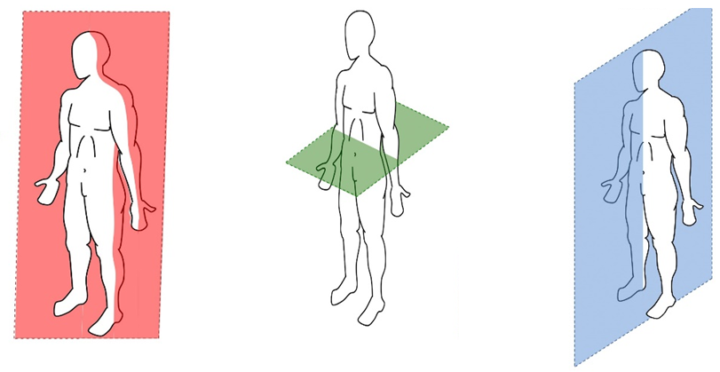
PE
BIOMECHANICS - Planes and axes for movement
Plane | An imaginary line that divides the body into two
Frontal Plane (left picture) | A vertical plane that divides the body into front and back.
Transverse plane (middle picture) | A horizontal plane that divides the body into upper and lower halves.
Sagittal plane (right picture) | A vertical plane that divides the body into right and left sides.
15

Slide 18
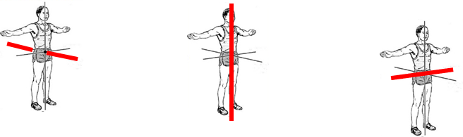
PE
BIOMECHANICS - Planes and axes for movement
PAxes for movement | An axis is an imaginary line at right angles to the plane
Sagittal axis (left picture) | Runs through the body horizontally from the back to front.
Vertical axis (middle picture) | Runs through the body vertically from the top to bottom.
Frontal axis (right picture) | Runs through the body horizontally from the left to right.
16

Slide 19
Computing
Selection
Module | In Python, a module is a file containing Python definitions and statements. The functionality of these definitions and statements is then available for use.
Import | The keyword that enables a module to be brought into your programs.
MOD/modulo | Calculates the remainder of a division. For example 7 MOD 3 will calculate as 1.
Integer division | In integer division there can be remainders because the resulting value will be a whole number. For example 7 ÷ 3 will calculate as 2.
Operator | A symbol or function that performs an operation. For example +.
Condition | Used to control the flow of execution in a program. A condition contains a logical expression.
Selection | Controlling the flow of execution in programs using if statements.
Execution | Carrying out the instructions for a computer program.
Logical expression | An expression that results in either True or False.
Boolean expression | An expression that evaluates as True or False. Also known as a logical expression.
Iteration
Iteration | Repetition of code blocks. For example, a while loop.
While loop | A loop that will continue to iterate whilst its condition evaluates as True.
Variable | A value held under one name.
Function | A subroutine that returns a value.
Return value | A value that is returned by a function.
Data validation | A check performed on data input to ensure that it can be accepted by the program without causing an error.
Robustness | A program is robust when it does not produce any errors during execution.
17

Slide 20
Business
Key Term | Definition
PROFIT | Total Revenue – Total Costs
GROSS PROFIT | Sales Revenue – Cost of Sales
COST OF SALES | Direct costs of purchasing raw materials & manufactured finished products.
NET PROFIT | Gross profit – other operating expenses & interest
PROFIT MARGIN | A measure of profitability calculated as a percentage of income.
GROSS PROFIT MARGIN (GPM) | The difference between sales revenue & the cost of sales. GPM = Gross profit / sales revenue X 100
NET PROFIT MARGIN (NPM) | The difference between sales revenue & total costs. NPM = Net Profit / sales revenue X 100
AVERAGE RATE OF RETURN | Is the average annual amount of income generated over the life of an investment. ARR % = avg annual profit (total profit /no. of years)/ cost of investment X 100
VARIABLE | A quantity used in a calculation or some measurable piece of information.
DEMOGRAPHIC | Relating to the structure of the population.
QUALITATIVE DATA | Descriptive data that cannot be measured in numbers.
QUANTITATIVE DATA | Numerical data.
Key Term | Definition
DEBT | This refers to borrowing from external sources which incurs interest costs. Typical examples include Overdrafts, Loans & Mortgages.
RETURN ON INVESTMENT | The amount of money that an investor gets back in return for investing in a business.
SHAREHOLDER | Investors who are part owners in a company.
CREDIT CHECK | A check on the financial status to ensure
SECURITY | When the lender asks the borrower to put up an asset against a loan.
ASSET | Any item of value that a business owns, such as its machinery or premises.
GUARANTOR | A named person who guarantees to pay the repayments on a loan should the person who has taken out the loan not be able to do so.
INFLATION | The general increase in prices.
MARKET SHARE | The proportion of sales in a market that are taken by one business.
18

Slide 21
Business
Key Term | Definition
REVENUE | PRICE X QUANTITY SOLD
TOTAL VARIABLE COSTS | VC X QUANTITY SOLD
TOTAL COSTS | FIXED COSTS + TOTAL VARIABLE COSTS
GROSS PROFIT | SALES REVENUE – COST OF SALES
NET PROFIT | GROSS PROFIT – OTHER OPERATING EXPENSES AND INTEREST
INTEREST IN % | (TOTAL REPAYMENT – BORROWED AMOUNT)/ BORROWED AMOUNT) x100
CONTRIBUTION | PRICE – VARIABLE COSTS
BREAK EVEN POINT | FIXED COSTS / (PRICE – VARIABLE COST)
MARGIN OF SAFETY | ACTUAL OR BUDGETED SALES – BREAK EVEN SALES
NET CASH FLOW | CASH INFLOWS – CASH OUTFLOWS
CLOSING BALANCE | OPENING BALANCE + NET CASH FLOW
Key Term | Definition
SHORT TERM SOURCES
OVERDRAFT | A facility offered by a bank that allows an account holder to borrow money at short notice. Going below zero in account
TRADE CREDIT | A credit arrangement that is offered only to businesses by suppliers. Usually only for 30 days
LONG TERM SOURCES
PERSONAL SAVINGS |  | Refer to any money that the entrepreneur has saved up.
VENTURE CAPITAL |  | Money given by a large business to small start-up businesses or entrepreneurs.
SHARE CAPITAL |  | The amount of money invested in a business by shareholders.
LOANS |  | An amount of money lent to an individual or a business that will be paid off with interest.
RETAINED PROFIT |  | Money that a business keeps, rather than paying out to its shareholders.
CROWDFUNDING |  | Obtaining funds from a large number of people who each pay a small amount.
19

Slide 22
iMedia
Topic Area 3 | Pre-production Planning
Work Planning | The process of organizing tasks, timelines, and resources to achieve project goals efficiently
Production Schedule | A detailed timeline outlining the tasks and activities involved in the production process.
Gantt Chart | A visual representation of a project schedule, showing tasks and their durations over time.
Contingency | Pre-planned actions or resources set aside to address unforeseen events or changes in a project.
Mind Map | A visual representation of ideas and concepts, showing their relationships and connections.
Mood Board | A collage of images, colours, and textures used to convey the visual and emotional style of a project.
Asset Logs | Records documenting and tracking various project assets, such as images, videos, and other resources.
Flowcharts | Diagrams representing processes or systems using symbols and arrows to indicate the flow of information or steps.
Script | A written document containing the dialogue, actions, and directions for a performance or media production
Dialogue | The written or spoken words exchanged by characters in a play, movie, or other forms of media.
Keyword | Definition
Storyboard | A sequence of illustrated images or panels representing the scenes and actions of a video or film.
Visualization Diagram | A diagram that visually represents data, concepts, or processes to aid understanding.
Wireframe Layout | A visual guide representing the skeletal structure of a website or application.
Privacy | The right of individuals to control their personal information and protect it from unauthorized use.
Permissions | Authorization or consent given by individuals or entities for specific actions or uses of information.
Defamation | False statements that harm the reputation of an individual or entity, including libel and slander.
Libel | Written or published false statements that damage someone's reputation.
Slander | Spoken false statements that harm someone's reputation.
Data Protection | Measures and regulations to safeguard the privacy and security of personal data.
Intellectual Property Rights | Legal rights protecting creations of the mind, such as inventions, designs, and artistic works.
Regulation | Rules or laws established by authorities to govern specific activities, industries, or practices.
Certification | Formal recognition that a product, service, or process meets certain standards or requirements.
Classification | Categorization based on specific criteria, such as age appropriateness or content type.
20

Slide 23
Art
Key Word | Definition
Art movement | An art movement is a tendency or style in art with a specific common philosophy or goal, followed by a group of artists during a specific period of time.
Landscape | all the visible features of an area of land, often considered in terms of their aesthetic appeal.
Zooming | change smoothly from a long shot to a close-up or vice versa.
Concept theme | Concepts are defined as abstract ideas
Context | the circumstances that form the setting for an event, statement, or idea, and in terms of which it can be fully understood.
Juxtaposed | place or deal with close together for contrasting effect.
Viewpoint | a position giving a good view.
Perspective | the art of representing three-dimensional objects on a two-dimensional surface so as to give the right impression of their height, width, depth, and position in relation to each other.
Obscured | keep from being seen; conceal.
21

Slide 24
Performing Arts
Scripted Performing + Live Theatre Evaluation
Acting Skills
Accepting Ideas | Responding positively to another performer’s suggestion for a line of dialogue or action within the drama. Allowing the drama to flow.
Body Language | How a performer uses their posture and positioning to display how a character behaves or feels.
Characterisation | Physical and vocal skills that are used to portray a role
Blocking Ideas | Not allowing the drama to flow or be added to.
Stimulus | A thing that acts as a starting point. In drama it could be a word, phrase, music or script.
Style | The genre or type of improvisation that is being created.
Facial Expressions | The different moods and emotions of a character shown facially
Gesture | The hand movements made by the actor to accompany emotions or language.
Dialogue | The words or speech that a character says
Improvisation | To perform quickly in response to something, without previous planning.
Off Stage | The area ‘back stage’ where the audience can’t see the actors
Multi-role | When an actor plays more than one role
Plot | The storyline of a piece of drama.
Tableaux | A ‘frozen picture’ that tells a story. Costume and props are needed, and physicality used to show emotion.
Language Register | The level of formality with which you speak. Different people and situations call for different registers. For example talking to a teacher and your friends.
Listening and Responding | Vital skills when improvising. You listen to your group members, respond and work together with them.
Corpsing | Laughing due to embarrassment, or becoming distracted, whilst playing a role. The biggest “CRIME” in acting.
Action Narration | Actors respond to a narrator, by acting out what they are describing to their audience.
22

Slide 25
Cooking and Nutrition
Key Word | Definition
Anaemia | A disease caused by lack of vitamin C and iron which means insufficient red blood cells are formed so not enough oxygen can be carried around the body in the blood.
Reference Intake (RI) | The recommended quantity of a nutrient that an adult should eat every day
Rickets | A disease caused by poor bone strength where the bones bend during formation
Antioxidant | A substance which helps prevent harmful chemicals such as pollutants from the air, entering the body and causing harm
Correct nutrients | All the key nutrients needed for a balanced diet
Saturated fats | These fats usually come from animal sources and can be harmful to health
Unsaturated fats | These fats usually come from plant sources and can be good for health
Protein alternatives | Sources of protein other than meat that are suitable for vegetarians
Nutrition | A study of what people eat and how all the nutrients in foods work together in the body
Nutrients | Natural chemical substances in foods that are essential for body growth, function and health
Macro-Nutrients | Nutrients needed by the body in large a mounts
Micro-Nutrients | Nutrients needed in the body in smaller amounts
Balanced Diet | A balanced diet is one that contains the correct nutrients in the correct proportions, plus the correct amount of water and dietary fibre to meet the body’s needs
Osteoporosis | A disease caused by lack of vitamin D and calcium where the bone degenerates and new bone is not created. The bones become weak and break easily
Anaemia | A disease caused by lack of Vitamin C and iron which means insufficient red blood cells are formed, so not enough oxygen can be carried around the body in the blood, causing tiredness
Soluble Fibre | This slows down the digestive process and can help lower blood sugar and cholesterol levels
Insoluble fibre | This absorbs water and helps prevent constipation
23

Slide 26



Music
Anacrusis | One or more notes that come before the first strong beat of a piece or phrase, often called a pickup note.
Structure | The overall plan, organization, or layout of a piece of music (e.g., binary, ternary, rondo, verse-chorus).
Syncopation | When the emphasis is placed on normally weak beats or off-beats, creating unexpected accents and making the rhythm more interesting.
Texture | How the different layers of sound (melodies, harmonies, rhythms) are combined in a piece of music (e.g., monophonic, homophonic, polyphonic).
Rhythm | The pattern of sounds and silences in time, organized by beat, tempo, and meter.
Practice | Regular and repeated work on specific musical skills or sections to improve technique and consistency.
Accuracy | Performing the correct notes, rhythms, and dynamics as written or intended.
Expression | Using dynamics, articulation, and phrasing to convey emotion and musical character.
Metronome | A device or app that produces a steady beat to help musicians stay in time while practicing.
Dynamics | The volume of the music — how loud or quiet it is — and the changes between different levels.
Mixing | Blending different audio tracks by adjusting volume, panning, and effects to create a balanced final track.
Loops | Pre-recorded short sections of music that can be repeated and layered in music production.
24

Slide 27
W/c 3rd November Thinking definition: Thinking is making connections, reasoning and asking questions to make the learning stick
Reflecting on learning behaviours for thinking… | Experience log
 | Successful moment… | In hindsight… Where you could have done better on reflection? | At home…
I gave an idea and reasoned/justified.
I reflected on my idea and made it better after discussing with others
I used a revision strategy to help make the learning stick.
I made connections between what I am learning and the outside world.
I asked questions to deepen my understanding.
25

Slide 28
W/c 10th November Thinking definition: Thinking is making connections, reasoning and asking questions to make the learning stick
Reflecting on learning behaviours for thinking… | Experience log
 | Successful moment… | In hindsight… Where you could have done better on reflection? | At home…
I gave an idea and reasoned/justified.
I reflected on my idea and made it better after discussing with others
I used a revision strategy to help make the learning stick.
I made connections between what I am learning and the outside world.
I asked questions to deepen my understanding.
26

Slide 29
W/c 17th November Thinking definition: Thinking is making connections, reasoning and asking questions to make the learning stick
Reflecting on learning behaviours for thinking… | Experience log
 | Successful moment… | In hindsight… Where you could have done better on reflection? | At home…
I gave an idea and reasoned/justified.
I reflected on my idea and made it better after discussing with others
I used a revision strategy to help make the learning stick.
I made connections between what I am learning and the outside world.
I asked questions to deepen my understanding.
27

Slide 30
W/c 24th November Thinking definition: Thinking is making connections, reasoning and asking questions to make the learning stick
Reflecting on learning behaviours for thinking… | Experience log
 | Successful moment… | In hindsight… Where you could have done better on reflection? | At home…
I gave an idea and reasoned/justified.
I reflected on my idea and made it better after discussing with others
I used a revision strategy to help make the learning stick.
I made connections between what I am learning and the outside world.
I asked questions to deepen my understanding.
28

Slide 31
W/c 1st December Thinking definition: Thinking is making connections, reasoning and asking questions to make the learning stick
Reflecting on learning behaviours for thinking… | Experience log
 | Successful moment… | In hindsight… Where you could have done better on reflection? | At home…
I gave an idea and reasoned/justified.
I reflected on my idea and made it better after discussing with others
I used a revision strategy to help make the learning stick.
I made connections between what I am learning and the outside world.
I asked questions to deepen my understanding.
29

Slide 32
W/c 8th December Thinking definition: Thinking is making connections, reasoning and asking questions to make the learning stick
Reflecting on learning behaviours for thinking… | Experience log
 | Successful moment… | In hindsight… Where you could have done better on reflection? | At home…
I gave an idea and reasoned/justified.
I reflected on my idea and made it better after discussing with others
I used a revision strategy to help make the learning stick.
I made connections between what I am learning and the outside world.
I asked questions to deepen my understanding.
30

Slide 33
W/c 15th December Thinking definition: Thinking is making connections, reasoning and asking questions to make the learning stick
Reflecting on learning behaviours for thinking… | Experience log
 | Successful moment… | In hindsight… Where you could have done better on reflection? | At home…
I gave an idea and reasoned/justified.
I reflected on my idea and made it better after discussing with others
I used a revision strategy to help make the learning stick.
I made connections between what I am learning and the outside world.
I asked questions to deepen my understanding.
31

Slide 34
Reading Log w/c 3rd November (20 mins reading per day – all five logs MUST be completed)
Date | Title of novel | Number of pages read | Summary about what I have read
 |  |  | • • •
 |  |  | • • •
 |  |  | • • •
 |  |  | • • •
 |  |  | • • •
Checked by form tutor:
32

Slide 35
Reading Log w/c 10th November (20 mins reading per day – all five logs MUST be completed)
Date | Title of novel | Number of pages read | Summary about what I have read
 |  |  | • • •
 |  |  | • • •
 |  |  | • • •
 |  |  | • • •
 |  |  | • • •
Checked by form tutor:
33

Slide 36
Reading Log w/c 17th November (20 mins reading per day – all five logs MUST be completed)
Date | Title of novel | Number of pages read | Summary about what I have read
 |  |  | • • •
 |  |  | • • •
 |  |  | • • •
 |  |  | • • •
 |  |  | • • •
Checked by form tutor:
34

Slide 37
Reading Log w/c 24th November (20 mins reading per day – all five logs MUST be completed)
Date | Title of novel | Number of pages read | Summary about what I have read
 |  |  | • • •
 |  |  | • • •
 |  |  | • • •
 |  |  | • • •
 |  |  | • • •
Checked by form tutor:
35

Slide 38
Reading Log w/c 1st December (20 mins reading per day – all five logs MUST be completed)
Date | Title of novel | Number of pages read | Summary about what I have read
 |  |  | • • •
 |  |  | • • •
 |  |  | • • •
 |  |  | • • •
 |  |  | • • •
Checked by form tutor:
36

Slide 39
Reading Log w/c 8th December (20 mins reading per day – all five logs MUST be completed)
Date | Title of novel | Number of pages read | Summary about what I have read
 |  |  | • • •
 |  |  | • • •
 |  |  | • • •
 |  |  | • • •
 |  |  | • • •
Checked by form tutor:
37

Slide 40
Reading Log w/c 15th December (20 mins reading per day – all five logs MUST be completed)
Date | Title of novel | Number of pages read | Summary about what I have read
 |  |  | • • •
 |  |  | • • •
 |  |  | • • •
 |  |  | • • •
 |  |  | • • •
Checked by form tutor:
38

Slide 41
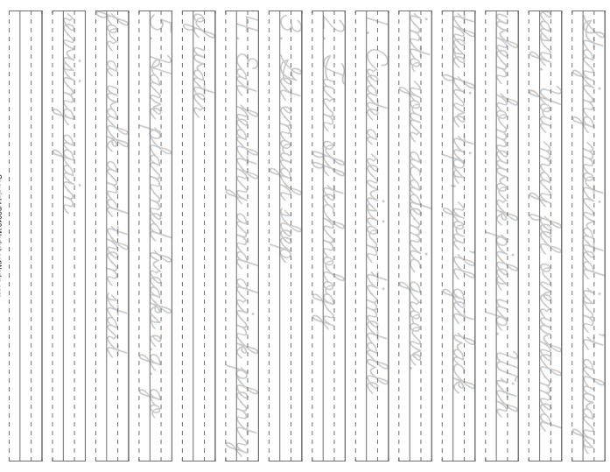
39

Slide 42
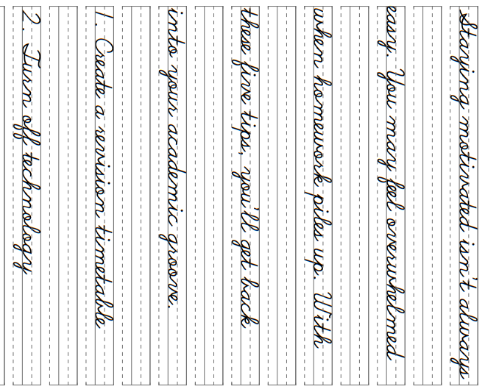
40

Slide 43
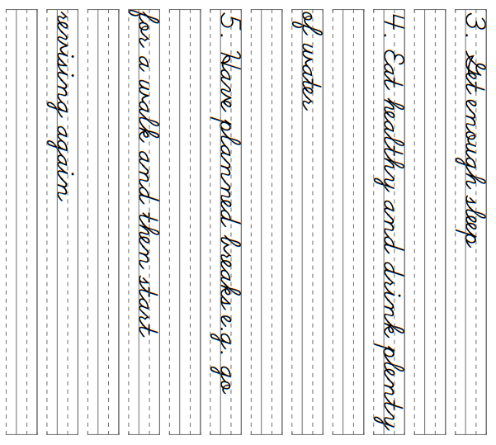
41

Slide 44
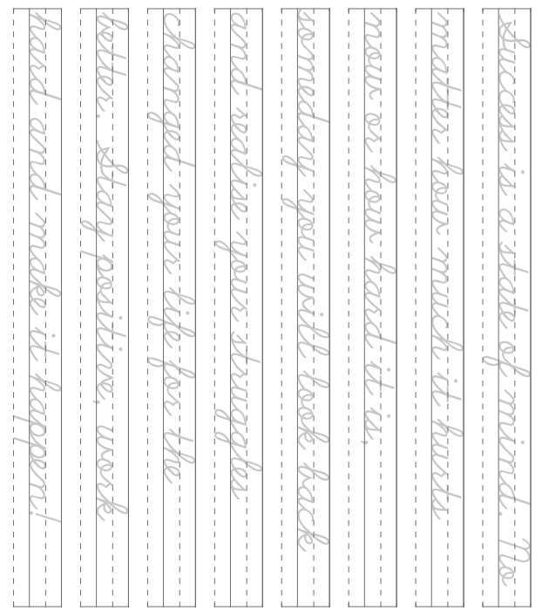
42

Slide 45
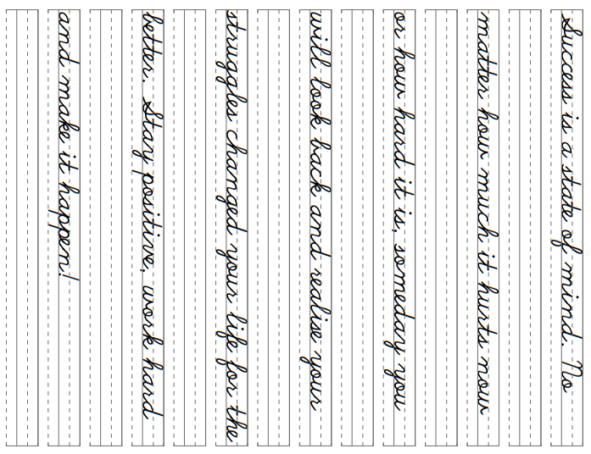
43

