Slide 1

Year 11 Knowledge Organiser HT3
Knowledge is Power
Name: ______________________________
Form: _______

Slide 2
Contents Page
Subject | Page
English | 1
Maths | 2
Science | 6
History | 8
Geography | 9
Spanish | 10
PE | 11
Performing Arts | 17
Business | 18
iMedia | 20
Cooking and Nutrition | 21
Art | 22
Music | 23
‘Thinking’ reflection log | 24
Reading log | 29
Handwritting Practice | 35

Slide 3
English
Week 5 – A Christmas Carol Vocabulary
Parsimonious | Someone who is greedy with their money.
Sabbatarianism | A religious belief that it is a sin to work on Sunday as it is the Lord’s day.
Philanthropy | A desire to promote the welfare of others, especially by generous donations to good causes.
Misanthropy | An active dislike of humankind.
Penitence | The action of feeling or showing sorrow and regret for having done wrong.
Allegory | A story that holds a deeper, moral or political meaning.
Week 1 – Macbeth Vocabulary
Retribution | Inflicting punishment for a wrongful act.
Patriarchy | Society dominated by males who rule over females.
Tyrannical | Exercising power in a cruel way.
Masculinity | Traits relating to being stereotypically male.
Malevolence | Being deliberately hostile to others.
Regicide | Killing the King or Queen in charge, usually in order to take over e.g. Macbeth murdering King Duncan.
Week 3 – DNA Vocabulary
Enigma | Something that is mysterious, difficult to understand.
Duologue | A section of the play with only two speaking roles.
Exposition | The opening part of a play where setting and characters are introduced.
Chorus | In Greek drama, a group of performers who comment on the main action.
Narrator | The person telling the story or delivering a commentary alongside the action.
Week 4 – DNA Vocabulary
Social Institution | A group constructed o fulfil a common purpose of society such as law and order, educational or religious.
Short Utterances | Quick/rapid spoken words/statement.
Stichomythia | Lines in a play alternating between two characters but repeating certain words to emphasise specific ideas.
Moral Panic | Public anxiety in response to a problem concerning the potential decline of society’s morals.
Primitive | Referring to society at an early stage in historical social development.
Week 6 – A Christmas Carol Vocabulary
Altruism | The act of being kind and giving to others.
Miser | Someone who earns lots of money but spends none.
Benevolence | Being kind, caring and considerate to others.
Covetous | Synonymous with suspicious.
Humbug | An expression of distaste.
1834 Poor Law | A system of welfare which introduced workhouses.
Week 2 – Macbeth Vocabulary
Hamartia | Fatal flaw leading to the downfall of the main character.
Usurp | Take position of power by force or wrongfully.
Motif | A dominant/reoccurring idea.
Apparitions | A ghost/ghost-like image of a person.
Virtuous | Having high moral standards.
Futile | Something that is seen as pointless.
1
Notes:
1 and 2

Slide 4
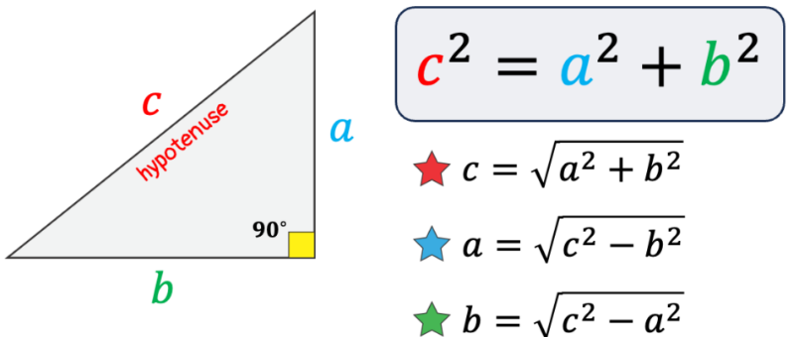
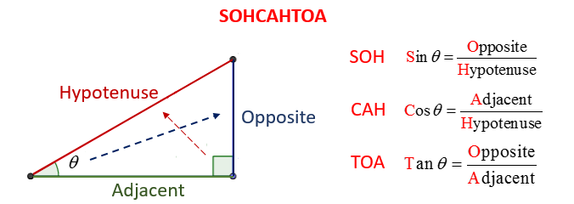
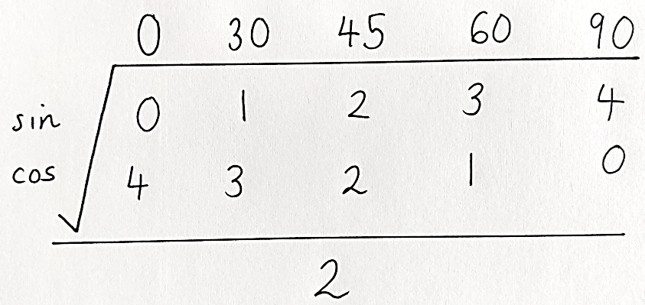
Maths – Foundation and Higher
Vectors
Key Word | Definition
Vectors | A vector describes a movement from one point to another. A vector quantity has both direction and magnitude (size).
Vector notation | A vector between two points A and B is described as: $\vec{AB}$
Column vector | A column vector is written in this format: $$\left({x \atop y}\right)$$ $x$ = right (+) and left (-) movement y = up (+) and down (-) movement
Key Term | Definition | Method
Pythagoras’ Theorem | A method we use to find missing sides in right angled triangles.
Trigonometry | A method we use to find missing sides and angles in right angled triangles.
Exact trigonometric values | Exact trig values are the exact trigonometric values for certain angles that you are expected to know for GCSE mathematics.
Transformations
Reflection | When a shape is flipped (reflected) in a mirror line
Rotation | When a shape is turned (rotated) around a centre of rotation by a given direction (clockwise/anticlockwise) and angle (90⁰ or 180⁰)
Translation | When a shape is moved by a column vector
Enlargement | When a shape is made bigger or smaller. They must have a scale factor and they may involve a centre of enlargement.
2

Slide 5
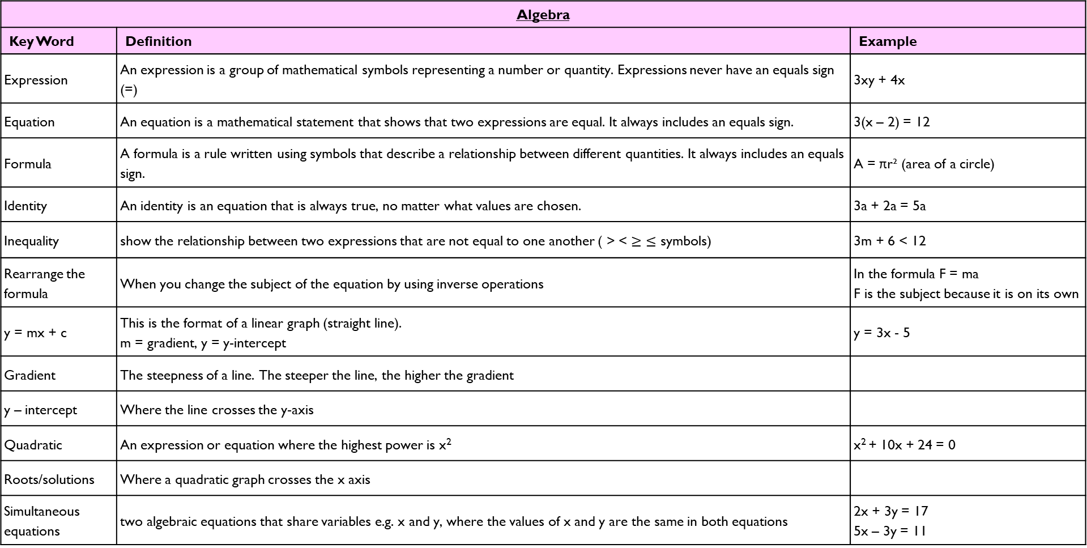
Maths – Foundation and Higher
Algebra
Key Word | Definition | Example
Expression | An expression is a group of mathematical symbols representing a number or quantity. Expressions never have an equals sign (=) | 3xy + 4x
Equation | An equation is a mathematical statement that shows that two expressions are equal. It always includes an equals sign. | 3(x – 2) = 12
Formula | A formula is a rule written using symbols that describe a relationship between different quantities. It always includes an equals sign. | A = πr² (area of a circle)
Identity | An identity is an equation that is always true, no matter what values are chosen. | 3a + 2a = 5a
Inequality | show the relationship between two expressions that are not equal to one another ( > < $≥$ $≤$ symbols) | 3m + 6 < 12
Rearrange the formula | When you change the subject of the equation by using inverse operations | In the formula F = ma F is the subject because it is on its own
y = mx + c | This is the format of a linear graph (straight line). m = gradient, y = y-intercept | y = 3x - 5
Gradient | The steepness of a line. The steeper the line, the higher the gradient
y – intercept | Where the line crosses the y-axis
Quadratic | An expression or equation where the highest power is x² | x² + 10x + 24 = 0
Roots/solutions | Where a quadratic graph crosses the x axis
Simultaneous equations | two algebraic equations that share variables e.g. x and y, where the values of x and y are the same in both equations | 2x + 3y = 17 5x – 3y = 11
3

Slide 6
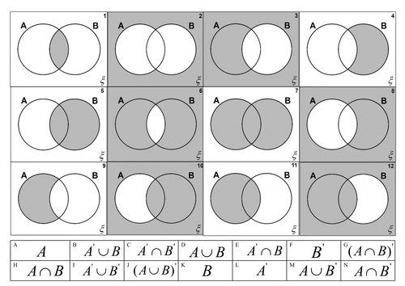
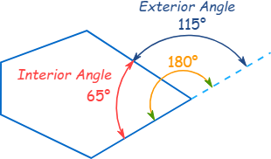
Maths – Foundation and Higher
Venn Diagrams – Set Notation
Set | Numbers that feature in a certain list/part of Venn diagram
Element | An individual number within a set
$$Set A$$ | Everything inside the circle of A
$$Set B$$ | Everything inside the circle of B
$$A∪B$$ | The ‘union’ of A and B – all the elements in both circles
$$A∩B$$ | The ‘intersection’ of A and B – the elements in the cross over
$$A′$$ | The ‘complement’ of A – everything apart from elements in A
$$B′$$ | The ‘complement’ of A – everything apart from elements in B
Angles in other Polygons
Polygon | a closed 2D shape with 3 or more sides
Regular | Equal sides and angles
Irregular | Unequal sides and angles
Interior angle | angle inside a shape
Exterior angle | angle between any side of a shape, and a line extended from the next side.
Formulae you need to memorise:
n = number of sides in the shape
Formula 1 | exterior + interior = 180⁰
Formula 2 | n $×$ exterior = 360⁰
Formula 3 | (n – 2) $×$ 180 = sum of interior angles
Names and properties of polygons
Pentagon | 5 sides and angles
Hexagon | 6 sides and angles
Heptagon | 7 sides and angles
Octagon | 8 sides and angles
Nonagon | 9 sides and angles
Decagon | 10 sides and angles
4

Slide 7
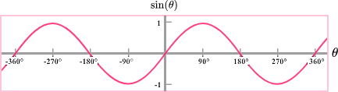
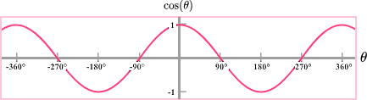
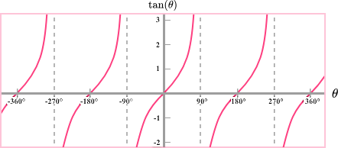
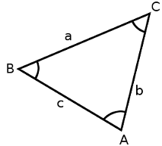
Maths – Higher only
Trigonometric Graphs
y = sin(x) | - Graph is a continuous curve and repeats every 360⁰ - Passes through (0, 0) - Maximum point of 1, minimum point of -1
y = cos(x) | - Graph is a continuous curve and repeats every 360⁰ - Passes through (0, 1) - Maximum point of 1, minimum point of -1
y = tan(x)
Advanced Trigonometry
Sine rule (sides) | $$\frac{a}{SinA}=\frac{b}{SinB}=\frac{c}{SinC}$$
Sine rule (angles) | $$\frac{SinA}{a}=\frac{SinB}{b}=\frac{SinC}{c}$$
Cosine rule (sides) | $$a^{2}=b^{2}+c^{2}−2bcCos(A)$$
Cosine rule (angles) | $$Cos\left(A\right)=\frac{b^{2}+c^{2}−a^{2}}{2bc}$$
Area of any triangle | $$\frac{1}{2}abSin(C)$$
- Repeats every 180⁰
- Not a continuous curve
- Vertical aysmptotes (lines where it is not allowed to touch) at 90⁰ and 180⁰
5

Slide 8
Science
Using resources key words
Finite resource | A resource used by humans that has a limited supply e.g. coal.
Renewable resource | A resource used by humans that can be replenished e.g. trees. If not managed correctly, the resource may decrease.
Potable water | Water that is safe to drink. Has low levels of dissolved salts and microbes.
Fresh water | Water that has low levels of dissolved salts. Sea water is not fresh water.
Pure water | Only contains water molecules, nothing else
Desalination | A process that removes salt from sea water to create potable water. Expensive as it requires a lot of energy. Only necessary in areas with small amounts of fresh water e.g. Spain.
Sewage | Wastewater produced by people. Contains potentially dangerous chemicals and large numbers of bacteria.
Bioleaching | Bacteria grow on low-grade copper ores. They produce a leachate (liquid) that contains copper compounds.
Phytomining | Plants are grown on low-grade copper ores. The plants absorb the copper and are then burned. The ash contains copper compounds.
Life Cycle Assessment | Life cycle assessments assess the environmental impact of products.
Reuse | The environmental impact of products can be reduced by reusing the product. Only suitable for some products e.g. glass bottles.
Recycling | Some materials can be recycled e.g. metals. Metals can be recycled by melting and recasting or reforming into different products.
Chemistry of the atmosphere key words
Atmosphere | the gases that surround the Earth or other planet.
Precipitated | a substance is produced as a solid from a liquid.
Algae | simple plant type organism, occurring in water, that have chlorophyll but lack true stems, roots, and leaves.
Bias | supporting one idea in an unfair way based on personal values / ideas.
carbon footprint | the total amount of carbon dioxide and other greenhouse gases emitted over the full life cycle of a product, service or event.
Combustion | A reaction between a fuel and oxygen that produces heat
Carbon monoxide | A toxic gas. It is colourless and odourless and so is not easily detected. Produced during incomplete combustion.
Sulfur dioxide and oxides of nitrogen | Acidic gases that are released from burning fuels. Cause respiratory problems in humans and cause acid rain.
Particulates | Tiny carbon particles that cause global dimming and health problems for humans.
6

Slide 9
Science
Word | Definition
Permanent magnet | Magnet which produces its own magnetic field
Compass | Compasses contain small bar magnets which points to the north pole of the Earth’s magnetic field.
Repel | Occurs when two like poles are brought close together. The magnets push apart.
Attract | Occurs when two opposite poles are brought close together. The magnets move together.
Induced magnet | Object which becomes a magnet when placed in a magnetic field. When removed from the magnetic field it loses its magnetism quickly
Magnetic field | Region around a magnet where a force acts on another magnet
Magnetic material | here are four magnetic materials: iron, steel, cobalt and nickel.
Solenoid | a wire shaped into a cylindrical coil
Electromagnet | A solenoid with an iron core
Motor effect (HT) | When a conductor carrying a current is placed in a magnetic field, the magnet and the conductor exert a force on each other
Fleming’s Left Hand Rule (HT) | A rule that shows the relative direction of the current, force and magnetic field in the motor effect.
Magnetic flux density (HT) | Density of magnetic field lines (measured in Tesla (T))
Word | Definition
mechanical waves | Waves which require a medium (substance) to travel through
medium | The substance that a wave is travelling through e.g. air, water
matter | Material, anything that is made of atoms
oscillation | vibration
transverse wave | A wave in which the vibrations (oscillations) are at right angles to the direction of energy transfer
longitudinal wave | A wave in which the vibrations (oscillations) are parallel to the direction of energy transfer
compression | Area in a longitudinal wave where particles are close together
rarefaction | Area in a longitudinal wave where particles are far apart
amplitude | The maximum displacement of a point on a wave away from its undisturbed position
wavelength | Distance from a point on one wave to the equivalent point on the adjacent wave
frequency | Number of waves passing a point each second
hertz (Hz) | Unit for measuring frequency. 1 Hz = 1 wave per second
period | Time taken (in seconds) for one wave to pass
7

Slide 10
History
Key Term | Definition
Vaccine | Substance that is injected into a person to protect against a particular disease
Laissez-faire | Means ‘leave alone’; in the 19th C many people felt this is what the Government should do – not interfere
Antibiotic | Medications used to cure, and in some cases prevent, bacterial infections
Pharmaceutical Industry | Businesses that develop and produce drugs for use in medicine and healthcare
Mould | Type of fungus that grows in thin threads, usually in warm, moist conditions
Bacteriologist | Someone who studies bacteria
Spore | Cell or small organism that can grow into a new organism in the correct conditions
DNA | Deoxyribonucleic Acid. Molecules that genes are made from
Key Term | Definition
Human Genome Project | International project to decode and identify human genes
Keyhole Surgery | Modern surgical technique in which operations are performed inside the body using cameras and instruments inserted through small incisions on the skin
Positive Health | Focus on the prevention of illnesses and disease rather than cure
Alternative Medicine | Any way of treating an illness or health condition that does not rely on mainstream, doctor-dispensed scientific medicine
Health Visitor | Qualified nurse or midwife with additional training and qualifications in public health
Welfare State | System by which the Government looks after the well-being of the nation, particularly those who cannot help themselves
Workhouse | Public institution in which the destitute of a parish received board and lodging in return for work
8

Slide 11
Geography
Key Word | Definition
Assess | To judge the importance /significant of using evidence provided/
Calculate | Work out the value of something. Sometimes, the command ‘calculate’ may not be used, but the question will require a calculation, eg ‘What is the total…’
Compare | Identify similarities and differences.
Define | To give the meaning of something without using the word in question
Describe | Set out characteristics – to say what something is, is like, or appears like.
Discuss | Present key points about different sides of an argument, issue or the strengths and weaknesses of an idea.
Evaluate | Judge from evidence, the effectiveness of something or weighing up both sides of an argument.
Explain | Set out purposes or reasons – say why or how.
Identify | To find something. To provide a simple work or statement
Justify | Support a case with evidence – give detailed reasons for an idea.
Outline | Set out main characteristics – to give a brief account or summary.
Suggest | Present a possible case, to propose an idea, solution or answer in an unfamiliar situation
To what extent | Judge the importance or success of (strategy, scheme, project) and to show scale of importance
9

Slide 12
Spanish
Spanish | English
Me gustaría ser más verde | I would like to be greener
Siempre apago la luz | I always turn off the light
Reciclo la basura cada día | I recycle rubbish every day
Creo que soy… | I think I am…
Quiero ser más… | I want to be more….
Tengo que ahorrar energía en casa. | I have to save energy at home…
La contaminación del aire es muy preocupante | Air pollution is very concerning
Tenemos que cuidar el planeta | We have to look after the planet
Ayer reciclé el vidrio y el plástico | Yesterday I recycled the glass and the plastic.
Me preocupa mucho el problema del calentamiento global… | I am really worried about the problem of global warming
Muchos países se enfrentan a graves problemas sociales. | Lots of countries face serious social problems
Es un gran problema a nivel mundial que afecta a muchos países. | It’s a big problem that affects many countries
¡Qué verde! | How green !
La basura | rubbish
Los recursos | resources
El mundo | The world
La escasez de agua | The scarcity of water
Spanish | English
El efecto invernadero | The Greenhouse effect
¡Qué malgasto! | What a waste !
Los desechos | waste
El medio ambiente | The environment
La deforestación | Deforestation
El hambre | Hunger
La sequía | drought
Si pudiera, reciclaría toda mi basura…. | If I could, I would recycle all my rubbish…
Si tuviera el dinero, Compraría un coche eléctrico. | If I were to have the money I would buy an electric car.
quiero ahorrar energía | I want to save energy
los efectos del calentamiento global | The greenhouse effect
intento reciclar todo lo posible | I intend to recycle everthing possible
deberíamos ahorrar la energía | We should save energy
la energía renovable. | Renewable energy
usar menos electricidad | Use less electricity
soy muy ecológico/a | I am ecologically-friendly
10

Slide 13

PE
Muscular System
Key Word | Definition
Muscular system | Works in conjunction with the skeleton to produce movement of the limbs and body
Antagonistic pairs | Muscles are arranged in antagonistic pairs. As one contracts, its partner relaxes
Agonist | The muscle that contracts to produce movement
Antagonist | The muscle that relaxes to allow the movement to occur
11

Slide 14

PE
Skeletal System
Key Word | Definition
Skeletal system | Works in conjunction with the muscular system to produce movement of the limbs and body
Ligaments | Connect bone to bone
Tendons | Connect muscular muscle to bone
12

Slide 15

PE
Cardiovascular System
Deoxygenated blood = BLUE (Right side) Oxygenated = RED (Left side)
13

Slide 16

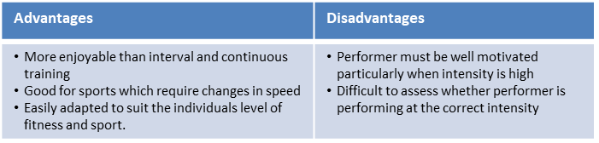
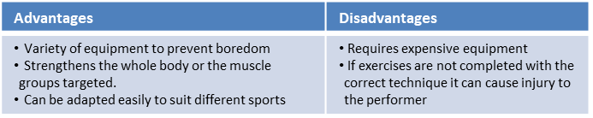
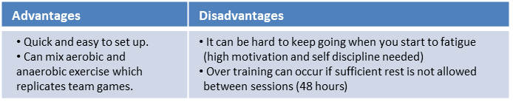
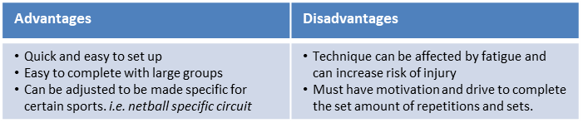
Key Word | Definition
Methods of training
Continuous training - | Involves a steady but regular pace at a moderate intensity (aerobic) which should last for at least 20 minutes. i.e. running, walking, swimming, rowing or cycling. Used by a marathon runner.
Fartlek training | Referred to as ‘speed play’ This is a form interval training but without rest. Involves a variety of changing intensities over different distances and terrains. i.e. 1 lap at 50% max, 1 lap walking, 1 lap at 80% (aerobic and anaerobic used) Used by games players – Hockey players
Weight/Resistance training | A form of training that uses progressive resistance against a muscle group. Used by cyclists. Muscular strength: High weight x low repetitions. Muscular endurance: Low weight x high repetitions
Interval training | Involves periods of work followed by periods of rest. i.e. Sprint for 20 metre + walk back to start. Used by a 200m sprinter
Plyometric training | Involves high-impact exercises that develop power. i.e. bounding/hopping, squat jumps. Used by long jumpers, 100 m sprinters or basketball players.
Circuit training | A series of exercises completed one after another. Each exercise is called a station. Each station should work a different area of the body to avoid fatigue. i.e. press ups, sit ups, squats, shuttle runs.
PE
14

Slide 17
PE GCSE
Types of practice
Massed practice | When no rest intervals are given
Distributed practice | When a rest interval is given to allow recovery, feedback & coaching
Fixed practice | Uses repetition of the same activity to develop consistency in performance
Variable practice | Involves performing a skill in different situations where conditions are changeable
Goal Setting
Goal Setting | Done to motivate performances
Short term goals | A goal you want to accomplish soon
Long term goals | A goal you want to accomplish in the future
Outcome goal | Helps the performer to focus on the big picture of what they are trying to achieve.
Performance goal | Allows the athlete to focus in on details of the performance, not just winning and losing
SMART Targets | Are used to help guide goal setting. SMART is an acronym for Specific, Measureable, Achievable, Realistic and Time bound
Specific | Targets must be concise
Measureable | Must be measured and compared
Achievable | Target must be challenging but yet reachable
Realistic | Matched to the performers skill level
Time bound | Set for a particular time to be completed.
15

Slide 18
PE GCSE
Mental preparation
Mental Preparation | Involves the athlete imagining themselves in an environment performing a specific activity using all of their senses
Feedback
Feedback | Vital part of information processing which provides confidence, motivation and improves performance
Intrinsic feedback | This comes from within the performer. Kinaesthetic senses provide feelings from muscles/joints about the action
Extrinsic feedback | This comes from results and match analysis
Concurrent feedback | Information provided to the athlete during the performance
Terminal feedback | Information provided to the athlete before or after the performance
16

Slide 19
Performing Arts
Unit 3
Promoting and Pitching
Target Audience | The target audience refers to the specific group of audience members who would most benefit from your production.
Pitch | A pitch is a presentation of an idea to a group of people who can help turn the idea into a production/performance/event.
Arts Commission | This is where an individual or organisation funds an artist to create a piece of work based on their specifications.
Artistic Intention | This is the overarching aim which is communicated clearly to the audience.
Market Research | This is the process of gaining information about your chosen target audience through collecting data to help reveal key trends.
Public Relations | This is the process of promoting the production with a key focus on image and relaying key product information to the audience.
Arts Organisations
Arts Council England | An arts council is a government or private non-profit organization dedicated to promoting the arts; mainly by funding local artists, awarding prizes, and organizing arts events.
BBFC | This stand for the British Board of Film Classification. This organization is responsible for censorship of all films content released.
Stage Roles
SM ASM | Stage Manager is responsible for the running of the show and is responsible for the stage.
Director | ARTISTIC DIRECTOR – They may be involved in the directing of the show and the programming of a venue. TECHNICAL DIRECTOR – This involves overseeing the technical requirements of a production.
Stage Crew | The stage crew are a team of members who take responsibility for moving any scenery and props.
Actor | The actor is the person whose role it is to play a character
Stage Terms
Strike | Striking the set and rigging at the end of a production run.
Blocking | The precise planning of how actors will move about the stage.
Auditorium | The auditorium is a room that enables an audience to hear and watch performances.
Curtain Call | The curtain call occurs at the end of a production.
17

Slide 20
Business
Key Word | Definition
Social objectives | Likely to be non-financial, such as to reduce the carbon emissions of a business or improve the quality of life for a local community
Asset | Any item of value that a business owns, such as its machinery or premises
Net cash flow | The difference between cash in e.g. revenue and cash out e.g. utility bills. (A prediction remember)
Limited liability | The level of risk is limited to the amount of money that has been invested in the business or promised as investment
Franchise | When one business gives another business permission to trade using its name and products in return for a fee and share of its profits
Product differentiation | Designing a product with some unique features that distinguish it from similar products sold by competitors
Brand loyalty | A customer’s willingness to buy a product from a particular business rather than from its competitors
Business plan | A document that outlines how an entrepreneur is going to set up a new business
Target market | That group of people that a business has identified as potential customers
Budgets | Pre-set financial targets for a business to achieve, like a sales budget, or abide by, such as an expenditure budget, in a given period of time
Footfall | The number of people passing a particular location within a given time period
Labour | Workers, workforce, employees
Conflict | A serious disagreement, usually between people (stakeholders), countries or ideas
Key Word | Definition
Entrepreneur | Someone who creates a business, taking on financial risks with the aim of making a profit from the business
E-commerce | Using the internet to carry out business transactions
Demographic | Relating to the population, such as average age, average income and so on
Sales revenue | The amount of money that comes in from a business’s sales
Market share | The proportion of sales in a market that are taken by one business
Market segmentation | The process of breaking the whole population into smaller parts. Age, gender, occupation, lifestyle, income
Focus group | A group of people who discuss their views on a product, service advertisement or idea, either face-to-face or online
Ethics | Moral principles or standards that guide the behaviour of a person or business (Doing the right thing)
Stakeholder | Anyone who has an interest in the activities of a business, such as its workers, its suppliers, the local community and the government
Overdraft | A facility offered by a bank that allows an account holder to borrow money at short notice and go below 0 in their account for a short time.
Share capital | Money to invest in a business is raised by the business issuing shares that it then sells to those who wish to invest in the company
Break-even point | The point where revenue received meets all of the costs of the business
18

Slide 21
Business
Key Word | Definition
Minimum wage | The lowest legal rate of pay for employees, depending on their age and their type of employment
Globalisation | When businesses operate and in international scale and gain international influence or power
Tax | A proportion of an individual’s income or a business’s profits that must be paid to the government
Imports | The flow of goods and services into a country from another country
Exports | The flow of goods and services out of a country to another country
Marketing mix | Product, price, promotion, place
Inflation | The costs of products and services are increasing
Interest rates | The % rate of borrowing goes up. Also savers do receive higher rates as well though
Exchange rates | The value of your £ against another can go up or down. Meaning you get more or less for your £ when buying abroad
Recession | When earnings, productivity and employment can fall within the country
Social media | Facebook, Instagram etc. to promote the business products, services and customers to leave reviews
Key Word | Definition
Fixed costs | Costs that do not change with productivity
Variable costs | Costs associated with production e.g. raw materials
Legislation | Laws that impact on business e.g. Data protection, Health and safety, consumer law, minimum wage
Location | Where you choose to locate physical premises. Consider cost of rent, near competitors, near target audience, near labour and raw materials
Quantitative data | Numbers, statistics, percentages, charts—All can be easily interpreted and analysed
Qualitative data | Opinions and more in depth responses to market research
Margin of safety | Distance between current number of sales back to the breakeven level of sales.
Market research | Finding out what consumers want and/or what your competitors are doing. Primary or secondary methods can be used
Market mapping | Mapping out your competitors to see if there is a gap in the market. The criteria may be price against quality
19

Slide 22
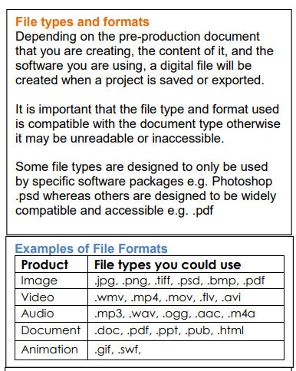
iMedia
Topic Area 1: The media industry
Traditional media | Film, Television, Radio, Print publication (newspapers, magazines)
New media | Computer games, Interactive media/website, Internet, Digital publishing (e-books)
Products | Video, Audio, Music, Animation, Special effects, Digital images and graphics, Apps, Digital games, comics, websites, Multimedia, AR/VR
Job roles media industry
Creative | Animator, Content creator, Copy writer, Graphic designer, Illustrator, Photographer, Script writer, Web designer
Technical | Camera operator, Games programmer/developer, Sound editor, Audio technician, Video editor, Web developer
Senior roles | Campaign manager, Creative director, Director, Editor, Production Manager
Pre-production | Mind maps of concepts Mood boards Visualisation diagrams Storyboards Script writing | Designing client briefs Creating Work plan Identifying target audience Considering H&S Considering legislation
Production | Filming, sound recording, creating media graphics, recording music/soundtracks, creating websites/animation
Post production | Editing, CGI, sound effects, opening titles ,closing titles, editing music, distribution
20

Slide 23
Cooking and Nutrition
Key Word | Definition
Nutrition | A study of what people eat and how all the nutrients in foods work together in the body
Balanced Diet | A balanced diet is one that contains the correct nutrients in the correct proportions, plus the correct amount of water and dietary fibre to meet the body’s needs
Cholesterol | A type of fatty substance made in the liver
Coeliac Disease | A disease which develops from an intolerance to gluten
Eatwell Guide | A pictorial food guide showing the amounts and types of foods that are needed to make up a healthy balanced diet
Allergen | A substance that causes an allergic reaction
Anaphylaxis | A serious allergenic reaction that is very rapid in onset and can cause death if the throat swells and the person cannot breathe
Reference Intake (RI) | The recommended quantity of a nutrient that an adult should eat every day
Recipe Amendment | Changing or altering a recipe eg changing some ingredients and/ or cooking methods
Food Poisoning | Illness caused by bacteria or other toxins in food
Bacteria | Extremely small single celled organisms that can only be seen under a microscope.
Salmonella | Food poisoning bacteria found in chicken, some dairy foods and raw eggs
Staphylococcus | Food poisoning bacteria found in egg products , chicken, salad, tuna and eggs
Temperature probe | Device used to check the temperature in the centre of cooked food.
21

Slide 24
Art
Key Word | Definition
Rule of Thirds | The Rule of Thirds has an off-centre composition, which is more pleasing to the eye and looks more natural than the subject placed right in the middle
Golden Section | The Golden Section of rectangles are the most visually pleasing rectangles known, which are based on a mathematical ratio.
Proportion/Scale | The relationship between objects with respect to size/ number.
Rhythm/movement | The use of recurring elements to direct the movement of the eye through the artwork
Harmony | The arrangement of elements to give the viewer the feeling that all the parts of the piece form a coherent whole
22

Slide 25
Music
Key Word | Definition
Syncopation | Emphasis placed on a note that is not normally stressed, or between beats music with a steady beat.
Dotted note | A dot added after a note, adding an extra half to its lenght three beats per bar
Chords | A chord in music is a combination of three or more notes played simultaneously, forming the harmonic foundation of a piece.
Triplet | Three notes played in the time of two.
Structure in pop | organization and arrangement of various song sections like verses, choruses, bridges, and the overall layout, creating the framework for the composition.
Harmony | is the combination of different musical notes played simultaneously, creating a rich and pleasing sound that adds depth and character to a musical piece.
Time signature | It tells you how many beats are in each measure and which note gets one beat, helping you keep track of the rhythm while playing or singing.
Dynamic | The volume of a sound or piece of music – loud/soft
Pulse | The steady beat in music
Timbre | Each instrument own unique ‘tone quality’ and the voice as an instrument had different Timbre
Accent | Extra stress placed on a note or chord
Texture | Sometimes voices sing different parts at the same time creating Harmony. Not all vocal music is accompanied by instruments, unaccompanied singing is called A Cappella.
Rhythm | Rhythm is the pattern of sounds and beats in music that creates a sense of movement and flow. It is like the heartbeat of a song that helps us feel the music and dance or sing along. Rhythm can be fast or slow, simple or complex, and is created by combining different beats and notes in a particular order. It is an essential element of music that makes it enjoyable and exciting to listen to.
Tempo | Tempo refers to the speed of music. It's how fast or slow a song sounds.
23

Slide 26
W/c 5th January Thinking definition: Thinking is making connections, reasoning and asking questions to make the learning stick
Reflecting on learning behaviours for thinking… | Experience log
 | Successful moment… | In hindsight… Where you could have done better on reflection? | At home…
I gave an idea and reasoned/justified.
I reflected on my idea and made it better after discussing with others
I used a revision strategy to help make the learning stick.
I made connections between what I am learning and the outside world.
I asked questions to deepen my understanding.
24

Slide 27
W/c 12th January Thinking definition: Thinking is making connections, reasoning and asking questions to make the learning stick
Reflecting on learning behaviours for thinking… | Experience log
 | Successful moment… | In hindsight… Where you could have done better on reflection? | At home…
I gave an idea and reasoned/justified.
I reflected on my idea and made it better after discussing with others
I used a revision strategy to help make the learning stick.
I made connections between what I am learning and the outside world.
I asked questions to deepen my understanding.
25

Slide 28
W/c 19th January Thinking definition: Thinking is making connections, reasoning and asking questions to make the learning stick
Reflecting on learning behaviours for thinking… | Experience log
 | Successful moment… | In hindsight… Where you could have done better on reflection? | At home…
I gave an idea and reasoned/justified.
I reflected on my idea and made it better after discussing with others
I used a revision strategy to help make the learning stick.
I made connections between what I am learning and the outside world.
I asked questions to deepen my understanding.
25

Slide 29
W/c 26th January Thinking definition: Thinking is making connections, reasoning and asking questions to make the learning stick
Reflecting on learning behaviours for thinking… | Experience log
 | Successful moment… | In hindsight… Where you could have done better on reflection? | At home…
I gave an idea and reasoned/justified.
I reflected on my idea and made it better after discussing with others
I used a revision strategy to help make the learning stick.
I made connections between what I am learning and the outside world.
I asked questions to deepen my understanding.
26

Slide 30
W/c 2nd February Thinking definition: Thinking is making connections, reasoning and asking questions to make the learning stick
Reflecting on learning behaviours for thinking… | Experience log
 | Successful moment… | In hindsight… Where you could have done better on reflection? | At home…
I gave an idea and reasoned/justified.
I reflected on my idea and made it better after discussing with others
I used a revision strategy to help make the learning stick.
I made connections between what I am learning and the outside world.
I asked questions to deepen my understanding.
27

Slide 31
W/c 9th February Thinking definition: Thinking is making connections, reasoning and asking questions to make the learning stick
Reflecting on learning behaviours for thinking… | Experience log
 | Successful moment… | In hindsight… Where you could have done better on reflection? | At home…
I gave an idea and reasoned/justified.
I reflected on my idea and made it better after discussing with others
I used a revision strategy to help make the learning stick.
I made connections between what I am learning and the outside world.
I asked questions to deepen my understanding.
28

Slide 32
Reading Log w/c 5th January (20 mins reading per day – all five logs MUST be completed)
Date | Title of novel | Number of pages read | Summary about what I have read
 |  |  | • • •
 |  |  | • • •
 |  |  | • • •
 |  |  | • • •
 |  |  | • • •
Checked by form tutor:
29

Slide 33
Reading Log w/c 12th January(20 mins reading per day – all five logs MUST be completed)
Date | Title of novel | Number of pages read | Summary about what I have read
 |  |  | • • •
 |  |  | • • •
 |  |  | • • •
 |  |  | • • •
 |  |  | • • •
Checked by form tutor:
30

Slide 34
Reading Log w/c 19th January (20 mins reading per day – all five logs MUST be completed)
Date | Title of novel | Number of pages read | Summary about what I have read
 |  |  | • • •
 |  |  | • • •
 |  |  | • • •
 |  |  | • • •
 |  |  | • • •
Checked by form tutor:
31

Slide 35
Reading Log w/c 26th January (20 mins reading per day – all five logs MUST be completed)
Date | Title of novel | Number of pages read | Summary about what I have read
 |  |  | • • •
 |  |  | • • •
 |  |  | • • •
 |  |  | • • •
 |  |  | • • •
Checked by form tutor:
32

Slide 36
Reading Log w/c 2nd February (20 mins reading per day – all five logs MUST be completed)
Date | Title of novel | Number of pages read | Summary about what I have read
 |  |  | • • •
 |  |  | • • •
 |  |  | • • •
 |  |  | • • •
 |  |  | • • •
Checked by form tutor:
33

Slide 37
Reading Log w/c 9th February (20 mins reading per day – all five logs MUST be completed)
Date | Title of novel | Number of pages read | Summary about what I have read
 |  |  | • • •
 |  |  | • • •
 |  |  | • • •
 |  |  | • • •
 |  |  | • • •
Checked by form tutor:
34

Slide 38

35

Slide 39

36

Slide 40

37

Slide 41

38

Slide 42

39

Slide 43

40

Slide 44


41

Slide 45
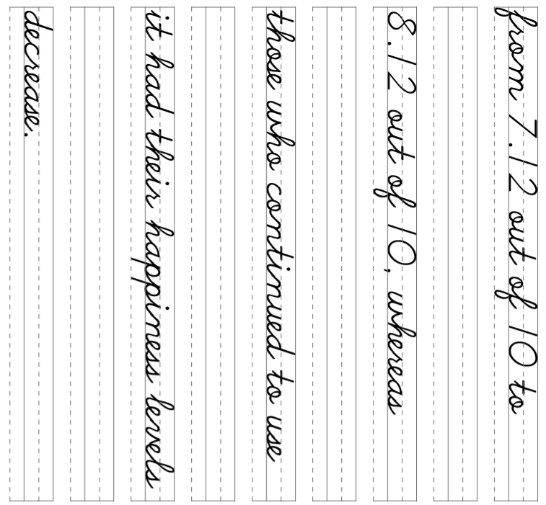
42

Slide 46
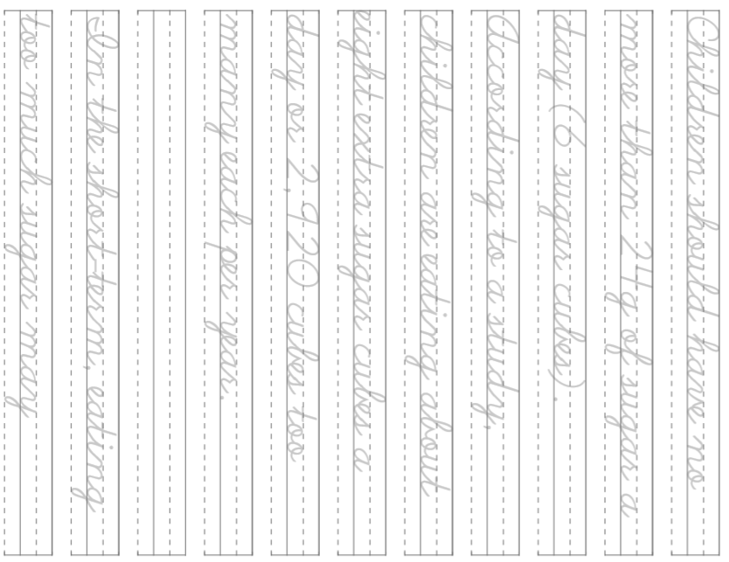
43

Slide 47
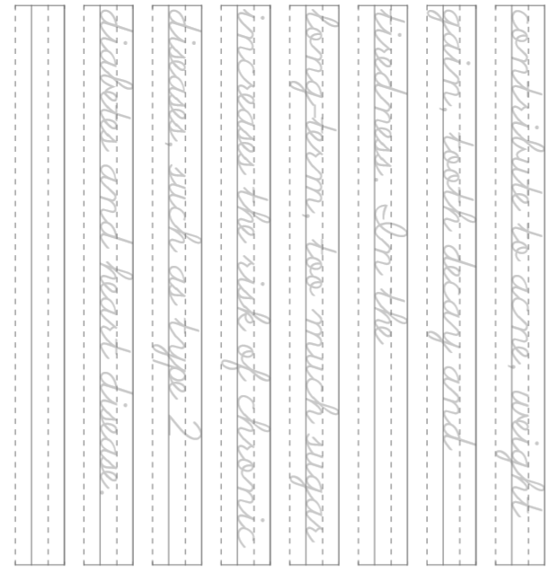
44

