Slide 1

Year 11 Knowledge Organiser HT4
Knowledge is Power
Name: ______________________________
Form: _______

Slide 2
Contents Page
Subject | Page
English | 1
Maths | 2
Science | 7
Spanish | 9
History | 10
Geography | 11
PE | 12
Business | 19
Computing | 21
iMedia | 23
Art | 25
Performing Arts | 26
Music | 28
‘Resilience’ reflection log | 29
Reading log | 34
Cursive Handwriting Practice | 39

Slide 3
English
Week 3 – Language devices
Metaphor | A direct comparison between two things, stating that one thing is another, without using "like" or "as".
Hyperbole | An extreme exaggeration used for emphasis.
Imagery | Using vivid descriptions to create a mental picture for the reader.
Symbolism | Using an object, image, or event to represent a larger abstract concept.
Week 5 – A Christmas Carol Vocabulary
Antithesis | A person or thing that is the direct opposite of someone or something else.
Benevolence | The quality of being well meaning; kindness.
Proletariat | Working-class people regarded collectively.
Catharsis | The process of releasing, and thereby providing relief from, strong or repressed emotions.
Allegory | A story, poem, or picture that can be interpreted to reveal a hidden meaning, typically a moral or political one.
Week 1 – Macbeth Vocabulary
Jacobean | Relating to the reign of James I of England. 1603- 1625.
Purgatory | (in Catholic doctrine) a place or state of suffering inhabited by the souls of sinners who are expiating their sins before going to heaven.
Divine Right of Kings | The doctrine that kings derive their authority from God.
Treason | The crime of betraying one's country, especially by attempting to kill or overthrow the sovereign or government.
Protagonist | The leading character or one of the major characters in a play, film, novel, etc.
Week 4 – Structural Devices
Flashback | A narrative technique where the story jumps back in time to recount past events, often used to provide context or build suspense
Juxtaposition | Placing two contrasting ideas or elements side-by-side to highlight their differences and create emphasis.
In media res | A narrative technique that starts in the middle of the action, then provides backstory later.
Anaphora | The deliberate repetition of a word or phrase at the beginning of successive sentences or clauses, often used for emphasis
Ignorant | Lacking knowledge and awareness in general; uneducated or unsophisticated.
Inferior | Lower in rank, status, or quality.
Redemption | The action of saving or being saved from sin, error, or evil.
Transformation | A marked change in form, nature, or appearance.
Humanity | The quality of being humane; benevolence.
Week 2 – Macbeth Vocabulary
Ambivalence | The state of having mixed feelings or contradictory ideas about something or someone.
Machiavellian | Cunning, scheming, and unscrupulous, especially in politics.
Resolute | Admirably purposeful, determined, and unwavering.
Regicide | The action of killing a king.
1
Notes:
1 and 2

Slide 4
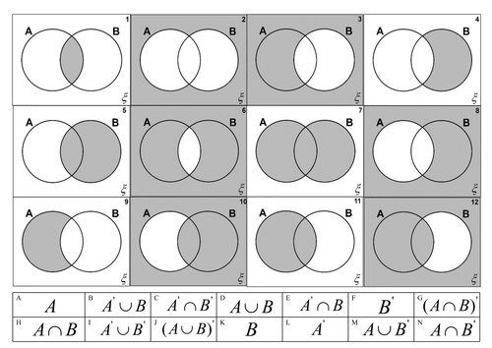
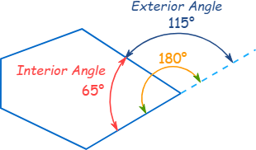
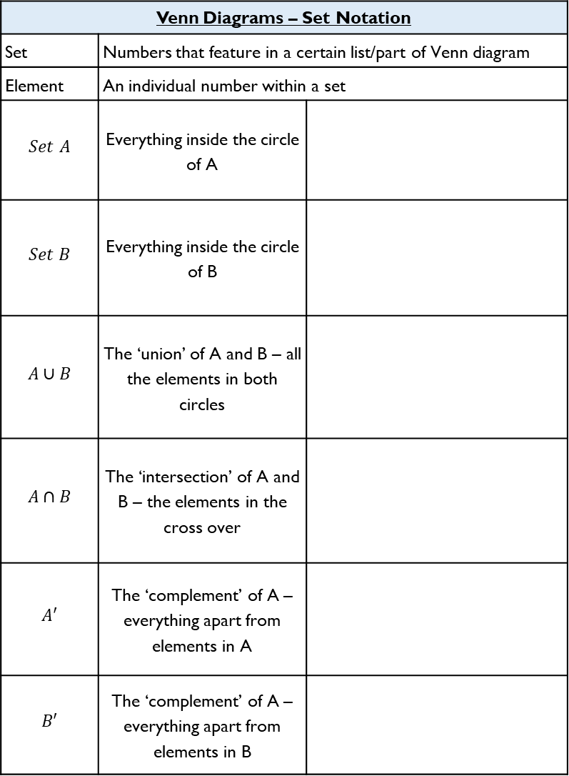
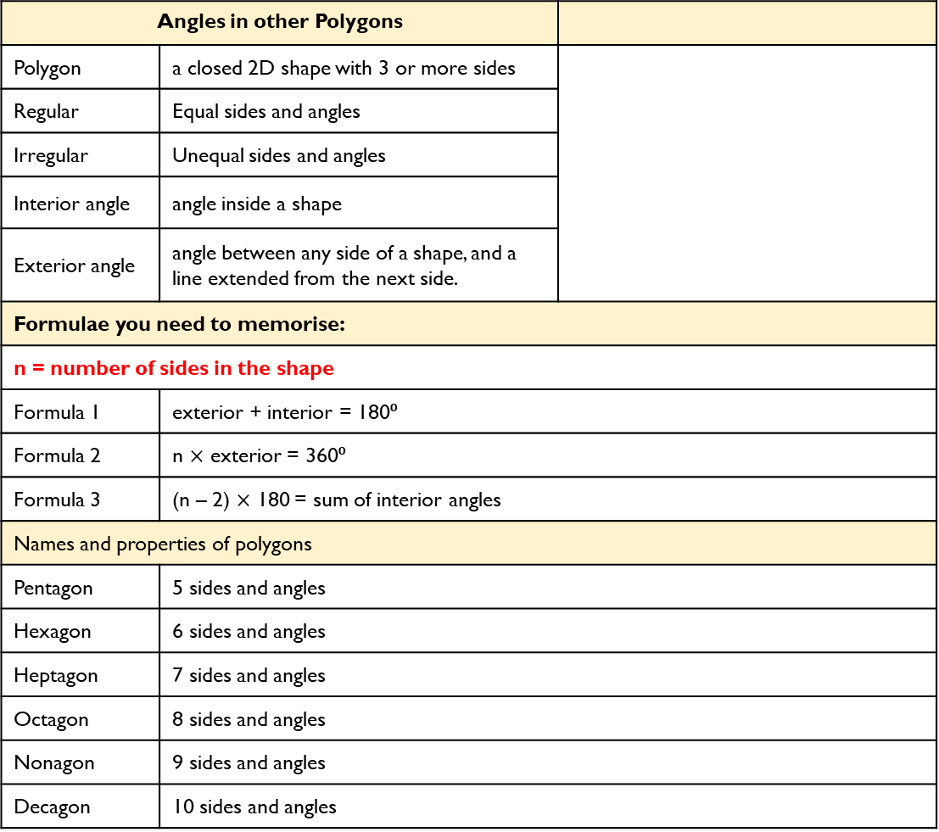
Maths – Higher and Foundation
Venn Diagrams – Set Notation
Set | Numbers that feature in a certain list/part of Venn diagram
Element | An individual number within a set
$$Set A$$ | Everything inside the circle of A
$$Set B$$ | Everything inside the circle of B
$$A∪B$$ | The ‘union’ of A and B – all the elements in both circles
$$A∩B$$ | The ‘intersection’ of A and B – the elements in the cross over
$$A′$$ | The ‘complement’ of A – everything apart from elements in A
$$B′$$ | The ‘complement’ of A – everything apart from elements in B
Angles in other Polygons
Polygon | a closed 2D shape with 3 or more sides
Regular | Equal sides and angles
Irregular | Unequal sides and angles
Interior angle | angle inside a shape
Exterior angle | angle between any side of a shape, and a line extended from the next side.
Formulae you need to memorise:
n = number of sides in the shape
Formula 1 | exterior + interior = 180⁰
Formula 2 | n $×$ exterior = 360⁰
Formula 3 | (n – 2) $×$ 180 = sum of interior angles
Names and properties of polygons
Pentagon | 5 sides and angles
Hexagon | 6 sides and angles
Heptagon | 7 sides and angles
Octagon | 8 sides and angles
Nonagon | 9 sides and angles
Decagon | 10 sides and angles
2

Slide 5
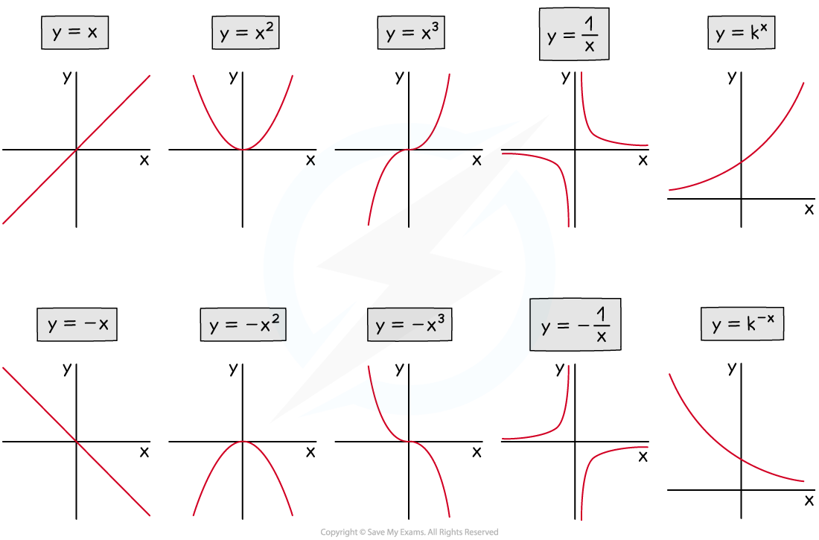
Maths – Higher and Foundation
3

Slide 6
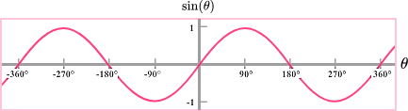
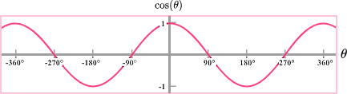
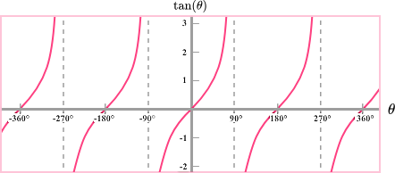
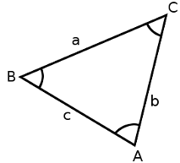
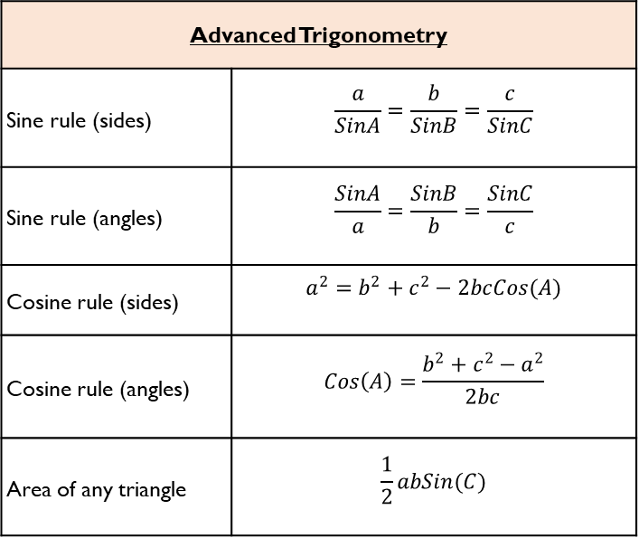
Maths – Year 11 Higher only
Trigonometric Graphs
y = sin(x) | - Graph is a continuous curve and repeats every 360⁰ - Passes through (0, 0) - Maximum point of 1, minimum point of -1
y = cos(x) | - Graph is a continuous curve and repeats every 360⁰ - Passes through (0, 1) - Maximum point of 1, minimum point of -1
y = tan(x)
Advanced Trigonometry
Sine rule (sides) | $$\frac{a}{SinA}=\frac{b}{SinB}=\frac{c}{SinC}$$
Sine rule (angles) | $$\frac{SinA}{a}=\frac{SinB}{b}=\frac{SinC}{c}$$
Cosine rule (sides) | $$a^{2}=b^{2}+c^{2}−2bcCos(A)$$
Cosine rule (angles) | $$Cos\left(A\right)=\frac{b^{2}+c^{2}−a^{2}}{2bc}$$
Area of any triangle | $$\frac{1}{2}abSin(C)$$
- Repeats every 180⁰
- Not a continuous curve
- Vertical aysmptotes (lines where it is not allowed to touch) at 90⁰ and 180⁰
4

Slide 7
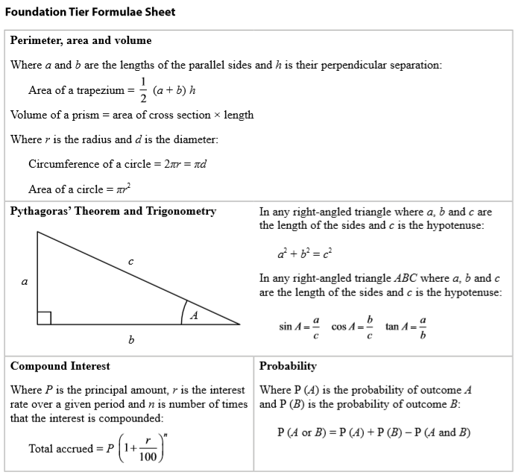
Maths
Foundation Formula Sheet
This is the formula sheet you will be given in the GCSE exams.
You do not need to memorise it, but you should refer to it when doing revision and practice papers.
5

Slide 8
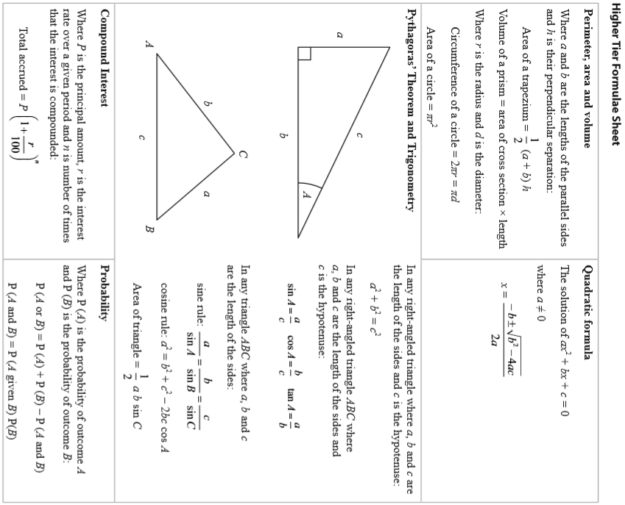
Maths
Higher Formula Sheet
This is the formula sheet you will be given in the GCSE exams.
You do not need to memorise it, but you should refer to it when doing revision and practice papers.
6

Slide 9
Science
Paper 1 Biology
Embryonic stem cell | Can divide into most types of cell.
Adult stem cell | Can divide into a limited number of cells e.g. bone marrow stem cells can form various blood cells.
Meristem | Found in plants. Can differentiate (divide) into any type of plant cell.
Diffusion | Spreading out of the particles (gas/ solution) resulting in a net movement from an area of higher concentration to an area of lower concentration.
Osmosis | The diffusion of water from a dilute solution to a concentrated solution through a partially permeable membrane.
Active Transport | The movement of substances from a more dilute solution to a more concentrated solution (against a concentration gradient). Requires energy from respiration.
Enzyme | A biological catalyst that can speed up the rate of reaction without being used itself. Made of a large protein molecule.
Denatured | When the active site of an enzyme changes shape and the substrate can no longer fit in. Can be caused by pH or temperature.
Antibodies | Some white blood cells (lymphocytes) produce antibodies. These bind to pathogens and destroy them or stick them together.
Antitoxins | Some white blood cells (lymphocytes) produce antitoxins. Antitoxins neutralise toxins.
Antibiotics | Antibiotics kill bacteria. Specific antibiotics should be used for specific bacteria. Some bacteria are resistant to antibiotics. Do not kill viruses.
Paper 1 Biology
Mitochondria | Provides energy from aerobic respiration.
Ribosome | Synthesises (makes) proteins.
Chloroplast | Where photosynthesis occurs.
Xylem cell | Waterproofed cell wall; cells are hollow to allow water to move through.
Phloem cell | Some cells have lots of mitochondria for active transport; some cells have very little cytoplasm for sugars to move through easily.
Light microscope | Basic microscope with a maximum magnification of 1500x. Low resolution.
Electron microscope | Microscope with a much higher magnification (up to 500 000x) and resolving power than a light microscope. This means that it can be used to study cells in much finer detail.
Resolution | The ability of a microscope to distinguish detail.
Magnification | The degree by which an object is enlarged. Magnification = size of image__ size of real object
7

Slide 10
Science
Paper 1 Physics
Conservation of energy | energy can not be created or destroyed, only transferred from one form to another
Renewable energy | comes from natural sources or processes that won’t run out
Work done | energy has been transferred from one energy store to another
Specific heat capacity | the amount of energy needed to raise the temperature of 1kg of a substance by 1o Celsius
Alternating current | The current regularly changes direction e.g. mains electricity
Direct current | The current flows in one direction only e.g. batteries.
Mains electricity | UK mains is an alternating current of 230V and at a frequency of 50Hz.
National grid | A series of cables and transformers linking power stations to consumers.
Step up transformer | Increases the potential difference for transmission across power cables. This reduces the current and therefore less heat is lost from the cables. This makes the National Grid efficient.
Step down transformer | Reduces the potential difference from the cables to 230V for use by consumers.
Isotope | An atom of the same element with different numbers of neutrons.
Half life | The time it takes for the number of nuclei of the isotope in a sample to halve Or, The time it takes for the count rate (or activity) from a sample containing the isotope to fall to half its initial level.
Paper 1 Chemistry
Mixtures | Two or more elements or compounds not chemically combined together
Element | Contains only one type of atom
Compound | Two or more elements chemically combined
Filtration | Separating an insoluble solid from a liquid
Crystallisation | To separate a solid from a solution
Simple distillation | To separate a solvent from a solution
Fractional distillation | Separating a mixture of liquids each with different boiling points
Chromatography | Separating substances that move at different rates through a medium
7
Li
3
Mass number | The sum of the protons and neutrons in the nucleus
Atomic number | The number of protons in the atom | Number of electrons = number of protons
8

Slide 11
Spanish
Spanish | English
Me encanta | I love
Me chifla | I’m mad about
Me mola | I’m mad about
Me aburre | It bores me
Me interesa | It interests me
Me fascina | I’m fascinated by
Me enoja | It annoys me
Me fastidia | It annoys
Me molesta | It annoys me
Odio | I hate
Detesto | I hate
Disfruto | I enjoy
Pienso que | I think that
Creo que | I believe that
Según yo | According to me
A mi modo de pensar | In my way of thinking
No me gusta nada | I don’t like at all
Spanish | English
Sin embargo | However
Aunque | Although
Pero | But
Además | Furthermore
No obstante | However
También | Also
Por un lado | On the one hand
Por otro lado | On the other hand
Muy | very
Bastante | quite
Un poco | A little
Demasiado | too
Tan | so
Más …que | More…than
Menos…que | Less…than
Tal…como | As…as
Prefiero | I prefer
9

Slide 12
History
The Americas and Drake’s Circumnavigation Motivations
Conquest of new land/trade | Areas like Brazil and Peru were relatively unexplored. There were markets for English cloth and Spanish ships to seize and trade with.
The encouragement of Elizabeth I | After 1573 she part-financed (secretly) Drake’s to South America. She also gave permission and secretly invested in the planned voyage of 1577.
Acquisition of wealth | Hawkins made large sums from the slave trade and brought goods like sugar, spice back to trade. In 1572 Drake made a successful voyage to the Americas, helped by Diego, capturing much Spanish gold and silver.
Finding the Strait of Anian | Drake was convinced there was a Northwest Sea passage that linked the Atlantic and the Pacific Oceans. This would speed up the time taken to travel between East Asia.
Hawkin’s influence | Drake sailed with Hawkins on several slave trading missions, leading to Drake captaining the Judith, in Hawkins 1568 mission to the Americas.
Revenge on the Spanish | In 1568 at San Juan de Ulua, the Spanish attacked Hawkins’ fleet. Only Drake and Hawkins’ ship escaped. In 1572 Drakes expedition to the Americas saw him raiding ships leaving Nombre de Dios.
The Americas and Drake’s Circumnavigation Outcomes
Wealth and treasure |  | Vast sums of Spanish gold and silver, goods to trade – Drake personally gained £10,000 and crew shared £40,000
Drake’s social standing |  | Knighted in 1581, bought Buckland Abbey, seen heroically, charmed Elizabeth, Drake Passage named in his honour
Spanish relations with England |  | Declined! Treasure ships and ports raided – nicknamed Drake ‘El Draque’ – Phillip II reinforced Spanish defences
English imperialism |  | Led to future voyages e.g. Lancaster. South America less fruitful – English turn to North America
Geographical understanding |  | Drake’s rutters corrected European maps – Drake Passage improved travel from Europe to Americas.
The Americas and Drake’s Circumnavigation Impact
Drake | Lost all but the Golden Hind and wounded at Mocha Island. Returned with treasure worth £480million, plus £10,000 gold for himself.
England | Gained treasure worth over £480million and new territories/trade routes to use. Challenged Spanish imperial dominance. Elizabeth gained personal gifts from Drake.
Spain/ Portugal | Exposed vulnerability of colonies – led to Phillip II reinforcing them. Led in part to Spanish Armada. Portuguese lost trading with Maluku people as future English voyages exploited new trade routes.
Crew/ Backers | Initially angry – not told of destination in Americas. Only 59 returned and Thomas Doughty executed for treason. Shared £40,000 of treasure on their return. Led to future voyages e.g., James Lancaster.
10

Slide 13
Geography
Command Word | Definition
Assess | To judge the importance /significant of using evidence provided/
Calculate | Work out the value of something. Sometimes, the command ‘calculate’ may not be used, but the question will require a calculation, eg ‘What is the total…’
Compare | Identify similarities and differences.
Define | To give the meaning of something without using the word in question
Describe | Set out characteristics – to say what something is, is like, or appears like.
Discuss | Present key points about different sides of an argument, issue or the strengths and weaknesses of an idea.
Evaluate | Judge from evidence, the effectiveness of something or weighing up both sides of an argument.
Explain | Set out purposes or reasons – say why or how.
Identify | To find something. To provide a simple work or statement
Justify | Support a case with evidence – give detailed reasons for an idea.
Outline | Set out main characteristics – to give a brief account or summary.
Suggest | Present a possible case, to propose an idea, solution or answer in an unfamiliar situation
To what extent | Judge the importance or success of (strategy, scheme, project) and to show scale of importance
11

Slide 14

PE
Muscular System
Key Word | Definition
Muscular system | Works in conjunction with the skeleton to produce movement of the limbs and body
Antagonistic pairs | Muscles are arranged in antagonistic pairs. As one contracts, its partner relaxes
Agonist | The muscle that contracts to produce movement
Antagonist | The muscle that relaxes to allow the movement to occur
12

Slide 15

PE
Skeletal System
Key Word | Definition
Skeletal system | Works in conjunction with the muscular system to produce movement of the limbs and body
Ligaments | Connect bone to bone
Tendons | Connect muscular muscle to bone
13

Slide 16

PE
Cardiovascular System
Deoxygenated blood = BLUE (Right side) Oxygenated = RED (Left side)
14

Slide 17
PE
Types of joint found in the body
A joint is a place where two or more bones meet. There are 3 types of joints found in the body
Fixed | Joints are immoveable and their function is for protection e.g. cranium, pelvis
Cartilaginous | Are slightly moveable joints e.g. the 33 bones in the vertebral column
Synovial | Are freely moveable joints. There are 6 types of synovial joint found in the body; Pivot, hinge, ball & socket, condyloid, gliding and saddle.
The 6 types of synovial joint
Synovial joints are freely moveable joints. There are 6 types of synovial joint:
Ball & Socket | This is found in either the shoulder or the hip. A round bone fits into a cup shaped socket. This allows for all types of movement.
Hinge | A hinge joint can be found in either the knee or the elbow. This allows for one plane of movement. The type of movement is flexion and extension.
Pivot | This type of joint can only be found in the neck. This type of joint only allows for rotation.
Condyloid | This can be found in the wrist and is very similar to ball and socket joint. It allows for flexion, extension, abduction and adduction. Ligaments in the wrist prevent rotation
Saddle | This is where the bones forming the joint are shaped like a saddle with other bones resting on it. This can be found in the thumb where the carpals meet the metacarpals.
Gliding | This type of joint is formed between bones that meet at flat or nearly flat articular surfaces. For example where the clavicle and scapulae (flat bone)
15

Slide 18
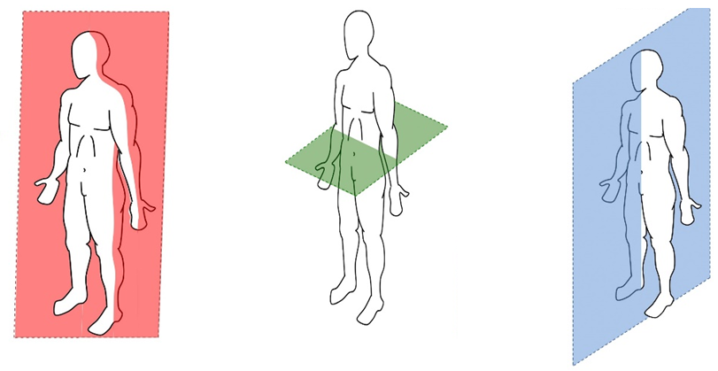
PE
Y11 GCSE Biomechaincs
Planes & Axes for movement
Plane | An imaginary line that divides the body into two
Frontal Plane (left picture) | A vertical plane that divides the body into front and back.
Transverse plane (middle picture) | A horizontal plane that divides the body into upper and lower halves.
Sagittal plane (right picture) | A vertical plane that divides the body into right and left sides.
16

Slide 19
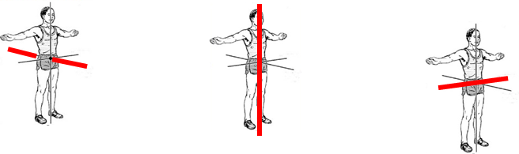
PE
Biomechanics
Planes & Axes for movement
PAxes for movement | An axis is an imaginary line at right angles to the plane
Sagittal axis (left picture) | Runs through the body horizontally from the back to front.
Vertical axis (middle picture) | Runs through the body vertically from the top to bottom.
Frontal axis (right picture) | Runs through the body horizontally from the left to right.
17

Slide 20
PE
Year 11 GCSE
Mental preparation
Mental Preparation | Involves the athlete imagining themselves in an environment performing a specific activity using all of their senses
Feedback
Feedback | Vital part of information processing which provides confidence, motivation and improves performance
Intrinsic feedback | This comes from within the performer. Kinaesthetic senses provide feelings from muscles/joints about the action
Extrinsic feedback | This comes from results and match analysis
Concurrent feedback | Information provided to the athlete during the performance
Terminal feedback | Information provided to the athlete before or after the performance
18

Slide 21
Business
Key Word | Definition
Social objectives | Likely to be non-financial, such as to reduce the carbon emissions of a business or improve the quality of life for a local community
Asset | Any item of value that a business owns, such as its machinery or premises
Net cash flow | The difference between cash in e.g. revenue and cash out e.g. utility bills. (A prediction remember)
Limited liability | The level of risk is limited to the amount of money that has been invested in the business or promised as investment
Franchise | When one business gives another business permission to trade using its name and products in return for a fee and share of its profits
Product differentiation | Designing a product with some unique features that distinguish it from similar products sold by competitors
Brand loyalty | A customer’s willingness to buy a product from a particular business rather than from its competitors
Business plan | A document that outlines how an entrepreneur is going to set up a new business
Target market | That group of people that a business has identified as potential customers
Budgets | Pre-set financial targets for a business to achieve, like a sales budget, or abide by, such as an expenditure budget, in a given period of time
Footfall | The number of people passing a particular location within a given time period
Labour | Workers, workforce, employees
Conflict | A serious disagreement, usually between people (stakeholders), countries or ideas
Key Word | Definition
Entrepreneur | Someone who creates a business, taking on financial risks with the aim of making a profit from the business
E-commerce | Using the internet to carry out business transactions
Demographic | Relating to the population, such as average age, average income and so on
Sales revenue | The amount of money that comes in from a business’s sales
Market share | The proportion of sales in a market that are taken by one business
Market segmentation | The process of breaking the whole population into smaller parts. Age, gender, occupation, lifestyle, income
Focus group | A group of people who discuss their views on a product, service advertisement or idea, either face-to-face or online
Ethics | Moral principles or standards that guide the behaviour of a person or business (Doing the right thing)
Stakeholder | Anyone who has an interest in the activities of a business, such as its workers, its suppliers, the local community and the government
Overdraft | A facility offered by a bank that allows an account holder to borrow money at short notice and go below 0 in their account for a short time.
Share capital | Money to invest in a business is raised by the business issuing shares that it then sells to those who wish to invest in the company
Break-even point | The point where revenue received meets all of the costs of the business
19

Slide 22
Business
Key Word | Definition
Minimum wage | The lowest legal rate of pay for employees, depending on their age and their type of employment
Globalisation | When businesses operate and in international scale and gain international influence or power
Tax | A proportion of an individual’s income or a business’s profits that must be paid to the government
Imports | The flow of goods and services into a country from another country
Exports | The flow of goods and services out of a country to another country
Marketing mix | Product, price, promotion, place
Inflation | The costs of products and services are increasing
Interest rates | The % rate of borrowing goes up. Also savers do receive higher rates as well though
Exchange rates | The value of your £ against another can go up or down. Meaning you get more or less for your £ when buying abroad
Recession | When earnings, productivity and employment can fall within the country
Social media | Facebook, Instagram etc to promote the business products, services and customers to leave reviews
Key Word | Definition
Fixed costs | Costs that do not change with productivity
Variable costs | Costs associated with production e.g. raw materials
Legislation | Laws that impact on business e.g. Data protection, Health and safety, consumer law, minimum wage
Location | Where you choose to locate physical premises. Consider cost of rent, near competitors, near target audience, near labour and raw materials
Quantitative data | Numbers, statistics, percentages, charts—All can be easily interpreted and analysed
Qualitative data | Opinions and more in depth responses to market research
Margin of safety | Distance between current number of sales back to the breakeven level of sales.
Market research | Finding out what consumers want and/or what your competitors are doing. Primary or secondary methods can be used
Market mapping | Mapping out your competitors to see if there is a gap in the market. The criteria may be price against quality
20

Slide 23
Computing
Number bases
Denary (or decimal) | base-10 and is the number system we are most familiar with. We have the columns of units, tens, hundreds, thousands and so on. Base-10 means that we have 10 possible values (0, 1, 2, 3, 4, 5, 6, 7, 8, 9) in each column
Binary | base-2 and has 2 values, 0 and 1. It requires a greater number of digits in binary to represent a number than denary. This is how data and instructions are stored in a computer.
Hexadecimal | base-16. To make up the 16 values we use the ten denary numbers in addition to 6 letters (A, B, C, D, E, F).
Strings and lists
GUI | Acronym for graphical user interface. It is an event-driven program that allows the user to interact with it in a variety of ways. For example, buttons and icons.
Concatenate | When two or more strings are joined together.
String | A value that is text. This can include numbers but they will be read as text.
Array | A fixed (static) data structure that holds items of the same data type under one name.
Index | The location of items or elements in a list, array, or string.
Append | Adding to an existing data structure.
Data structure | Used to store data in an organised and accessible way.
Operator | A symbol or function that performs an operation. For example, +.
Denary | Hex. | Binary |  | Denary | Hex. | Binary
0₁₀ | 0₁₆ | 0000₂ |  | 8₁₀ | 8₁₆ | 1000₂
1₁₀ | 1₁₆ | 0001₂ |  | 9₁₀ | 9₁₆ | 1001₂
2₁₀ | 2₁₆ | 0010₂ |  | 10₁₀ | A₁₆ | 1010₂
3₁₀ | 3₁₆ | 0011₂ |  | 11₁₀ | B₁₆ | 1011₂
4₁₀ | 4₁₆ | 0100₂ |  | 12₁₀ | C₁₆ | 1100₂
5₁₀ | 5₁₆ | 0101₂ |  | 13₁₀ | D₁₆ | 1101₂
6₁₀ | 6₁₆ | 0110₂ |  | 14₁₀ | E₁₆ | 1110₂
7₁₀ | 7₁₆ | 0111₂ |  | 15₁₀ | F₁₆ | 1111₂
21

Slide 24
Computing
Processes
Decomposition | Breaking down a complex problem or system into smaller parts
Algorithm | A step-by-step procedure that is created to solve a problem
Abstraction | The process of removing details and patterns that will not help us to solve a problem
Computational thinking | Computational thinking is a way to solve problems by thinking and making decisions like a computer
Pattern recognition | Looking for things that repeat or are the same.
Strings and lists
GUI | Acronym for Graphical User Interface. It is an event-driven program that allows the user to interact with it in a variety of ways. For example, buttons and icons.
Concatenate | When two or more strings are joined together
String | A value that is text. This can include numbers but they will be read as text
String handling | Performing operations on string
Substring | Part of a string
ASCII | Used to represent characters with a numerical value.
List | A dynamic data structure that holds items under one name.
Array | A fixed (static) data structure that holds items of the same data type under one name
Index | The location of items or elements in a list, array, or string
Append | Adding to an existing data structure
Data structure | Used to store data in an organised and accessible way
Operator | A symbol or function that performs an operation. For example, +.
2D array | A static data structure that holds data both horizontally and vertically. The structure is fixed and each element has the same data type.
2D list | A dynamic data structure that holds data both horizontally and vertically. The structure can change during program execution and the data types of the elements can be different.
22

Slide 25
iMedia
Topic Area 3 | Pre-production Planning
Camera Angles | The position of the camera in relation to the subject, influencing the viewer's perception.
Camera Shots | Different perspectives achieved by framing a subject in a specific way.
Camera Movement | Techniques used to physically or digitally move the camera during filming.
Pan | Horizontal camera movement from one side to another.
Tilt | Vertical camera movement, tilting up or down.
Zoom | Adjusting the focal length of the lens to make the subject appear closer or farther.
Dolly | Moving the entire camera to change the distance between the camera and the subject.
Long Shot | Capturing a scene from a significant distance.
Wide Angle Shot | Using a wide-angle lens to capture a broader view.
Close Up | Focusing on a subject at close range.
Extreme Closeup | Framing a subject in extreme detail, often focusing on a specific feature.
Low Level Shot | Capturing the subject from a low angle.
High Angle Shot | Capturing the subject from a high angle.
2 Shot | Framing two subjects in the same shot.
Key Word | Definition
Worm's Eye View Shot | Capturing the subject from a very low angle.
Aerial Shot | Capturing a scene from an elevated position, often using drones.
Establishing Shot | Providing an overview of the location to set the scene.
Patent | Legal protection for inventions, providing exclusive rights for a specified period.
Trademark | A recognizable sign, design, or expression identifying products or services.
Copyright | Legal protection for original works of authorship, including literary, artistic, and musical creations.
Ofcom | The UK's communications regulator, overseeing broadcasting, telecommunications, and postal services.
ASA (Advertising Standards Authority) | A UK organization regulating advertising content and ensuring compliance with advertising codes.
PEGI (Pan European Game Information) | A European video game content rating system.
BBFC (British Board of Film Classification) | A UK organization responsible for classifying films and video games.
Censorship | The suppression or restriction of information, media, or artistic works by authorities.
Health and Safety | Practices and regulations to protect the well-being of individuals in the workplace or other environments.
Risk Assessments | Evaluations of potential hazards and risks to health and safety in a given situation.
Recces | Short for "reconnaissance," referring to visiting and planning to assess risk
23

Slide 26
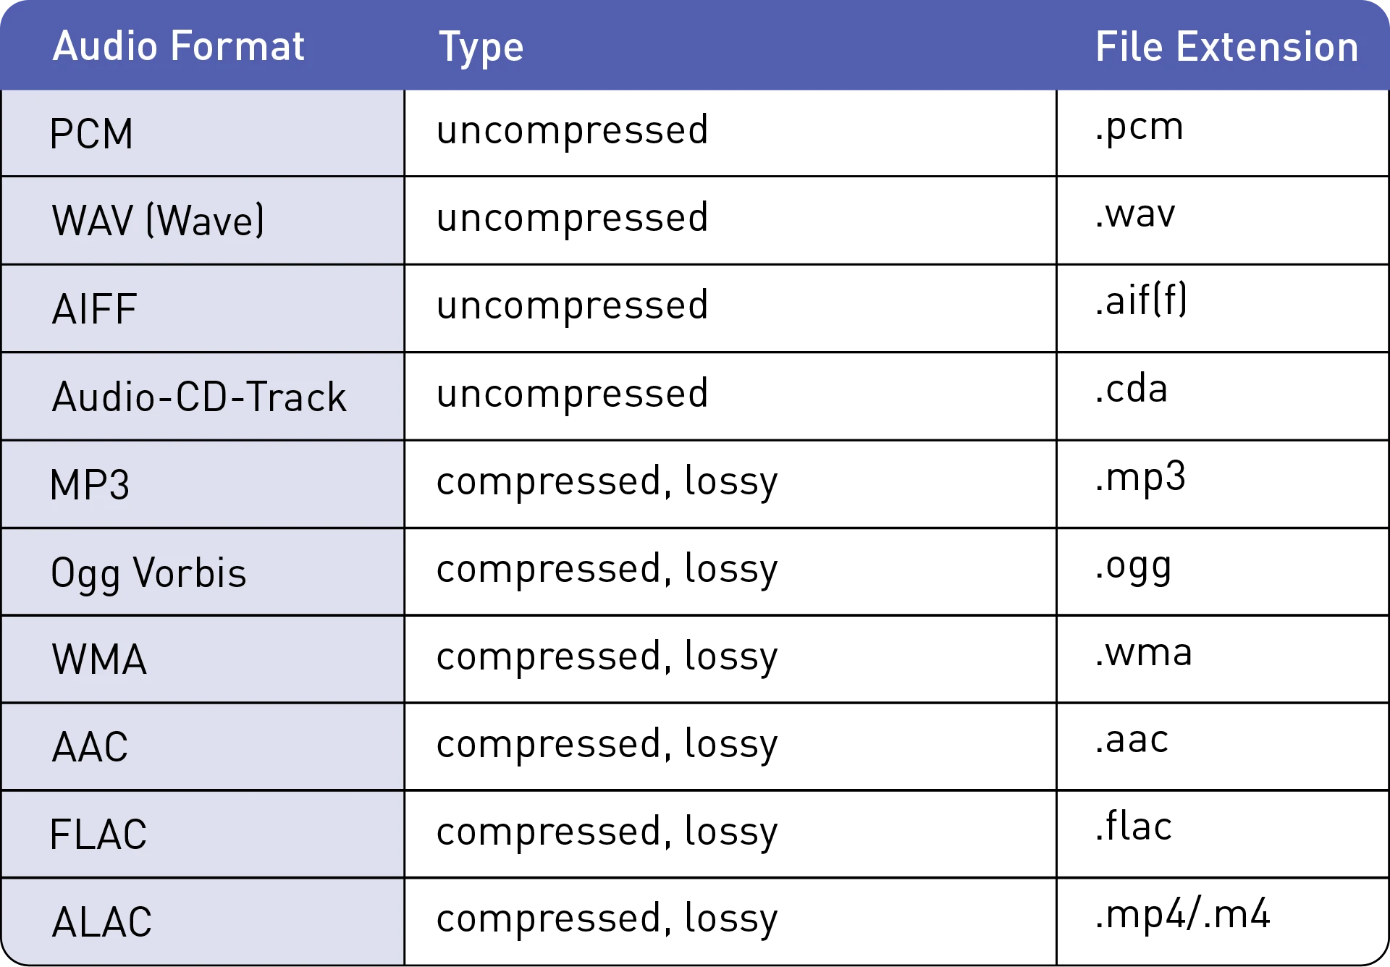
iMedia
Topic Area 4 | Distribution
Distribution | The process of making content available to an audience, often through various channels and platforms.
Streaming | The delivery of multimedia content in real-time over the internet, allowing users to access and consume it without downloading.
DPI (Dots Per Inch) | A measure of printing resolution, indicating the number of individual dots that can be placed in a linear inch.
PPI (Pixels Per Inch) | A measure of display resolution, indicating the number of pixels that can be accommodated in a linear inch.
Pixels | The smallest unit of a digital image, representing a single point of colour in a raster image.
Raster Images | Images composed of a grid of pixels, where each pixel contains colour information, commonly used in photography.
Bitmap Images | Another term for raster images, where each pixel is individually defined, and the file size is directly related to image dimensions.
Vector Images | Images created using mathematical equations to define shapes and lines, allowing for scalability without loss of quality.
File Compression | The reduction of file size to save storage space or speed up data transmission.
Lossy Compression | A compression method that sacrifices some data to achieve a smaller file size, often resulting in a loss of quality.
Lossless Compression | A compression method that reduces file size without sacrificing any data or image quality.
Sample Rate | The number of samples of audio taken per second, often measured in Hertz (Hz).
Bit Depth | The number of bits used to represent the color of each pixel in an image or the audio amplitude in digital audio.
Resolution | The clarity and detail of an image, often measured in terms of the number of pixels (width x height).
Frame Rate | The number of individual frames displayed per second in video footage, measured in frames per second (fps).
24

Slide 27
Art
Key Word | Definition
Abstract expressionism | A development of abstract art which originated in New York in the 1940s and 1950s aimed at subjective emotional expression with particular emphasis on the spontaneous creative act.
Avant-garde | Avant-garde ​ideas, ​styles, and ​methods are very ​original or ​modern in ​comparison to the ​period in which they ​happen.
Chiaroscuro | An Italian term which refers to the use of the dramatic contrast of light and dark in a painting
Dadaism | An art movement formed during the First World War in reaction to the horrors and folly of the war, in which the work produced is often satirical and nonsensical.
Futurism | An artistic and social movement that originated in Italy in the early twentieth century. It emphasised speed, technology, youth, and violence, and objects such as the car, the aeroplane, and the industrial city
Impressionism | A style of painting associated mainly with French artists of the late nineteenth century, such as Edgar Degas, Edouard Manet, Claude Monet, and Pierre-Auguste Renoir. Impressionist painting seeks to re-create the artist's or viewer's general impression of a scene.
Minimalism | A style that uses pared-down design elements (uncomplicated, kept purposefully simple
Photorealism | A genre of art that encompasses painting, drawing and other graphic media, in which an artist studies a photograph and then attempts to reproduce the image as realistically as possible in another medium.
Still life | One of the principal genres (subject types) of Western art – essentially, the subject matter of a still life painting or sculpture is anything that does not move or is dead.
25

Slide 28
Performing Arts
Scripted Performing + Live Theatre Evaluation
Acting Skills
Accepting Ideas | Responding positively to another performer’s suggestion for a line of dialogue or action within the drama. Allowing the drama to flow.
Body Language | How a performer uses their posture and positioning to display how a character behaves or feels.
Characterisation | Physical and vocal skills that are used to portray a role
Blocking Ideas | Not allowing the drama to flow or be added to.
Stimulus | A thing that acts as a starting point. In drama it could be a word, phrase, music or script.
Style | The genre or type of improvisation that is being created.
Facial Expressions | The different moods and emotions of a character shown facially
Gesture | The hand movements made by the actor to accompany emotions or language.
Dialogue | The words or speech that a character says
Improvisation | To perform quickly in response to something, without previous planning.
Off Stage | The area ‘back stage’ where the audience can’t see the actors
Multi-role | When an actor plays more than one role
Plot | The storyline of a piece of drama.
Tableaux | A ‘frozen picture’ that tells a story. Costume and props are needed, and physicality used to show emotion.
Language Register | The level of formality with which you speak. Different people and situations call for different registers. For example talking to a teacher and your friends.
Listening and Responding | Vital skills when improvising. You listen to your group members, respond and work together with them.
Corpsing | Laughing due to embarrassment, or becoming distracted, whilst playing a role. The biggest “CRIME” in acting.
Action Narration | Actors respond to a narrator, by acting out what they are describing to their audience.
26

Slide 29
Year 11 Music
Key Word | Definition
Forte | Loud
Piano | Quit
Crescendo | Getting louder
Diminuendo | Getting quieter
Syncopation | Emphasis placed on a note that is not normally stressed, or between beats music with a steady beat.
Dotted note | A dot added after a note, adding an extra half to its length three beats per bar
Triplet | Three notes played in the time of two.
Harmony | is the combination of different musical notes played simultaneously, creating a rich and pleasing sound that adds depth and character to a musical piece.
Time signature | It tells you how many beats are in each measure and which note gets one beat, helping you keep track of the rhythm while playing or singing.
Dynamic | The volume of a sound or piece of music – loud/soft
pulse | The steady beat in music
Timbre | Each instrument own unique ‘tone quality’ and the voice as an instrument had different Timbre
accent | Extra stress placed on a note or chord
Texture | Sometimes voices sing different parts at the same time creating Harmony. Not all vocal music is accompanied by instruments, unaccompanied singing is called A Cappella.
Rhythm | Rhythm is the pattern of sounds and beats in music that creates a sense of movement and flow. It is like the heartbeat of a song that helps us feel the music and dance or sing along. Rhythm can be fast or slow, simple or complex, and is created by combining different beats and notes in a particular order. It is an essential element of music that makes it enjoyable and exciting to listen to.
28

Slide 30
Resilience definition: Grappling to get unstick
Reflecting on learning behaviours for thinking… | Experience log
 | Successful moment… | In hindsight… An example where you could have done better on reflection | At home…
I gave an idea and reasoned/justified.
I reflected on my idea and made it better after discussing with others
I used a revision strategy to help make the learning stick.
I made connections between what I am learning and the outside world.
29

Slide 31
Resilience definition: Grappling to get unstick
Reflecting on learning behaviours for thinking… | Experience log
 | Successful moment… | In hindsight… An example where you could have done better on reflection | At home…
I gave an idea and reasoned/justified.
I reflected on my idea and made it better after discussing with others
I used a revision strategy to help make the learning stick.
I made connections between what I am learning and the outside world.
30

Slide 32
Resilience definition: Grappling to get unstick
Reflecting on learning behaviours for thinking… | Experience log
 | Successful moment… | In hindsight… An example where you could have done better on reflection | At home…
I gave an idea and reasoned/justified.
I reflected on my idea and made it better after discussing with others
I used a revision strategy to help make the learning stick.
I made connections between what I am learning and the outside world.
31

Slide 33
Resilience definition: Grappling to get unstick
Reflecting on learning behaviours for thinking… | Experience log
 | Successful moment… | In hindsight… An example where you could have done better on reflection | At home…
I gave an idea and reasoned/justified.
I reflected on my idea and made it better after discussing with others
I used a revision strategy to help make the learning stick.
I made connections between what I am learning and the outside world.
32

Slide 34
Resilience definition: Grappling to get unstick
Reflecting on learning behaviours for thinking… | Experience log
 | Successful moment… | In hindsight… An example where you could have done better on reflection | At home…
I gave an idea and reasoned/justified.
I reflected on my idea and made it better after discussing with others
I used a revision strategy to help make the learning stick.
I made connections between what I am learning and the outside world.
33

Slide 35
Reading Log w/c 23rd February (20 mins reading per day – all five logs MUST be completed)
Date | Title of novel | Number of pages read | Summary about what I have read
 |  |  | • • •
 |  |  | • • •
 |  |  | • • •
 |  |  | • • •
 |  |  | • • •
Checked by form tutor:
34

Slide 36
Reading Log w/c 2rd March (20 mins reading per day – all five logs MUST be completed)
Date | Title of novel | Number of pages read | Summary about what I have read
 |  |  | • • •
 |  |  | • • •
 |  |  | • • •
 |  |  | • • •
 |  |  | • • •
Checked by form tutor:
35

Slide 37
Reading Log w/c 9th March (20 mins reading per day – all five logs MUST be completed)
Date | Title of novel | Number of pages read | Summary about what I have read
 |  |  | • • •
 |  |  | • • •
 |  |  | • • •
 |  |  | • • •
 |  |  | • • •
Checked by form tutor:
36

Slide 38
Reading Log w/c 16th March (20 mins reading per day – all five logs MUST be completed)
Date | Title of novel | Number of pages read | Summary about what I have read
 |  |  | • • •
 |  |  | • • •
 |  |  | • • •
 |  |  | • • •
 |  |  | • • •
Checked by form tutor:
37

Slide 39
Reading Log w/c 23rd March (20 mins reading per day – all five logs MUST be completed)
Date | Title of novel | Number of pages read | Summary about what I have read
 |  |  | • • •
 |  |  | • • •
 |  |  | • • •
 |  |  | • • •
 |  |  | • • •
Checked by form tutor:
38

Slide 40

Cursive Handwriting Practice – Week 1
39

Slide 41

Cursive Handwriting Practice – Week 2
40

Slide 42

41

Slide 43

Cursive Handwriting Practice – Week 3
42

Slide 44

Cursive Handwriting Practice – Week 4
43

Slide 45

44

