Slide 1
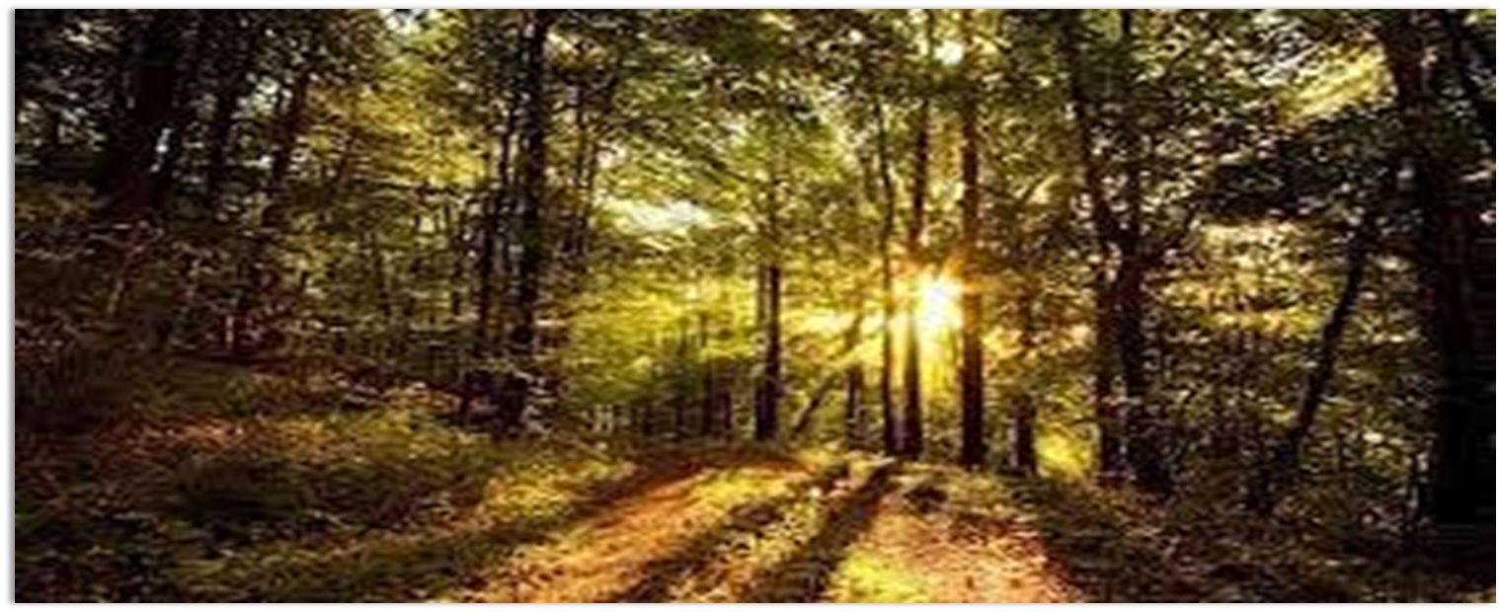
Relaxation
Find a place to stand, at least two metres away from others.
We are going to try three different relaxation techniques.

Slide 2
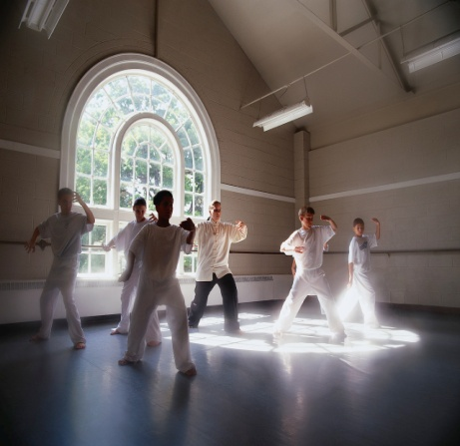
Time to practise: Tai Chi
http://www.youtube.com/watch?v=qeIYu1skSNY&feature=related
You will need space to do this.
You will need to stand clear of others.
You will be shown a short clip and you will be asked to follow the instructions.
It should calm the mind and reduce stress.
It is not hard, you won’t look silly.
Notes:
Show the clip from youtube: http://www.youtube.com/watch?v=qeIYu1skSNY&feature=related

Slide 3
Deep Breathing..
Sit comfortably with your back straight
Put one hand on your chest and the other on your stomach
Breathe in through your nose. The hand on your stomach chest should rise, the hand on your stomach should move very little.
Breathe out (exhale) through your mouth, pushing out as much air as you can. You should feel your abdomen (stomach) moving in, your chest should move very little.
Continue to breathe in through your nose and out through your mouth. Try to inhale enough so that your lower abdomen rises and falls. Count slowly as you exhale.
http://www.youtube.com/watch?v=Xz-KDXWsepI
Notes:
You may want to do this lying down, taking off shoes…

Slide 4
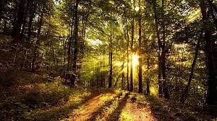
Now, close your eyes and picture YOUR place of peace. Whenever you need to relax, visualise your place and BREATHE…

Slide 5
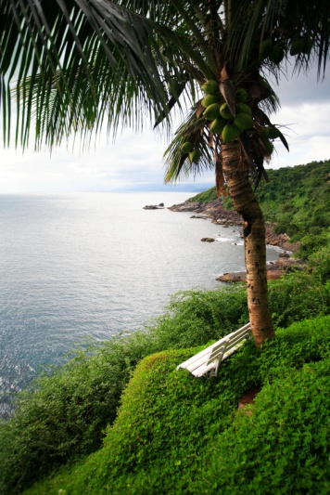
Visualisation
Close your eyes, let your worries drift away
Feel the wind around you
Hear the birds singing
See the beautiful mountains
Feel the warmth of the sun
Taste the fresh, clean air
(Play video – students can watch or listen)
http://www.youtube.com/watch?v=mkoqtERaNY8
Notes:
You may want to play calming music in the background:
http://www.youtube.com/watch?v=xpT5MrD44wM
http://www.youtube.com/user/healinghandsreiki#p/a/f/0/2N-WAhwvx08

