Slide 1
Progression in Mastery
Year 4 Count in 1,000s
Are you ready to count in thousands?
©Deepening Understanding LTD 2019

Slide 2
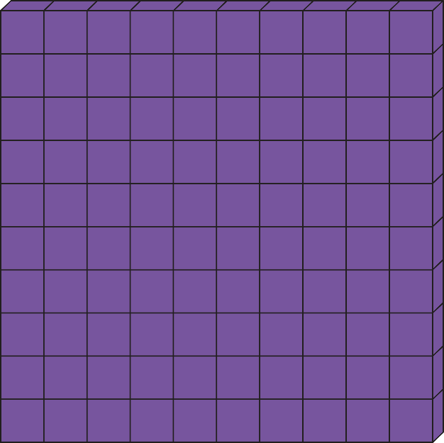
Let’s do this!
What number is represented here?
How did you work it out?
©Deepening Understanding LTD 2019

Slide 3
Let’s revisit what we should know…
Let’s count in 100s.
Continue the sequence…..
Add 100
Add 100
H | T | O
2 | 0 | 0
H | T | O
3 | 0 | 0
H | T | O
4 | 0 | 0
200
300
400
©Deepening Understanding LTD 2019

Slide 4
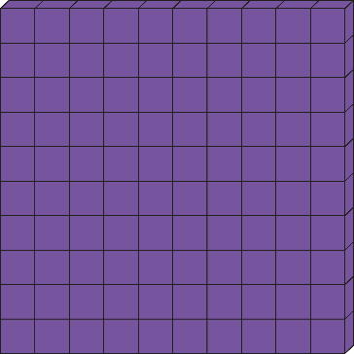
Let’s learn.
_____ tens make one hundred.
_____ hundreds make one thousand.
We all say it!
I say it!
You say it!
©Deepening Understanding LTD 2019

Slide 5
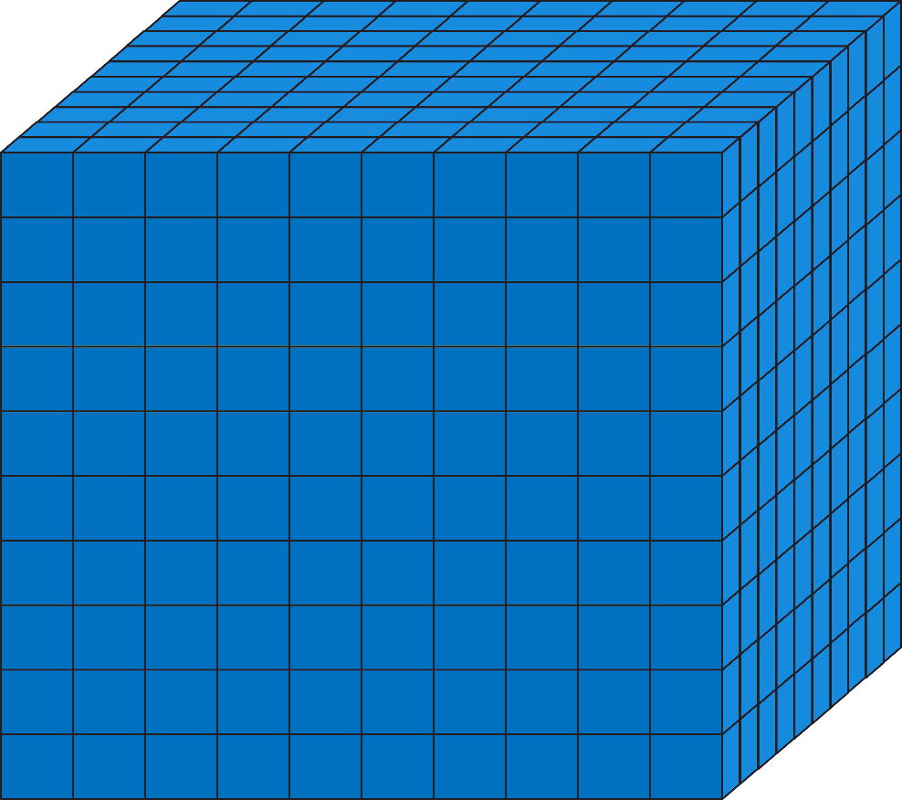
Let’s talk
What does this block represent?
Explain why?
©Deepening Understanding LTD 2019

Slide 6
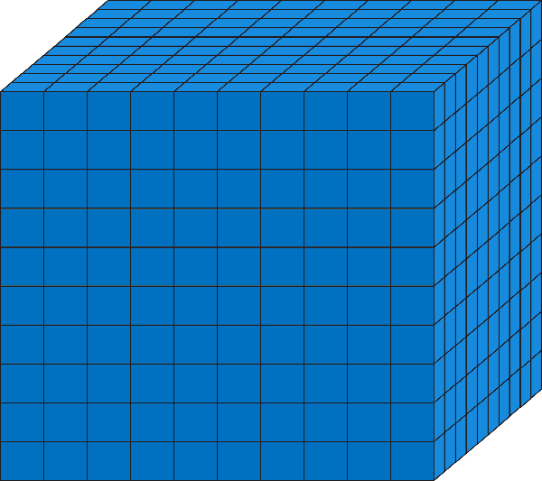
Let’s learn
Which number is represented here?
There are ______ blocks, each block is worth _______
The number _______ is represented.
We all say it!
I say it!
You say it!
©Deepening Understanding LTD 2019

Slide 7
Let’s learn
Which number is represented here?
There are ______ blocks, each block is worth _______
The number _______ is represented.
©Deepening Understanding LTD 2019

Slide 8
Let’s talk
Help Anita work out how many 100s in 4,000.
Explain to your partner how found your answer.
©Deepening Understanding LTD 2019

Slide 9
Let’s develop our learning
There are ______ hundreds in ______ thousand so each block has _______ hundreds
There are _______ hundreds in _______ thousand.
We all say it!
I say it!
You say it!
©Deepening Understanding LTD 2019

Slide 10
Independent Task
Let’s showcase our learning
©Deepening Understanding LTD 2019

Slide 11
Exit task – Dong Nao Jin
On a video game in the arcade, Jerry, Ranjit and Jane got a combined score of 10,000 points.
Jerry scored the lowest amount of points with 2,000.
All the children’s scores are multiples of 1,000.
How many points could the rest of the gang have scored?
©Deepening Understanding LTD 2019

