Slide 1
Family Members

Slide 2
mother

Slide 3
father

Slide 4
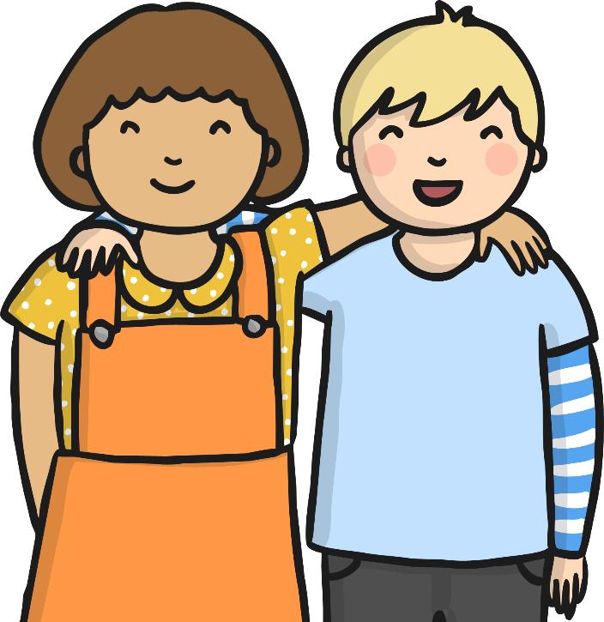
brother
sister

Slide 5
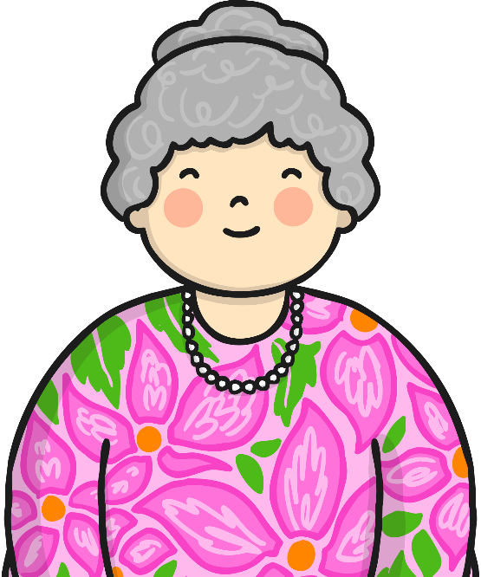
grandmother

Slide 6
grandfather

Slide 7
uncle

Slide 8
aunt

Slide 9
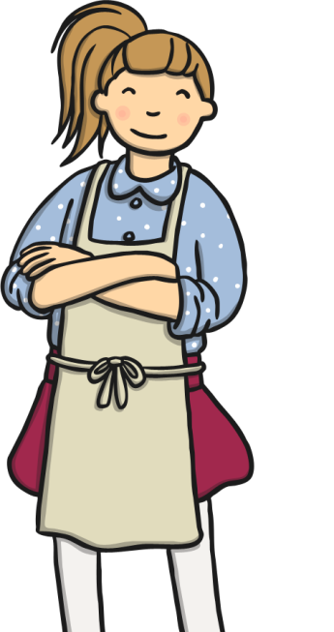
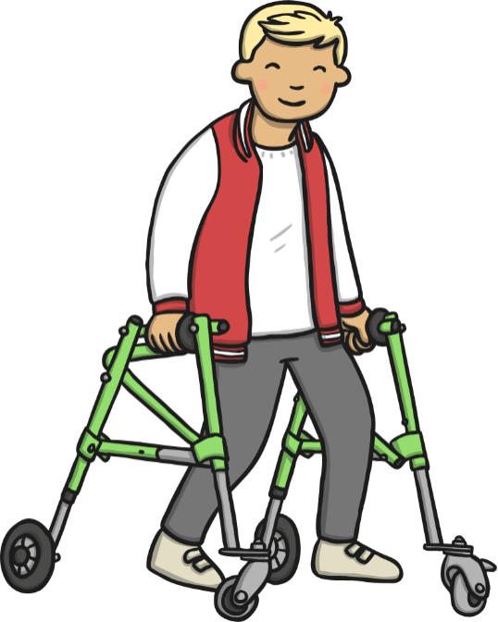
cousin
cousin

Slide 10
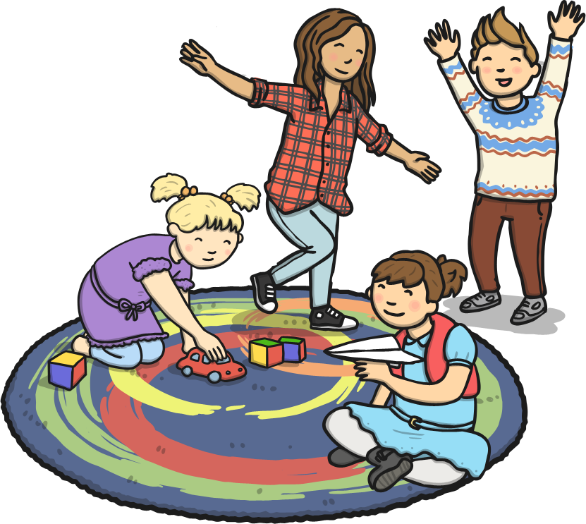
nephews and nieces

Slide 11
carer

Slide 12
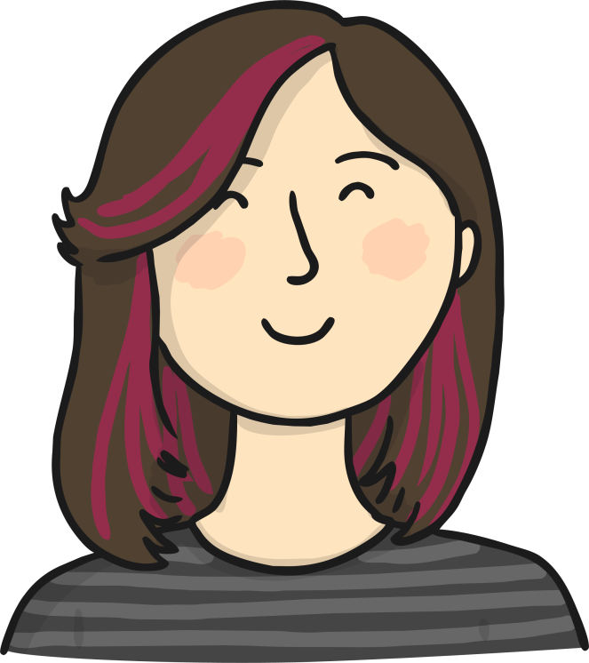
carer

