Slide 1
SDP: Spelling

Slide 2
Spelling Research analysis
Starting point
“But school spelling tests have an essential design flaw, which is that involving parents hugely amplifies the opportunity to pile on stress and pressure.” Jane Considine
76% of 1,362 teachers surveyed think tests are an ineffective way to teach spelling.
82% of teachers believe spelling has suffered as a result of the restrictions to teaching over the past 18 months as a result of the pandemic.

Slide 3
Further research…
“What we need to do is keep everything within schools, so we don’t up the anxiety. Then, we need to focus on the words each individual child needs to learn to spell – and that’s different for each pupil.”
Reading: “Reading is fundamentally critical because it’s about interplay. But reading gets you so far, and beyond that it’s about sharpening children to be effective word detectives. In the schools that are best at literacy, vocabulary is prized and teachers work really hard with word-catching and word-collecting. It’s about instilling a love of words – and that starts with finding patterns.”
The bottom line for both parents and teachers, she says, is to recognise the power of words. “We work so hard to let children be connected to books, but spelling misses out because it hasn’t got the razzle-dazzle of writing or the emotive spell of reading. And yet it’s so important, and that needs to be acknowledged. Spelling is the nuts and bolts of writing: once you can do it, you’re on track. You can soar.”

Slide 4
Autumn focus: High frequency
Why?
What are High Frequency Words?
The words that are most frequently used in the written text are called High Frequency Words. For example, 'the,' 'have,' and 'to,' may not have any specific meaning on their own, but these words contribute considerably in providing meaning to a sentence as a whole. Some high frequency words are also called sight words or tricky words. These words are not only difficult to sound out, but most of these also have a relatively abstract meaning which is difficult to explain to young learners. It is easy for children to learn words like "apple" and "boat" because these can be easily related to a picture or a real object, but it's tricky to explain the words like "of" or "the" because there's no point of reference.

Slide 5
Why focus on this area of spelling?
Why is it important to focus on high frequency words?
Children frequently come across high frequency words while reading texts. Due to this, it is important for the children to pronounce these words, read them correctly, spell them, and know what they indicate within a sentence. These words are considered to be a crucial part of literacy development as children will be frequently using these words in writing too.
Research suggests that there are 16 high frequency words that constitute around a quarter of every text, for both children and adults, which shows exactly why it is important for children to understand these words.
Words like 'I' 'and' 'he' and more complex words such as 'then' 'that' and 'went' are commonly used as we read and write. An educated adult might not notice, but these words can be very tricky for children if they aren't taught how to use these words properly.
Learning and being able to identify high frequency words offers more confidence to the children. If a young learner can already identify a quarter of the words in a written text, they are more likely to become more interested to continue reading. Being able to recognize and read high frequency words can make reading and writing easier for children in the early years of their educational life.
‍

Slide 6
Baseline and End-point assessments
Year group | Baseline score* | End of scheme score
3 | 45% | 56.2%
4 | 63% | 69.4%
5 | 55% | 67.5%
6 | 69% | 71.9%
*Based on a dictation test containing age-appropriate high frequency words

Slide 7
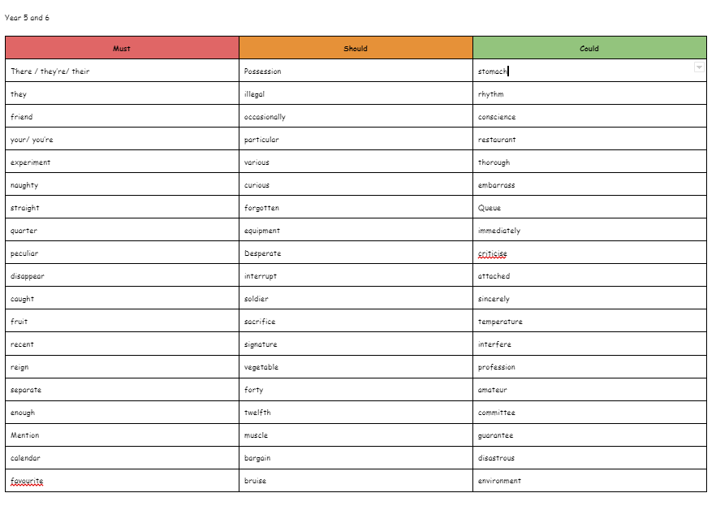
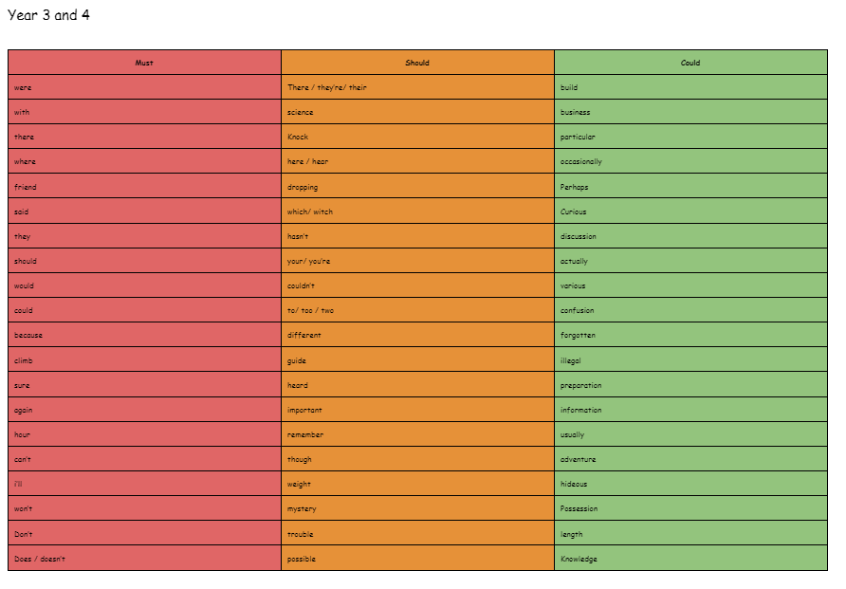
The plan…

Slide 8
What will this look like…
Children will not be given spelling tests each week.
Words will be taught in school throughout the week.
Work marked will target these spellings only with children asked to copy out spellings three times at the end of their work.
Bespoke target spellings to be given to each child (via a card flap in their books) for further focus of individual need.
Words will be available on classroom displays and resources on tables so children are immersed in them.
Spelling Shed will be set up so children can access additional spellings at home if they desire.

Slide 9
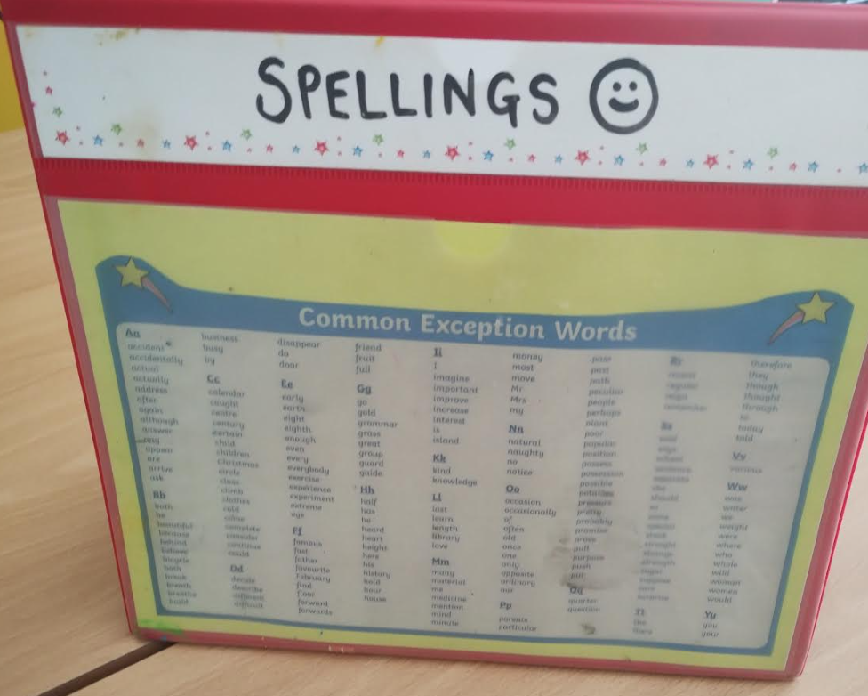
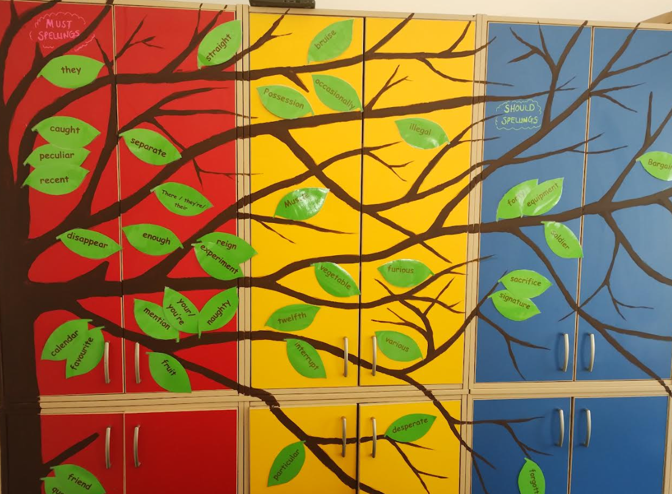

Slide 10
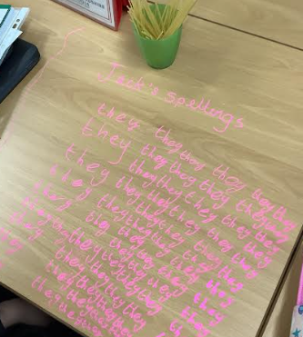
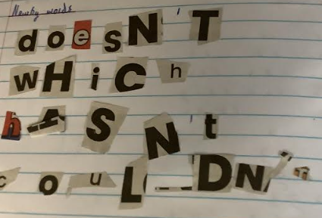

Slide 11
