Slide 1
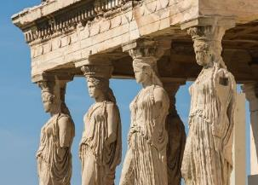
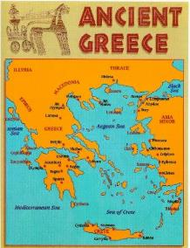
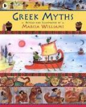
Ancient Greeks KS2 Knowledge Mat
Subject Specific Vocabulary |  |  | Where is Greece?
philosophy | Philosophy is a way of thinking about the world, the universe, and society.
Athenians | It is the birth place of democracy and the heart of the Ancient Greek civilisation.
Spartans | The Spartans believed that strict discipline and a tough upbringing was the secret to making the best soldiers.
democracy | Democracy means allowing citizens to make their own decisions for their personal lives.
 |  | Sticky Knowledge about Ancient Greece
Olympics | The ancient Olympic Games were originally a festival, or celebration of Zeus.
plague | The plague of Athens was an epidemic illness that devastated the city. | The Ancient Greeks invented the theatre because they loved watching plays, and most cities had a theatre.
truce | A truce is when two fighting sides declare peace or a break in the war. |  | Exciting Books
 |  | Events at the Greek’s Olympics included wrestling, boxing, long jump, javelin, discus and chariot racing.
Zeus | The supreme god of the Olympians, Zeus was the father of Perseus and Heracles.
loincloth | A single piece of cloth wrapped round the hips, typically worn by men in some hot countries as their only garment. | The Ancient Greeks held many festivals in honour of their gods.
 |  | Most Ancient Greeks wore a chiton, which was a long T-shirt made from one large piece of cotton. The poor slaves, however, had to make do with a loincloth.
Apollo | Apollo was the god of music, truth and prophecy.
sacred truce | A special truce called whilst the Olympics were taking place.
temple | A building devoted to the worship of a god or gods.

